Slide 1
Scraping Craiglist Real Estate Listings

Slide 2
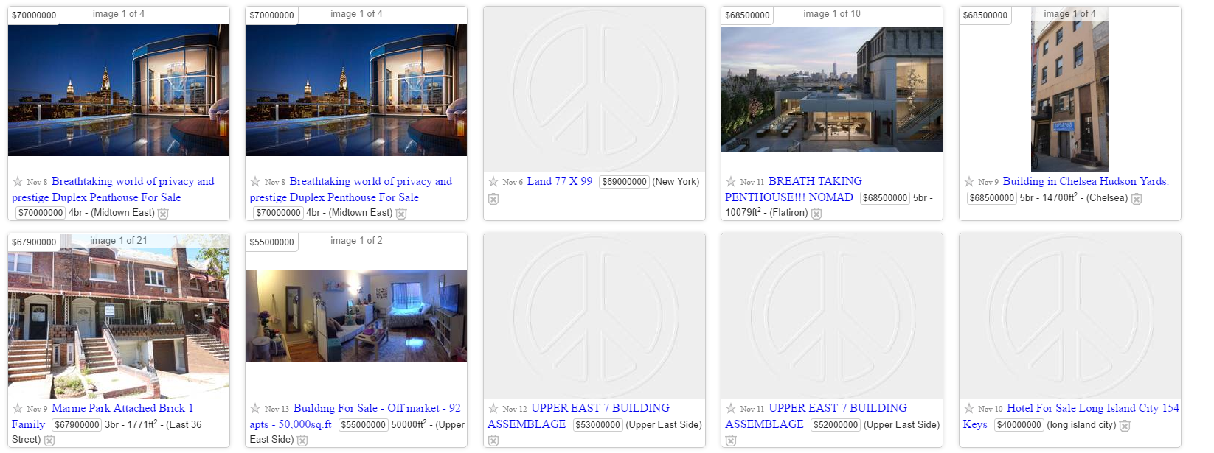
My goal was to gain insight into how real estate is priced in the New York area

Slide 3
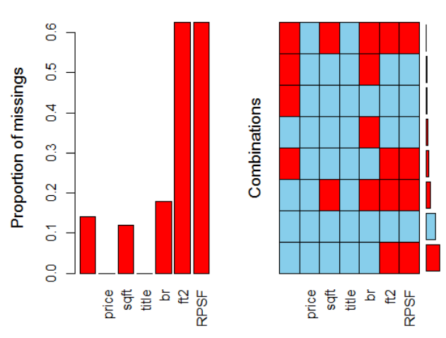
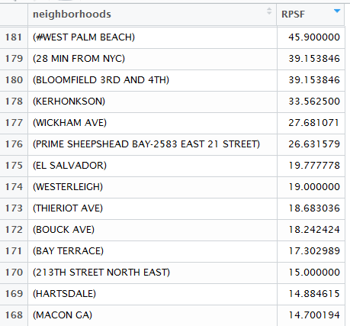
Data was very messy (had to make several adjustments), with a high degree of missingness, and oftentimes didn’t seem to conflict with common sense

Slide 4
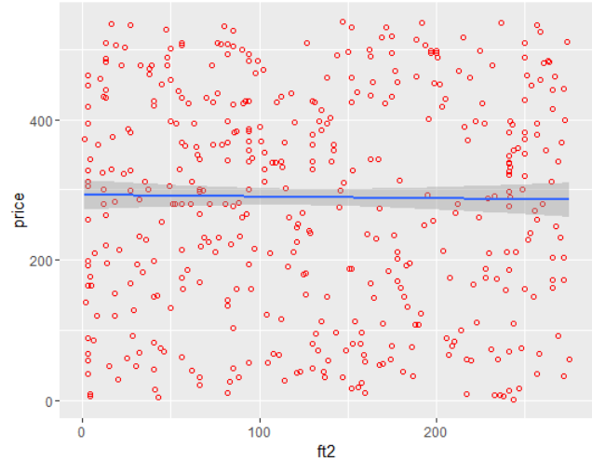
Ultimately I examined square footage, neighborhood, and # of bedrooms to try to determine price (these were the only predictor variables readily available from the site
The only relationship that appears both linear and significant is square footage vs. price.
Does not appear so but adjusted r^2 is .5 with a significant p-value, and the two variables meet the criteria for linearity.

Slide 5
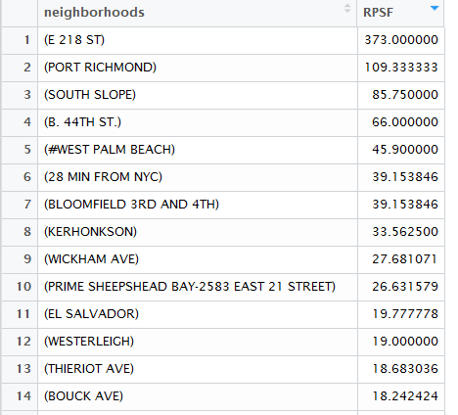
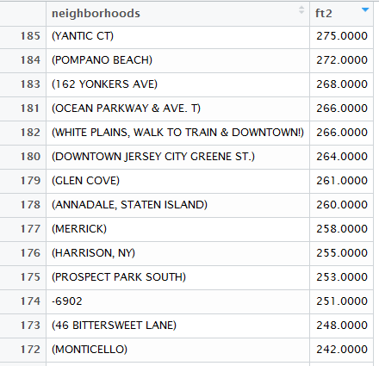
Other Interesting Findings

Slide 6
Further Research
Find better quality data and apply the same methodology
It would seem that many of these relationships should and can be modeled.

