Slide 1
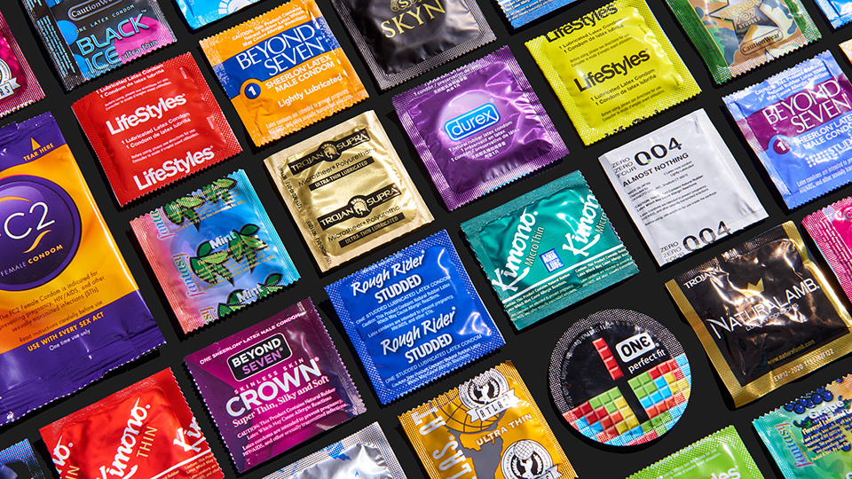
E-commerce Market Analysis of Condom
Presenter: Boyang ‘David’ Dai

Slide 2
Outline
Industry Analysis
Macro Market
Motivation
Pipeline
Data Analysis
Features of the dataset
Text Mining
Numeric Analysis
Conclusion
Summary & Outlooks

Slide 3
Industry Analysis

Slide 4
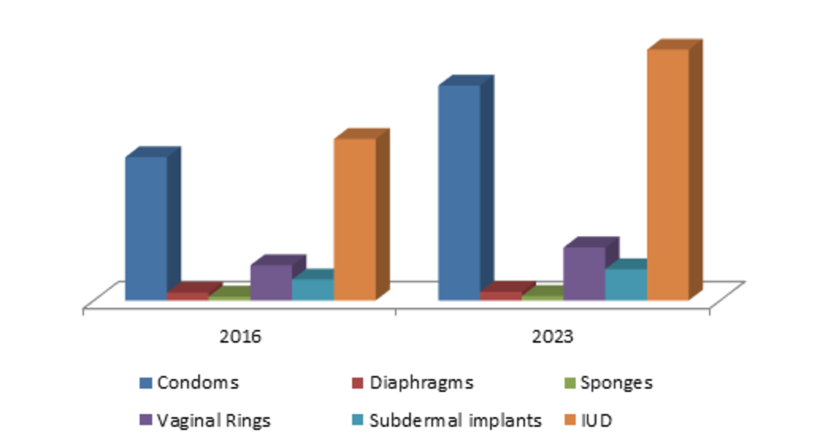
1. Industry Analysis
- Macro Market
Contraceptives market size was valued at USD 19.8 billion in 2015, with forecast target exceeding USD 33 billion by 2023, at over 6.8% compound annual growth rate.
North America contraceptive devices market size, by product, 2016-2023 (USD Million)
Source: Global Market Insights, Inc.

Slide 5
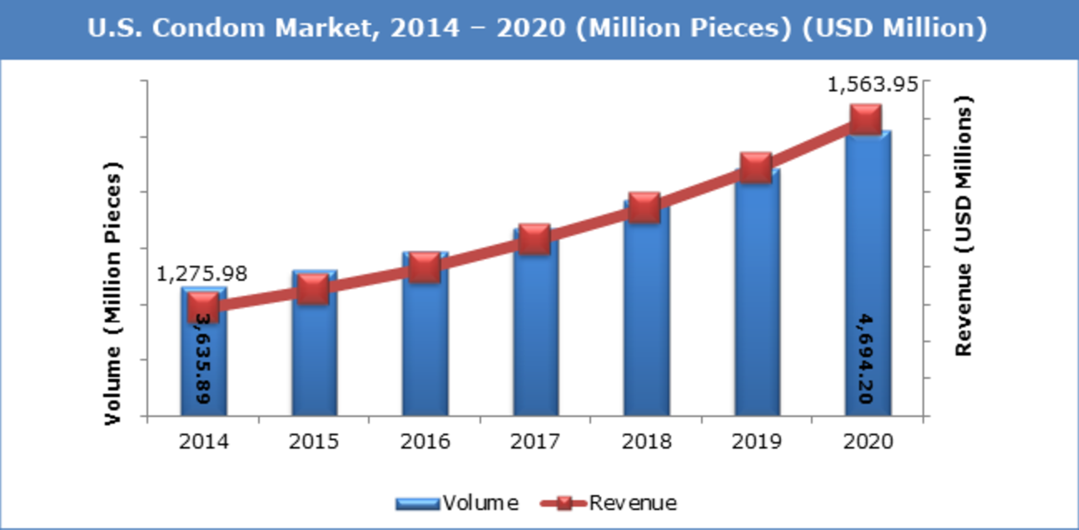
1. Industry Analysis
- Macro Market
Condoms are identified to be the most lucrative segment in the overall contraceptive devices market, with market revenue size target to exceed over USD 1.3 billion in 2016 in U.S. market.
Source: Zion Research Analysis 2016

Slide 6
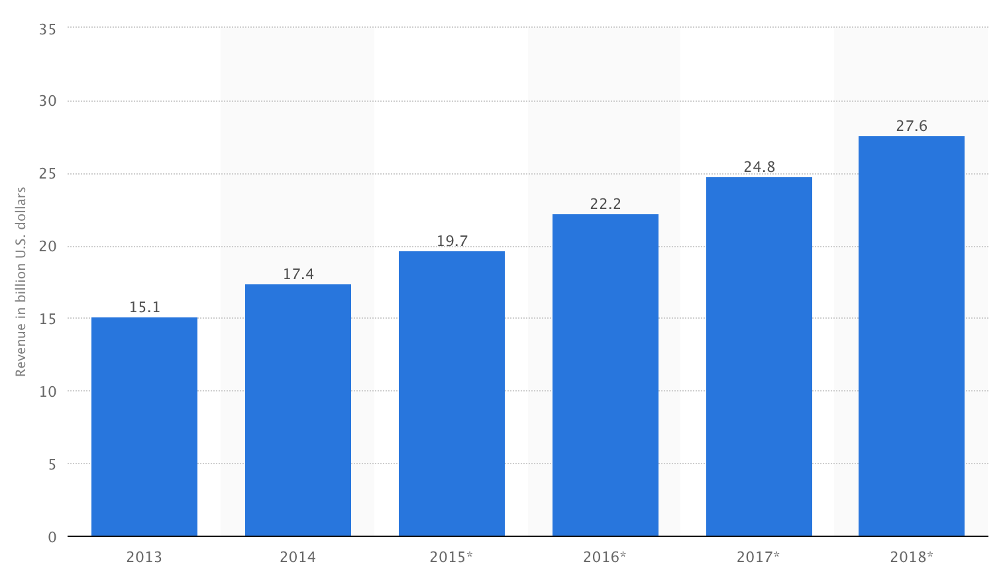
1. Industry Analysis
- Motivation
Why e-commerce?
U.S. Health & Personal Care E-commerce Revenue From 2013 to 2018 (in billion USD)
Source: Statista 2016

Slide 7
1. Industry Analysis
- Motivation
Why Amazon?
Rank by Revenue | Company | Revenue ($B) | Market cap ($B) | Headquarters
1 | Amazon | $107 | $329.7 | Seattle, WA, USA
2 | Alibaba | $12.29 | $204.8 | Hangzhou, Zhejiang, CHN
3 | eBay | $8.59 | $26.98 | San Jose, CA, USA
4 | Rakuten | $6.3 | $13.06 | Tokyo, Japan
5 | Zalando | $3.28 | $8.7 | Berlin, Germany
6 | Groupon | $3.1 | $1.96 | Chicago, IL, USA
Source: wikipedia.org 2016

Slide 8
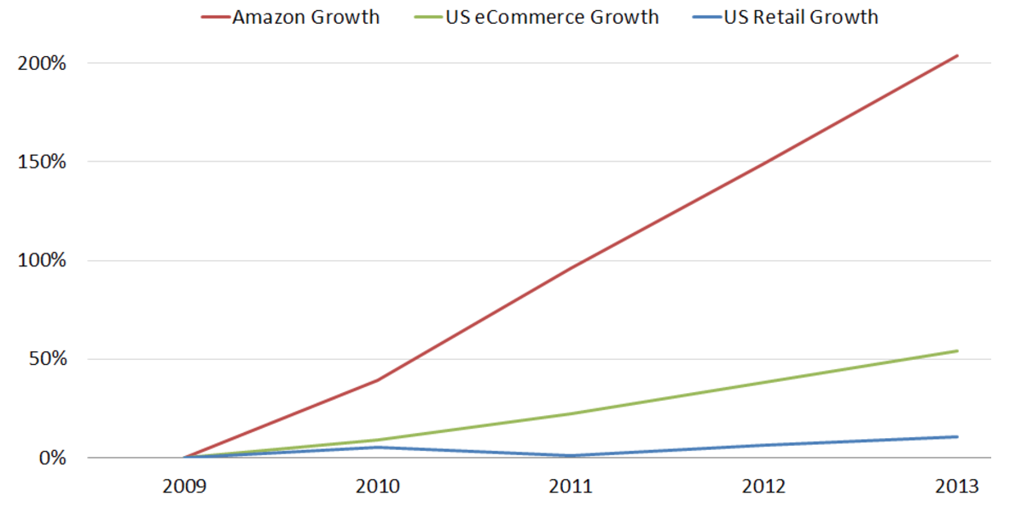
1. Industry Analysis
- Motivation
Why e-commerce on Amazon?
Amazon vs. E-commerce vs. Retail sales in the U.S. market
Source: Dispell Magic Ltd., 2016

Slide 9
1. Industry Analysis
- Motivation
Primary concerns:
What are major condom brands in current e-commerce market?
Key factors influencing the rank of a condom listed on e-commerce website?
Key factors influencing the rating of a condom listed on e-commerce website?
Would customer reviews influence product rankings? How?
Aim
Improve our condom product’s rank on Amazon.com

Slide 10
Pipeline

Slide 11
2. Pipeline
Conduct data mining on condom products on Amazon.com
Scrapped information of top 2,800 condom products.
Information of the products was processed and stored into a new *.csv file.
Statistical software was utilized to deploy data mining, including:
Text Mining
Exploratory Data Analysis
Sentiment Analysis
Predictive Model Fitting
Inferences and insights extracted from the dataset were refined.

Slide 12
Data Analysis

Slide 13
3. Dataset Analysis
- Features of the dataset
Source: www.amazon.com
Dataset:
a. Dataset without customer reviews: 2,803 obs, 34 variables
b. Dataset with information of customer reviews: 6,072 obs, 3 variables
Sample of key features:
BRAND | Categorical: Band of the products
NAME | Character: Name of the products listed on Amazon
SALE_PRICE | Numeric;
STAR | Numeric; Customer rating (min = 0, max = 5)
RANK_IN_CONDOM | Numeric;
PREVIEW_IMAGE_COUNT | Numeric; (min = 0, max = 8)
NumANSWERED_QUESTION | Numeric;
NumCUSTOMER_REVIEW | Numeric

Slide 14
3. Dataset Analysis
- Text Mining on “NAME”
Target: “NAME” (the name of products)
Aim:
To extract information from the name of products.
To impute missing values in other variables using corresponding information mined.
To find out the concentration of:
General condom market
Different major condom brands.

Slide 15
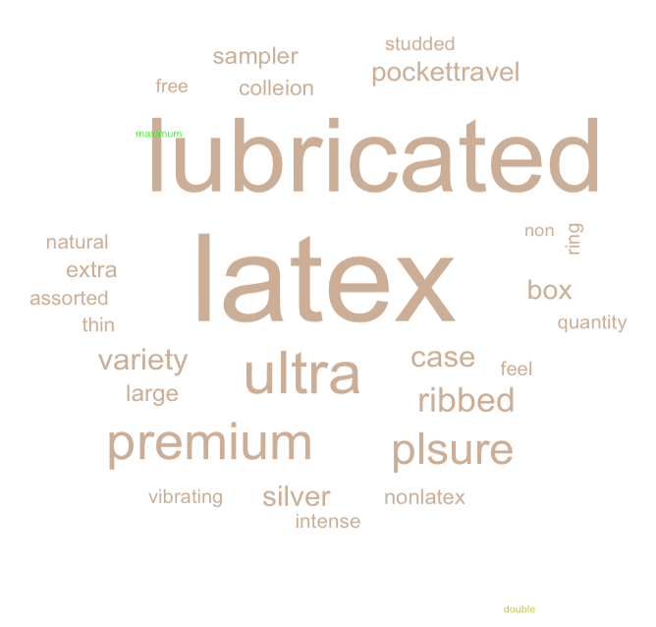
3. Dataset Analysis
- Text Mining on “NAME”
Aim: To find out the concentration of general condom market.
Word Cloud of names of 2,800 condom products listed on Amazon

Slide 16
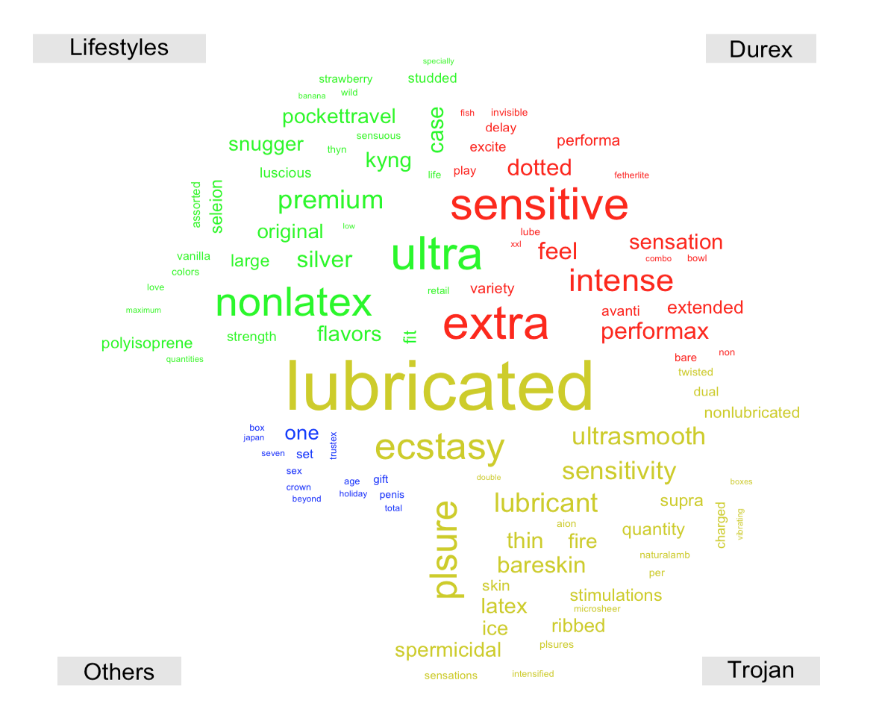
3. Dataset Analysis
- Text Mining on “NAME”
Aim: To find out the concentration of different major condom brands.
Word Cloud of major condom brands

Slide 17
3. Dataset Analysis
- Text Mining on “NAME”
Inferences from text mining:
General condom market
Primary material: Latex
Primary trait: Lubricated
Primary adjectives: Ultra, Premium
Different major condom brands:
Durex
Sensitive, Extra, Intense
Lifestyles
Ultra, Nonlatex
Trojan
Lubricated, Ecstasy, Plsure

Slide 18
3. Dataset Analysis
- Numerical Analysis
Target: Exploratory Data Analysis
Aim:
To find out the major brands of condom on Amazon.
To find out the rating distribution of condom on Amazon.
To find out the relation between product ratings and rankings.
To find out the value of correlation among numerical variables.
NOTE: New variables were introduced after sentiment analysis, prior to correlation analysis.

Slide 19
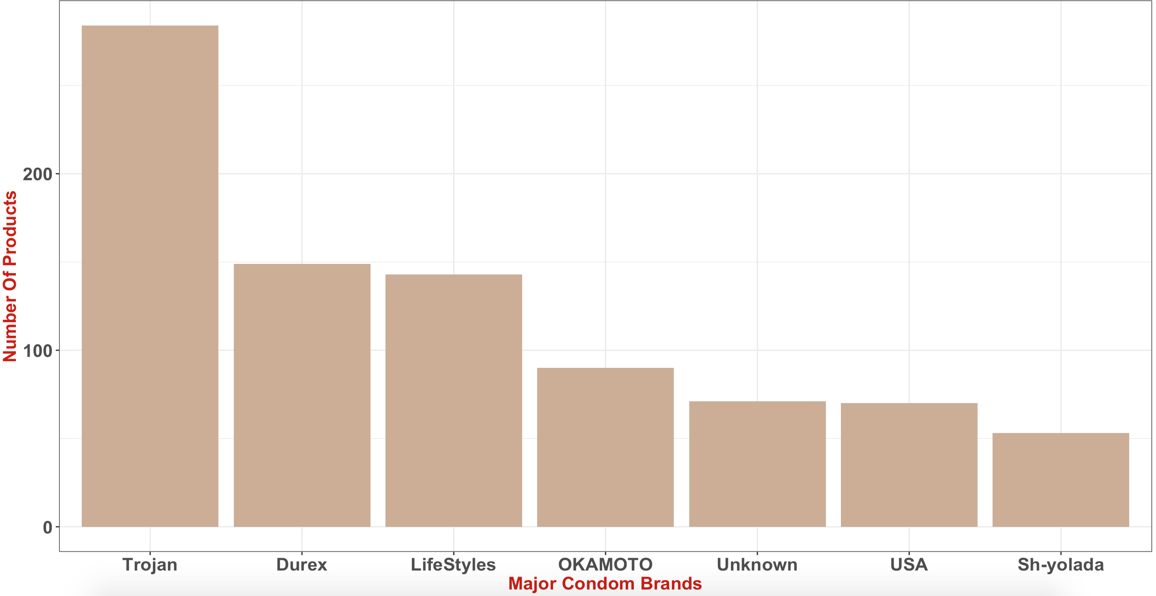
3. Dataset Analysis
- Numerical Analysis
Aim: To find out the major brands of condom on Amazon.
Major brands/retailers in condom market on Amazon

Slide 20
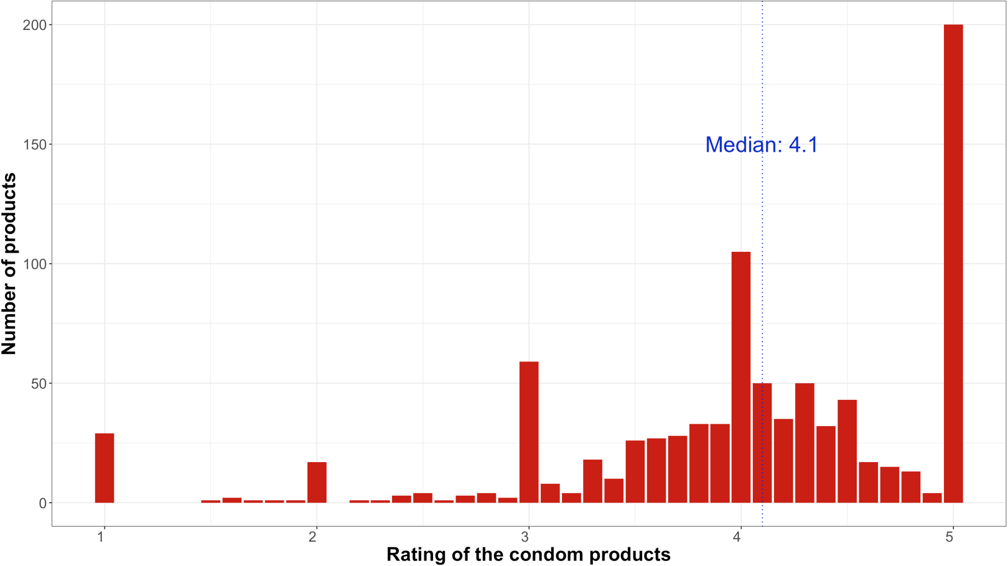
3. Dataset Analysis
- Numerical Analysis
Aim: To find out the rating distribution of condom on Amazon.
Distribution of ratings for 2,800 condom products on Amazon

Slide 21
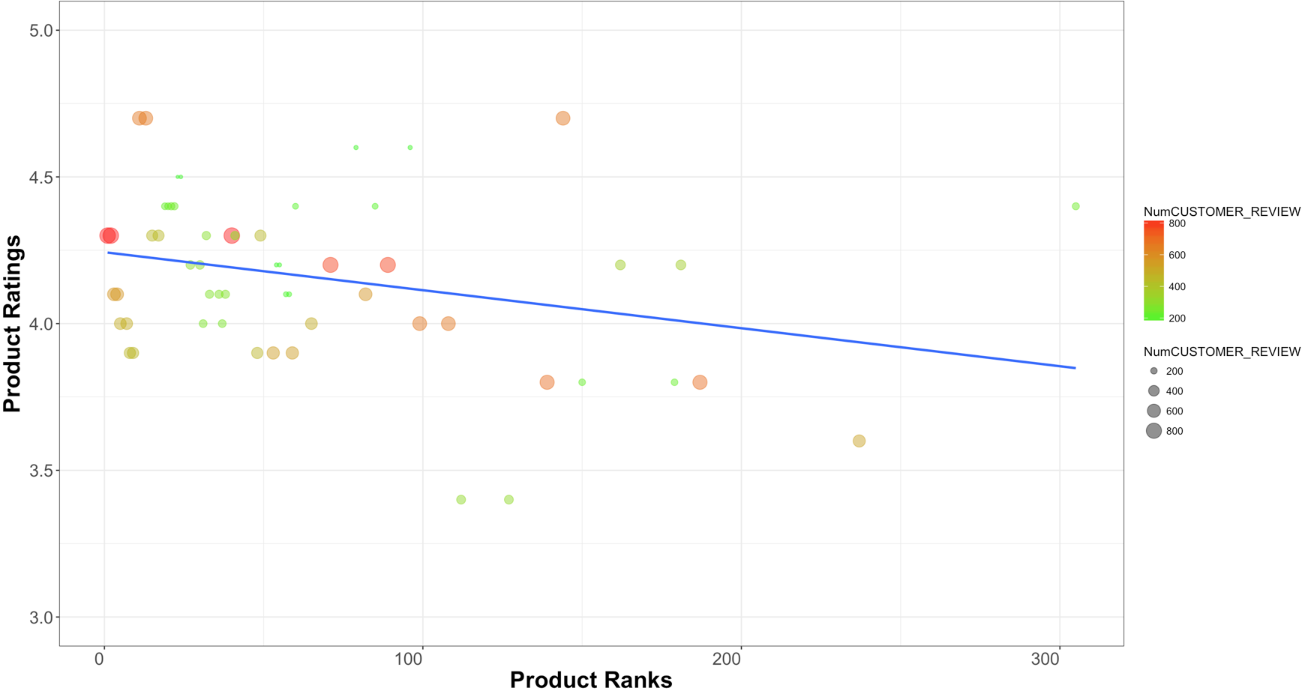
3. Dataset Analysis
- Numerical Analysis
Aim: Find out the relation between product ratings and rankings.
Product Ratings (freq. > 150) vs. Product Ranks

Slide 22
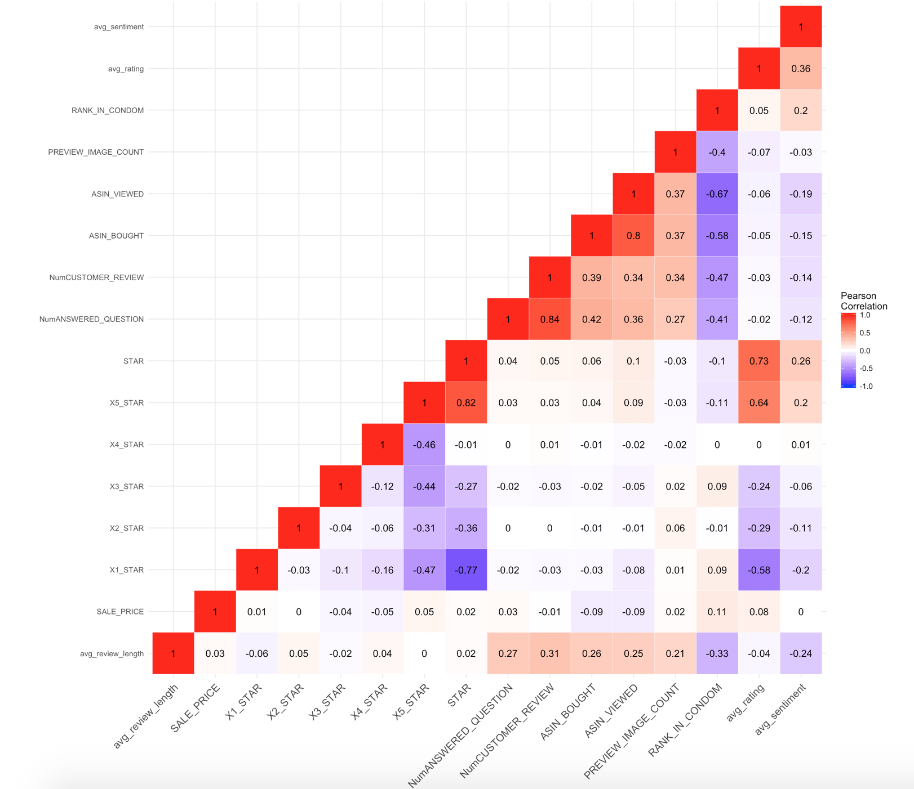
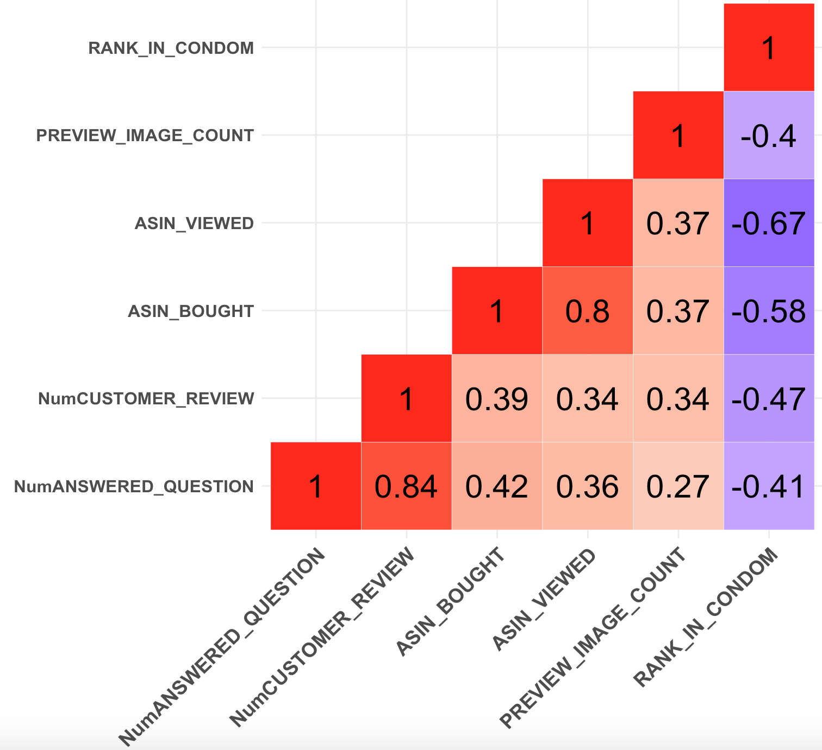
3. Dataset Analysis
- Numerical Analysis
Aim: To find out the value of correlation among numerical variables.
avg_rating
STAR
Observations:
‘avg_rating’ (0.36) and ‘STAR’ (0.26) have positive correlation with ‘avg_sentiment’
The Zoomed-In area.
avg_sentiment

Slide 23
3. Dataset Analysis
- Numerical Analysis
Target: Sentiment Analysis based on AFINN lexicon
Aim:
To find out the relation between review sentiments and rankings.
To generate sentiment scores for individual products, and use the score in fitting predictive model on product ratings.

Slide 24
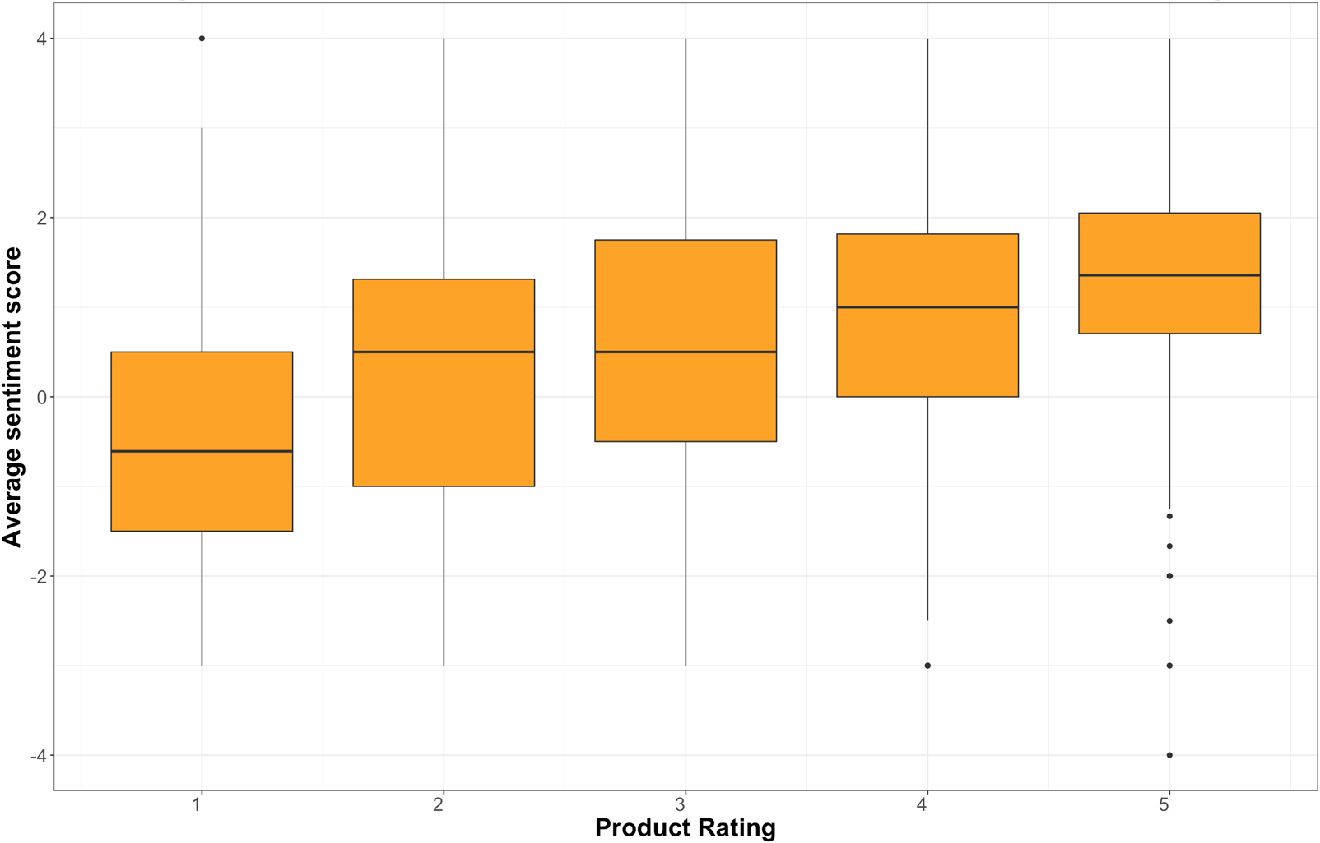
3. Dataset Analysis
- Sentiment Analysis
Aim: To find out the relation between review sentiments and rankings.
Avg. Sentiment of Individual Product vs. Product Ratings

Slide 25
3. Dataset Analysis
- Text Mining on “NAME”
Inferences from numeric analysis:
Top 4 brands
1. Trojan 2. Durex 3. Lifestyles 4. OKAMOTO
Rating distribution
Median: 4.1
Perfect rating of 5 is most popular for products
Local maxima at the midpoint between each discrete value
(i.e. 3.5 stars and 4.5 stars are surprisingly common ratings)
Rating ⬆ --> Rank ⬆ (corr = -0.1)
The Zoomed-In area
A bundle of variables that, taken together, might boost the rank of the product
Sentiment of customer reviews
Sentiment scores are correlated with positive ratings
(i.e. the higher the sentiment score, the more likely a product would be ranked high)

Slide 26
3. Dataset Analysis
- Predictive Model Fitting
Target: Numeric Variables
Aim:
To fit a multiple regression model on product ranking.
Result:
A MLR model is created:
P-value: < 2.2e-16
Multiple r-squared score: 0.5437
VIF: max = 3.68

Slide 27
Conclusion

Slide 28
4. Conclusion
- Summary & Outlook
Summary:
Outlook:
Machine learning technique can be applied for classification and prediction.
A/B testing in terms of products might reveal more information.
Advance data mining techniques might be applied to detect fake/true reviews.
Rank-up the product
Increase product ratings
Obtain better customer reviews
1. More preview images
2. More exposure of the product
3. More customer reviews and question answered
Increase product popularity using key words.
Notes:
Increase product ratings
Increase product ranks
Increase product popularity
s

