Slide 1
Billboard The Hot 100
Popularity analysis

Slide 2

The hot 100 ranking

Slide 3
Goal
Analyze the correlation between songs’ peak position and weeks on the Hot 100 chart
Making prediction on how long a song can last on the list by giving peak position

Slide 4
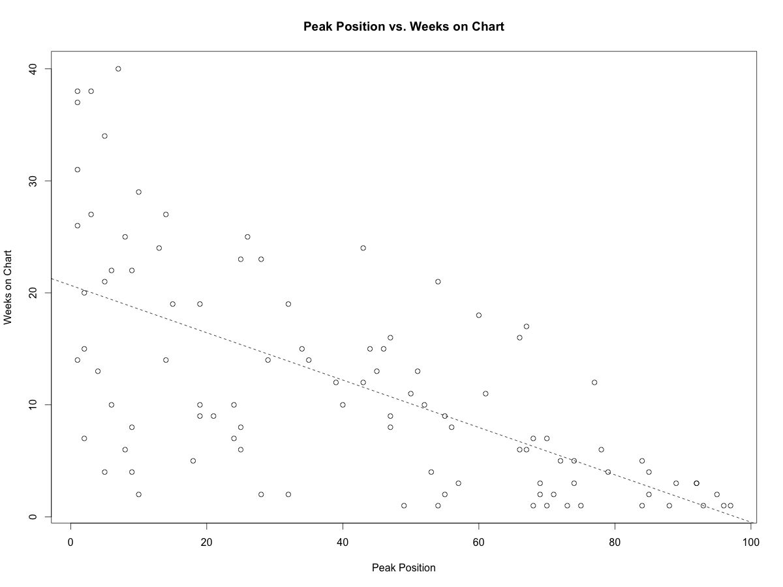
Setup
Correlation between peak position and weeks on chart
corr(x, y) = -0.63937

Slide 5
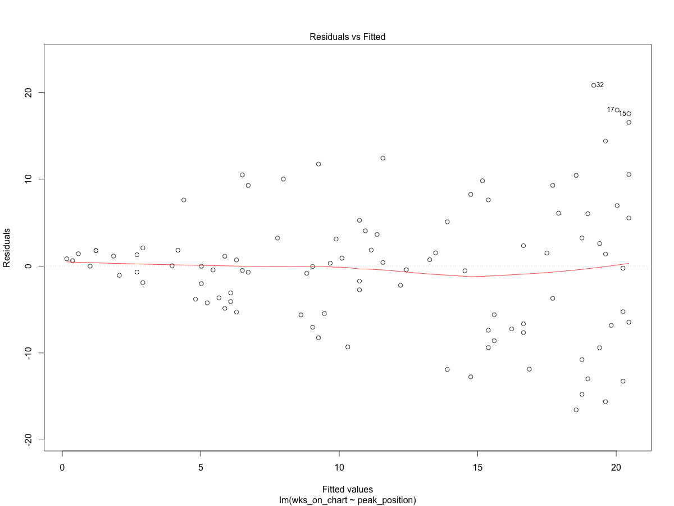
Assumptions & Diagnostics

Slide 6
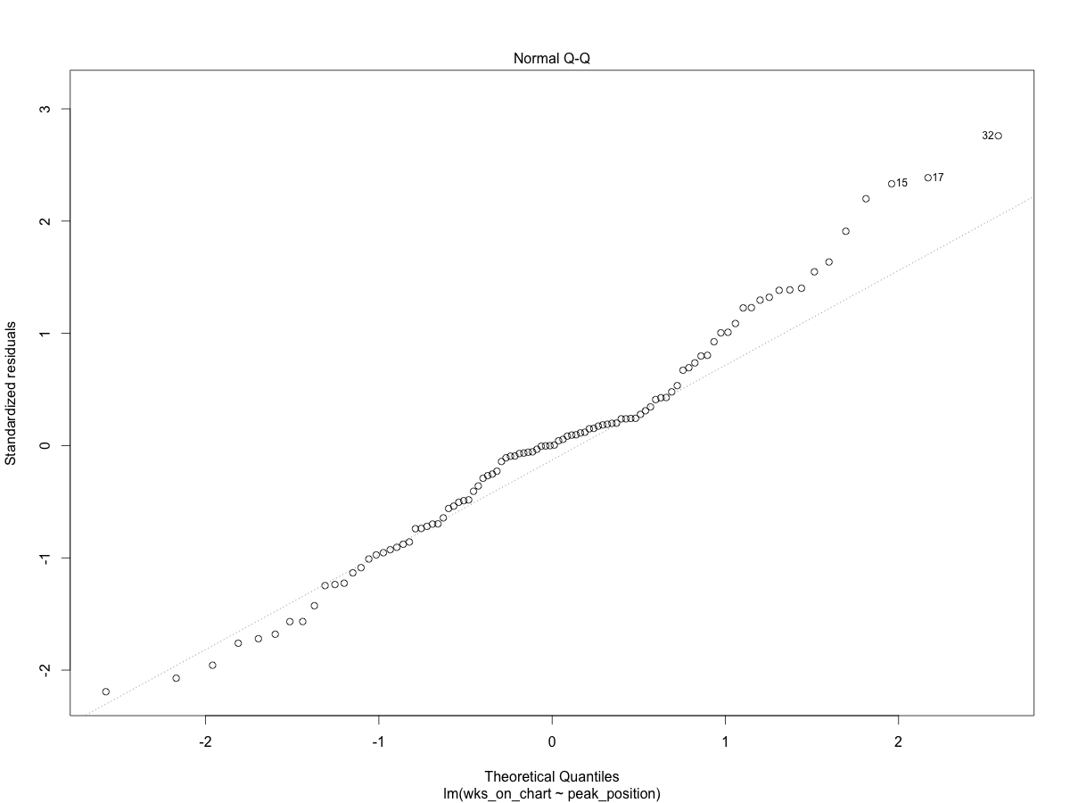
Normality

Slide 7
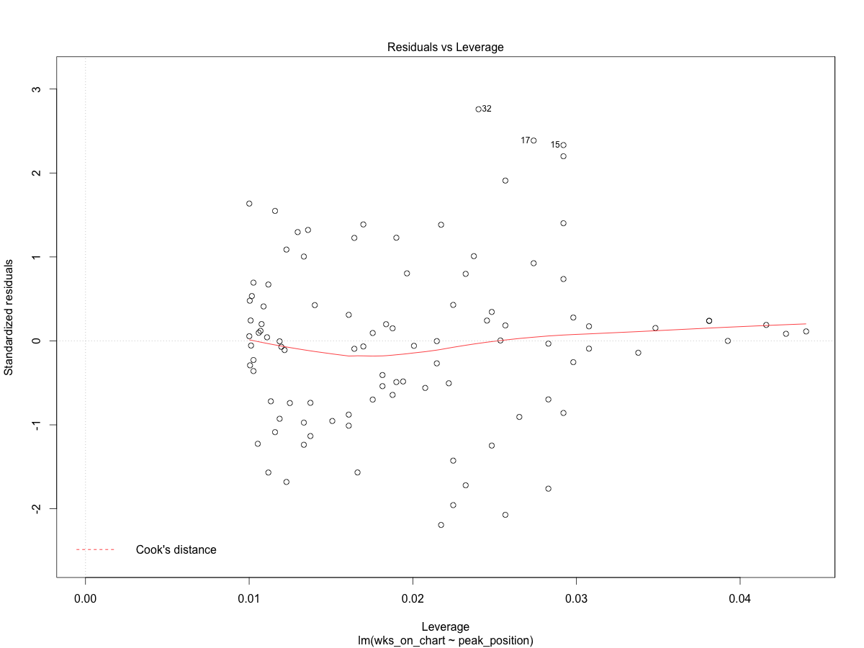
Residuals vs leverage

Slide 8


Slide 9
Adele’s Hot 100 songs
Predict her on list songs
fit lwr upr
1 20.457922 5.0901888 35.82566
2 18.977702 3.6546347 34.30077
3 17.708942 2.4176344 33.00025
4 17.286022 2.0039553 32.56809
5 16.228722 0.9668019 31.49064
6 7.347403 -7.9132301 22.60804
7 5.867183 -9.4224114 21.15678
8 4.386963 -10.9398481 19.71378
9 2.272364 -13.1218138 17.66654

Slide 10
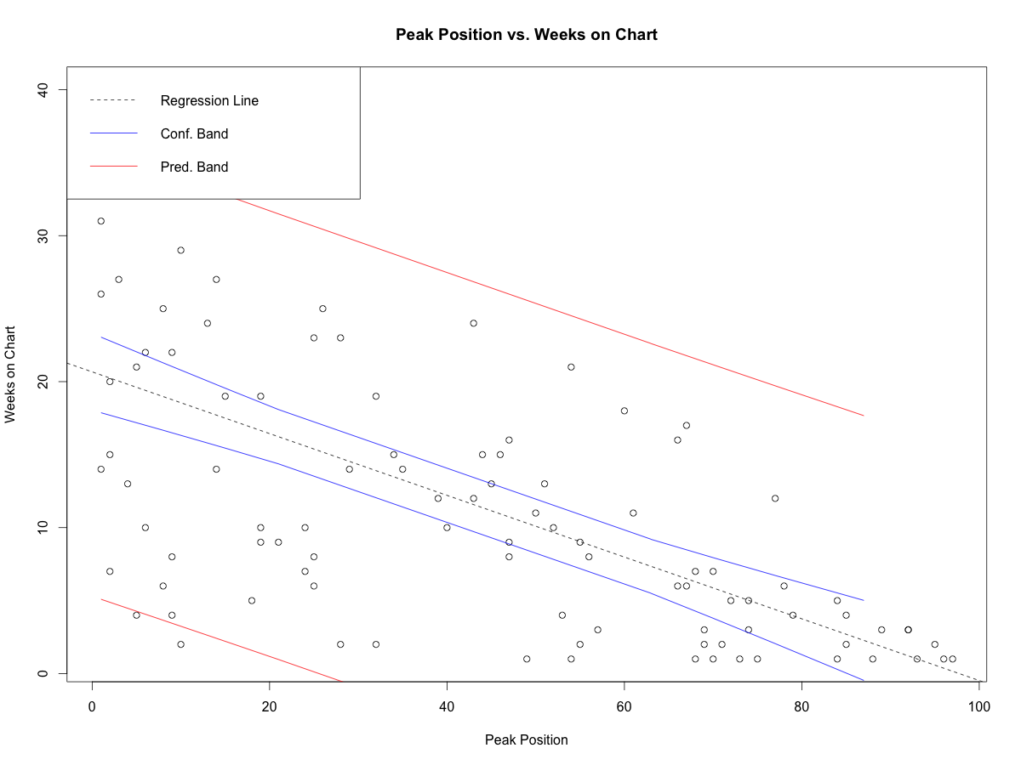

Slide 11
How good is our model?
Residual standard error: 7.633
Multiplle R-squared: 0.4088
Adjusted R-squared: 0.4028

Slide 12
Conclusion
There is a correlation between songs’ peak position and weeks on the Hot 100 chart
Prediction on Adele’s song isn’t well made. Need a more accurate model.

