Slide 1
User-User Yelp Recommendation System
Jordan Waters

Slide 2
Understanding the Data
Dataset from Yelp Kaggle Challenge(1.9GB)
2.7M reviews by 687K users for 86K businesses in 10 cities.
Because ultimate project goal was to create a tool that would be adaptable to most rating data, I only chose to work with the user, business, and rating variables.
To decrease the size of the data and increase the likelihood of user-user interactions , users with less than 100 reviews were filtered out.
The final dataset consisted 327238 reviews and had 1681 of unique users and 52322 unique businesses.
Train Test was split 80/20

Slide 3
Euclidian Distance
1/(1+sum([math.sqrt(pow((reviews[stars].loc[(reviews[userId] == user_1) & (reviews['business_id'] == item)]).iloc[0] - (reviews[stars].loc[(reviews[userId] == user_2) & (reviews['business_id'] == item)]).iloc[0],2)) for item in commonRestaurants]))
AKA:
1/ 1 + The combined sum of the absolute values of the difference in commonly rated businesses
This produces a number between 1 and 0 that can be used to create a weighted average for predicting a user’s rating.
A distance of 1 reflects exact matching between users

Slide 4
Euclidian Distance cont.
Leaving the root out of the equation gives the ability to exaggerate the punishment for greater differences between ratings.
Personally, I’d rather have a great meal with the chance of it being terrible, than a meal that has is guaranteed to be a few stars off of my rating.
If the data was ratings a gift for a significant other, I’d much rather get by with a 3 or 4 star product then run the risk of bombing with a 1 star.
The simplicity of this type of filtering makes it very easy to explain and understand

Slide 5
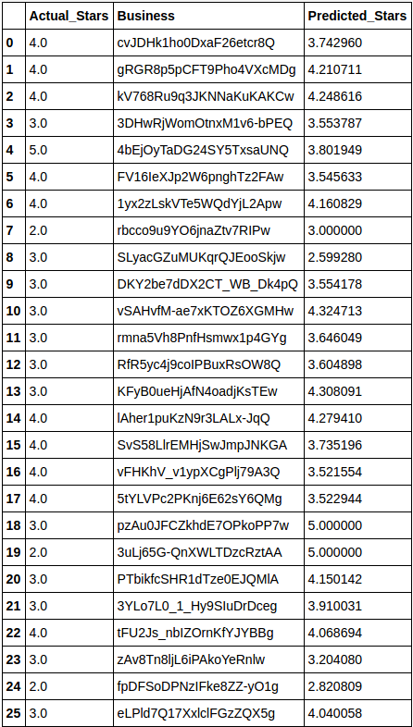

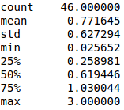
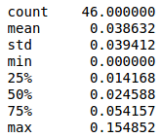
Square Root
No Square Root

Slide 6

My dream is dead...

Slide 7
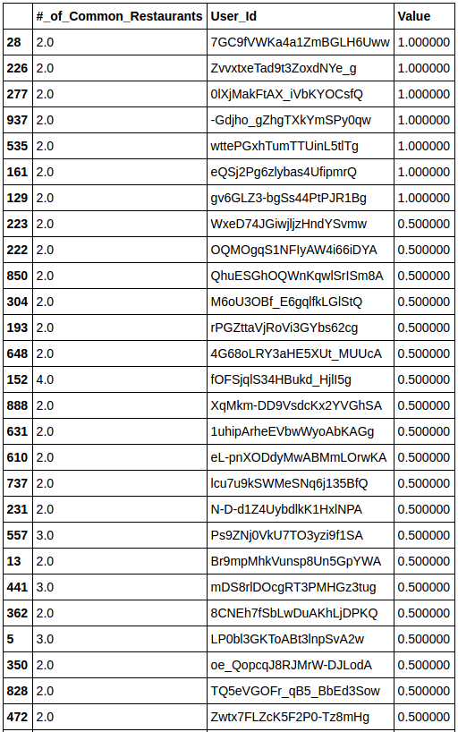
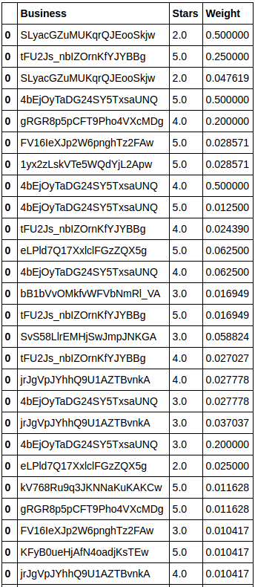
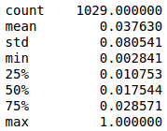
1010
1029
Weight.describe()
Predictions were made by taking a weighted average, but not many reviewers bringing a lot of weight to the party.
Users with Common Reviews
Common Reviews for 50 restaurants in test data

Slide 8
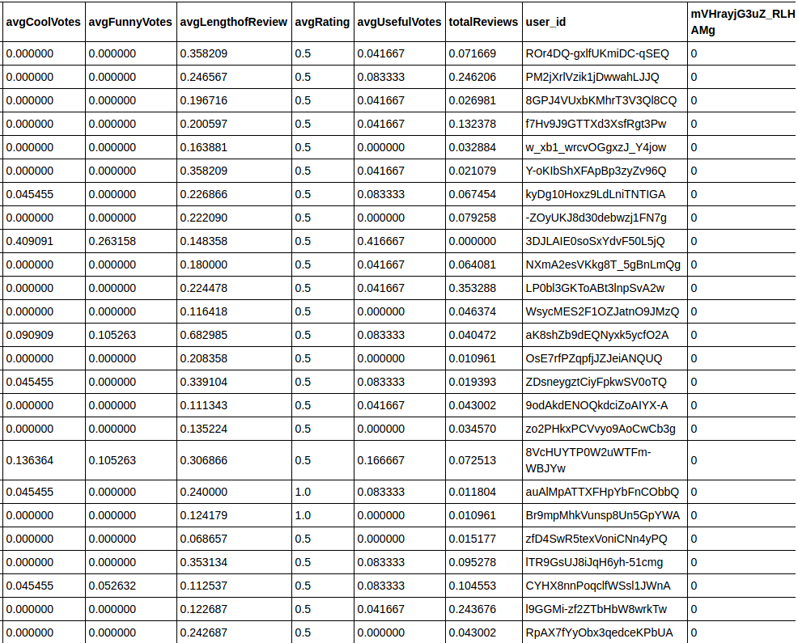
KNN
In attempt to produce better predictions, I sacrificed some interpretability.
Created scaled dataframe containing a column for each restaurant in the test data containing 1681 user’s rating.
Included user features specific to Yelp data.
The first 5 test cases had at most 2 users that had rated the restaurant…

Slide 9
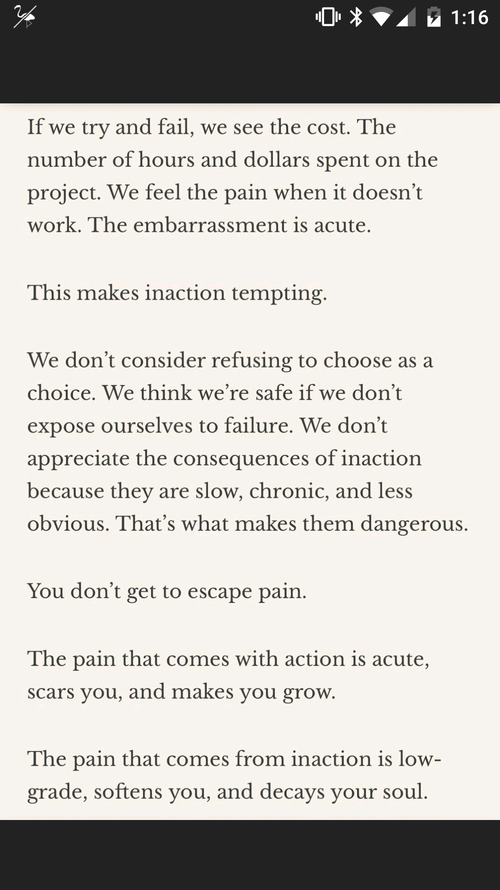
Conclusions:
Front page of Reddit today...
Lack of difference between weighting methods was due to a shortage of common reviewers.
Number of available reviews needs to increase exponentially as number of reviewable objects increases.
Spend less time thinking more time doing
I am now a Pandas wizard

Slide 10
HOW I’M GOING TO FINISH THIS PROJECT
Thanks!
Original goal was to create a python script that accepted rating data (that has at least user ids, restaurant ids, and a numeric rating) and returned as analysis of popular collaborative filtering methods, I still believe this is still an option.
All the moving parts are in place, just need to scale up with Spark.

