Slide 1

When twitter Meet #brexit
Yehui He

Slide 2
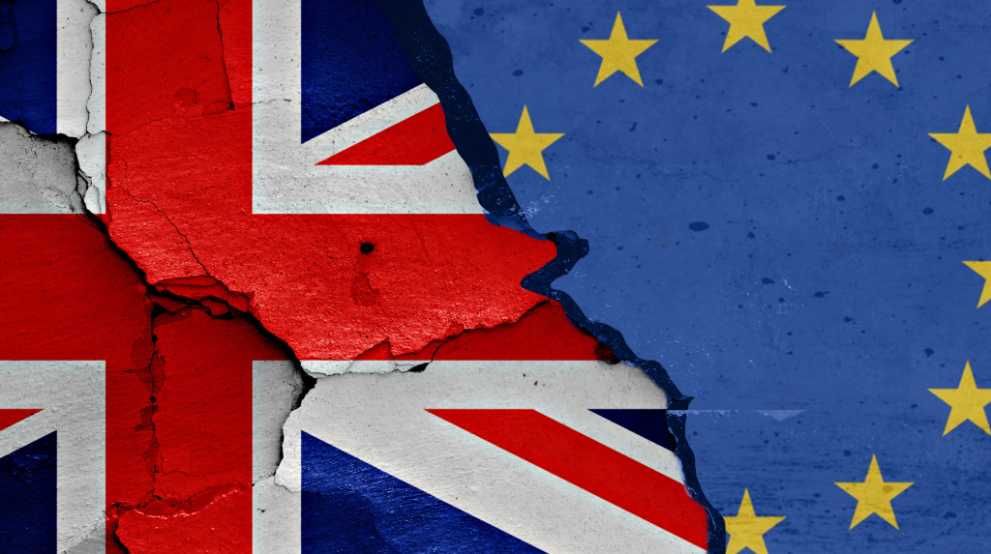
What is Brexit?
Brexit: NOUN
A term for the potential departure of the United Kingdom from the European Union
Pros
Single Market within EU
London Main Financial Hub
Cons
Pays 11% of the GDP
Unwanted Regulations
Immigration

Slide 3
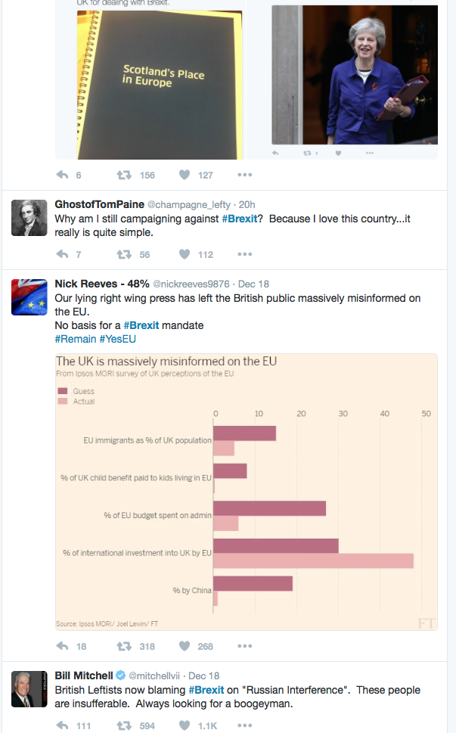

Why Twitter?
As of March 2016, Twitter had more than 310 million monthly active users.
Twitter provide audience general public’s opinion.
Political campaigning
The largest source of breaking news
In business. Reaching the potential customers. Promotional tool
In this case: political sentiment towards Brexit.

Slide 4
Tweets Retrieval
Tool: Twitter API
Tweets: #brexit
Geolocation: London (51.50722, -0.1275), 10 miles radius
Time: Dec. 08th to Dec. 14th
Language: en
No re-tweets
3014 tweets

Slide 5
Tweets Sentiment
Crap. I just realised my mum is a Russian spy. She voted #BRExit. Anyone got the MI6 phone number so I can report her? | Negative
It was because of #Brexit https://t.co/VG5kAFBflu | Neutral
Ooh look, more evidence #Brexit a trading and red tape disaster. We could just hope it'll be ok. Or just #StopBrexit https://t.co/X0frgT8csA | Negative
Urgent #Brexit deal needed to avert #banking job losses, warns @UKHouseofLords @lsebrexitvote #finance #forex https://t.co/a2Bx915AL1 | Negative
#chickenfarming looks pretty good compared to some #officeworkers but you decide which sector generated moreâ€¦ https://t.co/f7rDVk4Lrk | Negative
and the #Brexit-ers tell us we need to get out of the EU because it's doing so badly https://t.co/FHZlwPIJF0 | Positive
America ’Ê_’_â at least they're openly racist unlike the UK. When it's only really obvious through #Brexit https://t.co/oyLSmdFyrb | Negative
@WeNeedEU We do not!! #Brexit needs to happen and new deals to happen with EU, Canada, US China etc asap . work with EU not be run by them | Positive
Q: How will Christmas dinner be different after #Brexit? A: No #Brussels. https://t.co/ZkIhRBvO78 | Neutral
Bombing civilians, rail strikes, return of far right...what year is it? Where is mankind's upward trajectory of progress? #Trump #Brexit etc | Negative
@MickyGambino @realDonaldTrump #BritishPublic were tricked to join EU! Lied to for 30 years by politicians. Shamef‰Û_ https://t.co/sOxfYON7vp | Positive
Manually labeled 2000 Tweets
Categories: Positive, Negative, Neutral
Methods
Positive: remainers + negativity
Negative: leavers + positivity
Neutral: Informative + ambiguous
Positive: 285
Negative: 484
Neutral: 1231
Total tweets count for my model: 769

Slide 6


Slide 7
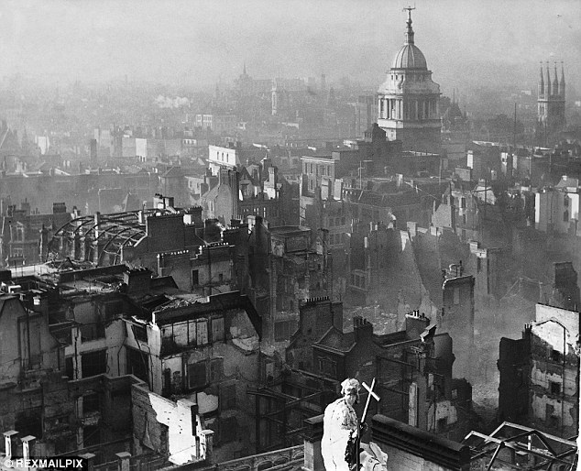

Slide 8
Tweets Sentiment AI
Tokenization
Stemming and lemmatization
Removing stop words and punctuation
tf-idf
Building classifier and Evaluation

Slide 9
Words that matters -- #Features
derivatives',
'criminals',
'spoke',
'would',
'achieve',
'negative',
'\xcd\xbe_\xcd\xb1\x8f',
'call',
'calm',
'strike',
'https//tco/7gww8lakjv',
'@speakoutsodem',
'@smallbusinessuk',
'#banking',
'abusing',
'supporters',
'brings',
'naive',
'antieu',
'antidemocratic',
'warn',
'phone',
'kgb',
'https//tco/p1xnz1meif',
'excellent',
'hold',
'must',
'disappointing',
'join',
'room',

Slide 10
#Pipeline
No principle components analysis to do dimensionality reduction on the training set.
Divide the tweets in to training and test sets. All tweets are fed in to a simple, token-based feature extractor to produce feature vectors.
tf-idf
Use the training set to teach classifiers
#MultinomialNB
#RandomForestClassifier
#LinearSVC
Use the test set to score the classifier.

Slide 11
#Evaluation
Accuracy
MultinomialNB: 72.289%
RandomForestClassifier: 71.084%
LinearSVC: 69.879%
Confusion Matrix (MultinomialNB)
Sensitivity (TPR): 0.58
Specificity (TNR): 0.42
| 0 1 |
--+-------+
0 |<442> 5 |
1 | 208 <114>|
--+-------+
(row = reference; col = test)
| 0 1 |
--+-------+
0 |<440> 7 |
1 | 210 <112>|
--+-------+
(row = reference; col = test)
| 0 1 |
--+-------+
0 |<429> 13 |
1 | 220 <107>|
--+-------+
(row = reference; col = test)

Slide 12
How well AI works?
Tweets | Prediction | Actual
Highly probable' that Russia interfered in #Brexit referendum #leave #remain https://t.co/znp6AzUnBn | Negative | Negative
HYPOCRITS. How Labour betrayed us, our democracy &amp; the people they CLAIM to represent. Sick of Remainers. #brexit\x8a\x97_ https://t.co/S9os5G0BfU | Positive | Positive
An excellent @gdnlongread diagnosing our present predicament: 'Welcome to the age of anger'https://t.co/90ge8kEIsX #Trump #Brexit @guardian | Negative | Negative
['@WeNeedEU \nWe do not!! #Brexit needs to happen and new deals to happen with EU, Canada, US China etc asap . work with EU not be run by them', | Positive | Negative

Slide 13

#Conclusion
AI depend on how to classify tweets, account for key words, facts, humor, sarcasm.
#brexit sentiment is somewhat negative, either Londoner’s opinion, economic condition, forecast, or fear of foreign intervention.

Slide 14
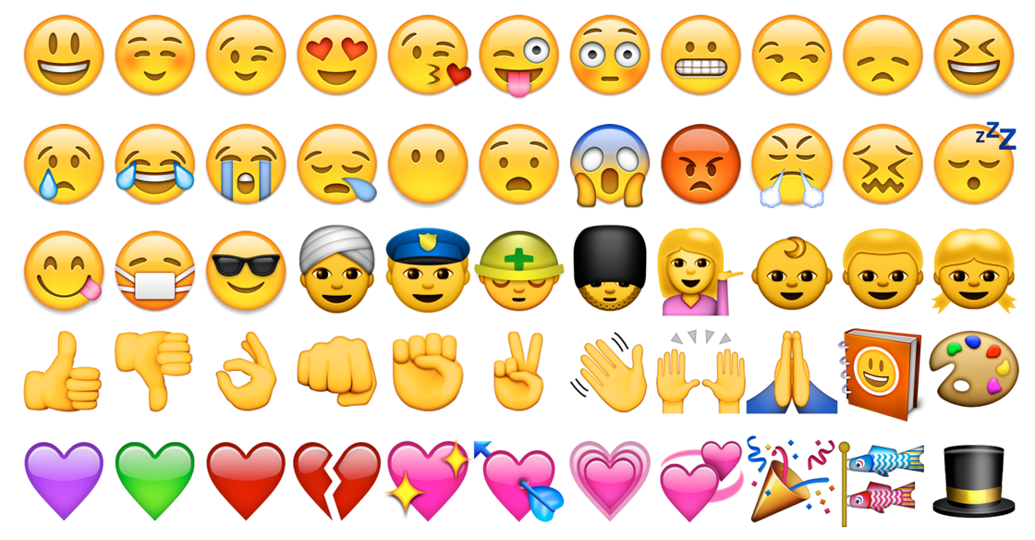
Future Work
Use a principle components analysis to do dimensionality reduction on the training set. In principle, this should help Naive Bayes classifiers deal better with dependent features.
Classification results could probably be improved by using Parts of Speech (PoS) tagging together with actual semantic analysis. The challenge is that tweets have both atrocious grammar and god-awful spelling. A simpler PoS tagger may actually work better than a fancy one for tweets.
Feature extractors should be internet acronym and emoji aware. For example <3 as an emoticon for "heart" or "love”.
It may be advantageous to consider multiple, sequential tweets from a given user when doing classification. Sarcasm, in particular, can sometimes be hard to identify given only a single tweet.

