Slide 1
Chronic Diseases in the U.S.
Dina Mirijanian

Slide 2

Chronic Diseases

Slide 3
Top Causes of Death, United States, 2011
Rank | Cause of Death | Number | Death Rate
1 | Diseases of the heart | 596,339 | 191.4
2 | Malignant neoplasms | 575,313 | 184.6
. . .
7 | Diabetes mellitus | 73,282 | 23.5
Adapted from Hoyert DL, Xu J. Deaths: Preliminary data for 2011. Natl Vital Stat Rep. 2012;61(6):1-51. Rates are per 100,000 population.

Slide 4

Cancer
*
*average over the years 2008-2012

Slide 5

Cancer

Slide 6
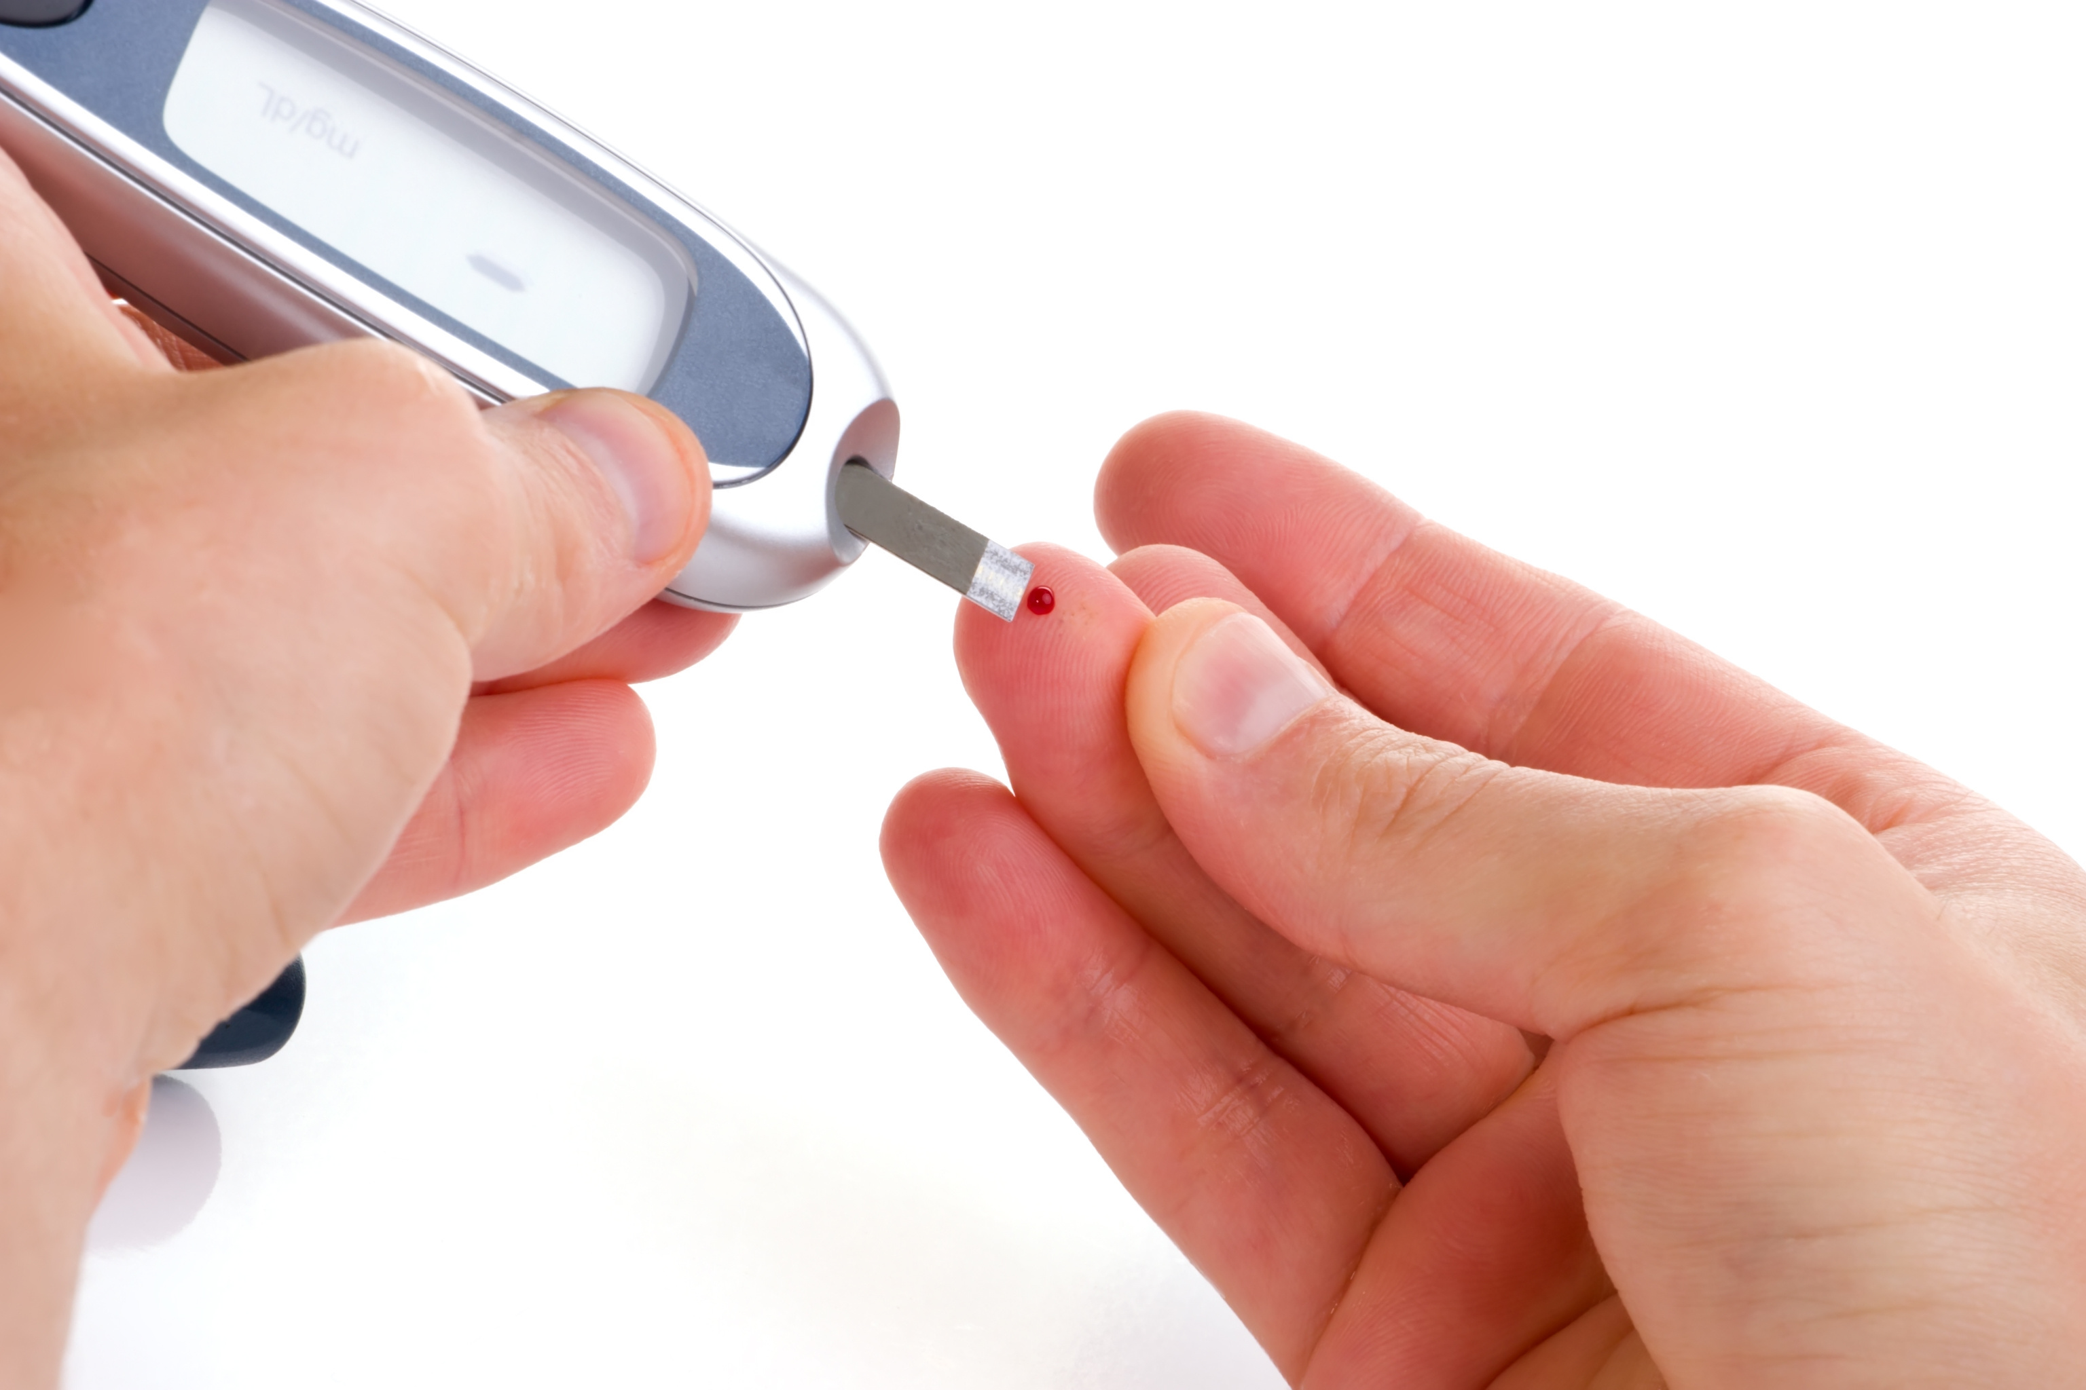
Diabetes

Slide 7
Diabetes
%
2014
Where you live matters.

Slide 8

Cardiovascular Disease

Slide 9
Cardiovascular Disease
per 100,000
2014
Where you live matters.

Slide 10
Cardiovascular Disease and Diabetes
cardiovascular
per 100,000
diabetes
2014
%

Slide 11
Conclusions
Some trends in chronic diseases are troubling
- Mammography screening for early detection of breast cancer is
on the decline for the most vulnerable age group
- Mortality from cardiovascular disease is on the rise
Geography is a key factor in the prevalence of diabetes and
cardiovascular disease
Possible correlation between diabetes and cardiovascular disease
Further Work
Look at the gender stratification in lung cancer, diabetes and cardiovascular disease
Research the cause for the drop in use of mammography

