Slide 1
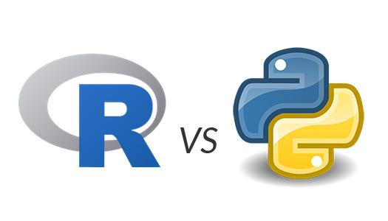
R or Python?
Stack Overflow Tells You Which One is
More Popular !
Chuan Hong
10/30/2016

Slide 2
Why Do this Project?
R or Python
Kaggle:
R Quesitons from Stack Overflow
Python Questions from Stack Overflow

Slide 3
About Datasets
R |  |  | Python
Questions | Answers | Tags | Questions | Answers | Tags
Title Body Score Date ID_Q OwnerID | Body Score Date ID_A ID_Q OwnerID IsAccepted | Tags ID_Q | Title Body Score Date ID_Q OwnerID | Body Score Date ID_A ID_Q Owner ID IsAccepted | Tags ID_Q

Slide 4
ShinyApp
Variables
R and Python’s package names from internet
R |  |  | Python
Questions | Answers | Tags | Questions | Answers | Tags
Date ID_Q OwnerID | Date ID_A ID_Q OwnerID | Tags ID_Q | Date ID_Q OwnerID | Date ID_A ID_Q OwnerID | Tags ID_Q

Slide 5
Conclusions
The number of users have continuously increased
Growth of python is much more obvious
For Python:
Top 5 packages diango, pandas, numpy, matplotlib, regex
For R
Top 5 packages ggplot2, shiny, data.table, matrix, dplyr

Slide 6
Limitation and Improvement
Only based on Stack Overflow community
To investigate Q & A
Tags versus Q/A
To add “search” function to find answer with highest score
Quesitons, answers, score, isAccepted
Natural language processing

