Slide 1
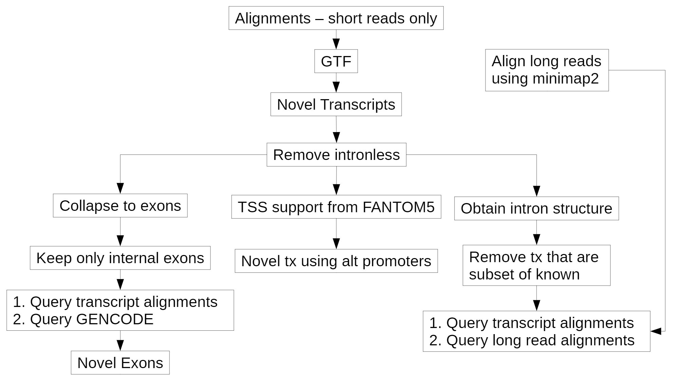

Slide 2
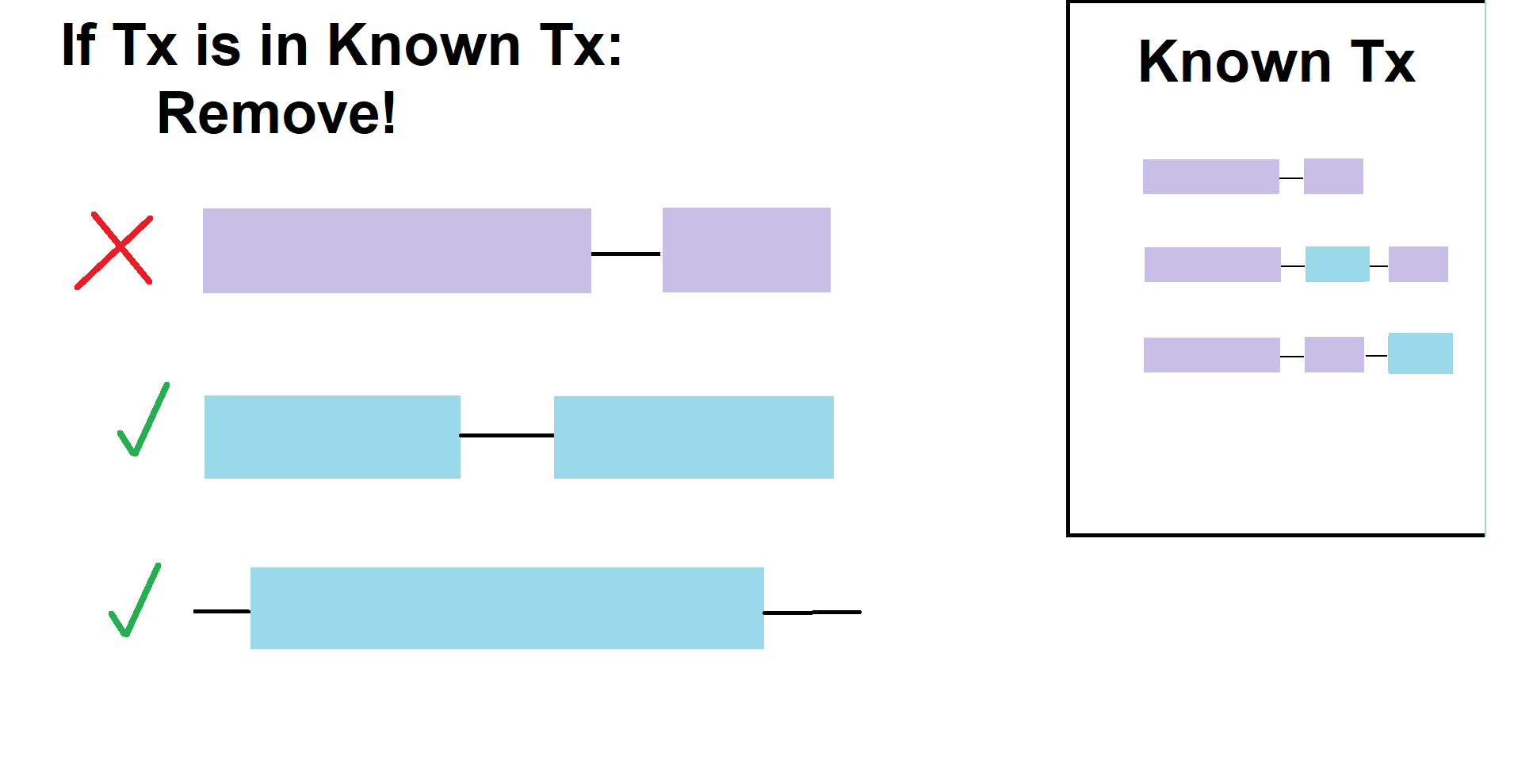
We are only looking for novel transcripts!

Slide 3
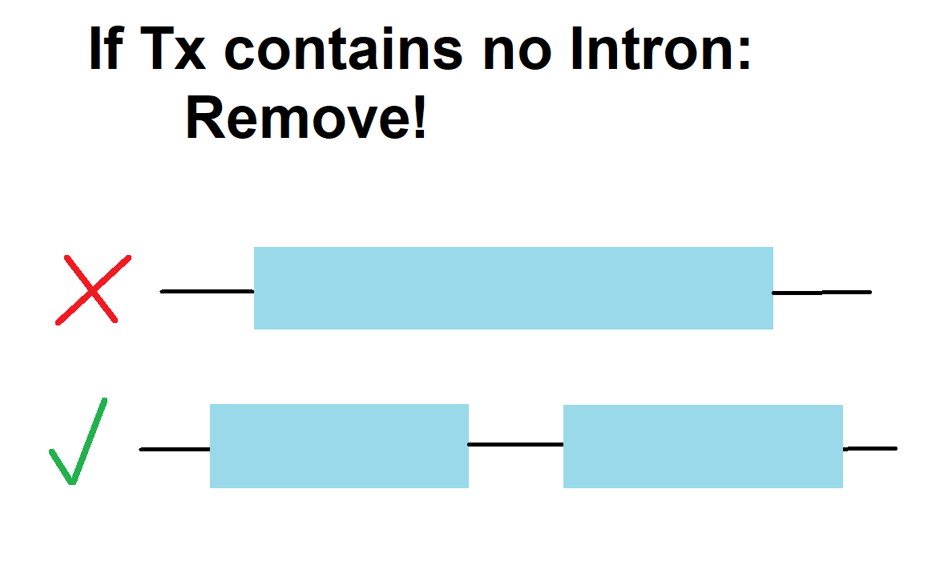
Intron-less transcripts are not relevant to our analysis and are likely due to experimental error

Slide 4
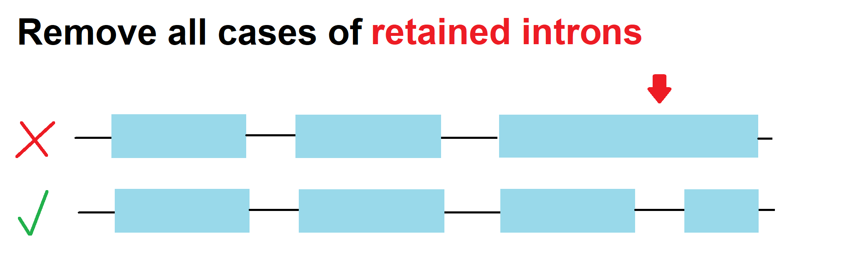
Although biologically relevant, we are uncertain how to parse true retained introns against experimental error

Slide 5


