Slide 1
Feature Extraction Methods for Images
Traditional vs Deep Learning Approaches

Slide 2
Introduction
Feature extraction is a fundamental step in the field of computer vision and image analysis. It involves transforming raw image data into meaningful, measurable information that can be used by machine learning or deep learning models.

Slide 3
The Feature extraction:
Helps machines "understand" image content
Reduces image complexity while preserving essential patterns
Plays a critical role in tasks like classification, object detection, and recognition
Have 2 types:
Traditional (hand-crafted features)
Deep Learning-based (automatically learned features)

Slide 4
Traditional Feature Extraction Methods
Traditional feature extraction methods rely on manually designed algorithms to identify patterns, textures, shapes, and key points within images. Often used with classical machine learning algorithms like SVM, k-NN, or Random Forest

Slide 5
Common Techniques Include:
SIFT – Scale and rotation invariant key point detection
SURF – Faster alternative to SIFT
Edge Detection

Slide 6
SIFT (Scale-Invariant Feature Transform)
SIFT is a widely used algorithm for detecting and describing local features in images.
Detects key points (interest points) in an image that are invariant to scale, rotation, and illumination
Computes a 128-dimensional descriptor for each key point, representing local gradient information

Slide 7
How It Works
Scale-space construction: Detect extrema in DoG (Difference of Gaussians) across scales
Key point localization: Select stable key points by eliminating low-contrast and edge responses (Localizes key points by fitting a quadratic function to refine position and scale.)
Orientation assignment: Assign orientations based on gradient directions
Descriptor generation: Create histograms of gradients around each key point in a 16x16 region

Slide 8
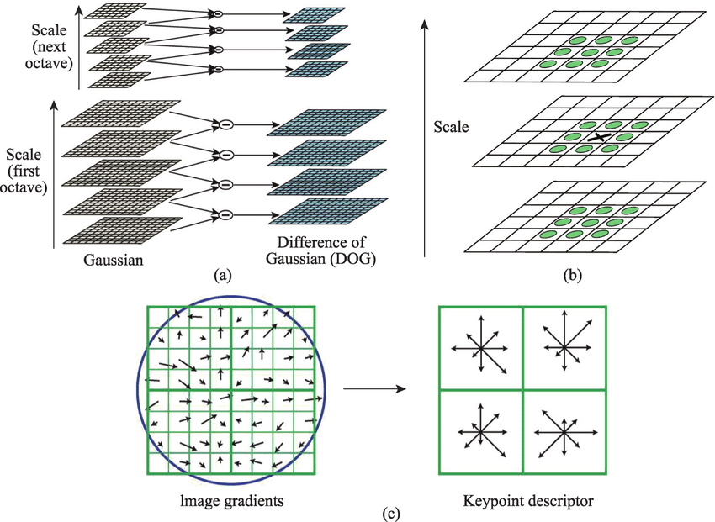

Slide 9
Advantage
Robust to changes in scale, rotation, viewpoint, and illumination.
Good for object recognition.
Limitations
Computationally expensive

Slide 10
SURF (Speeded-Up Robust Features)
SURF is a faster, real-time alternative to SIFT designed for robust feature detection in images.
Like SIFT it Detects key points (interest points) in an image that are invariant to scale, rotation, and illumination.
Unlike Sift it Computes a 64-dimensional descriptor for each key point, representing local gradient information

Slide 11
How it work
Scale-Space construction: its use of box filters and the Hessian matrix for scale-space and key point localization
Key point Localization: uses the Hessian matrix to detect keypoints based on curvature.
orientation assignment: SURF uses Haar wavelet responses for orientation assignment and descriptor generation
Descriptor generation: SURF produces a 64-dimensional descriptor making SURF more compact than SIFT descriptor but potentially less accurate in some cases.

Slide 12
Advantages
Faster than SIFT (real-time applications)
Rotation and scale invariant
Compact descriptors (64 values)
disadvantages
Less accurate than SIFT in some cases

Slide 13
Edge Detection
Edge Detection is a fundamental technique in image processing used to identify points where brightness changes sharply — which often corresponds to object boundaries, features, and shapes.
Why to use it:
Detects boundaries of objects in an image.
Helps simplify image analysis by reducing the amount of data to process.
Converts images into a form more suitable for tasks like segmentation and object recognition

Slide 14
Popular Edge Detection Methods:
Sobel Operator
Prewitt Operator
Roberts Cross Operator
Canny Edge Detector

Slide 15
Deep Learning Feature Extraction Methods
Deep learning methods automatically learn features from images using large neural networks. They don’t require manual feature engineering like SIFT or SURF. But they Require Large Datasets And Compute Power.
Examples:
CNNs (Convolutional Neural Networks)
Pretrained Models: Like VGG, ResNet, MobileNet – trained on ImageNet.

Slide 16
Advantages
High accuracy for tasks like classification, detection, and segmentation.
Adaptable to complex and high-dimensional data.

