Slide 1
Install turbo cli
Delete the node modules of the downloaded project
Move into the folder and then run “npm install” (to get the node modules)
To check Run: turbo devserver

Slide 3
Deploy:
Commands:
1- turbo login ( Use your credentials to login)
2- turbo connect ( in your turbo account it’ll give you the siteID and apiKey)
3- turbo deploy. ( you’ll get a link or you can use your site to check the deployment)

Slide 4
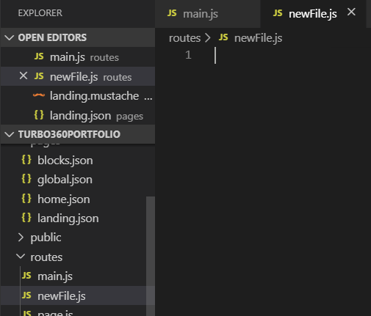
Making a route.
Open the project in your editor
Browse to your routes folder and create a new file

Slide 5
const vertex = require('vertex360')({site_id: process.env.TURBO_APP_ID})
const router = vertex.router()
module.exports = router

Slide 6
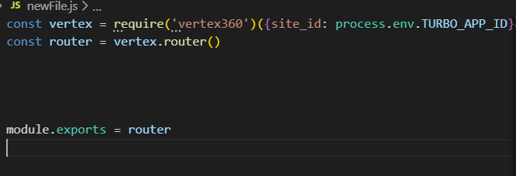

Slide 7
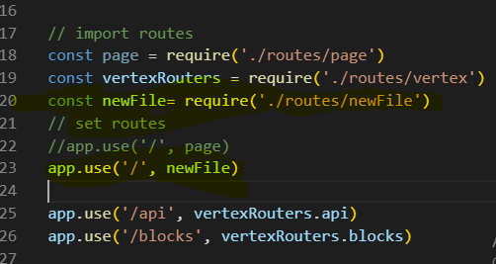
Call it from app.js

Slide 8
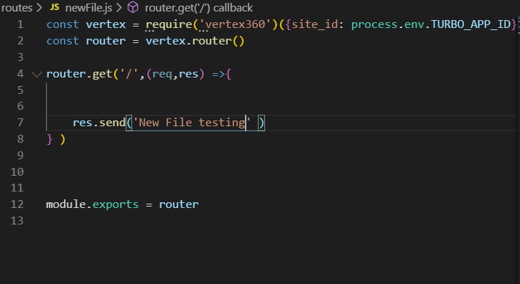
Testing newFile

Slide 9
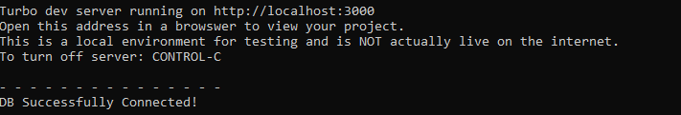
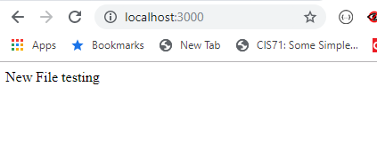
Run devserver ( turbo devserver )

Slide 10
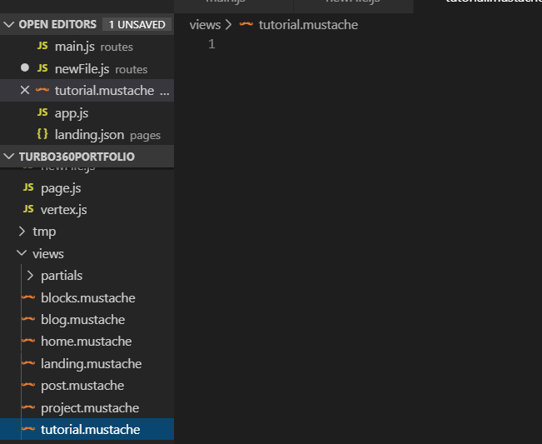
To render a page rather then just a text.
Browse to the views folder
Create a new file (with mustache extension)

Slide 11
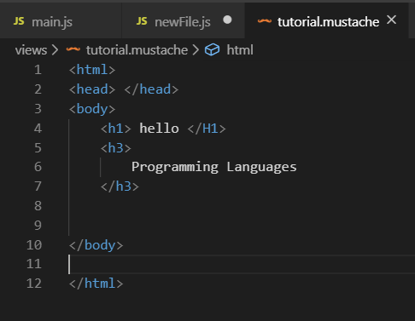
Add your html in the file:

Slide 12
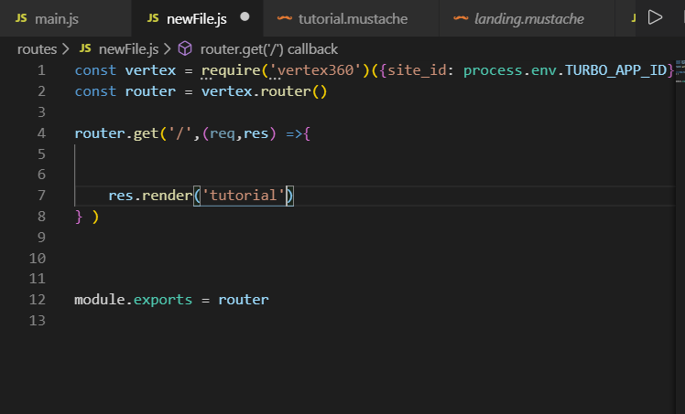
Render the html file:

Slide 13
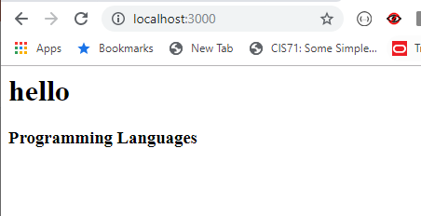
To check:

Slide 14
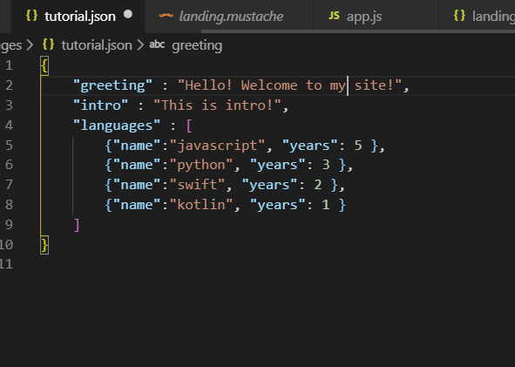
To pass values to html file.
Browse to pages folder and create a new page with json extension (json name should be the same as mustache name)

Slide 15

* To update a json page on server
Turbo page “name” eg
Turbo page landing/ turbo page global
You should just upload the page instead of the whole project

