Slide 1
Sample composed of SDSS sources at 0.05 < z < 0.06
SELECT TOP 11000 sp.plate, sp.fiberid, sp.mjd, sp.specObjID, sp.class, sp.ra, sp.dec, sp.z, sp.psfMag_u, sp.psfMag_g, sp.psfMag_r, sp.psfMag_i, sp.psfMag_z, gse.bptclass, gse.lgm_tot_p50, gse.lgm_fib_p50, gse.sfr_tot_p50, gse.sfr_fib_p50, gse.specsfr_tot_p50, gse.specsfr_fib_p50, gsl.oii_3726_eqw, gsl.oii_3726_eqw_err, gsl.oii_3726_flux, gsl.oii_3726_flux_err, gsl.oii_3729_eqw, gsl.oii_3729_eqw_err, gsl.oii_3729_flux, gsl.oii_3729_flux_err, gsl.h_beta_eqw, gsl.h_beta_eqw_err, gsl.h_beta_flux, gsl.h_beta_flux_err, gsl.oiii_5007_eqw, gsl.oiii_5007_eqw_err, gsl.oiii_5007_flux, gsl.oiii_5007_flux_err, gsl.h_alpha_eqw, gsl.h_alpha_eqw_err, gsl.h_alpha_flux, gsl.h_alpha_flux_err, gsl.nii_6548_eqw, gsl.nii_6548_eqw_err, gsl.nii_6548_flux, gsl.nii_6548_flux_err, gsl.nii_6584_eqw, gsl.nii_6584_eqw_err, gsl.nii_6584_flux, gsl.nii_6584_flux_err, gsi.d4000, gsi.d4000_err, gsi.d4000_n, gsi.d4000_n_err, gsinfo.spectrotype, gsinfo.subclass, gsinfo.v_disp, gsinfo.sn_median, gsinfo.e_bv_sfd
FROM SpecPhoto as sp LEFT JOIN galSpecExtra as gse ON sp.specObjID=gse.specObjID LEFT JOIN galSpecLine as gsl ON gse.specObjID=gsl.specObjID LEFT JOIN galSpecIndx as gsi ON gsl.specObjID=gsi.specObjID LEFT JOIN galSpecInfo as gsinfo ON gsi.specObjID=gsinfo.specObjID
WHERE ((class='QSO' OR class='GALAXY' OR class='STAR') AND (sp.z BETWEEN 0.05 AND 0.06) AND zWarning=0)
CAUTION: of the previous selection, only the spectra with spectral channels between 3700 and 8600 Å, once rest framed, have been interpolated to this common grid with a step of delta_lambda=2Å. Others have been discarded.
The final sample is therefore composed of 8133 (sample1) + 2804 (sample2) = 10937 galaxies.

Slide 2
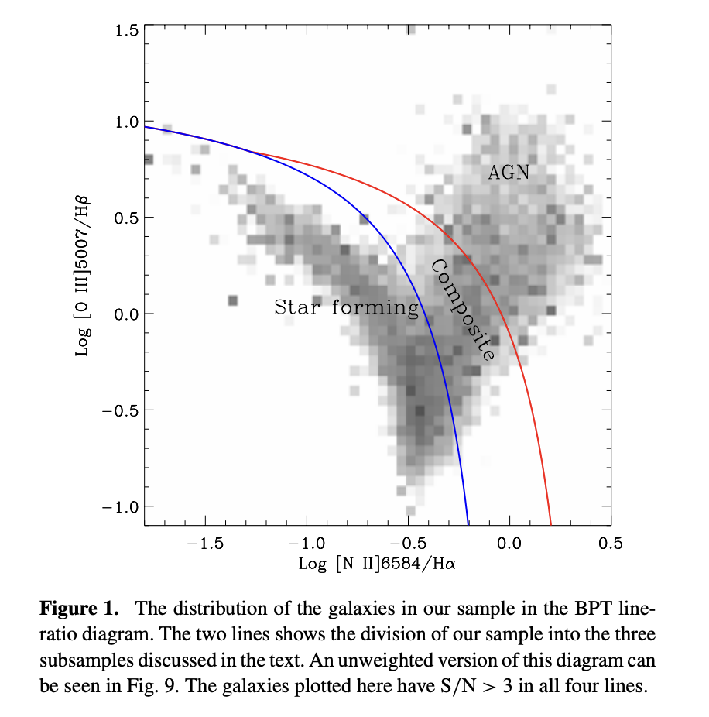
Brinchmann et al. 2004
Baldwin, Phillips & Terlevich (BPT, 1981) diagram

Slide 3
Brinchmann et al. 2004
SF. The star-forming galaxies. These are the galaxies with S/N > 3 in all four BPT lines that lie below our most conservative AGN rejection criterion. As discussed in Section 4, they are expected to have a very low (<1 per cent) contribution to Hα from AGN.
C. The objects with S/N > 3 in all four BPT lines that are between the upper and lower lines in Fig. 1. We refer to these as composite galaxies. Up to 40 per cent of their Hα luminosity might come from an AGN. The lower line is taken from Kauffmann et al. (2003c) and is a shifted version of the upper line. It does lie very close to an empirical determination of the SF class (see Section 4 below) but we have kept the Kauffmann et al. line to be consistent with that work. No results below are affected by this choice.
AGN. The AGN population consists of the galaxies above the upper line in Fig. 1. This line corresponds to the theoretical upper limit for pure starburst models so that a substantial AGN contribution to the line fluxes is required to move a galaxy above this line. The line has been taken from equation (5) in Kewley et al. (2001b), but our models have an identical upper limit.
Low S/N AGNs. A minimum classification for AGN galaxies is that they have [N II]6584/Hα > 0.6 (and S/N > 3 in both lines) (e.g. Kauffmann et al. 2003c). It is therefore possible to classify these even if [O III]5007 and/or Hβ have too low S/N to be useful (cf. Fig. 3, later). A similar approach is taken by Miller et al. (2003). In general, we will include these galaxies together with the AGN class.
Low S/N SF. After we have separated out the AGN, the composites and the low S/N AGNs, we have thrown out most galaxies with a possible AGN contribution to their spectra. The remaining galaxies with S/N > 2 in Hα are considered low S/N star formers. We can still estimate the SFR of these galaxies from their line strengths, even though we cannot use the full modelling apparatus described in the following section.
Unclassifiable. Those remaining galaxies that are impossible to classify using the BPT diagram. This class is mostly made up of galaxies with no or very weak emission lines.
Baldwin, Phillips & Terlevich (BPT, 1981) diagram

Slide 4
Brinchmann et al. 2004
Classification is based on the values of line flux ratios and on the quality of spectra, i.e. the S/N of the lines used for classification
SF
C
AGN
LowSN AGN
LowSN SF
UNCLASSIFIABLE = PASSIVE
Baldwin, Phillips & Terlevich (BPT, 1981) diagram
Kewley et al. (2001b)
position in the BPT diagram AND S/N > 3 for all four lines
Kauffmann et al. (2003)
less strict conditions, lower S/N on some lines

Slide 5
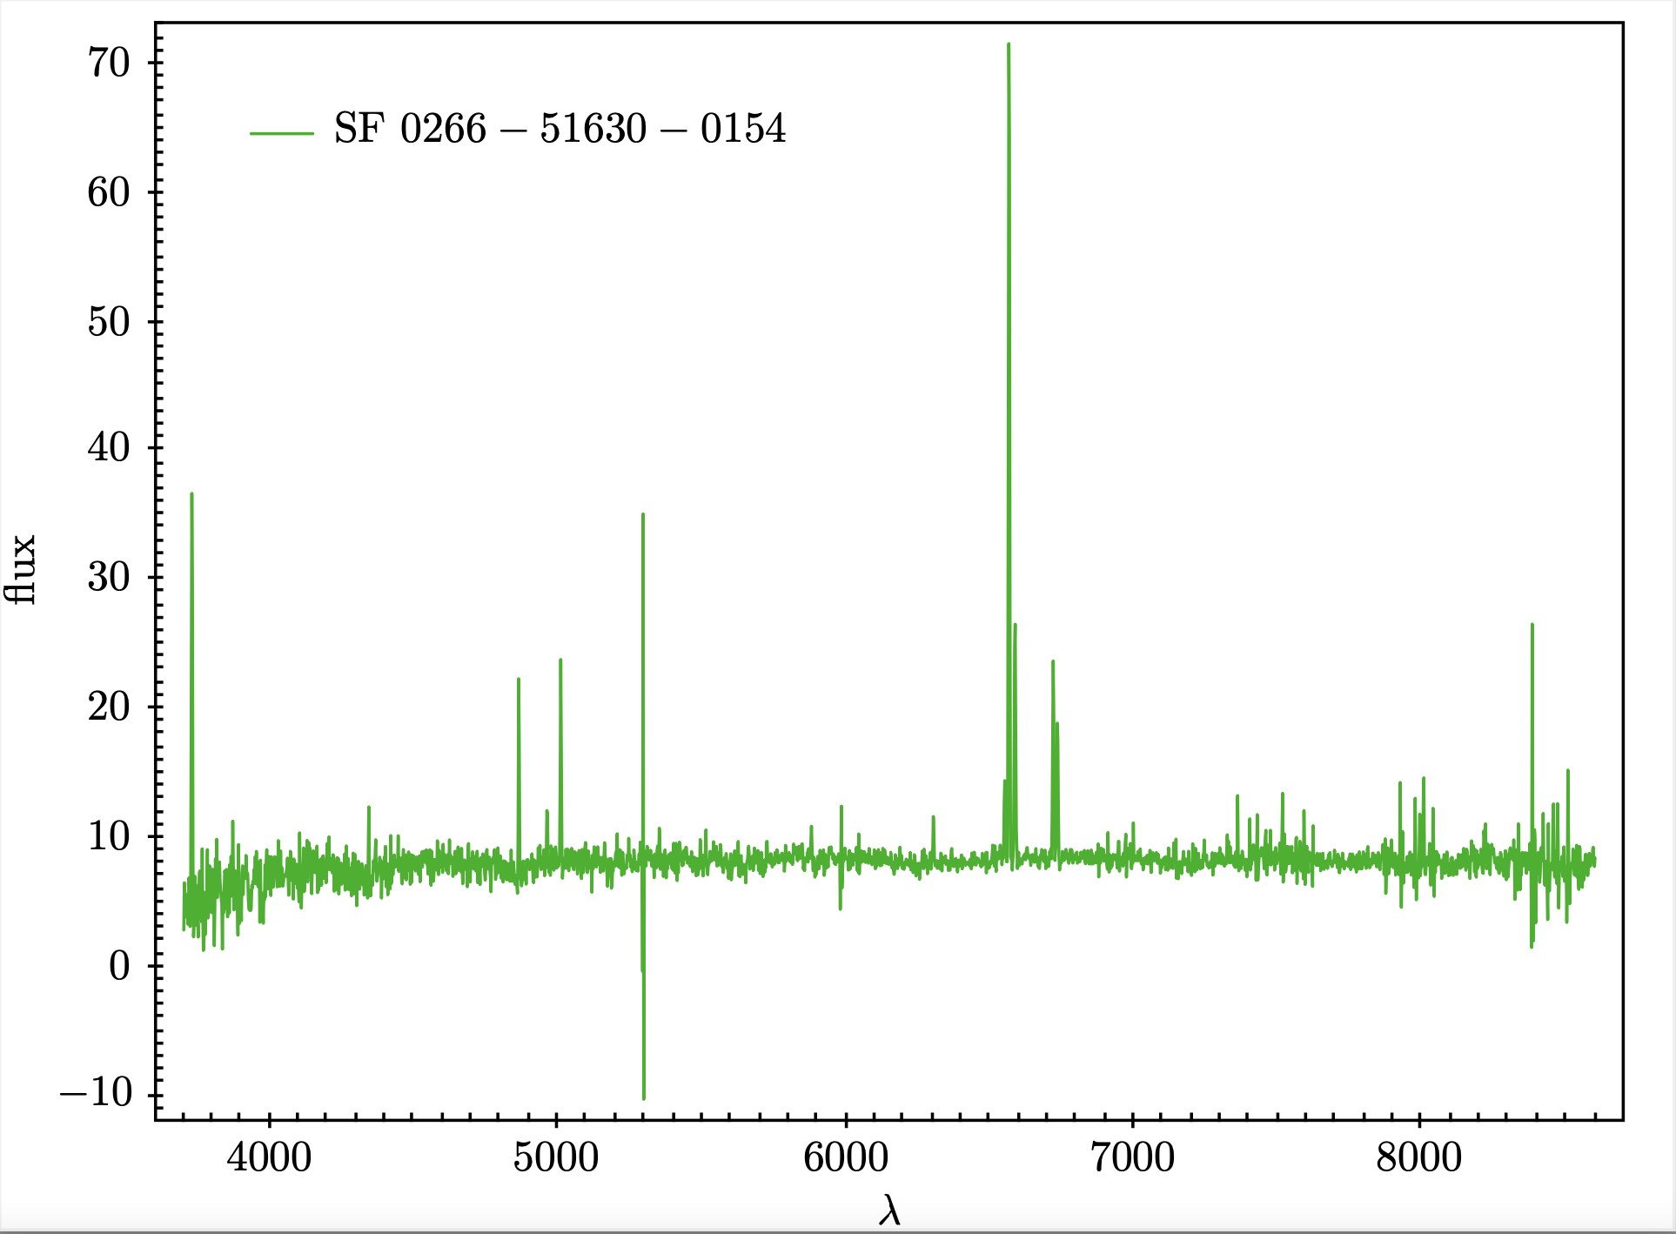
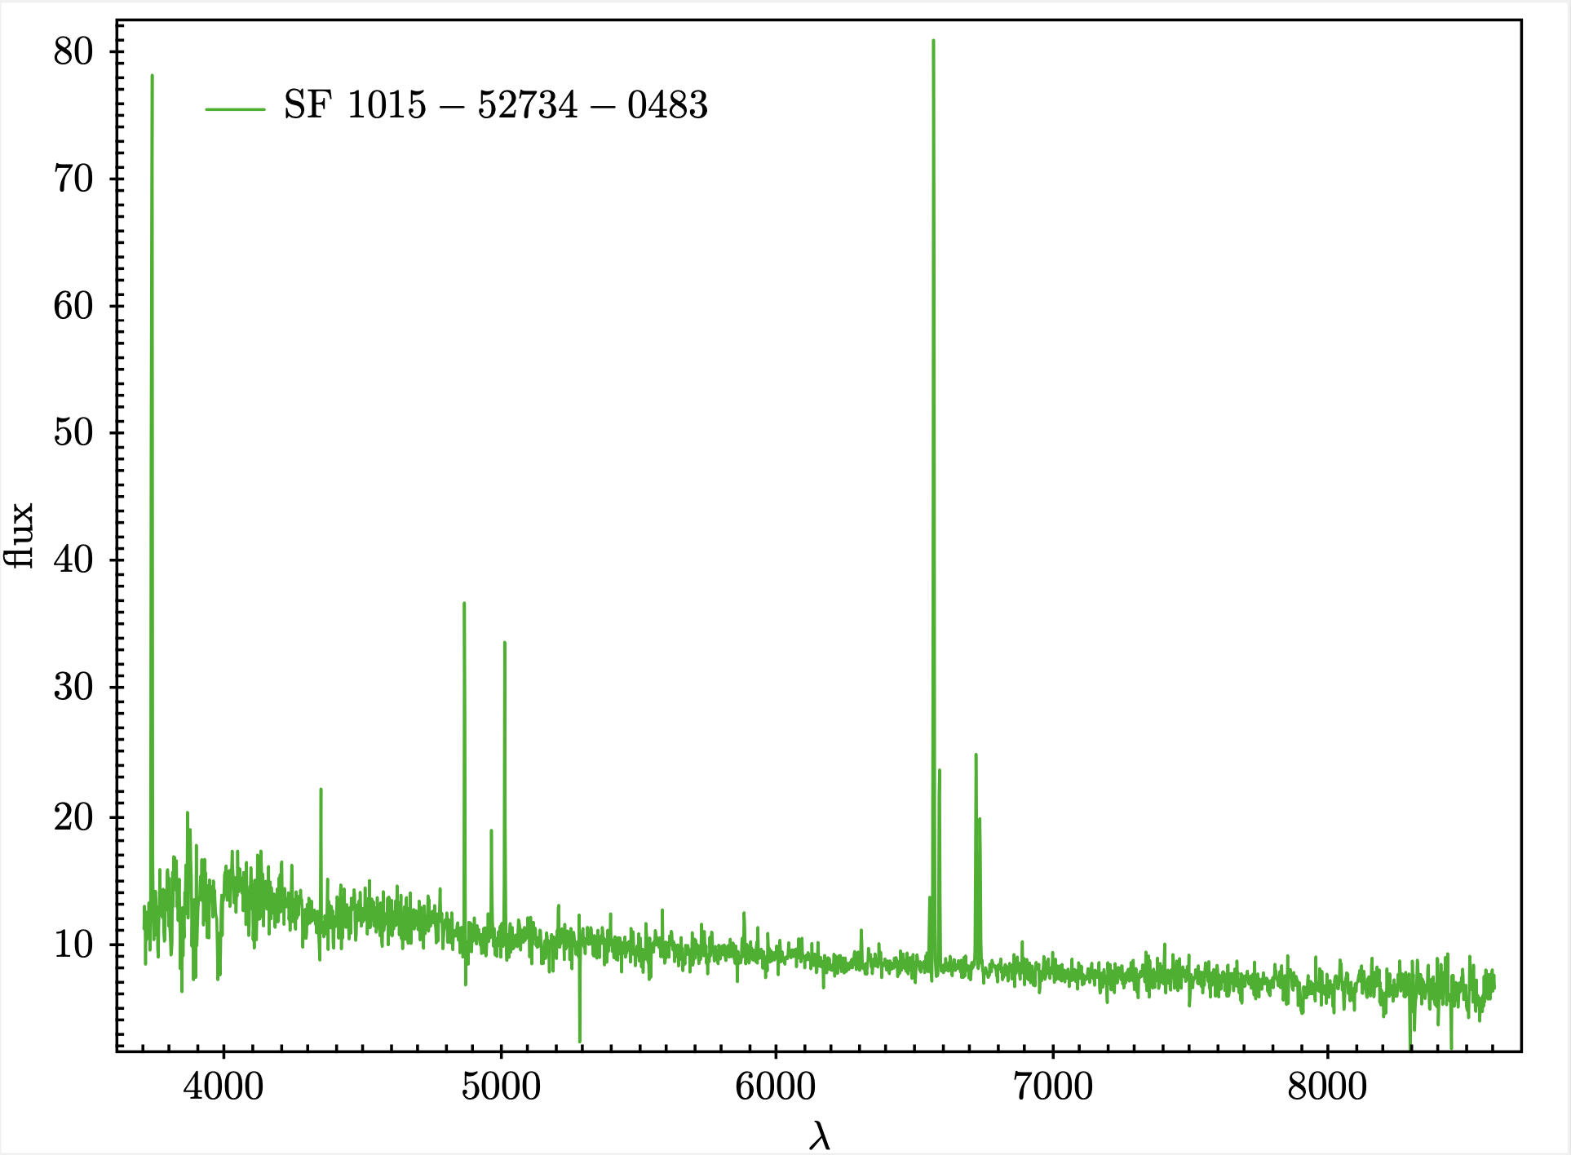

Slide 6
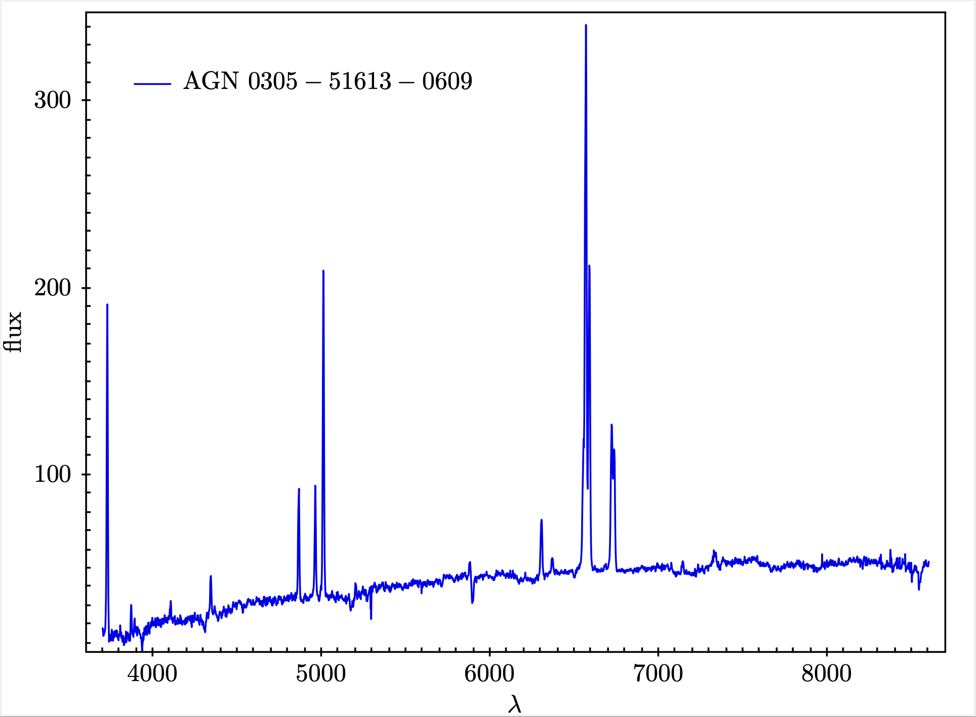
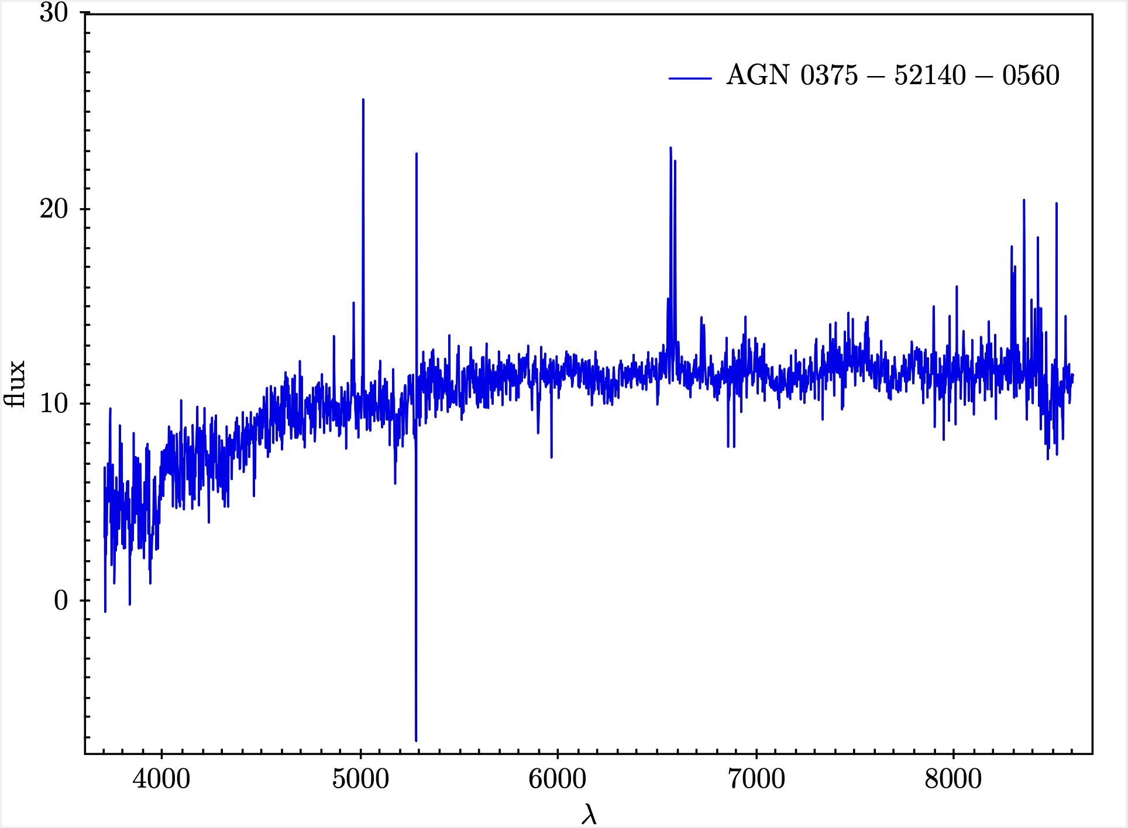

Slide 7
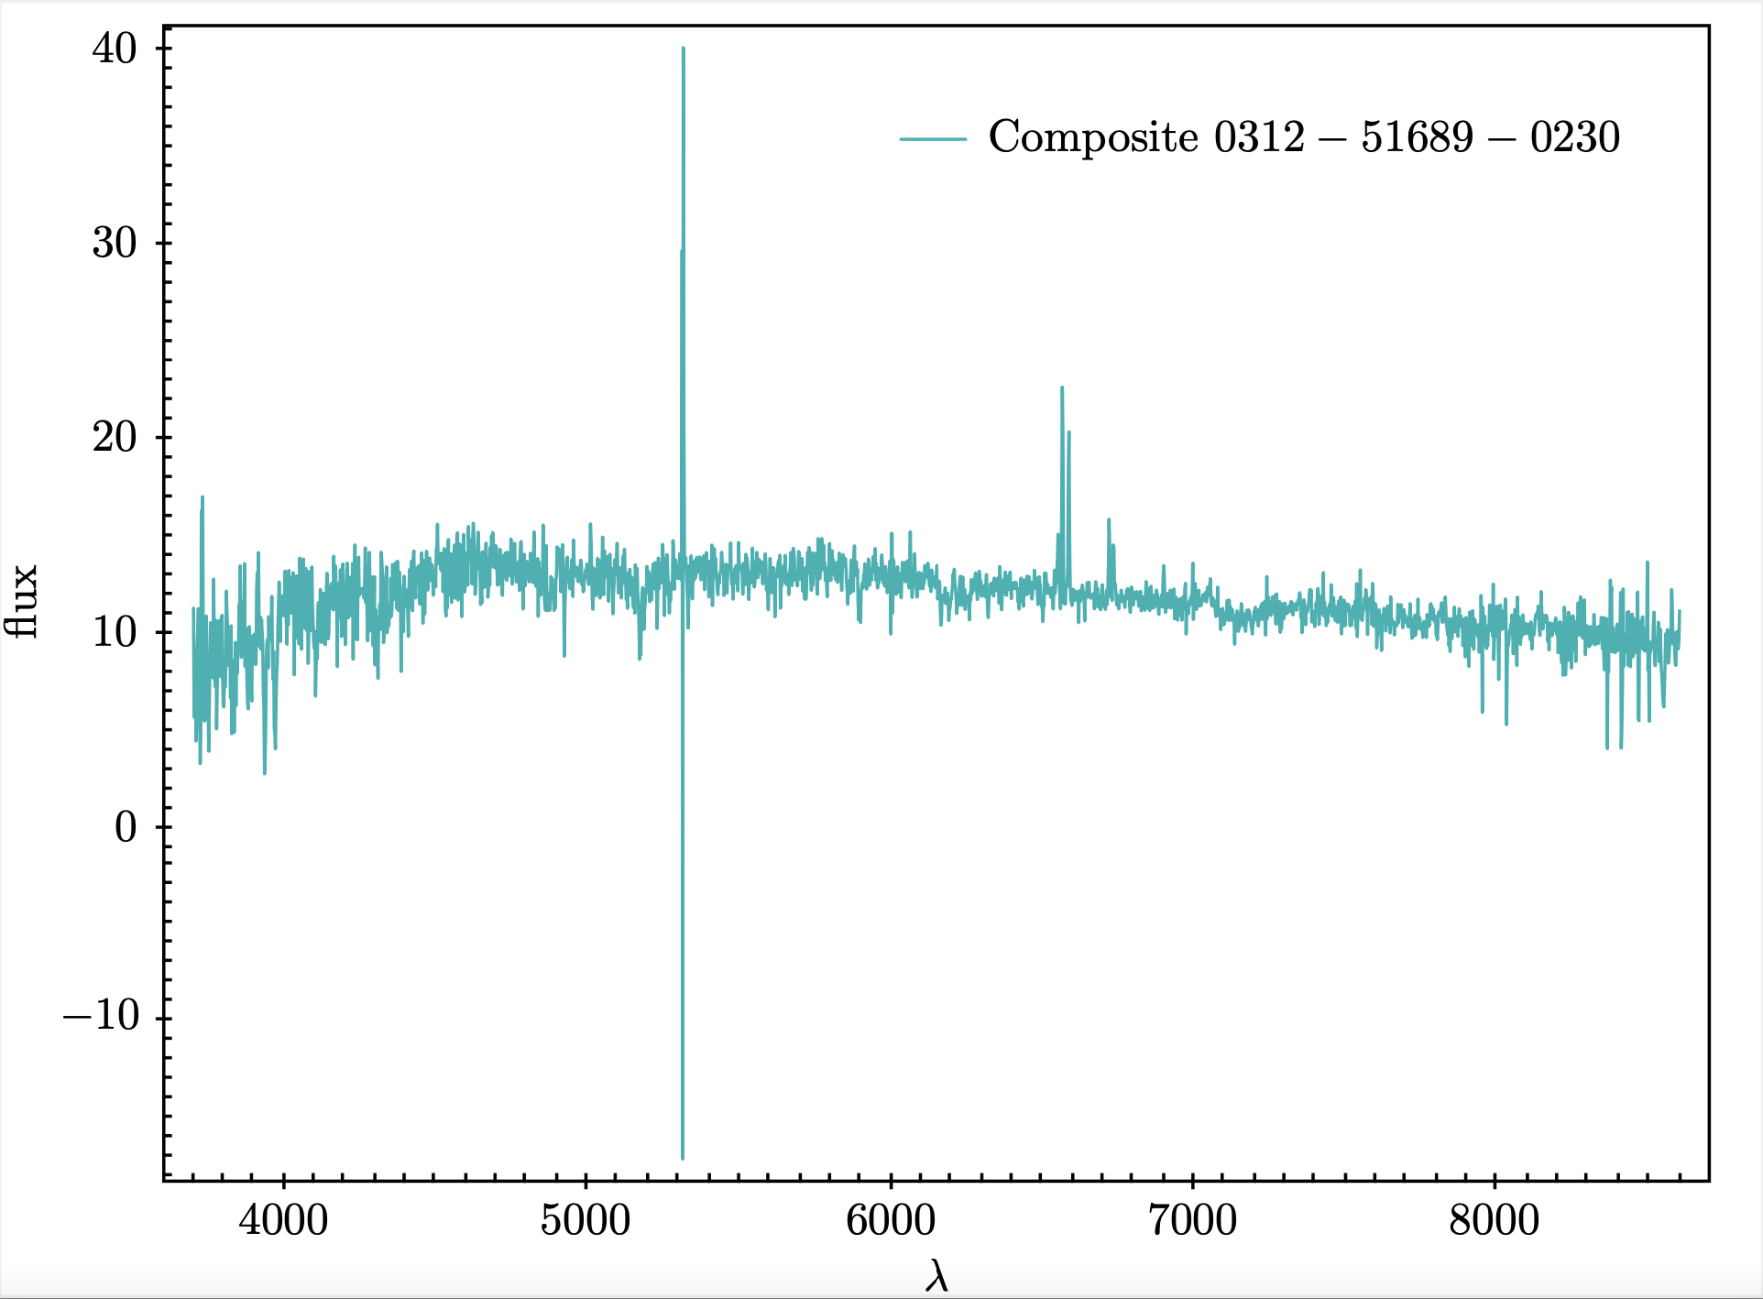
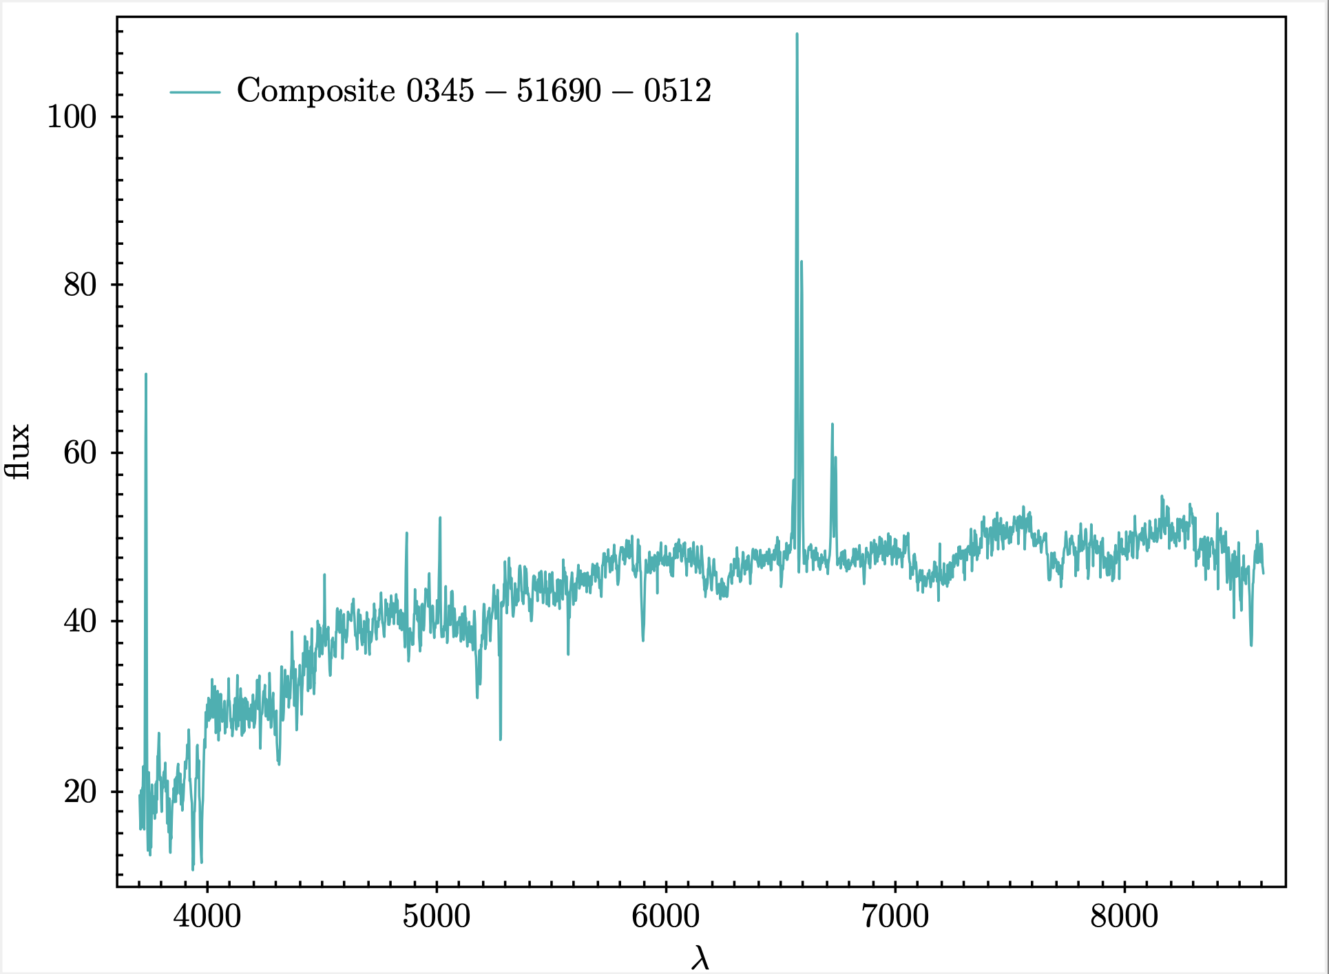

Slide 8
