Slide 1
CodeColosseum
1v1 Competitive Coding Platform
CSE3044 — Software Engineering
Spring 2025–2026
Kerem Adalı (150123055)
Buğra Kaya (150123045)
Ali Talip Keleş (150122029)
1 / 14

Slide 2
Problem Definition
What is CodeColosseum?
Why does it matter?
A web-based real-time 1v1 competitive programming platform where developers are matched by skill level, solve identical coding challenges head-to-head, and see their solutions evaluated instantly in a sandboxed environment.
Existing platforms (LeetCode, HackerRank) focus on solo practice. There is no mainstream, accessible platform offering real-time 1v1 head-to-head competitive coding with fair Elo-based matchmaking.
⚡
🎯
🔒
Real-time
Fair Matching
Secure Exec
Live 1v1 matches with
synchronized timers
Elo-rated matchmaking
ensures balanced play
Sandboxed code evaluation
via Judge0 API
2 / 14
CodeColosseum · CSE3044 Software Engineering · Spring 2025–2026

Slide 3
Project Aims
01
Matchmaking Engine
Build an Elo-based matchmaking system that dynamically pairs contestants of similar skill within expanding tolerance windows.
02
Real-time Match Sessions
Deliver synchronized match experiences over WebSockets with live timers, instant verdict delivery, and opponent status tracking.
03
Sandboxed Code Evaluation
Integrate Judge0 API for secure, isolated compilation and execution of user-submitted code in multiple languages.
04
Community Problem Pool
Enable users to propose, review, and approve programming tasks through a role-based admin workflow.
05
Rating & Leaderboard
Implement Elo rating recalculation with floor clamping and a public global leaderboard ranking players by skill.
3 / 14
CodeColosseum · CSE3044 Software Engineering · Spring 2025–2026

Slide 4
Related Work
Platform | Real-time 1v1 | Elo Rating | Auto Matching | User Problems
LeetCode | ✕ | ✕ (Contest only) | ✕ | ✕
Codeforces | ✕ | ✓ | ✕ | ✓ (Polygon)
HackerRank | ✕ | ✕ | ✕ | ✕
CodeColosseum | ✓ | ✓ | ✓ | ✓
What makes CodeColosseum different?
Unlike existing platforms that focus on contests or solo practice, CodeColosseum provides instant, fair, skill-based 1v1 matchmaking — combining real-time WebSocket-driven matches, dynamic Elo-rated pairing, and a community-contributed problem pool with admin review into a single integrated experience.
4 / 14
CodeColosseum · CSE3044 Software Engineering · Spring 2025–2026

Slide 5
Scope & Constraints
In Scope
Out of Scope
✓ User registration, login, JWT authentication
✓ Elo-rated matchmaking with tolerance expansion
✓ Real-time 1v1 match sessions over WebSockets
✓ Sandboxed code execution via Judge0 API
✓ Problem proposal & admin approval workflow
✓ Global Elo leaderboard & match history
✓ Java and Python language support
✕ Team/group contests
✕ In-match chat or spectator mode
✕ Plagiarism detection
✕ Multi-node horizontal scaling
✕ Mobile native application
5 / 14
CodeColosseum · CSE3044 Software Engineering · Spring 2025–2026

Slide 6
Technical Architecture
Server Tier (Spring Boot)
Client Tier
REST API
(Spring MVC)
Matchmaking
Service
React 18 SPA
(Vite)
WebSocket
(STOMP)
Match
Service
Security / Identity
Data & External Services
JWT Auth
(Identity & Sec)
PostgreSQL
Database
Judge0 API
(Sandboxed Exec)
6 / 14
CodeColosseum · CSE3044 Software Engineering · Spring 2025–2026

Slide 7
Technology Stack
☕
Backend
⚛
Frontend
💾
Database
Java 21 · Spring Boot 4.0
Spring WebSocket · STOMP
React 19 · Vite 8
React Router · Axios
Neon PostgreSQL
Spring Data JDBC
🔒
Security
⚙
Code Execution
🏆
Rating System
Stateless JWT (HMAC-SHA256)
BCrypt password hashing
Judge0 REST API
Standard Elo (K=32)
7 / 14
CodeColosseum · CSE3044 Software Engineering · Spring 2025–2026

Slide 8
Tasks Accomplished
✓
Backend Core
✓
Matchmaking
REST API controllers, JWT auth guards,
user registration/login, role-based access
In-memory ConcurrentLinkedQueue,
1s scan, expanding Elo tolerance
✓
Match Engine
✓
Code Evaluation
WebSocket match sessions, problem
assignment by difficulty, timer sync
Judge0 integration, verdict mapping,
partial scoring, early termination
✓
Frontend
✓
Testing
React SPA: Dashboard, Match, Problem
Suggestion, Admin Review, Leaderboard
27 automated tests (unit + integration
+ static analysis), IEEE 829 test plan
8 / 14
CodeColosseum · CSE3044 Software Engineering · Spring 2025–2026

Slide 9
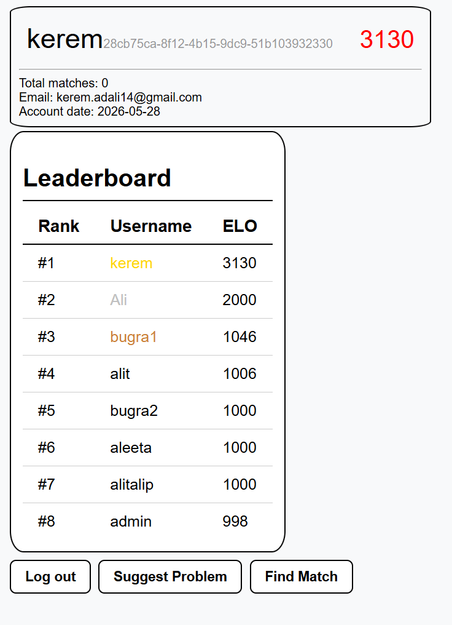
Dashboard & Leaderboard
After login, users see their profile card (username, Elo rating, match count) and the global leaderboard ranking all players by Elo. Top 3 ranks are highlighted with gold, silver, and bronze styling.
9 / 14
CodeColosseum · CSE3044 Software Engineering · Spring 2025–2026

Slide 10
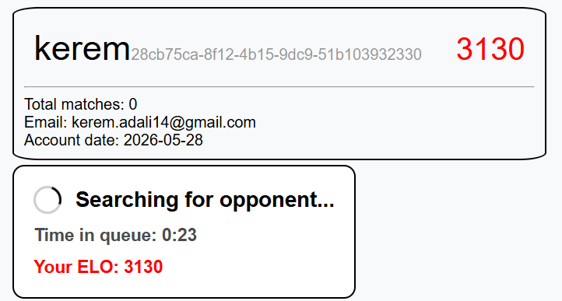
Matchmaking Search
Clicking "Find Match" connects to the matchmaking WebSocket. A live spinner and queue timer show elapsed search time while the system scans for opponents within the user's Elo tolerance window.
10 / 14
CodeColosseum · CSE3044 Software Engineering · Spring 2025–2026

Slide 11
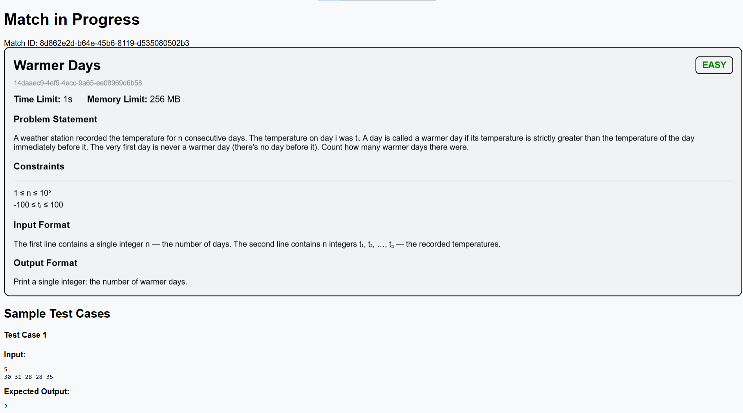
Match in Progress
Once matched, both players receive the same problem with statement, constraints, input/output formats, and sample test cases. A code editor with language selection (Java/Python) and a "Submit Solution" button are provided below.
11 / 14
CodeColosseum · CSE3044 Software Engineering · Spring 2025–2026

Slide 12
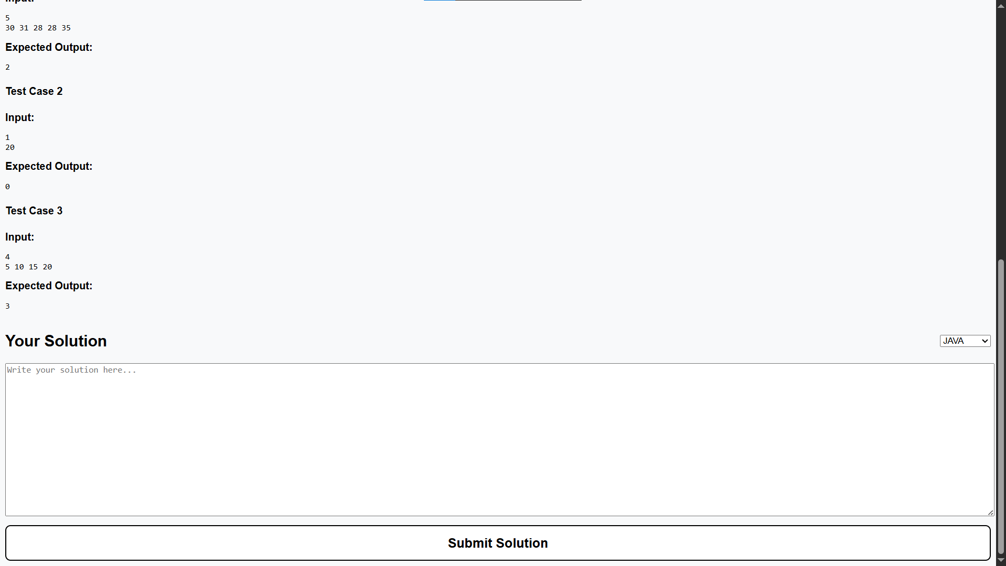
Code Submission
Players write their solution in the textarea editor, select their preferred language from the dropdown, and submit. The solution is sent via WebSocket to Judge0 for sandboxed compilation and execution against all test cases.
12 / 14
CodeColosseum · CSE3044 Software Engineering · Spring 2025–2026

Slide 13
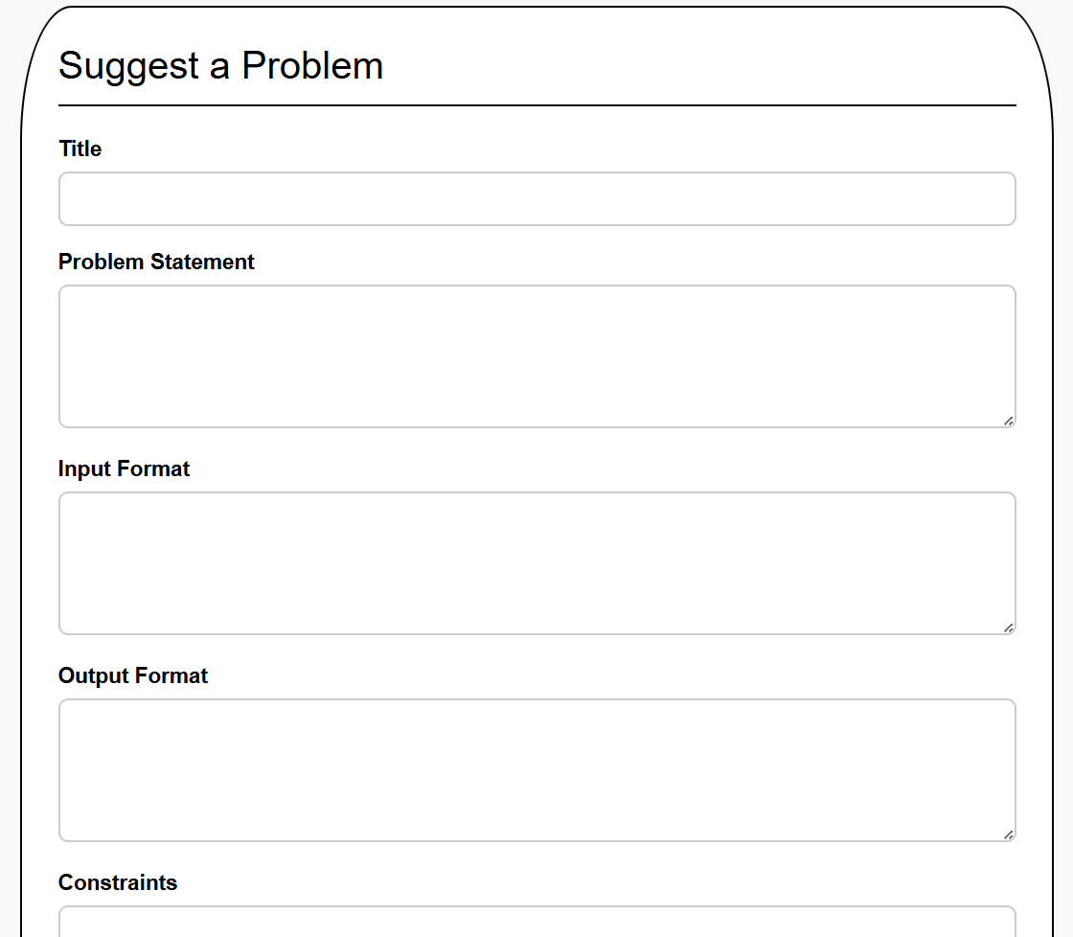
Problem Suggestion
Any user can propose a new programming problem by filling out the title, problem statement, input/output format, constraints, difficulty level, and test cases (input + expected output pairs).
13 / 14
CodeColosseum · CSE3044 Software Engineering · Spring 2025–2026

Slide 14
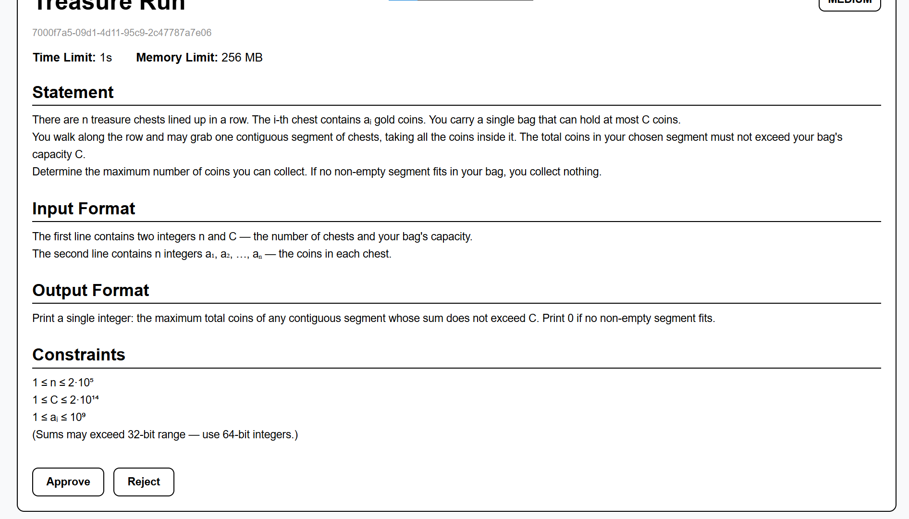
Admin Review & Approval
Administrators see pending problems with full detail. Each problem can be reviewed for correctness and approved or rejected. Approved problems enter the active pool and become available during matches.
14 / 14
CodeColosseum · CSE3044 Software Engineering · Spring 2025–2026

