Slide 1


Record a Presentation
Use the Camtasia Add-in to record your presentations. Start by going to the Add-ins tab.
Chapter 3: Idea Behind Digital Circuits
RAHDG201_N03_P01_R01

Slide 2
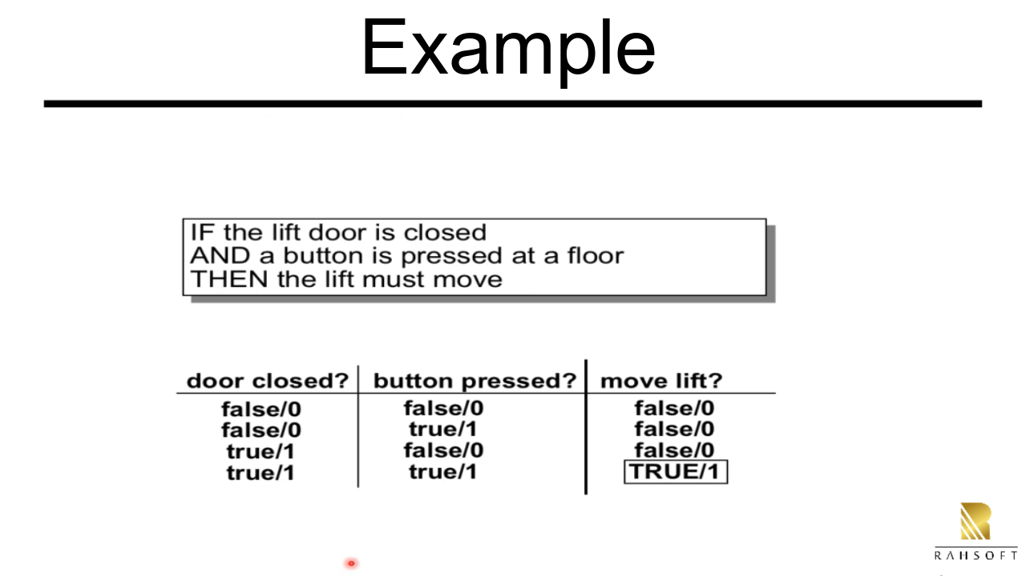


Slide 3
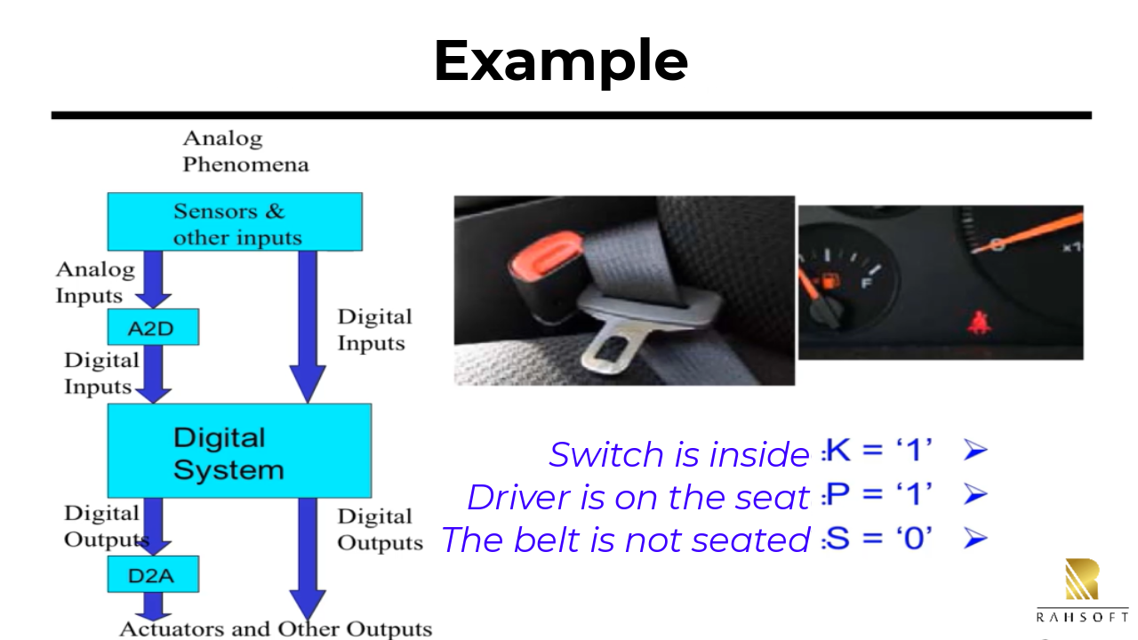

Slide 4
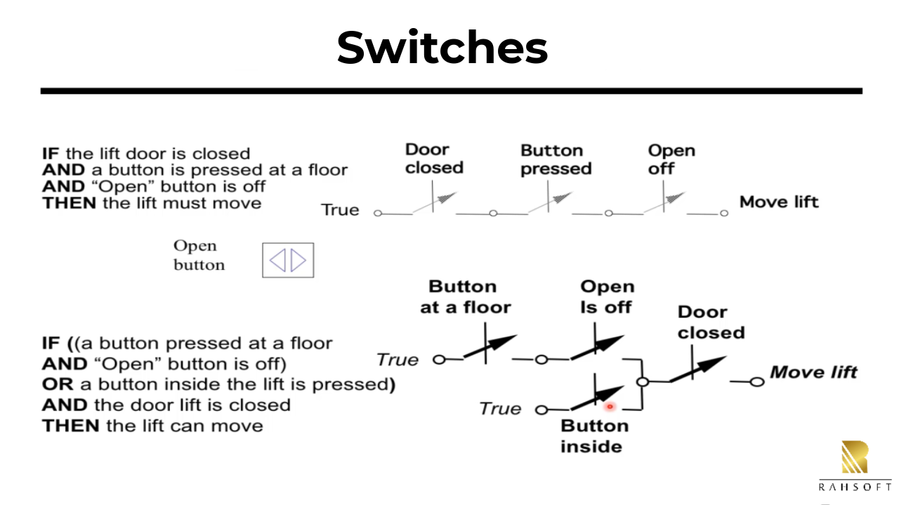


Slide 5
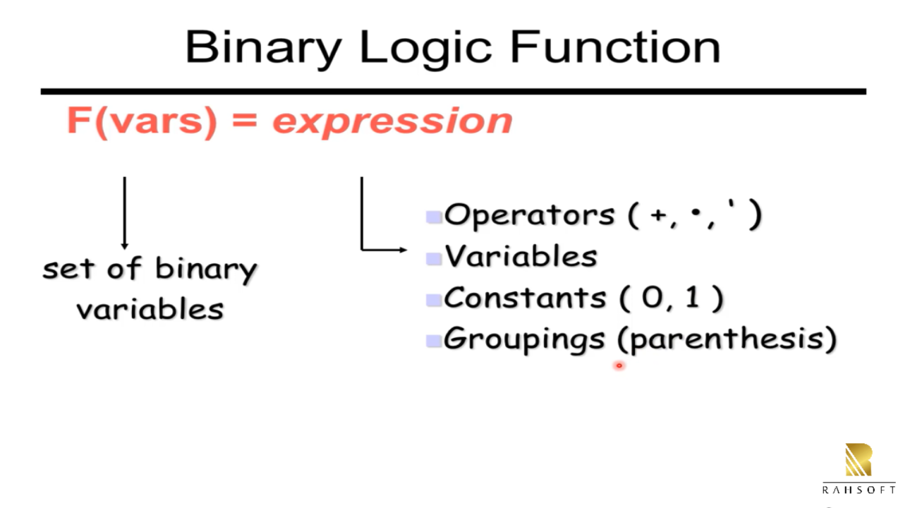


Slide 6
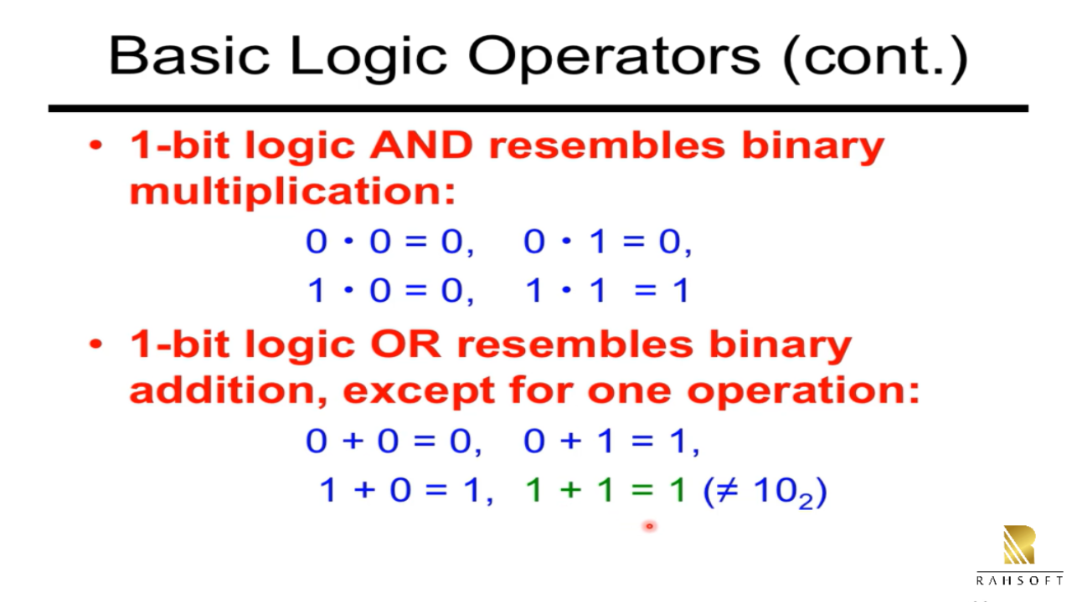


Slide 7



Slide 8
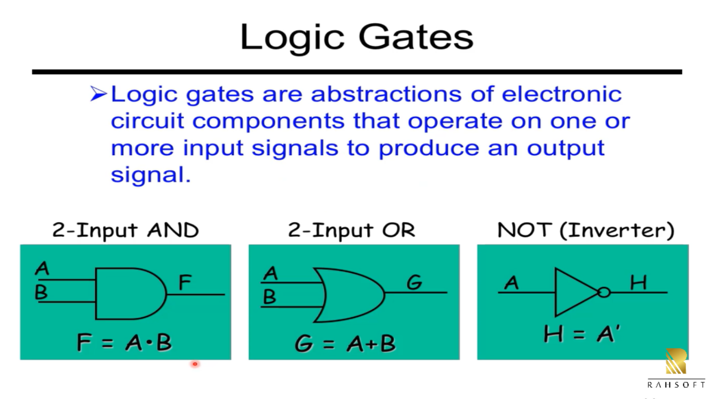


Slide 9
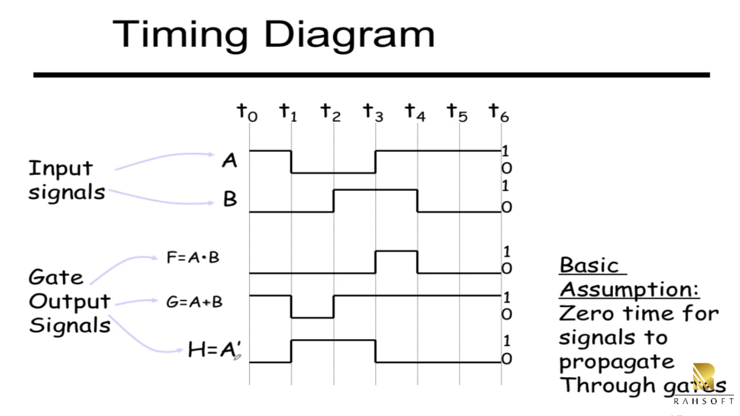


Slide 10
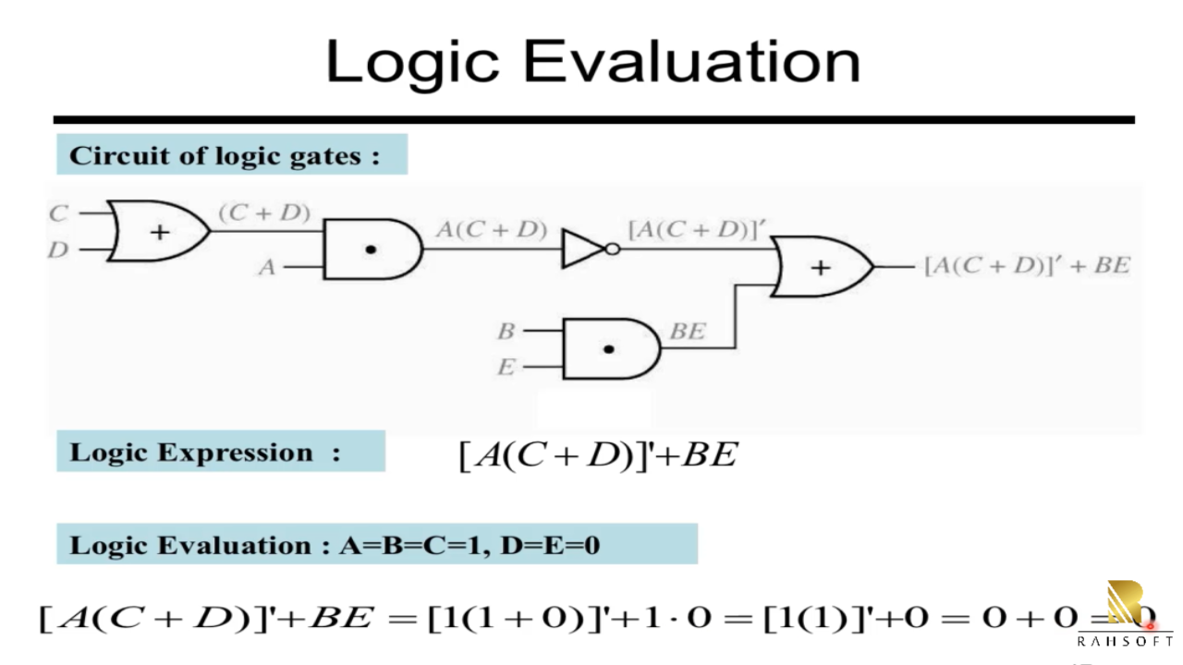

Slide 11
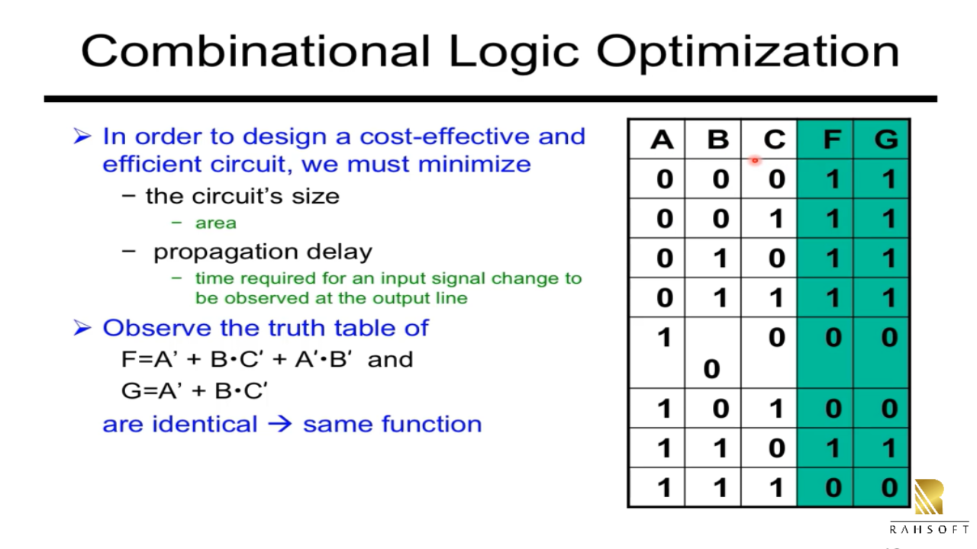

Slide 12
