Slide 1
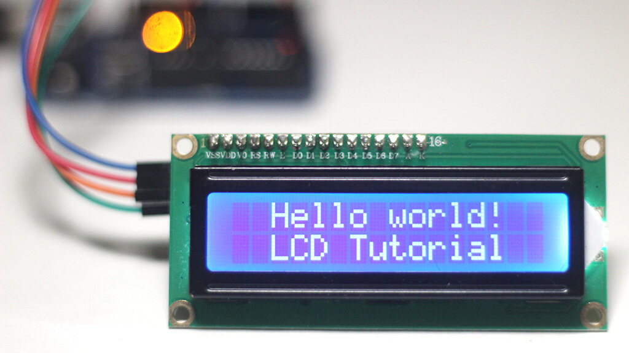
LCD_Keypad

Slide 2
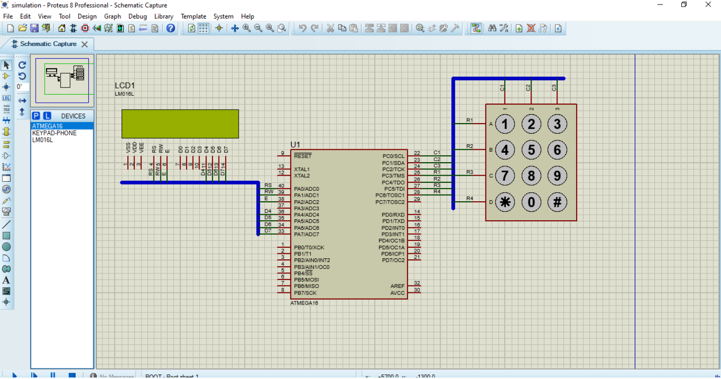
Simulation

Slide 3
Table connection
Device | Port
LCD | PORTA
Keypad | PORTC

Slide 4
Hardware needed
ATmega16 Microcontroller: The main controllerfor your system.
Keypad: To input the Id and PC.
LCD Display: To provide feedback and display information.
Wires to connect to microcontrollers.

Slide 5
Code
/*
* Leypad_lcd.c
* Description: This program demonstrates
interfacing a 4x3 keypad with an LCD using the
ATmega16 microcontroller.
*/
#include <mega16.h>
#include <alcd.h>
#include <delay.h>
// Function prototypes
char keypad();
// Global variables
int cnt = 0, y = 0, i = 0, cpy = 0;
void main(void)
{

Slide 6
int x1 = 0;
DDRC = 0b00000111; // Configure the lower 3
bits of PORTC as outputs for the keypad
PORTC = 0b11111000; // Enable pull-up
resistors for the upper 5 bits of PORTC
lcd_init(16); // Initialize the LCD with 16
columns
while (1)
{
lcd_puts("Hello!");
delay_ms(300);
lcd_clear();
while (1)
{
x1 = keypad();
lcd_gotoxy(i, y);
lcd_printf("%d", x1);
if(x1 == 10 || x1 == 11)
i = i + 1;
i = i + 1;
if (i == 16 || i == 17)
{
cpy = i;

Slide 7
i = 0;
if(cpy == 17)
{
i = i + 1;
cpy = 0;
}
y = 1;
cnt = cnt + 1;
}
if (cnt == 2)
{
i = 0;
y = 0;
cnt = 0;
delay_ms(200);
lcd_clear();
}
}
lcd_clear();
}
}
// Function to read keypress from the keypad
char keypad()

Slide 8
{
while (1)
{
PORTC.0 = 0;
PORTC.1 = 1;
PORTC.2 = 1;
// Only C1 is activated
switch (PINC)
{
case 0b11110110:
while (PINC.3 == 0);
return 1;
break;
case 0b11101110:
while (PINC.4 == 0);
return 4;
break;
case 0b11011110:
while (PINC.5 == 0);
return 7;
break;
case 0b10111110:
while (PINC.6 == 0);

Slide 9
return 10;
break;
}
PORTC.0 = 1;
PORTC.1 = 0;
PORTC.2 = 1;
// Only C2 is activated
switch (PINC)
{
case 0b11110101:
while (PINC.3 == 0);
return 2;
break;
case 0b11101101:
while (PINC.4 == 0);
return 5;
break;
case 0b11011101:
while (PINC.5 == 0);
return 8;
break;
case 0b10111101:

Slide 10
while (PINC.6 == 0);
return 0;
break;
}
PORTC.0 = 1;
PORTC.1 = 1;
PORTC.2 = 0; // Only C3 is activated
switch (PINC) {
case 0b11110011:
while (PINC.3 == 0);
return 3;
break;
case 0b11101011:
while (PINC.4 == 0);
return 6;
break;
case 0b11011011:
while (PINC.5 == 0);
return 9;
break;

Slide 11
case 0b10111011:
while (PINC.6 == 0);
return 11;
break;
}
}
}

