Slide 1
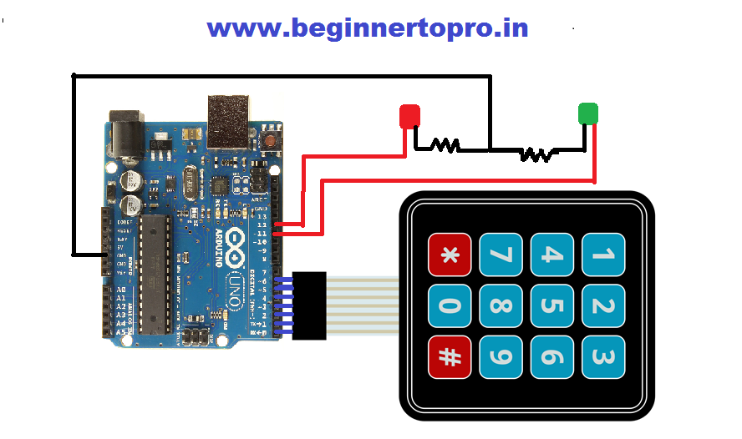
Security system
(Lock door)

Slide 2
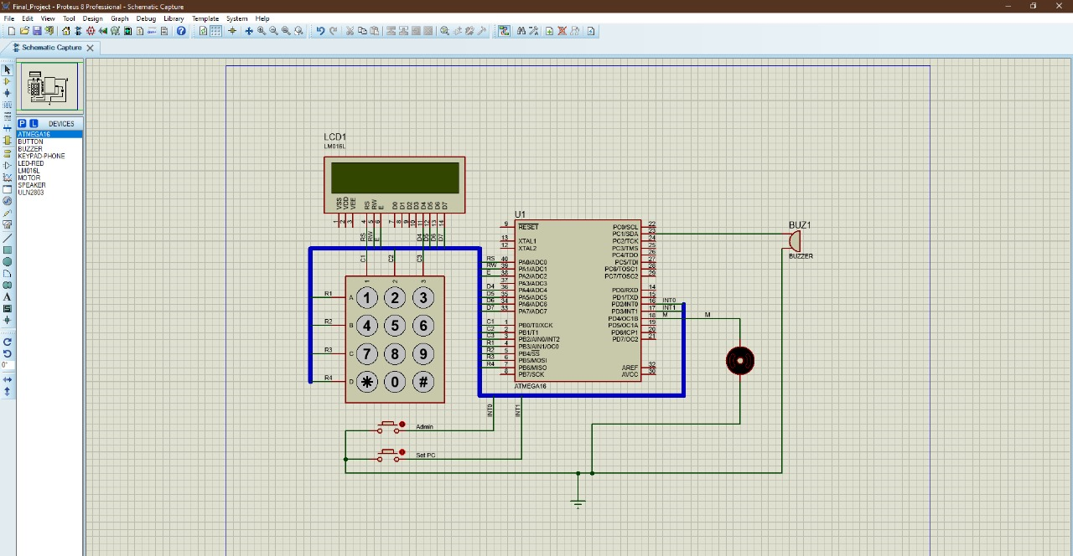
Simulation

Slide 3
Table connection
Device | Port
lcd | PORTA
keypad | PORTB
Motor | PORTD.4
BUZZER | PORTC.1
Button (admin) | PORTD.2/INT_0
Button (student) | PORTD.3/INT_1

Slide 4
Hardware needed
ATmega16 Microcontroller : The main controller for your system.
Keypad: To input the Id and PC.
LCD Display : To provide feedback and display information.
Motor Lock: To simulate the locking/unlocking door.
Two Buttons: Used for additional functions, such as system control.
Alarm System: to sound an alarm when triggered.
Wires to connect to microcontrollers.
* We used interrupt_0 for Prof to change his PC or change the PC Of the students, and interrupt _1 for students to change their PCs.We did this because the professor has priority over the student.
* We do not use the mentioned "high level trigger" because ATmega16 microcontroller does not support a high-level trigger for INT1.and,we used falling-edge trigger instead.

Slide 5
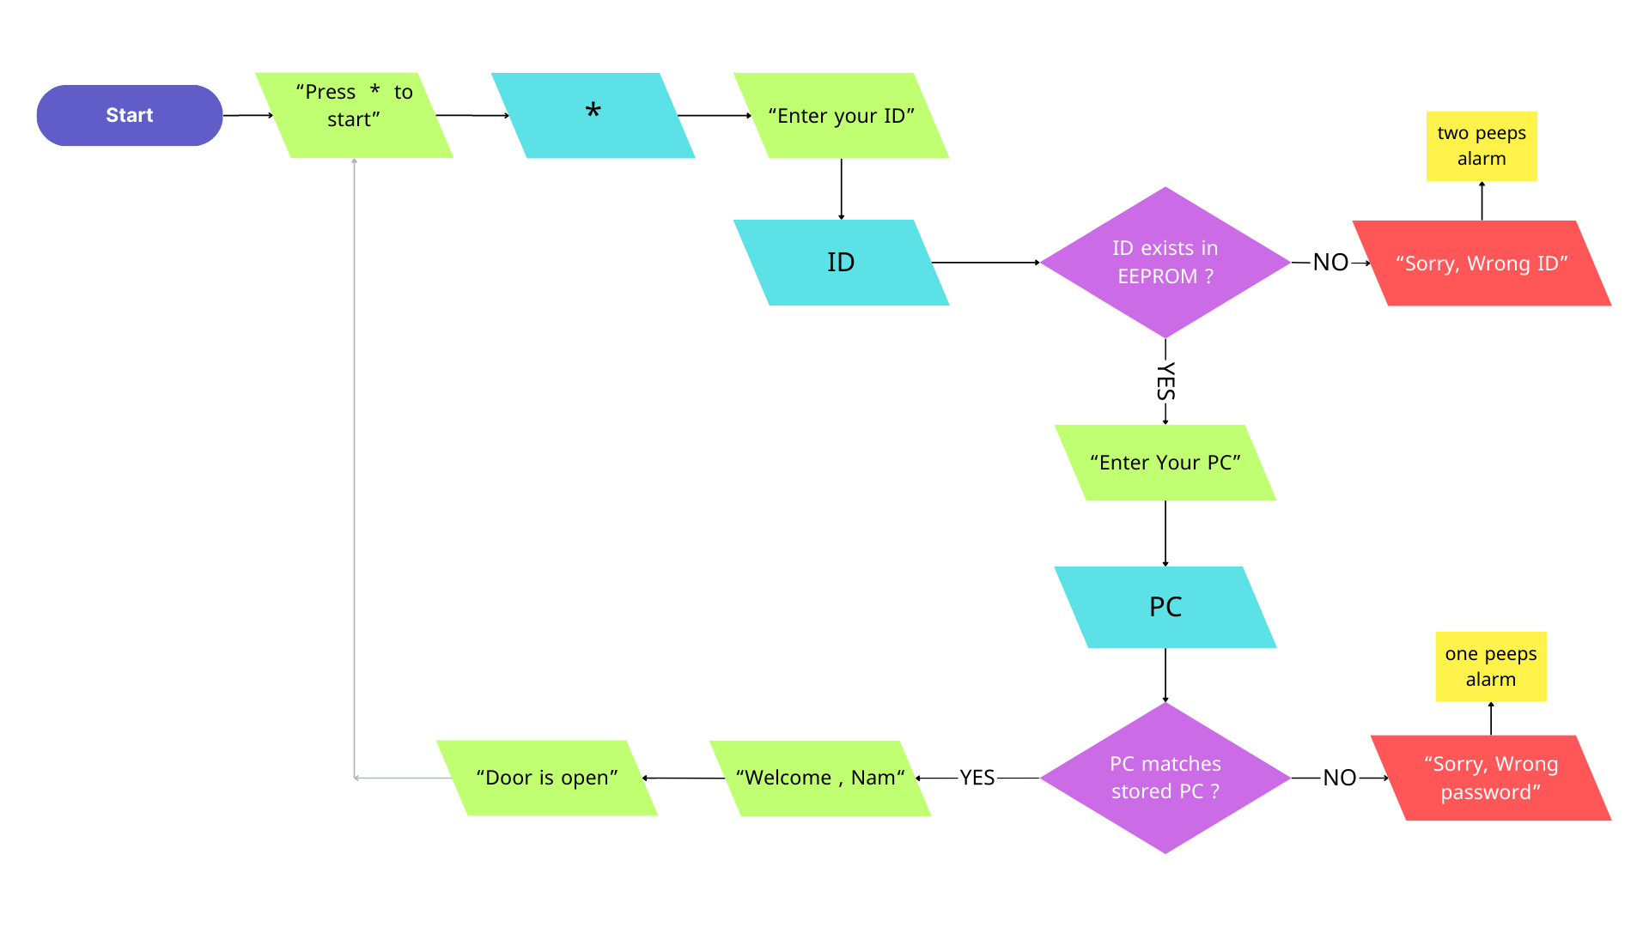
Enter the system..

Slide 6
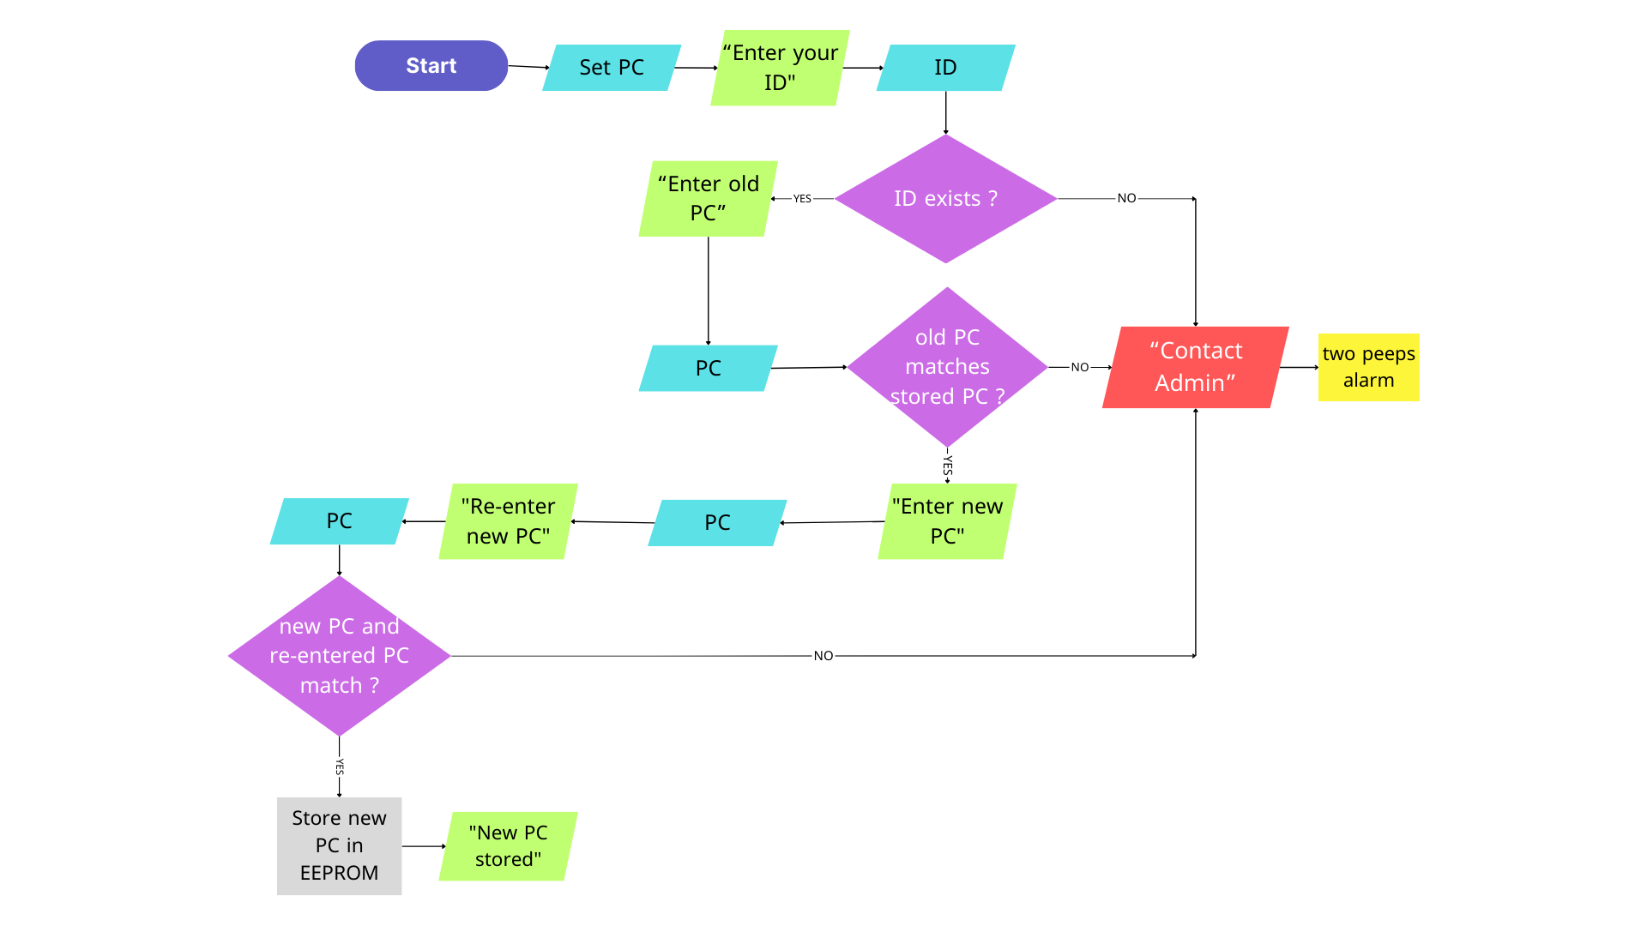
Reset PC ( Student )

Slide 7
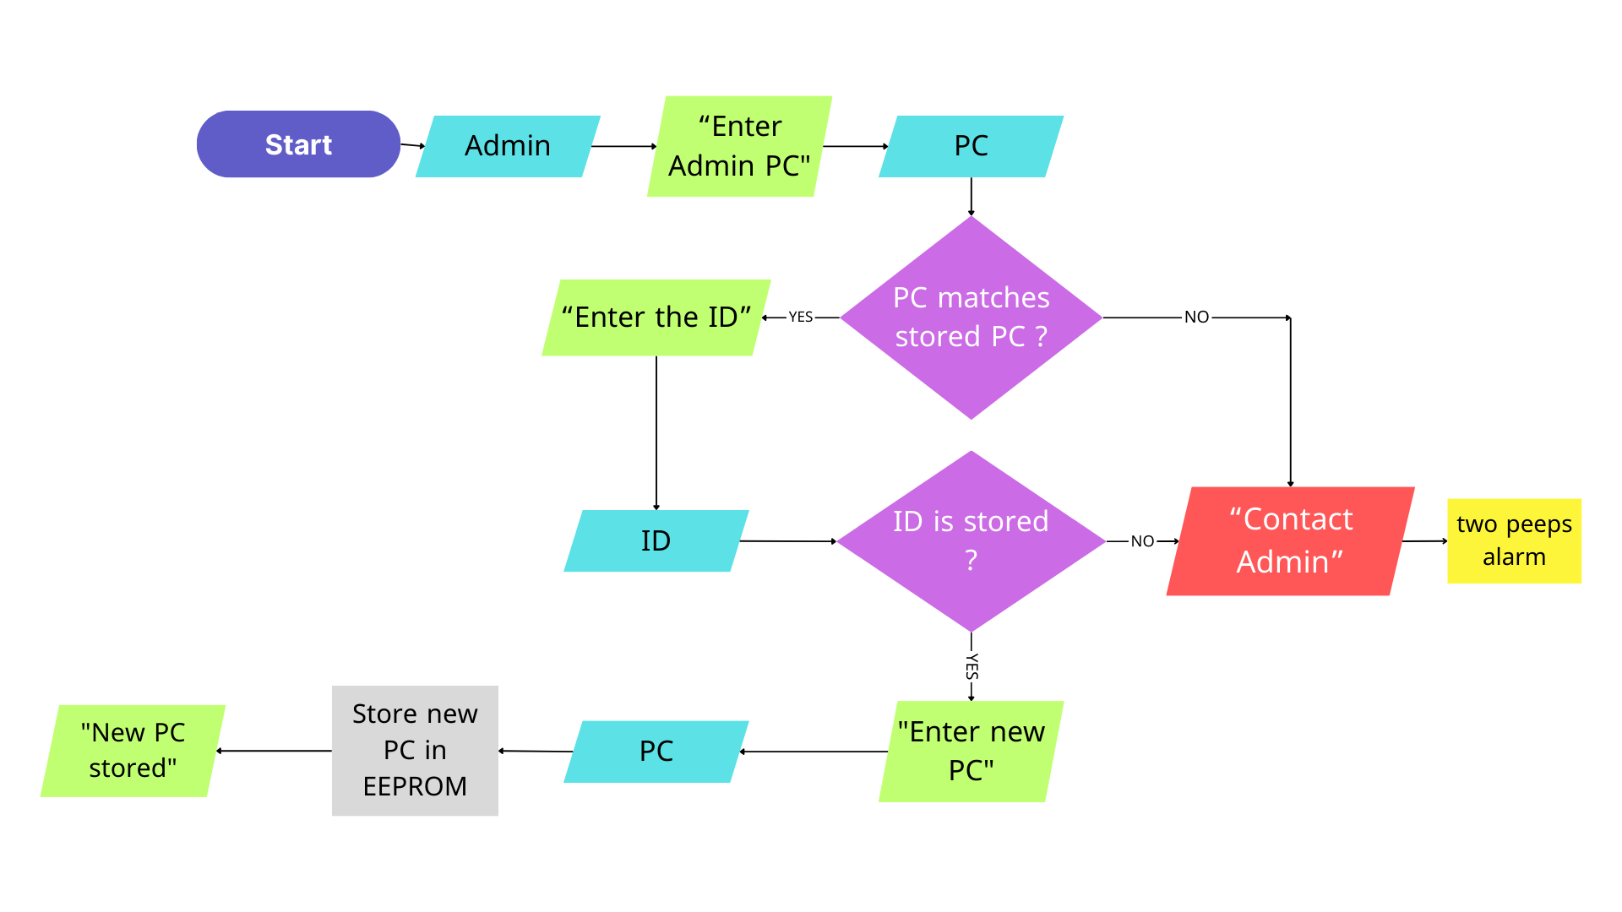
Reset PC ( Admin)

Slide 8
Code
#include <mega16.h>
#include <alcd.h>
#include <delay.h>
#include <eeprom.h>
#include <stddef.h>
unsigned char keypad();
unsigned char EE_Read(unsigned int address); //function to read from eeprom
void EE_Write(unsigned int address, unsigned int data);//function to write in eeprom
void Store();
int checkID(unsigned int id); //function to check id
int checkPASS(unsigned int id, unsigned int pass); //function to check pass
int changePASS(unsigned int id, unsigned int npass); //function to change pass
int check_PASS_Admin(unsigned int pass); //function to check pass of admin
int read();
int pass_sure;
void peep();
int n;

Slide 9
void main(void)
{
DDRB = 0b00000111;
PORTB = 0b11111000;
//DDRB.0 = 1;
DDRC.1 = 1;
PORTC.1 = 0;
DDRD.4 = 1;
PORTD.4 = 0;
//PORTC.0=0;
DDRD.2 = 0;
PORTD.2 = 1;
DDRD.3 = 0;
PORTD.3 = 1;
SREG.7 = 1;
MCUCR |= (1 << 1); //falling
MCUCR |= (1 << 3); //falling
MCUCR &= ~(1 << 0);
MCUCR &= ~(1 << 2);
GICR |= (1 << 6);//intrrupt_0
GICR |= (1 << 7);//intrrupt_1
DDRD.5 = 1;
PORTD.5 = 0;

Slide 10
//...end */
lcd_init(16);
lcd_puts("press * to start,please");
//Store();
while (1)
{
char num = keypad();
int c1 = 0;
int c2 = 0;
lcd_clear();
if(num == '*')
{
PORTC.1 = 0;
PORTD.4=0;
lcd_puts("Enter your ID");
c1 = read();
delay_ms(500);
lcd_clear();

Slide 11
if(checkID(c1) == 1)
{
lcd_clear();
lcd_puts("Enter your PC");
c2 = read();
delay_ms(500);
lcd_clear();
if(checkPASS(c1, c2) == 1)
{
switch(c1)
{
case 111:
lcd_puts("Welcome, Prof ");
break;
case 126:
lcd_puts("Welcome, Ahmed ");
break;
case 128:
lcd_puts("Welcome, Amr ");
break;
case 130:

Slide 12
lcd_puts("Welcome, Adel ");
break;
case 132:
lcd_puts("Welcome, Omar ");
break;
}
delay_ms(500);
lcd_clear();
PORTD.4=1;
delay_ms(1500);
lcd_puts("Door is open");
PORTD.4=0;
}
else
{
lcd_puts("Sorry wrong password ");
delay_ms(500);
lcd_clear();

Slide 13
PORTC.1 = 1;
delay_ms(2000);
PORTC.1 = 0; //one peep instead of turning on lamp
delay_ms(2000);
}
}
else
{
lcd_puts("Sorry wrong ID ");
delay_ms(1000);
peep();
}
}
}
}
// Function to read keypress from the keypad
unsigned char keypad()
{
while(1)
{
PORTB.0 = 0; PORTB.1 = 1; PORTB.2 = 1;

Slide 14
//Only B1 is activated
switch(PINB)
{
case 0b11110110:
while (PINB.3 == 0);
return 1;
break;
case 0b11101110:
while (PINB.4 == 0);
return 4;
break;
case 0b11011110:
while (PINB.5 == 0);
return 7;
break;
case 0b10111110:
while (PINB.6 == 0);
return '*';
break; }
PORTB.0 = 1; PORTB.1 = 0; PORTB.2 = 1;
//Only B2 is activated

Slide 15
switch(PINB)
{
case 0b11110101:
while (PINB.3 == 0);
return 2;
break;
case 0b11101101:
while (PINB.4 == 0);
return 5;
break;
case 0b11011101:
while (PINB.5 == 0);
return 8;
break;
case 0b10111101:
while (PINB.6 == 0);
return 0;
break;
}
PORTB.0 = 1; PORTB.1 = 1; PORTB.2 = 0;
//Only B3 is activated

Slide 16
switch(PINB)
{
case 0b11110011:
while (PINB.3 == 0);
return 3;
break;
case 0b11101011:
while (PINB.4 == 0);
return 6;
break;
case 0b11011011:
while (PINB.5 == 0);
return 9;
break;
case 0b10111011:
while (PINB.6 == 0);
return '#';
break;
}
}

Slide 17
// Function to read from EEPROM
unsigned char EE_Read(unsigned int address)
{
while(EECR.1 == 1); //Wait till EEPROM is ready
EEAR = address; //Prepare the address you want to read from
EECR.0 = 1; //Execute read command
return EEDR;
}
// Function to write in EEPROM
void EE_Write(unsigned int address, unsigned int data)
{
while(EECR.1 == 1); //Wait till EEPROM is ready
EEAR = address; //Prepare the address you want to read from
EEDR = data; //Prepare the data you want to write in the address above
EECR.2 = 1; //Master write enable
EECR.1 = 1; //Write Enable
}

Slide 18
// Interrupt service routine for INT0
interrupt [2] void init_0(void)
{
int pass = 0;
int pass1 = 0;
int new_pass = 0;
int id = 0;
lcd_clear();
lcd_puts("Enter Admin PC");
pass = read();
delay_ms(500);
lcd_clear();
if(check_PASS_Admin(pass) == 1)
{
lcd_puts("Enter Student ID");
id = read();
delay_ms(500);
lcd_clear();

Slide 19
if(checkID(id) == 1)
{
lcd_puts("Enter new PC");
pass = read();
delay_ms(1000);
delay_ms(500);
lcd_clear();
pass1 = pass / 10;
new_pass = pass1 * 10 + pass % 10;
changePASS(id, pass)
delay_ms(500);
lcd_clear();
lcd_puts("PC is stored");
delay_ms(1000);
lcd_clear();
}
else
{
lcd_puts("ID is not found");
peep();
}
}

Slide 20
else
{
lcd_puts("Contact Admin");
delay_ms(500);
lcd_clear();
peep();
}
}
// Interrupt service routine for INT1
interrupt [3] void init_1(void)
{
int id = 0;
int pass_new = 0;
int new_pass1 = 0;
int pass_old = 0;
int pass2 = 0;
SREG.7 = 1;
lcd_clear();
lcd_puts("Enter ID");

Slide 21
id = read();
delay_ms(500);
lcd_clear();
if(id == 111)
{
lcd_puts("you donnot have permission,Contact admin");
peep();
}
else
{
if(checkID(id) == 0)
{
lcd_puts("contact admin"); delay_ms(500);
peep();
}
else
{
lcd_puts("Enter old PC"); delay_ms(500);
pass_old = read();
delay_ms(500);
lcd_clear();

Slide 22
if(checkPASS(id, pass_old) != 1)
{
lcd_puts("Wrong pass, Contact admin");
peep();
}
else
{
lcd_puts("Enter new PC");
delay_ms(1000);
lcd_clear();
pass_new = read();
delay_ms(500);
lcd_clear();
lcd_puts("Renter PC");
pass_sure = read();
delay_ms(500);
lcd_clear();
if(pass_new == pass_sure)
{

Slide 23
pass2 = pass_new / 10;
new_pass1 = pass2 * 10 + pass_new % 10;
changePASS(id, pass_new);
lcd_puts("New PC stored");
delay_ms(500);
lcd_clear();
}
else
{
lcd_puts("2 passwords arenot match,Contact admin");
peep();
delay_ms(500);
lcd_clear();
}
}
}
}

Slide 24
void Store()
{
EE_Write(111, 20); //devide pass to 2 sections(2 bits ,1 bit)in 2 different Consecutive ids
EE_Write(112, 3);
EE_Write(126, 12);
EE_Write(127, 9);
EE_Write(128, 32);
EE_Write(129, 5);
EE_Write(130, 42);
EE_Write(131, 6);
EE_Write(132, 07);
EE_Write(133, 9);
}

Slide 25
int checkID(unsigned int id)
{
if(EE_Read(id) != 255)
return 1;
return 0;
}
int checkPASS(unsigned int id, unsigned int pass)
{
if(EE_Read(id) == pass / 10 && EE_Read(id + 1) == pass % 10)
return 1;
return 0;
}
int check_PASS_Admin(unsigned int pass)
{
int admin_id = 111;
if(EE_Read(admin_id) == pass / 10 && EE_Read(admin_id + 1) == pass % 10)
return 1;
return 0;
}

Slide 26
// Function to change password
int changePASS(unsigned int id, unsigned int npass)
{
EE_Write(id, npass / 10);
EE_Write(id + 1, npass % 10);
return 1;
}
// Function to read multiple keypresses from the keypad
int read()
{
int i = 3 , c = 0, c1 = 0;
while(i)
{
c = keypad();
lcd_clear();
c1 = c1 * 10 + c;
lcd_printf("%d ", c1);
i = i - 1;
}
return c1;
}

Slide 27
// Function to generate peep sounds
void peep()
{
PORTC.1 = 1;
delay_ms(1000);
PORTC.1 = 0; // two peeps instead of turning on lamp
delay_ms(1000);
PORTC.1 = 1;
delay_ms(1000);
PORTC.1 = 0;
delay_ms(1000);
}

