Slide 1


Sign Language
Presentation on Computer Vision Project

Slide 2

Team profile
Task description
Demo
Contribution
Data
Project architecture
Methods
Results
CONTENT

Slide 3
Team Profile
Team ID:
35
Name & Student ID:
Aliaa Ezz Shahat Mohamed
162021216
Fatma Alzhraa Alaa Ali
162021236

Slide 4
A sign language project leveraging neural networks and MediaPipe for real-time hand gesture recognition and translation. The model processes hand landmarks extracted by MediaPipe, enabling accurate classification of sign language gestures. Utilizing deep learning, it facilitates seamless communication for the deaf people through automated interpretation of sign language gestures.
Task description

Slide 5
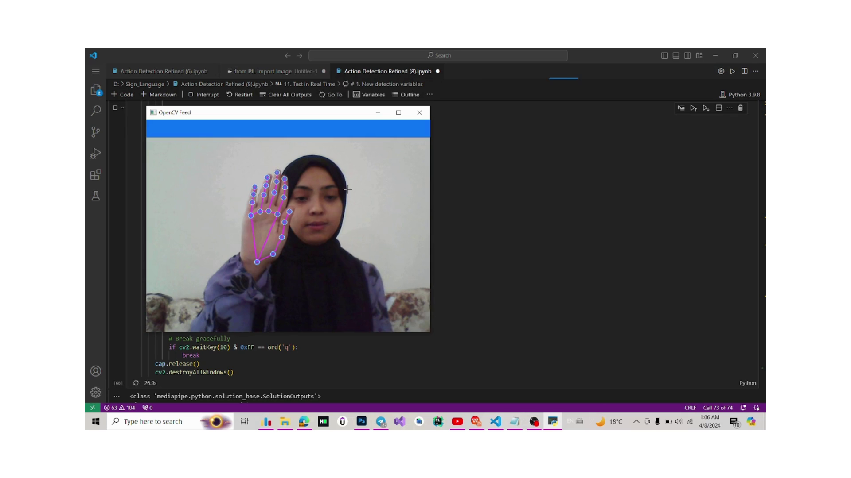
Demo

Slide 6
In the beginning, we searched a lot for models to implement what we needed in the sign language project until we settled on this model, and the source was a githup repository:
https://github.com/nicknochnack/ActionDetectionforSignLanguage/tree/main.
The model was built and trained, but we changed some parts of it and retrained it .
We tried to increase number of layers , number of epochs , aim to increase number of signs, but it decreased accuracy of model and the ability to detect the sign correctly so we decide to train this model with three signs.
In the basic model, it was taking data from the live stream, dividing it into frames, and saving it in folders, but we modified this by using ready-made dataset and setup path for exported data , define an array containing action names, converting it to a numby array and save it.
In the basic model , it was making detection on face , pose and hands ,but we deleted the face and body pose.
We modified model to train up to 500 epochs.
In the Real Time Test part, there was a bar that showed all the words expressing the signs, but we deleted it and made it show only the cuurent word for the sign that we are doing.
Contribution

Slide 7
Data
The link of Dataset : https://www.kaggle.com/datasets/innominate817/hagrid-sample-30k-384p/code
We used ready-made Dataset from Kagel's website.
We chose three signs from it to train our model: Like, OK, and Stop.
We used 3,776 different images with jpg extension, 1,208like, 1,216 OK, and 1,352 stop.
Every photo has size 384*512 but when it was converted to NPY file became 1*126
We split our data into 95% train and 5% test.
We preprocced data and create labels and featchers.

Slide 8
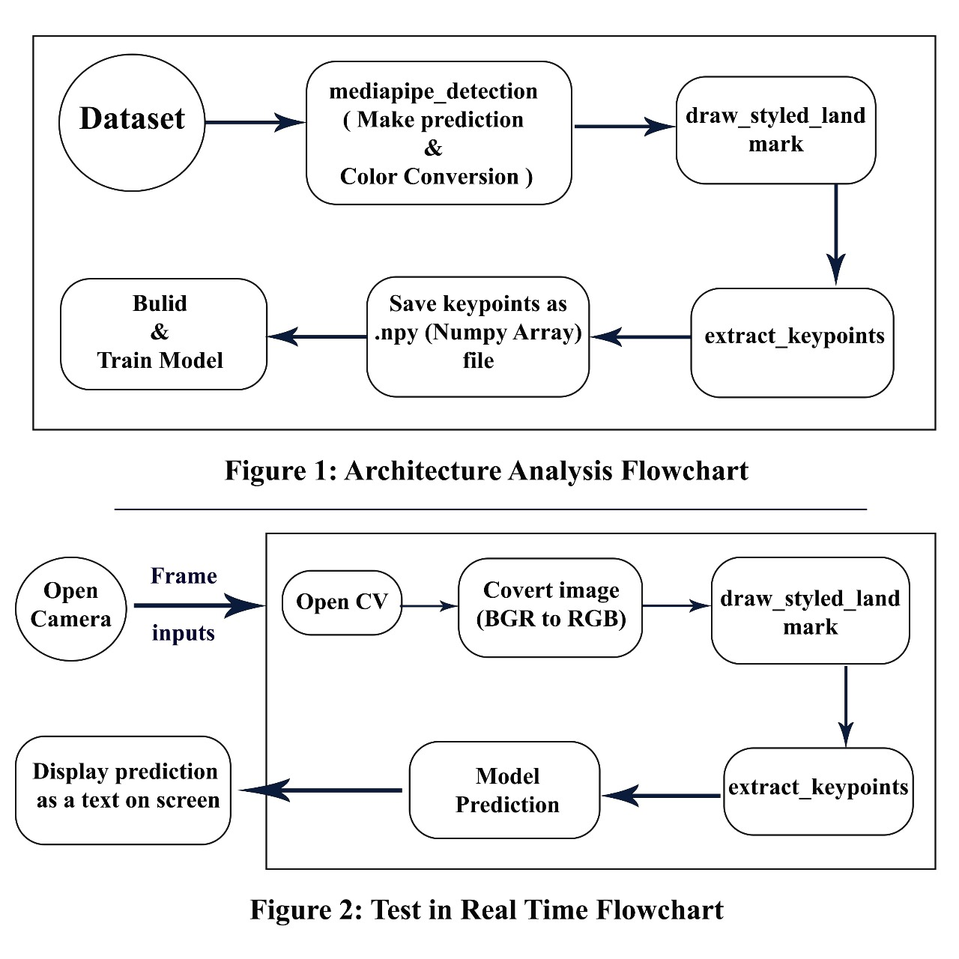
Project architecture

Slide 9
Architecture of Model
This model contains six layers: LSTM and Dense layer
Dense layers, also known as fully connected layers, are the basic building blocks of neural networks.
LSTM is a type of recurrent neural network (RNN) architecture designed to overcome the limitations of traditional RNNs in capturing long-term dependencies in sequential data.
Activation function was Relu and softmax.
Softmax is an activation function takes a vector of arbitrary real-valued scores (often referred to as logits) as input and normalizes them into a probability distribution over multiple classes.
Relu is an activation function commonly used in neural networks, particularly in deep learning models.
We use optimizer called Adam ,it is well-suited for training deep neural networks, and loss function called Categorical cross-entropy and metrics called Categorical accuracy calculates the accuracy .
We use ‘model.fit() function’ to train the model with the specified training data for 500 epochs, and it includes a TensorBoard ‘callback tb_callback’ for monitoring the training progress.
Methods

Slide 10
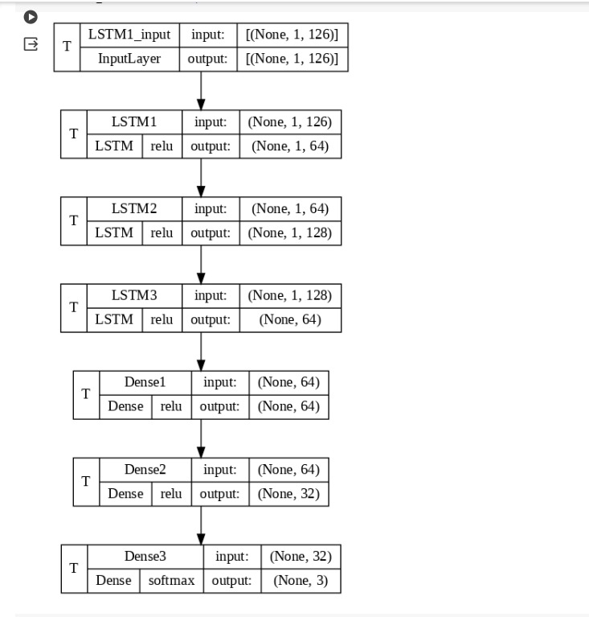
Methods
Figure 3: Model Architecture

Slide 11
Results
We measure accuracy with categorical_accuracy and loss with categorical_crossentropy.
Accuracy | Loss
0.7378048896789551 | 0.4507569968700409

Slide 12
THANK YOU

