Slide 1
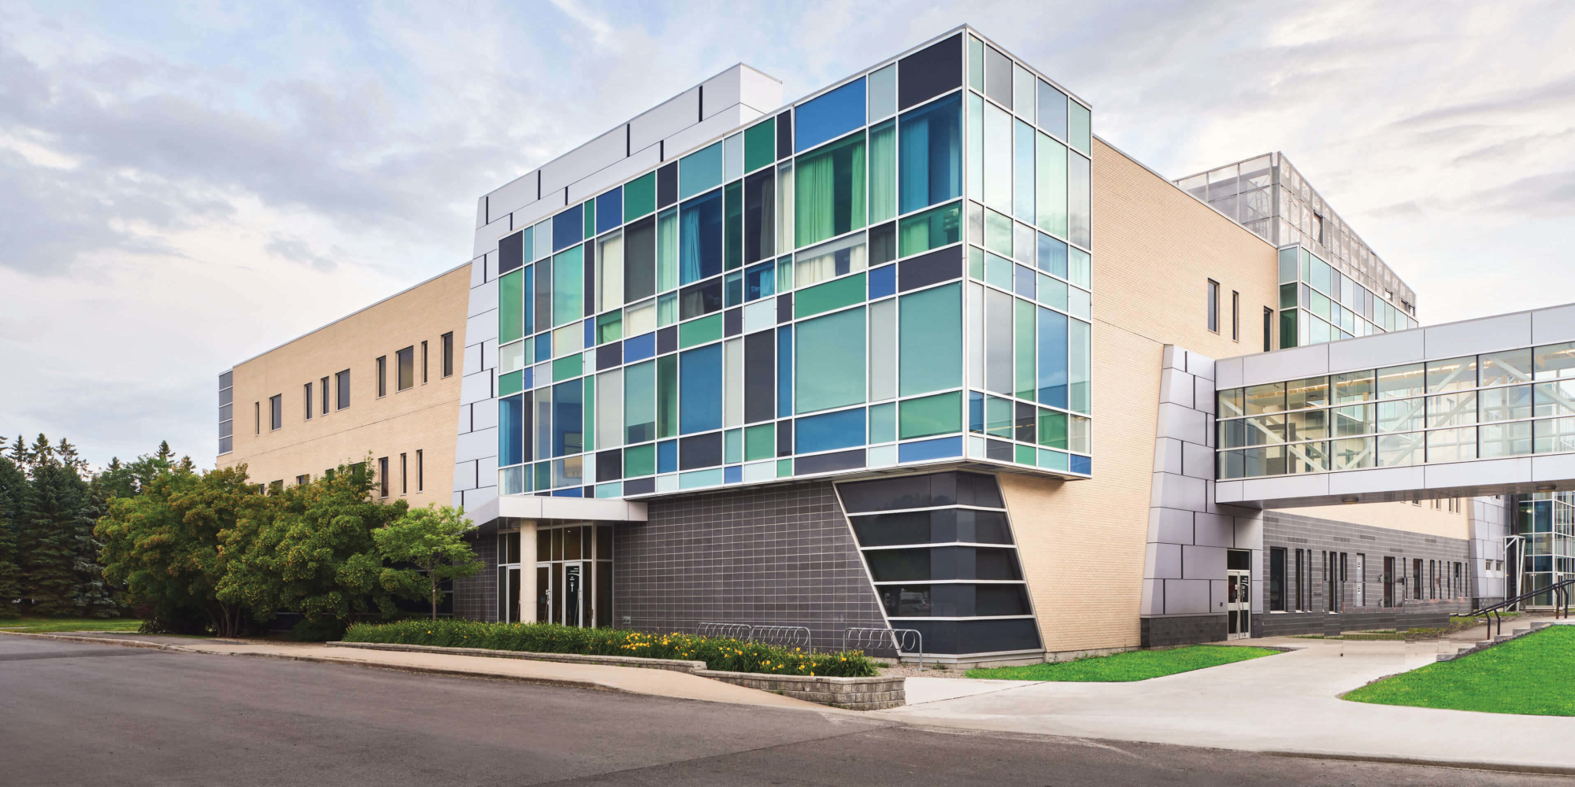
Algonquin College
Sol
A21
Computer Engineering Technology
CST8152
Compilers
Fall, 2021
Prof. Paulo Sousa

Slide 2
Regular Expressions (small differences acceptable)
Activity: Considering the following syntax:
(0) L = [A-Za-z] (Letters)
(1) D = [0-9] (Digits)
(2) U = _ (Underscore)
(3) M = & (Method name suffix)
(4) Q = ‘ (SL delimitator – single quotes)
(5) O = [^LDUMQ] (Other chars)
MNID = L(L|D|U)*M
SL = Q[^Q]*Q
KEY = {data, code, int, float, str, if, then, else, while, do}

Slide 3
Automata (small differences acceptable)
M
S7
S2
L
L|D|U
MNID
S1
S0
Q
^LDUM
^Q
S6
S3
*
S4
KEY
Q
S10
S5
SL

Slide 4
TT (Transition Table)
Input | Input Symbol |  |  |  |  |  | Output
State \ Classes | 0 | 1 | 2 | 3 | 4 | 5 | Type
 | L(A-Z) | D(0-9) | U(_) | M(&) | Q(') | O | -
S0 | 1 | ESNR | ESNR | ESNR | 4 | ESNR | NOAS [0]
S1 | 1 | 1 | 1 | 2 | 3 | 3 | NOAS [1]
S2 | FS | FS | FS | FS | FS | FS | ASNR (MNID) [2]
S3 | FS | FS | FS | FS | FS | FS | ASWR (KEY) [3]
S4 | 4 | 4 | 4 | 4 | 5 | 4 | NOAS [4]
S5 | FS | FS | FS | FS | FS | FS | ASNR (SL) [5]

Slide 5
TT:
static boa_intg transitionTableMin[][TABLE_COLUMNS] = {
/* [A-z], [0-9], _, &, ', other */
/* L(0), D(1), U(2), M(3), Q(4), O(5) */
/* S00 */ { 1, ESNR, ESNR, ESNR, 4, ESNR}, /* NOAS */
/* S01 */ { 1, 1, 1, 2, 3, 3}, /* NOAS */
/* S02 */ { FS, FS, FS, FS, FS, FS}, /* ASNR (MNID) */
/* S03 */ { FS, FS, FS, FS, FS, FS}, /* ASWR (KEY) */
/* S04 */ { 4, 4, 4, 4, 5, 4}, /* NOAS */
/* S05 */ { FS, FS, FS, FS, FS, FS} /* ASNR (SL) */
};

Slide 6
End of Models

