Slide 1
Code The Game
CO1531
(Swapnil Parekh, Harsh Chheda, Aliabbas Merchant)

Slide 2
Summary of Stage 1:
Finding out the major events in the given cricket match, on 9th April, 2017 between teams Mumbai Indians and Kolkata Knight Riders, teams of the Indian Premier League, a popular cricket franchise in the country.
The APIs used are Watson Discovery Service, Watson Knowledge Studio, and Watson Natural Language Understanding.
WATSON DISCOVERY SERVICE-To find answers, monitor trends and surface patterns in all types of data with the world’s most advanced cloud-native insight engine.
NATURAL LANGUAGE UNDERSTANDING-To do natural language processing for advanced text analysis.
WATSON KNOWLEDGE STUDIO-To teach Watson to discover meaningful insights in unstructured text.

Slide 3
Summary of Stage 1:
1) Data Collection and Processing
The data was unstructured, structured and graphical, extracted from various sports websites, blogs, news articles, highlights pages and other websites that had documented the match.
A python script was especially written on Notepad and executed to scrape the internet for data from these websites. It was made so that in a day 1000 web pages can be scraped for unstructured data.
The URLs were then extracted in Json format, and were the sent to NATURAL LANGUAGE UNDERSTANDING to process. The NATURAL LANGUAGE UNDERSTANDING returned sentiment analysis and the analyzed text in Json.
The data was finally uploaded onto 2 Watson APIs, the Watson Discovery Service and the Watson Knowledge Studio.

Slide 4
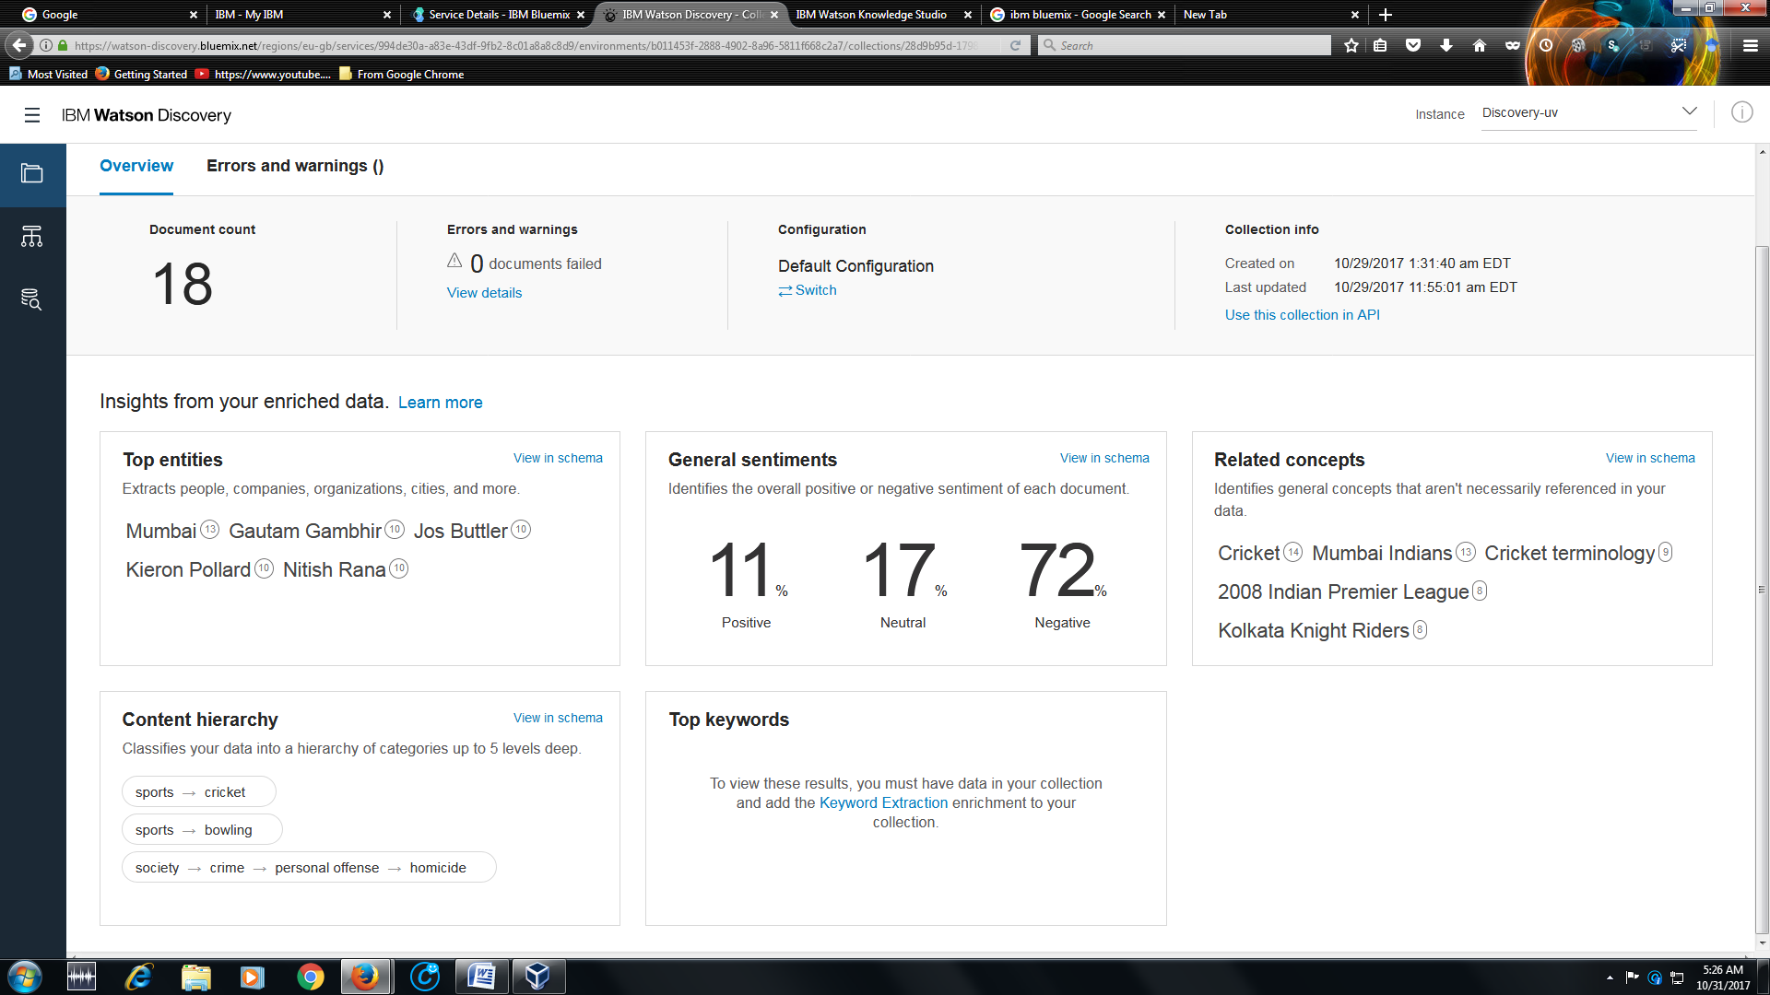
Watson Discovery Service

Slide 5
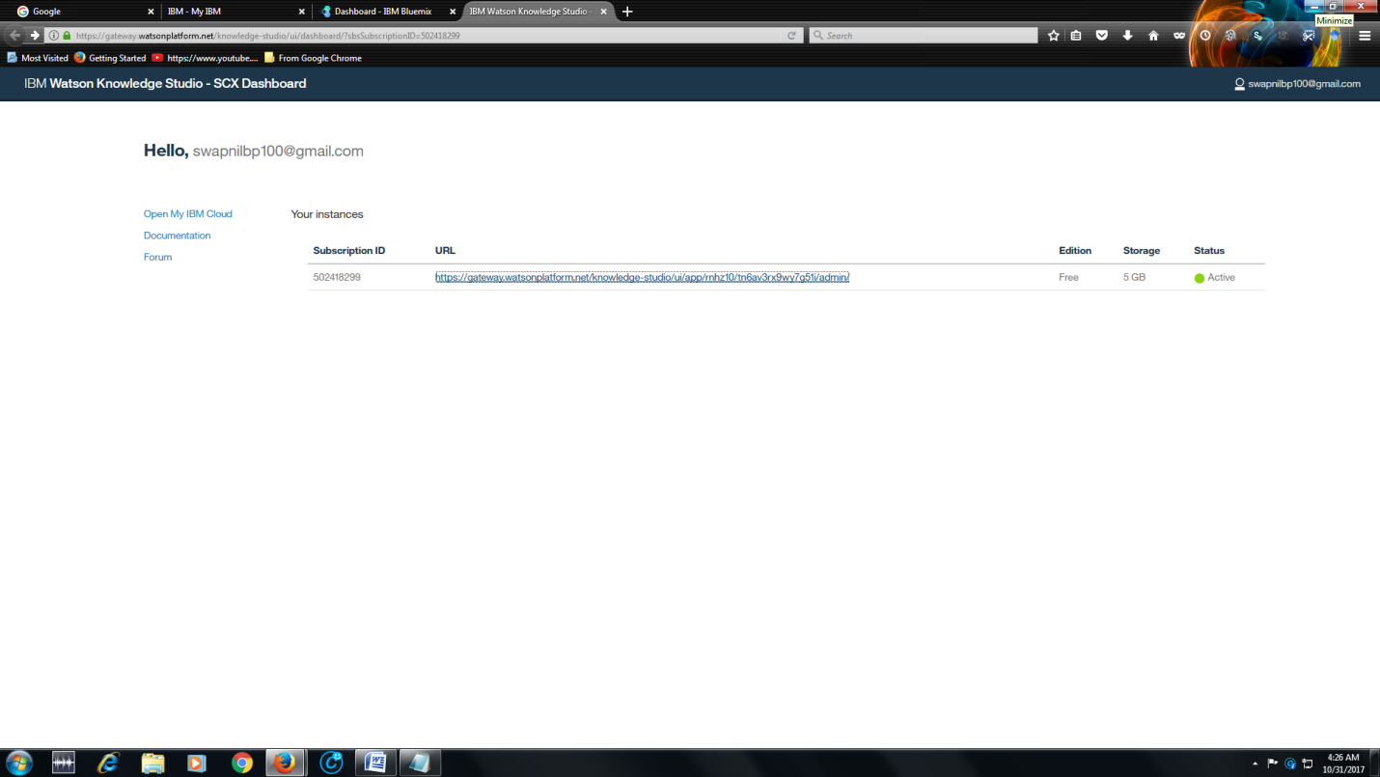
Watson Knowledge Studio

Slide 6
Summary of Stage 1:
2)Training of WATSON KNOWLEDGE STUDIO and query DISCOVERY SERVICE
A new dataset was created and new type values were created, called GAME_EVENT and MI_PLAYER and KKR_PLAYER.
The data was then annotated for mentions, relations and correlation by using existing professional dictionaries and the cricket expert, highlighting the players of both teams and the important game events.
Finally, a machine learning annotator instance was created and deployed
When a satisfactory model was obtained, a snapshot was taken and deployed to WATSON DISCOVERY SERVICE to change its configuration to match the new model configuration that has learnt about important game events, players and teams using complex machine learning algorithms.
The changes are implemented by normalizing the data and enriching using several curl commands from the documentation of Watson Discovery Service.

Slide 7
Summary of Stage 1:
A new configuration is created for the Watson discovery service to query the events of the Watson Knowledge Studio ml model.
The existing configuration was downloaded as my_config.json, the changes were made in a text editor and the file was then re-uploaded onto Watson Discovery Service to retrain the model on all the data using the new configuration.
The changes made were, that the model id of new model created on Watson Knowledge Studio was added to the my_config file, and some entries were removed to see the data more clearly.
The new configuration is applied to the data and it is queried for GAME_EVENT attribute and the results of top events are noted.
Therefore the top 50 events of the KKR vs. MI game are extracted and a model has been created to learn important cricket events in real time.

Slide 8
Workflow STAGE-2:
STAGE-1:
Watson
Discovery Service +
Watson Knowledge Studio
Data
(Given)
Parsing algorithm
(Swapnil Parekh)
CSV file-
Ball by ball analysis
Implementation
of Model+UI
(Aliabbas Merchant)
Analysis Model
(Harsh Chheda)
Final output-
Points assigned to Players

Slide 9
Parsing Algorithm
The parsing algorithm is essentially an XML parsing script.
By converting the pdf → docx,the raw XML data was extracted and then processed using the Element Tree method of the XML.etree script.
Using the tags of XML file, the table column texts were extracted from the root of the tree and using specifics font characteristics of the data, the needless nodes were eleminated.

Slide 10
Parsing Algorithm
This left just the ball-wise commentary of the match in string form.
With more filtering, the characteristics of the ball like ball no., batsman, bowler, runs and special events like wickets, lb’s, wides, no-balls etc were extracted and appended to the a ball-wise list, which was then added to central repository list of the whole match.

Slide 11
Parsing Algorithm
The final data was once again screened for inconsistencies in the XML file itself like misplaced special characters and imperfect ordering of the XML trees, and were filtered out.
Finally the data was written into a csv file with each record being a description of the ball and the players involved and all events that occured; which was then put into the model.

Slide 12
Analysis Model
Our main motive is to form the DREAM 11 from the given data .
So there needs to be a basis according to which we compare all the players and give them rankings.
Hence, with the help of Watson, I identified the events that took place and gave each event a score based on my experience and caliber .
Therefore we get the following rankings of the players .

Slide 13
Analysis Model
run_score = 0.5 four_score = 0.5 six_score = 1 fifty_score = 4 hundred_score = 6 duck_score = -2 # except bowler played_score = 2 w_score = 10 # not excluding run out four_w_score = 4 five_w_score = 8 maiden_score = 4 field_score = 5 extras_score = -1 economy_0_4 = 3 economy_4_5 = 2 economy_5_6 = 1 economy_9_10 = -1 economy_10_11 = -2 economy_11_above = -3 strike_60_70 = -1 # min 10 balls except bowlers strike_50_60 = -2 # min 10 balls except bowlers strike_0_50 = -3 # min 10 balls except bowlers

Slide 14
Analysis Model
Run 0.5 | Extras -1.0
Four 0.5 | Economy b/w 0 and 4 3.0
Six 1.0 | Economy b/w 4 and 5 2.0
Half-century 4.0 | Economy b/w 5 and 6 1.0
Century 6.0 | Economy b/w 9 and 10 -1.0
Duck(except bowler) -2.0 | Economy b/w 10 and 11 -2.0
In playing 11 2.0 | Economy above 11 -3.0
Wicket(excluding run out) 10.0 | FOR BATSMEN
Four wicket haul 4.0 | (min. 10 balls to be played)
Five wicket haul 8.0 | Strike rate b/w 60 and 70 -1.0
Maiden over 4.0 | Strike rate b/w 50 and 60 -2.0
Fielding(including run out) 5.0 | Strike rate b/w 0 and 50 -3.0

Slide 15
Implementation of the Model
General
Name
Team
Role
Matches Played
Batting
Runs
Fours
Sixes
Fifties
Hundreds
Balls Batted
Duck Out
Average Runs
Strike Rate
Bowling
Wickets
Four Wicket Haul
Five Wicket Haul
Maidens
Balls Bowled
Runs Conceded
Extras
Economy Rate
Average Wickets
Fielding
Field Help
Average Field Help
POINTS

Slide 16
Ideal Team Composition
4-Batsmen
4-Bowlers
2-All-rounders
1-WicketKeeper

