Slide 1
Digital Image Processing
By
Muhammad Ameen Chhajro
(Assistant Professor)
Sindh Madressatul Islam University

Slide 2
What is Digital Image Processing
Digital Image Processing means processing digital image by means of a digital computer.
We can also say that it is a use of computer algorithms, to get enhanced image or to extract some useful information.
Digital image processing is the use of algorithms and mathematical models to process and analyze digital images.
The goal of digital image processing is to enhance the quality of images, extract meaningful information from images, and automate image-based tasks.

Slide 3
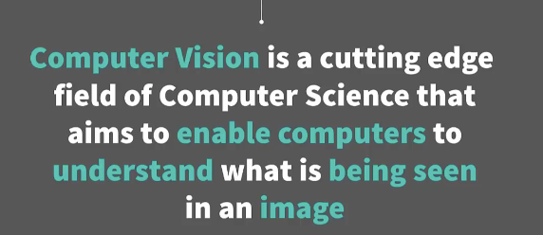

Slide 4
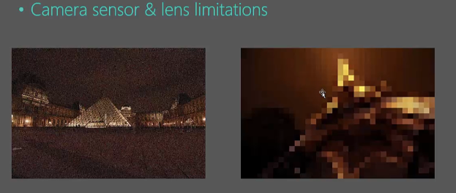
Challenges in Digital Image Processing
limitation of the sensor and the lens
Firstly, with camera sensor and lens limitations. Camera sensors are particularly bad in low-light conditions producing noisy images like this or what if we wanted to zoom in to image a small segment of the image you would get a very pixilated image here and that's a limitation of the sensor and the lens.

Slide 5
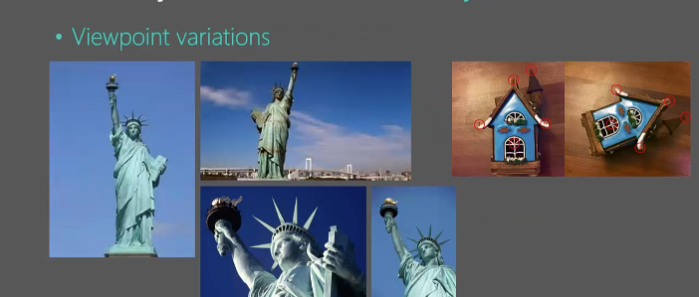
Viewpoints variations
one image of one statue taken in different viewpoints.

Slide 6
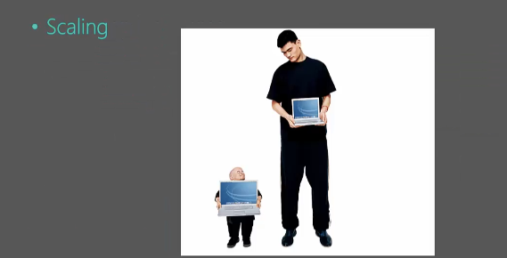
Scaling issues
Resizing of the digital images

Slide 7
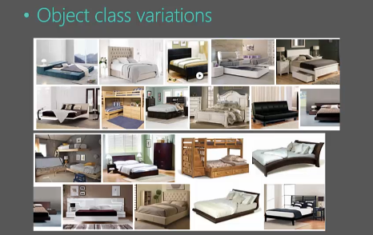
Object Class variations
Object class variation in images refers to the diversity and differences in the appearance, shape, size, orientation, and context of objects belonging to the same class or category within a dataset. This variation is a key challenge in computer vision tasks such as object detection, classification, and segmentation. Understanding and handling object class variation is crucial for building robust and generalizable machine learning models.

Slide 8
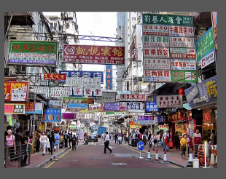
Cluttering or noisy images
Trying to pick up an object that is noisy or cluttered image that's going to be quite a challenge.

Slide 9
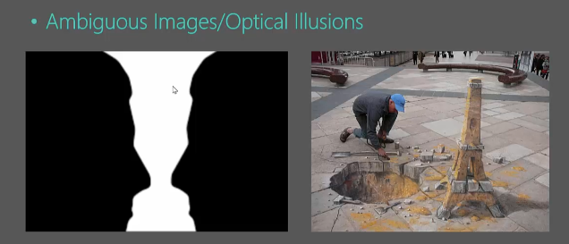
Ambiguous Images
Images that can be interpreted in more than one way, depending on how the viewer perceives them. Example include the famous "Rubin's Vase" (which can be seen as either a vase or two faces in profile)

Slide 10
Optical Illusions
Images that deceive the eye and brain, creating a perception that differs from reality. These can involve geometric distortions, color contrasts, or motion effects.

Slide 11
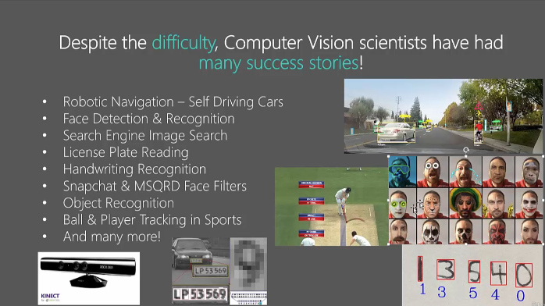

Slide 12
Projects/application
face filters
pedestrian identification
car identification
facial landmark identification
shape identification
face swaps
face recognition
handwritten digit recognition and more..

