Slide 1

Modern Programming Language Go
Dr. Alvin Grissom
CS-374-A: Principles of Programming Language
Spring 2019
Aliaksandr Hladkou

Slide 2
History of Go
Go was designed at Google by Robert Griesemer, Robe Pike, and Ken Thompson. They started to develop a new language on September 21, 2007 and became a public open source project on November 10, 2009.
“We decided to take a step back and think about what major issues were going to dominate software engineering in the years ahead as technology developed, and how a new language might help address them…”
Notes:
In the beginning of the 2008, Ken started to work on exploring their ideas and theories by making a small compiler which generated C code as the output.

Slide 3
Advantages of Go
Go is Easy to Learn
Multi-threading
No Virtual Machine
Cross-Platform
Embedded Garbage Collector
Code is easy to maintain

Slide 4
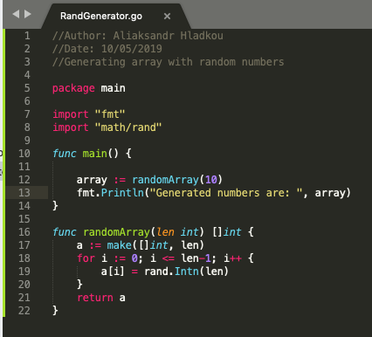
Easy to Learn
Go is a relatively simple language with a relatively simple standard library. In addition, this language has rigidly fixed style code which makes it easier to read for other developers.
The output is:
Notes:
One of the purposes of Go is simplicity. Therefore, this programming language has rigidly fixed style code

Slide 5
Easy to Learn
Comparing to the other languages, Go is simple language with small technical documentation.
Comparing to the other languages:
 | Java | C# | C++ | Go
Multi-threading | Simple | Simple | Complex | Simple
Garbage Collector | Yes | Yes | No | Yes
Virtual Machine | Require | Require | No | No
Learning | Simple | Simple | Difficult | Simple
Specification (pages) | 780 | 500 | 1300 | 85
Notes:
Go is a relatively simple language with a relatively simple standard library. For instance, experienced developers would start coding within first two days. One of the purposes of Go is simplicity. Therefore, this programming language has rigidly fixed style code, a developer would spend less time writing a code rather than reading it. Also, the code written by many developers will look very similar. Another example, Go has less specifications than most other programming languages.

Slide 6
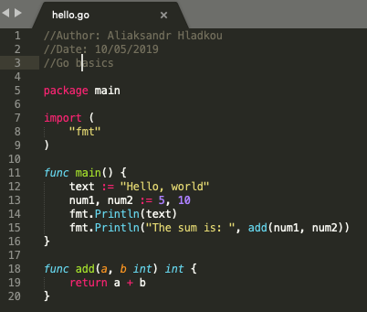
Code is Easy to Maintain
No features that OOP languages do:
• No classes
• No inheritance
• No constructors
• No annotations
• No generics
• No exceptions

Slide 7
Multi-threading
Go is efficient in terms of concurrent execution. Comparing to Java, Go uses lightweight threads called goroutines which consume about 2KB memory.
func main() {
go f(x, y, z)
}
Goroutines v/s Treads:
Goroutines have a faster startup time than threads
Goroutines use channels to communicate between themselves while communications between threads are very difficult
Notes:
Goroutines have a faster startup time than threads Goroutines use channels to communicate between themselves while communications between threads are very difficult

Slide 8
No Virtual Machine
Many programming languages require VM in order to translate human readable code into machine readable. However, Go is compiled language which means that performance can be increased by translating into binaries directly.

Slide 9
Cross-Platform
Portability is one of the most important advantages of Go. So, we can run Go platform on any platform that we select.
GOOS=windows GOARCH=386 go build -o hello.exe hello.go
That’s it! hello.exe will run on any Windows machine with x86 CPU
GOOS=darwin GOARCH=amd64 go build hello.go
That’s it! It is ready to work on Mac with 64-bit CPU

Slide 10
Embedded Garbage Collector
No more free(str); function. It makes to work with Go more simple. Garbage collection adds overhead, but it also eliminates a number of devastating bugs.

Slide 11

Issues While Learning Go
There are several annoying things that Go has. Let’s look back at the previous code example:
By running program several times:

Slide 12
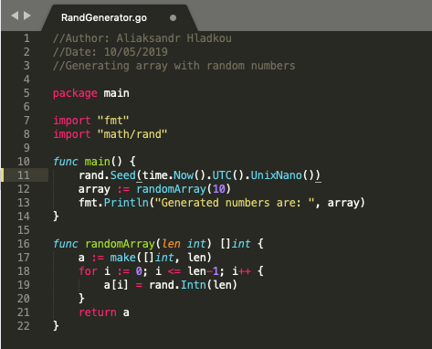
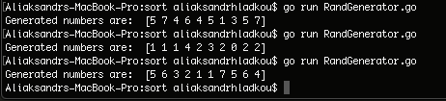
Issues While Learning Go
It is necessary to use rand.Seed() function in order to have different set of random values when executing the program over and over again. Otherwise, it will keep using the same values.
By running program several times again:

Slide 13
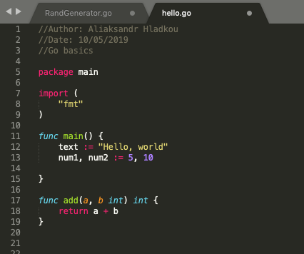
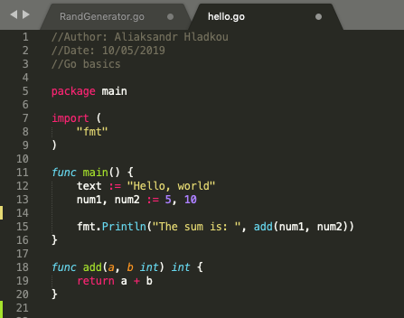
Issues While Learning Go
Another point is that Go program can not have any unused imports or variables. Consider examples below.

Slide 14
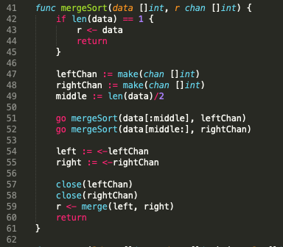
What About Multi-Threading?
Avg time:
 | Go | Java
100,000 | 99ms | 259ms
1,000,000 | 898.6ms | 937.7ms
10,000,000 | 11.2s | 19s

Slide 15
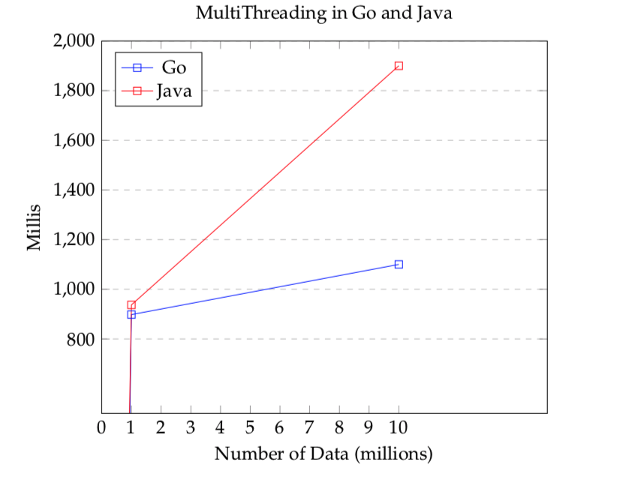
What About Multi-Threading?
Avg time:
 | Go | Java
100,000 | 99ms | 259ms
1,000,000 | 898.6ms | 937.7ms
10,000,000 | 11.2s | 19s

Slide 16
References
Karl Seguin, “The Little Go Book,” https://github.com/karlseguin/the-little-go-book
Keval Patel, “Why should you learn Go?,” Medium, 2017, Jan 8. https://medium.com/@kevalpatel2106/why-should-you-learn-go-f607681fad65
“Go (programming language),” Wikipedia.org, https://en.wikipedia.org/wiki/Go_(programming_language)
“The Go Programming Language,” golang.org, https://golang.org/doc/faq#What_is_the_purpose_of_the_project
Johannes Liebermann, “Why Golang Is Great for Portable Apps,” codeburst.io, https://codeburst.io/why-golang-is-great-for-portable-apps-94cf1236f481

