Slide 1

Data Quality
Big Data Overview

Slide 2
Agenda
What is Big Data?
Big Data architecture
Why so fast? Map-Reduce, optimization techniques
Special file types
Batching/Streaming
Big Data tools
Data Quality in Big Data

Slide 3
WHAT IS BIG DATA
(Vs AND APPROACHES)

Slide 4
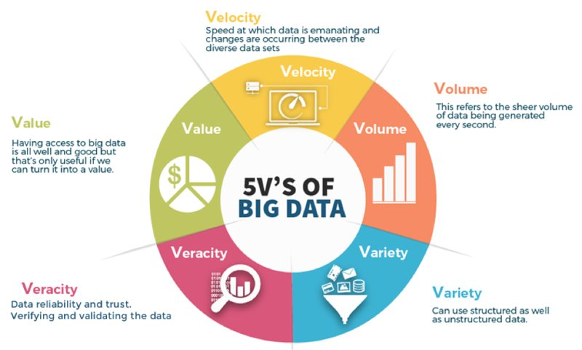
What is Big Data (Vs and approaches)
Data is a new oil
business value
data-driven business decisions
future insights to come from the data
3-5 Vs
Tools and processes, not volume
Hadoop (commodity-level hardware)
Clouds (pay only for usage)
Data types
Structured – Relational DBs, ready to process
Non-structured (text, video, images, audio), Data lakes
Semi-structured (JSON, CSV, XML, mobile photo+time, location, etc.), needs the effort to gain insights
Notes:
Veracity – accuracy, Data Quality issues
The development of open-source tools such as Hadoop and Spark led to growth.
500 Tbs generated on Facebook by users per day. The jet engine generates 10 Tbs per 30 min of flight
Structured - tables

Slide 5
BIG DATA ARCHITECTURE

Slide 6
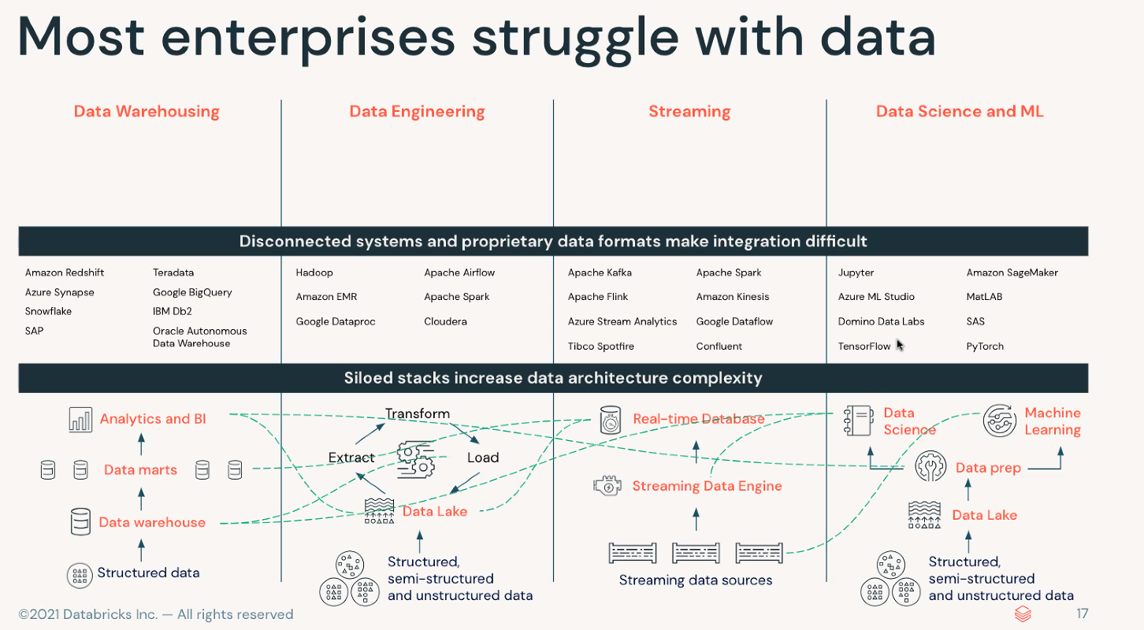
Big Data architecture: Why do we need it besides DWH?
Real world is not so structured as in Kimball and Inmon books
Notes:
DWH is not gone, but we do not need data to be structured, cleaned, and prepared. We could collect everything, even before we consider how data will be used in future.

Slide 7
Big Data architecture: Why do we need something besides DWH?
New technologies: DWH invented >30 years ago
Lower storage cost and better performance
Agile business so no need to plan and implement thoughtfully
Limited access to raw and unstructured data (DS cases)
No streaming in DWH
No fast scalability of DWH (e.g. for Xmas season)
We could adopt the progress and build better data solutions
Operate in the world with modern challenges
Fast time to market to test business assumptions
No upfront cost
Notes:
DWH is not gone, but we do not need data to be structured, cleaned, and prepared. We could collect everything, even before we consider how data will be used in future.

Slide 8
Big Data architecture: Data Lake
A central cheap location that holds a large amount of data in its native, raw format
Just any files in buckets (+ tools to process it). Buckets: S3, Google Cloud Storage, Azure storage, HDFS, DBFS, etc.
ETL vs ELT: storage decoupled from transformations
Analytics could be built on top of every file
Poor Data Quality and Governance, no ACID transactions, Data Swamp (ungoverned unused data)
Characteristics | Data Warehouse | Data Lake
Data | Relational data from transactional systems, operational databases, and line of business applications | All data, including structured, semi-structured, and unstructured
Schema | Often designed prior to the data warehouse implementation but also can be written at the time of analysis (schema-on-write or schema-on-read) | Written at the time of analysis (schema-on-read)
Price/Performance | Fastest query results using local storage | Much cheaper. Query results getting faster using low-cost storage and decoupling of computing and storage
Data quality | Highly curated data that serves as the central version of the truth | Any data that may or may not be curated (i.e. raw data)
Users | Business analysts, data scientists, and data developers | Business analysts (using curated data), data scientists, data developers, data engineers, and data architects
Analytics | Batch reporting, BI, and visualizations | Machine learning, exploratory analytics, data discovery, streaming, operational analytics, big data, and profiling
https://aws.amazon.com/data-warehouse/
Notes:
Data Governance – who owns, data lineage, access, integrity

Slide 9
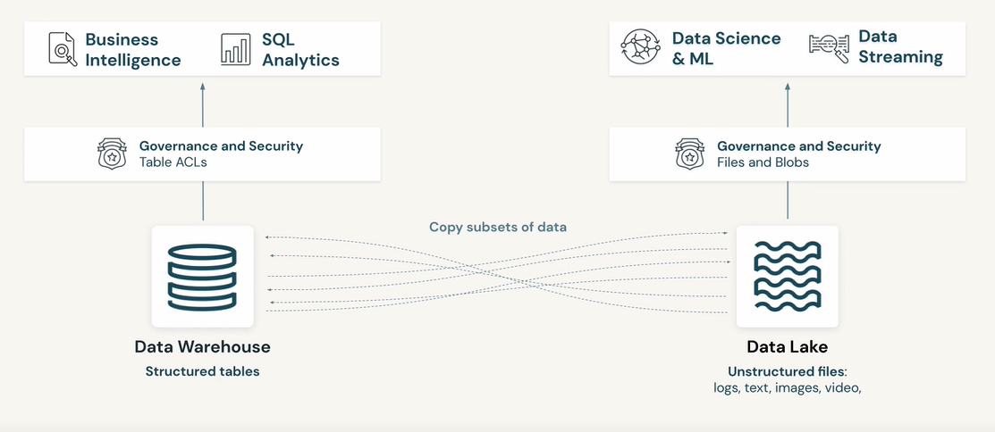
Big Data architecture: Challenges

Slide 10
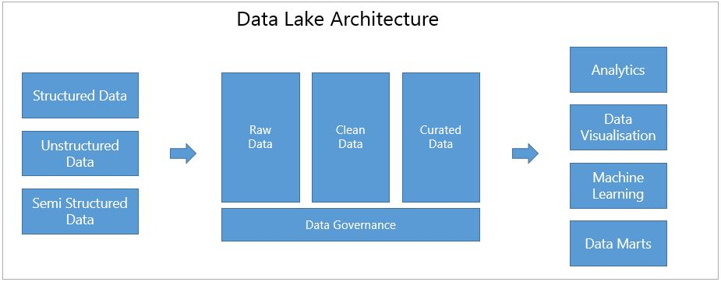
Big Data architecture: Lakehouse
Best of two worlds - hybrid architecture: DWH on top of Data Lake
Structured&unstructured data, ELT, Data Marts, DS jobs with data from any layer, Streaming sources, ACID, open formats
Add governance and quality to Data Lakes
3-layer architecture (see next slide)
Track data up to the source
Use any data for ML and AI studies
Notes:
Atomicity means that all transactions either succeed or fail completely.
Consistency guarantees relate to how a given state of the data is observed by simultaneous operations.
Isolation refers to how simultaneous operations potentially conflict with one another.
Durability means that committed changes are permanent.
ML/AI needs Raw data. Not sure what data could be useful in future ML is not DQE or DE

Slide 11
Big Data architecture: Lakehouse
3-layer architecture:
Bronze (Raw, Landing, Ingestion): Not cleaned data, ingest as is, no data to be dropped.
Silver (Refinement, Staging, Validated, Standardization, Clean): Refined Tables. Schema added. Joins, transformations, refinement, filtration, cleansing. To not lose data by overwriting data in the Bronze layer. Reproducibility after mistakes, possibility to take a step back.
Gold (Production, Analytics, Curated, Enriched): Layer where data becomes information. Aggregated data, to be used for reports by business, ML. Primary zone for applications, teams, and users to consume data products.
Just a framework, not 100% template for all use
Notes:
Ask if the same was on the DWH lectures
Always possible to take a step back and re-process the data in case of issues.
Other architecture frameworks: data factory, Data Mesh, Active schema

Slide 12
WHY SO FAST?
MAP-REDUCE, OPTIMIZATION TECHNIQUES

Slide 13
Why so fast? Map-Reduce, optimization techniques
MPP: Clusters, nodes, workers
Different roles in cluster: Driver-Worker, Driver does not calculate, only aggregates the calculation done by Workers and orchestrates (gives commands)
Hadoop ecosystem: HDFS (NameNode, DataNode), Map-Reduce, Orchestration. Horizontal scalability on commodity hardware
Rack awareness
Data locality - moving computation to data, not data to computation: shared variables, broadcast joins
Special file type to read it partially and good for compression
Columnar DBs and file types
Notes:
Massively parallel processing

Slide 14
Why so fast? Map-Reduce, optimization techniques
Splitting data to not to read it: Partitioning (folders), Bucketing/Clustering (+Sorting), Z-Ordering (skipping read of data with not required stats e. g. max mark of students), Sharding (split between clusters)
DAG (Direct acyclic graph): not to compute from the beginning
Lazy evaluation
In-memory computations
Metastore: schema and data profiles (stats) in separate relational DB + possibility to use “external tables” without the need to move data between clusters
Query optimization: to reduce the amount of data as soon as possible, move cost operations (like ORDER BY) to the end of execution after all the filters applied
Notes:
Buckets same as Clusters – splitting data by volume, not by meaningful content, should be sorted inside

Slide 15
SPECIAL FILE TYPES

Slide 16
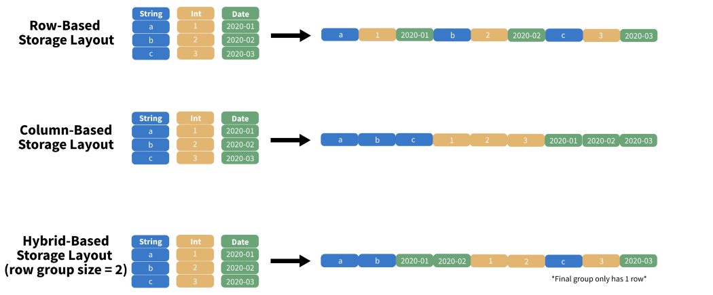
Special file types
Smaller – faster
No need to read all the file
Schema evolution (change schema without actual data change (e.g., via adding default value)
Raw-based vs. Columnar data format
Notes:
Files optimized for storage, “archived”

Slide 17

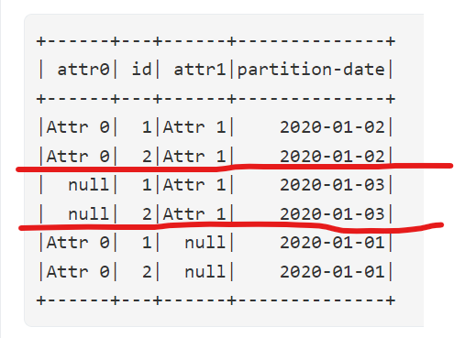
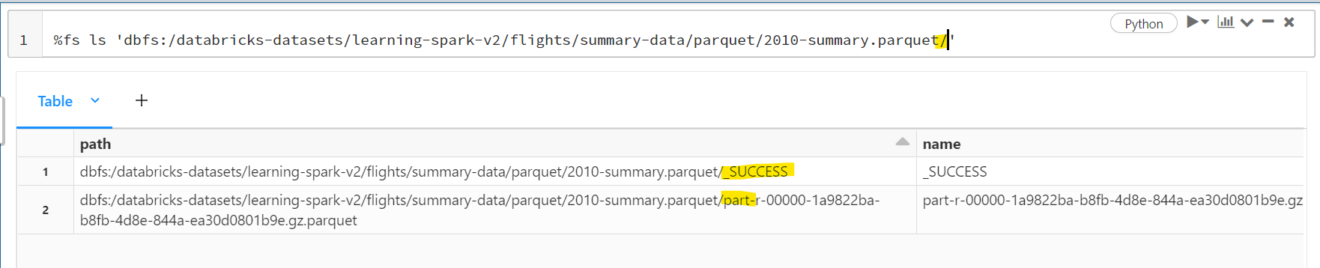
Special file types: Parquet
Columnar format: read only required columns, even partially
Schema in the end of the file (read from tail)
Schema append+merge: add several files to 1 DF -> schema will be merged (or added) for all files
Several compression options: fast read or less space
Good for storing data of any kind (tables, images, videos)
Good for analytical queries
Most popular as developed by Spark guys and universal
Partitioning: almost every file is a folder
Notes:
E.g. for reading only top 100 values

Slide 18

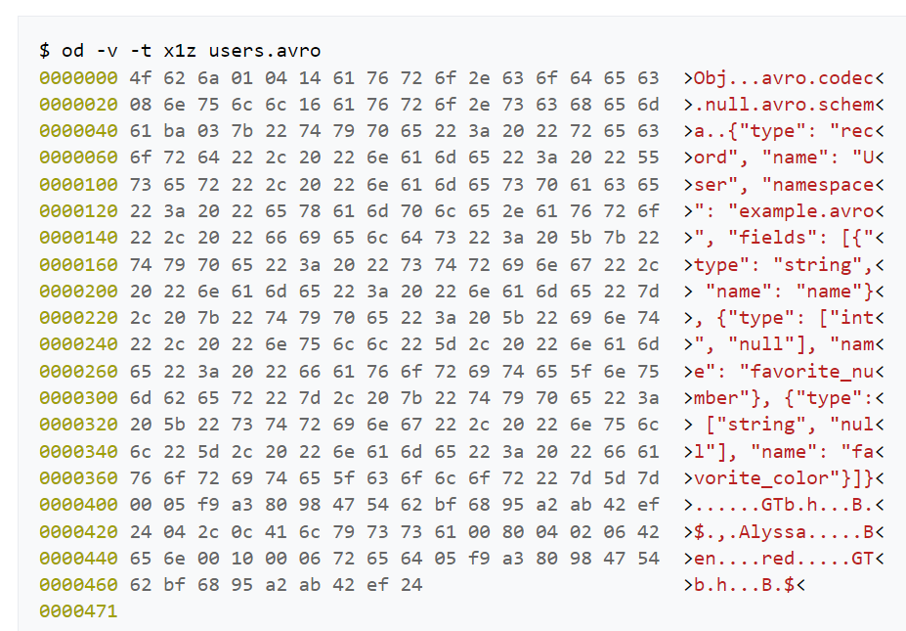
Special file types: Avro
Row-based
Schema in JSON format (human-readable format, could be read separately)
Good for RAW layer (files should be written and read fully)

Slide 19

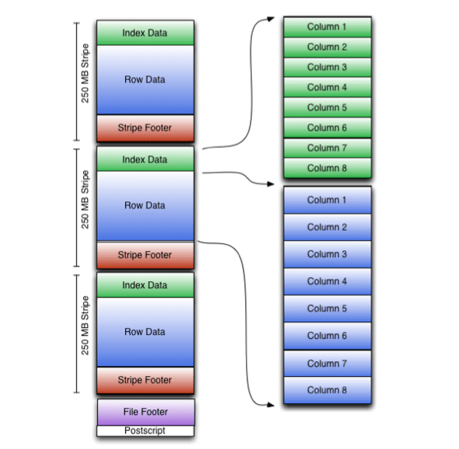
Special file types: ORC
Not Orc, but Optimized Row Columnar: try to take best from both
Concurrent read: several threads for one file
Stripes
Column-level aggregates at the end of each stripe: count, min, max, and sum.
ACID transactions
Compression-efficient
Never saw it in production
Notes:
Spend here as less time as possible
Atomicity - each statement in a transaction (to read, write, update or delete data) is treated as a single unit. Either the entire statement is executed, or none of it is executed. This property prevents data loss and corruption from occurring if, for example, if your streaming data source fails mid-stream.
Consistency - ensures that transactions only make changes to tables in predefined, predictable ways. Transactional consistency ensures that corruption or errors in your data do not create unintended consequences for the integrity of your table.
Isolation - when multiple users are reading and writing from the same table all at once, isolation of their transactions ensures that the concurrent transactions don’t interfere with or affect one another. Each request can occur as though they were occurring one by one, even though they're actually occurring simultaneously.
Durability - ensures that changes to your data made by successfully executed transactions will be saved, even in the event of system failure.

Slide 20
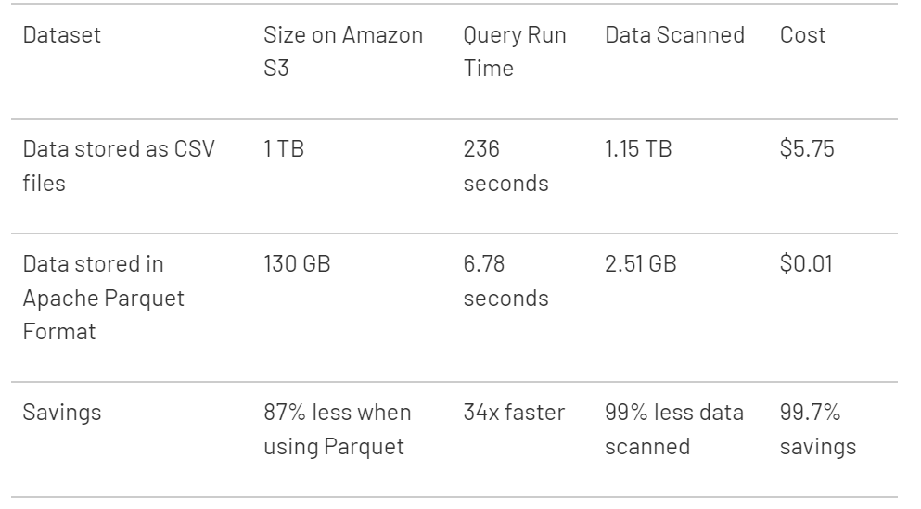
Special file types: CSV, JSON, etc.
Human-readable, but…
https://www.databricks.com/glossary/what-is-parquet
Notes:
Sometimes you must use simple files: stakeholders, reports, DS (Pandas), front-end, API

Slide 21
BATCHING/STREAMING

Slide 22
Batching/Streaming
Batch
Once per time quant: daily, hourly, second, millisecond (microbatch)
Streaming
Real-time data for processing and analytics: processed as soon as generated
Individual events handled
Areas: EOT, fraud detection, sensors in vehicle, clickstreams, GPS tracking, stock trades
Immediate alerting and quick decisions to be made
Information flows between microservices
Data producers – scalable queue – Consumers waiting for data
Complexity – late events handling, scalability, ordering, Fault Tolerance
Notes:
scalable queue - several nodes

Slide 23
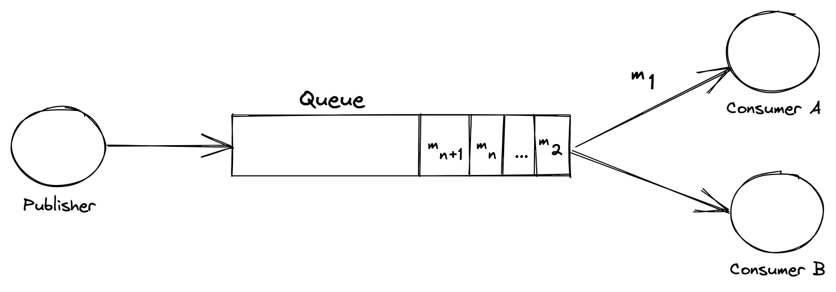
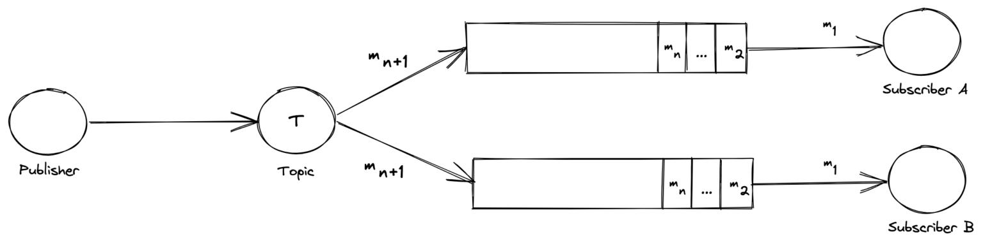
Streaming architecture
Message queue
One message consumed by 1 subscriber
Ensures only 1 action per msg
FIFO
Pub-sub
All consumers subscribed to topic receive msg (hopefully 1 copy each)
Names: Kafka, Spark Streaming, Google Pub/Sub, AWS Kinesis, AWS SQS, Azure Event Hub, RabbitMQ, ActiveMQ
Notes:
scalable queue - several nodes

Slide 24
BIG DATA TOOLS

Slide 25
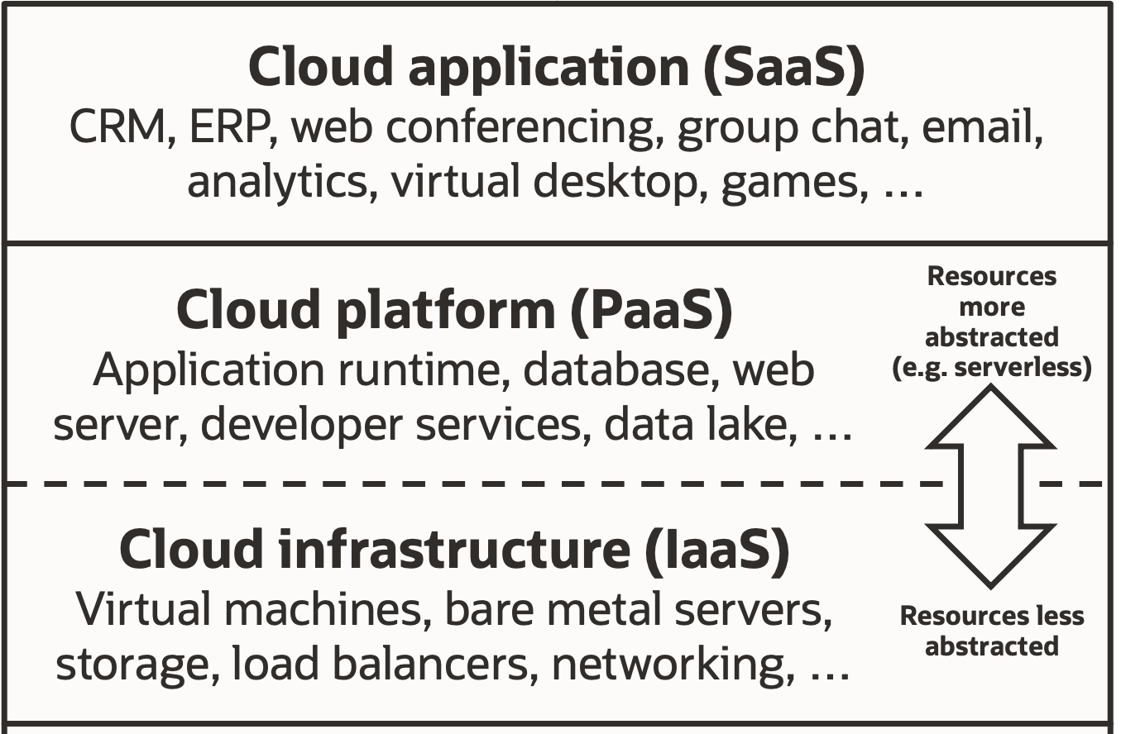
Big Data tools
In Clouds:
IaaS – any tools you like on fast and scalable clusters, e.g. EMR
PaaS – AWS Lambda (you only write code), DBs like Redshift, Cosmos DB, BigQuery. Enough for Data projects
SaaS – DWH and data processing: Snowflake, Databricks. BI+: Tableau, Power BI
Spark
Hive
ELK (Elasticsearch, Logstash, Kibana)
Greenplum
Clickhouse
Cassandra

Slide 26
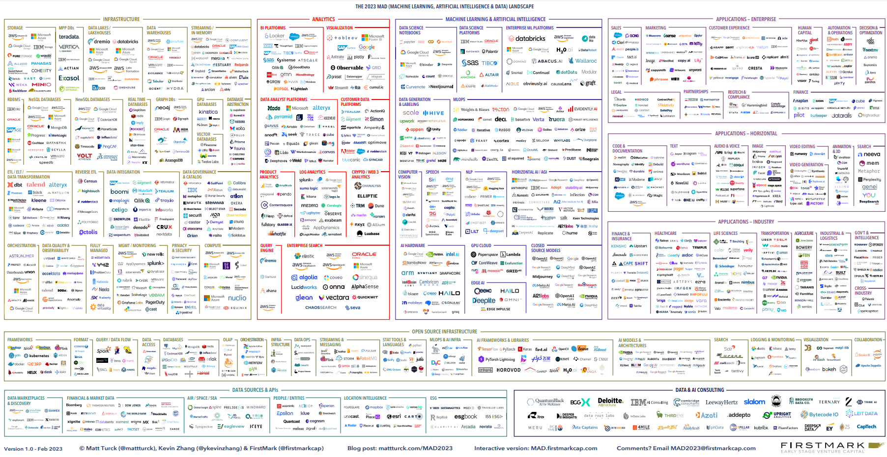
Data tools
https://mad.firstmark.com/

Slide 27
DATA QUALITY IN BIG DATA

Slide 28
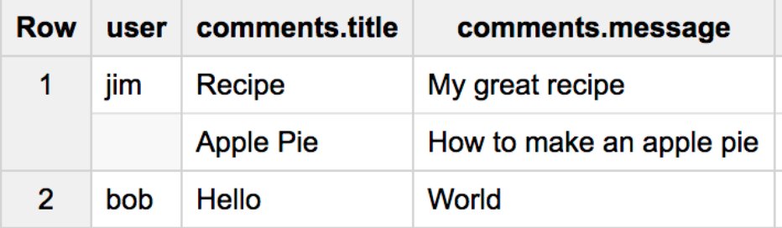
Data Quality in Big Data: Why and how?
Issues are expected:
No enforced constraints (except NOT NULL)
Duplicates due to speeding up table incremental load
Complex data type mapping due to variety of sources (STRING-VARCHAR, INT-DOUBLE(38,0))
Complex data types to process complex data (ARRAY, NESTING)
No clear requirements for data, no data governance – no one knows all the data in a company
Collect requirements, approve it and expect no significant changes
AI and ML requires special data – clear and prepared, but with possibility to access raw data
{"user": "jim", "comments": { "title": ["Recipe", "Apple Pie"], "message": [ "My great recipe", "How to make an apple pie" ]}}
{"user": "bob", "comments": { "title": ["Hello"], "message": ["World"]}}

Slide 29
Data Quality in Big Data: Checks examples
Notes:
Data checked before and after movement/transformations

Slide 30
Data Quality in Big Data: Checks examples
Correct naming and file formats
Correct buckets/tables
Timeliness/schedules
Expected data profiles: row count threshold, NULLs/blanks count, Uniqueness, max values, etc.
Notes:
Data checked before and after movement/transformations

Slide 31
Data Quality in Big Data: Checks examples
Correct naming and file formats
Correct buckets/tables
Timeliness/schedules
Expected data profiles: row count threshold, NULLs/blanks count, Uniqueness, max values, etc.
Same checks as on previous layer
Expected schema, no schema drift
No duplicates
Expected volume: all data from this layer should be on the Raw too
Check for outliers & anomalies
Expected constraints
Notes:
Data checked before and after movement/transformations

Slide 32
Data Quality in Big Data: Checks examples
Correct naming and file formats
Correct buckets/tables
Timeliness/schedules
Expected data profiles: row count threshold, NULLs/blanks count, Uniqueness, max values, etc.
Same checks as on previous layer
Expected schema, no schema drift
No duplicates
Expected volume: all data from this layer should be on the Raw too
Check for outliers & anomalies
Expected constraints
Monitoring and alerting
Check results storage
Security/access checks
Data cataloging
Data lineage
DQ reports
Notes:
Data checked before and after movement/transformations

Slide 33
Data Quality in Big Data: Checks examples
Correct naming and file formats
Correct buckets/tables
Timeliness/schedules
Expected data profiles: row count threshold, NULLs/blanks count, Uniqueness, max values, etc.
Same checks as on previous layer
Expected schema, no schema drift
No duplicates
Expected volume: all data from this layer should be on the Raw too
Check for outliers & anomalies
Expected constraints
Monitoring and alerting
Check results storage
Security/access checks
Data cataloging
Data lineage
DQ reports
Same checks as on previous layer
Business rules/transformations compliance
Consistency (PK, FK, etc.)
Notes:
Data checked before and after movement/transformations

Slide 34
Data Quality in Big Data: Checks examples
BI Reports checks
AI/ML-related checks
Correct naming and file formats
Correct buckets/tables
Timeliness/schedules
Expected data profiles: row count threshold, NULLs/blanks count, Uniqueness, max values, etc.
Same checks as on previous layer
Expected schema, no schema drift
No duplicates
Expected volume: all data from this layer should be on the Raw too
Check for outliers & anomalies
Expected constraints
Monitoring and alerting
Check results storage
Security/access checks
Data cataloging
Data lineage
DQ reports
Same checks as on previous layer
Business rules/transformations compliance
Consistency (PK, FK, etc.)
Notes:
Data checked before and after movement/transformations

Slide 35
Q & A

