Slide 1
Bangalore house data
TEAM SOPHIA – ABHISHEK, MITHALI, PARTH
IDS (ue17CS203) Project - 2018

Slide 2

Introduction
Introduction
Data Science helps one to gain new insights from large data sets by asking right questions, manipulating data and visualizing one’s findings in a way that is presentable and easy to understand.
In this project, we hope to understand how to work with large data sets and analyse them.
We are using Python to analyse data. Here, data manipulation is done with pandas and data visualization with matplotlib.

Slide 3
Our dataset
dataset
The data set that we have chosen is of the prices of houses in Bangalore. The columns of the data set specifies the area type, availability, location, size, society, total sqft, number of baths, balconies and its price. (9 features)
These are the exact parameters that buyers look for before purchasing a house. Therefore, with the analysis drawn from this dataset, we could potentially help a number of buyers in choosing their home.
We can observe that the various columns affect the prices of the houses and the purpose of our project would be to analyse the parameters that affect not just the prices of houses but how some of the parameters affect the others.

Slide 4
Data cleaning
cleaning
In order to clean our dataset with 9 columns, we began with analysing each column to see if they contained any missing values, outliers or non-uniform units.
1. Missing values: For the columns that contained missing values, we filled them with either the median or with NaN or with a phrase, in this case, ‘Not Ready To Move’.
2. Outliers: Any house above 8,000 square feet or above 10 BHK were deemed to be outliers.
3. Non-uniform units: For the columns that had values with several units, we simply converted them to one single unit, in this case square feet for uniformity.

Slide 5
Data cleaning
cleaning
Availability: For this column, some of the values contained dates and the others contained ‘Ready To Move’. The dates make the dataset hard to read and the visualizations unclear. Therefore, we changed all the values that contained dates to ‘Not Ready To Move’.
Size: The size column represents the number of bedrooms per house. In this dataset, some of the values contained ‘BHK’ and the others ‘Bedrooms’. This again creates some non-uniformity in the dataset. Here, we changed all the values that contained ‘Bedrooms’ to ‘BHK’ by iterating through the size column. This makes the dataset much more readable.
Total_sqft: the total_sqft column contains the total square feet of the house. However, this was given in various units such as: gunthas, grounds, acres, square yards, cents and some more. Some were also given as hyphenated values. Therefore, in order to clean this column, we identified the various units that were present and by implementing a simple switch-case loop, we converted all the values to square feet. The missing values were filled with the median of the column. The outliers are house with more than 10 bedrooms or with more than 10,000 square feet.

Slide 6
Data cleaning
cleaning
Balcony: The balcony column contained many missing values we identified by simply iterating through the column and using the function ‘isNan’ from the numpy module and filled it with the median.

Slide 7
Data visualization

Slide 8
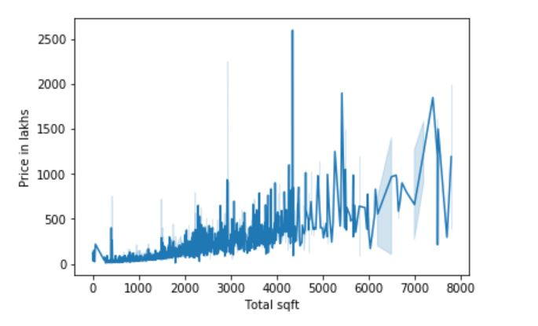
Price v/s total_sqft
Data Visualisation - line graph
In order to see the variation of price with the area of the house, we plotted a simple line graph.
It was observed that the price generally increased with the increase in the size of the house which means that the bigger the house, the more it costs.
However, some outliers were observed perhaps because the prices of houses also vary with its location.

Slide 9
Code
code
x=[]
y=[]
z=[]
w=[]
v=[]
for index, row in df['total_sqft'].iteritems():
var = df['total_sqft'].loc[index]
prc = df['price'].loc[index]
siz = df['size'].loc[index]
avi = df['availability'].loc[index]
bat = df['bath'].loc[index]
if(int(var)<8000 and int(siz)<10):
x.append(var)
y.append(prc)
z.append(siz)
w.append(avi)
v.append(bat)
sns.lineplot(x,y)
plt.xlabel("Total sqft")
plt.ylabel("Price in lakhs")

Slide 10
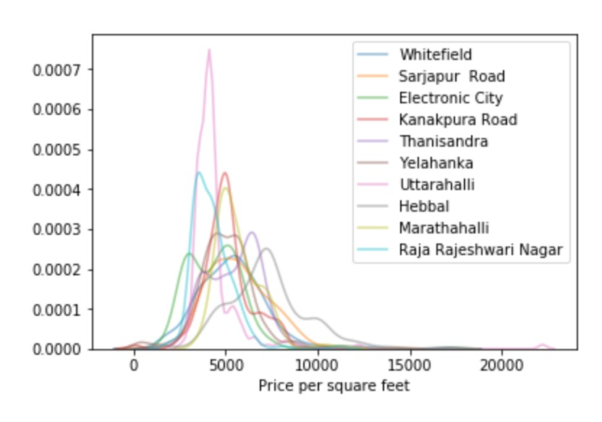
Number of houses v/s price per sqft
Data Visualization- line graph
The graph shows that there are more number of houses in Uttarahalli making it a more crowded area. However, the price per square feet is seen to peak for Hebbal thereby making it a more expensive place to reside.
We also observed that the curves for Marathahalli and Kanakapura almost follows a normal curve. Therefore, we can infer that the price per square feet does not vary much from what is expected for houses in that area.
In the graph for Electronic City, we can see that the curve has many ups and downs. This means that there is a fair distribution of houses with different prices in that area.

Slide 11
Code
CODE
top5loc=[]
sqpr={}
for index, row in df['location'].iteritems():
l=df['location'].loc[index]
ttsq=df['total_sqft'].loc[index]
prc=df['price'].loc[index]
if l in x:
top5loc.append(l)
if l not in sqpr:
sqpr[l]=[]
else:
if(((prc*100000)/ttsq)<30000):
sqpr[l].append((prc*100000)/ttsq)
for l in x:
sns.kdeplot(sqpr[l], alpha=0.5, label=l)
plt.xlabel("Price per square feet")

Slide 12
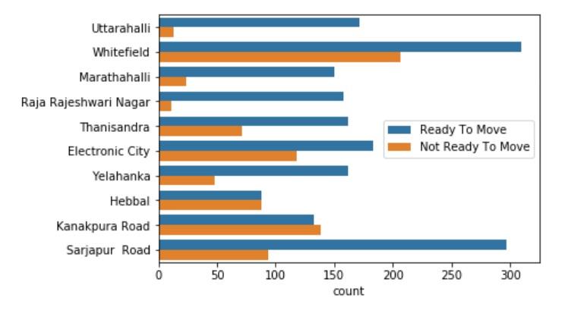
Houses ‘ready to move’ and ‘not ready to move’ in different localities
Data Visualisation - bar graph
The graph represents the number of houses that are ‘Ready To Move’ versus the number of houses that are ‘Not Ready To Move’ in different locations.
Although from the graph it seems as though Whitefield has the most number of houses that can readily be occupied, it must also be noted that the area also has a considerable number of houses that are ‘Not Ready To Move’.
Whereas on the other hand, Uttarahalli has a good number of houses that can be occupied and very few houses that cannot be occupied, therefore making it easier to find a house that can be immediately occupied.
This graph is important as one can understand the status of the houses(of whether they can be occupied or not), in different localities. This makes it easier for the buyer too choose a locality and house according to his needs.

Slide 13
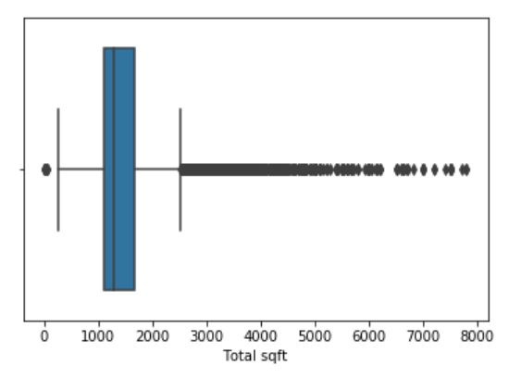
Box plot for total sqft
Data Visualisation - box plot
The graph shows a box plot which is plotted for the total square feet or area of the house. From the box plot, we can identify outliers. After identifying the outliers, they may be omitted to create a much cleaner data set which can be analysed more accurately.
After plotting the box plot, we have included only those houses with less than 8000 sqft, as the ones that have more area are considered as outliers in our dataset.

Slide 14
Code
CODE
sns.boxplot(x)
plt.xlabel("Total sqft")
plt.show()

Slide 15
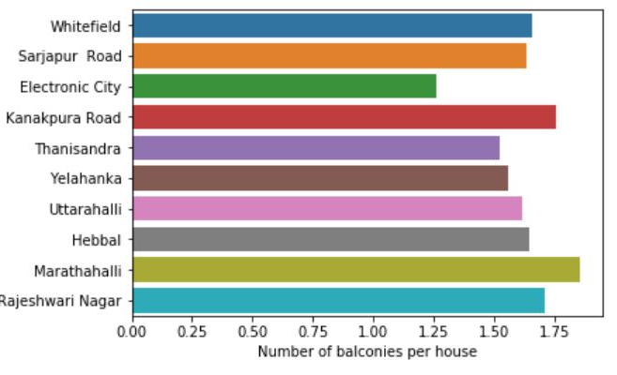
Balconies v/s location
Data visualisation - histogram
In order to plot the number of balconies versus location, we have used a histogram, where the categorical value is the location and the numerical value is the number of balconies.
The graph shows that Electronic City has fewer number of balconies per house as compared to the other localities. From this, we may infer that the residents of Electronic City do not prefer balconies in their house. This may be due to a number of reasons. Electronic City being an industrial area, might have poor air quality when compared to the other localities.
On the other hand, Marathahalli seems to have a considerably larger number of balconies per house. We inferred that this could possible be because there are better views, more open spaces and better air quality in this locality.

Slide 16
Code
CODE
import operator
numberOfBalconies = {}
numberOfHouses = {}
loc=[] #top 10 locations
div=[]
for index, row in df['location'].iteritems():
l = df['location'].loc[index]
if(l not in numberOfBalconies):
numberOfBalconies[l] = df['balcony'].loc[index]
else:
numberOfBalconies[l] += df['balcony'].loc[index]
for index, row in df['location'].iteritems():
l = df['location'].loc[index]
if(l not in numberOfHouses):
numberOfHouses[l] = 1
else:
numberOfHouses[l] += 1
for i in range(0, 10):
locHouseNum = max(numberOfHouses.items(), key=operator.itemgetter(1))
loc.append(locHouseNum[0])
div.append(numberOfBalconies[locHouseNum[0]]/locHouseNum[1])
del numberOfHouses[locHouseNum[0]]
plt.ylabel("Location")
plt.xlabel("Number of balconies per house")
sns.barplot(div, loc, orient='h')
plt.show()

Slide 17
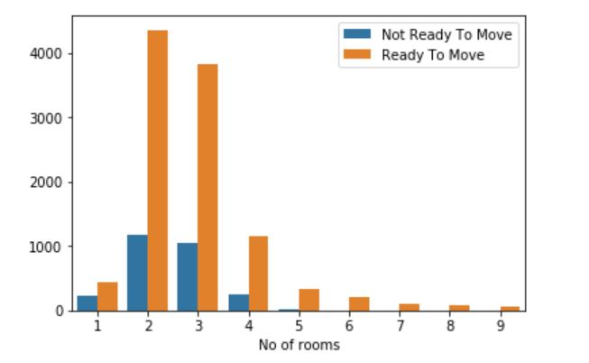
Availability v/s number of rooms
Data visualisation - bar graph
This graph is a simple bar graph that checks the availability of the houses versus the number of rooms. We have taken ‘Ready To Move’ as the house being available and vice-versa.
From this graph, we can infer that there are very few houses with a larger number of rooms. However all the houses with rooms greater than 6 are ‘Ready To Move’ or in other words, ‘Available’.
On the other hand, houses with fewer number of rooms have a considerable number houses that are ‘Not Ready To Move’ or ‘Not Available’. From this we can infer that people prefer smaller homes as there are considerable more number of houses with fewer number of rooms.

Slide 18
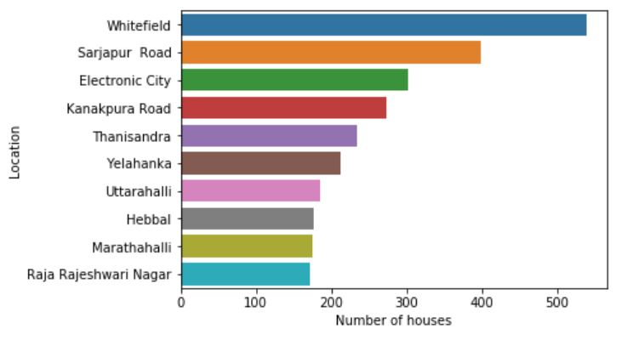
Location v/s number of houses
Data visualisation - histogram
This graph is a simple histogram which represents the number of houses in different localities. From the graph, we can see that Whitefield has the most number of houses. From this we can infer that Whitefield is a highly preferred area to reside in, as it has the most number of houses, followed by Sarjapur Road and Electronic City.
On the other hand, Raja Rajeshwari Nagar and Marathahalli do not have as many number of houses as compared to the other localities. Therefore, we can infer that people generally do not prefer to reside in such areas. The factors for making an area more popular to reside in are plenty. It includes accessibility to hospitals, schools, supermarkets and malls as well facilities such as water supply, electricity and many more.

Slide 19
Code
CODE
s={} #dictionary to store number of homes in each location
x=[] #top 10 locations
number=[]
for index, row in df['location'].iteritems():
l = df['location'].loc[index]
if(l not in s):
s[l] = 1
else:
s[l] += 1
def findmax(s):
max = 0
maxloc = ""
for i in s:
if(s[i] > max):
max = s[i]
maxloc = i
return maxloc,max
for i in range(0,10):
x.append(findmax(s)[0])
number.append(findmax(s)[1])
del(s[findmax(s)[0]])
plt.ylabel("Location")
plt.xlabel("Number of houses")
sns.barplot(number, x, orient='h')
plt.show()

Slide 20
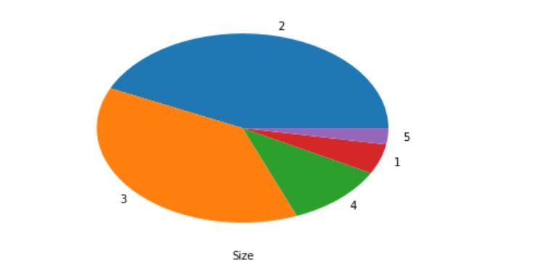
houses with varying size
Data visualisation - pie chart
The pie chart represents the number of houses of varying sizes. Size here is determined by the number of bedrooms.
From this graph we can see that there are more number of houses with 2 or 3 bedrooms and fewer number of houses with more 3 bedrooms or less than 2 bedrooms. From this, we can infer that people generally prefer smaller homes with either 2 or 3 bedrooms.

Slide 21
Code
CODE
df['size'].value_counts().nlargest(5).plot(kind="pie")
plt.xlabel("Size")
plt.ylabel("")

Slide 22
Hypothesis testing
Hypothesis testing
Null Hypothesis: H0: 80% or more of the houses which are ‘Ready To Move’ are 2/3 BHK. Alternate Hypothesis: H1: Less than 80% of the houses which are ‘Ready To Move’ are 2/3 BHK.
Conclusion: Fail to reject the Null Hypothesis (significant at 5%).

Slide 23
Conclusion
Conclusion
The purpose of this project was to make a thorough analysis of the dataset of the houses of Bangalore. We were able to identify trends in the dataset and were also able to visualise the dataset by making use of different graphs, each suited for different parameters.
With the analysis that we have made, it makes it easier to for a buyer to choose not only a house of his preference but also an area of his choice. By plotting graphs and charts, the data becomes more clear and readable and conclusions can be drawn and trends can be identified. The raw dataset that we have chosen has over 13,000 rows and therefore makes it impossible to infer anything from it.
From this project, we have learnt not only how to clean data and visualise it by using different kinds of graphs, but we have also learnt how to make conclusions from these graphs.

