Slide 1
Design and Analysis of Algorithms (CS345/CS345A) Jan-April 2014
Lecture 10
Huffman code : A data compression algorithm

Slide 2
A motivating example

Slide 3

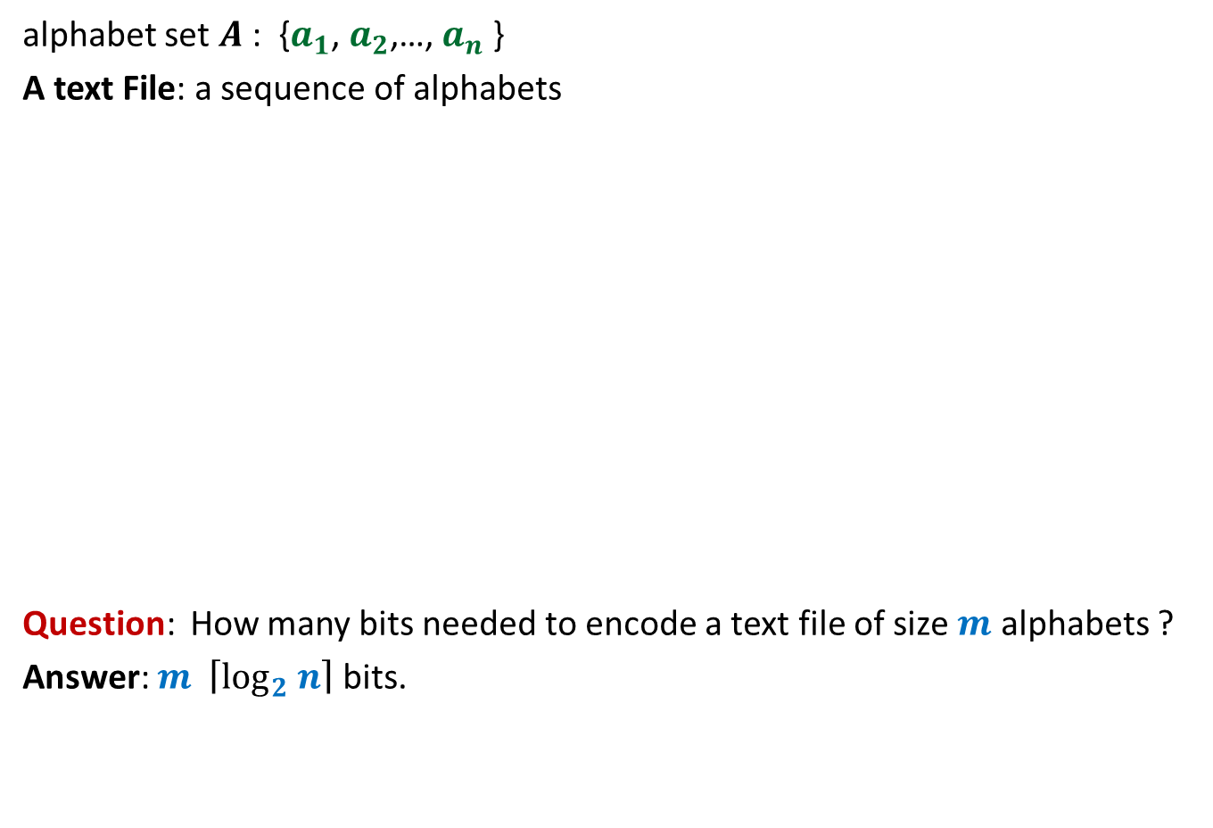
Binary coding
alphabet set $A$: {$a_{1}$, $a_{2}$,…, $a_{n}$ }
A text File: a sequence of alphabets
Question: How many bits needed to encode a text file of size $m$ alphabets ?
Answer: $m \left\lceil \log_{2} n\right\rceil$ bits.
once upon a time …………..
…………………………….
……………………………..
…………………
A text file F
Binary coding of F

Slide 4
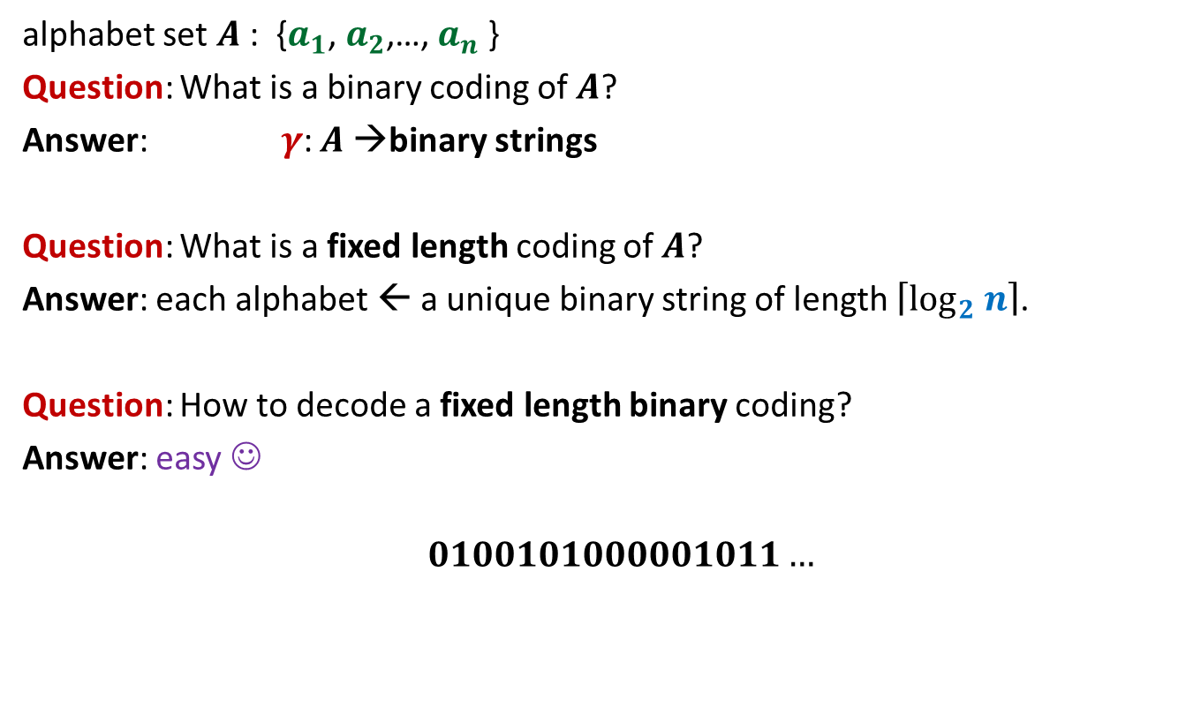
Fixed length coding
alphabet set $A$: {$a_{1}$, $a_{2}$,…, $a_{n}$ }
Question: What is a binary coding of $A$?
Answer: $γ$: $A$→binary strings
Question: What is a fixed length coding of $A$?
Answer: each alphabet ← a unique binary string of length $\left\lceil \log_{2} n\right\rceil$.
Question: How to decode a fixed length binary coding?
Answer: easy ☺
$$0100101000001011…$$

Slide 5

Fixed length coding
alphabet set $A$: {$a_{1}$, $a_{2}$,…, $a_{n}$ }
Question: Can we use fewer bits to store alphabet set $A$ ?
Answer: No.
Question: Can we use fewer bits to store a file ?
Answer: Yes

Slide 6
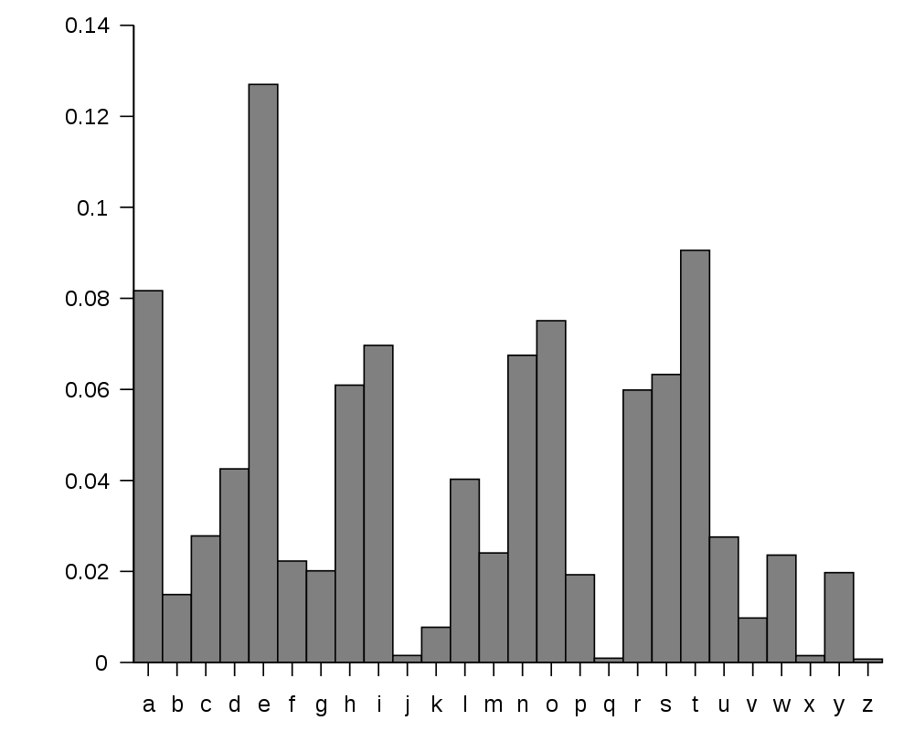
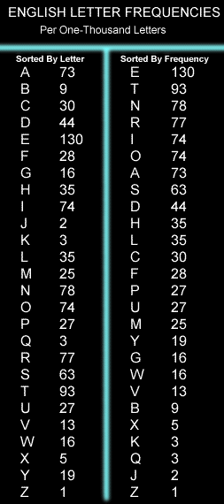
huge variation in the frequency of alphabets in a text.
http://en.wikipedia.org/wiki/Letter_frequency

Slide 7
huge variation in the frequency of alphabets in a text.
Question: How to exploit variation in the frequencies of alphabets ?
Answer:
More frequent alphabets ⬅ coding with shorter bit string
Less frequent alphabets ⬅ coding with longer bit string

Slide 8
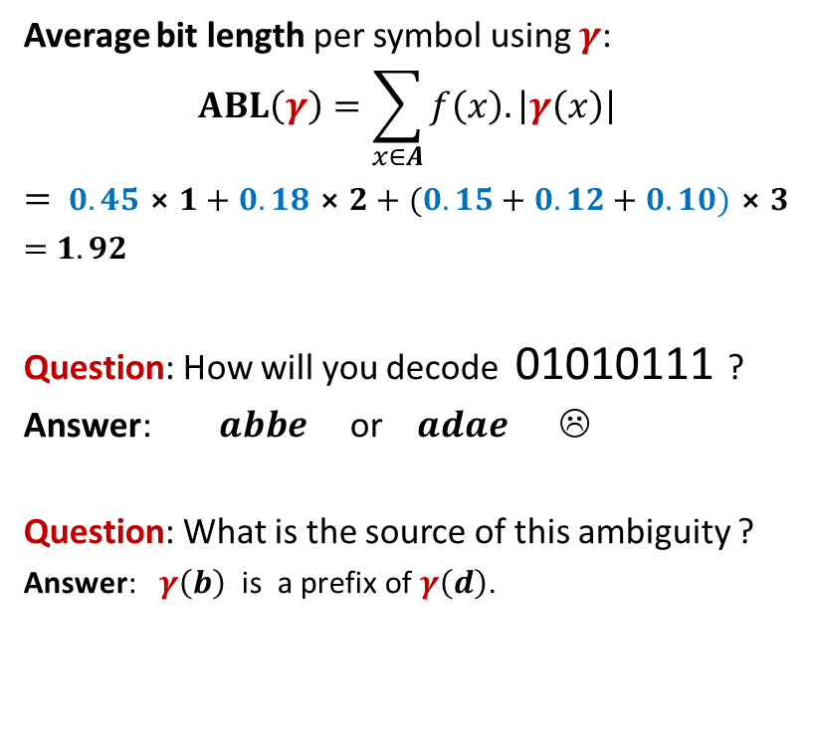
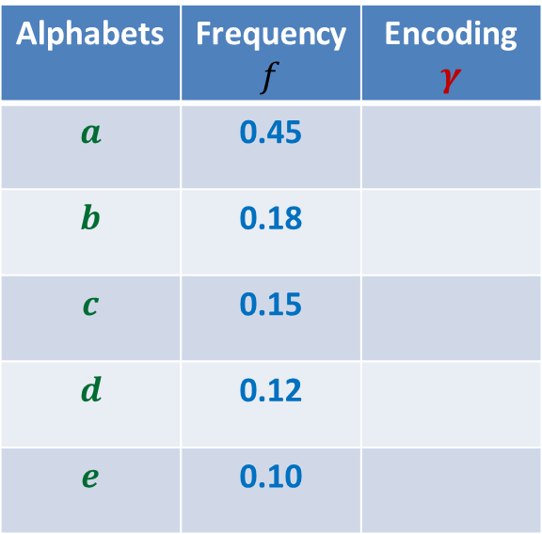

Variable length encoding
Average bit length per symbol using $γ$:
$$ABL\left(γ\right)=\sum_{x∈A}{f\left(x\right).\left|γ\left(x\right)\right|}$$
$=$ $0.45⨯1+0.18⨯2+(0.15+0.12+0.10)⨯3$
$=$ $1.92$
Question: How will you decode 01010111 ?
Answer: $abbe$ or $adae$ ☹
Question: What is the source of this ambiguity ?
Answer: $γ\left(b\right)$ is a prefix of $γ\left(d\right)$.
Alphabets | Frequency $f$ | Encoding $$γ$$
$$a$$ | 0.45
$$b$$ | 0.18
$$c$$ | 0.15
$$d$$ | 0.12
$$e$$ | 0.10
0
10
110
101
111
There is a serious problem with the $γ$encoding. Can you see?
Can we fix it ?

Slide 9

Variable length Coding
Average bit length per symbol using $γ$:
$$ABL\left(γ\right)=\sum_{x∈A}{f\left(x\right).\left|γ\left(x\right)\right|}$$
$=$ $0.45⨯1+0.18⨯3+(0.15+0.12+0.10)⨯3$
$=$ $2.1$
Alphabets | Frequency $f$ | Encoding $$γ$$
$$a$$ | 0.45
$$b$$ | 0.18
$$c$$ | 0.15
$$d$$ | 0.12
$$e$$ | 0.10
0
100
110
101
111

Slide 10
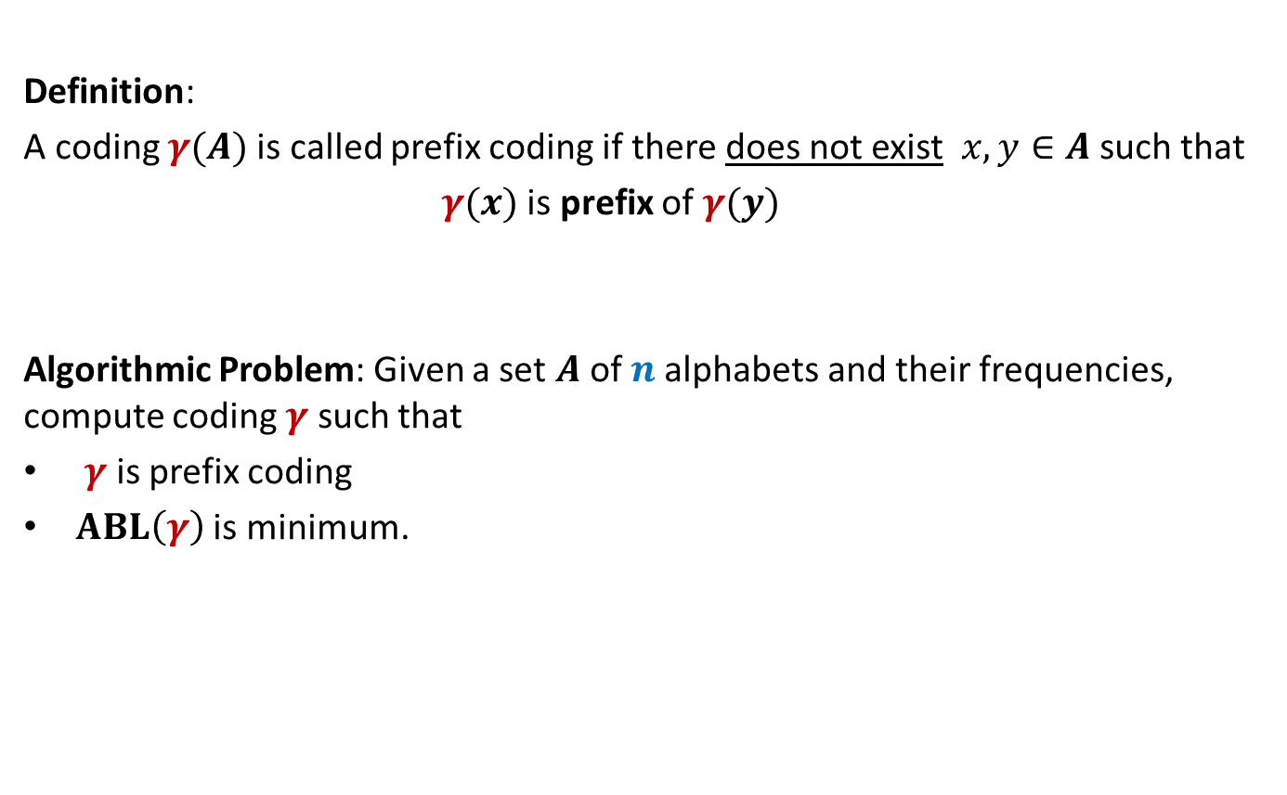
Prefix Coding
Definition:
A coding $γ(A)$is called prefix coding if there does not exist $x,y∈A$ such that
$γ(x)$ is prefix of $γ(y)$
Algorithmic Problem: Given a set $A$of $n$alphabets and their frequencies, compute coding $γ$ such that
$γ$ is prefix coding
$ABL\left(γ\right)$ is minimum.

Slide 11

The challenge of the problem
Among all possible binary coding of $A$, how to find the optimal prefix coding ?

Slide 12
The novel idea of Huffman
?
Binary coding
Binary tree

Slide 13
prefix codes and labeled Binary tree

Slide 14
A labeled binary tree
nodes → alphabets
Code of an alphabet = ?
0
1
0
1
1
0
0
1
0
1
0
1
0
1
leaf
Label of path from root

Slide 15
A labeled binary tree
nodes → alphabets
Code of an alphabet =
0
1
01,
001,
0000,
11,
100,
10110,
10111
0
1
1
0
0
1
0
1
0
1
0
1
leaf
Label of path from root

Slide 16

Variable length Coding
Question:
How to build the labeled tree for a prefix code ?
Alphabets | Frequency $f$ | Encoding $$γ$$
$$a$$ | 0.45
$$b$$ | 0.18
$$c$$ | 0.15
$$d$$ | 0.12
$$e$$ | 0.10
0
{0, 100, 101, 110, 111}
0
1
100
110
{00,01,10,11}
$$a$$
101
111

Slide 17
Variable length Coding
Question:
How to build the labeled tree for a prefix code ?
Alphabets | Frequency $f$ | Encoding $$γ$$
$$a$$ | 0.45
$$b$$ | 0.18
$$c$$ | 0.15
$$d$$ | 0.12
$$e$$ | 0.10
0
0
1
100
110
0
1
$$a$$
101
{0,1}
{0,1}
111

Slide 18




Variable length Coding
Question:
How to build the labeled tree for a prefix code ?
Alphabets | Frequency $f$ | Encoding $$γ$$
$$a$$ | 0.45
$$b$$ | 0.18
$$c$$ | 0.15
$$d$$ | 0.12
$$e$$ | 0.10
0
0
1
100
110
0
1
$$a$$
101
0
1
0
1
111
$$b$$
$$d$$
$$c$$
$$e$$

Slide 19
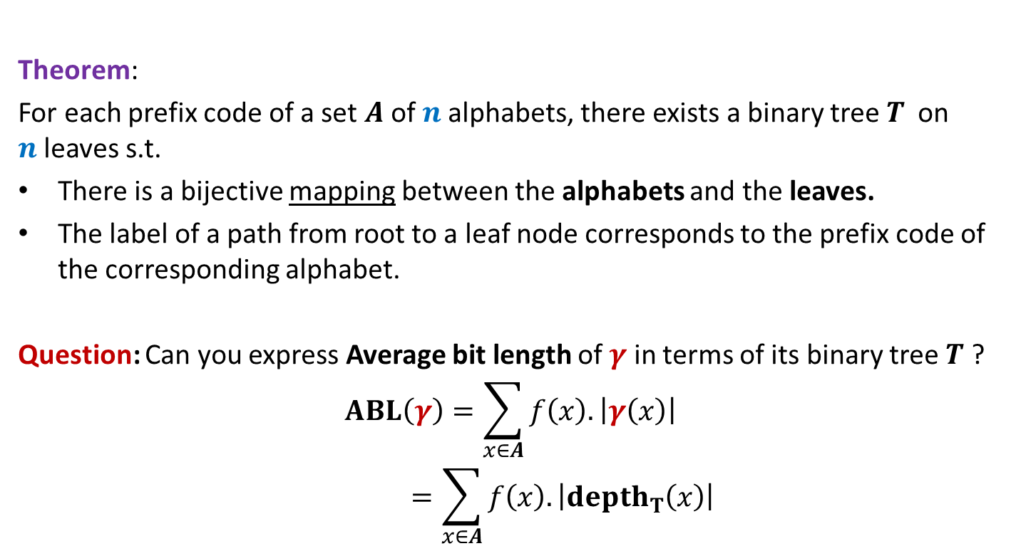
Theorem:
For each prefix code of a set $A$of $n$alphabets, there exists a binary tree$T$ on $n$leaves s.t.
There is a bijective mapping between the alphabets and the leaves.
The label of a path from root to a leaf node corresponds to the prefix code of the corresponding alphabet.
Question: Can you express Average bit length of $γ$ in terms of its binary tree $T$ ?
$$ABL\left(γ\right)=\sum_{x∈A}{f\left(x\right).\left|γ\left(x\right)\right|}$$
$$=\sum_{x∈A}{f\left(x\right).\left|depth_{T}\left(x\right)\right|}$$

Slide 20
Finding the labeled binary tree for the optimal prefix codes

Slide 21
Is the following prefix coding optimal ?
0
1
0
1
1
0
0
1
0
1
0
1
0
1

Slide 22
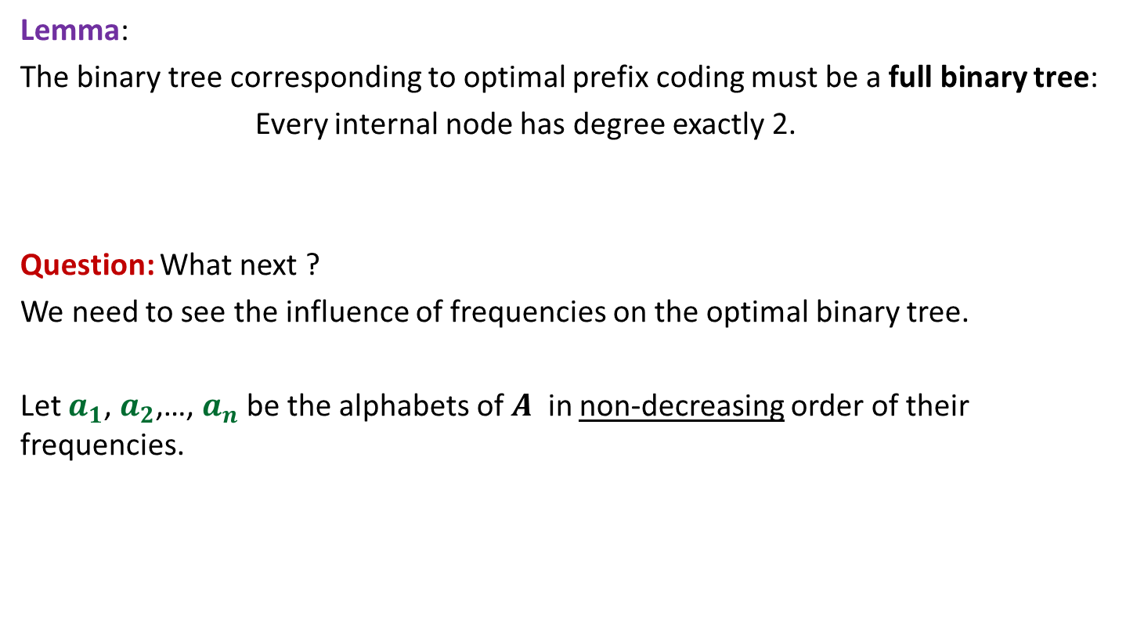
Observations on the binary tree of the optimal prefix code
Lemma:
The binary tree corresponding to optimal prefix coding must be a full binary tree:
Every internal node has degree exactly 2.
Question: What next ?
We need to see the influence of frequencies on the optimal binary tree.
Let $a_{1}$, $a_{2}$,…, $a_{n}$ be the alphabets of $A$ in non-decreasing order of their frequencies.

Slide 23
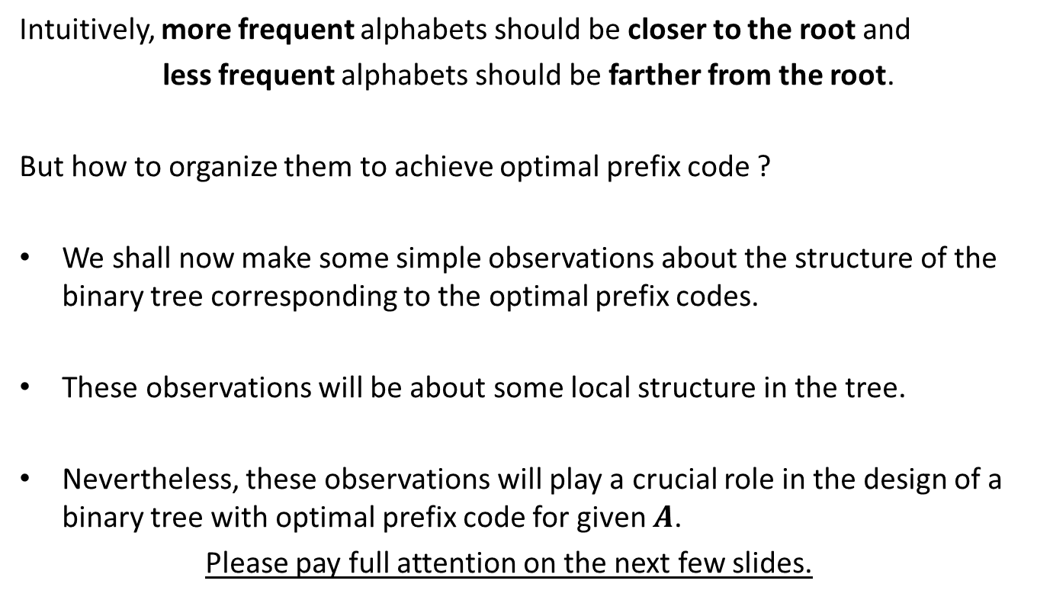
Observations on the binary tree of the optimal prefix code
Intuitively, more frequent alphabets should be closer to the root and
less frequent alphabets should be farther from the root.
But how to organize them to achieve optimal prefix code ?
We shall now make some simple observations about the structure of the binary tree corresponding to the optimal prefix codes.
These observations will be about some local structure in the tree.
Nevertheless, these observations will play a crucial role in the design of a binary tree with optimal prefix code for given $A$.
Please pay full attention on the next few slides.

Slide 24



Observations on the binary tree of the optimal prefix code
0
1
0
1
0
1
Can $a_{1}$be present at a higher level ? If not, how to prove it ?
. . .
0
1
0
$$a_{1}$$
Deepest level
$$a_{i}$$

Slide 25

Observations on the binary tree of the optimal prefix code
0
1
0
1
0
1
Swapping $a_{1}$ with $a_{i}$ can not increase ABL.
. . .
0
1
0
$$a_{1}$$
Deepest level
$$a_{i}$$

Slide 26
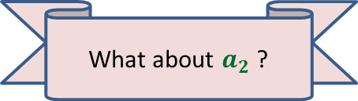

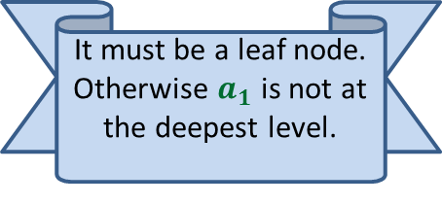


Observations on the binary tree of the optimal prefix code
0
1
Since the tree is full binary, $a_{1}$ must have a sibling. What can we say about it ?
0
1
0
1
It must be a leaf node. Otherwise $a_{1}$ is not at the deepest level.
. . .
What about $a_{2}$ ?
0
1
$$a_{2}$$
0
1
Deepest level
$$a_{1}$$
$$a_{i}$$

Slide 27

Observations on the binary tree of the optimal prefix code
0
1
0
1
0
1
. . .
1
0
1
Deepest level
$$a_{1}$$
$$a_{2}$$

Slide 28
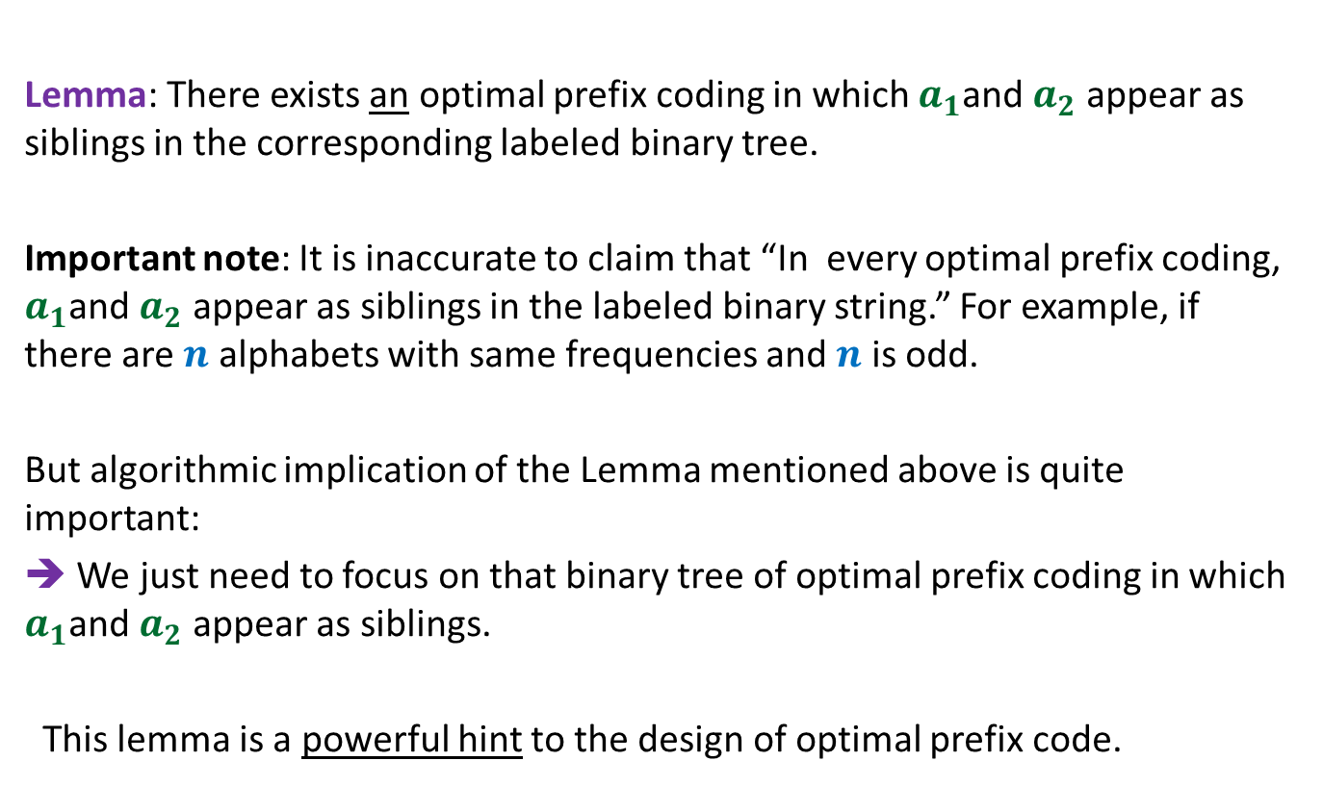
The important observation
Lemma: There exists an optimal prefix coding in which $a_{1}$and $a_{2}$ appear as siblings in the corresponding labeled binary tree.
Important note: It is inaccurate to claim that “In every optimal prefix coding, $a_{1}$and $a_{2}$ appear as siblings in the labeled binary string.” For example, if there are $n$ alphabets with same frequencies and $n$ is odd.
But algorithmic implication of the Lemma mentioned above is quite important:
➔ We just need to focus on that binary tree of optimal prefix coding in which $a_{1}$and $a_{2}$ appear as siblings.
This lemma is a powerful hint to the design of optimal prefix code.

Slide 29
Observations on the binary tree of the optimal prefix code
0
1
0
1
0
1
. . .
1
0
1
Deepest level
$$a_{1}$$
$$a_{2}$$

Slide 30

Observations on the binary tree of the optimal prefix code
0
1
This animation is a hint. Use it to design the algorithm. We shall discuss it in the next class
0
1
0
1
. . .
1
$a$’
Deepest level

