Slide 1
Design and Analysis of Algorithms (CS345/CS345A) Jan-April 2014
Lecture 11
Huffman code : A data compression algorithm (continued. From last lecture)

Slide 2
A Recapitulation of the last lecture

Slide 3
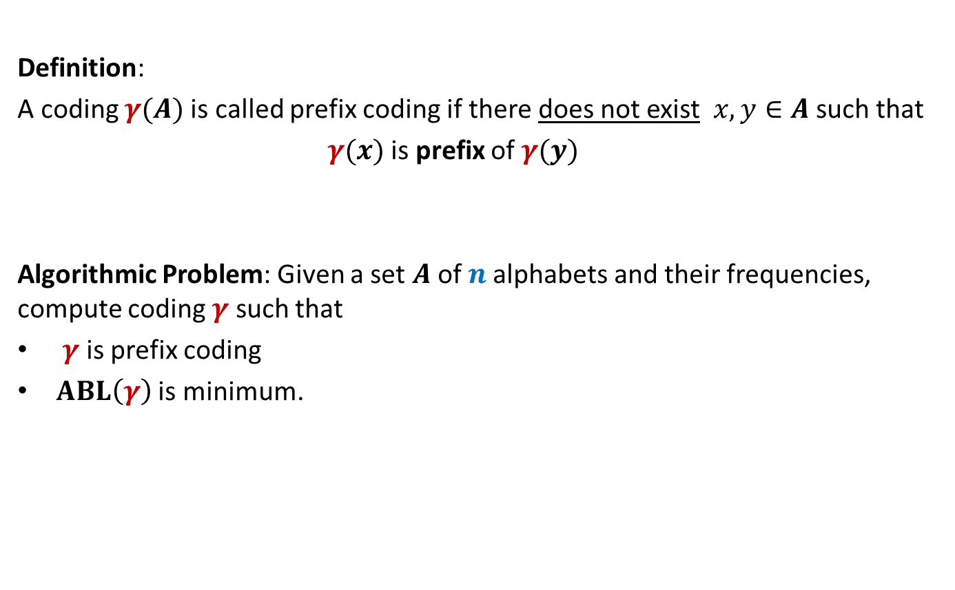
Prefix Coding
Definition:
A coding $γ(A)$is called prefix coding if there does not exist $x,y∈A$ such that
$γ(x)$ is prefix of $γ(y)$
Algorithmic Problem: Given a set $A$of $n$alphabets and their frequencies, compute coding $γ$ such that
$γ$ is prefix coding
$ABL\left(γ\right)$ is minimum.

Slide 4

The novel idea of Huffman
?
Binary coding
Binary tree

Slide 5
A labeled binary tree
nodes → alphabets
Code of an alphabet =
0
1
01,
001,
0000,
11,
100,
10110,
10111
0
1
1
0
0
1
0
1
0
1
0
1
leaf
Label of path from root

Slide 6






Variable length Coding
Question:
How to build the labeled tree for a prefix code ?
Alphabets | Frequency $f$ | Encoding $$γ$$
$$a$$ | 0.45
$$b$$ | 0.18
$$c$$ | 0.15
$$d$$ | 0.12
$$e$$ | 0.10
0
0
1
100
110
0
1
$$a$$
101
0
1
0
1
111
$$b$$
$$d$$
$$c$$
$$e$$

Slide 7
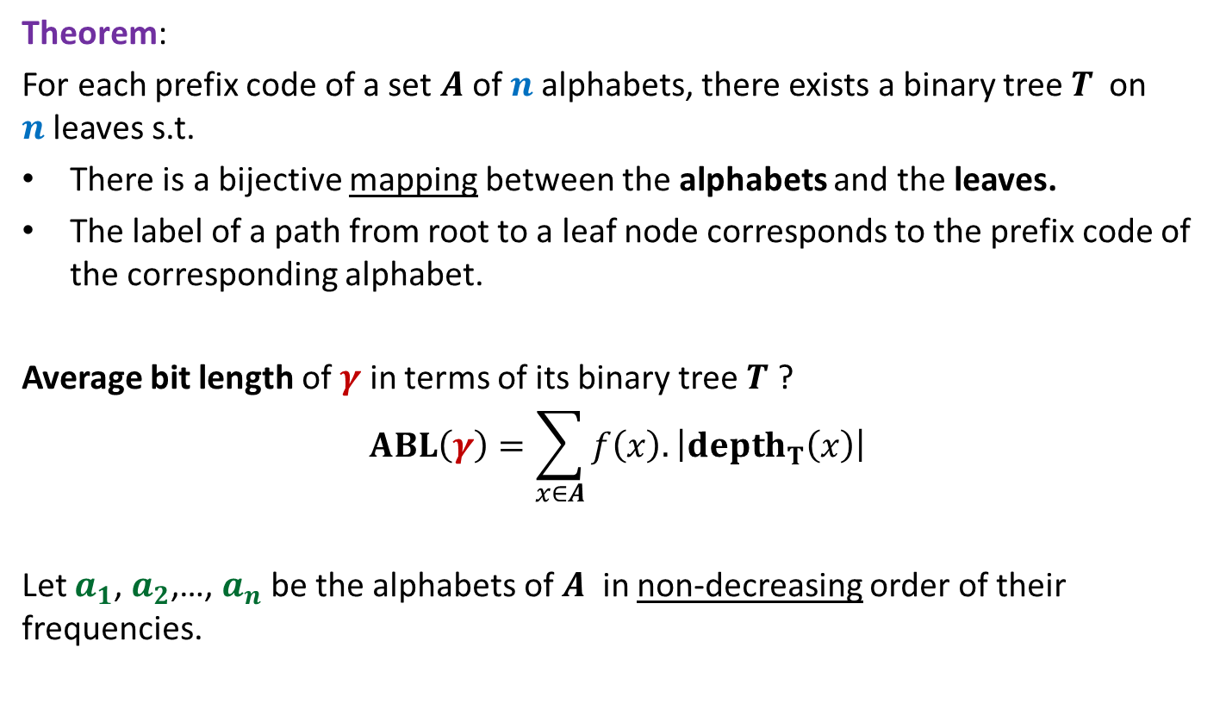
Theorem:
For each prefix code of a set $A$of $n$alphabets, there exists a binary tree$T$ on $n$leaves s.t.
There is a bijective mapping between the alphabets and the leaves.
The label of a path from root to a leaf node corresponds to the prefix code of the corresponding alphabet.
Average bit length of $γ$ in terms of its binary tree $T$ ?
$$ABL\left(γ\right)=\sum_{x∈A}{f\left(x\right).\left|depth_{T}\left(x\right)\right|}$$
Let $a_{1}$, $a_{2}$,…, $a_{n}$ be the alphabets of $A$ in non-decreasing order of their frequencies.

Slide 8

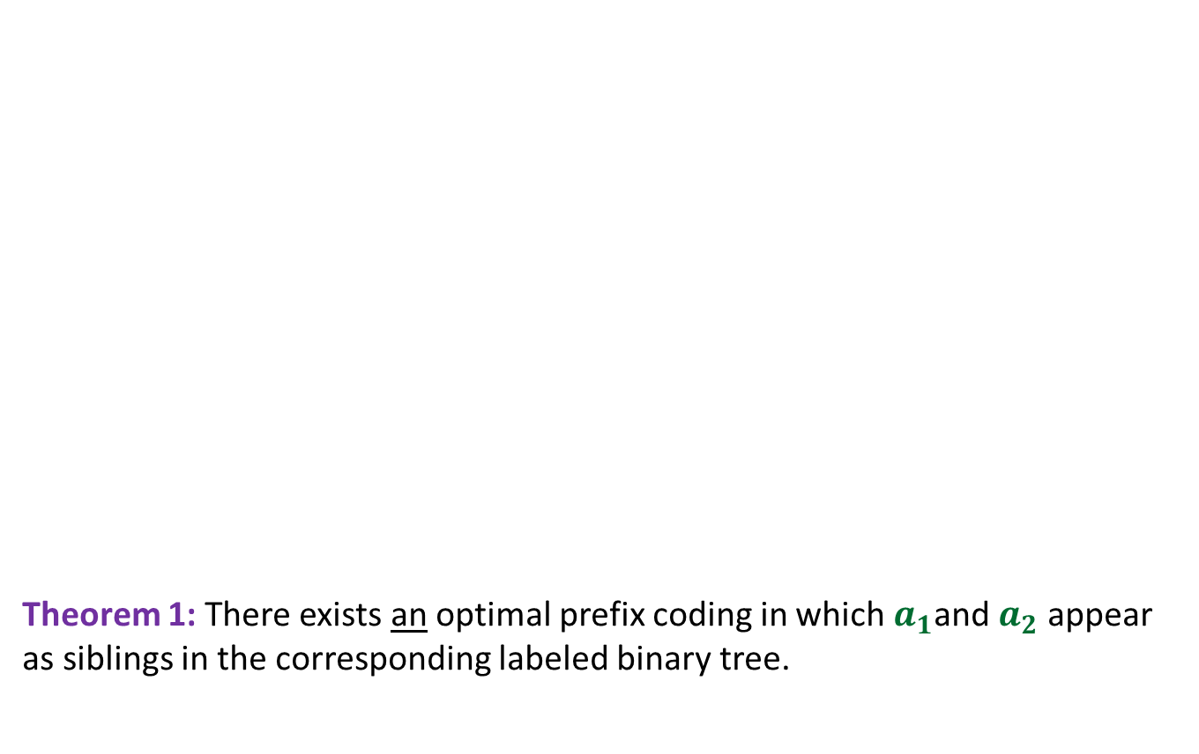

Observations on the binary tree of the optimal prefix code
0
1
Theorem 1: There exists an optimal prefix coding in which $a_{1}$and $a_{2}$ appear as siblings in the corresponding labeled binary tree.
0
1
0
1
. . .
1
0
1
Deepest level
$$a_{1}$$
$$a_{2}$$

Slide 9

Observations on the binary tree of the optimal prefix code
0
1
0
1
0
1
. . .
1
Deepest level
$a$’

Slide 10

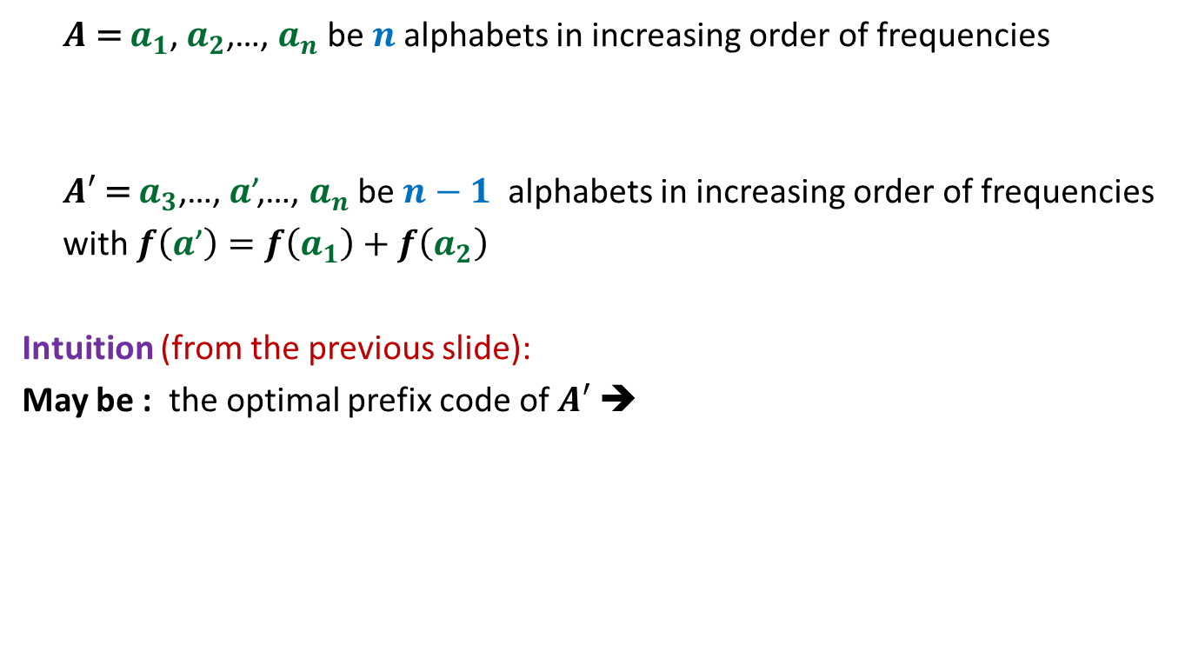
$A$ = $a_{1}$, $a_{2}$,…, $a_{n}$ be $n$alphabets in increasing order of frequencies
$A′$ = $a_{3}$,…, $a$’,…, $a_{n}$ be $n−1$ alphabets in increasing order of frequencies
with $f\left(a\text{’}\right)=$ $f\left(a_{1}\right)+f\left(a_{2}\right)$
Intuition (from the previous slide):
May be : the optimal prefix code of $A′$ ➔
optimal prefix code of $A$

Slide 11
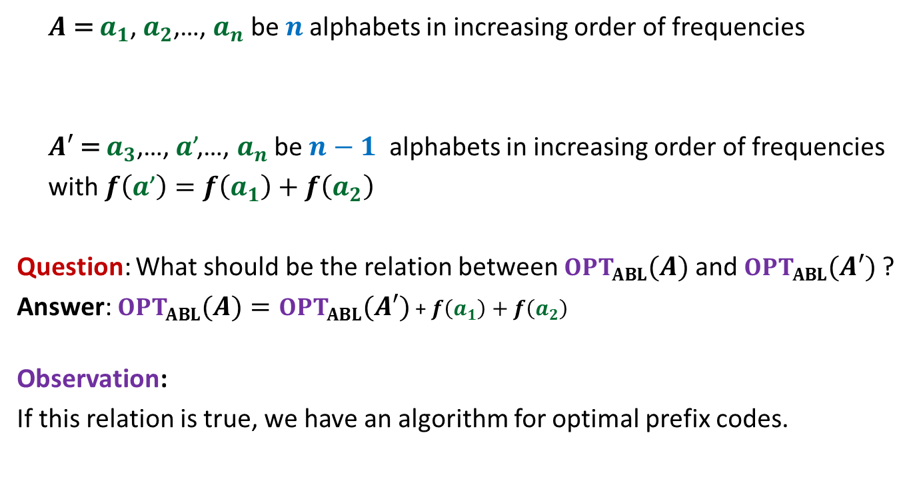
$A$ = $a_{1}$, $a_{2}$,…, $a_{n}$ be $n$alphabets in increasing order of frequencies
$A′$ = $a_{3}$,…, $a$’,…, $a_{n}$ be $n−1$ alphabets in increasing order of frequencies
with $f\left(a\text{’}\right)=$ $f\left(a_{1}\right)+f\left(a_{2}\right)$
Question: What should be the relation between $OPT_{ABL}(A)$ and $OPT_{ABL}(A′)$ ?
Answer: $OPT_{ABL}\left(A\right)=OPT_{ABL}(A′)$ + $f\left(a_{1}\right)+f\left(a_{2}\right)$
Observation:
If this relation is true, we have an algorithm for optimal prefix codes.

Slide 12
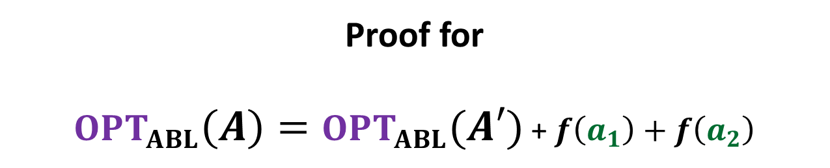
Proof for $OPT_{ABL}\left(A\right)=OPT_{ABL}(A′)$ + $f\left(a_{1}\right)+f\left(a_{2}\right)$

Slide 13

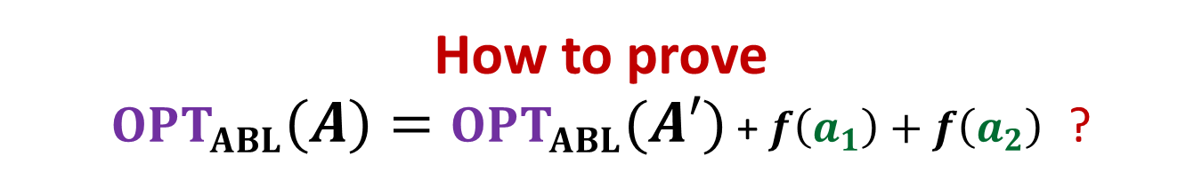
How to prove $OPT_{ABL}\left(A\right)=OPT_{ABL}(A′)$ + $f\left(a_{1}\right)+f\left(a_{2}\right)$ ?
Question: Can we derive a prefix coding for $A$from $OPT(A′)$ ?
Question: Can we derive a prefix coding for $A′$from $OPT(A)$ ?

Slide 14




A prefix coding for $A$from $OPT\left(A^{′}\right)$
$T′$: the binary tree corresponding to $OPT_{ABL}(A′)$
0
1
0
1
0
1
$$T′$$
. . .
1
$a$’

Slide 15






A prefix coding for $A$from $OPT(A′)$
$T′$: the binary tree corresponding to $OPT_{ABL}(A′)$
This gives a prefix coding for $A$ with $ABL$ = ??
➔ $OPT_{ABL}\left(A\right)≤OPT_{ABL}(A′)$ + $f\left(a_{1}\right)+f\left(a_{2}\right)$
0
1
0
1
0
1
$$T′$$
. . .
1
0
1
$a$’
$$a_{1}$$
$$a_{2}$$
$OPT_{ABL}(A′)$ + $f\left(a_{1}\right)+f\left(a_{2}\right)$

Slide 16





A prefix coding for $A′$from $OPT(A)$
$T$: the binary tree corresponding to $OPT_{ABL}(A)$
0
1
Using Theorem 1
0
1
0
1
$$T$$
. . .
1
0
1
Deepest level
$$a_{1}$$
$$a_{2}$$

Slide 17

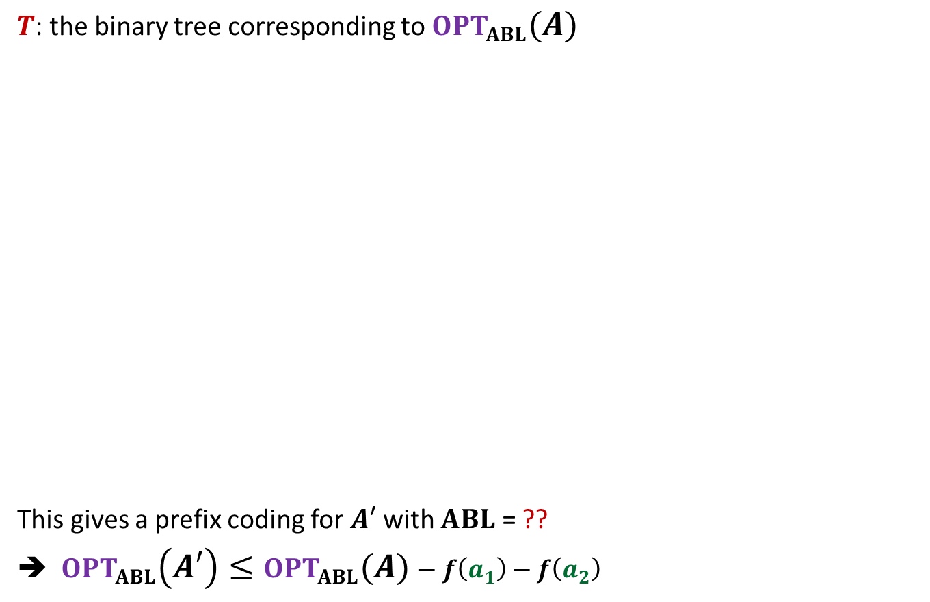

A prefix coding for $A′$from $OPT(A)$
$T$: the binary tree corresponding to $OPT_{ABL}(A)$
This gives a prefix coding for $A′$ with $ABL$ = ??
➔ $OPT_{ABL}\left(A′\right)≤OPT_{ABL}(A)−f\left(a_{1}\right)−f\left(a_{2}\right)$
0
1
Using Theorem 1
0
1
0
1
$$T$$
. . .
1
0
1
$a$’
Deepest level
$$a_{1}$$
$$a_{2}$$
$$OPT_{ABL}\left(A\right)−f\left(a_{1}\right)−f\left(a_{2}\right)$$

Slide 18
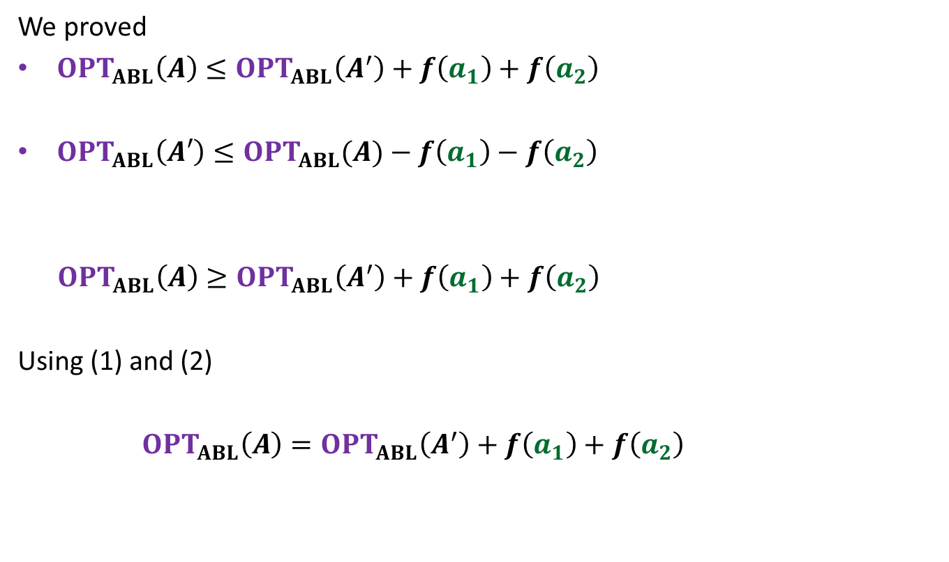
We proved
$OPT_{ABL}\left(A\right)≤OPT_{ABL}\left(A^{′}\right)+f\left(a_{1}\right)+f\left(a_{2}\right)$
$OPT_{ABL}\left(A′\right)≤OPT_{ABL}(A)−f\left(a_{1}\right)−f\left(a_{2}\right)$
$OPT_{ABL}\left(A\right)≥OPT_{ABL}\left(A^{′}\right)+f\left(a_{1}\right)+f\left(a_{2}\right)$
Using (1) and (2)
$OPT_{ABL}\left(A\right)=OPT_{ABL}\left(A^{′}\right)+f\left(a_{1}\right)+f\left(a_{2}\right)$
(1)
(2)

Slide 19

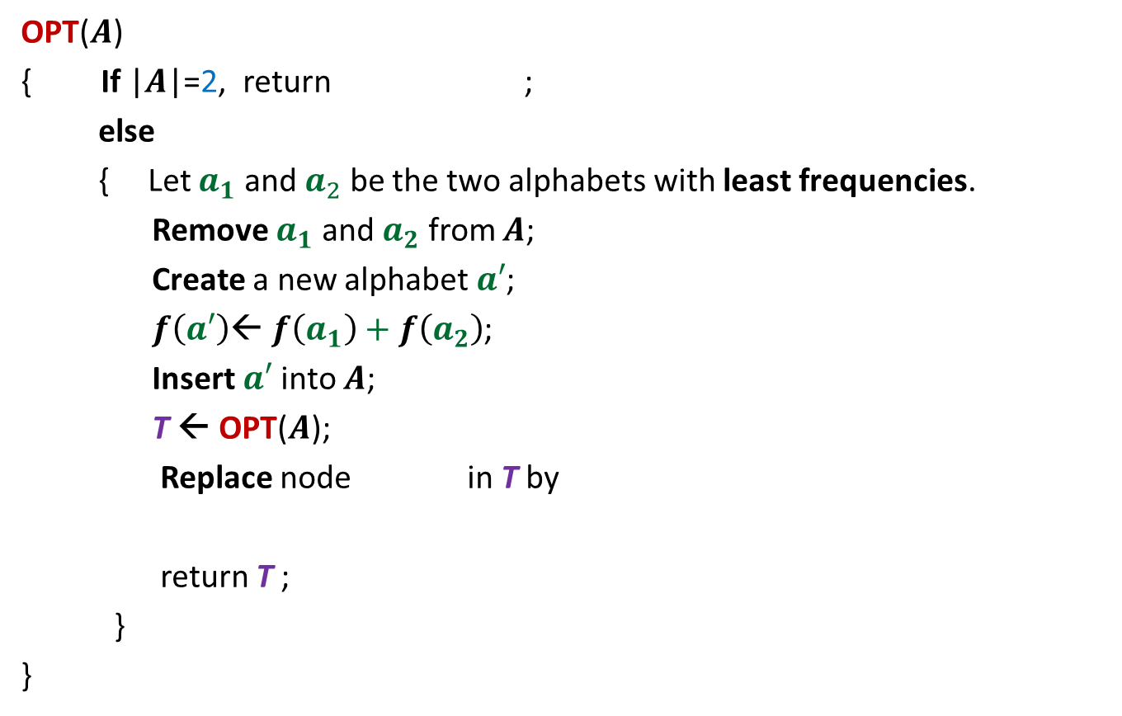




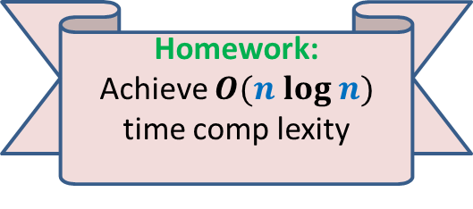


The algorithm based on $OPT_{ABL}\left(A\right)=OPT_{ABL}(A′)$ + $f\left(a_{1}\right)+f\left(a_{2}\right)$
OPT($A$)
{ If |$A$|=2, return ;
else
{ Let $a_{1}$ and $a_{2}$ be the two alphabets with least frequencies.
Remove $a_{1}$ and $a_{2}$ from $A$;
Create a new alphabet $a′$;
$f\left(a′\right)$← $f\left(a_{1}\right)+f\left(a_{2}\right)$;
Insert $a′$into $A$;
T ← OPT($A$);
Replace node in T by
return T ;
}
}
0
1
$$a_{1}$$
$$a_{2}$$
$O(n^{2})$ time complexity
Homework:
Achieve $O(n log n)$ time comp lexity
0
1
$a$’
$$a_{1}$$
$$a_{2}$$

Slide 20
The last 3 problems we discussed
Synchronizing the delays in a circuit (complete binary tree)
Scheduling jobs to minimize maximum lateness
Huffman codes: data compression algorithm using variation in freq.
These first 2 algorithms had adhoc algorithm and adhoc proof of correctness.
But actually they lie under the same algorithm paradigm : greedy strategy.
In fact their algorithms and proof of correctness can be viewed as similar to that of Huffman codes.

Slide 21
An important tool we discovered today

Slide 22

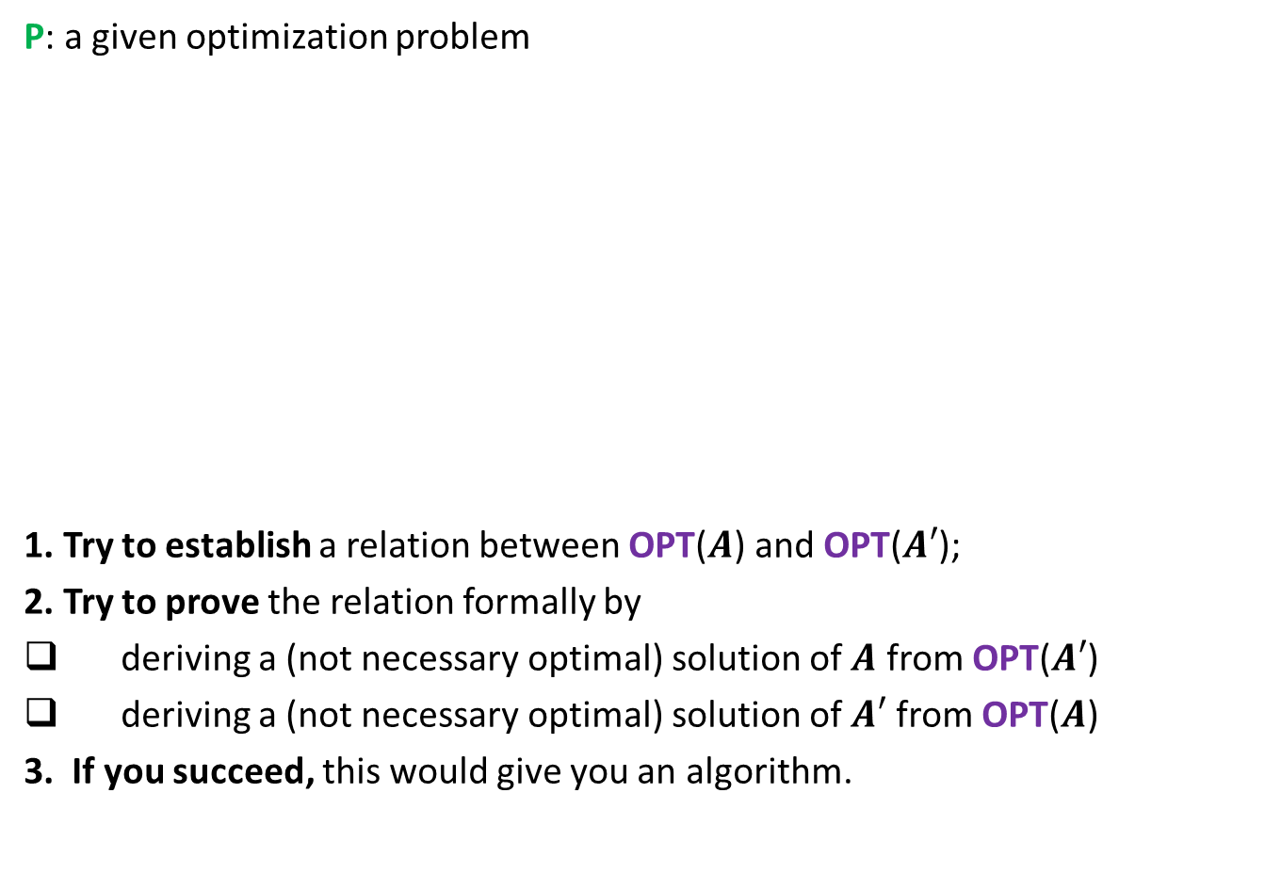



To prove that a greedy strategy works
P: a given optimization problem
1. Try to establish a relation between OPT($A$) and OPT($A′$);
2. Try to prove the relation formally by
deriving a (not necessary optimal) solution of $A$ from OPT($A′$)
deriving a (not necessary optimal) solution of $A′$ from OPT($A$)
3. If you succeed, this would give you an algorithm.
$$A$$
instance of size $n$of problem P
Greedy
step
$$A′$$
instance of size $<n$of problem P

Slide 23
Example 1 Synchronization of circuit with min delay enhancment

Slide 24

An Electric Circuit: instance $A$
Electric signal
6
5
3
2
4
2
2
1
6
2
1
2
3
2
Delay 11 10 14 10 10 11 10 9

Slide 25
An Electric Circuit: instance $A$
Electric signal
Theorem2: There exists an optimal solution in which
No delay enhancement on (u,v)
Delay enhancement on (u,w) = 1
6
5
3
2
4
2
u
2
1
6
2
1
2
3
2
v
w
Delay 11 10 14 10 10 11 10 9

Slide 26


An Electric Circuit: instance $A′$
Electric signal
Question: What might be the relation between OPT($A$) and OPT($A′$) ?
Answer: OPT($A$) = OPT($A′$) + 1
6
5
3
4
5
2
2
U
u
2
1
6
2
1
2
3
2
v
w
Delay 11 10 14 10 10 11 10 9

Slide 27
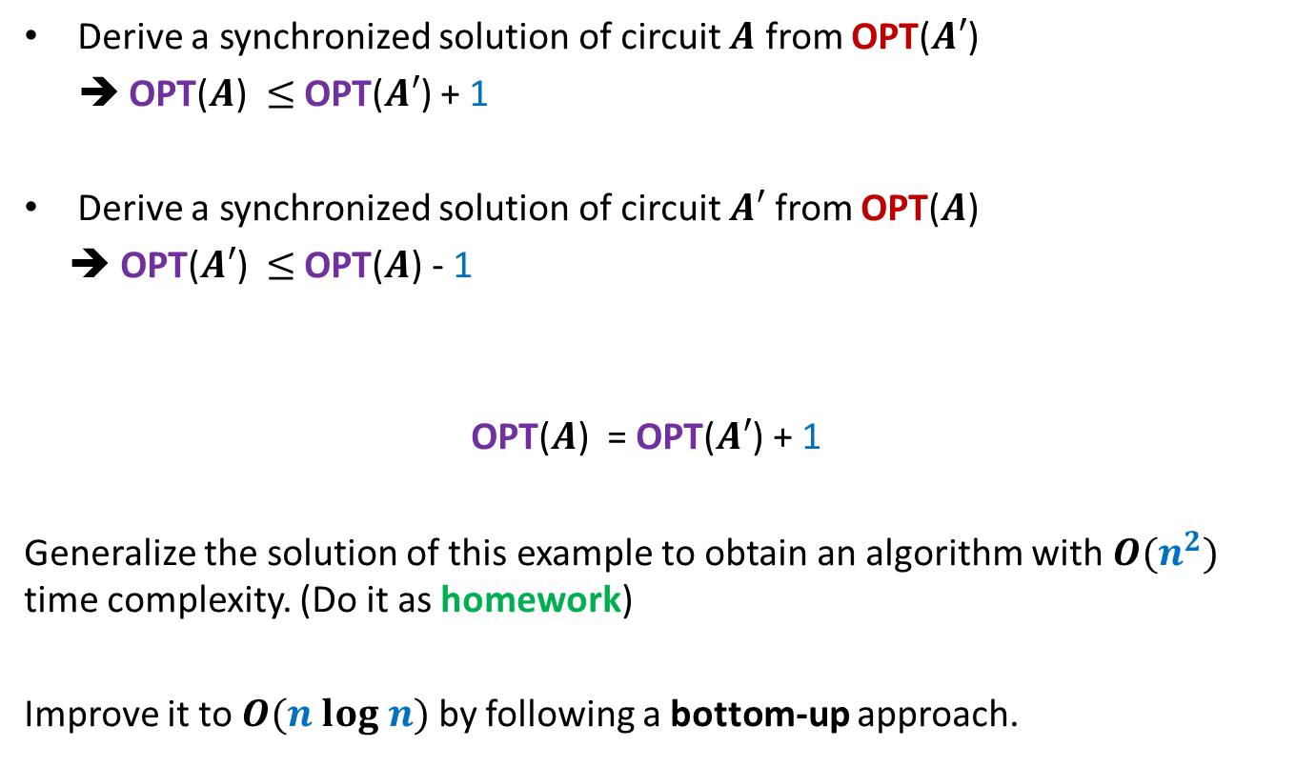

Proof of OPT($A$) = OPT($A′$) + 1
Derive a synchronized solution of circuit $A$ from OPT($A′$)
➔ OPT($A$) $≤$ OPT($A′$) + 1
Derive a synchronized solution of circuit $A′$ from OPT($A$)
➔ OPT($A′$) $≤$ OPT($A$) - 1
OPT($A$) = OPT($A′$) + 1
Generalize the solution of this example to obtain an algorithm with $O(n^{2})$ time complexity. (Do it as homework)
Improve it to $O(n log n)$ by following a bottom-up approach.
Using
Theorem 2

Slide 28
Example 2 Minimum spanning tree

Slide 29

instance $A$
170
54
33
63
35
50
70
31
41
81
64
78
53
42
52
80
49
54
42
60
44
43
50
30
49
57
29
102

Slide 30
instance $A$
Theorem 3: There is a MST with edge (u,v)
170
54
33
63
35
50
70
31
41
81
64
78
53
42
52
80
49
54
42
60
44
43
50
30
49
57
u
29
102
v

Slide 31

instance $A′$
170
54
33
63
35
50
70
31
41
81
64
78
53
42
52
80
49
54
42
44
60
43
50
30
49
57
w
102
This is graph $G′$

Slide 32
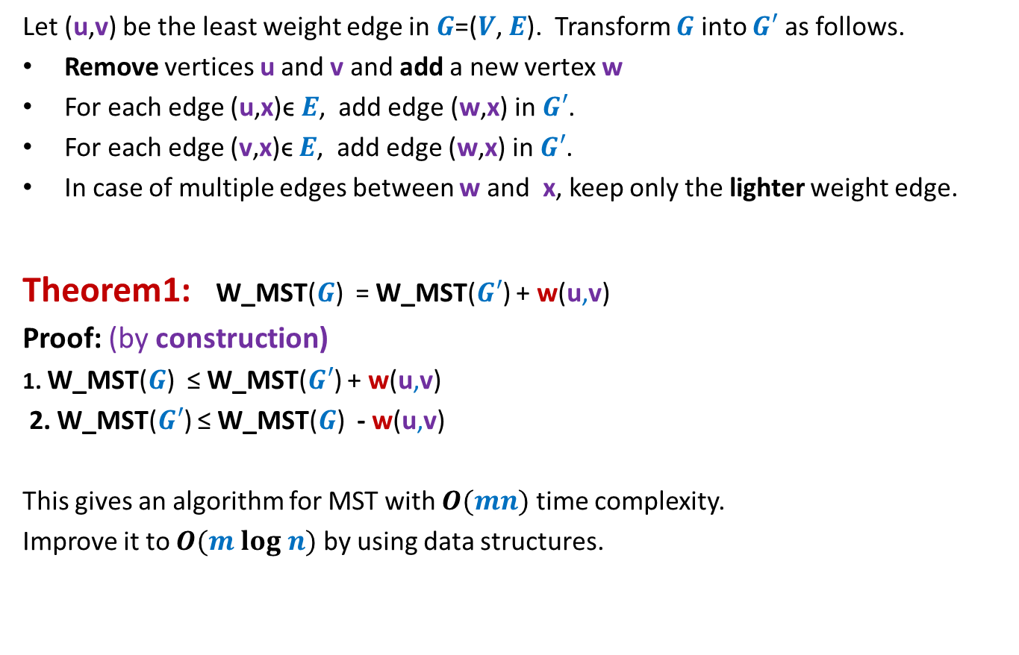

How to compute instance $A′$
Let (u,v) be the least weight edge in $G$=($V$, $E$). Transform $G$ into $G′$ as follows.
Remove vertices u and v and add a new vertex w
For each edge (u,x)ϵ $E$, add edge (w,x) in $G′$.
For each edge (v,x)ϵ $E$, add edge (w,x) in $G′$.
In case of multiple edges between w and x, keep only the lighter weight edge.
Theorem1: W_MST($G$) = W_MST($G′$) + w(u,v)
Proof: (by construction)
1. W_MST($G$) ≤ W_MST($G′$) + w(u,v)
2. W_MST($G′$) ≤ W_MST($G$) - w(u,v)
This gives an algorithm for MST with $O(mn)$ time complexity.
Improve it to $O(m log n)$ by using data structures.
straightforward
Use Theorem

Slide 33
Homework:
Give an alternate algorithm and its proof for
the job scheduling to achieve minimum lateness

