Slide 1
Design and Analysis of Algorithms (CS345/CS345A) Jan-April 2014
Lecture 13
Algorithms for Directed Acyclic Graphs

Slide 2
Directed Acyclic GRaphs

Slide 3






Directed Acyclic Graphs
Question: what is a cycle in $G$?
Answer: A sequence $v_{1}$, $v_{2}$,…, $v_{k}$ such that ($v_{i}$,$v_{i+1}$) $∈E$ for all $1≤i<k$
and ($v_{k}$,$v_{1}$) $∈E$ .
Definition: A directed graph $G=(V,E)$ is said to be acyclic if there is no cycle present in it.
DAG: Directed acyclic graph.
…
$$v_{1}$$
$$v_{2}$$
$$v_{3}$$
$$v_{k−1}$$
$$v_{k}$$

Slide 4
Directed Acyclic Graphs
Example:
u
z
b
v
y
x
w
a

Slide 5


Topological ordering
vertices of a DAG can be arranged along a line so that
every edge goes from left to right.
Theorem: There exists a mapping $τ$ : $V$→[$1…n$] such that
for each edge $\left(u,v\right)∈E$
$τ$($u$) < $τ$($v$)
1 2 3 4 5 6 7 8 9 10 11

Slide 6
Topological ordering
Example:
This is indeed a valid topological ordering.
u
z
b
v
y
x
w
a
u
v
a
b
x
z
w
y
1 2 3 4 5 6 7 8

Slide 7
Topological ordering
Three questions
Question 1: Why should a topological ordering exist for every DAG ?
Question 2: How efficiently can we compute a topological ordering ?
Question 3: What is the use of topological ordering ?

Slide 8
applications of Topological ordering
Question 3

Slide 9
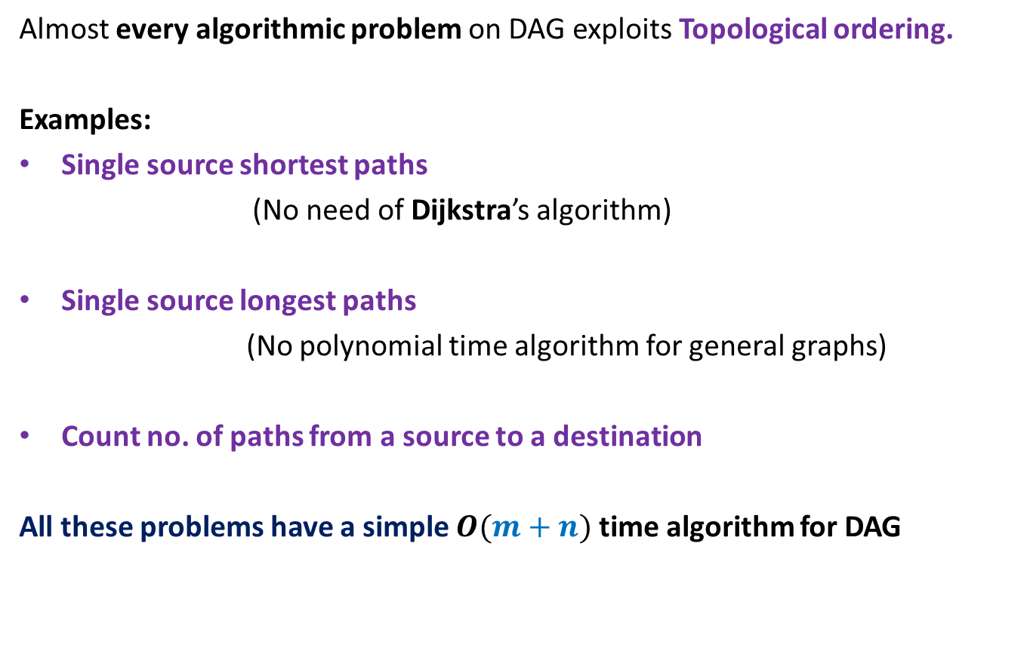
Applications of Topological ordering
Almost every algorithmic problem on DAG exploits Topological ordering.
Examples:
Single source shortest paths
(No need of Dijkstra’s algorithm)
Single source longest paths
(No polynomial time algorithm for general graphs)
Count no. of paths from a source to a destination
All these problems have a simple $O(m+n)$ time algorithm for DAG

Slide 10
Why should Topological ordering exist ?
Question 1

Slide 11
Why should Topological ordering exist ?
Example:
Question: Is there any vertex for which you can be sure of its place in the ordering?
u
z
b
v
y
x
w
a
u
v
a
b
x
z
w
y
1 2 3 4 5 6 7 8

Slide 12
Why should Topological ordering exist ?
Lemma 1: Every DAG has at least one vertex with in-degree = 0.
Proof:
(an algorithmic proof)
Pick any vertex $v$.
While in-degree$(v)$ $≠$ 0 do
{ Let $(u,v)$ be an edge
$v$← $u$;
}
return $v$;
…
c
b
y
x
c
a
cycle

Slide 13

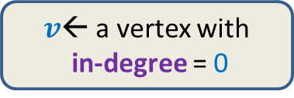
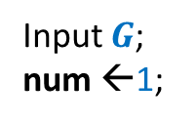
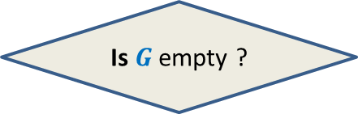

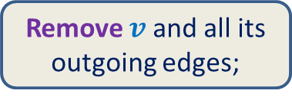
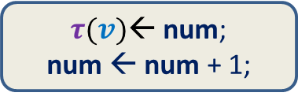
Why should Topological ordering exist ?
Lemma 1: Every DAG has at least one vertex with in-degree = 0.
Input $G$;
num ←1;
$v$← a vertex with
in-degree = 0
$τ(v)$← num;
num ← num + 1;
How to use Lemma 1 to show existence of a valid $τ$ ?
Remove $v$ and all its outgoing edges;
Yes
NO
Is $G$ empty ?
A valid $τ$

Slide 14
Why should Topological ordering exist ?
Example:
u
z
b
v
y
x
w
a

Slide 15

Why should Topological ordering exist ?
Example:
Time complexity of the algorithm: $O(n^{2})$
u
z
b
v
y
x
w
a
u
v
a
b
x
z
w
y
1
2
3
4
5
6
7
8

Slide 16

How efficiently can we compute Topological ordering ?
$O(m+n)$ time

Slide 17
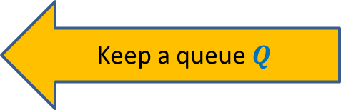
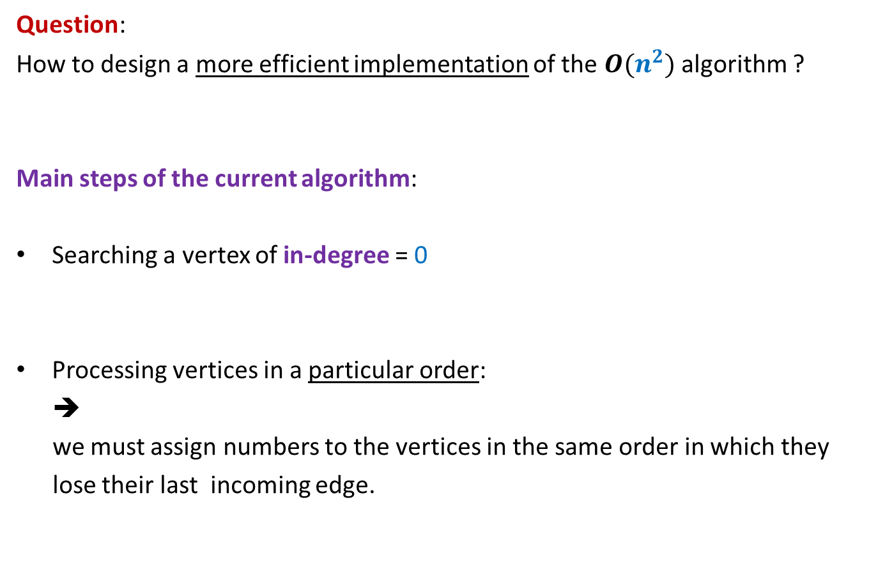
Algorithm for Topological ordering ?
Question:
How to design a more efficient implementation of the $O(n^{2})$ algorithm ?
Main steps of the current algorithm:
Searching a vertex of in-degree = 0
Processing vertices in a particular order:
➔
we must assign numbers to the vertices in the same order in which they
lose their last incoming edge.
Keep an array In-degree[]
Keep a queue $Q$

Slide 18

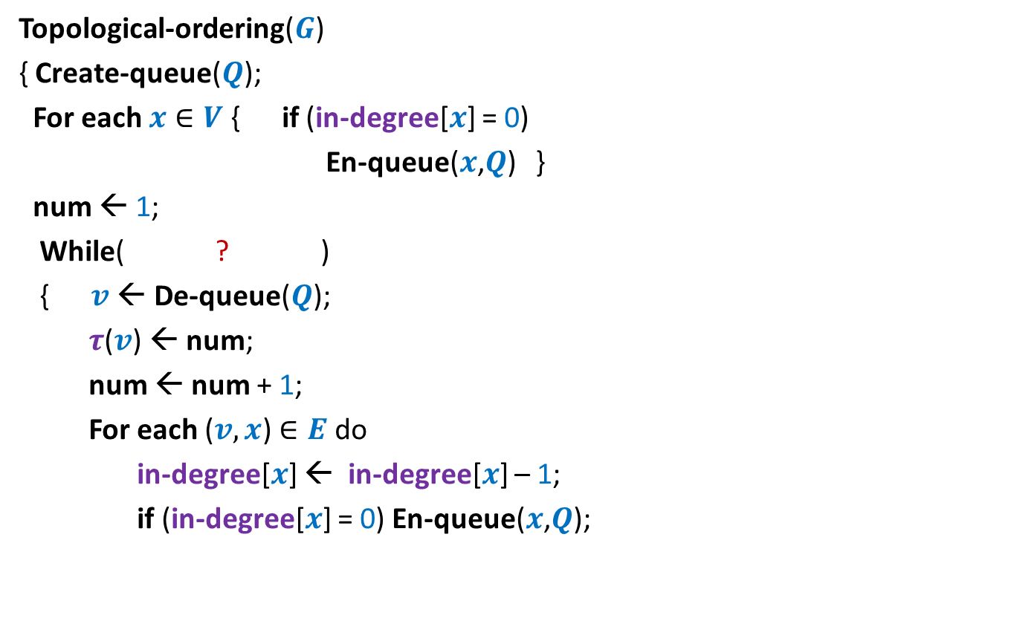


Algorithm for Topological ordering ?
Topological-ordering($G$)
{ Create-queue($Q$);
For each $x∈V$ { if (in-degree[$x$] = 0)
En-queue($x$,$Q$) }
num ← 1;
While( ? )
{ $v$← De-queue($Q$);
$τ$($v$) ← num;
num ← num + 1;
For each ($v,x$) $∈E$ do
in-degree[$x$] ← in-degree[$x$] – 1;
if (in-degree[$x$] = 0) En-queue($x$,$Q$);
not-empty($Q$)
O($deg(v)$) time
{
}
} return $τ$ ;

Slide 19
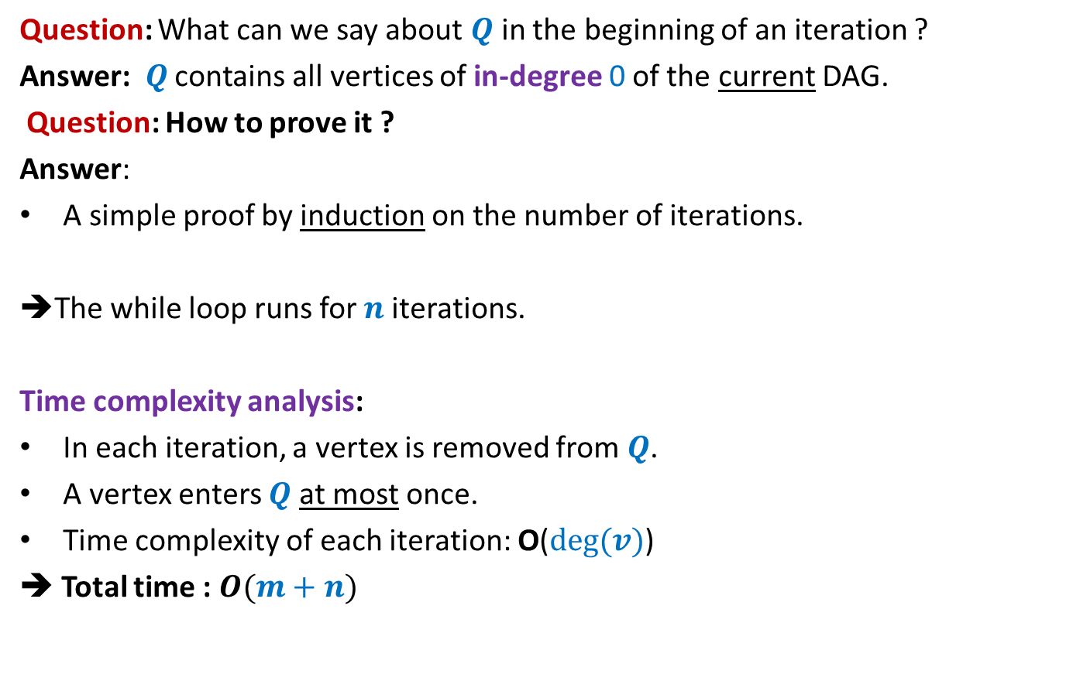
Algorithm for Topological ordering ?
Question: What can we say about $Q$in the beginning of an iteration ?
Answer: $Q$ contains all vertices of in-degree 0 of the current DAG.
Question: How to prove it ?
Answer:
A simple proof by induction on the number of iterations.
➔The while loop runs for $n$iterations.
Time complexity analysis:
In each iteration, a vertex is removed from $Q$.
A vertex enters $Q$at most once.
Time complexity of each iteration: O($deg(v)$)
➔ Total time : $O(m+n)$

Slide 20
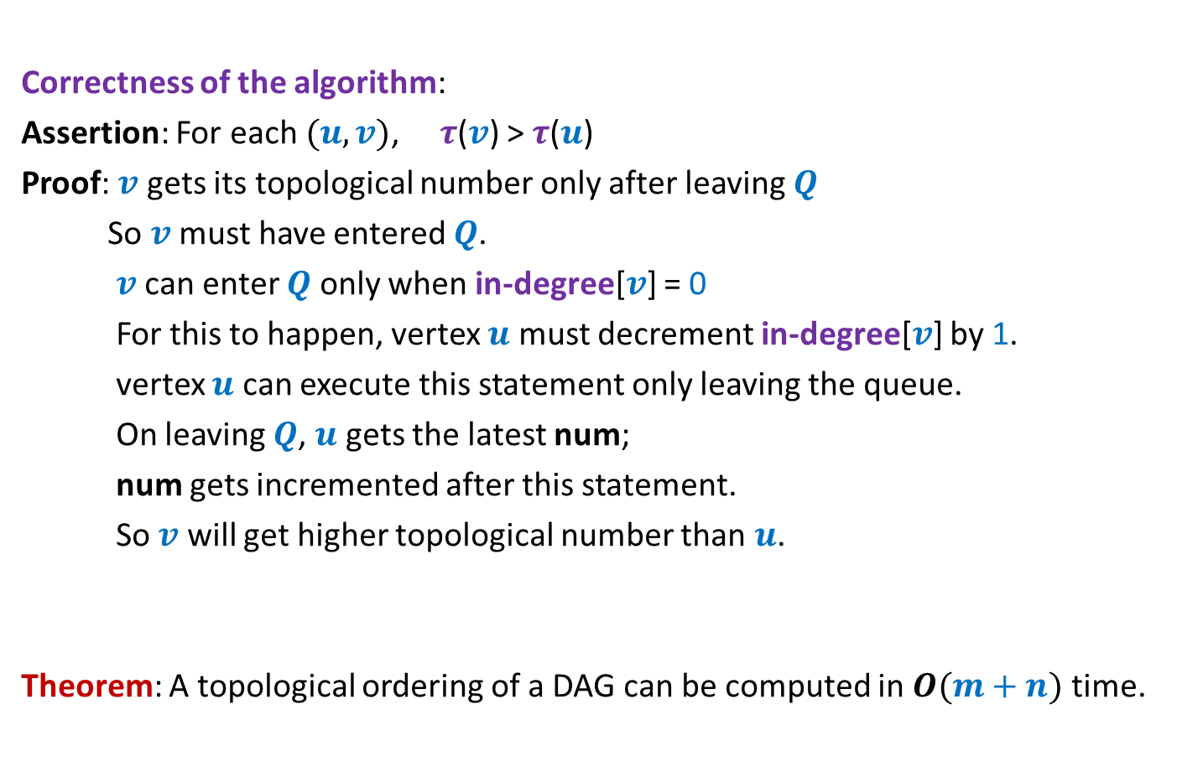
Algorithm for Topological ordering ?
Correctness of the algorithm:
Assertion: For each $(u,v)$, $τ$($v$) > $τ$($u$)
Proof: $v$ gets its topological number only after leaving $Q$
So $v$ must have entered $Q$.
$v$ can enter $Q$ only when in-degree[$v$] = 0
For this to happen, vertex $u$ must decrement in-degree[$v$] by 1.
vertex $u$ can execute this statement only leaving the queue.
On leaving $Q$, $u$ gets the latest num;
num gets incremented after this statement.
So $v$ will get higher topological number than $u$.
Theorem: A topological ordering of a DAG can be computed in $O(m+n)$ time.

Slide 21
Applications of topological ordering ?

Slide 22

Topological ordering
A mapping $τ$ : $V$→[$1…n$] such that
For each edge $\left(u,v\right)∈E$ , $τ$($u$) < $τ$($v$)
1 2 3 4 5 6 7 8 9 10 11

Slide 23

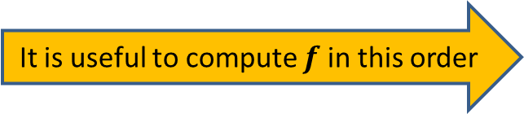

Applications of Topological ordering I
A mapping $τ$ : $V$→[$1…n$] such that
For each edge $\left(u,v\right)∈E$ , $τ$($u$) < $τ$($v$)
Let $f$ be a function on $V$that we wish to compute
If $f(y)$ can be expressed in terms of ONLY $\left\{f\left(x\right) \right|\left(x,y\right)∈E\}$
➔We can compute $f$ by processing vertices in increasing order of $τ$.
It is useful to compute $f$ in this order
1 2 3 4 5 6 7 8 9 10 11
$$y$$

Slide 24
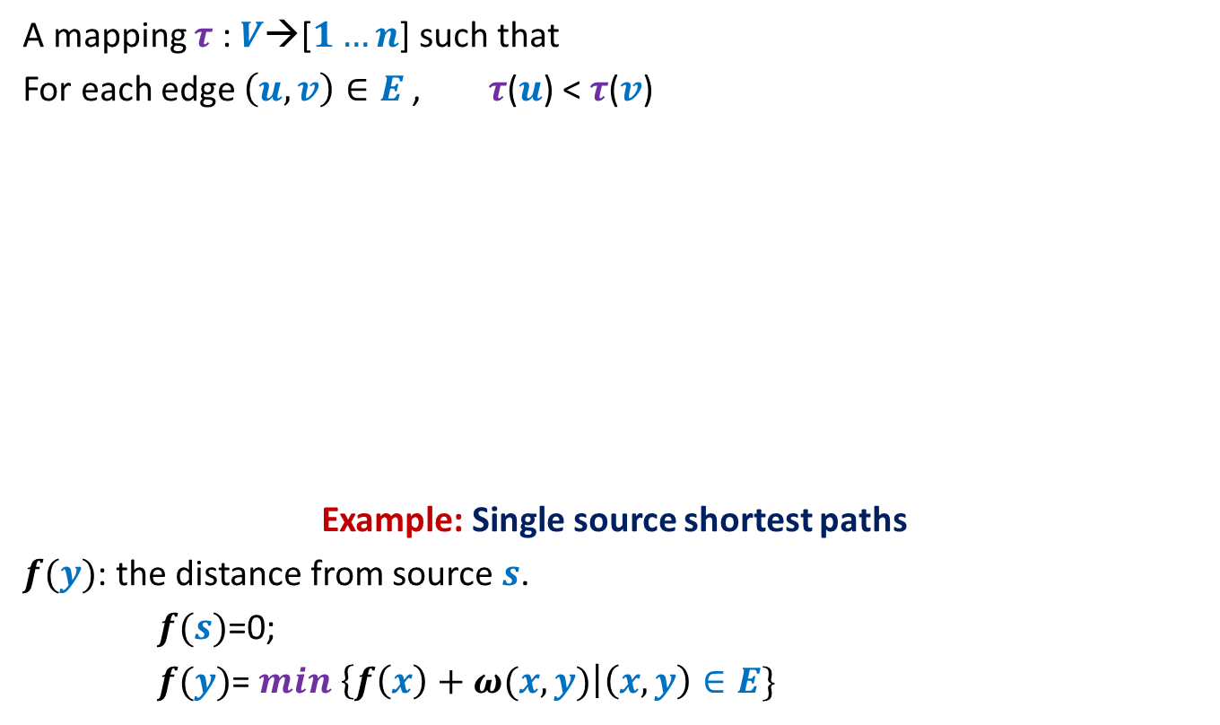

Applications of Topological ordering I
A mapping $τ$ : $V$→[$1…n$] such that
For each edge $\left(u,v\right)∈E$ , $τ$($u$) < $τ$($v$)
Example: Single source shortest paths
$f(y)$: the distance from source $s$.
$f(s)$=0;
$f(y)$= $min$ $\left\{f\left(x\right)+ω(x,y)\right|\left(x,y\right)∈E\}$
It is useful to compute $f$ in this order
1 2 3 4 5 6 7 8 9 10 11
$$y$$
$O(m+n)$ time algo

Slide 25


Applications of Topological ordering II
A mapping $τ$ : $V$→[$1…n$] such that
For each edge $\left(u,v\right)∈E$ , $τ$($u$) < $τ$($v$)
Let $f$ be a function on $V$that we wish to compute
If $f(y)$ can be expressed in terms of ONLY $\left\{f\left(z\right) \right|\left(y,z\right)∈E\}$
➔We can compute $f$ by processing vertices in decreasing order of $τ$.
It is useful to compute $f$ in this order
1 2 3 4 5 6 7 8 9 10 11
$$y$$

Slide 26
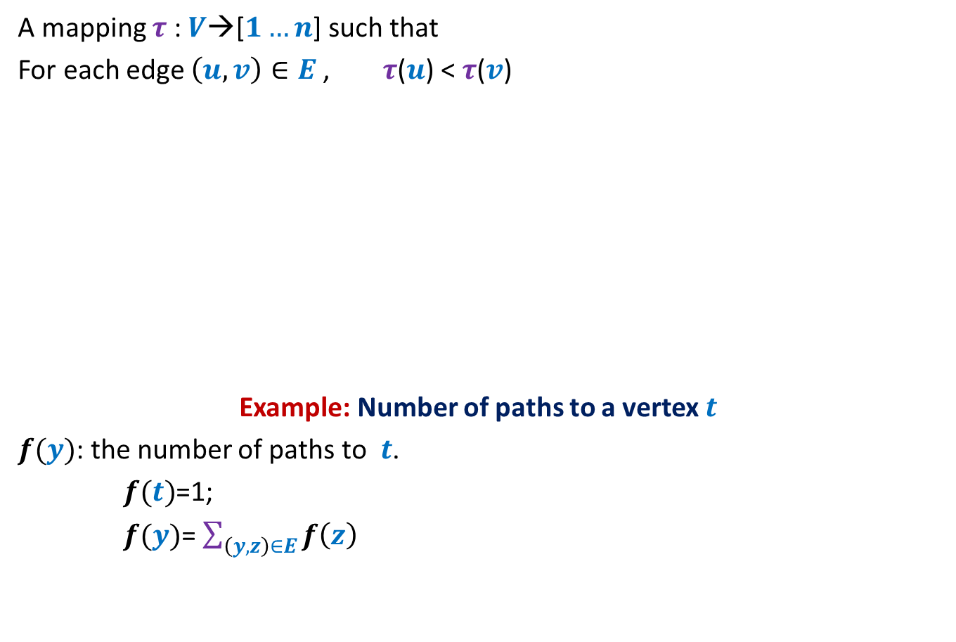
Applications of Topological ordering II
A mapping $τ$ : $V$→[$1…n$] such that
For each edge $\left(u,v\right)∈E$ , $τ$($u$) < $τ$($v$)
Example: Number of paths to a vertex $t$
$f(y)$: the number of paths to $t$.
$f(t)$=1;
$f(y)$= $\sum_{\left(y,z\right)∈E}{f\left(z\right)}$
It is useful to compute $f$ in this order
1 2 3 4 5 6 7 8 9 10 11
$$y$$
$O(m+n)$ time algo

Slide 27

Homework
Design an $O(m+n)$ time algorithm for the following problem:
Given a directed acyclic graph $G$, and a sequence of vertices $x_{1},x_{2},…,x_{k}$,
does there exist a path $G$which looks like :
$$x_{1}⇝x_{2}⇝…{⇝x}_{k}$$

