Slide 1
Design and Analysis of Algorithms (CS345/CS345A) Jan-April 2014
Lecture 14
Depth First Search in Directed Graph

Slide 2
Depth First Search (DFS)
A graph traversal algorithm
Key properties:
Recursive algorithm
Is quite different for directed and undirected graphs
Applications:
Computing reachability
Alternate algorithm for topological ordering of a DAG
Computing Strongly connected components
Checking if a graph is Eulerian (we will define this when we solve it)
tool for many graph algorithms:
Maximum flow, matching,…

Slide 3
applications of DEPTH FIRST SEARCH
Three problems

Slide 4


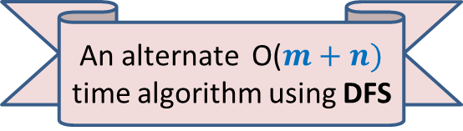
Topological ordering
vertices of a DAG can be arranged along a line so that
every edge goes from left to right.
Theorem: There exists a mapping $τ$ : $V$→[$1…n$] such that
for each edge $\left(u,v\right)∈E$
$τ$($u$) < $τ$($v$)
1 2 3 4 5 6 7 8 9 10 11
An alternate O($m+n)$ time algorithm using DFS

Slide 5

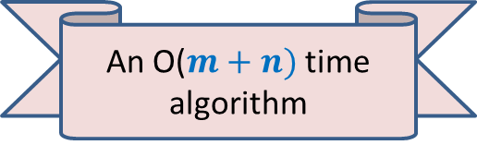
Strongly connected components
Definition: Two vertices $u$ and $v$ are said to be strongly connected if
$u$ is reachable from $v$
$v$ is reachable from $u$
A strongly connected component:
a maximal subset of “strongly connected vertices”
x
An O($m+n)$ time algorithm
y
u
v
q
b
d
w
j
r
p
h
c
t
k

Slide 6


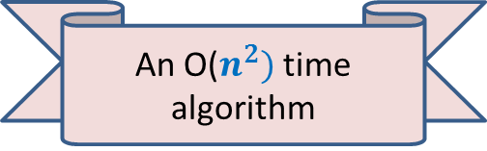
Single-connectedness of a directed graph
Definition: A directed graph $G$=($V$, $E$) is said to be singly connected if
For each pair $u$, $v∈V$, there is at most one path from $u$ to $v$.
In other words,
$u⇝v$
Aim: Design an efficient algorithm to determine whether $G$ is singly connected.
➔ there is only one path from $u$ to $v$
An O($n^{2})$ time algorithm
y
u
v
q
b
d
w
j
r
p
h
c
t
k

Slide 7

DEPTH FIRST SEARCH
From a vertex $u$

Slide 8
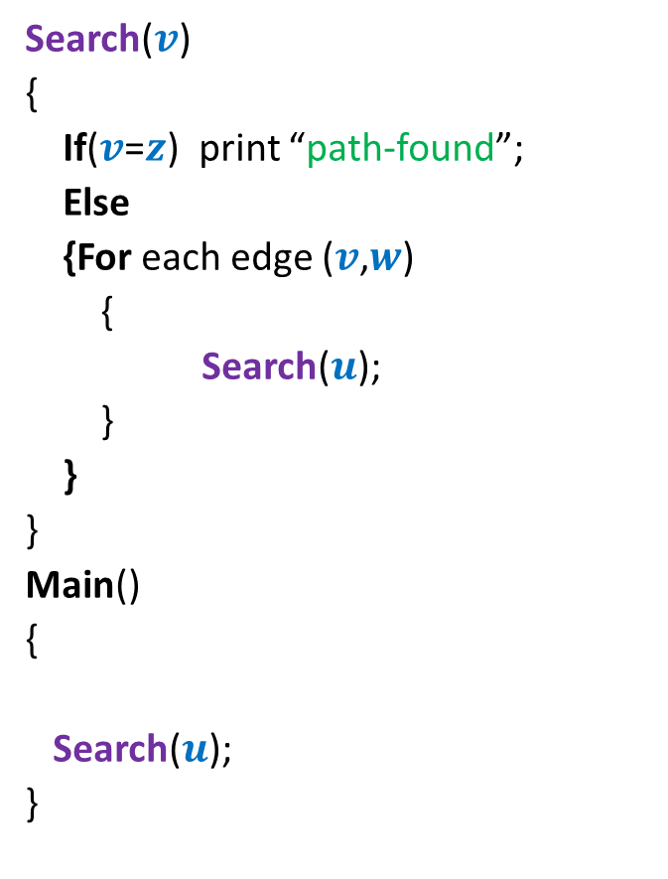



Searching path from $u$ to $z$
Search($v$)
{
If($v$=$z$) print “path-found”;
Else
{For each edge ($v$,$w$)
{
Search($u$);
}
}
}
Main()
{
Search($u$);
}
x
Visited[v] ← true;
y
u
s
q
If (Visited[$u$]=false)
w
j
r
p
z
t
For each $v$ $∈V$ Visited[$v$] ← false;
b
d
h
c

Slide 9





DFS from a vertex $u$
DFS($v$)
{
D[$v$]← count++ ;
…;
For each edge ($v$, $w$)
{
DFS($w$);
}
…;
}
Main()
{
count← 1;
DFS($u$);
}
x
Visited[$v$] ← true;
y
u
s
q
If (Visited[$w$]=false)
w
j
r
p
z
t
For each $v$ $∈$ $V$ Visited[$v$] ← false;
b
d
h
c

Slide 10
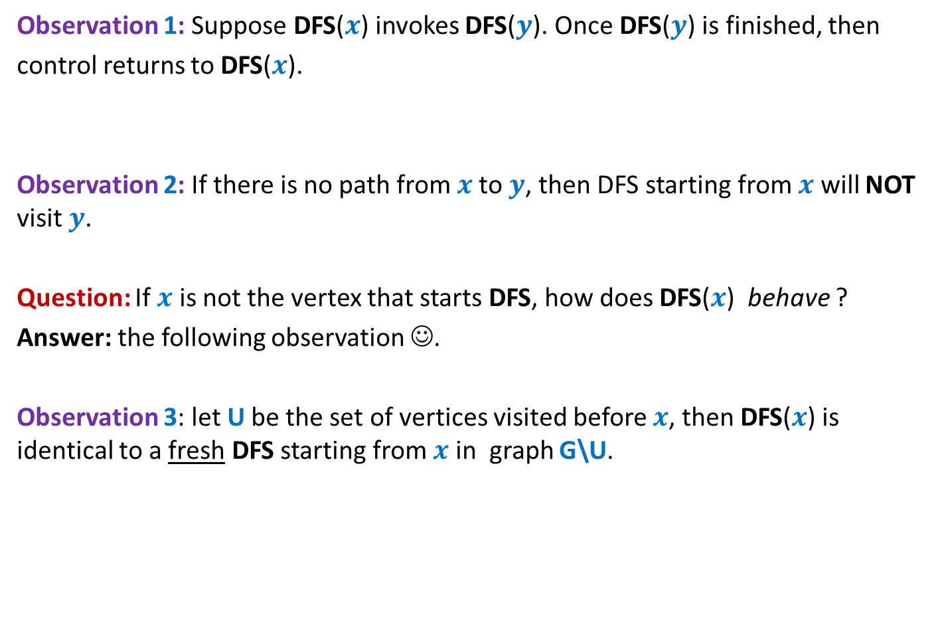
Relation among various DFS() calls
Observation 1: Suppose DFS($x$) invokes DFS($y$). Once DFS($y$) is finished, then
control returns to DFS($x$).
Observation 2: If there is no path from $x$to $y$, then DFS starting from $x$ will NOT visit $y$.
Question: If $x$ is not the vertex that starts DFS, how does DFS($x$) behave ?
Answer: the following observation ☺.
Observation 3: let U be the set of vertices visited before $x$, then DFS($x$) is identical to a fresh DFS starting from $x$ in graph G\U.

Slide 11

DFS from a vertex $u$
Lemma 1: DFS($u$) visits all vertices reachable from $u$.
Proof: We show that DFS($u$) visits $v$ if $u⇝v$
Based on three Observations
Induction on number of vertices in graph.
Focus on the first vertex visited after $u$.
x
y
u
s
q
w
j
r
p
v
t

Slide 12
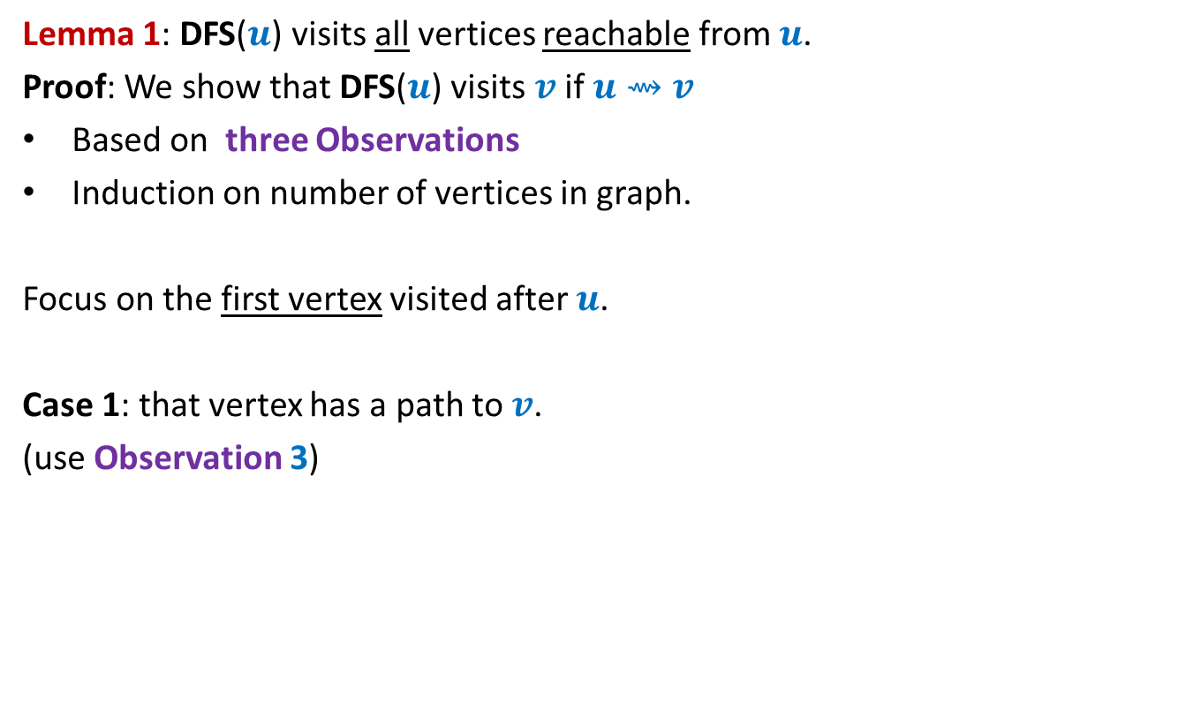
DFS from a vertex $u$
Lemma 1: DFS($u$) visits all vertices reachable from $u$.
Proof: We show that DFS($u$) visits $v$ if $u⇝v$
Based on three Observations
Induction on number of vertices in graph.
Focus on the first vertex visited after $u$.
Case 1: that vertex has a path to $v$.
(use Observation 3)
x
y
u
s
q
w
j
r
p
v
t

Slide 13
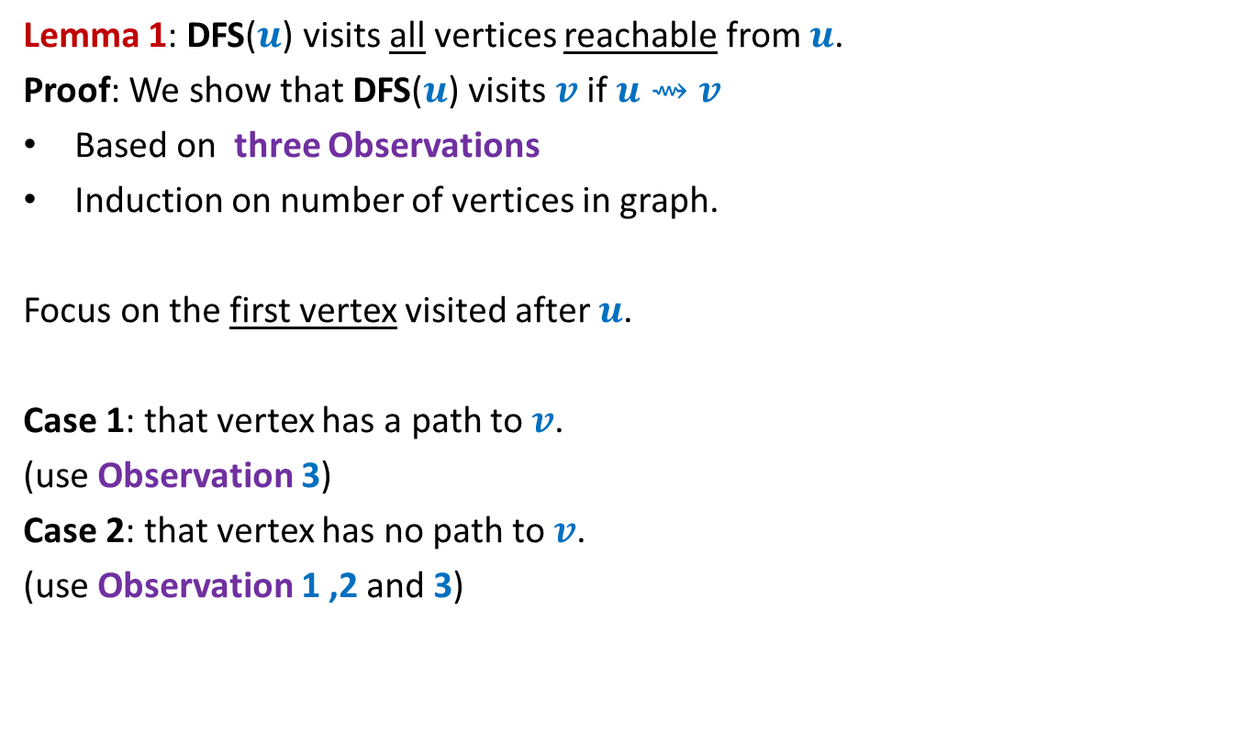
DFS from a vertex $u$
Lemma 1: DFS($u$) visits all vertices reachable from $u$.
Proof: We show that DFS($u$) visits $v$ if $u⇝v$
Based on three Observations
Induction on number of vertices in graph.
Focus on the first vertex visited after $u$.
Case 1: that vertex has a path to $v$.
(use Observation 3)
Case 2: that vertex has no path to $v$.
(use Observation 1 ,2 and 3)
x
y
u
s
q
w
j
r
p
v
t

Slide 14

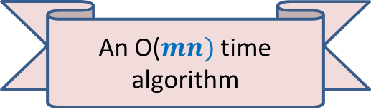
DFS from a vertex $u$
Lemma 1: DFS($u$) visits all vertices reachable from $u$.
Application 1:
Computing reachability from all vertices in graph
It suffices to execute fresh DFS($u$) from each $u∈V$.
An O($mn)$ time algorithm

Slide 15

More insights of DFS($u$)

Slide 16
DFS from a vertex $u$
x
y
u
s
q
w
j
r
p
v
t

Slide 17
DFS from a vertex $u$
x
y
u
s
q
w
j
r
p
v
t

Slide 18

DFS from a vertex $u$
Lemma 2: DFS($u$) computes a tree on all vertices reachable from $u$.
Question: Is the DFS tree unique ?
x
y
u
s
q
w
j
r
p
v
t

Slide 19

DFS from a vertex $u$
Lemma 2: DFS($u$) computes a tree on all vertices reachable from $u$.
Question: Is the DFS tree unique ?
Answer: No. But every tree is also not a DFS tree.
x
y
u
NOT a DFS tree. Can you explain it?
s
Another DFS tree
q
w
j
Is this a DFS tree ?
r
p
v
t

Slide 20

DEPTH FIRST SEARCH
For entire graph $G$

Slide 21
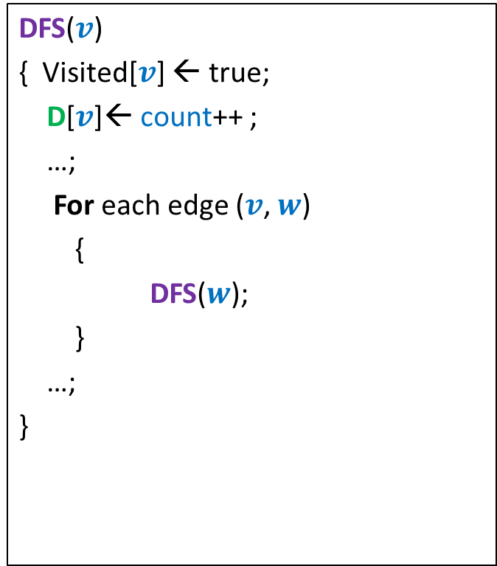

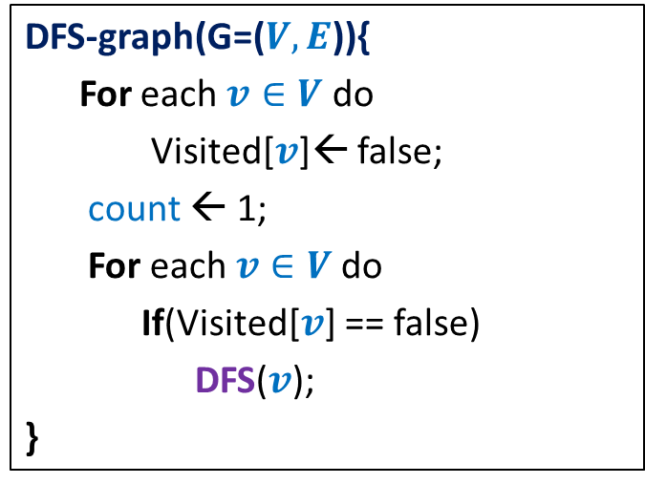
DFS on the graph
DFS($v$)
{ Visited[$v$] ← true;
D[$v$]← count++ ;
…;
For each edge ($v$, $w$)
{
DFS($w$);
}
…;
}
DFN number of v to denote the time when
DFS starts at v.
DFS-graph(G=($V,E$)){
For each $v∈V$ do
Visited[$v$]← false;
count ← 1;
For each $v∈V$do
If(Visited[$v$] == false)
DFS($v$);
}
F[$v$]← count++ ;
Finish number of v to denote the time when DFS
at v ends.
Notes:
Interestingly, adding only a few statements in the code DFS(v) leads to efficient algorithms for a variety of problems.

Slide 22
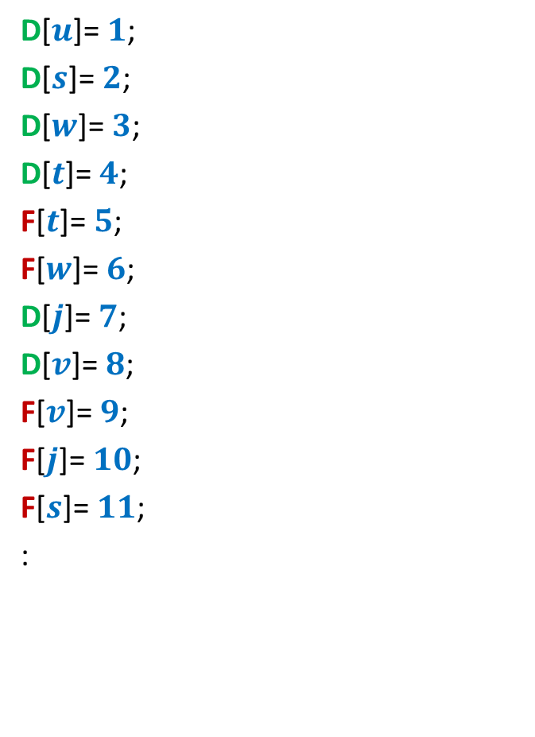
DFS on the graph
D[$u$]= $1$;
D[$s$]= $2$;
D[$w$]= $3$;
D[$t$]= $4$;
F[$t$]= $5$;
F[$w$]= $6$;
D[$j$]= $7$;
D[$v$]= $8$;
F[$v$]= $9$;
F[$j$]= $10$;
F[$s$]= $11$;
:
x
y
u
s
q
w
j
r
p
v
t

Slide 23





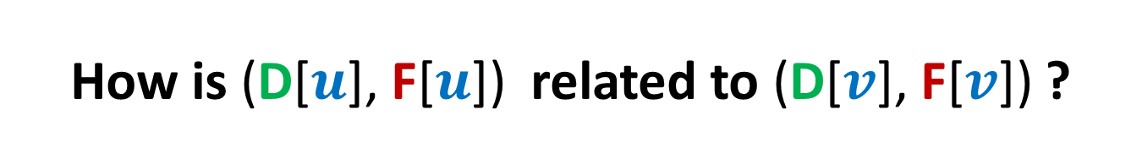








How is (D[$u$], F[$u$]) related to (D[$v$], F[$v$]) ?
Disjoint
One enclosing another
What about D[$u$] < D[$v$] <F[$u$] < F[$v$] ?
D[$u$]
F[$u$]
D[$v$]
F[$v$]
D[$u$]
F[$u$]
D[$v$]
F[$v$]
D[$u$]
F[$u$]
D[$v$]
F[$v$]

Slide 24
x
y
u
v
q
b
d
w
j
r
p
h
c
t
k
u
b
d
x
v
q
y
h
c
w
j
r
p
DFS partitions the graph into a forest of DFS trees.
k
t

Slide 25
Application - I
Alternate algorithm for topological numbering of a DAG.

Slide 26
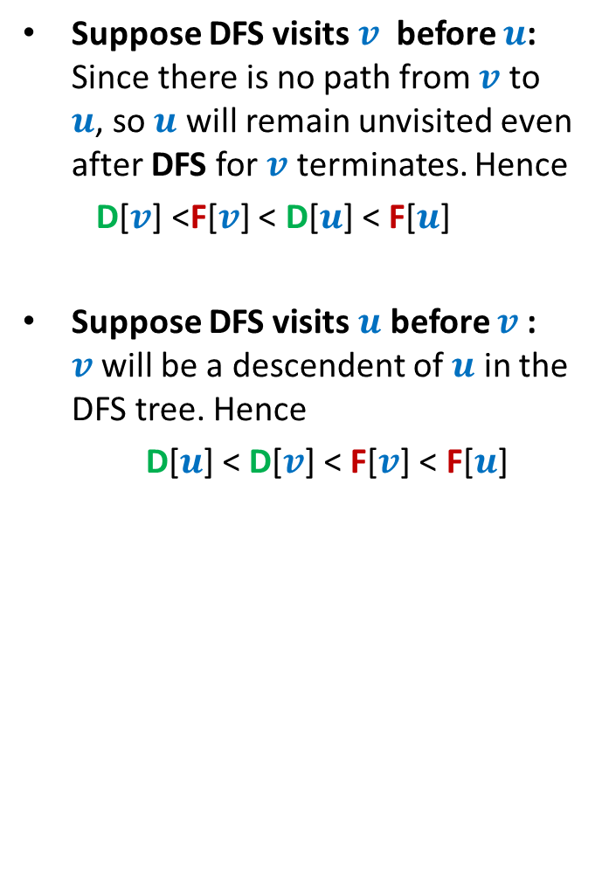
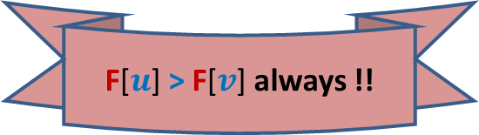
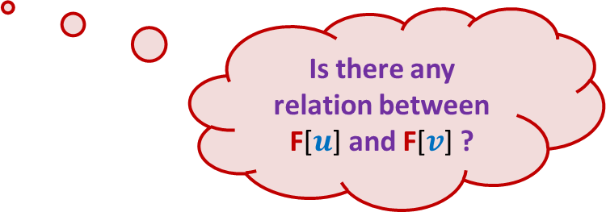
DFS on a DAG
Is there any relation between F[$u$] and F[$v$] ?
Suppose DFS visits $v$ before $u$: Since there is no path from $v$ to $u$, so $u$ will remain unvisited even after DFS for $v$ terminates. Hence
D[$v$] <F[$v$] < D[$u$] < F[$u$]
Suppose DFS visits $u$ before $v$: $v$ will be a descendent of $u$ in the DFS tree. Hence
D[$u$] < D[$v$] < F[$v$] < F[$u$]
u
v
F[$u$] > F[$v$] always !!

Slide 27

DFS on a DAG
Lemma 1: For any edge ($u$, $v$) , F[$u$] > F[$v$] always.
Theorem: Vertices arranged in decreasing order of their finish time during DFS is a valid topological ordering.
Decreasing order of F
1 2 3 4 5 6 7 8 9 10 11

Slide 28
Homework
Go through the entire lecture and internalize the fundamentals of the DFS traversal.
Spend some time to solve the problem of single-connectedness
Spend some time to solve the problem of strongly connected components.
Do this homework sincerely before coming to the next class. Otherwise it will be difficult for you to understand the solutions of these problems presented in the next class.

