Slide 1
Design and Analysis of Algorithms (CS345/CS345A) Jan-April 2014
Lecture 15
Depth First Search in Directed Graph - II

Slide 2
A Recapitulation of the last lecture

Slide 3







DFS from a vertex $u$
DFS($v$)
{
D[$v$]← count++ ;
…;
For each edge ($v$, $w$)
{
DFS($w$);
}
…;
}
Main()
{
count← 1;
DFS($u$);
}
x
Visited[$v$] ← true;
y
u
s
q
If (Visited[$w$]=false)
w
j
r
p
z
t
For each $v$ $∈$ $V$ Visited[$v$] ← false;
b
d
Time complexity = O($m+n$)
h
c

Slide 4

DFS from a vertex $u$
Lemma 1: DFS($u$) visits all vertices reachable from $u$.
Lemma 2: DFS($u$) computes a tree on all vertices reachable from $u$.
Question: Is the DFS tree unique ?
Answer: No.
x
But every tree is also not a DFS tree.
y
u
s
q
w
j
r
p
v
t

Slide 5
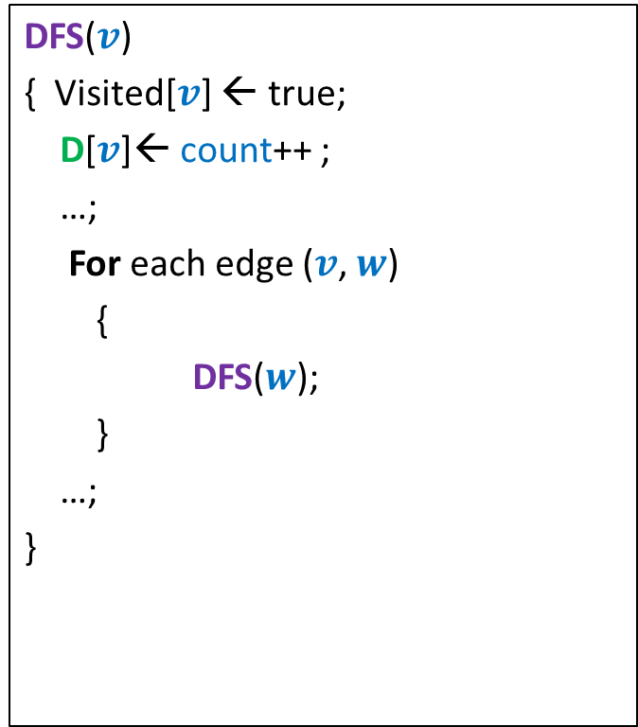


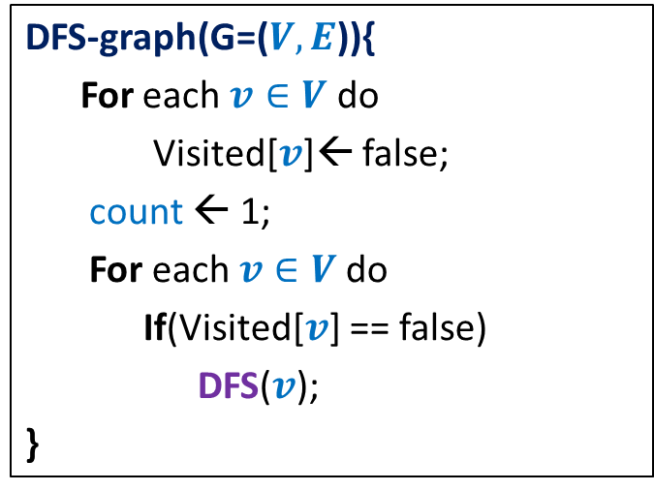
DFS on the graph
DFS($v$)
{ Visited[$v$] ← true;
D[$v$]← count++ ;
…;
For each edge ($v$, $w$)
{
DFS($w$);
}
…;
}
DFN number of v to denote the time when
DFS starts at v.
DFS-graph(G=($V,E$)){
For each $v∈V$ do
Visited[$v$]← false;
count ← 1;
For each $v∈V$do
If(Visited[$v$] == false)
DFS($v$);
}
F[$v$]← count++ ;
Finish number of v to denote the time when DFS
at v ends.
Time complexity = O($m+n$)
Notes:
Interestingly, adding only a few statements in the code DFS(v) leads to efficient algorithms for a variety of problems.

Slide 6
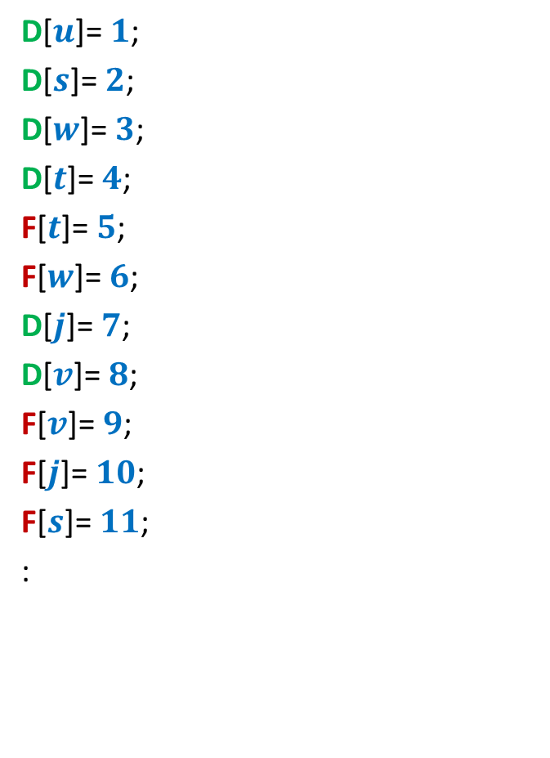

How is (D[$u$], F[$u$]) related to (D[$v$], F[$v$]) ?
D[$u$]= $1$;
D[$s$]= $2$;
D[$w$]= $3$;
D[$t$]= $4$;
F[$t$]= $5$;
F[$w$]= $6$;
D[$j$]= $7$;
D[$v$]= $8$;
F[$v$]= $9$;
F[$j$]= $10$;
F[$s$]= $11$;
:
x
y
u
s
q
w
j
r
p
v
t

Slide 7





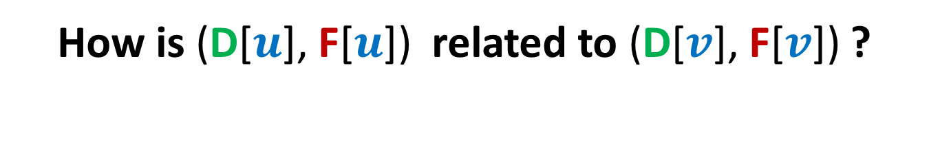








How is (D[$u$], F[$u$]) related to (D[$v$], F[$v$]) ?
Disjoint
One enclosing another
What about D[$u$] < D[$v$] <F[$u$] < F[$v$] ?
D[$u$]
F[$u$]
D[$v$]
F[$v$]
D[$u$]
F[$u$]
D[$v$]
F[$v$]
D[$u$]
F[$u$]
D[$v$]
F[$v$]

Slide 8
x
x
y
y
u
u
Lemma 3: DFS partitions the graph into a forest of DFS trees.
v
q
v
q
w
j
w
j
r
p
r
p
k
t
k
t
b
b
d
d
h
h
c

Slide 9
The structure of a DFS forest

Slide 10
Classification of non-tree edges
Question: Given a DFS forest, how can we characterize/classify its non-tree edges ?
Answer: Using the relation between D values and F values.
x
y
b
d
u
s
q
h
c
w
j
r
p
v
t

Slide 11









Characterization of non-tree edges
Consider an edge ($u$,$v$)
Case 1: ancestor to descendant
Case 2: descendant to ancestor
Case 3:
Tree edge or Forward edge
D[$u$]
F[$u$]
D[$v$]
F[$v$]
D[$v$]
F[$v$]
Backward edge
D[$u$]
F[$u$]
Cross edge
D[$v$]
F[$v$]
D[$u$]
F[$u$]
D[$u$]
F[$u$]
D[$v$]
F[$v$]

Slide 12
Characterization of non-tree edges
x
Forward edges
(u,w)
(b,c)
y
u
s
q
w
j
r
p
v
t
b
d
h
c

Slide 13
Characterization of non-tree edges
x
Forward edges
(u,w)
(b,c)
Backward edges
(t,u)
(j,u)
(r,q)
(c,b)
y
u
s
q
w
j
r
p
v
t
b
d
h
c

Slide 14
Characterization of non-tree edges
x
Forward edges
(u,w)
(b,c)
Backward edges
(t,u)
(j,u)
(r,q)
(c,b)
Cross edges
y
u
s
q
w
j
r
p
v
t
b
d
h
c

Slide 15
Characterization of non-tree edges
x
Forward edges
(u,w)
(b,c)
Backward edges
(t,u)
(j,u)
(r,q)
(c,b)
Cross edges
(x,u)
(j,t)
(y,u)
(y,q)
y
u
s
q
w
j
r
p
v
t
b
d
h
c

Slide 16
Application - II
Checking for single-connectedness of a directed graph

Slide 17

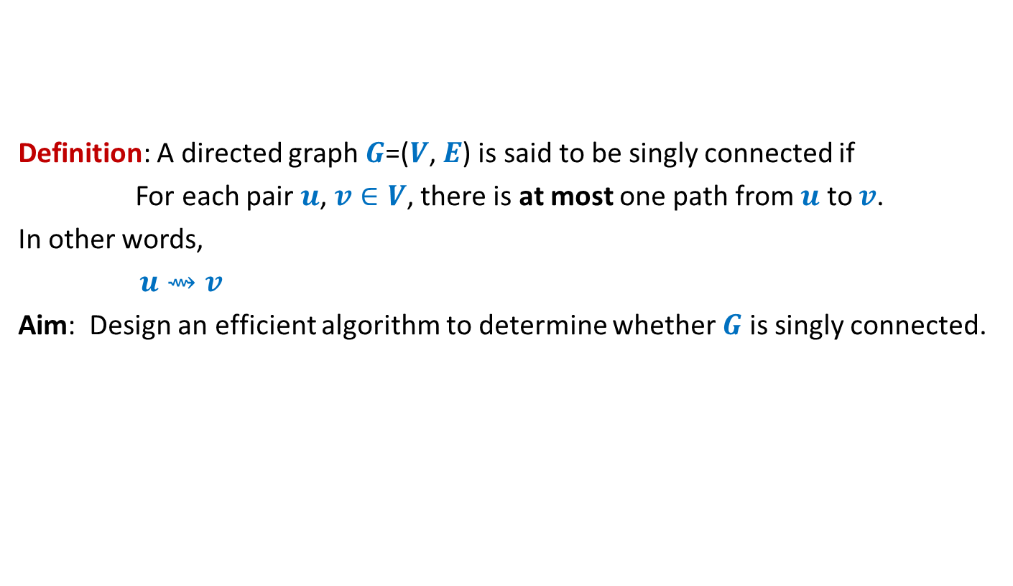

Single-connectedness of a directed graph
Definition: A directed graph $G$=($V$, $E$) is said to be singly connected if
For each pair $u$, $v∈V$, there is at most one path from $u$ to $v$.
In other words,
$u⇝v$
Aim: Design an efficient algorithm to determine whether $G$ is singly connected.
➔ there is only one path from $u$ to $v$
An O($n^{2})$ time algorithm

Slide 18
Single-connectedness of a directed graph
y
u
v
q
b
d
w
j
r
p
h
c
t
k

Slide 19


Single-connectedness of a directed graph An O($mn$) time algorithm
For each vertex $u∈V$ do
{ determine if $u$ is singly-connected to the vertices reachable from it }
$u⇝v$ ➔there is only one path from $u$ to $v$
a
b
u
s
q
w
j
r
p
v
t

Slide 20
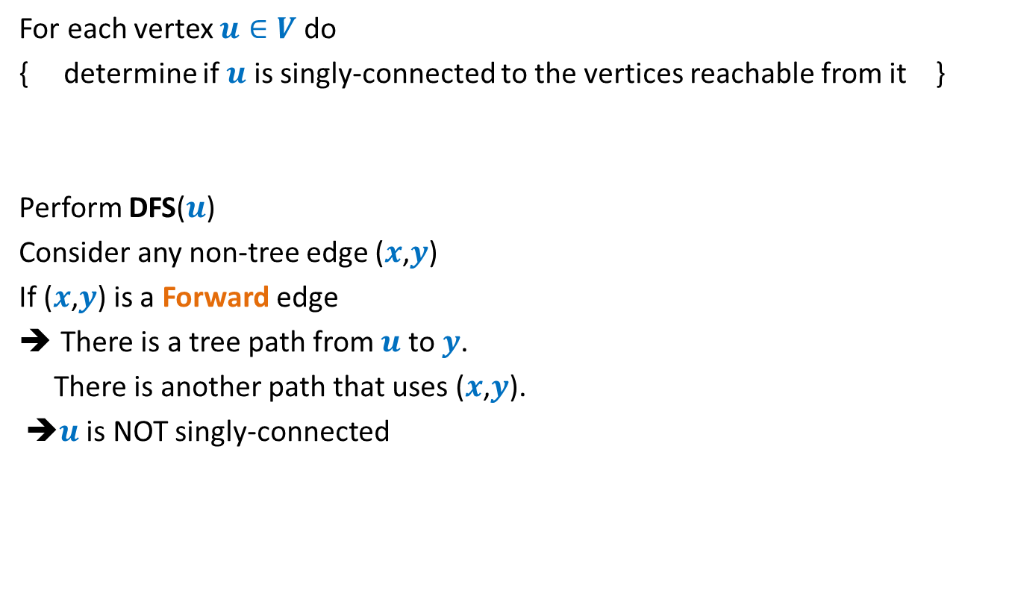
Single-connectedness of a directed graph An O($mn$) time algorithm
For each vertex $u∈V$ do
{ determine if $u$ is singly-connected to the vertices reachable from it }
Perform DFS($u$)
Consider any non-tree edge ($x$,$y$)
If ($x$,$y$) is a Forward edge
There is a tree path from $u$ to $y$.
There is another path that uses ($x$,$y$).
➔$u$ is NOT singly-connected
a
b
u
s
q
w
j
r
p
v
t

Slide 21
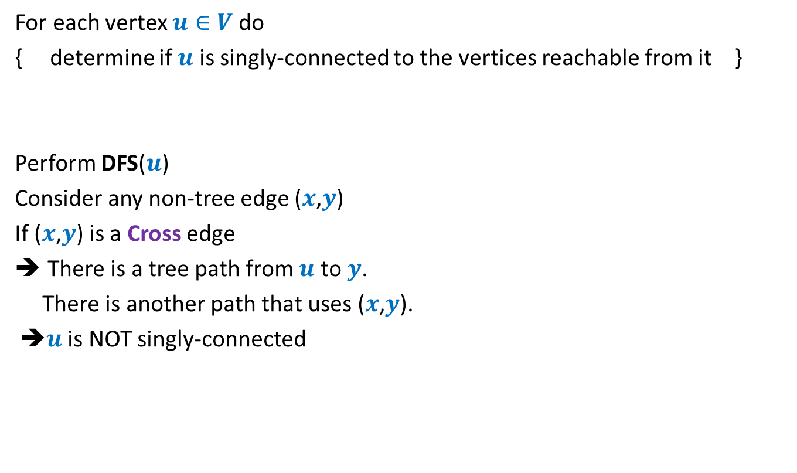
Single-connectedness of a directed graph An O($mn$) time algorithm
For each vertex $u∈V$ do
{ determine if $u$ is singly-connected to the vertices reachable from it }
Perform DFS($u$)
Consider any non-tree edge ($x$,$y$)
If ($x$,$y$) is a Cross edge
There is a tree path from $u$ to $y$.
There is another path that uses ($x$,$y$).
➔$u$ is NOT singly-connected
u
s
q
w
j
r
p
v
t

Slide 22

Single-connectedness of a directed graph An O($mn$) time algorithm
For each vertex $u∈V$ do
{ determine if $u$ is singly-connected to the vertices reachable from it }
Perform DFS($u$)
Consider any non-tree edge ($x$,$y$)
If ($x$,$y$) is a Backward edge
u
s
q
w
j
r
p
v
t

Slide 23
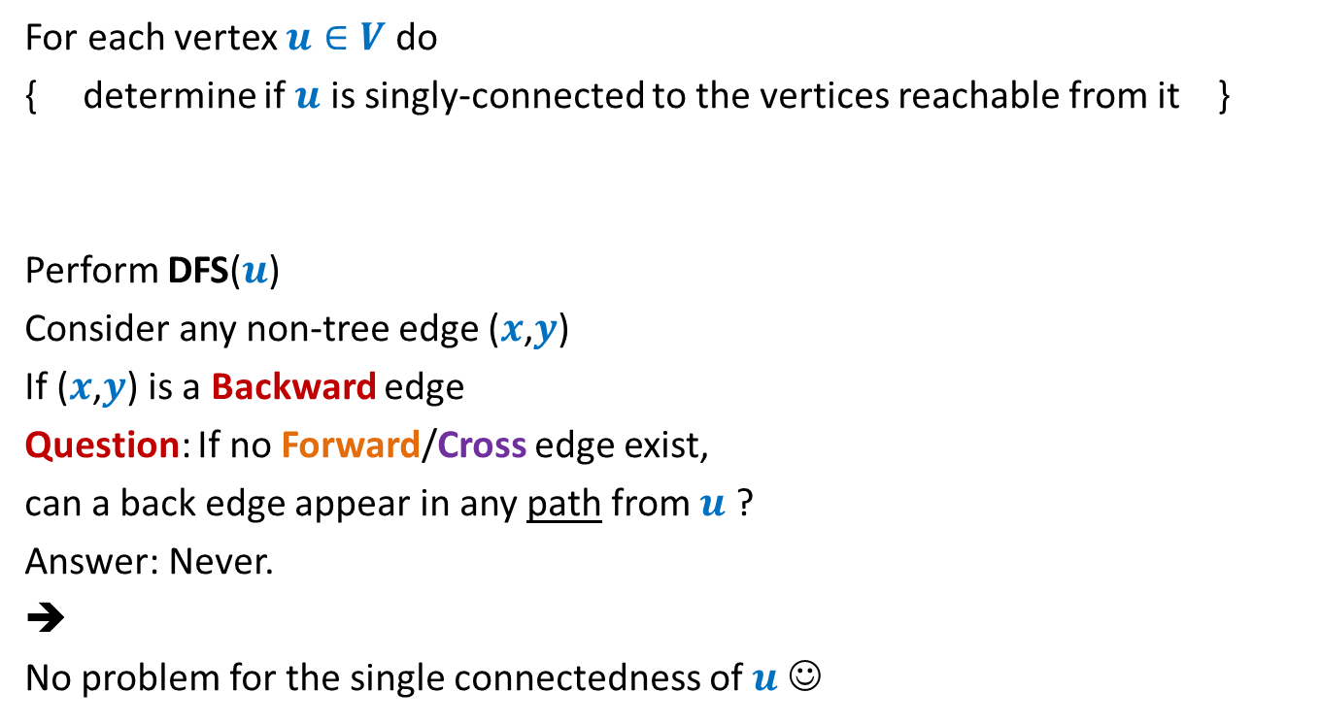
Single-connectedness of a directed graph An O($mn$) time algorithm
For each vertex $u∈V$ do
{ determine if $u$ is singly-connected to the vertices reachable from it }
Perform DFS($u$)
Consider any non-tree edge ($x$,$y$)
If ($x$,$y$) is a Backward edge
Question: If no Forward/Cross edge exist,
can a back edge appear in any path from $u$ ?
Answer: Never.
➔
No problem for the single connectedness of $u$ ☺
u
s
q
w
j
r
p
v
t

Slide 24
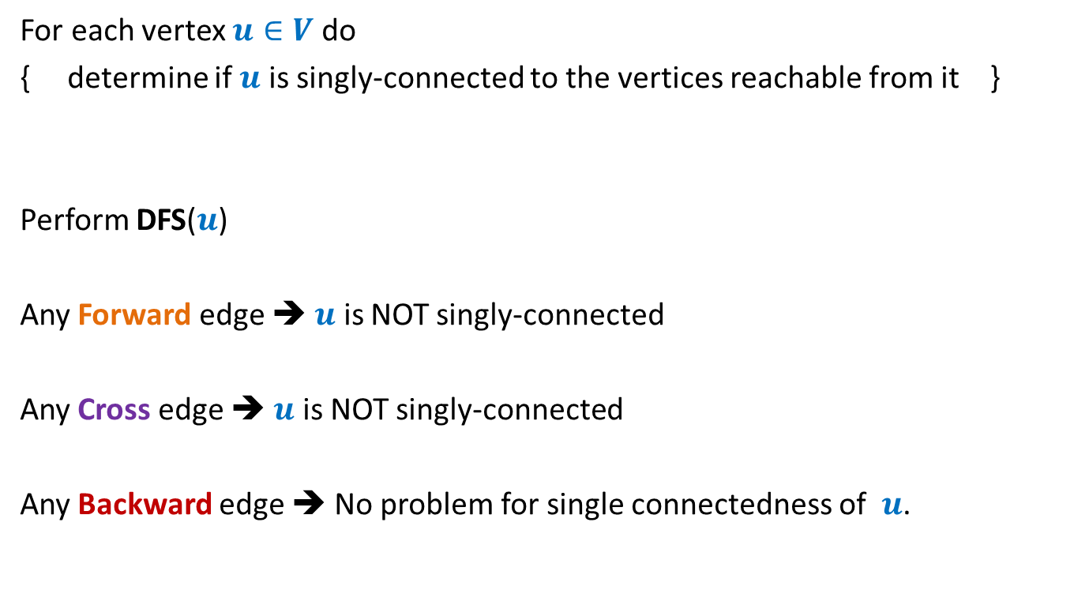
Single-connectedness of a directed graph An O($mn$) time algorithm
For each vertex $u∈V$ do
{ determine if $u$ is singly-connected to the vertices reachable from it }
Perform DFS($u$)
Any Forward edge ➔ $u$ is NOT singly-connected
Any Cross edge ➔ $u$ is NOT singly-connected
Any Backward edge ➔ No problem for single connectedness of $u$.

Slide 25


Single-connectedness of a directed graph How to achieve O($n^{2}$) time algorithm ?
Question: Can we do just a single DFS of the graph ?
Any Forward edge ➔ $u$ is NOT singly-connected
Any Cross edge ➔
This explains, at least intuitively, why it is not easy to pursue a single DFS of the graph to solve this problem.
?

Slide 26
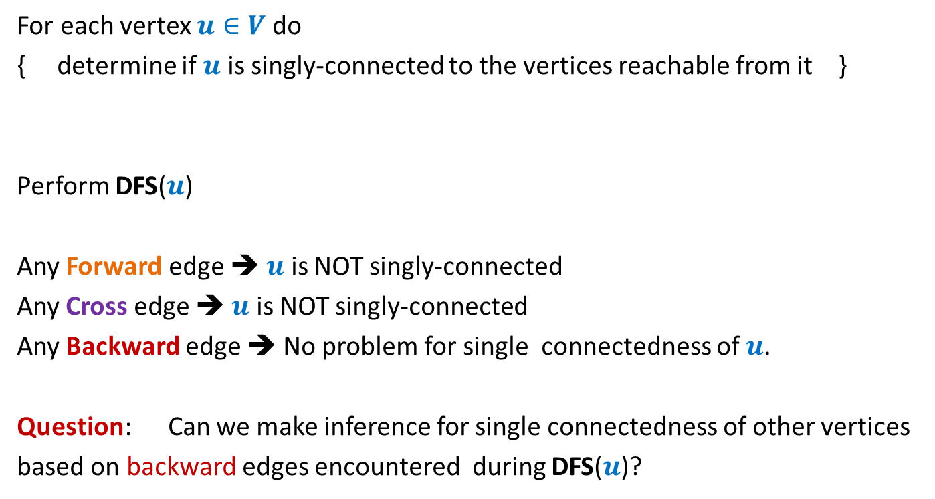

Single-connectedness of a directed graph Let us revisit the O($mn$) time algorithm
For each vertex $u∈V$ do
{ determine if $u$ is singly-connected to the vertices reachable from it }
Perform DFS($u$)
Any Forward edge ➔ $u$ is NOT singly-connected
Any Cross edge ➔ $u$ is NOT singly-connected
Any Backward edge ➔ No problem for single connectedness of $u$.
Question: Can we make inference for single connectedness of other vertices
based on backward edges encountered during DFS($u$)?

Slide 27

Towards achieving O($n^{2}$) time algorithm ?
Question: How many Backward edges can emerge from a single vertex without leading to non single-connectedness?
Answer: at most 1

Slide 28


Towards achieving O($n^{2}$) time algorithm ?
Multiple back edges from subtree T($x$) to proper ancestor of $x$
➔ $x$is not singly connected.
Exploring single-connectedness when there is at most one backward edge from each vertex.
$$x$$

Slide 29
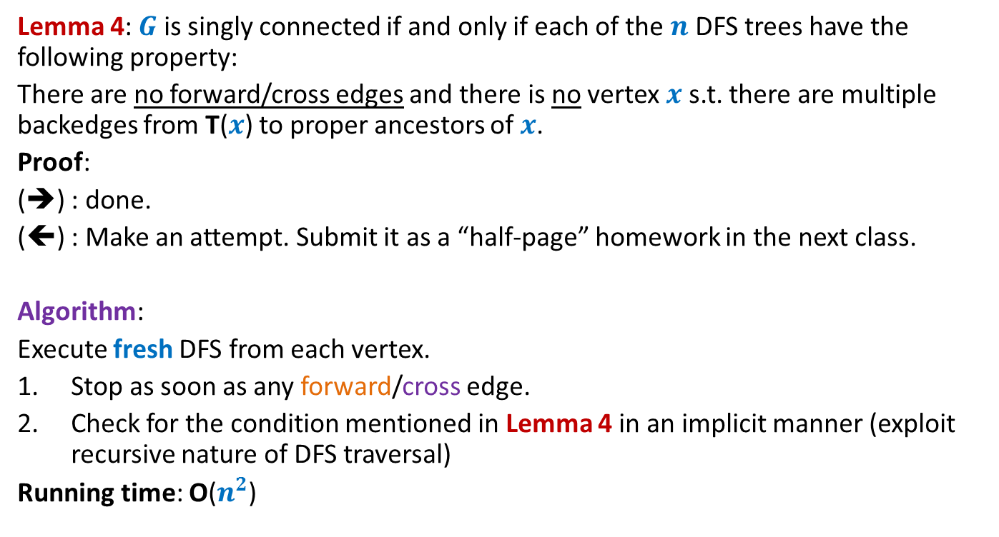
Towards achieving O($n^{2}$) time algorithm ?
Lemma 4: $G$ is singly connected if and only if each of the $n$ DFS trees have the following property:
There are no forward/cross edges and there is no vertex $x$s.t. there are multiple backedges from T($x$) to proper ancestors of $x$.
Proof:
(➔) : done.
(⬅) : Make an attempt. Submit it as a “half-page” homework in the next class.
Algorithm:
Execute fresh DFS from each vertex.
Stop as soon as any forward/cross edge.
Check for the condition mentioned in Lemma 4 in an implicit manner (exploit recursive nature of DFS traversal)
Running time: O($n^{2}$)

