Slide 1
Design and Analysis of Algorithms (CS345/CS345A) Jan-April 2014
Lecture 16
Depth First Search in Directed Graph - III

Slide 2
Application - III
Computing Strongly connected components of a directed graph.

Slide 3


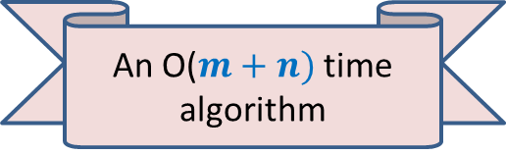
Strongly connected components
Definition: Two vertices $u$ and $v$ are said to be strongly connected if
$u$ is reachable from $v$
$v$ is reachable from $u$
A strongly connected component:
a maximal subset of “strongly connected vertices”
x
An O($m+n)$ time algorithm
y
u
v
q
b
d
w
j
r
p
h
c
t
k

Slide 4

SCC graph of $G$

Slide 5


SCC graph
x
{x,y}
y
u
v
q
{u,v,w,j}
{p,q,r}
w
j
r
p
{t}
{k}
t
k
{b,c,d}
b
d
h
{h}
c
$$G$$
SCC graph of $G$

Slide 6
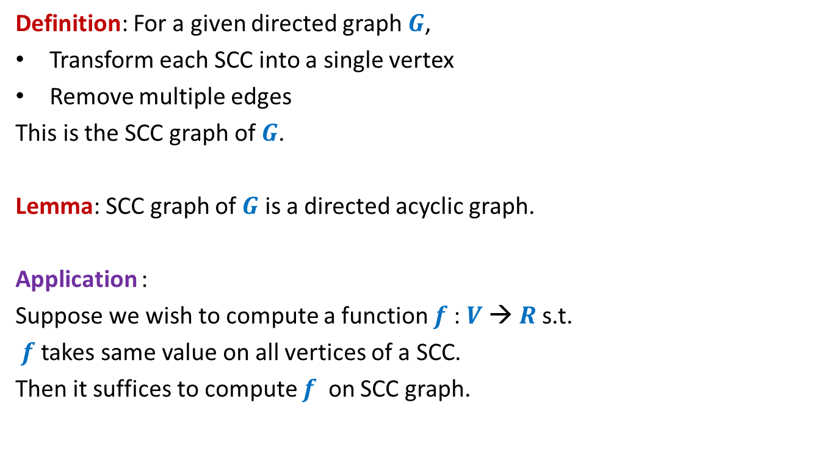
SCC graph
Definition: For a given directed graph $G$,
Transform each SCC into a single vertex
Remove multiple edges
This is the SCC graph of $G$.
Lemma: SCC graph of $G$ is a directed acyclic graph.
Application :
Suppose we wish to compute a function $f$: $V$→ $R$s.t.
$f$ takes same value on all vertices of a SCC.
Then it suffices to compute $f$ on SCC graph.

Slide 7

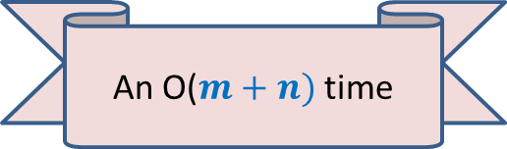
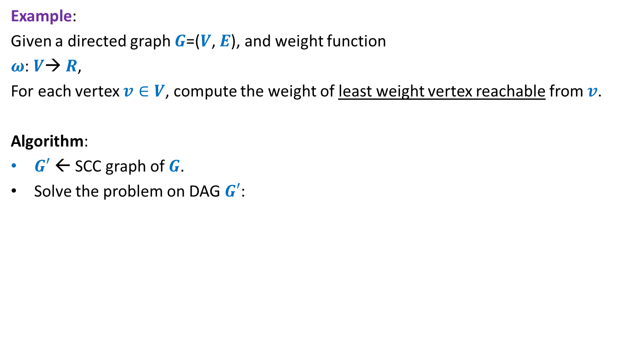

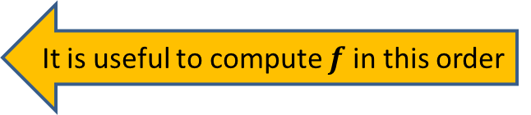
SCC graph
Example:
Given a directed graph $G$=($V$, $E$), and weight function
$ω$: $V$→ $R$,
For each vertex $v∈V$, compute the weight of least weight vertex reachable from $v$.
Algorithm:
$G′$← SCC graph of $G$.
Solve the problem on DAG $G′$:
An O($m+n)$ time
It is useful to compute $f$ in this order
Topolog. order 1 2 3 4 5 6 7 8 9 10 11
Vertices of $G′$
$$y$$

Slide 8
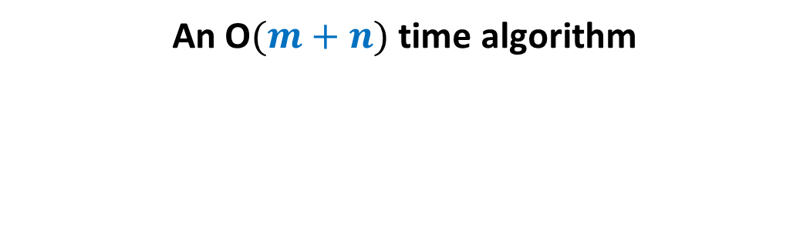
Computing SCC efficiently
An O$(m+n)$ time algorithm

Slide 9
x
x
y
y
u
u
Lemma 1: A tree in the forest of DFS trees contains one or more SCC.
v
q
v
q
w
j
w
j
r
p
r
p
k
t
k
t
b
b
d
d
h
h
c

Slide 10
An idea to compute SCC efficiently
x
y
u
There is still some order there !
Vertices of a SCC appear together in tree.
➔
Once we have a DFS forest, if we proceed in a suitable order, then we might compute distinct SCCs easily ?
To pursue the idea, analyze finish times.
Notation:
root of an SCC:
the vertex of the SCC which is visited first during the DFS
v
q
w
j
r
p
k
t
b
d
h
c

Slide 11
An example
u
u
There does not appear to be any order ☹.
➔ Let us analyze finish time more formally.
v
v
q
q
w
j
w
j
r
p
r
p
t
k
t
k
t w k j v r p q u
Increasing order of f[]

Slide 12

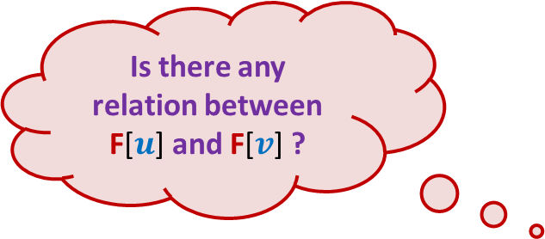



DFS on Directed Graph: analyzing the finish time
Case 1: $u$ and $v$ belong to same SCC.
If $u$is visited before $v$, then
F[$u$] > F[$v$]
If $v$is visited before $u$, then
F[$u$] < F[$v$]
➔ No order
$$u$$
$$v$$
Is there any relation between F[$u$] and F[$v$] ?

Slide 13
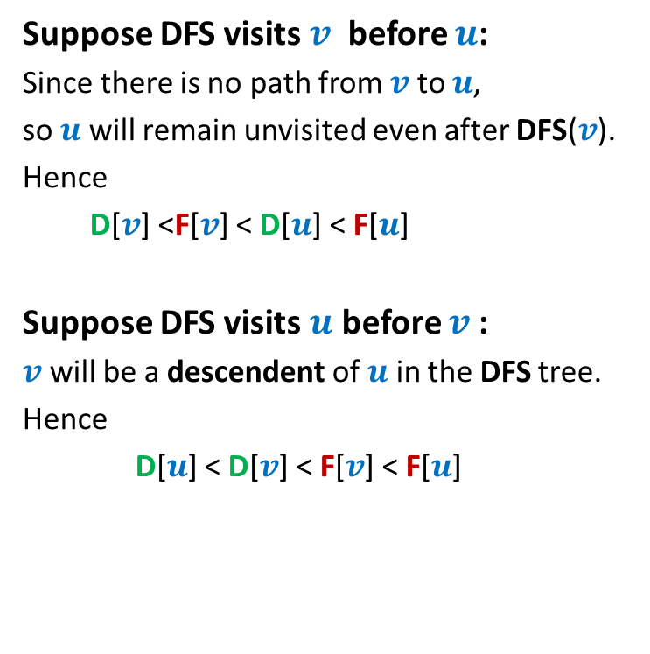
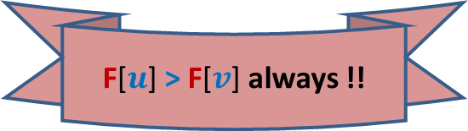

DFS on Directed Graph: analyzing the finish time
Case 2: $u$ and $v$ belong to different SCC.
Suppose DFS visits $v$ before $u$:
Since there is no path from $v$ to $u$,
so $u$ will remain unvisited even after DFS($v$).
Hence
D[$v$] <F[$v$] < D[$u$] < F[$u$]
Suppose DFS visits $u$ before $v$:
$v$ will be a descendent of $u$ in the DFS tree.
Hence
D[$u$] < D[$v$] < F[$v$] < F[$u$]
$$u$$
$$v$$
Is there any relation between F[$u$] and F[$v$] ?
F[$u$] > F[$v$] always !!

Slide 14



DFS on Directed Graph: analyzing the finish time
Lemma2: If ($u$,$v$) is an edge and, $u$ & $v$ belong to different SCCs, then F[$u$] > F[$v$]
Question: If ($u$,$v$) is an edge and, $u$ & $v$ belong to different SCCs, then is there any relation between finish times of the roots of SCCs of $v$ and $u$ ?
Answer: F[root($S_{2}$)] > F[root($S_{1}$)]
$$u$$
$$v$$
$$S_{2}$$
$$S_{1}$$

Slide 15
Searching for an order using Finish time
SCC A
SCC B
Increasing order of F[]
Can there be an edge from some vertex of A to some vertex of B ?
NEVER

Slide 16
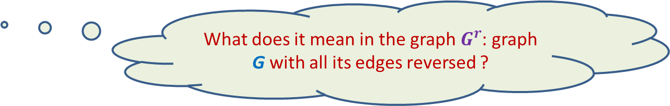
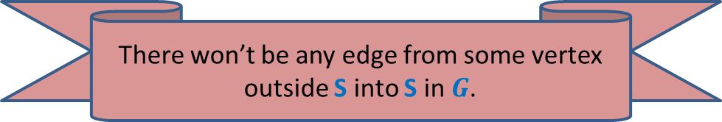


Searching for an order using Finish time
What can we infer for the vertex with max finish time ?
$$u$$
SCC S
$$u$$
Increasing order of F[]
SCC S
There won’t be any edge from some vertex outside S into S in $G$.
What does it mean in the graph $G^{r}$: graph G with all its edges reversed ?
SCC S remains intact in $G^{r}$.

Slide 17

The key IDEA
$$u$$
Question: If $u$ is vertex with max. finish time, what is the set of vertices reachable from $u$ in $G^{r}$
Answer: SCC of $u$.
SCC S
$$u$$
SCC S
Increasing order of F[]

Slide 18
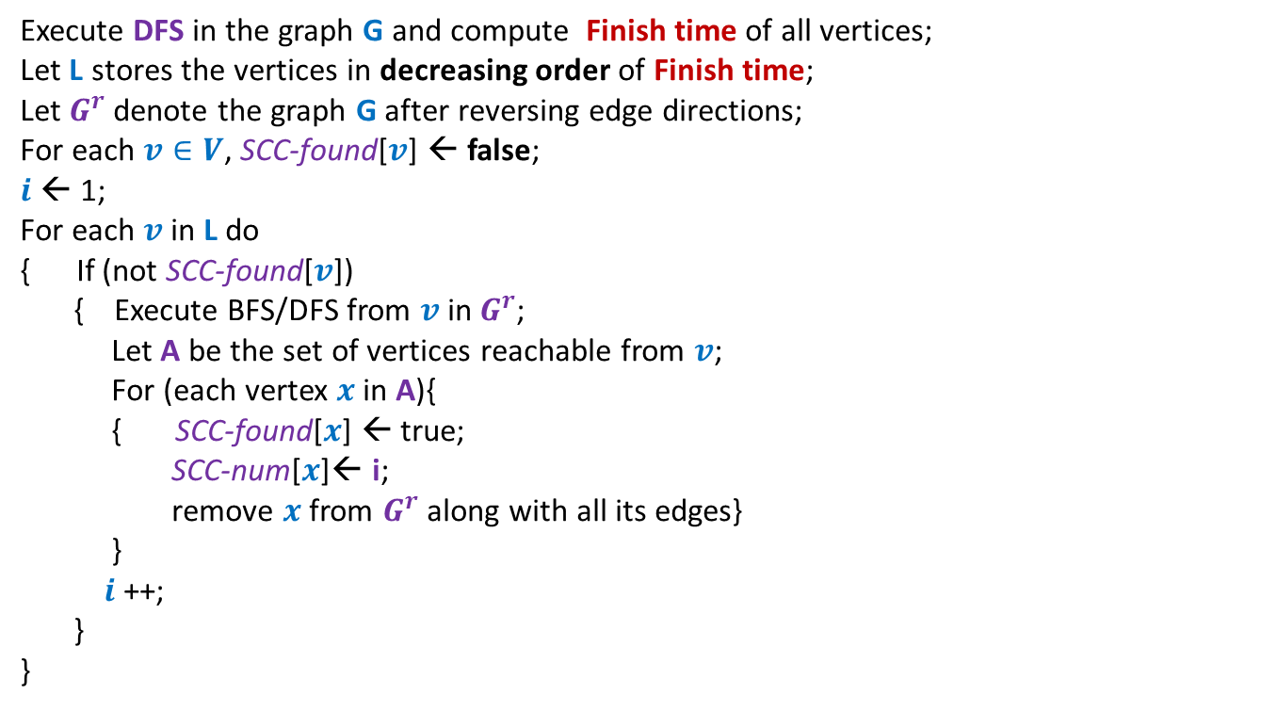
Algorithm for computing SCC
Execute DFS in the graph G and compute Finish time of all vertices;
Let L stores the vertices in decreasing order of Finish time;
Let $G^{r}$denote the graph G after reversing edge directions;
For each $v∈V$, SCC-found[$v$] ← false;
$i$ ← 1;
For each $v$ in L do
{ If (not SCC-found[$v$])
{ Execute BFS/DFS from $v$ in $G^{r}$;
Let A be the set of vertices reachable from $v$;
For (each vertex $x$ in A){
{ SCC-found[$x$] ← true;
SCC-num[$x$]← i;
remove $x$ from $G^{r}$along with all its edges}
}
$i$ ++;
}
}

Slide 19
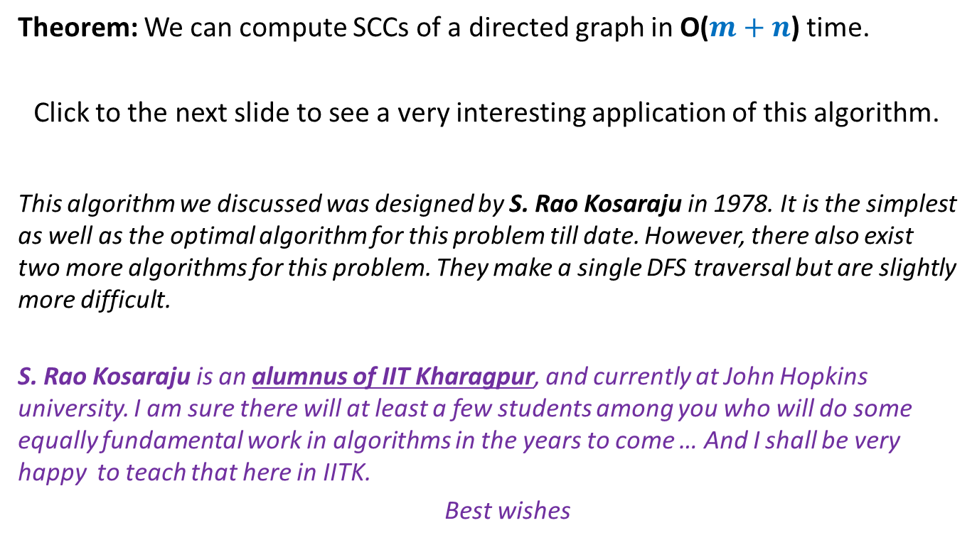
Conclusion
Theorem: We can compute SCCs of a directed graph in O($m+n$) time.
Click to the next slide to see a very interesting application of this algorithm.
This algorithm we discussed was designed by S. Rao Kosaraju in 1978. It is the simplest as well as the optimal algorithm for this problem till date. However, there also exist two more algorithms for this problem. They make a single DFS traversal but are slightly more difficult.
S. Rao Kosaraju is an alumnus of IIT Kharagpur, and currently at John Hopkins university. I am sure there will at least a few students among you who will do some equally fundamental work in algorithms in the years to come … And I shall be very happy to teach that here in IITK.
Best wishes

Slide 20
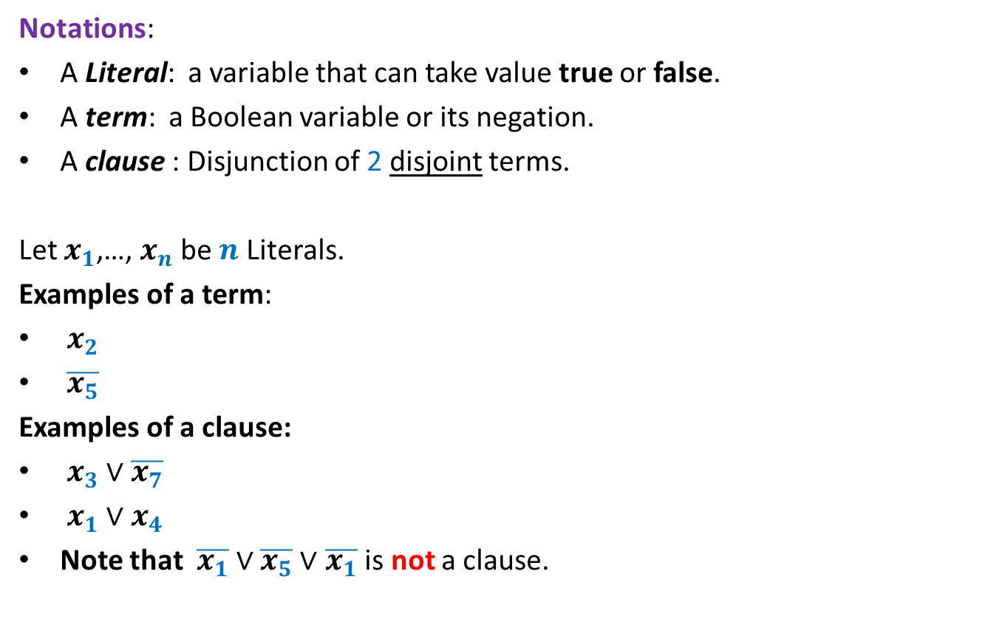
2-Satisfiability Problem
Notations:
A Literal: a variable that can take value true or false.
A term: a Boolean variable or its negation.
A clause : Disjunction of 2 disjoint terms.
Let $x_{1}$,…, $x_{n}$ be $n$ Literals.
Examples of a term:
$x_{2}$
$\overline{x_{5}}$
Examples of a clause:
$x_{3}∨\overline{x_{7}}$
$x_{1}∨x_{4}$
Note that $\overline{x_{1}}∨$ $\overline{x_{5}}∨$ $\overline{x_{1}}$ is not a clause.

Slide 21
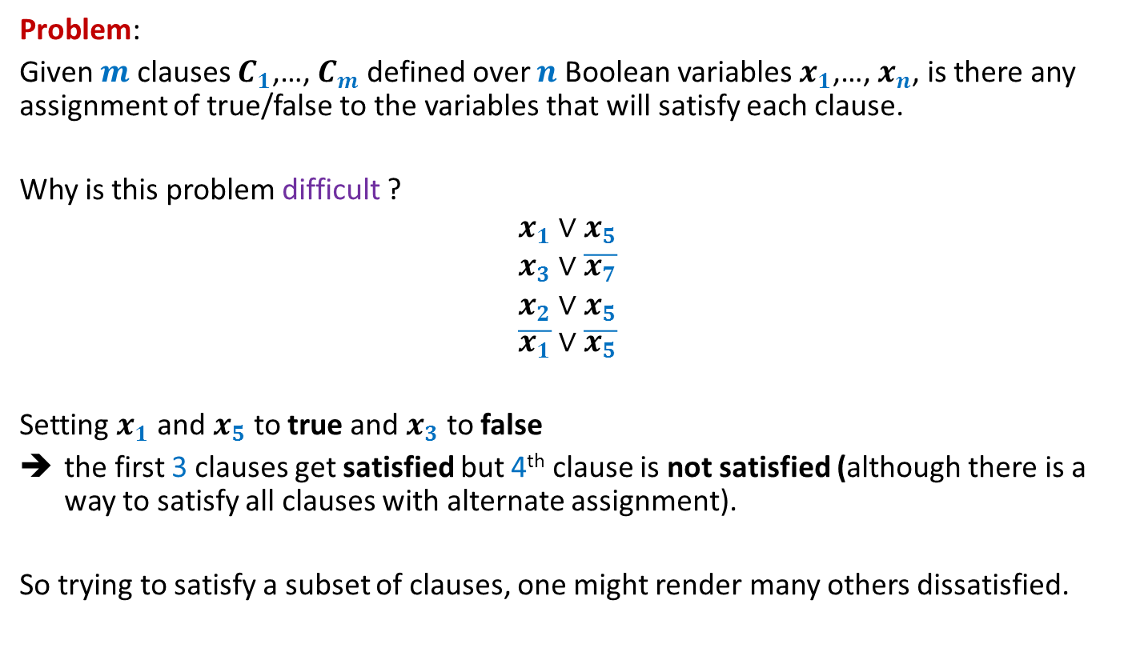
2-Satisfiability Problem
Problem:
Given $m$ clauses $C_{1}$,…, $C_{m}$ defined over $n$ Boolean variables $x_{1}$,…, $x_{n}$, is there any assignment of true/false to the variables that will satisfy each clause.
Why is this problem difficult ?
$$x_{1}∨x_{5}$$
$$x_{3}∨\overline{x_{7}}$$
$$x_{2}∨x_{5}$$
$$\overline{x_{1}}∨\overline{x_{5}}$$
Setting $x_{1}$ and $x_{5}$ to true and $x_{3}$ to false
the first 3 clauses get satisfied but 4th clause is not satisfied (although there is a way to satisfy all clauses with alternate assignment).
So trying to satisfy a subset of clauses, one might render many others dissatisfied.

Slide 22
2-Satisfiability Problem
Outline:
Model an instance of 2-Satisfiability Problem as a graph suitably.
* What will the vertices of the graph correspond to ?
* What might be the edges of the graph correspond to?
Formulate a problem on this graph which captures the 2-satisfiability problem.
You might require an efficient algorithm for SCC for solving the graph problem.
Fill in the details as a homework. You are welcome to discuss it if you wish.

