Slide 1
Design and Analysis of Algorithms (CS345/CS345A) Jan-April 2014
Lecture 17
Dynamic Programming

Slide 2
Greedy algorithm paradigm
Local approach
Proof of correctness is usually nontrivial and it involves establishing a relation between
solution of original instance
solution of smaller instance

Slide 3
Divide and Conquer algorithm paradigm
Divide the input instance into 2 or more parts of equal sizes
Solve the same problem for each smaller instance recursively.
Combine their solutions to get the solution of the original instance
It is usually quite straight forward to see if divide and conquer can be applied to solve a problem.

Slide 4
Iterative versus Recursive implementation of an algorithm

Slide 5
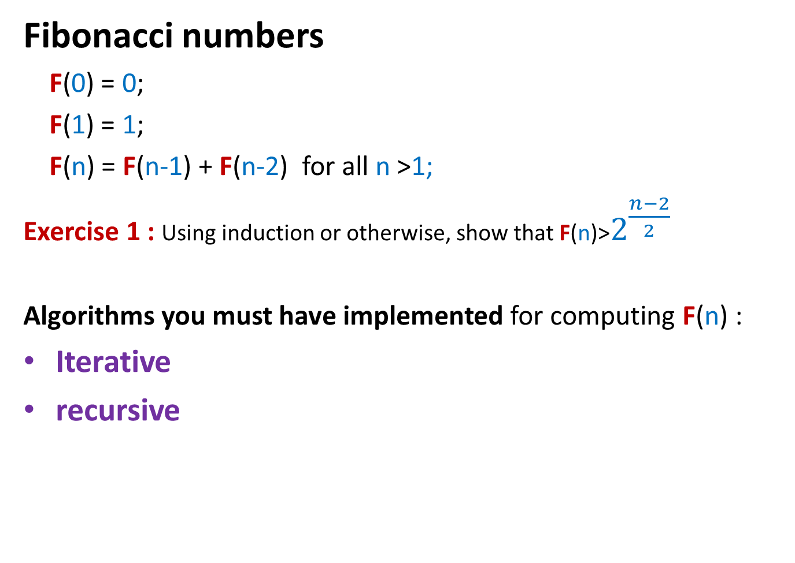
Algorithms for Fibonacci numbers
Fibonacci numbers
F(0) = 0;
F(1) = 1;
F(n) = F(n-1) + F(n-2) for all n >1;
Exercise 1 : Using induction or otherwise, show that F(n)>$2^{\frac{n−2}{2}}$
Algorithms you must have implemented for computing F(n) :
Iterative
recursive

Slide 6
Recursive algorithm for F(n)
Rfib(n)
{ if n=0 return 0;
else if n=1 return 1;
else return(Rfib(n-1) + Rfib(n-2))
}
Let G(n) denote the number of instruction executed by RFib(n)
G(0) = 1; G(1) = 2;
For n>1 G(n) = G(n-1)+G(n-2) + 4
Observation 1: G(n)>F(n) for all n;
It follows from Observation 1 and Exercise 1 that G(n) is exponential in n !
Explore the recursion tree of Rfib(n) to find the reason behind this exponential time.

Slide 7
Iterative Algorithm for F(n)
Total number of instructions= 4+3(n-2)+1 < 3n
IFib(n)
if n=0 return 0;
else if n=1 return 1;
else { a ← 0; b← 1;
For(i=2 to n) do
{ temp ← b;
b← a+b;
a← temp;
}
}
return b;
Let us calculate the number of instruction executed by IFib(n)
4 instructions
n-2 iterations
3 instructions per iteration
the final instruction

Slide 8
Longest common subsequence

Slide 9

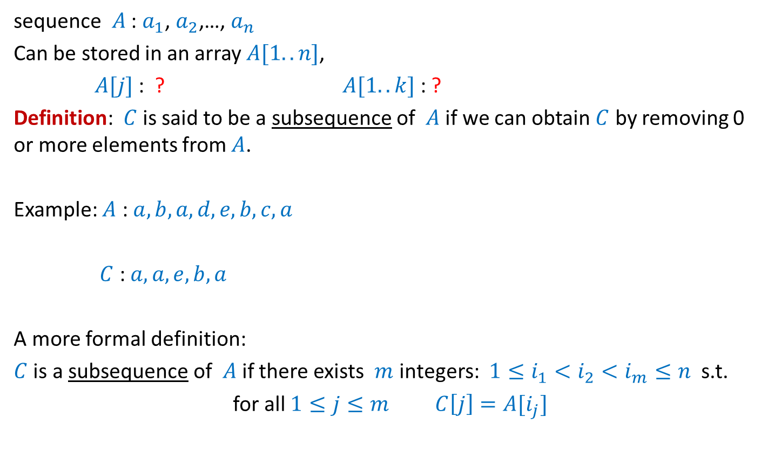

What is a subsequence
sequence $A$ : $a_{1}$, $a_{2}$,…, $a_{n}$
Can be stored in an array $A[1..n]$,
$A[j]$ : ? $A[1..k]$ : ?
Definition: $C$ is said to be a subsequence of $A$ if we can obtain $C$ by removing 0 or more elements from $A$.
Example: $A$ : $a,b,a,d,e,b,c,a$
$C$ : $a,a,e,b,a$
A more formal definition:
$C$ is a subsequence of $A$ if there exists $m$ integers: $1≤i_{1}<i_{2}<i_{m}≤n$ s.t.
for all $1≤j≤m$ $C\left[j\right]=A[i_{j}]$
$$a_{j}$$
$a_{1}$, $a_{2}$,…, $a_{k}$

Slide 10
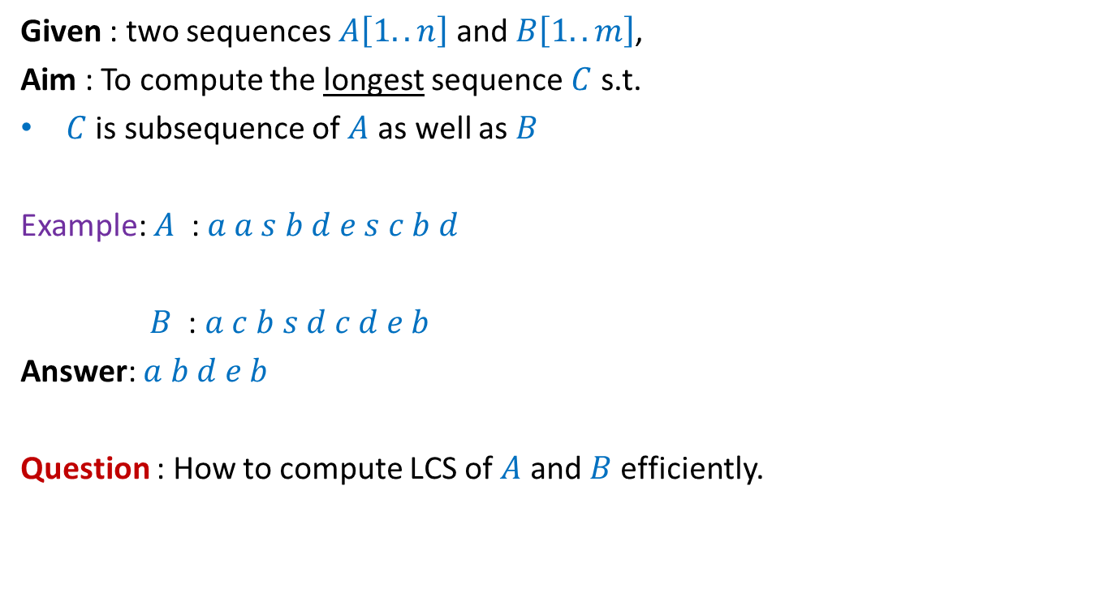
Problem Definition
Given : two sequences $A\left[1..n\right]$ and $B\left[1..m\right]$,
Aim : To compute the longest sequence $C$ s.t.
$C$ is subsequence of $A$ as well as $B$
Example: $A$ : $a a s b d e s c b d$
$B$ : $a c b s d c d e b$
Answer: $a b d e b$
Question : How to compute LCS of $A$ and $B$ efficiently.

Slide 11
Recursive formulation

Slide 12
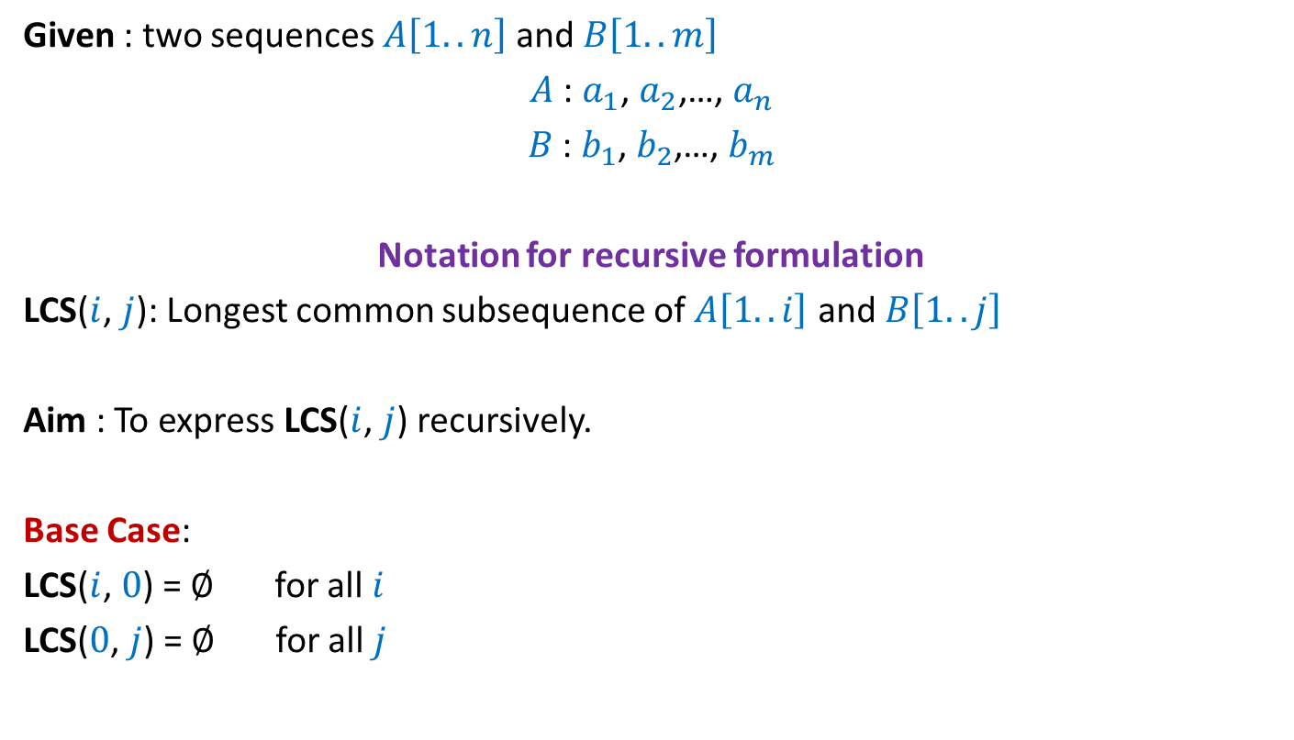
Given : two sequences $A\left[1..n\right]$ and $B\left[1..m\right]$
$A$ : $a_{1}$, $a_{2}$,…, $a_{n}$
$B$ : $b_{1}$, $b_{2}$,…, $b_{m}$
Notation for recursive formulation
LCS($i$, $j$): Longest common subsequence of $A\left[1..i\right]$ and $B\left[1..j\right]$
Aim : To express LCS($i$, $j$) recursively.
Base Case:
LCS($i$, $0$) = $∅$ for all $i$
LCS($0$, $j$) = $∅$ for all $j$

Slide 13



Recursive formulation of LCS($n$,$m$)
$a_{1}$ $a_{2}$ $a_{3}$ … $a_{n−1}{ a}_{n}$
$b_{1}$ $b_{2}$ $b_{3}$ … $b_{m−1}{ b}_{m}$

Slide 14
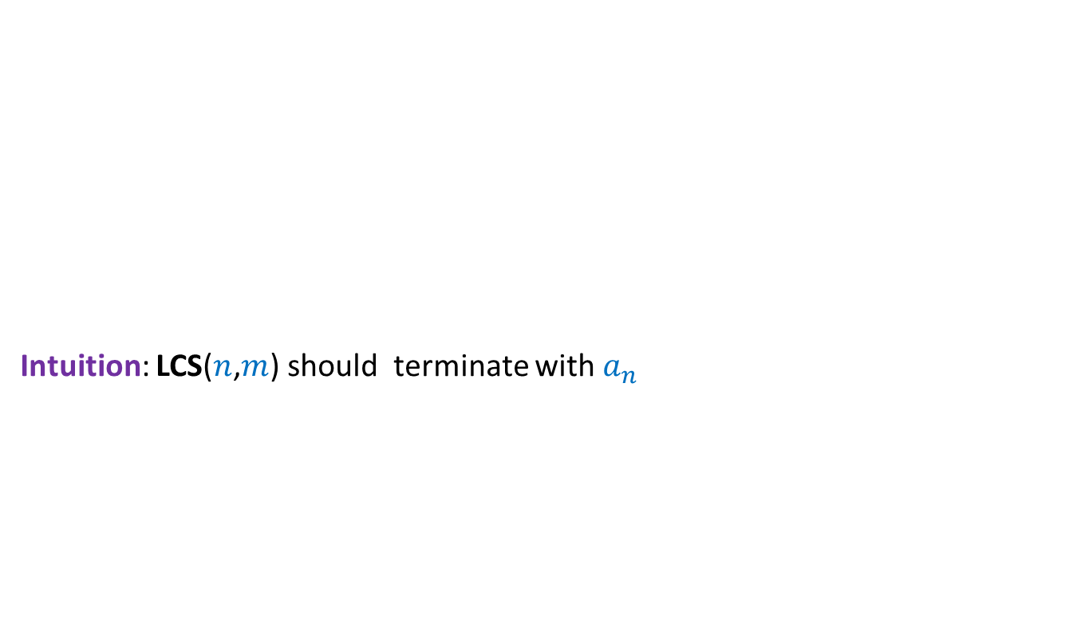

How does LCS($n$,$m$) look like when $a_{n}=b_{m}$ ?
Intuition: LCS($n$,$m$) should terminate with $a_{n}$
$a_{1}$ $a_{2}$ $a_{3}$ … $a_{n−1}{ a}_{n}$
$b_{1}$ $b_{2}$ $b_{3}$ … $b_{m−1}{ b}_{m}$

Slide 15


How does LCS($n$,$m$) look like when $a_{n}=b_{m}$ ?
Intuition: LCS($n$,$m$) should terminate with $a_{n}$
Lemma: If $a_{n}=b_{m}$then
LCS($n$,$m$) = ?
$a_{1}$ $a_{2}$ $a_{3}$ … $a_{n−1}{ a}_{n}$
$b_{1}$ $b_{2}$ $b_{3}$ … $b_{m−1}{ b}_{m}$
LCS($n−1$,$m−1$) ::${ a}_{n}$

Slide 16


How does LCS($n$,$m$) look like when $a_{n} ≠b_{m}$ ?
Intuition: Either $a_{n}$or $b_{m}$is not the last symbol of LCS($n$,$m$).
Observation: If $a_{n}$is not the last symbol of LCS($n$,$m$)
$a_{1}$ $a_{2}$ $a_{3}$ … $a_{n−1}{ a}_{n}$
$b_{1}$ $b_{2}$ $b_{3}$ … $b_{m−1}{ b}_{m}$

Slide 17
How does LCS($n$,$m$) look like when $a_{n} ≠b_{m}$ ?
Intuition: Either $a_{n}$or $b_{m}$is not the last symbol of LCS($n$,$m$).
Observation: If $a_{n}$is not the last symbol of LCS($n$,$m$)
$a_{1}$ $a_{2}$ $a_{3}$ … $a_{n−1}{ a}_{n}$
$b_{1}$ $b_{2}$ $b_{3}$ … $b_{m−1}{ b}_{m}$

Slide 18


How does LCS($n$,$m$) look like when $a_{n} ≠b_{m}$ ?
Intuition: Either $a_{n}$or $b_{m}$is not the last symbol of LCS($n\text{,}m$).
Observation: If $a_{n}$is not the last symbol of LCS($n$,$m$)
➔ LCS($n$,$m$) is ?
$a_{1}$ $a_{2}$ $a_{3}$ … $a_{n−1}{ a}_{n}$
$b_{1}$ $b_{2}$ $b_{3}$ … $b_{m−1}{ b}_{m}$
LCS($n−1$,$m$)

Slide 19
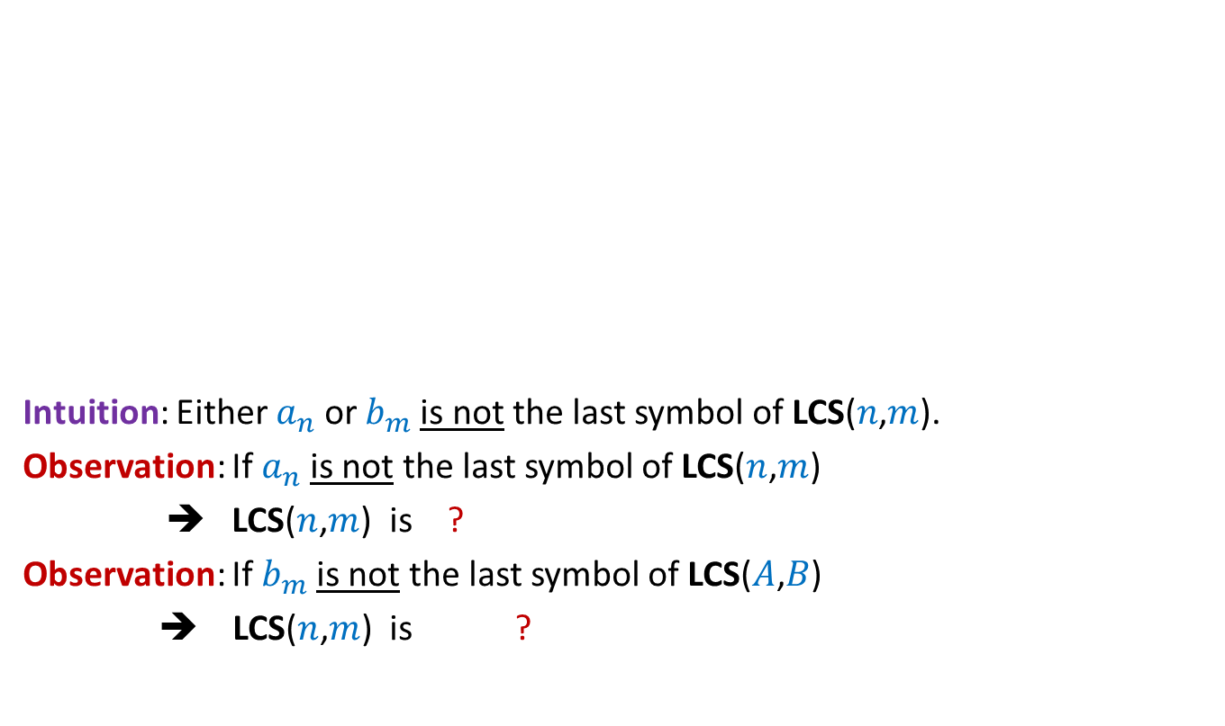

How does LCS($n$,$m$) look like when $a_{n} ≠b_{m}$ ?
Intuition: Either $a_{n}$or $b_{m}$is not the last symbol of LCS($n\text{,}m$).
Observation: If $a_{n}$is not the last symbol of LCS($n$,$m$)
➔ LCS($n$,$m$) is ?
Observation: If $b_{m}$is not the last symbol of LCS($A$,$B$)
➔ LCS($n$,$m$) is ?
$a_{1}$ $a_{2}$ $a_{3}$ … $a_{n−1}{ a}_{n}$
$b_{1}$ $b_{2}$ $b_{3}$ … $b_{m−1}{ b}_{m}$
LCS($n−1$,$m$)
LCS($n$,$m−1$)

Slide 20

How does LCS($n$,$m$) look like when $a_{n} ≠b_{m}$ ?
Intuition: Either $a_{n}$or $b_{m}$is not the last symbol of LCS($n$,$m$).
Lemma: If $a_{n}≠b_{m}$then
LCS($n\text{,}m$) is either LCS($n$,$m−1$) or LCS($n−1$,$m$)
$a_{1}$ $a_{2}$ $a_{3}$ … $a_{n−1}{ a}_{n}$
$b_{1}$ $b_{2}$ $b_{3}$ … $b_{m−1}{ b}_{m}$

Slide 21
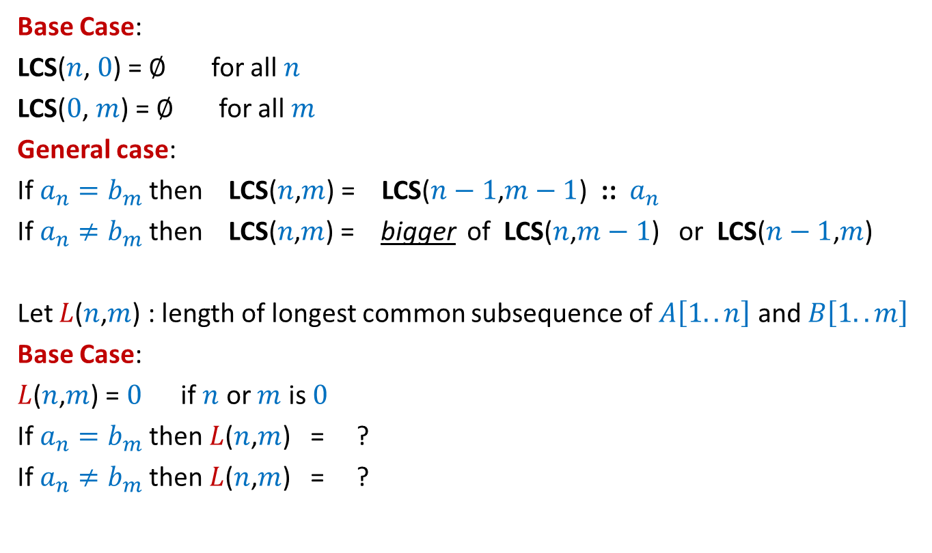



Recursive formulation for LCS($n$,$m$)
Base Case:
LCS($n$, $0$) = $∅$ for all $n$
LCS($0$, $m$) = $∅$ for all $m$
General case:
If $a_{n}=b_{m}$then LCS($n$,$m$) = LCS($n−1$,$m−1$) ::${ a}_{n}$
If $a_{n}≠b_{m}$then LCS($n\text{,}m$) = bigger of LCS($n$,$m−1$) or LCS($n−1$,$m$)
Let $L$($n$,$m$) : length of longest common subsequence of $A\left[1..n\right]$ and $B\left[1..m\right]$
Base Case:
$L$($n$,$m$) = $0$ if $n$ or $m$ is $0$
If $a_{n}=b_{m}$then $L$($n$,$m$) = ?
If $a_{n}≠b_{m}$then $L$($n$,$m$) = ?
$L$($n−1$,$m−1$) + 1
Max( $L$($n−1$,$m$) , $L$($n$,$m−1$))

Slide 22
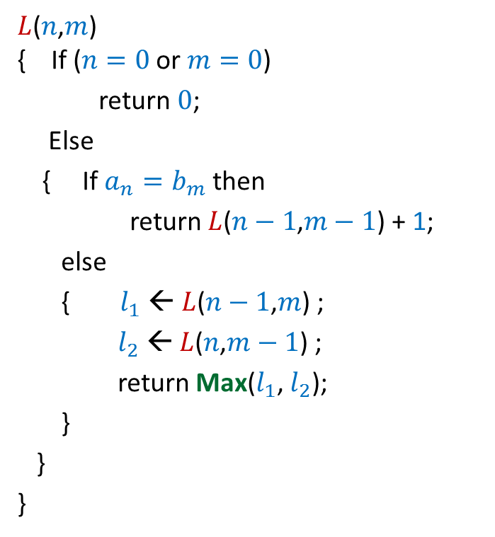

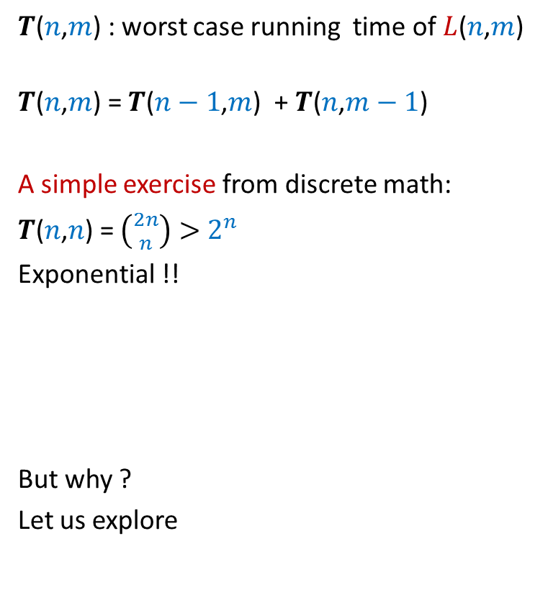
Recursive algorithm for $L$($n$,$m$)
$L$($n$,$m$) { If ($n=0$ or $m=0$)
return $0$;
Else
{ If $a_{n}=b_{m}$then
return $L$($n−1$,$m−1$) + 1;
else
{ $l_{1}$ ← $L$($n−1$,$m$) ;
$l_{2}$ ← $L$($n$,$m−1$) ;
return Max($l_{1}$, $l_{2}$);
}
}
}
$T$($n$,$m$) : worst case running time of $L$($n$,$m$)
$T$($n$,$m$) = $T$($n−1$,$m$) + $T$($n$,$m−1$)
A simple exercise from discrete math:
$T$($n$,$n$) = $\left({2n \atop n}\right)>$ $2^{n}$
Exponential !!
But why ?
Let us explore

Slide 23








Recursive algorithm for $L$($n$,$m$)
$L$($n$,$m$)
$L$($n$,$m$) { If ($n=0$ or $m=0$)
return $0$;
Else
{ If $a_{n}=b_{m}$then
return $L$($n−1$,$m−1$) + 1;
else
{ $l_{1}$ ← $L$($n−1$,$m$) ;
$l_{2}$ ← $L$($n$,$m−1$) ;
return Max($l_{1}$, $l_{2}$);
}
}
}
Solving same sub-problem multiple times !!
But how many sub-problems are there ?
only ($n+1$)*($m+1$)
Can we compute them efficiently ?
Get inspiration from algo for Fibonacci number !
$L$($n−1$,$m$)
$L$($n$,$m−1$)
$L$($n−1$,$m−1$)
$L$($n$,$m−2$)
$L$($n−2$,$m$)
$L$($n−1$,$m−1$)

Slide 24







Recursive algorithm for $L$($n$,$m$)
$T$[$i$,$j$] = $L$($i$,$j$)
$L$($n$,$m$) { If ($n=0$ or $m=0$)
return $0$;
Else
{ If $a_{n}=b_{m}$then
return $L$($n−1$,$m−1$) + 1;
else
{ $l_{1}$ ← $L$($n−1$,$m$) ;
$l_{2}$ ← $L$($n$,$m−1$) ;
return Max($l_{1}$, $l_{2}$);
}
}
}
$$m$$
0
$$j$$
…
…
1
0
0
0 0 0 ... 0
0 1 ... $n$
$$i$$
$$T$$

Slide 25
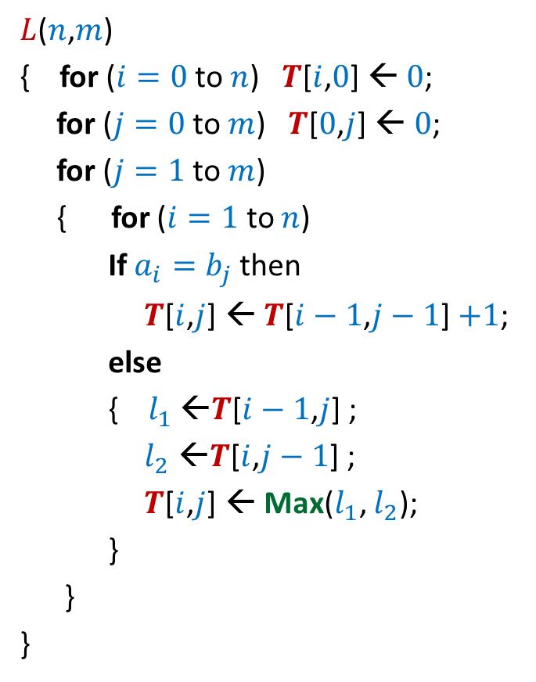


Iterative algorithm for $L$($n$,$m$)
$L$($n$,$m$)
{ for ($i=0$ to $n$) $T$[$i$,$0$] ← $0$;
for ($j=0$ to $m$) $T$[$0$,$j$] ← $0$;
for ($j=1$ to $m$)
{ for ($i=1$ to $n$)
If $a_{i}=b_{j}$then
$T$[$i$,$j$] ← $T$[$i−1$,$j−1$] $+1$;
else
{ $l_{1}$ ←$T$[$i−1$,$j$] ;
$l_{2}$ ←$T$[$i$,$j−1$] ;
$T$[$i$,$j$] ← Max($l_{1}$, $l_{2}$);
}
}
}
$$m$$
0
$$j$$
…
…
1
0
0
0 0 0 ... 0
0 1 ... $n$
$$i$$
Time complexity: O($nm$)
$$T$$

Slide 26
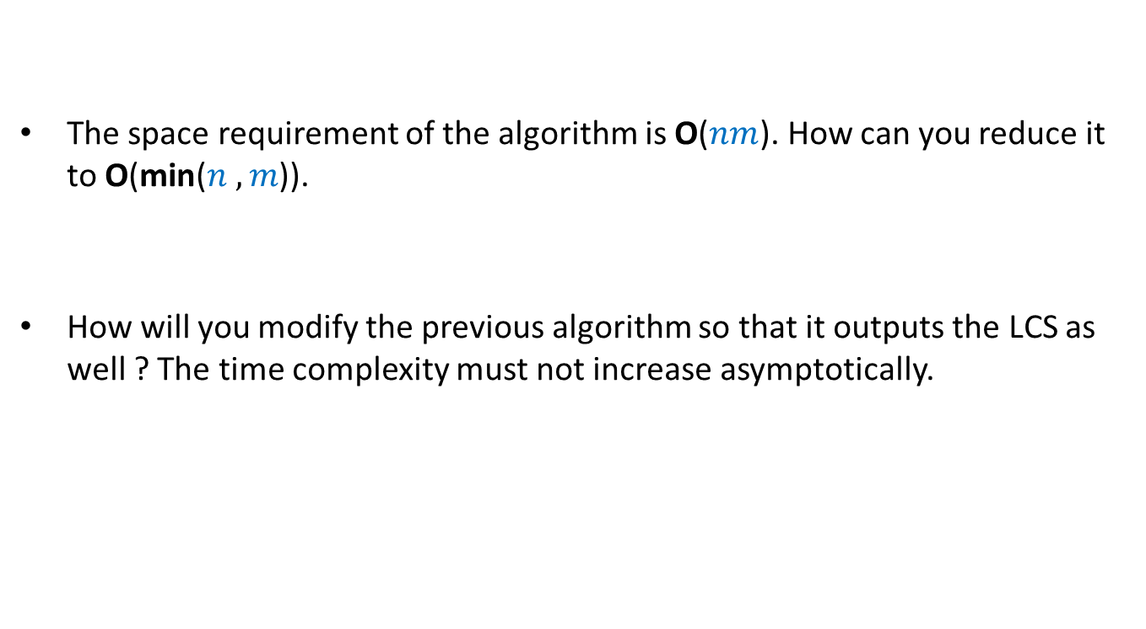
Homework
The space requirement of the algorithm is O($nm$). How can you reduce it to O(min($n ,m$)).
How will you modify the previous algorithm so that it outputs the LCS as well ? The time complexity must not increase asymptotically.

Slide 27
Dynamic Programming algorithm paradigm
Expressing the solution recursively.
Overall there are only Polynomial number of subproblems.
But there is a huge overlap among the subproblems. So the recursive algorithm takes exponential time (solving same subproblem multiple times).
So we compute the recursive solution iteratively in a bottom-up fashion (like in case of Fibonacci numbers). This avoids wastage of computation and leads to efficient implementation.

