Slide 1
Design and Analysis of Algorithms (CS345/CS345A) Jan-April 2014
Lecture 18
Dynamic Programming - II

Slide 2
a CONVEX POLYGON

Slide 3









Convex polygon
Representation: < $p_{1}$,…, $p_{n}$>
Stored in an array.
< $p_{i}$,…, $p_{j}$> :
Polygon consisting of points $p_{i}$,…, $p_{j}$
$$p_{i}$$
$$q$$
$$p_{3}$$
$$r$$
$$p_{2}$$
$$p_{n−1}$$
$$p_{n}$$
$$p_{1}$$

Slide 4
OPTMAL Triangulation of a CONVEX POLYGON

Slide 5

$ω$($i$,$j$,$k$): weight of triangle formed by $p_{i}$, $p_{j}$, $p_{k}$.
Assumption: It takes O(1) time to compute $ω$($i$,$j$,$k$)
Cost of a triangulation : sum of the weight of $n−2$ triangles formed.
$$p_{i}$$
$$p_{3}$$
$$p_{2}$$
$$p_{n−1}$$
$$p_{n}$$
$$p_{1}$$

Slide 6


$ω$($i$,$j$,$k$): weight of triangle formed by $p_{i}$, $p_{j}$, $p_{k}$.
Assumption: It takes O(1) time to compute $ω$($i$,$j$,$k$)
Cost of a triangulation : sum of the weight of $n−2$ triangles formed.
$$p_{k}$$
$$p_{3}$$
$$p_{2}$$
$$p_{n−1}$$
$$p_{n}$$
$$p_{1}$$

Slide 7






How to compute optimal triangulation ?
$$p_{k}$$
$$p_{3}$$
$$p_{2}$$
$$p_{n−1}$$
$$p_{n}$$
$$p_{1}$$

Slide 8

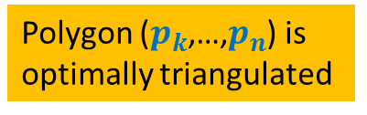
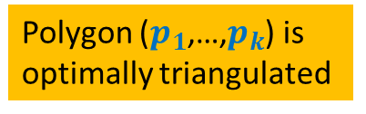
How to compute optimal triangulation ?
Question: If the opt. triangulation has triangle ($p_{1}$, $p_{k}$, $p_{n}$), what can we infer ?
$$p_{k}$$
$$p_{3}$$
Polygon ($p_{k}$,…,$p_{n}$) is
optimally triangulated
Polygon ($p_{1}$,…,$p_{k}$) is
optimally triangulated
$$p_{2}$$
$$p_{n−1}$$
$$p_{n}$$
$$p_{1}$$

Slide 9
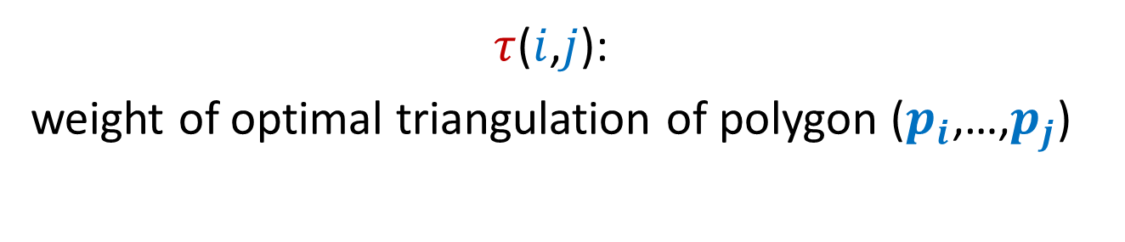
Recursive formulation of OPTMAL Triangulation
$τ$($i$,$j$):
weight of optimal triangulation of polygon ($p_{i}$,…,$p_{j}$)

Slide 10








Recursive formulation for $τ$($i$,$j$)
$τ$($i$,$i+1$) = 0
For $j>i+1$
$τ$($i$,$j$) =
$$\min_{?}{? }$$
$$p_{k}$$
$$p_{j}$$
($τ$($i$,$k$) $+τ\text{(}k,j\text{)+}ω\text{(}i,k,j\text{)}$ )
$i$<$k$< $j$
$$p_{i+1}$$
$$p_{i}$$

Slide 11
Recursive ALGORITHM of OPTMAL Triangulation

Slide 12
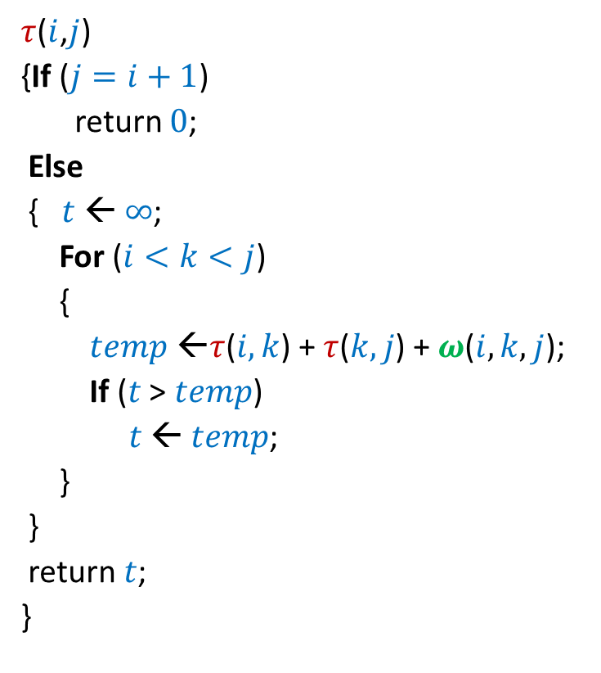

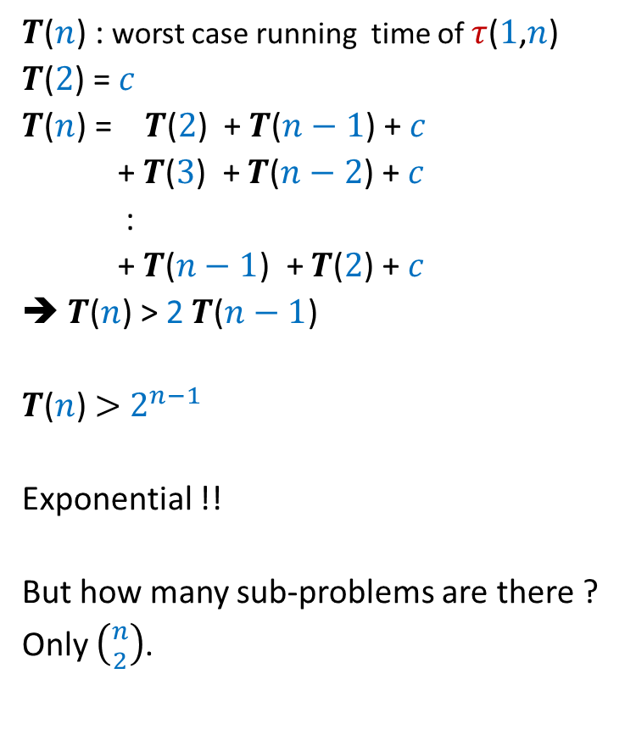
Recursive algorithm for $τ$($i$,$j$)
$τ$($i$,$j$)
{If ($j=i+1$)
return $0$;
Else
{$t$ ← $∞$;
For ($i<k<j$)
{
$temp$ ←$τ$($i,k$) + $τ$($k,j$) + $ω$($i,k,j$);
If ($t$ > $temp$)
$t$ ← $temp$;
}
}
return $t$;
}
$T$($n$) : worst case running time of $τ$($1$,$n$)
$T$($2$) = $c$
$T$($n$) = $T$($2$) + $T$($n−1$) + $c$
+ $T$($3$) + $T$($n−2$) + $c$
:
+ $T$($n−1$) + $T$($2$) + $c$
➔ $T$($n$) > 2 $T$($n−1$)
$T$($n$) $>$ $2^{n−1}$
Exponential !!
But how many sub-problems are there ?
Only $\left({n \atop 2}\right)$.

Slide 13






Recursive algorithm for $τ$($i$,$j$)
$T$[$i$,$j$] = $τ$($i$,$j$)
$τ$($i$,$j$)
{If ($j=i+1$)
return $0$;
Else
{$t$ ← $∞$;
For ($i<k<j$)
{
$temp$ ←$τ$($i,k$) + $τ$($k,j$) + $ω$($i,k,j$);
If ($t$ > $temp$)
$t$ ← $temp$;
}
}
return $t$;
}
$$n$$
0
0
0
0
0
0
0
0
0
$$i$$
0
…
0
2
0
1
0
1 2 ... $n$
$$j$$
$$T$$

Slide 14
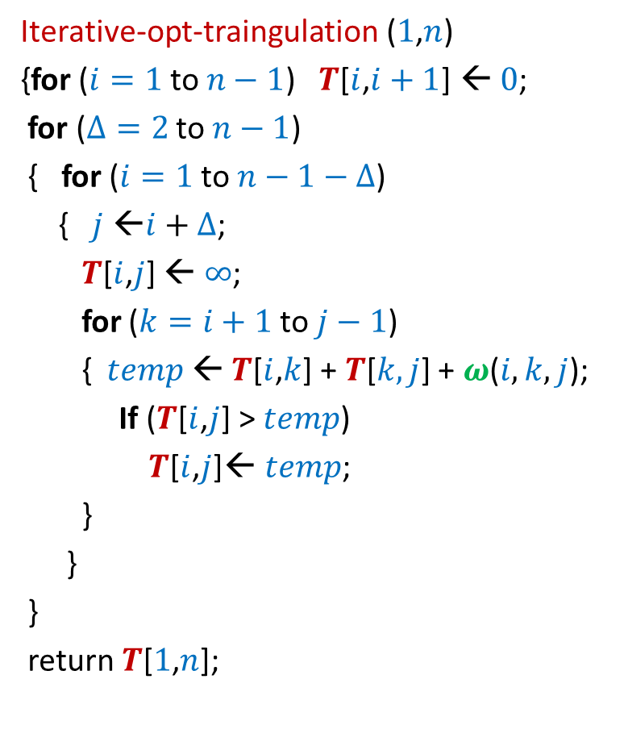



Iterative algorithm for $τ$($i$,$j$)
Iterative-opt-traingulation ($1$,$n$)
{for ($i=1$ to $n−1$) $T$[$i$,$i+1$] ← $0$;
for ($Δ=2$ to $n−1$)
{ for ($i=1$ to $n−1−Δ$)
{ $j$ ←$i+Δ$;
$T$[$i$,$j$] ← $∞$;
for ($k=i+1$ to $j−1$)
{ $temp$← $T$[$i$,$k$] + $T$[$k,j$] + $ω$($i,k,j$);
If ($T$[$i$,$j$] > $temp$)
$T$[$i$,$j$]← $temp$;
}
}
}
return $T$[$1$,$n$];
$T$[$i$,$j$] = $τ$($i$,$j$)
$$n$$
0
0
0
0
0
0
0
0
0
$$i$$
0
…
0
2
0
1
0
$$Δ$$
1 2 ... $n$
$$j$$
$$T$$

Slide 15

Iterative algorithm for $τ$($i$,$j$)
Theorem:
Given a convex polygon on $n$points and a weight function $ω$, we can compute its optimal triangulation in O($n^{3}$) time.

Slide 16
Section name

