Slide 1
Design and Analysis of Algorithms (CS345/CS345A) Jan-April 2014
Lecture 19
Shortest Paths in Directed Graphs with Negative Weights

Slide 2
OPTIMAL SUBSTRUCTURE PROPERTY
underlying every
Dynamic Programming based algorithm

Slide 3

Longest Common Subsequence
Lemma1: If $a_{n}=b_{m}$then
LCS($n$,$m$) = LCS($n−1$,$m−1$) ::${ a}_{n}$
Lemma2: If $a_{n}≠b_{m}$then
LCS($n\text{,}m$) is either LCS($n$,$m−1$) or LCS($n−1$,$m$)

Slide 4







Optimal triangulation of a convex polygon
$τ$($i$,$i+1$) = 0
For $j>i+1$
$τ$($i$,$j$) =
$$\min_{?}{? }$$
$$p_{k}$$
$$p_{j}$$
($τ$($i$,$k$) $+τ\text{(}k,j\text{)+}ω\text{(}i,k,j\text{)}$ )
$i$<$k$< $j$
$$p_{i+1}$$
$$p_{i}$$

Slide 5
OPTIMAL SUBSTRUCTURE PROPERTY
“Optimal solution of a problem contains within it
optimal solution for its smaller instances as well”.
Note:
Essential for every dynamic programming based algorithm
2. This property is also shared by Greedy algorithms.

Slide 6
Shortest pathS in a graph
Revisiting the problem

Slide 7
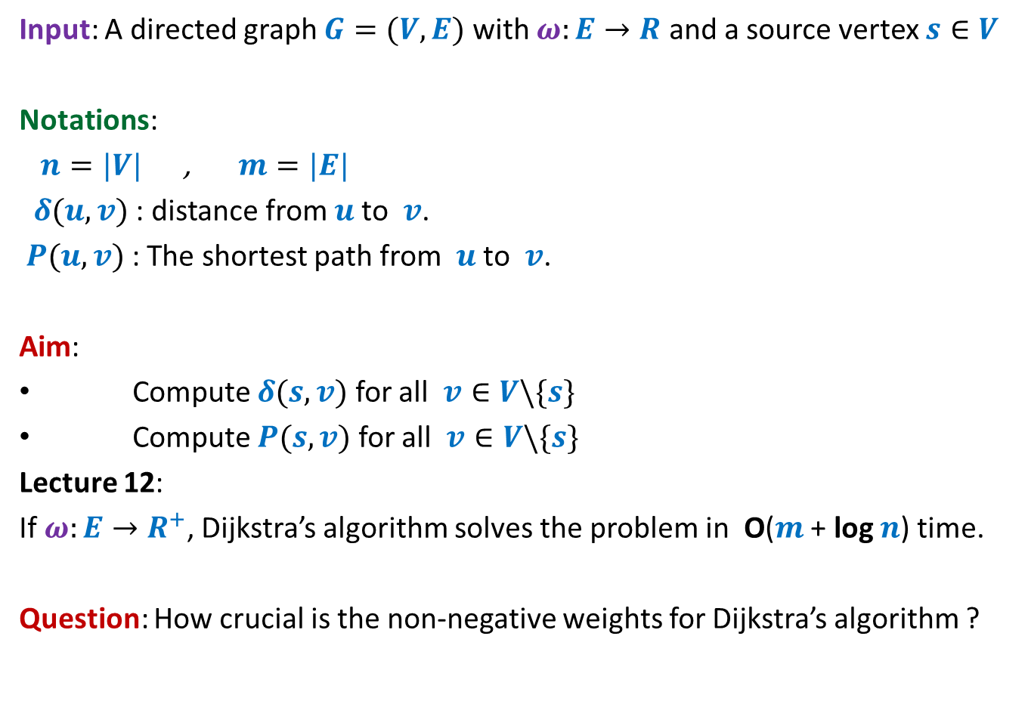
Problem Definition
Input: A directed graph $G=(V,E)$ with $ω:E→R$ and a source vertex $s∈V$
Notations:
$n=|V|$ , $m=|E|$
$δ(u,v)$ : distance from $u$to $v$.
$P(u,v)$ : The shortest path from $u$to $v$.
Aim:
Compute $δ(s,v)$ for all $v∈V\backslash \{s\}$
Compute $P(s,v)$ for all $v∈V\backslash \{s\}$
Lecture 12:
If $ω:E→R^{+}$, Dijkstra’s algorithm solves the problem in O($m$ + log $n$) time.
Question: How crucial is the non-negative weights for Dijkstra’s algorithm ?

Slide 8
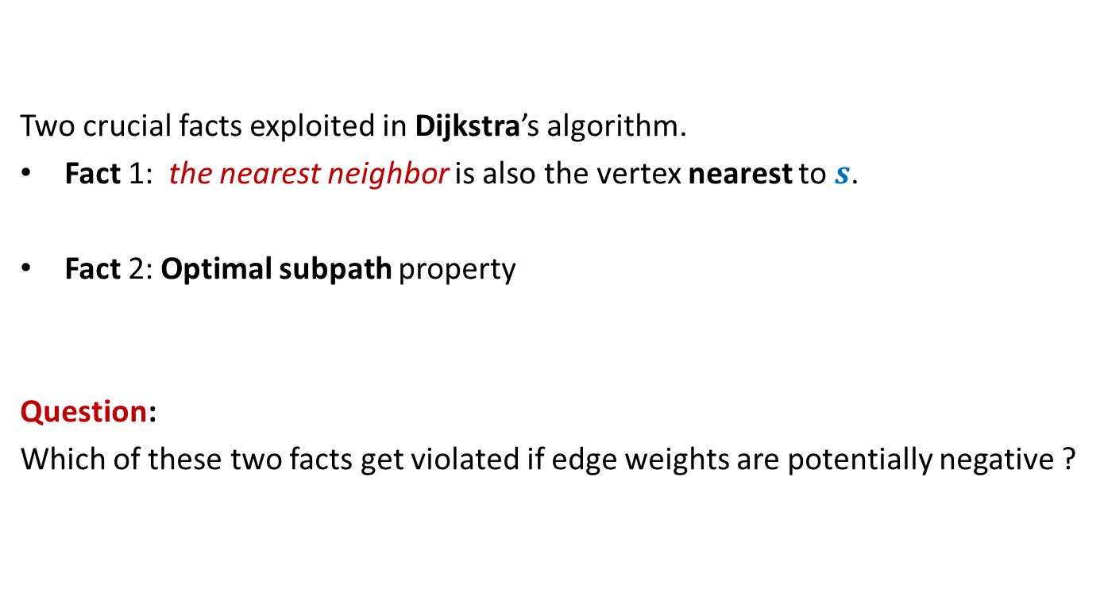
Revisiting Dijkstra’s algorithm
Two crucial facts exploited in Dijkstra’s algorithm.
Fact 1: the nearest neighbor is also the vertex nearest to $s$.
Fact 2: Optimal subpath property
Question:
Which of these two facts get violated if edge weights are potentially negative ?

Slide 9







Violation of Fact 1
Question: Can we be certain about the distance from $s$ to any vertex in this picture?
Answer: NO.☹
$$z$$
10
$$v$$
G
12
7
$$x$$
$$s$$
3
5
$$u$$
$$y$$

Slide 10

Violation of Fact 1
$$z$$
10
$$v$$
G
12
7
$$x$$
$$s$$
3
5
$$u$$
$$y$$
$$−11$$

Slide 11



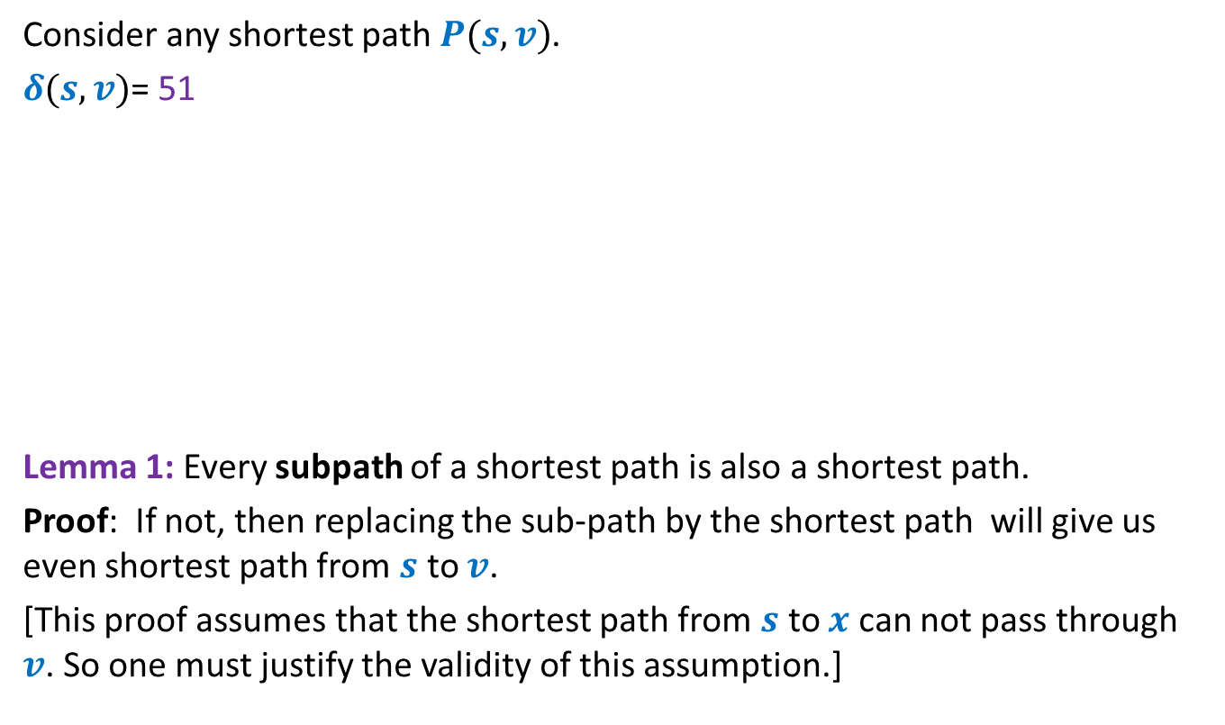




Violation of Fact 2 Optimal subpath property
Consider any shortest path $P(s,v)$.
$δ(s,v)$= 51
Lemma 1: Every subpath of a shortest path is also a shortest path.
Proof: If not, then replacing the sub-path by the shortest path will give us even shortest path from $s$ to $v$.
[This proof assumes that the shortest path from $s$ to $x$ can not pass through $v$. So one must justify the validity of this assumption.]
< 27
12
3
7
5
15
9
$$s$$
$$a$$
$$g$$
$$y$$
$$u$$
$$x$$
$v$
?

Slide 12

Violation of Fact 2 Optimal subpath property
Consider any shortest path $P(s,v)$.
$δ(s,v)$= 51
If the shortest path $P(s,x)$ passes through $v$, then we shall be covering even longer distance to reach $x$ from $s$. Hence the shortest path from $s$to $x$can not pass through $v$.
[See the crucial role played by the fact that the edge weights are nonnegative]
>= 36
12
3
7
5
15
9
$$s$$
$$a$$
$$g$$
$$y$$
$$u$$
$$x$$
$v$
>= 0

Slide 13
Violating the Optimal substructure property
in graphs having potentially negative edge

Slide 14



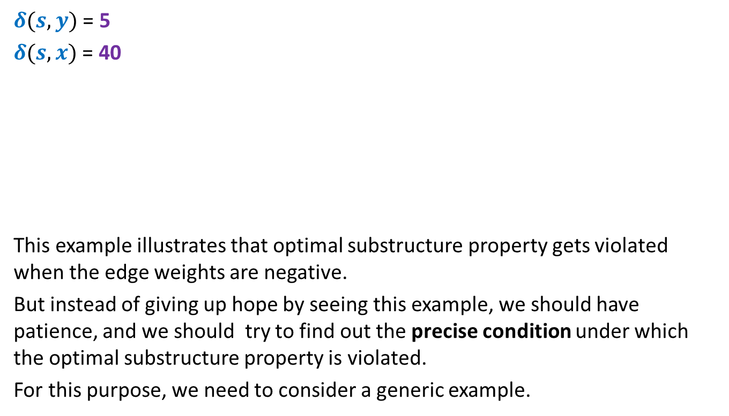






Violating the Optimal substructure property
$δ(s,y)$ = 5
$δ(s,x)$ = 40
This example illustrates that optimal substructure property gets violated when the edge weights are negative.
But instead of giving up hope by seeing this example, we should have patience, and we should try to find out the precise condition under which the optimal substructure property is violated.
For this purpose, we need to consider a generic example.
2
-3
10
$$a$$
$$b$$
$$c$$
$$f$$
5
6
$$P(s,y)$$
$$s$$
70
$$u$$
-20
$$v$$
10
$$x$$
-55
$$y$$
60
< 30
10

Slide 15

Violating the Optimal substructure property
Question: When can the shortest $s⇝x$ path pass through $y$ ?
$$P(s,y)$$
$$s$$
$$x$$
$$y$$

Slide 16


Violating the Optimal substructure property
Question: When can the shortest $s⇝x$ path pass through $y$ ?
Answer: Weight of the cycle $C$ must be NEGATIVE.
$$P(s,y)$$
$$s$$
$$x$$
$$y$$
Cycle $C$

Slide 17

Theorem: Given a directed $G=(V,E)$ with $ω:E→$ $R$,
all shortest paths in $G$possess optimal substructure property if there are no negative cycles.
Our patience proved helpful.☺

Slide 18
shortest paths in a graph
Negative weights
BUT No negative cycle

Slide 19
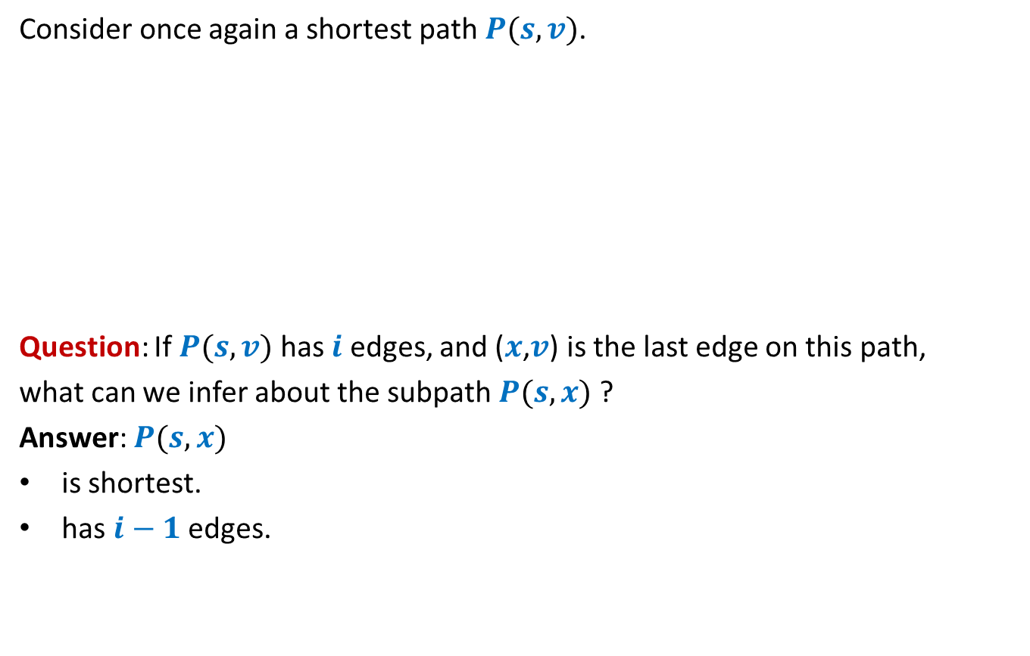

Exploiting the Optimal substructure property
Consider once again a shortest path $P(s,v)$.
Question: If $P(s,v)$ has $i$ edges, and ($x$,$v$) is the last edge on this path,
what can we infer about the subpath $P(s,x)$ ?
Answer: $P(s,x)$
is shortest.
has $i−1$ edges.
$$s$$
$$x$$
$v$

Slide 20





Exploiting the Optimal substructure property
$L(v,i)$ : length of the shortest $s⇝v$ having at most $i$ edges.
Aim: To compute $L(v, ? )$ for each $v$.
Question: How to find a recursive formulation for $L(v,i)$ ?
$$n−1$$
$$L$$
$$V$$
$$i$$

Slide 21

Recursive formulation for $L(v,i)$

Slide 22
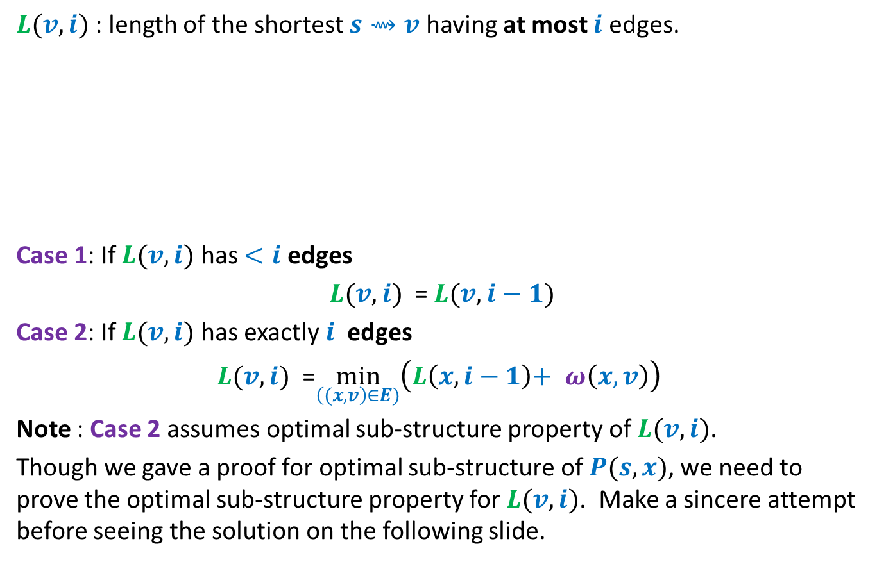


Recursive Formulation for $L(v,i)$
$L(v,i)$ : length of the shortest $s⇝v$ having at most $i$ edges.
Case 1: If $L(v,i)$ has $<i$ edges
$L(v,i)$ = $L(v, i−1)$
Case 2: If $L(v,i)$ has exactly $i$ edges
$L(v,i)$ =$\min_{\left((x,v\right)∈E)}\left(L\left(x, i−1\right)\text{+} ω\left(x,v\right)\right)$
Note : Case 2 assumes optimal sub-structure property of $L(v,i)$.
Though we gave a proof for optimal sub-structure of $P(s,x)$, we need to prove the optimal sub-structure property for $L(v,i)$. Make a sincere attempt before seeing the solution on the following slide.
$$s$$
$$x$$
$v$
$i−1$ edges

Slide 23

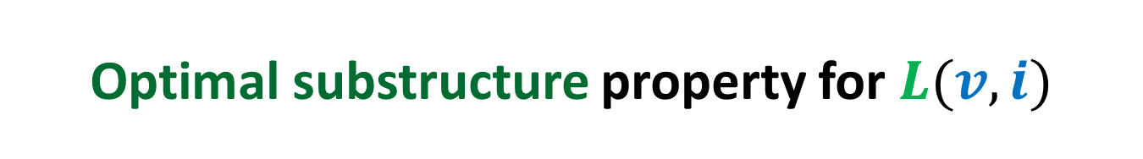

Optimal substructure property for $L(v,i)$
Suppose the path corresponding to $L(x,i−1)$ passes through $v$.
So $L\left(x,i−1\right)>ℓ$
Question: What can we say about $L(x,i−1)$ in this case ?
$$ℓ$$
$$s$$
$$x$$
$v$
$i−1$ edges

Slide 24


Optimal substructure property for $L(v,i)$
Suppose the path corresponding to $L(x,i−1)$ passes through $v$.
So $L\left(x,i−1\right)>ℓ$
Question: What can we say about $L(x,i−1)$ in this case ?
Answer: $L\left(x,i−1\right)≥$ $ℓ+ ω$($C$)
$≥$ $ℓ$
A contradiction!
$$ℓ$$
$$s$$
$$x$$
$v$
$i−1$ edges
Cycle $C$

Slide 25





Base case: $L(v,1)$
$L\left[s,1\right]=0$.
If $(s,v)∈E$ then $L[v,1]$ = ?
else $L[v,1]$ = ?
$$z$$
10
$$t$$
G
12
7
$$x$$
$$s$$
3
5
$$u$$
$$y$$
$ω\left(s,v\right)$
$∞$

Slide 26
BellMAN-Ford Algorithm
For shortest paths in a graph with
Negative weights
BUT No negative cycle

Slide 27








Bellman-Ford’s algorithm
Bellman-Ford-algo($s$,$G$)
{
For each $v∈V\backslash \{s\}$ do
If $(s,v)∈E$ then $L[v,1]$← ?
else $L[v,1]$← ?
$L[s,1]$← ?
For $i$ = $2$ to $n−1$ do
{ For each $v∈V$ do
$L[v,i]$←$L[v,i−1]$;
For each $(x,v)∈E$ do
$L[v,i]\text{←}$ min( ? , ? )
}
}
$ω\left(s,v\right)$
$∞$;
Initializing $L[∗,1]$
$0$;
{
Computing$L[v,i]$
$$L[v,i]$$
$L[x,i−1]+ω\left(x,v\right)$
}

Slide 28
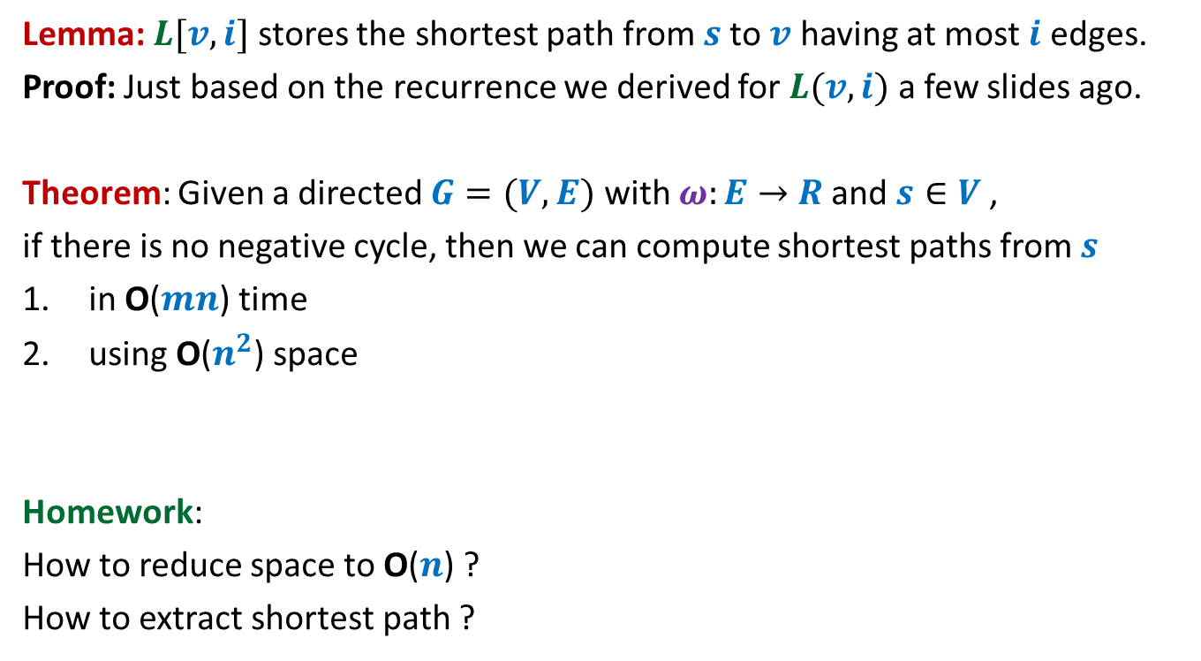
Bellman-Ford’s algorithm
Lemma: $L[v,i]$ stores the shortest path from $s$to $v$ having at most $i$ edges.
Proof: Just based on the recurrence we derived for $L(v,i)$ a few slides ago.
Theorem: Given a directed $G=(V,E)$ with $ω:E→$ $R$ and $s∈V$,
if there is no negative cycle, then we can compute shortest paths from $s$
in O($mn$) time
using O($n^{2}$) space
Homework:
How to reduce space to O($n$) ?
How to extract shortest path ?

Slide 29
shortest paths in a graph
Having Negative weight cycle

Slide 30
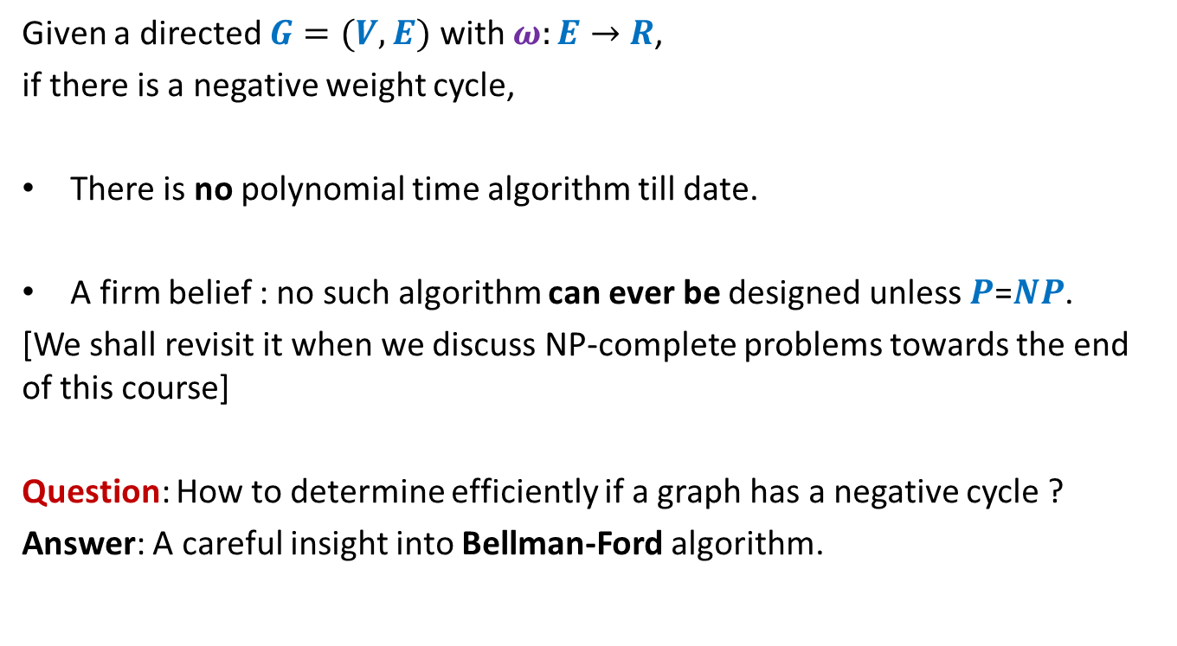
Shortest paths in presence of negative weight cycles
Given a directed $G=(V,E)$ with $ω:E→$ $R$,
if there is a negative weight cycle,
There is no polynomial time algorithm till date.
A firm belief : no such algorithm can ever be designed unless $P$=$NP$.
[We shall revisit it when we discuss NP-complete problems towards the end of this course]
Question: How to determine efficiently if a graph has a negative cycle ?
Answer: A careful insight into Bellman-Ford algorithm.

