Slide 1
Design and Analysis of Algorithms (CS345/CS345A) Jan-April 2014
Lecture 20
Shortest Paths in Directed Graphs with Negative Weights - II

Slide 2
Recap from the previous lecture

Slide 3
shortest paths in a graph
Negative weights
BUT No negative cycle

Slide 4








Bellman-Ford’s algorithm
Bellman-Ford-algo($s$,$G$)
{
For each $v∈V\backslash \{s\}$ do
If $(s,v)∈E$ then $L[v,1]$← ?
else $L[v,1]$← ?
$L[s,1]$← ?
For $i$ = $2$ to $n−1$ do
{ For each $v∈V$ do
$L[v,i]$←$L[v,i−1]$;
For each $(x,v)∈E$ do
$L[v,i]\text{←}$ min( ? , ? )
}
}
$ω\left(s,v\right)$
$∞$;
Initializing $L[∗,1]$
$0$;
{
Computing$L[v,i]$
$$L[v,i]$$
$L[x,i−1]+ω\left(x,v\right)$
}

Slide 5
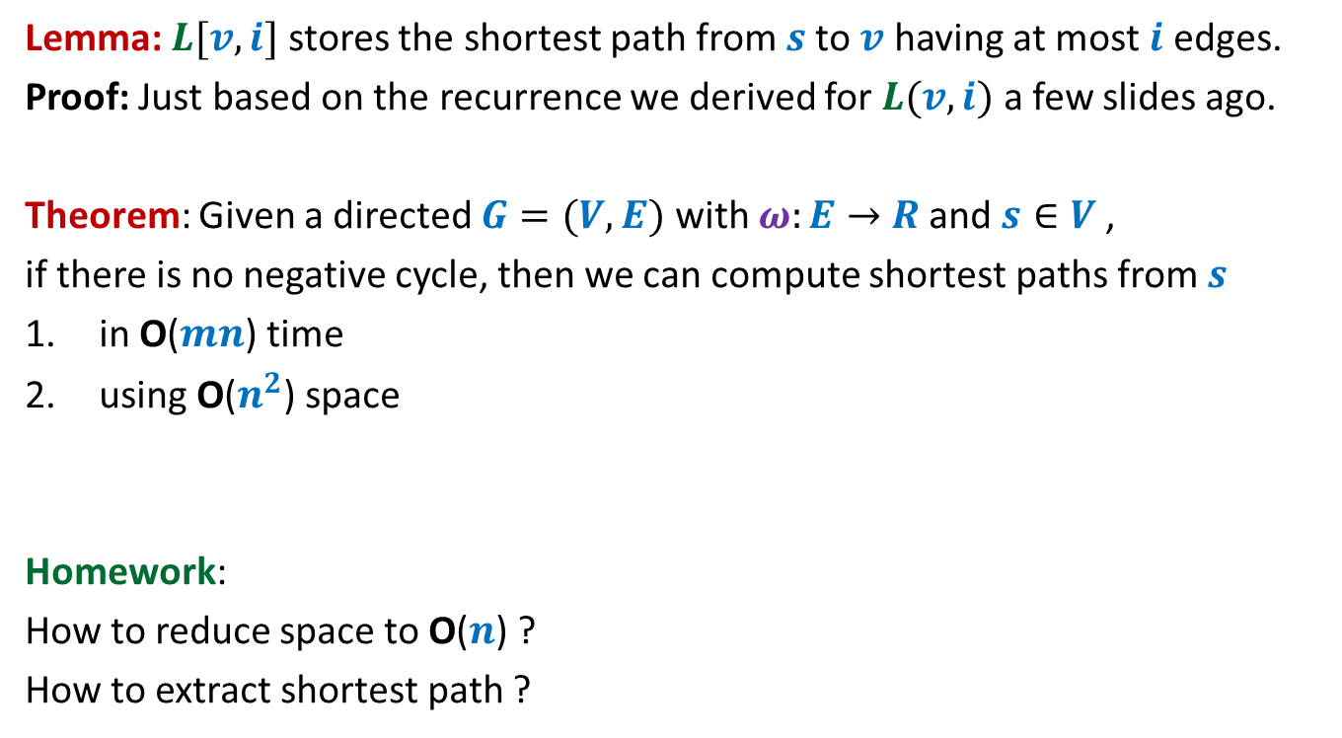
Bellman-Ford’s algorithm
Lemma: $L[v,i]$ stores the shortest path from $s$to $v$ having at most $i$ edges.
Proof: Just based on the recurrence we derived for $L(v,i)$ a few slides ago.
Theorem: Given a directed $G=(V,E)$ with $ω:E→$ $R$ and $s∈V$,
if there is no negative cycle, then we can compute shortest paths from $s$
in O($mn$) time
using O($n^{2}$) space
Homework:
How to reduce space to O($n$) ?
How to extract shortest path ?

Slide 6
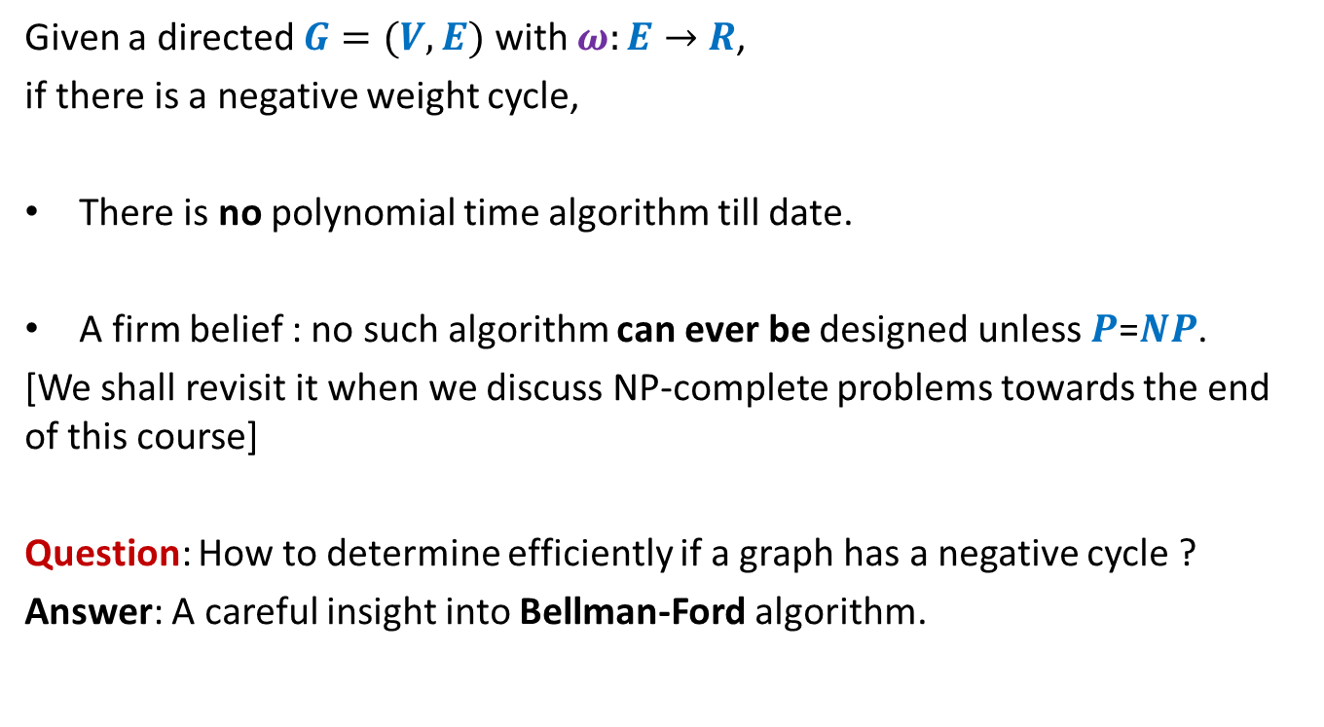
Shortest paths in presence of negative weight cycles
Given a directed $G=(V,E)$ with $ω:E→$ $R$,
if there is a negative weight cycle,
There is no polynomial time algorithm till date.
A firm belief : no such algorithm can ever be designed unless $P$=$NP$.
[We shall revisit it when we discuss NP-complete problems towards the end of this course]
Question: How to determine efficiently if a graph has a negative cycle ?
Answer: A careful insight into Bellman-Ford algorithm.

Slide 7
Getting insight into the Bellman-Ford algorithm

Slide 8
















Execution of Bellman-Ford algorithm
-2
$$v$$
$$x$$
5
$$y$$
$$∞$$
6
8
$$x$$
$$∞$$
$$s$$
6
7
-4
7
$$v$$
$$6$$
7
$$u$$
4
$$y$$
$$u$$
$$7$$
$$s$$
$$0$$
$$1 2 3 4$$
$$L$$

Slide 9





Execution of Bellman-Ford algorithm
-2
$$v$$
$$x$$
5
$$y$$
$$∞$$
$$11$$
6
8
$$x$$
$$∞$$
$$3$$
$$s$$
6
7
-4
7
$$v$$
$$6$$
$$6$$
7
$$u$$
4
$$y$$
$$u$$
$$7$$
$$7$$
$$s$$
$$0$$
$$0$$
$$1 2 3 4$$
$$L$$

Slide 10





Execution of Bellman-Ford algorithm
-2
$$v$$
$$x$$
5
$$y$$
$$∞$$
$$11$$
$$9$$
6
8
$$x$$
$$∞$$
$$3$$
$$3$$
$$s$$
6
7
-4
7
$$v$$
$$6$$
$$6$$
$$1$$
7
$$u$$
4
$$y$$
$$u$$
$$7$$
$$7$$
$$7$$
$$s$$
$$0$$
$$0$$
$$0$$
$$1 2 3 4$$
$$L$$

Slide 11








Execution of Bellman-Ford algorithm
-2
$$v$$
$$x$$
5
$$y$$
$$∞$$
$$11$$
$$9$$
$$8$$
6
8
$$x$$
$$∞$$
$$3$$
$$3$$
$$3$$
$$s$$
6
7
-4
7
$$v$$
$$6$$
$$6$$
$$1$$
$$1$$
7
$$u$$
4
$$y$$
$$u$$
$$7$$
$$7$$
$$7$$
$$7$$
$$s$$
$$0$$
$$0$$
$$0$$
$$0$$
$$1 2 3 4$$
$$L$$

Slide 12
Key Observations on Bellman-Ford algorithm

Slide 13






Observation 1
Bellman-Ford-algo($s$,$G$)
{
For each $v∈V\backslash \{s\}$ do
If $(s,v)∈E$ then $L[v,1]$← ?
else $L[v,1]$← ?
$L[s,1]$← ?
For $i$ = $2$ to $n−1$ do
{ For each $v∈V$ do
$L[v,i]$←$L[v,i−1]$;
For each $(x,v)∈E$ do
$L[v,i]\text{←}$ min($L[v,i]$, $L[x,i−1]+ω\left(x,v\right)$)
}
}
$ω\left(s,v\right)$
$∞$;
$0$;
$$L$$
$$V$$
{
$$i$$
}
Question: What if $L \left[v,i\right]=L [v,i−1]$ for all $v∈V$ ?
Answer: $L \left[v,j\right]=L [v,i−1]$ for all $j>i−1$ , $v∈V$ ?

Slide 14

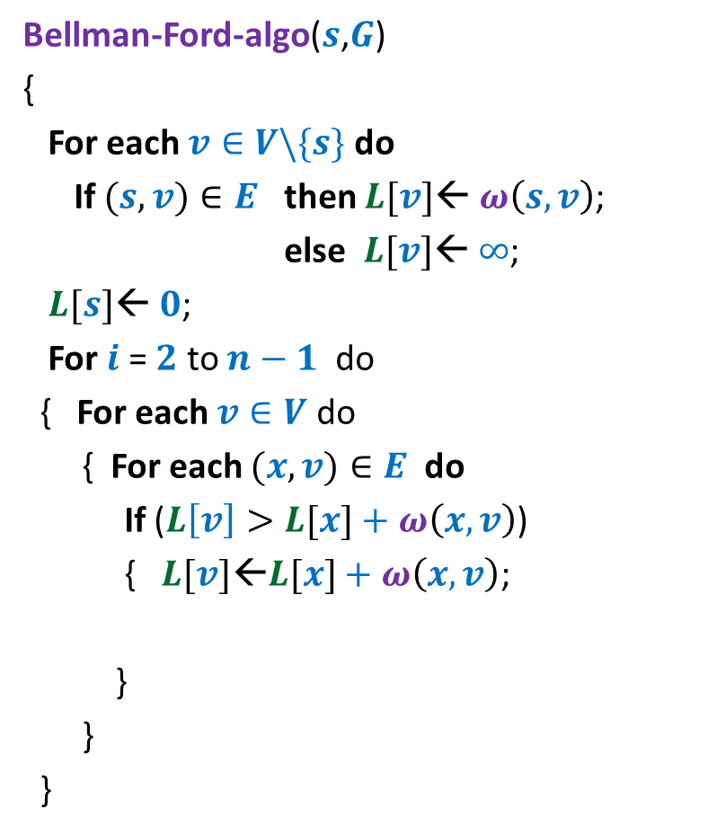



Observation 2 Solving the homework problems
Bellman-Ford-algo($s$,$G$)
{
For each $v∈V\backslash \{s\}$ do
If $(s,v)∈E$ then $L[v]$← $ω\left(s,v\right)$;
else $L[v]$← $∞$;
$L[s]$← $0$;
For $i$ = $2$ to $n−1$ do
{ For each $v∈V$ do
{ For each $(x,v)∈E$ do
If ($L\left[v\right]>L[x]+ω\left(x,v\right)$)
{ $L[v]\text{←}L[x]+ω\left(x,v\right)$;
}
}
}
Lemma: At the end of $i$th iteration, $L\left[v,i\right]=$ length of the shortest $s$to $v$ path having at most $i$ edges.
$$L\left[v\right]≤$$
$P[s]$← $s$;
$P[v]$← $x$;

Slide 15

Observations 3
Question: If there is no negative cycle, then what happens if we execute Bellman-Ford algorithm for $i>n−1$?
Answer: No change in the label $L[v]$ of any vertex.

Slide 16

Observations 4
Question: If there is a path from $s$ to $v$ consisting of $k$ edges,
in which iteration will $L\left[v\right]$get a finite value ?
Answer: $≤k$

Slide 17

Observations 5
Question: Does the order in which vertices are processed in the For loop have any influence on the running time ?
Answer: Yes
If vertices are processed in the BFS order of the shortest path tree, after one iteration itself, $L\left[v\right]$ will store the shortest path length from $s$ to $v$ for each $v∈V$.
$$s$$
Shortest path tree

Slide 18

Detecting negative cycle in $G$

Slide 19










$$v_{1}$$
Question: Once the cycle $C$ has been reached by $s$,
what will happen to labels of its vertices?
Answer: At least one label will change in each subsequent iteration.
Proof: If no label changes, then
$L\left[v_{1}\right]≤L[v_{k}]+ω\left(v_{k},v_{1}\right)$
$L\left[v_{2}\right]≤L[v_{1}]+ω\left(v_{1},v_{2}\right)$
$L\left[v_{3}\right]≤L[v_{2}]+ω\left(v_{2},v_{3}\right)$
:
$L\left[v_{k−1}\right]≤L[v_{k−2}]+ω\left(v_{k−2},v_{k−1}\right)$
$L\left[v_{k}\right]≤L[v_{k−1}]+ω\left(v_{k−1},v_{k}\right)$
➔
$0≤ω\left(v_{k},v_{1}\right)+ω\left(v_{1},v_{2}\right)+…+ω\left(v_{k−1},v_{k}\right)$
A contradiction !!
$$v_{k}$$
$$v_{2}$$
Cycle $C$
$$v_{3}$$
$$s$$
$$v_{4}$$
$$v_{6}$$
$$v_{5}$$

Slide 20

Detecting negative cycle in $G$
Execute Bellman-Ford algorithm.
Run one more iteration of the For loop
If any label changes, declare “there is a negative cycle”
else declare “the labels are correct distances”

Slide 21

Homework
Design an O($mn$) time algorithm to output a negative cycle (if present) in a directed weighted graph.

