Slide 1
Design and Analysis of Algorithms (CS345/CS345A) Jan-April 2014
Lecture 21
Dynamic Programming – V
All-Pairs Shortest Paths
Bitonic Tour

Slide 2
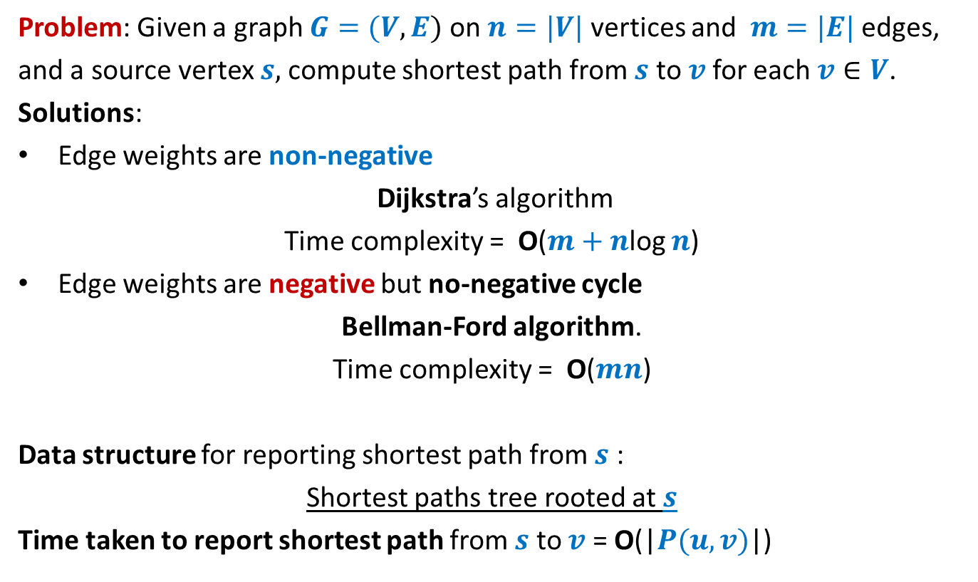
Single source shortest paths in a graph
Problem: Given a graph $G=(V,E)$ on $n=|V|$ vertices and $m=|E|$ edges,
and a source vertex $s,$compute shortest path from $s$ to $v$for each $v∈V$.
Solutions:
Edge weights are non-negative
Dijkstra’s algorithm
Time complexity = O($m+n$log $n$)
Edge weights are negative but no-negative cycle
Bellman-Ford algorithm.
Time complexity = O($mn$)
Data structure for reporting shortest path from $s$ :
Shortest paths tree rooted at $s$
Time taken to report shortest path from $s$ to $v$ = O(|$P(u,v)$|)

Slide 3
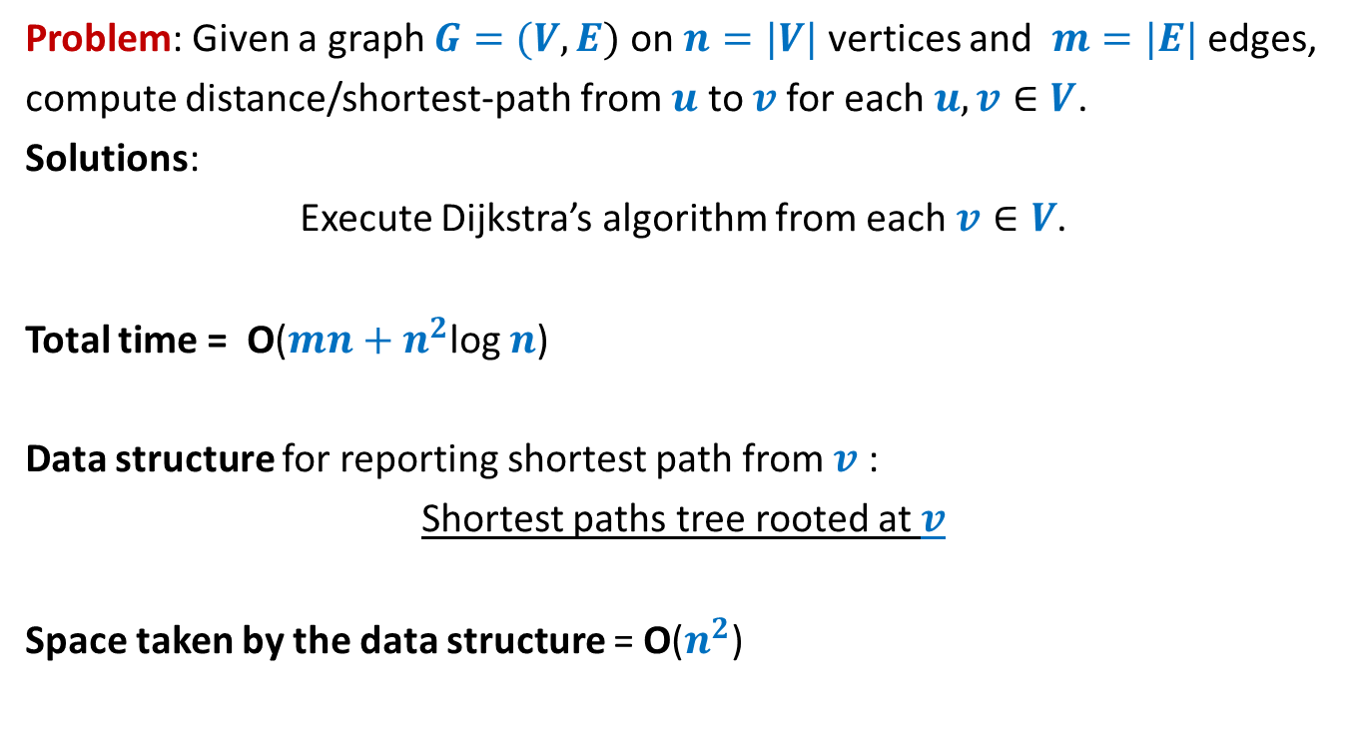
All-pairs shortest paths in a graph with positive edge weights
Problem: Given a graph $G=(V,E)$ on $n=|V|$ vertices and $m=|E|$ edges,
compute distance/shortest-path from $u$ to $v$for each $u,v∈V$.
Solutions:
Execute Dijkstra’s algorithm from each $v∈V$.
Total time = O($mn+n^{2}$log $n$)
Data structure for reporting shortest path from $v$ :
Shortest paths tree rooted at $v$
Space taken by the data structure = O($n^{2}$)

Slide 4
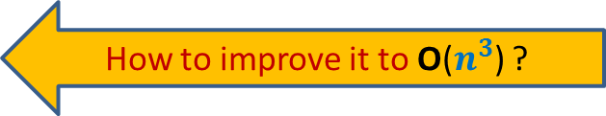
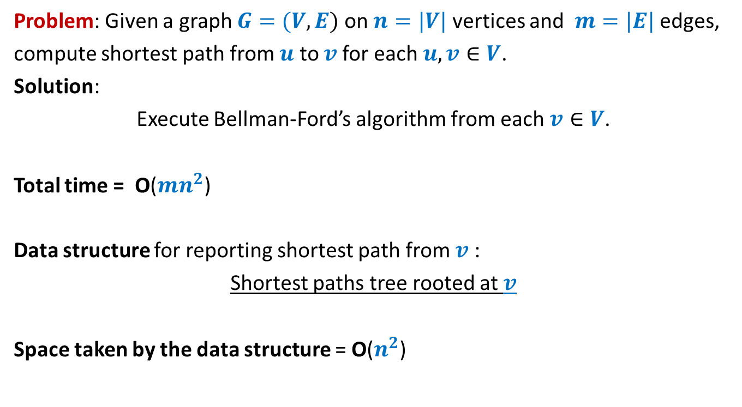
All-pairs shortest paths in a graph with negative edge weights but no negative cycle
Problem: Given a graph $G=(V,E)$ on $n=|V|$ vertices and $m=|E|$ edges,
compute shortest path from $u$ to $v$for each $u,v∈V$.
Solution:
Execute Bellman-Ford’s algorithm from each $v∈V$.
Total time = O($mn^{2}$)
Data structure for reporting shortest path from $v$ :
Shortest paths tree rooted at $v$
Space taken by the data structure = O($n^{2}$)
How to improve it to O($n^{3}$) ?

Slide 5

All-pairs shortest paths in O($n^{3}$) time
In graphs with negative edge weights
but no negative cycle

Slide 6






The Optimal substructure property
Consider any shortest path $P(u,v)$.
Lemma: Every subpath of a shortest path is also a shortest path.
$$u$$
$$x$$
$$y$$
$v$
?
Shortest path from $x$ to $y$
This property holds for graphs with negative weights but no negative cycle

Slide 7




The Optimal substructure property
Consider any shortest path $P(u,v)$.
We used “no. of edges” for a recursive formulation of $δ(s,v)$. [Bellman Ford algo]
$L(v,i)$ : length of the shortest $s⇝v$ having at most $i$ edges.
$δ(s,v)$ =$L(v,n−1)$
Expressed $L(v,i+1)$ recursvely in terms of $L(x,i)$ for all ($x,v$) $∈E$
Base case: $L(v,1)$ = $ω(s,v)$ if ($s,v$) $∈E$, and $∞$ otherwise.
$i$edges
$$u$$
$$x$$
$v$
$i−1$edges

Slide 8

The Optimal substructure property
Consider any shortest path $P(u,v)$.
Question: Can we use “vertices” for recursive formulation of $δ(u,v)$ ?
$$u$$
$v$

Slide 9










The Optimal substructure property
Consider any shortest path $P(u,v)$.
For a recursive formulation of $δ(u,v)$,
We can use max-index of intermediate vertices on $P(u,v)$.
$$24$$
$$11$$
$$3$$
$$35$$
$$9$$
$$17$$
$$9$$
$$u$$
$v$
?
max-index
?
<$35$
<$35$

Slide 10
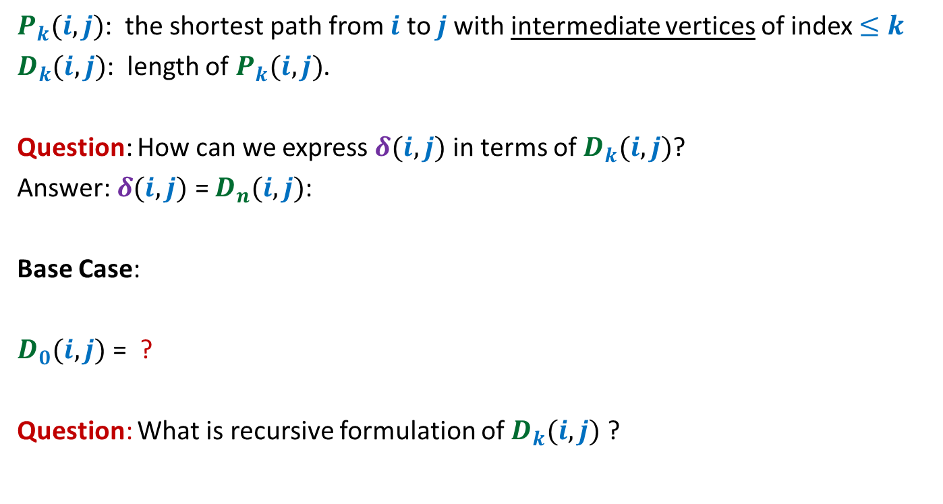
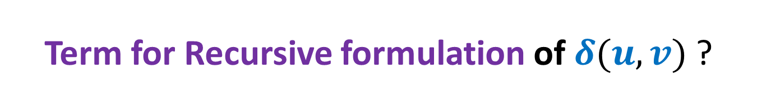

Term for Recursive formulation of $δ(u,v)$ ?
$P_{k}(i,j)$: the shortest path from $i$ to $j$with intermediate vertices of index $≤k$
$D_{k}(i,j)$: length of $P_{k}(i,j)$.
Question: How can we express $δ(i,j)$ in terms of $D_{k}(i,j)$?
Answer: $δ(i,j)$ = $D_{n}(i,j)$:
Base Case:
$D_{0}(i,j)$ = ?
Question: What is recursive formulation of $D_{k}(i,j)$ ?
$$\left\{\begin{aligned}ω\left(i,j\right) if (i,j)∈E \\ ∞ otherwise\end{aligned}\right.$$

Slide 11









Recursive formulation of $D_{k}(i,j)$
Consider the path $P_{k}(i,j)$
There are two cases:
Case 1 : $P_{k}(i,j)$ does not pass through $k$
Case 2 : $P_{k}(i,j)$ indeed passes through $k$
$D_{k}(i,j)$ = $min$($D_{k−1}(i,j)$ , $D_{k−1}(i,k)+D_{k−1}(k,j)$ )
➔ $D_{k}(i,j)$ = $D_{k−1}(i,j)$
➔ $D_{k}(i,j)$ = $D_{k−1}(i,k)+D_{k−1}(k,j)$
$$k$$
$$i$$
$j$
?
?
$P_{k−1}(i,k)$
$P_{k−1}(k,j)$

Slide 12

Floyd Warshal Algorithm for All Pairs Shortest Paths
in O($n^{3}$) time

Slide 13



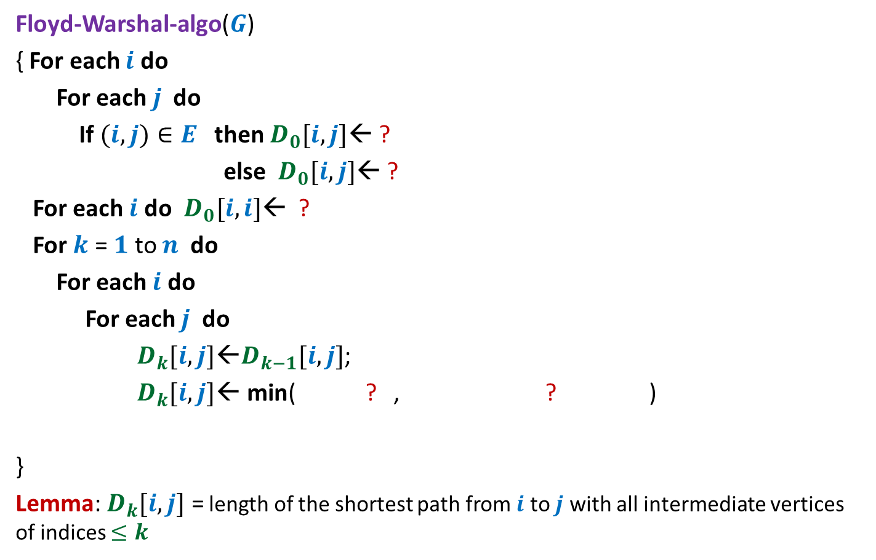




Floyd and Warshal’s algorithm
Floyd-Warshal-algo($G$)
{ For each $i$ do
For each $j$ do
If $(i,j)∈E$ then $D_{0}[i,j]$← ?
else $D_{0}[i,j]$← ?
For each $i$ do $D_{0}[i,i]$← ?
For $k$ = $1$ to $n$ do
For each $i$ do
For each $j$ do
$D_{k}[i,j]$←$D_{k−1}[i,j]$;
$D_{k}[i,j]\text{←}$ min( ? , ? )
}
Lemma: $D_{k}[i,j]$ = length of the shortest path from $i$ to $j$ with all intermediate vertices of indices $≤k$
$ω\left(i,j\right)$
$∞$;
Computing $D_{0}[∗,∗]$
$0$;
{
Computing$D_{k}[i,j]$
$$D_{k}[i,j]$$
$D_{k−1}[i,k]+$ $D_{k−1}[k,j]$
}

Slide 14
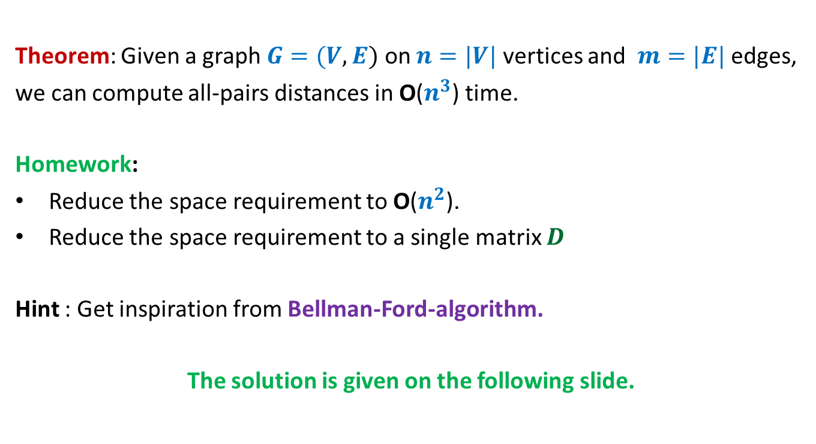
All-pairs shortest paths in a graph with negative edge weights but no negative cycle
Theorem: Given a graph $G=(V,E)$ on $n=|V|$ vertices and $m=|E|$ edges,
we can compute all-pairs distances in O($n^{3}$) time.
Homework:
Reduce the space requirement to O($n^{2}$).
Reduce the space requirement to a single matrix $D$
Hint : Get inspiration from Bellman-Ford-algorithm.
The solution is given on the following slide.

Slide 15
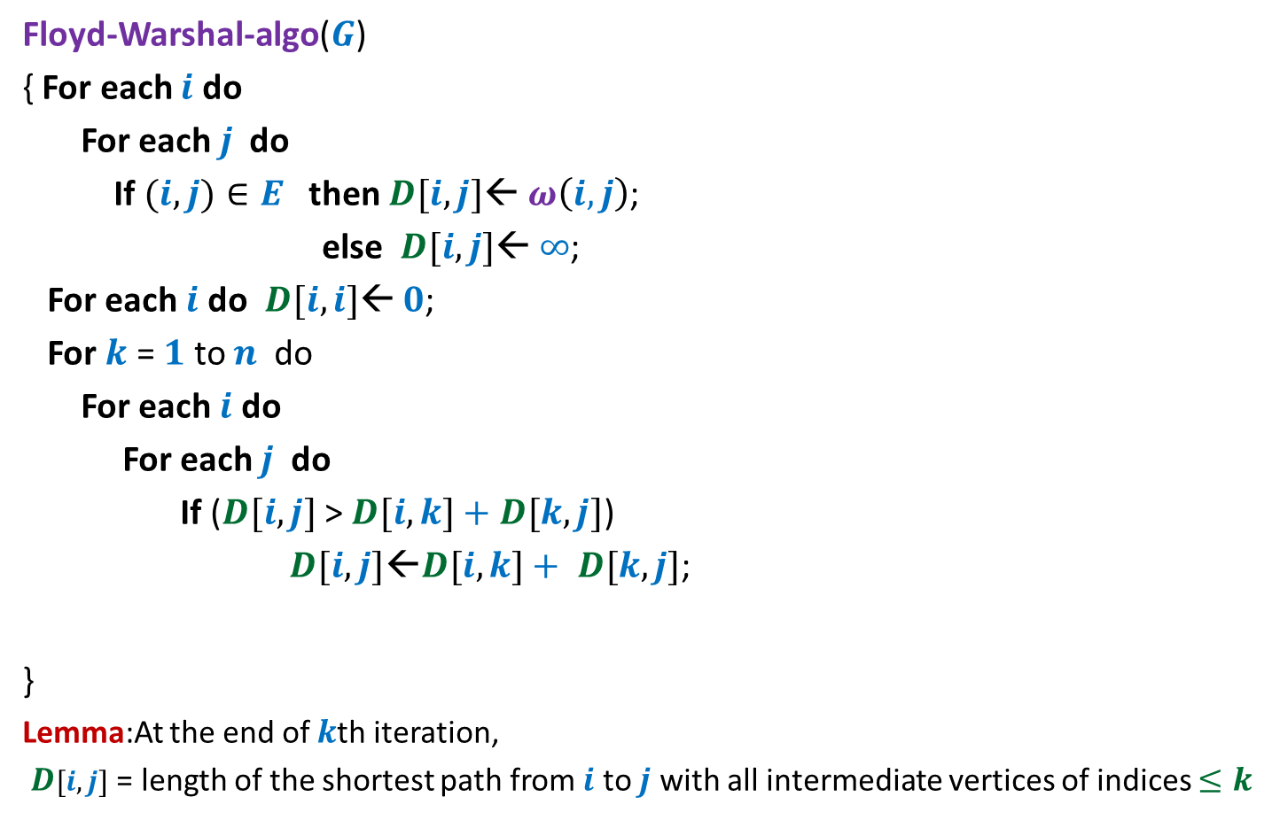
Floyd and Warshal’s algorithm
Floyd-Warshal-algo($G$)
{ For each $i$ do
For each $j$ do
If $(i,j)∈E$ then $D[i,j]$← $ω\left(i,j\right)$;
else $D[i,j]$← $∞$;
For each $i$ do $D[i,i]$← $0$;
For $k$ = $1$ to $n$ do
For each $i$ do
For each $j$ do
If ($D[i,j]$ > $D[i,k]+$ $D[k,j]$)
$D[i,j]\text{←}D[i,k]+ D[k,j]$;
}
Lemma:At the end of $k$th iteration,
$D[i,j]$ = length of the shortest path from $i$ to $j$ with all intermediate vertices of indices $≤k$
{
}

Slide 16
Bitonic tour

Slide 17












Bitonic tour
There are $n$ points in a plane.
$δ(p_{i},p_{j})$: distance between $p_{i}$ and $p_{j}$
Cost of a tour: Total distance traveled.
$$p_{6}$$
$$p_{2}$$
$$p_{4}$$
$$p_{7}$$
$$p_{10}$$
$$p_{1}$$
$$p_{9}$$
$$p_{11}$$
$$p_{3}$$
$$p_{5}$$
$$p_{8}$$

Slide 18

Bitonic tour
There are $n$ points in a plane.
$δ(p_{i},p_{j})$: distance between $p_{i}$ and $p_{j}$
Cost of a tour: Total distance traveled.
Not bitonic
$$p_{6}$$
$$p_{2}$$
$$p_{4}$$
$$p_{7}$$
$$p_{10}$$
$$p_{1}$$
$$p_{9}$$
$$p_{11}$$
$$p_{3}$$
$$p_{5}$$
$$p_{8}$$

Slide 19

Bitonic tour
There are $n$ points in a plane.
$δ(p_{i},p_{j})$: distance between $p_{i}$ and $p_{j}$
Cost of a tour: Total distance traveled.
Problem: Given $n$ points <$p_{1}$,$p_{2}$,…,$p_{n}$> in increasing $x$-coordinates, compute the least cost Bitonic tour from $p_{n}$.
Bitonic
$$p_{6}$$
$$p_{2}$$
$$p_{4}$$
$$p_{7}$$
$$p_{10}$$
$$p_{1}$$
$$p_{9}$$
$$p_{11}$$
$$p_{3}$$
$$p_{5}$$
$$p_{8}$$

Slide 20

Attempt 1
$T[i]$: The cost of optimal Bitonic tour for $p_{1}$,…,$p_{i}$
Aim: To compute $T[n]$.
Approach: Try to relate $T[n]$ and $T[n−1]$.
Observation: No obvious way !
$$p_{6}$$
$$p_{2}$$
$$p_{4}$$
$$p_{7}$$
$$p_{10}$$
$$p_{1}$$
$$p_{9}$$
$$p_{11}$$
$$p_{3}$$
$$p_{5}$$
$$p_{8}$$

Slide 21


New Idea: Split the tour
We have generalized the problem.
$$p_{6}$$
$$p_{2}$$
$$p_{4}$$
$$p_{7}$$
$$p_{10}$$
$$p_{1}$$
$$p_{n}$$
$$p_{9}$$
$$p_{n+1}$$
$$p_{3}$$
$$p_{5}$$
$$p_{8}$$

Slide 22

New Idea: Split the tour
Problem: Given $n+1$ points <$p_{1}$,…,$p_{n+1}$> in increasing $x$-coordinates,
We need to travel from $p_{n}$and $p_{n+1}$ to $p_{1}$traversing each point exclusively once. What is the least distance traveled ?
$$p_{6}$$
$$p_{2}$$
$$p_{4}$$
$$p_{7}$$
$$p_{10}$$
$$p_{1}$$
$$p_{n}$$
$$p_{9}$$
$$p_{3}$$
$$p_{8}$$
$$p_{n+1}$$
$$p_{5}$$

Slide 23
Term for Recursive formulation ?

Slide 24




Term for Recursive formulation ?
$$p_{6}$$
$$p_{2}$$
$$p_{i}$$
$$p_{7}$$
$$p_{5}$$
$$p_{10}$$
$$p_{1}$$
$$p_{n}$$
$$p_{9}$$
$$p_{i−1}$$
$$p_{j}$$
$$p_{n+1}$$
optimal Bitonic tour on $p_{1}$,…, $p_{i−1}$ starting from $p_{i}$ and $p_{j}$

Slide 25
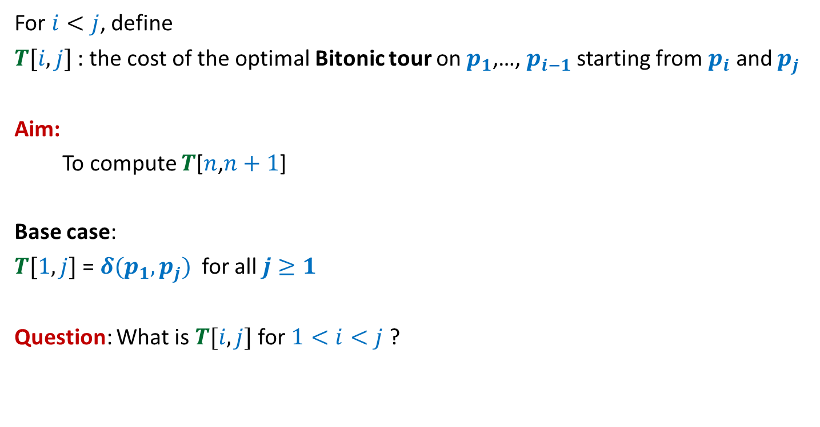
Term for Recursive formulation ?
For $i<j$, define
$T[i,j]$ : the cost of the optimal Bitonic tour on $p_{1}$,…, $p_{i−1}$starting from $p_{i}$ and $p_{j}$
Aim:
To compute $T$[$n$,$n+1$]
Base case:
$T[1,j]$ = $δ(p_{1},p_{j})$ for all $j≥1$
Question: What is $T[i,j]$ for $1<i<j$ ?

Slide 26

Recursive formulation for $$T[i,j]$$

Slide 27







Recursive formulation of $T[i,j]$
Two cases:
$p_{i−1}$ visited from $p_{i}$
$p_{i−1}$ visited from $p_{j}$
$T(i,j)$ = $min$($T(i−1,j)$ + $δ(p_{i−1},p_{i})$ , $T(i−1,i)$ + $δ(p_{i−1},p_{j})$)
➔ $T(i,j)$ = $T(i−1,j)$ + $δ(p_{i−1},p_{i})$
➔ $T$($i,j$)= $T(i−1,i)$ + $δ(p_{i−1},p_{j})$
$$p_{i}$$
$$p_{i−1}$$
$$p_{1}$$
$$p_{j}$$

Slide 28
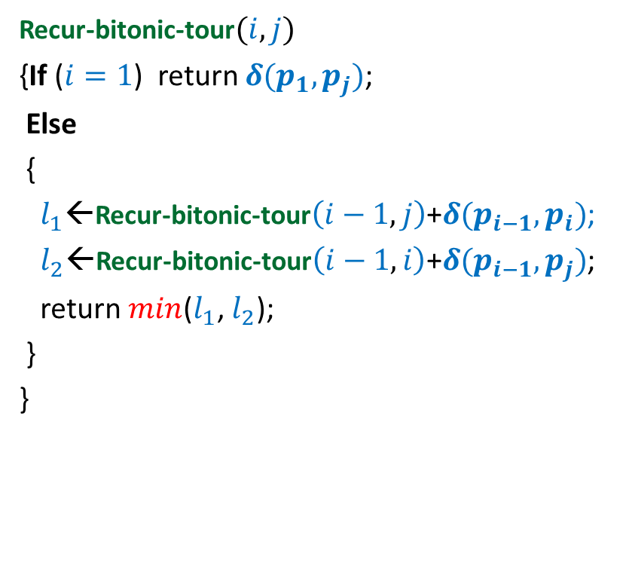

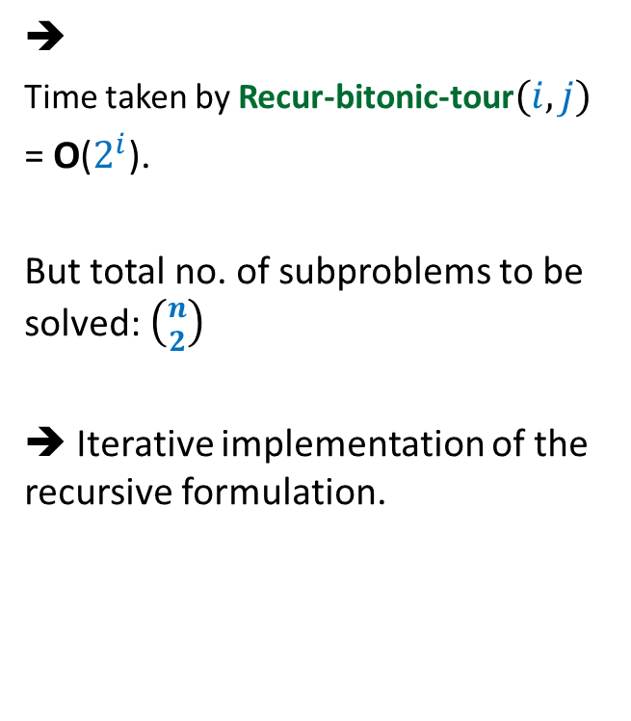
Recursive algorithm for $T(i,j)$
Recur-bitonic-tour$(i,j)$
{If ($i=1$) return $δ(p_{1},p_{j})$;
Else
{
$l_{1}$←Recur-bitonic-tour$\left(i−1,j\right)$+$δ(p_{i−1},p_{i})$;
$l_{2}$←Recur-bitonic-tour$\left(i−1,i\right)$+$δ(p_{i−1},p_{j})$;
return $min$($l_{1}$, $l_{2}$);
}
}
➔
Time taken by Recur-bitonic-tour$(i,j)$
= O($2^{i}$).
But total no. of subproblems to be solved: $\left({n \atop 2}\right)$
➔ Iterative implementation of the recursive formulation.

Slide 29





Recursive algorithm for $T(i,j)$
Recur-bitonic-tour$(i,j)$
{If ($i=1$) return $δ(p_{1},p_{j})$;
Else
{
$l_{1}$←Recur-bitonic-tour$\left(i−1,j\right)$+$δ(p_{i−1},p_{i})$;
$l_{2}$←Recur-bitonic-tour$\left(i−1,i\right)$+$δ(p_{i−1},p_{j})$;
return $min$($l_{1}$, $l_{2}$);
}
}
$$n$$
$$i$$
…
2
1
$$j$$
1 2 ... $n+1$
$$T$$

Slide 30
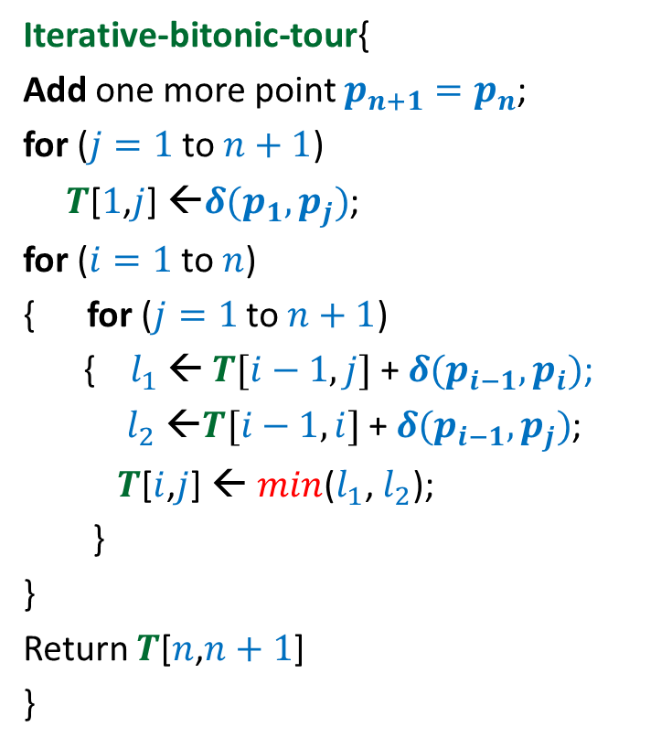


Iterative algorithm for Optimal Bitonic tour
Iterative-bitonic-tour{
Add one more point $p_{n+1}=p_{n}$;
for ($j=1$ to $n+1$)
$T$[$1$,$j$] ←$δ(p_{1},p_{j})$;
for ($i=1$ to $n$)
{ for ($j=1$ to $n+1$)
{ $l_{1}$ ← $T[i−1,j]$ + $δ(p_{i−1},p_{i})$;
$l_{2}$ ←$T[i−1,i]$ + $δ(p_{i−1},p_{j})$;
$T$[$i$,$j$] ← $min$($l_{1}$, $l_{2}$);
}
}
Return $T$[$n$,$n+1$]
}
$$n$$
$$i$$
…
2
1
1 2 ... $n+1$
$$j$$
Time complexity: O($n^{2}$)
$$T$$

