Slide 1
Design and Analysis of Algorithms (CS345/CS345A) Jan-April 2014
Lecture 22
Network Flow

Slide 2

Designing an algorithm
Divide and Conquer
problem
Greedy Strategy
Dynamic Programming
Always take a fresh and unconditioned approach to solve a problem

Slide 3
Designing an algorithm
Fresh and unconditioned approach
Working on examples and learning from them
Perseverance
Theoretical formulation for a better and clear understanding

Slide 4
Maximum Flow in a Network

Slide 5

Problem definition (Informal)
Given a network, where each edge has a certain capacity,
There is a designated source vertex $s$and sink vertex $t$.
Compute the maximum flow that we can achieve from $s$to $t$.

Slide 6
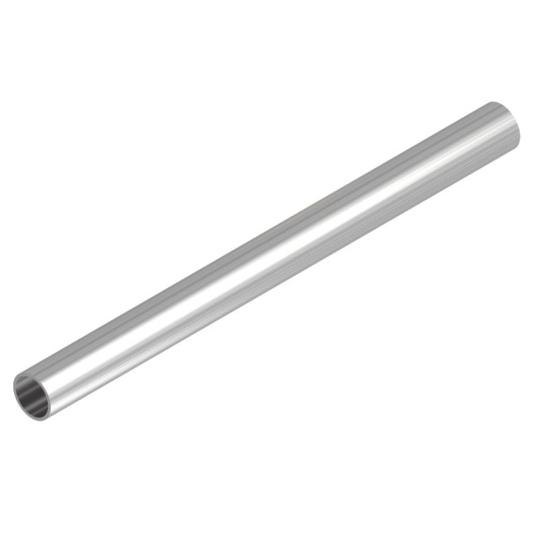
Question: What is flow along an edge ?
Answer: The rate (per unit time) at which the commodity is being transported along the edge ?
Question: What is capacity of an edge ?
Answer: The maximum rate at which the commodity can be transported along the edge.
Example: 25 litre/sec
An edge

Slide 7


Are there any constraints for a flow ?
Capacity constraint :
Flow along an edge cannot exceed its capacity
Conservation constraint :
Flow entering node $u$ = Flow leaving node $u$.
5
$$u$$
25
20

Slide 8
Formal Description of Flow

Slide 9

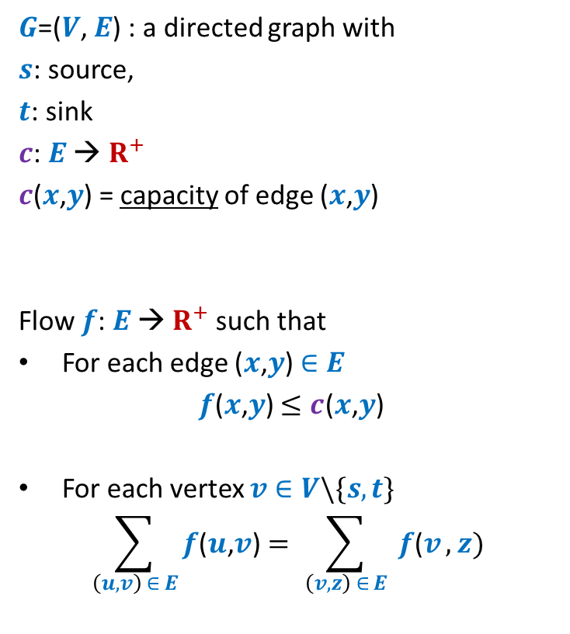





Formal Description of Flow
2
$G$=($V$, $E$) : a directed graph with
$s$: source,
$t$: sink
$c$: $E$ → $R^{+}$
$c$($x$,$y$) = capacity of edge ($x$,$y$)
Flow $f$: $E$ → $R^{+}$ such that
For each edge ($x$,$y$) $∈E$
$f$($x$,$y$) $≤c$($x$,$y$)
For each vertex $v∈V\backslash \{s,t\}$
$$\sum_{\left(u,v\right) ∈ E}{f\text{(}u\text{,}v\text{)}}=\sum_{ \left(v,z\right) ∈ E }{f\text{(}v},z)$$
$$v$$
$$x$$
5
6
15
8
$$t$$
$$s$$
6
7
14
7
17
$$u$$
4
$$y$$
Capacity constraint
Conservation constraint

Slide 10

Formal Description of Flow
2
$\text{value}\text{(}f\text{)=}$ flow leaving $s$
$$=\sum_{\left(s,v\right) ∈ E}{f\text{(}u\text{,}v\text{)}}$$
$G$=($V$, $E$) : a directed graph with
$s$: source,
$t$: sink
$c$: $E$ → $R^{+}$
$c$($x$,$y$) = capacity of edge ($x$,$y$)
Flow $f$: $E$ → $R^{+}$ such that
For each edge ($x$,$y$) $∈E$
$f$($x$,$y$) $≤c$($x$,$y$)
For each vertex $v∈V\backslash \{s,t\}$
$$\sum_{\left(u,v\right) ∈ E}{f\text{(}u\text{,}v\text{)}}=\sum_{ \left(v,z\right) ∈ E }{f\text{(}v},z)$$
$$v$$
$$x$$
4
5
5
11
6
1
15
8
$$t$$
$$s$$
6
7
1
7
7
14
7
17
$$u$$
4
$$y$$

Slide 11
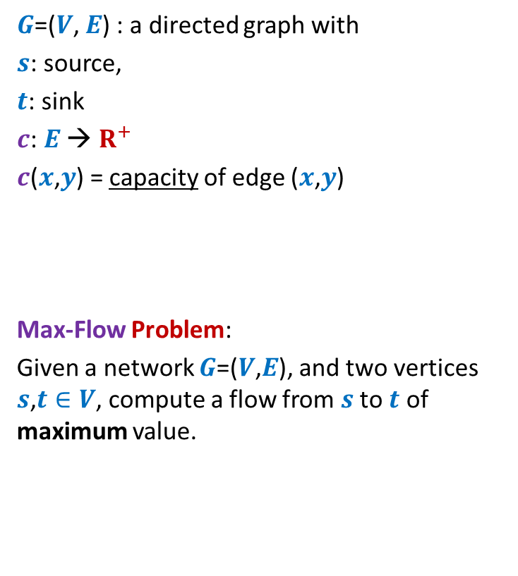
Formal Description of Flow
2
$\text{value}\text{(}f\text{)=}$ flow leaving $s$
$$=\sum_{\left(s,v\right) ∈ E}{f\text{(}u\text{,}v\text{)}}$$
$G$=($V$, $E$) : a directed graph with
$s$: source,
$t$: sink
$c$: $E$ → $R^{+}$
$c$($x$,$y$) = capacity of edge ($x$,$y$)
Max-Flow Problem:
Given a network $G$=($V$,$E$), and two vertices $s$,$t∈V$, compute a flow from $s$ to $t$ of maximum value.
$$v$$
$$x$$
5
6
15
8
$$t$$
$$s$$
6
7
14
7
17
$$u$$
4
$$y$$

Slide 12

Towards designing max flow algorithm
2
$$v$$
$$x$$
5
6
5
5
+1
5
12
+7
6
15
8
$$t$$
$$s$$
6
7
1
1
7
7
14
7
17
$$u$$
4
$$y$$
What is the most natural approach to solve this problem ?
Finding some $s−t$ path,
Sending flow along the path,
Updating capacities,
Finding some $s−t$ path, …

Slide 13
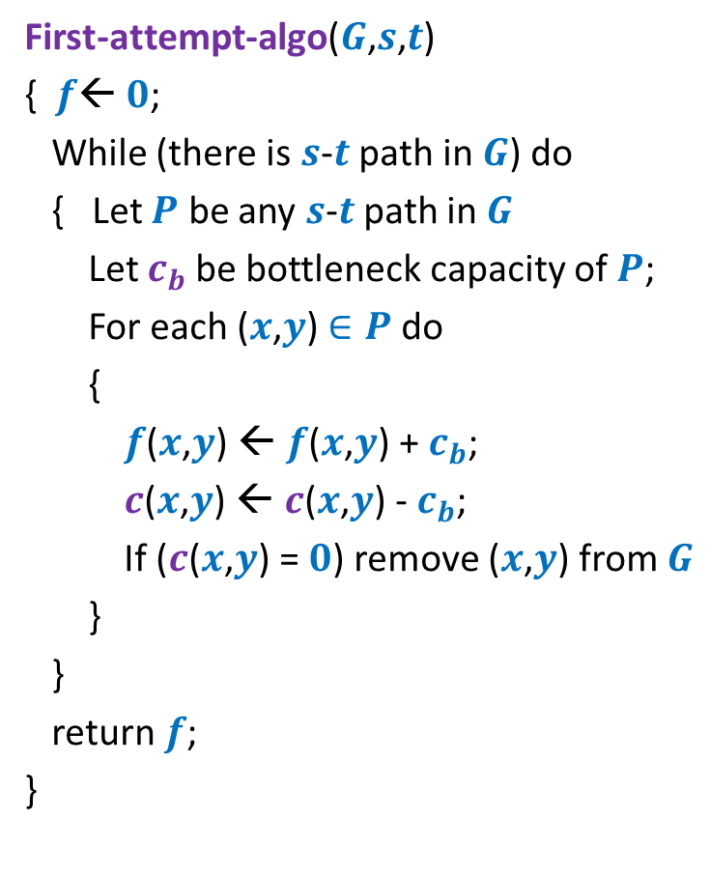
Towards designing max flow algorithm
First-attempt-algo($G$,$s$,$t$)
{ $f$← $0$;
While (there is $s$-$t$ path in $G$) do
{ Let $P$ be any $s$-$t$ path in $G$
Let $c_{b}$be bottleneck capacity of $P$;
For each ($x$,$y$) $∈P$ do
{
$f$($x$,$y$) ← $f$($x$,$y$) + $c_{b}$;
$c$($x$,$y$) ← $c$($x$,$y$) - $c_{b}$;
If ($c$($x$,$y$) = $0$) remove ($x$,$y$) from $G$
}
}
return $f$;
}
Question: Is the algorithm correct ?

Slide 14
A counterexample for First-attempt-algo

Slide 15





Question: What is the maximum flow from $s$ to $t$ ?
Answer: 30
$$x$$
20
10
$$s$$
50
$$t$$
10
20
$$y$$

Slide 16




Executing our first attempt algorithm
$$x$$
$$x$$
20
20
10
10
$$s$$
20
50
$$t$$
$$s$$
30
$$t$$
20
10
20
10
$$y$$
$$y$$
No $s−t$ path

Slide 17
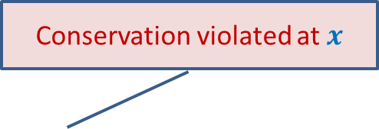
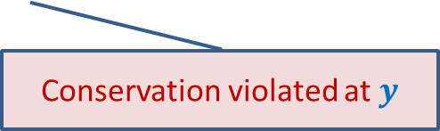

Finding a solution with scientific spirit
Conservation violated at $x$
Patience and perseverance paid ☺
$$x$$
20
10
20
10
How to send extra 10 units of flow from $s$to $t$ ?
$$s$$
20
$$t$$
10
50
10
20
10
20
$$y$$
Conservation violated at $y$

Slide 18
Insight into max-flow gained from the example
Redistribution of existing flow may allow additional flow.
Need a structure which may facilitate this redistribution
Increasing flow along an edge (if the current flow is less than capacity)
Reducing flow along an edge (if it is carrying some positive flow.)
$$x$$
20
10
20
10
$$s$$
10
50
$$t$$
10
20
10
20
$$y$$

Slide 19
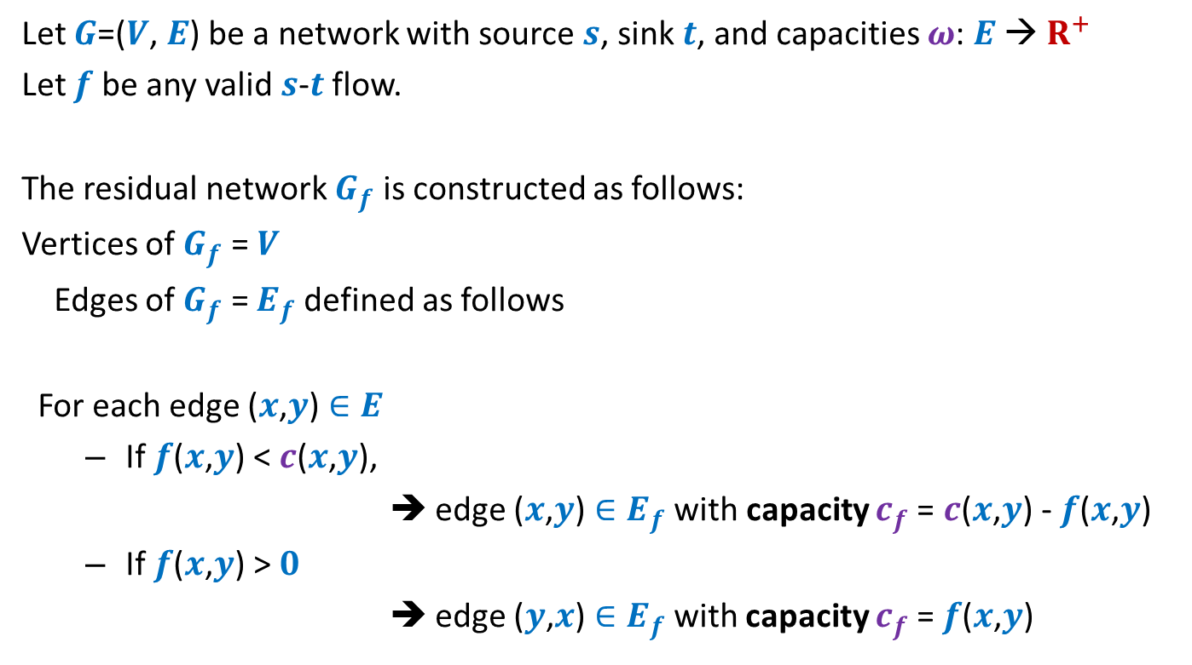
Residual network
Let $G$=($V$, $E$) be a network with source $s$, sink $t$, and capacities $ω$: $E$ → $R^{+}$
Let $f$ be any valid $s$-$t$ flow.
The residual network $G_{f}$ is constructed as follows:
Vertices of $G_{f}$ = $V$
Edges of $G_{f}$ = $E_{f}$ defined as follows
For each edge ($x$,$y$) $∈E$
If $f$($x$,$y$) < $c$($x$,$y$),
➔ edge ($x$,$y$) $∈E_{f}$ with capacity $c_{f}$= $c$($x$,$y$) - $f$($x$,$y$)
If $f$($x$,$y$) > $0$
➔ edge ($y$,$x$) $∈E_{f}$with capacity $c_{f}$= $f$($x$,$y$)
Forward edge
Backward edge

Slide 20




Example of Residual Network
$$G$$
$$G_{f}$$
$$x$$
$$x$$
20
20
20
10
10
$$s$$
20
50
$$t$$
$$s$$
30
20
$$t$$
20
10
20
10
20
$$y$$
$$y$$
Can you translate our exercise of achieving max flow of 30 in terms of $G_{f}$?
We found a $s−t$path in $G_{f}$, and updated flow in $G$ suitably ?

Slide 21












A generic step of increasing flow
Find a $s−t$ path $P$in $G_{f}$;
If edge ($x$, $y$) on the path is a forward edge
➔ Increase flow along ($x$, $y$) by $c′$ in $G$.
$$s$$
$$t$$
$$x$$
$$y$$
$$G$$
$$s$$
$$≥c′$$
$$≥c′$$
$$≥c′$$
$$t$$
$$x$$
$$y$$
$$P$$
$$G_{f}$$

Slide 22

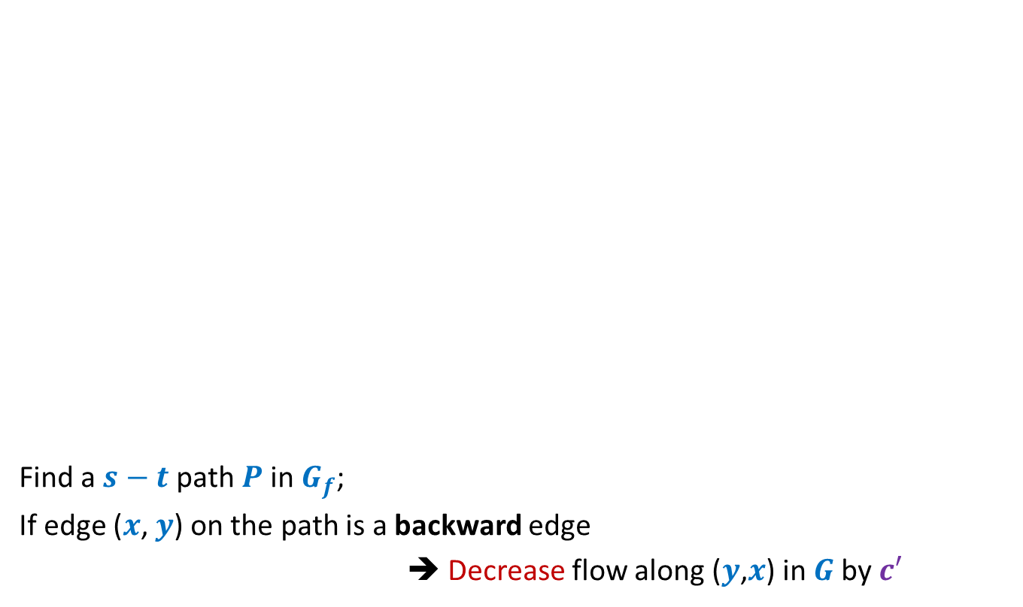
A generic step of increasing flow
Find a $s−t$ path $P$in $G_{f}$;
If edge ($x$, $y$) on the path is a backward edge
➔ Decrease flow along ($y$,$x$) in $G$by $c′$
$$s$$
$$t$$
$$x$$
$$y$$
$$G$$
This reduction of flow along ($y$,$x$) is a part of redistribution: we divert a part of $f$($y$,$x$) along some other outgoing edge of $y$, and increase flow along some edge entering $x$. Recall our example.
$$s$$
$$≥c′$$
$$≥c′$$
$$≥c′$$
$$t$$
$$x$$
$$y$$
$$P$$
$$G_{f}$$

Slide 23

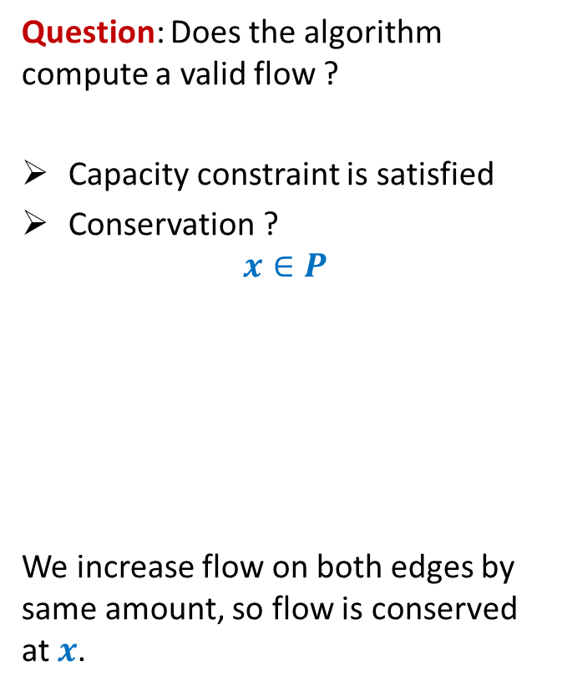

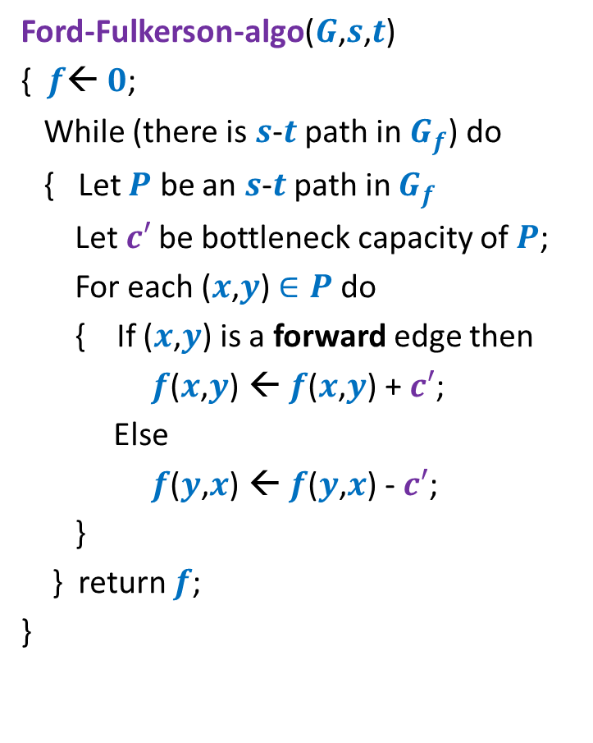





Ford Fulkerson algorithm
Ford-Fulkerson-algo($G$,$s$,$t$)
{ $f$← $0$;
While (there is $s$-$t$ path in $G_{f}$) do
{ Let $P$ be an $s$-$t$ path in $G_{f}$
Let$c′$ be bottleneck capacity of $P$;
For each ($x$,$y$) $∈P$ do
{ If ($x$,$y$) is a forward edge then
$f$($x$,$y$) ← $f$($x$,$y$) + $c′$;
Else
$f$($y$,$x$) ← $f$($y$,$x$) - $c′$;
}
} return $f$;
}
Question: Does the algorithm compute a valid flow ?
Capacity constraint is satisfied
Conservation ?
$$x∈P$$
We increase flow on both edges by same amount, so flow is conserved at $x$.
$$G$$
$$u$$
$$x$$
$$y$$
$$G_{f}$$
$$u$$
$$x$$
$$y$$

Slide 24
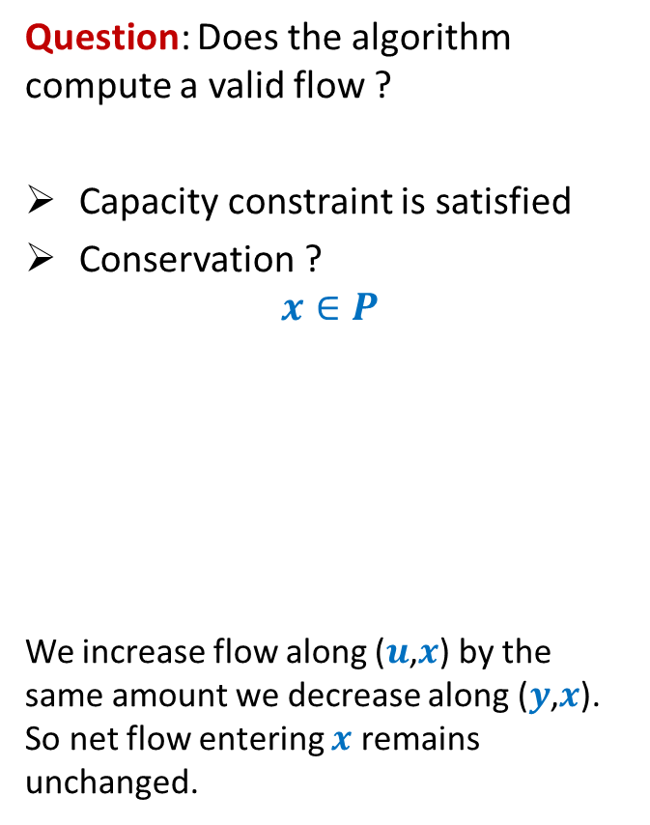




Ford Fulkerson algorithm
Ford-Fulkerson-algo($G$,$s$,$t$)
{ $f$← $0$;
While (there is $s$-$t$ path in $G_{f}$) do
{ Let $P$ be an $s$-$t$ path in $G_{f}$
Let$c′$ be bottleneck capacity of $P$;
For each ($x$,$y$) $∈P$ do
{ If ($x$,$y$) is a forward edge then
$f$($x$,$y$) ← $f$($x$,$y$) + $c′$;
Else
$f$($y$,$x$) ← $f$($y$,$x$) - $c′$;
}
} return $f$;
}
Question: Does the algorithm compute a valid flow ?
Capacity constraint is satisfied
Conservation ?
$$x∈P$$
We increase flow along ($u$,$x$) by the same amount we decrease along ($y$,$x$). So net flow entering $x$ remains unchanged.
$$G$$
$$u$$
$$x$$
$$y$$
$$G_{f}$$
$$u$$
$$x$$
$$y$$

Slide 25
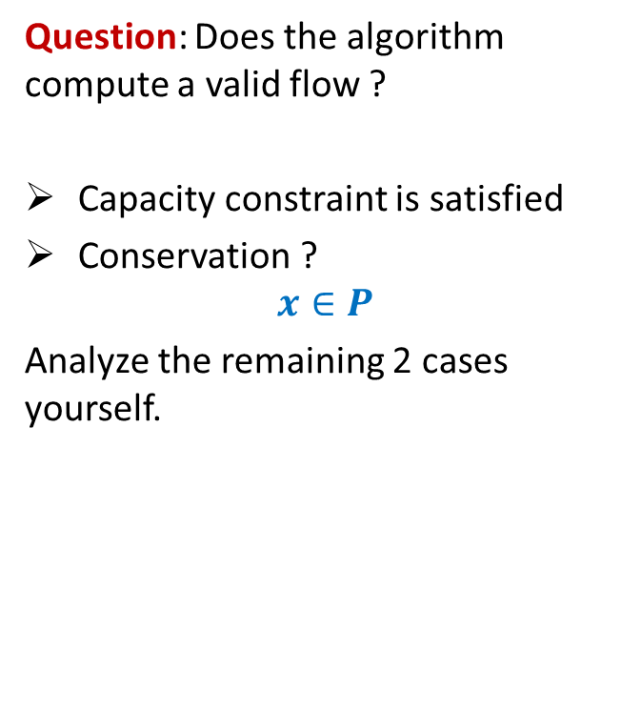
Ford Fulkerson algorithm
Ford-Fulkerson-algo($G$,$s$,$t$)
{ $f$← $0$;
While (there is $s$-$t$ path in $G_{f}$) do
{ Let $P$ be an $s$-$t$ path in $G_{f}$
Let$c′$ be bottleneck capacity of $P$;
For each ($x$,$y$) $∈P$ do
{ If ($x$,$y$) is a forward edge then
$f$($x$,$y$) ← $f$($x$,$y$) + $c′$;
Else
$f$($y$,$x$) ← $f$($y$,$x$) - $c′$;
}
} return $f$;
}
Question: Does the algorithm compute a valid flow ?
Capacity constraint is satisfied
Conservation ?
$$x∈P$$
Analyze the remaining 2 cases yourself.
$$G_{f}$$
$$u$$
$$x$$
$$y$$
$$G_{f}$$
$$u$$
$$x$$
$$y$$

Slide 26
Ford Fulkerson algorithm
Ford-Fulkerson-algo($G$,$s$,$t$)
{ $f$← $0$;
While (there is $s$-$t$ path in $G_{f}$) do
{ Let $P$ be an $s$-$t$ path in $G_{f}$
Let$c′$ be bottleneck capacity of $P$;
For each ($x$,$y$) $∈P$ do
{ If ($x$,$y$) is a forward edge then
$f$($x$,$y$) ← $f$($x$,$y$) + $c′$;
Else
$f$($y$,$x$) ← $f$($y$,$x$) - $c′$;
}
} return $f$;
}
Question: Does the algorithm compute a valid flow ?
Capacity constraint is satisfied
Conservation ?
$$x∈P$$
Analyze the remaining 2 cases yourself.
$$G_{f}$$
$$u$$
$$x$$
$$y$$
$$G_{f}$$
$$u$$
$$x$$
$$y$$

Slide 27
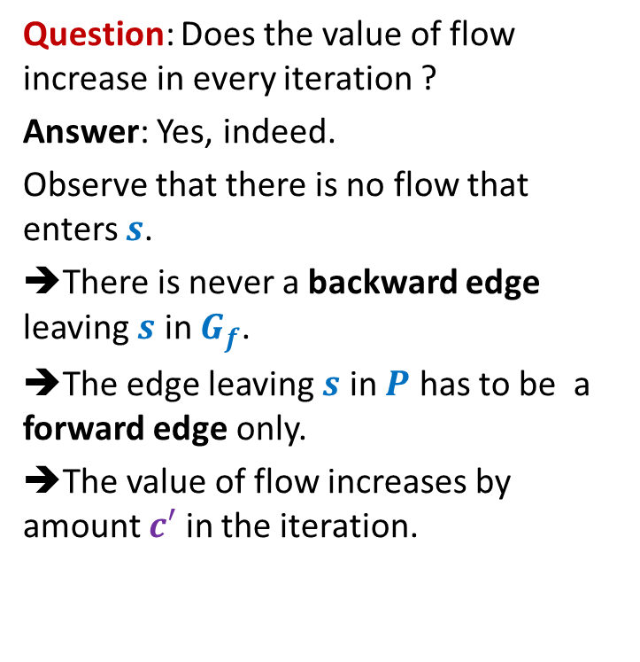
Ford Fulkerson algorithm
Ford-Fulkerson-algo($G$,$s$,$t$)
{ $f$← $0$;
While (there is $s$-$t$ path in $G_{f}$) do
{ Let $P$ be an $s$-$t$ path in $G_{f}$
Let$c′$ be bottleneck capacity of $P$;
For each ($x$,$y$) $∈P$ do
{ If ($x$,$y$) is a forward edge then
$f$($x$,$y$) ← $f$($x$,$y$) + $c′$;
Else
$f$($y$,$x$) ← $f$($y$,$x$) - $c′$;
}
} return $f$;
}
Question: Does the value of flow increase in every iteration ?
Answer: Yes, indeed.
Observe that there is no flow that enters $s$.
➔There is never a backward edge leaving $s$ in $G_{f}$.
➔The edge leaving $s$ in $P$ has to be a forward edge only.
➔The value of flow increases by amount $c′$ in the iteration.

Slide 28
Ford Fulkerson algorithm
Ford-Fulkerson-algo($G$,$s$,$t$)
{ $f$← $0$;
While (there is $s$-$t$ path in $G_{f}$) do
{ Let $P$ be an $s$-$t$ path in $G_{f}$
Let$c′$ be bottleneck capacity of $P$;
For each ($x$,$y$) $∈P$ do
{ If ($x$,$y$) is a forward edge then
$f$($x$,$y$) ← $f$($x$,$y$) + $c′$;
Else
$f$($y$,$x$) ← $f$($y$,$x$) - $c′$;
}
} return $f$;
}
Question: What is time complexity of algorithm ?
Question: What is the proof that the algorithm, if terminates, computes max-flow ?
The answers to these questions are not simple.
Nevertheless, ponder over these questions before we see their beautiful answers in the next week.
…Go the next slide…it is not the end...

Slide 29
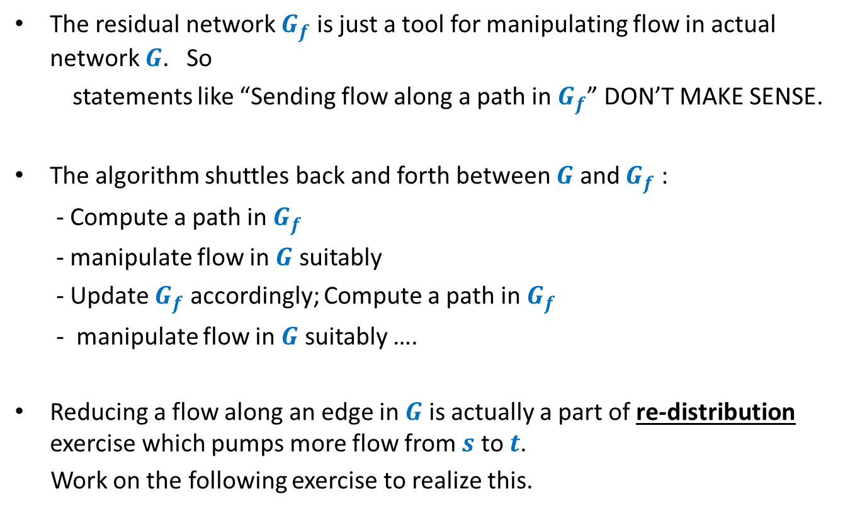
Key points of Ford-Fulkerson algorithm that you must fully realize
The residual network $G_{f}$ is just a tool for manipulating flow in actual network $G$. So
statements like “Sending flow along a path in $G_{f}$” DON’T MAKE SENSE.
The algorithm shuttles back and forth between $G$ and $G_{f}$ :
- Compute a path in $G_{f}$
- manipulate flow in $G$ suitably
- Update $G_{f}$ accordingly; Compute a path in $G_{f}$
- manipulate flow in $G$ suitably ….
Reducing a flow along an edge in $G$ is actually a part of re-distribution exercise which pumps more flow from $s$ to $t$.
Work on the following exercise to realize this.

Slide 30



A useful exercise
Execute Ford Fulkersion algorithm on this example when
The first path selected for sending the flow is <$s$, $x$, $v$, $t$>.
Show the execution of the iterations of the algorithm
What if the first path selected is <$s$, $y$, $v$, $t$>.
Internalize the entire algorithm fully through this example.
$$x$$
10
3
9
5
$$s$$
$$t$$
8
$$u$$
10
$$v$$
10
3
3
6
5
$$y$$

