Slide 1
Design and Analysis of Algorithms (CS345/CS345A) Jan-April 2014
Lecture 23
Analysis of Ford Fulkerson algorithm
(Max-Flow Min-Cut Theorem)

Slide 2
Ford Fulkerson algorithm
Recap from the last lecture

Slide 3

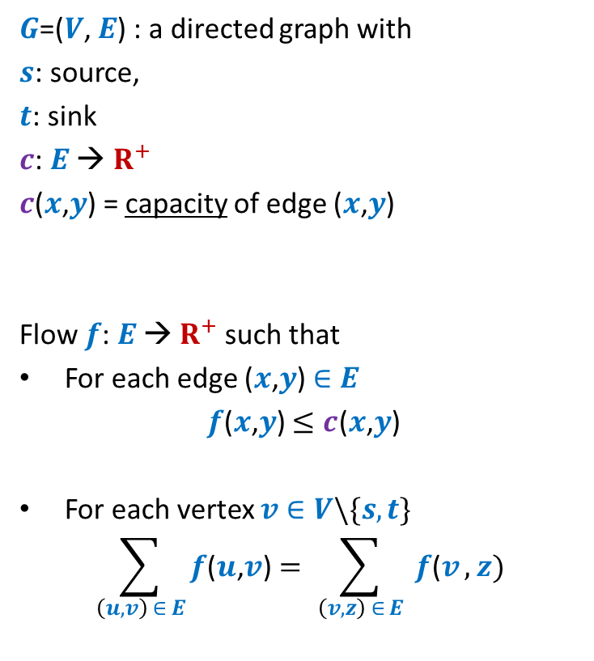





Formal Description of Flow
2
$G$=($V$, $E$) : a directed graph with
$s$: source,
$t$: sink
$c$: $E$ → $R^{+}$
$c$($x$,$y$) = capacity of edge ($x$,$y$)
Flow $f$: $E$ → $R^{+}$ such that
For each edge ($x$,$y$) $∈E$
$f$($x$,$y$) $≤c$($x$,$y$)
For each vertex $v∈V\backslash \{s,t\}$
$$\sum_{\left(u,v\right) ∈ E}{f\text{(}u\text{,}v\text{)}}=\sum_{ \left(v,z\right) ∈ E }{f\text{(}v},z)$$
$$v$$
$$x$$
5
6
15
8
$$t$$
$$s$$
6
7
14
7
17
$$u$$
4
$$y$$
Capacity constraint
Conservation constraint

Slide 4
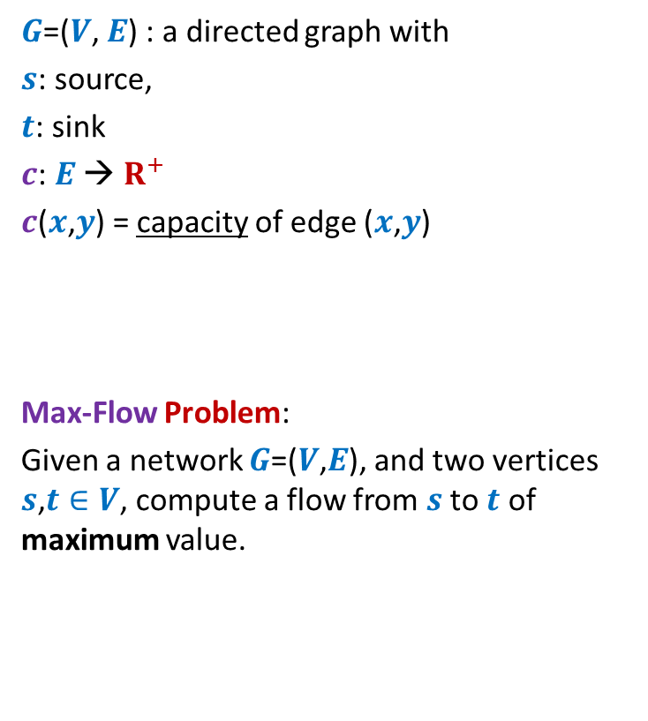

Formal Description of Flow
2
$\text{value}\text{(}f\text{)=}$ flow leaving $s$
$$=\sum_{\left(s,v\right) ∈ E}{f\text{(}u\text{,}v\text{)}}$$
$G$=($V$, $E$) : a directed graph with
$s$: source,
$t$: sink
$c$: $E$ → $R^{+}$
$c$($x$,$y$) = capacity of edge ($x$,$y$)
Max-Flow Problem:
Given a network $G$=($V$,$E$), and two vertices $s$,$t∈V$, compute a flow from $s$ to $t$ of maximum value.
$$v$$
$$x$$
5
6
15
8
$$t$$
$$s$$
6
7
14
7
17
$$u$$
4
$$y$$

Slide 5
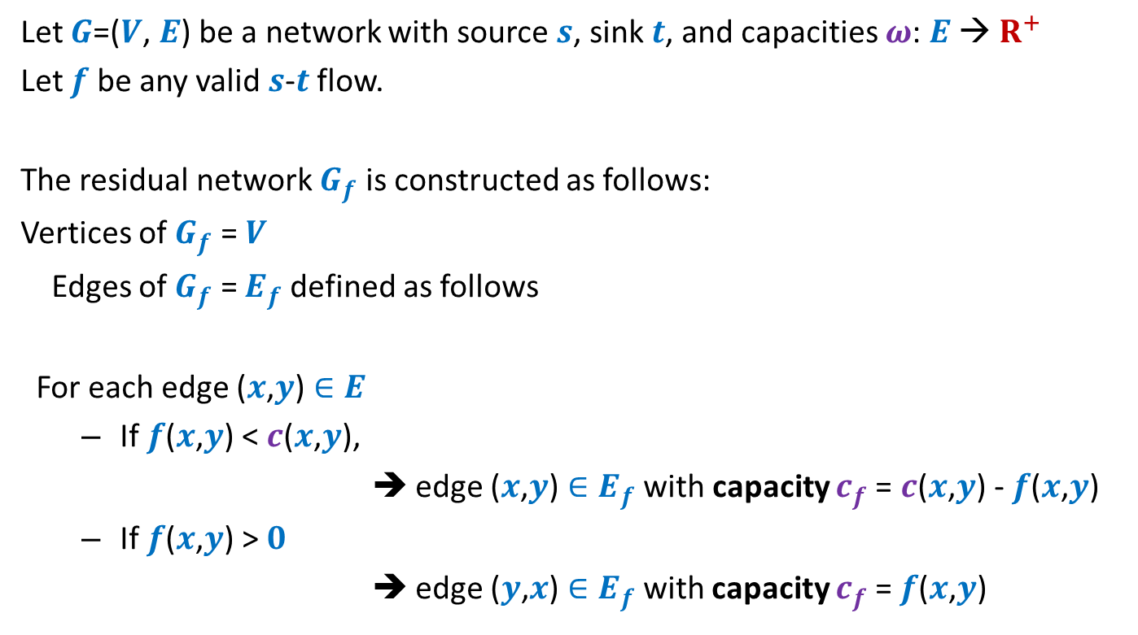
Residual network
Let $G$=($V$, $E$) be a network with source $s$, sink $t$, and capacities $ω$: $E$ → $R^{+}$
Let $f$ be any valid $s$-$t$ flow.
The residual network $G_{f}$ is constructed as follows:
Vertices of $G_{f}$ = $V$
Edges of $G_{f}$ = $E_{f}$ defined as follows
For each edge ($x$,$y$) $∈E$
If $f$($x$,$y$) < $c$($x$,$y$),
➔ edge ($x$,$y$) $∈E_{f}$ with capacity $c_{f}$= $c$($x$,$y$) - $f$($x$,$y$)
If $f$($x$,$y$) > $0$
➔ edge ($y$,$x$) $∈E_{f}$with capacity $c_{f}$= $f$($x$,$y$)
Forward edge
Backward edge

Slide 6












A generic step of increasing flow
Find a $s−t$ path $P$in $G_{f}$;
If edge ($x$, $y$) on the path is a forward edge
➔ Increase flow along ($x$, $y$) by $c′$ in $G$.
$$s$$
$$t$$
$$x$$
$$y$$
$$G$$
$$s$$
$$≥c′$$
$$≥c′$$
$$≥c′$$
$$t$$
$$x$$
$$y$$
$$P$$
$$G_{f}$$

Slide 7

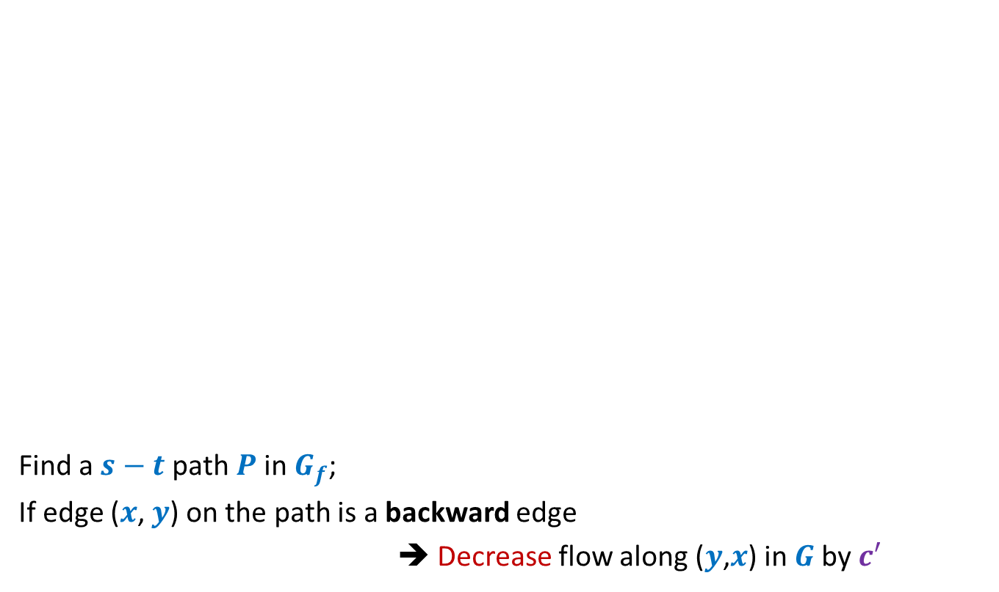
A generic step of increasing flow
Find a $s−t$ path $P$in $G_{f}$;
If edge ($x$, $y$) on the path is a backward edge
➔ Decrease flow along ($y$,$x$) in $G$by $c′$
$$s$$
$$t$$
$$x$$
$$y$$
$$G$$
This reduction of flow along ($y$,$x$) is a part of redistribution: we divert a part of $f$($y$,$x$) along some other outgoing edge of $y$, and increase flow along some edge entering $x$. Recall our example.
$$s$$
$$≥c′$$
$$≥c′$$
$$≥c′$$
$$t$$
$$x$$
$$y$$
$$P$$
$$G_{f}$$

Slide 8
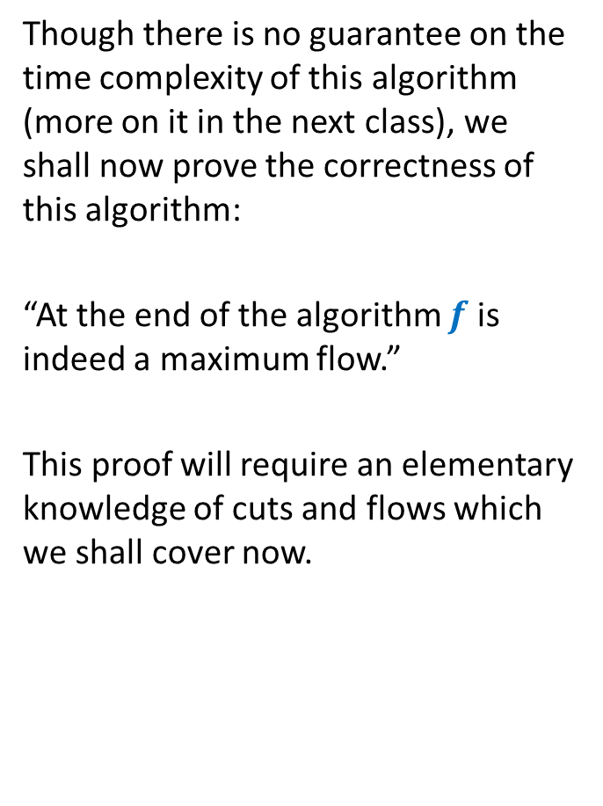
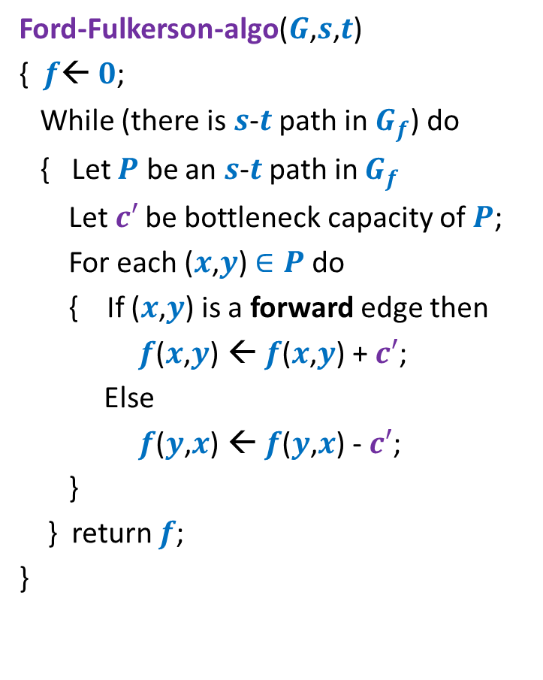
Ford Fulkerson algorithm
Ford-Fulkerson-algo($G$,$s$,$t$)
{ $f$← $0$;
While (there is $s$-$t$ path in $G_{f}$) do
{ Let $P$ be an $s$-$t$ path in $G_{f}$
Let$c′$ be bottleneck capacity of $P$;
For each ($x$,$y$) $∈P$ do
{ If ($x$,$y$) is a forward edge then
$f$($x$,$y$) ← $f$($x$,$y$) + $c′$;
Else
$f$($y$,$x$) ← $f$($y$,$x$) - $c′$;
}
} return $f$;
}
Though there is no guarantee on the time complexity of this algorithm (more on it in the next class), we shall now prove the correctness of this algorithm:
“At the end of the algorithm $f$ is indeed a maximum flow.”
This proof will require an elementary knowledge of cuts and flows which we shall cover now.

Slide 9



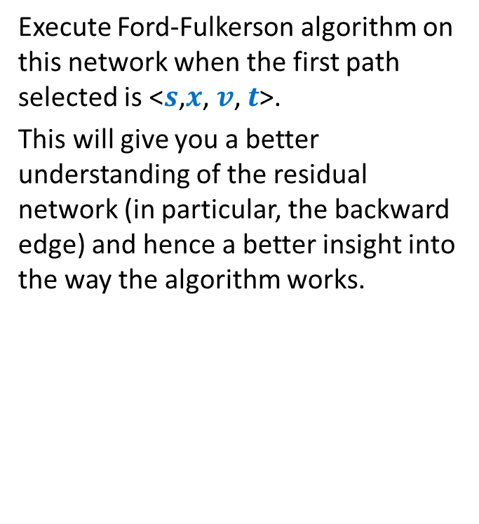



A useful exercise
Execute Ford-Fulkerson algorithm on this network when the first path selected is <$s$,$x$, $v$, $t$>.
This will give you a better understanding of the residual network (in particular, the backward edge) and hence a better insight into the way the algorithm works.
$$x$$
10
3
9
5
$$s$$
$$t$$
8
$$u$$
10
$$v$$
10
3
3
6
5
$$y$$
This exercise was given in the slides of the previous lecture as well. Please do this exercise now if you did not solve it earlier ☺

Slide 10

$s$-$t$Cuts

Slide 11






$s$-$t$cut
$A⊂V$, with
$s∈A$, $t∈\overline{A}$
$$s$$
$$t$$
$$A$$
$$\overline{A}$$
$$G$$

Slide 12
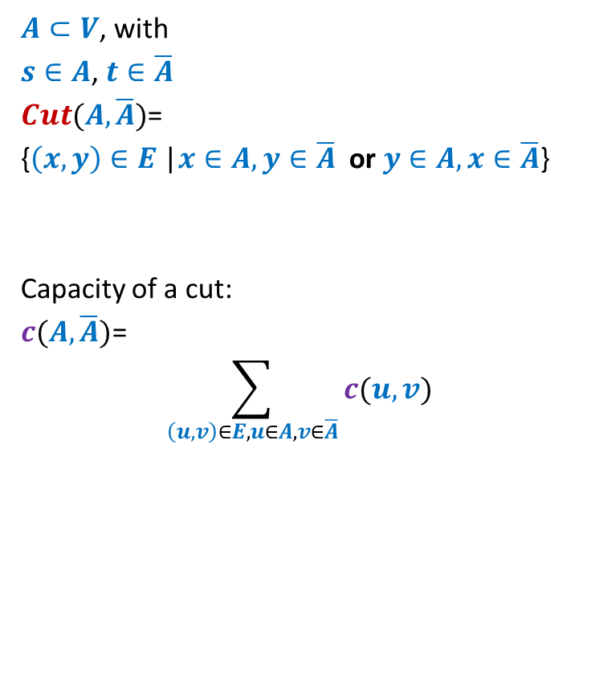
$s$-$t$cut
$A⊂V$, with
$s∈A$, $t∈\overline{A}$
$Cut(A,\overline{A})$=
{$\left(x,y\right)∈E$ |$x∈A,y∈\overline{A}$ or $y∈A,x∈\overline{A}$}
Capacity of a cut:
$c(A,\overline{A})$=
$$\sum_{\left(u,v\right)∈E,u∈A, v∈\overline{A}}{c(u,v)}$$
$$s$$
$$t$$
$$A$$
$$\overline{A}$$
$$G$$
Note: capacity of only outgoing edges is considered in capacity of a cut.

Slide 13
Cuts and Flows

Slide 14







Useful Generalizations
Let us revisit conservation constraint:
For each vertex $v∈V\backslash \{s,t\}$
Mathematically,
$$\sum_{\left(z,u\right) ∈ E}{f\text{(}z\text{,}u\text{)}}=\sum_{ \left(u,v\right) ∈ E }{f\text{(}u},v)$$
Lemma: $f_{out}\left(u\right)−f_{in}(u)$ =
$$f_{in}(u)$$
$$f_{out}(u)$$
$$u$$
$$f_{in}(u)$$
$$f_{out}(u)$$
0 if $u∈V\backslash \{s,t\}$
$value(f)$ if $u=s$
$−value(f)$ if $u=t$

Slide 15

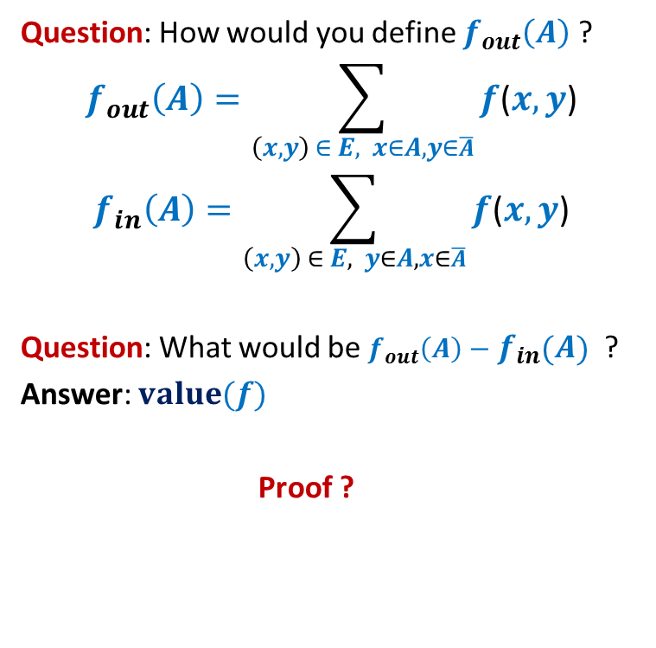

Useful Generalizations
Consider any valid flow $f$.
Question: How would you define $f_{out}\left(A\right)$ ?
$$f_{out}\left(A\right)=\sum_{\left(x,y\right) ∈ E, x∈A,y∈\overline{A}}{f\text{(}x,y\text{)}}$$
$$f_{in}\left(A\right)=\sum_{\left(x,y\right) ∈ E, y∈A,x∈\overline{A}}{f\text{(}x,y\text{)}}$$
Question: What would be $f_{out}\left(A\right)−f_{in}\left(A\right)$ ?
Answer: $value(f)$
Proof ?
$$s$$
$$A$$

Slide 16

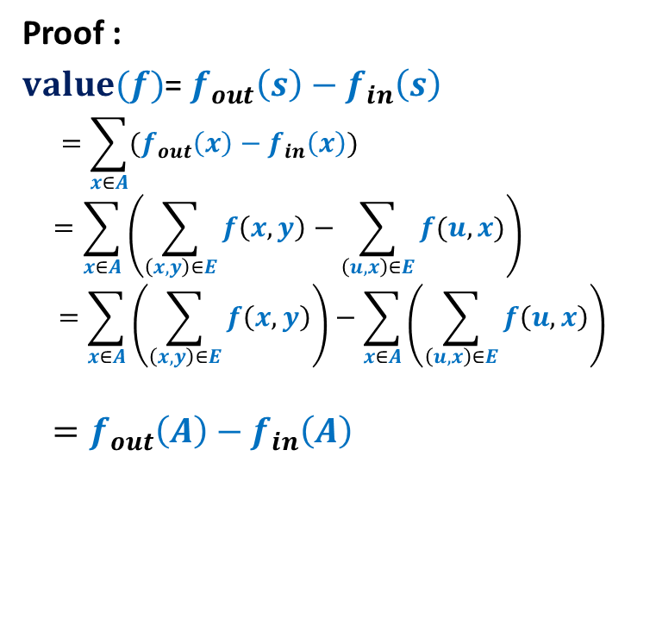

Proof for $f_{out}\left(A\right)−f_{in}\left(A\right)$ = $value(f)$
Consider any valid flow $f$.
Proof :
$value(f)$= $f_{out}\left(s\right)−f_{in}\left(s\right)$
$$=\sum_{x∈A}{(f_{out}\left(x\right)−f_{in}\left(x\right))}$$
$$=\sum_{x∈A}{\left(\sum_{\left(x,y\right)∈E}{f\left(x,y\right)}−\sum_{\left(u,x\right)∈E}{f(u,x)}\right)}$$
$$=\sum_{x∈A}{\left(\sum_{\left(x,y\right)∈E}{f\left(x,y\right)}\right)}−\sum_{x∈A}{\left(\sum_{\left(u,x\right)∈E}{f\left(u,x\right)}\right)}$$
$$=f_{out}\left(A\right)−f_{in}\left(A\right)$$
$$x$$
$$s$$
$$A$$

Slide 17
A simple Relation between Flows and capacity of cuts

Slide 18
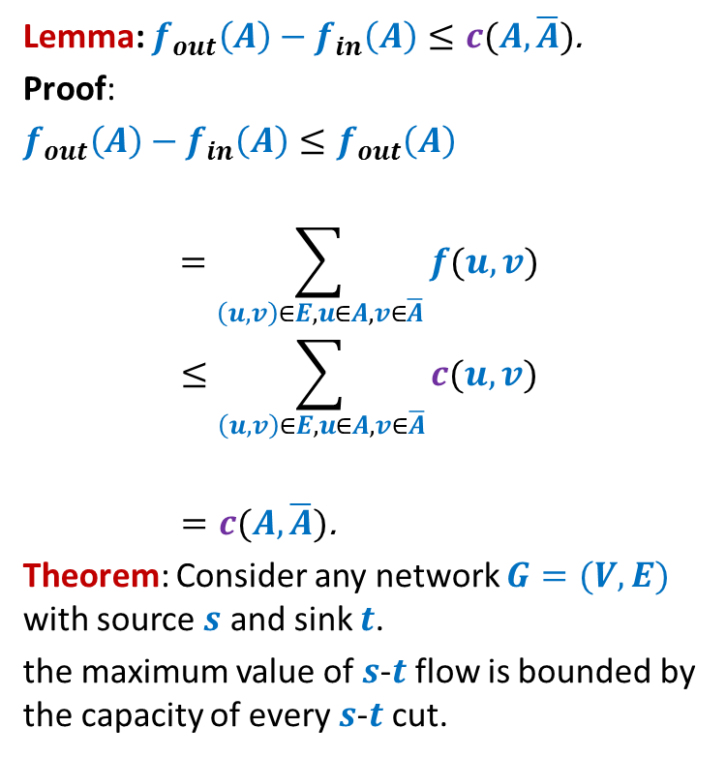
Flows and capacity of cuts
Consider any valid flow $f$.
Lemma: $f_{out}\left(A\right)−f_{in}\left(A\right)≤c(A,\overline{A})$.
Proof:
$f_{out}\left(A\right)−f_{in}\left(A\right)≤f_{out}\left(A\right)$
$$=\sum_{\left(u,v\right)∈E,u∈A, v∈\overline{A}}{f(u,v)}$$
$$≤\sum_{\left(u,v\right)∈E,u∈A, v∈\overline{A}}{c(u,v)}$$
$=c(A,\overline{A})\text{.}$
Theorem: Consider any network $G=(V,E)$ with source $s$ and sink $t$.
the maximum value of $s$-$t$flow is bounded by the capacity of every $s$-$t$cut.
$$s$$
$$t$$
$$A$$
$$\overline{A}$$
$$G$$

Slide 19
A deep Relation between Flows and capacity of cuts

Slide 20
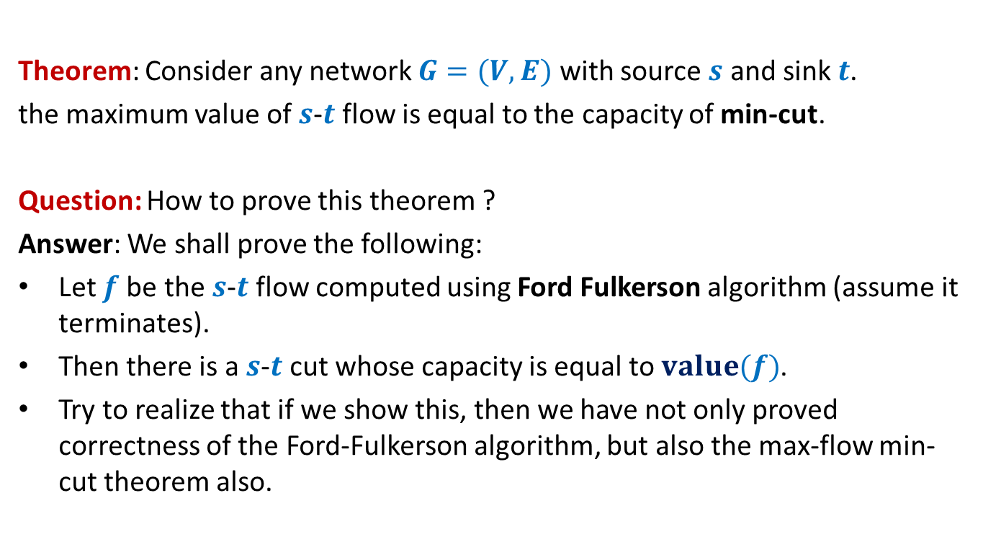
Max-Flow Min-Cut Theorem
Theorem: Consider any network $G=(V,E)$ with source $s$ and sink $t$.
the maximum value of $s$-$t$flow is equal to the capacity of min-cut.
Question: How to prove this theorem ?
Answer: We shall prove the following:
Let $f$be the $s$-$t$flow computed using Ford Fulkerson algorithm (assume it terminates).
Then there is a $s$-$t$cut whose capacity is equal to $value(f)$.
Try to realize that if we show this, then we have not only proved correctness of the Ford-Fulkerson algorithm, but also the max-flow min-cut theorem also.
Get ready to prove this milestone result. Try it yourself before seeing the next slids. It requires nothing more than a basic understanding of the algorithm. ☺

Slide 21









Proof of max-flow min-cut Theorem
Consider the flow $f$computed by Ford-Fulkerson algorithm.
How will $G_{f}$ look like ?
$A$: set of vertices reachable from $s$ in $G_{f}$
Claim: $value(f)$ = $c(A,\overline{A})$.
$$s$$
$$t$$
$$s$$
$$t$$
$$A$$
$$\overline{A}$$
$$A$$
$$\overline{A}$$
$$G$$
$$G_{f}$$

Slide 22
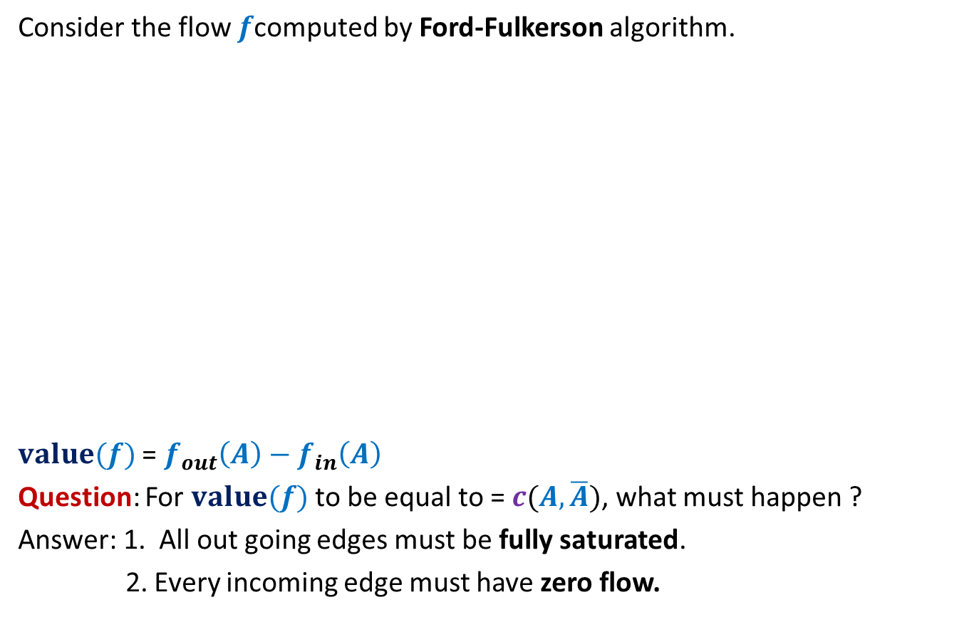
Proof of max-flow min-cut Theorem
Consider the flow $f$computed by Ford-Fulkerson algorithm.
$value(f)$ = $f_{out}\left(A\right)−f_{in}\left(A\right)$
Question: For $value(f)$ to be equal to = $c(A,\overline{A})$, what must happen ?
Answer: 1. All out going edges must be fully saturated.
2. Every incoming edge must have zero flow.
$$s$$
$$t$$
$$s$$
$$t$$
$$A$$
$$\overline{A}$$
$$A$$
$$\overline{A}$$
$$G$$
$$G_{f}$$
How will you show this ?

Slide 23


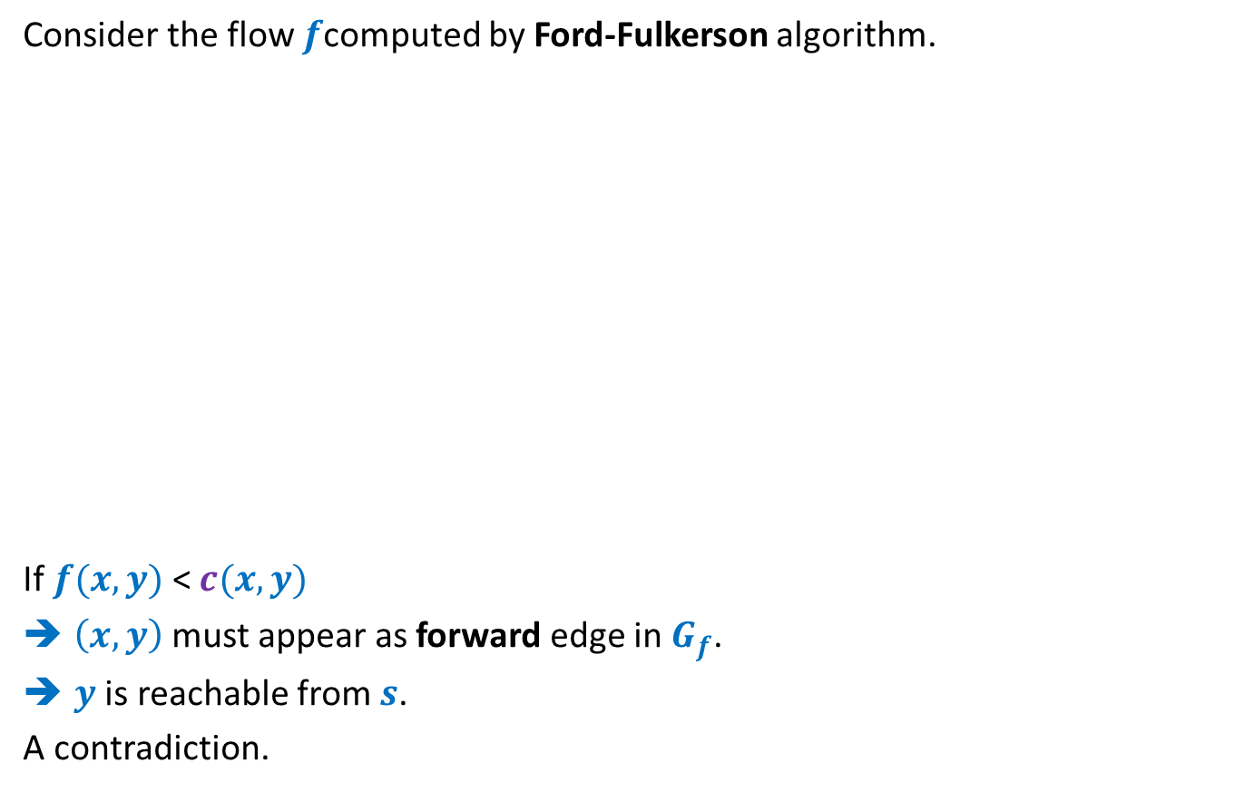

Proof of max-flow min-cut Theorem
Consider the flow $f$computed by Ford-Fulkerson algorithm.
If $f(x,y)$ < $c(x,y)$
$\left(x,y\right)$ must appear as forward edge in$G_{f}$.
$y$ is reachable from $s$.
A contradiction.
$$x$$
$$x$$
$$s$$
$$y$$
$$t$$
$$s$$
$$y$$
$$t$$
$$A$$
$$\overline{A}$$
$$A$$
$$\overline{A}$$
$$G$$
$$G_{f}$$

Slide 24





Proof of max-flow min-cut Theorem
Consider the flow $f$computed by Ford-Fulkerson algorithm.
If $f(x,y)$ > $0$
$\left(y,x\right)$appears as a backward edge in $G_{f}$.
$x$ is reachable from $s$.
A contradiction.
$$s$$
$$x$$
$$s$$
$$x$$
$$t$$
$$t$$
$$y$$
$$y$$
$$A$$
$$\overline{A}$$
$$A$$
$$\overline{A}$$
$$G$$
$$G_{f}$$

Slide 25
This lecture is indeed the core of the entire course. You may afford to forget anything from this course. But you must not forget what we covered in this lecture.
This lecture not only depicts the elegance involved in the design of an algorithm, but also shows that algorithmic ideas can be used to prove some deep graph theoretic results.
Even after nearly 15 years, I still find it amazing to see that there is a short and novel proof of Ford-Fulkerson’s algorithm.
In the next 3 lectures, we shall discuss equally amazing aspects of Max-Flow problem : A polynomial time algorithm and many applications.

