Slide 1
Design and Analysis of Algorithms (CS345/CS345A) Jan-April 2014
Lecture 28
Applications and Generalization of Maximum Flow – III
(Last lecture of the topic)

Slide 2

Application of Min-cut
These applications are arguably the most non-trivial applications.
Try to realize this fact consciously while going through these slides.
We begin with basic terminologies and facts about $s$-$t$cut and min-cut.
Remember and understand them fully.

Slide 3







$s$-$t$cut
$A⊂V$, with
$s∈A$, $t∈\overline{A}$
$$s$$
$$t$$
$$A$$
$$\overline{A}$$
$$G$$

Slide 4
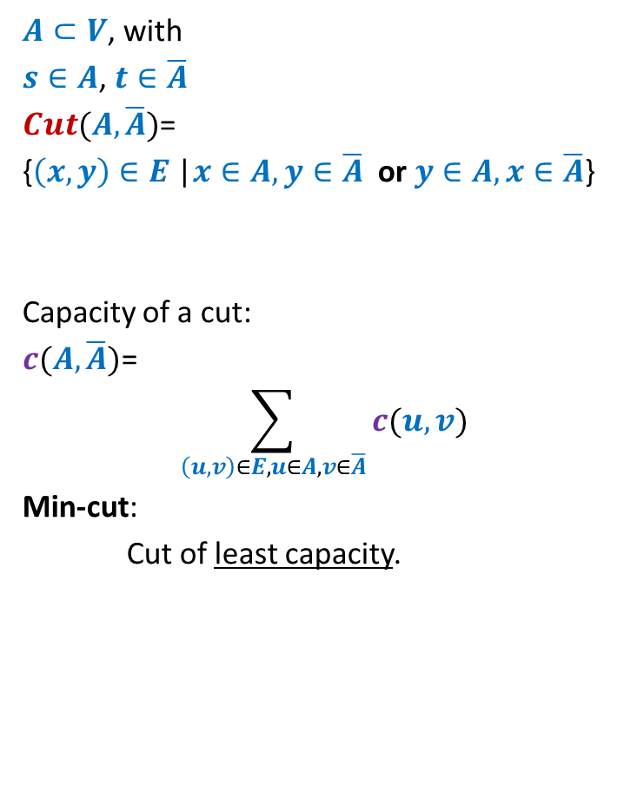
$s$-$t$cut
$A⊂V$, with
$s∈A$, $t∈\overline{A}$
$Cut(A,\overline{A})$=
{$\left(x,y\right)∈E$ |$x∈A,y∈\overline{A}$ or $y∈A,x∈\overline{A}$}
Capacity of a cut:
$c(A,\overline{A})$=
$$\sum_{\left(u,v\right)∈E,u∈A, v∈\overline{A}}{c(u,v)}$$
Min-cut:
Cut of least capacity.
$$s$$
$$t$$
$$A$$
$$\overline{A}$$
$$G$$
Note: capacity of only outgoing edges is considered in capacity of a cut.

Slide 5

Min-cut
Theorem: Consider any network $G=(V,E)$ with source $s$ and sink $t$.
the maximum value of $s$-$t$flow is equal to the capacity of min-cut.

Slide 6
Application of min-cut
Selection of Projects for maximum profit

Slide 7
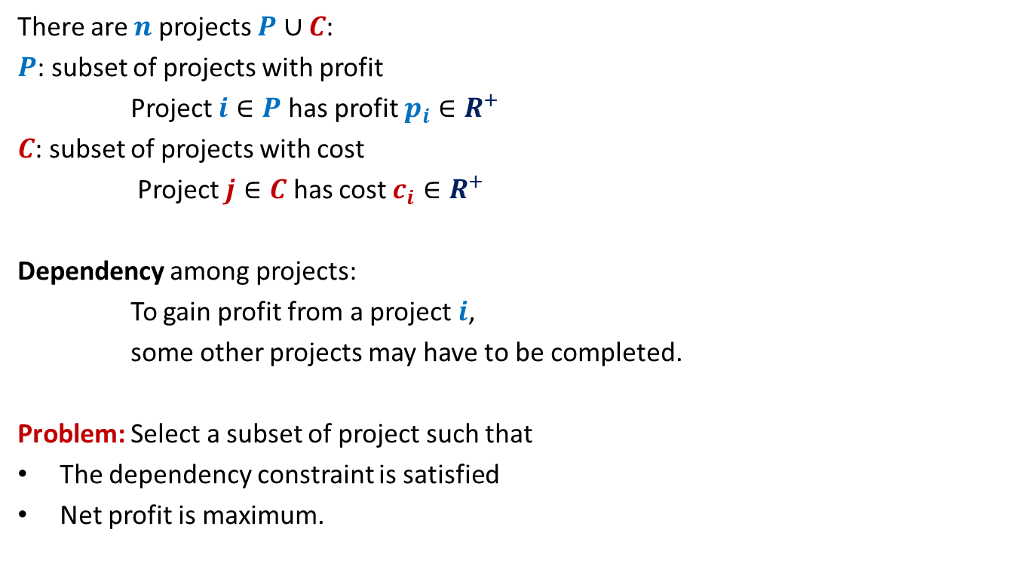
Project Selection Problem
There are $n$ projects $P∪C$:
$P$: subset of projects with profit
Project $i∈P$ has profit $p_{i}∈R^{+}$
$C$: subset of projects with cost
Project $j∈C$ has cost $c_{i}∈R^{+}$
Dependency among projects:
To gain profit from a project $i$,
some other projects may have to be completed.
Problem: Select a subset of project such that
The dependency constraint is satisfied
Net profit is maximum.

Slide 8
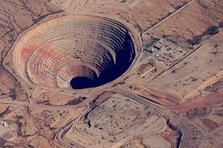
Example of Project Selection: Open Pit Mining

Slide 9
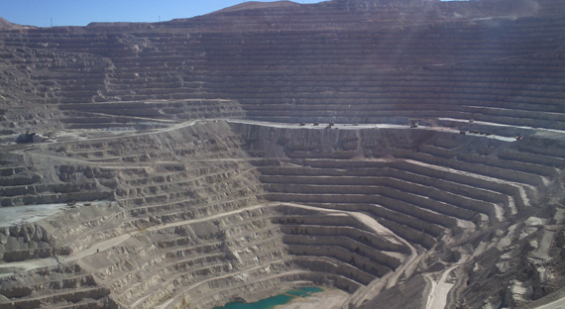
Example of Project Selection: Open Pit Mining

Slide 10
Example of Project Selection: Open Pit Mining
Projects with profit:
Different shades of blue
➔ different amount of profit
Projects with cost:
Different shades of red
➔ different amount of cost
To extract this slab rich in aluminium, you need to extract all slabs lying above it.

Slide 11
Project Selection Problem
There are $n$ projects $P∪C$:
$P$: subset of projects with profit
Project $i∈P$ has profit $p_{i}∈R^{+}$
$C$: subset of projects with cost
Project $j∈C$ has cost $c_{i}∈R^{+}$
Dependency among projects:
To gain profit from a project $i$,
some other projects may have to be completed.
Problem: Select a subset of project such that
The dependency constraint is satisfied
Net profit is maximum.

Slide 12











Project Selection Problem
$$p_{2}$$
$$p_{1}$$
$$p_{5}$$
$$p_{6}$$
$$p_{4}$$
$$p_{3}$$
$$c_{1}$$
$$c_{5}$$
$$c_{4}$$
$$c_{3}$$
$$c_{2}$$

Slide 13
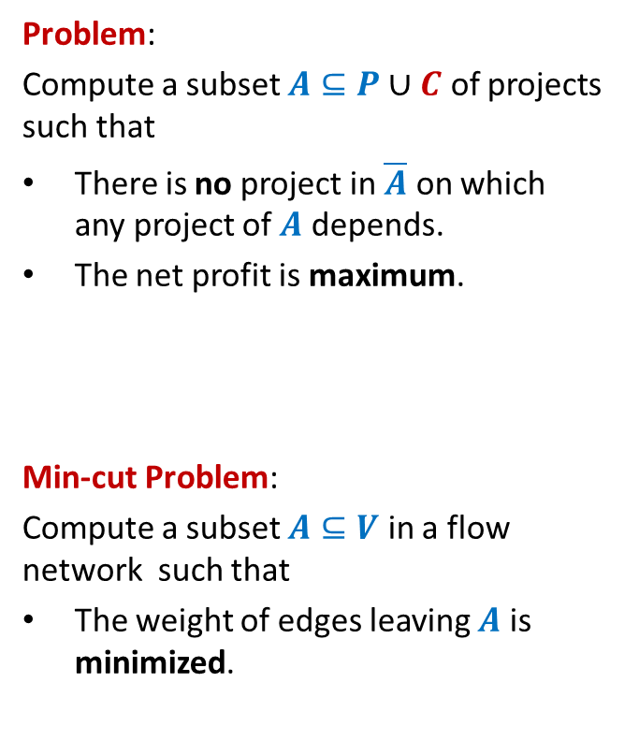
Project Selection Problem
Problem:
Compute a subset $A⊆P∪C$ of projects such that
There is no project in $\overline{A}$ on which any project of $A$ depends.
The net profit is maximum.
Min-cut Problem:
Compute a subset $A⊆V$ in a flow network such that
The weight of edges leaving $A$ is minimized.
$$p_{2}$$
$$p_{1}$$
$$p_{5}$$
$$p_{6}$$
$$p_{4}$$
$$p_{3}$$
?
$$c_{1}$$
$$c_{5}$$
$$c_{4}$$
$$c_{3}$$
$$c_{2}$$
Invalid
Invalid
valid

Slide 14
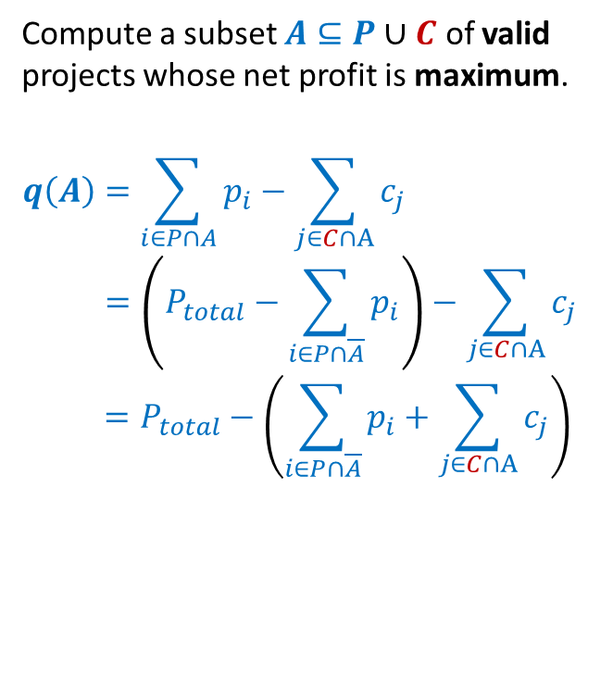

Project Selection Problem
Compute a subset $A⊆P∪C$ of valid projects whose net profit is maximum.
$$q\left(A\right)=\sum_{i∈P∩A}{p_{i}}−\sum_{j∈C∩A}{c_{j}}$$
$$=\left(P_{total}−\sum_{i∈P∩\overline{A}}{p_{i}}\right)−\sum_{j∈C∩A}{c_{j}}$$
$$=P_{total}−\left(\sum_{i∈P∩\overline{A}}{p_{i}}+\sum_{j∈C∩A}{c_{j}}\right)$$
$$p_{2}$$
Maximization
$$p_{1}$$
$$p_{5}$$
$$p_{6}$$
$$p_{4}$$
$$p_{3}$$
$$c_{1}$$
$$c_{5}$$
$$c_{4}$$
$$c_{3}$$
$$c_{2}$$
Minimization
$$A$$

Slide 15




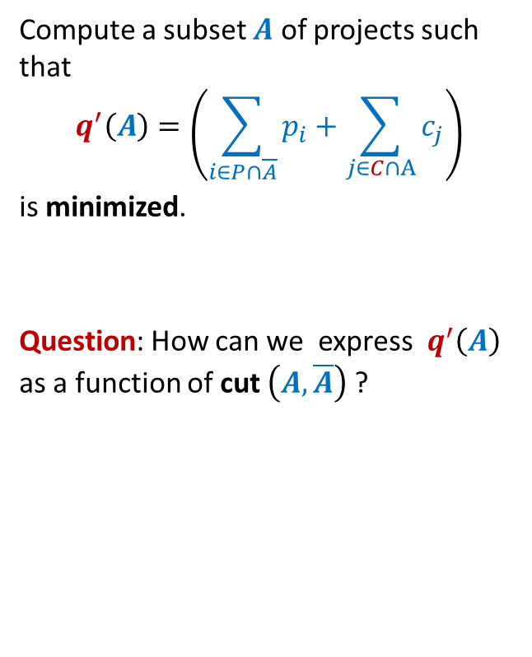








Project Selection Problem
Compute a subset $A$ of projects such that
$$q^{′}\left(A\right)=\left(\sum_{i∈P∩\overline{A}}{p_{i}}+\sum_{j∈C∩A}{c_{j}}\right)$$
is minimized.
Question: How can we express $q^{′}\left(A\right)$ as a function of cut $\left(A,\overline{A}\right)$ ?
$$p_{2}$$
$$p_{1}$$
$$p_{6}$$
$$p_{5}$$
$$p_{2}$$
$$p_{3}$$
$$p_{4}$$
$$p_{1}$$
$$p_{5}$$
$$p_{6}$$
$$p_{4}$$
$$p_{3}$$
$$c_{1}$$
$$c_{5}$$
$$c_{4}$$
$$c_{3}$$
$$c_{2}$$
$$c_{5}$$
$$A$$
$$c_{3}$$
$$c_{1}$$
$$c_{4}$$
$$c_{2}$$

Slide 16




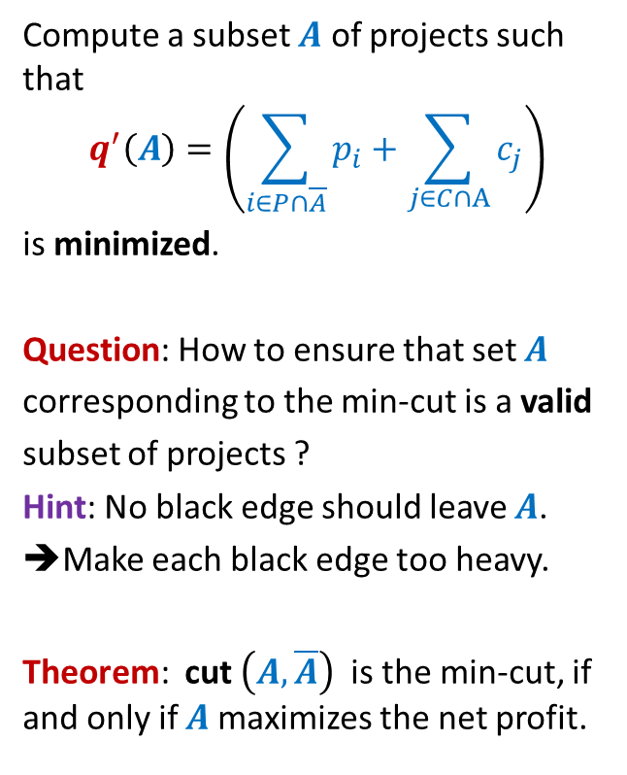








Project Selection Problem
Compute a subset $A$ of projects such that
$$q^{′}\left(A\right)=\left(\sum_{i∈P∩\overline{A}}{p_{i}}+\sum_{j∈C∩A}{c_{j}}\right)$$
is minimized.
Question: How to ensure that set $A$
corresponding to the min-cut is a valid
subset of projects ?
Hint: No black edge should leave $A$.
➔Make each black edge too heavy.
Theorem: cut $\left(A,\overline{A}\right)$ is the min-cut, if and only if $A$maximizes the net profit.
$$p_{2}$$
$$p_{1}$$
$$p_{6}$$
$$p_{5}$$
$$p_{2}$$
$$p_{3}$$
$$∞$$
$$p_{4}$$
$$p_{1}$$
$$∞$$
$$∞$$
$$p_{5}$$
$$p_{6}$$
$$p_{4}$$
$$p_{3}$$
$$∞$$
$$∞$$
$$∞$$
$$∞$$
$$∞$$
$$c_{1}$$
$$∞$$
$$∞$$
$$c_{5}$$
$$c_{4}$$
$$∞$$
$$∞$$
$$c_{3}$$
$$c_{2}$$
$$c_{5}$$
$$A$$
$$c_{3}$$
$$c_{1}$$
$$c_{4}$$
$$c_{2}$$

Slide 17
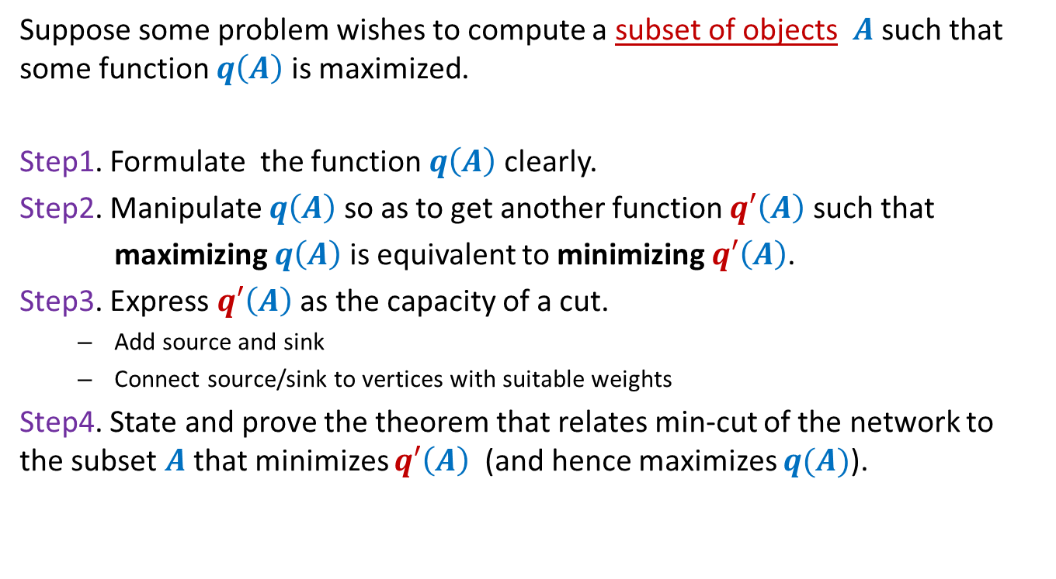
Application of Min-CUT (summary of steps)
Suppose some problem wishes to compute a subset of objects $A$ such that some function $q\left(A\right)$ is maximized.
Step1. Formulate the function $q\left(A\right)$ clearly.
Step2. Manipulate $q\left(A\right)$ so as to get another function $q′\left(A\right)$ such that
maximizing $q\left(A\right)$ is equivalent to minimizing $q′\left(A\right)$.
Step3. Express $q′\left(A\right)$ as the capacity of a cut.
Add source and sink
Connect source/sink to vertices with suitable weights
Step4. State and prove the theorem that relates min-cut of the network to the subset $A$ that minimizes $q′\left(A\right)$ (and hence maximizes $q(A)$).

Slide 18
Application of Min-CUT
Image Segmentation

Slide 19
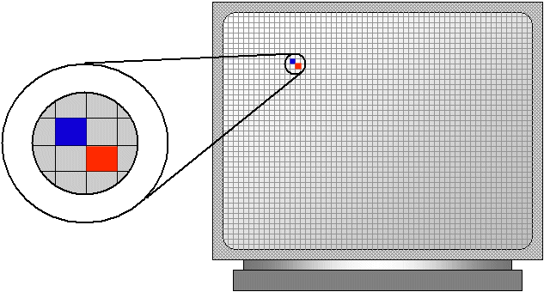
Image Segmentation
An image is a grid of pixels.

Slide 20

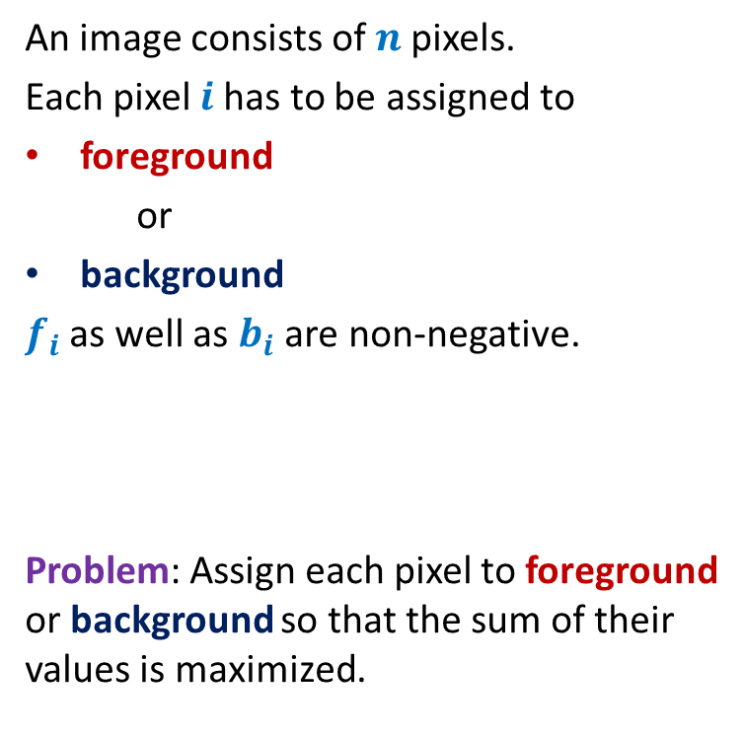

Image Segmentation
An image consists of $n$pixels.
Each pixel $i$has to be assigned to
foreground
or
background
$f_{i}$ as well as $b_{i}$ are non-negative.
Problem: Assign each pixel to foreground or background so that the sum of their values is maximized.
$f_{i}$ value
$b_{i}$ value

Slide 21

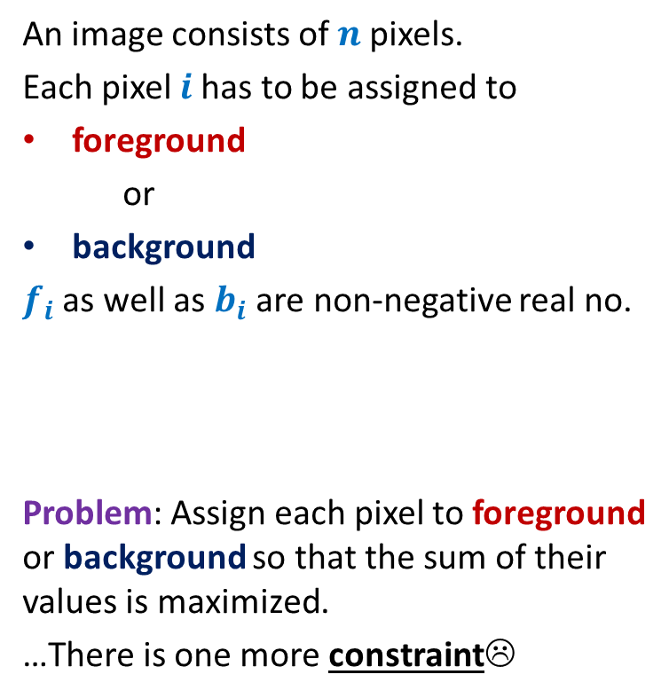


Image Segmentation
An image consists of $n$pixels.
Each pixel $i$has to be assigned to
foreground
or
background
$f_{i}$ as well as $b_{i}$ are non-negative real no.
Problem: Assign each pixel to foreground or background so that the sum of their values is maximized.
…There is one more constraint☹
$f_{i}$ value
$b_{i}$ value
$$i$$
$$j$$
If pixel $i$ and neighboring pixel $j$ get different assignments, then there is a penalty of $p_{ij}$.

Slide 22
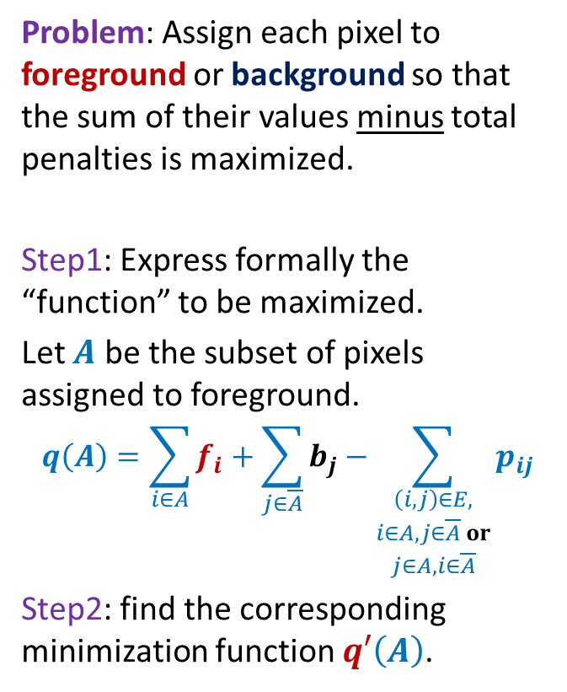
Image Segmentation
Problem: Assign each pixel to foreground or background so that the sum of their values minus total penalties is maximized.
Step1: Express formally the “function” to be maximized.
Let $A$ be the subset of pixels assigned to foreground.
$$q\left(A\right)=\sum_{i∈A}{f_{i}}+\sum_{j∈\overline{A}}{b_{j}}−\sum_{\begin{aligned}\left(i,j\right)∈E, \\ i∈A, j∈\overline{A} or \\ j∈A, i∈\overline{A}\end{aligned}}{p_{ij}}$$
Step2: find the corresponding minimization function $q′\left(A\right)$.

Slide 23
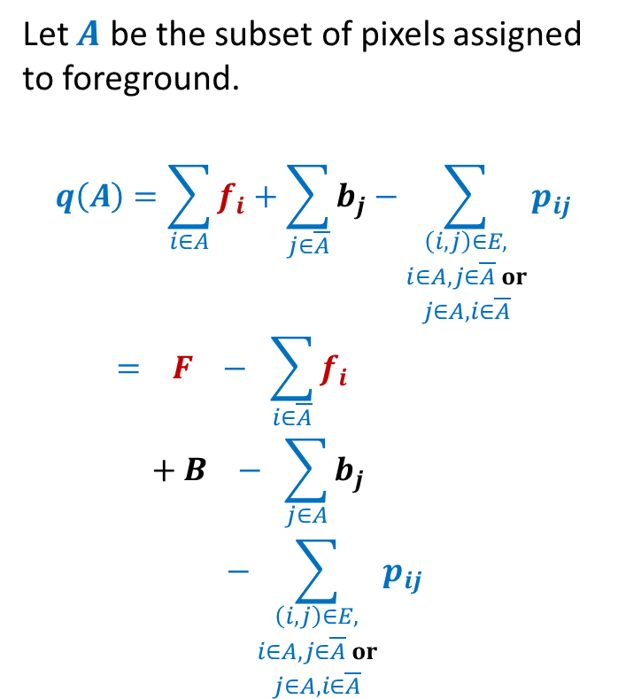
Image Segmentation
Let $A$ be the subset of pixels assigned to foreground.
$$q\left(A\right)=\sum_{i∈A}{f_{i}}+\sum_{j∈\overline{A}}{b_{j}}−\sum_{\begin{aligned}\left(i,j\right)∈E, \\ i∈A, j∈\overline{A} or \\ j∈A, i∈\overline{A}\end{aligned}}{p_{ij}}$$
$$= F − \sum_{i∈\overline{A}}{f_{i}}$$
$$+ B − \sum_{j∈A}{b_{j}}$$
$$−\sum_{\begin{aligned}\left(i,j\right)∈E, \\ i∈A, j∈\overline{A} or \\ j∈A, i∈\overline{A}\end{aligned}}{p_{ij}}$$

Slide 24
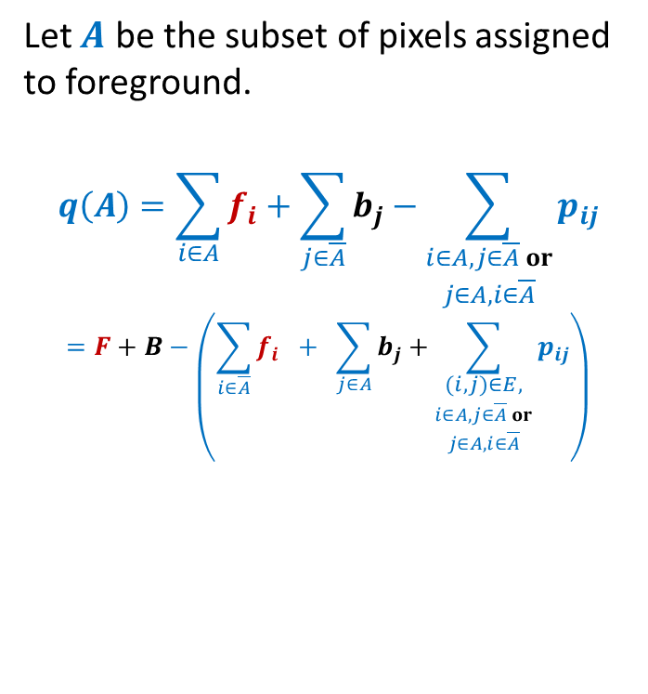
Image Segmentation
Let $A$ be the subset of pixels assigned to foreground.
$$q\left(A\right)=\sum_{i∈A}{f_{i}}+\sum_{j∈\overline{A}}{b_{j}}−\sum_{\begin{aligned}i∈A, j∈\overline{A} or \\ j∈A, i∈\overline{A}\end{aligned}}{p_{ij}}$$
$$=F+B−\left(\sum_{i∈\overline{A}}{f_{i}} + \sum_{j∈A}{b_{j}}+\sum_{\begin{aligned}\left(i,j\right)∈E, \\ i∈A, j∈\overline{A} or \\ j∈A, i∈\overline{A}\end{aligned}}{p_{ij}}\right)$$
Maximization
Minimization

Slide 25
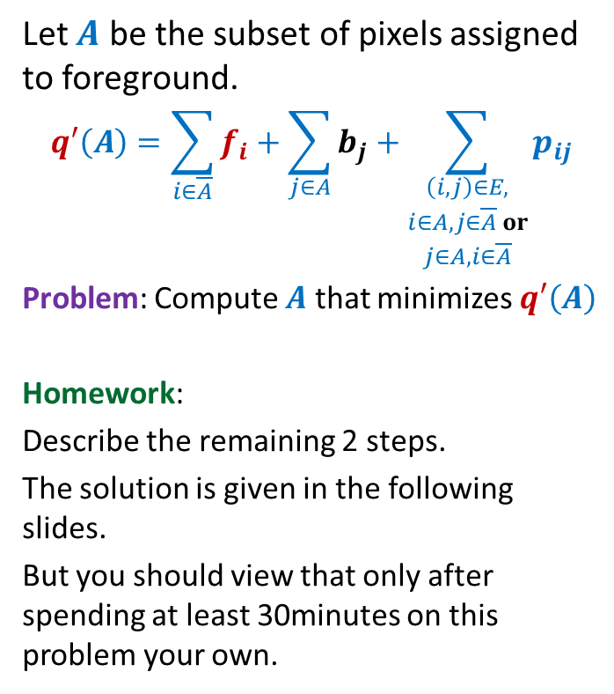
Image Segmentation
Let $A$ be the subset of pixels assigned to foreground.
$$q′\left(A\right)=\sum_{i∈\overline{A}}{f_{i}}+\sum_{j∈A}{b_{j}}+\sum_{\begin{aligned}\left(i,j\right)∈E, \\ i∈A, j∈\overline{A} or \\ j∈A, i∈\overline{A}\end{aligned}}{p_{ij}}$$
Problem: Compute $A$ that minimizes $q′\left(A\right)$
Homework:
Describe the remaining 2 steps.
The solution is given in the following slides.
But you should view that only after spending at least 30minutes on this problem your own.

Slide 26

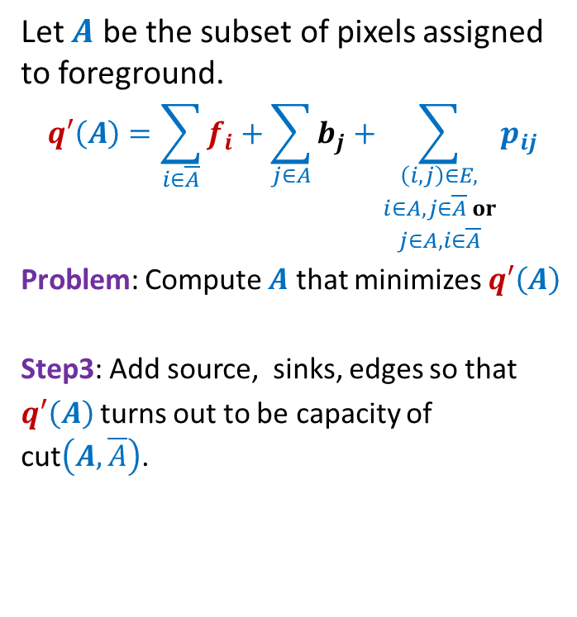



Image Segmentation
Let $A$ be the subset of pixels assigned to foreground.
$$q′\left(A\right)=\sum_{i∈\overline{A}}{f_{i}}+\sum_{j∈A}{b_{j}}+\sum_{\begin{aligned}\left(i,j\right)∈E, \\ i∈A, j∈\overline{A} or \\ j∈A, i∈\overline{A}\end{aligned}}{p_{ij}}$$
Problem: Compute $A$ that minimizes $q′\left(A\right)$
Step3: Add source, sinks, edges so that
$q′\left(A\right)$turns out to be capacity of cut$\left(A,\overline{A}\right)$.
$$s$$
$$A$$
Hint: Consider any fixed set $A$ and try to figure out edges and their capacities so that $q′\left(A\right)$= $C\left(A,\overline{A}\right)$.
$$t$$

Slide 27
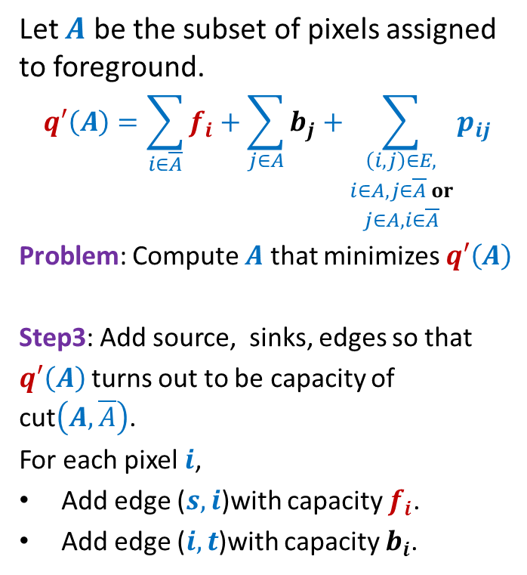
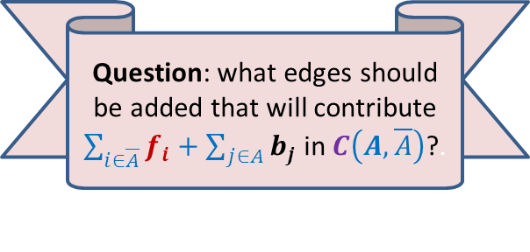
Image Segmentation
Let $A$ be the subset of pixels assigned to foreground.
$$q′\left(A\right)=\sum_{i∈\overline{A}}{f_{i}}+\sum_{j∈A}{b_{j}}+\sum_{\begin{aligned}\left(i,j\right)∈E, \\ i∈A, j∈\overline{A} or \\ j∈A, i∈\overline{A}\end{aligned}}{p_{ij}}$$
Problem: Compute $A$ that minimizes $q′\left(A\right)$
Step3: Add source, sinks, edges so that
$q′\left(A\right)$turns out to be capacity of cut$\left(A,\overline{A}\right)$.
For each pixel $i$,
Add edge ($s,i$)with capacity $f_{i}$.
Add edge ($i,t$)with capacity $b_{i}$.
$$s$$
$$A$$
Question: what edges should be added that will contribute $\sum_{i∈\overline{A}}{f_{i}}+\sum_{j∈A}{b_{j}}$ in $C\left(A,\overline{A}\right)$?.
$$t$$

Slide 28
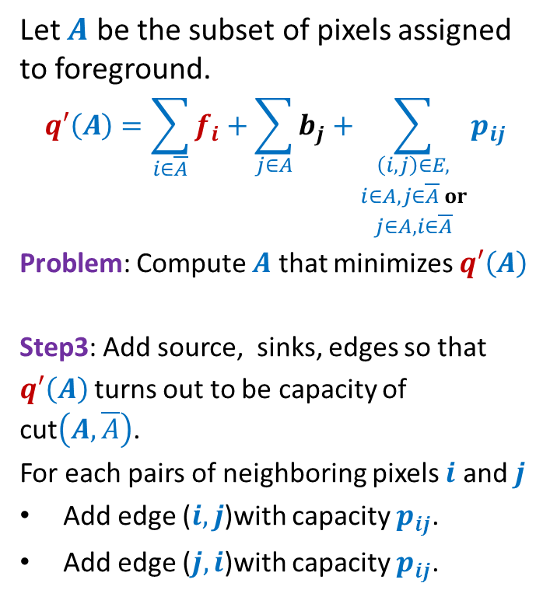
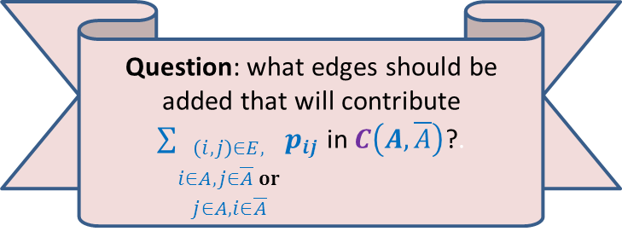
Image Segmentation
Let $A$ be the subset of pixels assigned to foreground.
$$q′\left(A\right)=\sum_{i∈\overline{A}}{f_{i}}+\sum_{j∈A}{b_{j}}+\sum_{\begin{aligned}\left(i,j\right)∈E, \\ i∈A, j∈\overline{A} or \\ j∈A, i∈\overline{A}\end{aligned}}{p_{ij}}$$
Problem: Compute $A$ that minimizes $q′\left(A\right)$
Step3: Add source, sinks, edges so that
$q′\left(A\right)$turns out to be capacity of cut$\left(A,\overline{A}\right)$.
For each pairs of neighboring pixels $i$ and $j$
Add edge ($i,j$)with capacity $p_{ij}$.
Add edge ($j,i$)with capacity $p_{ij}$.
$$s$$
$$i$$
$$j$$
$$A$$
Question: what edges should be added that will contribute
$\sum_{\begin{aligned}\left(i,j\right)∈E, \\ i∈A, j∈\overline{A} or \\ j∈A, i∈\overline{A}\end{aligned}}{p_{ij}}$ in $C\left(A,\overline{A}\right)$?.
$$t$$

Slide 29
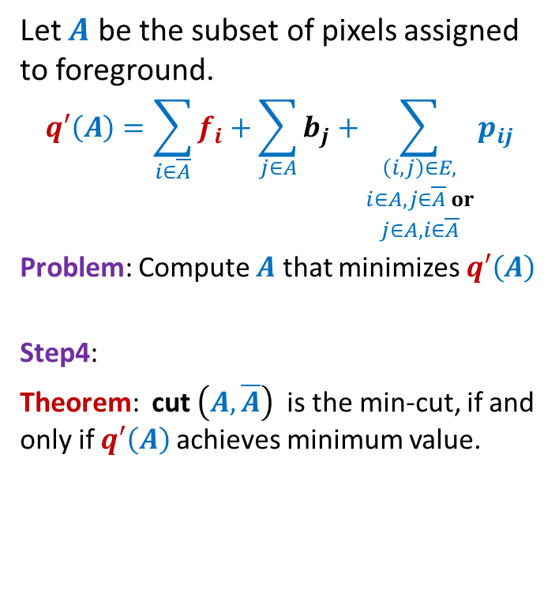
Image Segmentation
Let $A$ be the subset of pixels assigned to foreground.
$$q′\left(A\right)=\sum_{i∈\overline{A}}{f_{i}}+\sum_{j∈A}{b_{j}}+\sum_{\begin{aligned}\left(i,j\right)∈E, \\ i∈A, j∈\overline{A} or \\ j∈A, i∈\overline{A}\end{aligned}}{p_{ij}}$$
Problem: Compute $A$ that minimizes $q′\left(A\right)$
Step4:
Theorem: cut $\left(A,\overline{A}\right)$ is the min-cut, if and only if $q′\left(A\right)$achieves minimum value.
$$s$$
$$i$$
$$j$$
$$A$$
$$t$$

Slide 30
Try to internalize the solution of the two problems we solved in this lecture.
Their solution is indeed the most non-trivial application of max flow and min-cut.
Solve the problems from the practice sheet 6 to master the topic of Max-flow.
Happy Holi ☺

