Slide 1
Design and Analysis of Algorithms (CS345/CS345A) Jan-April 2014
Lecture 30
Amortized Analysis – II
(Application: Dynamic Table)

Slide 2
Summary of Previous Lecture

Slide 3
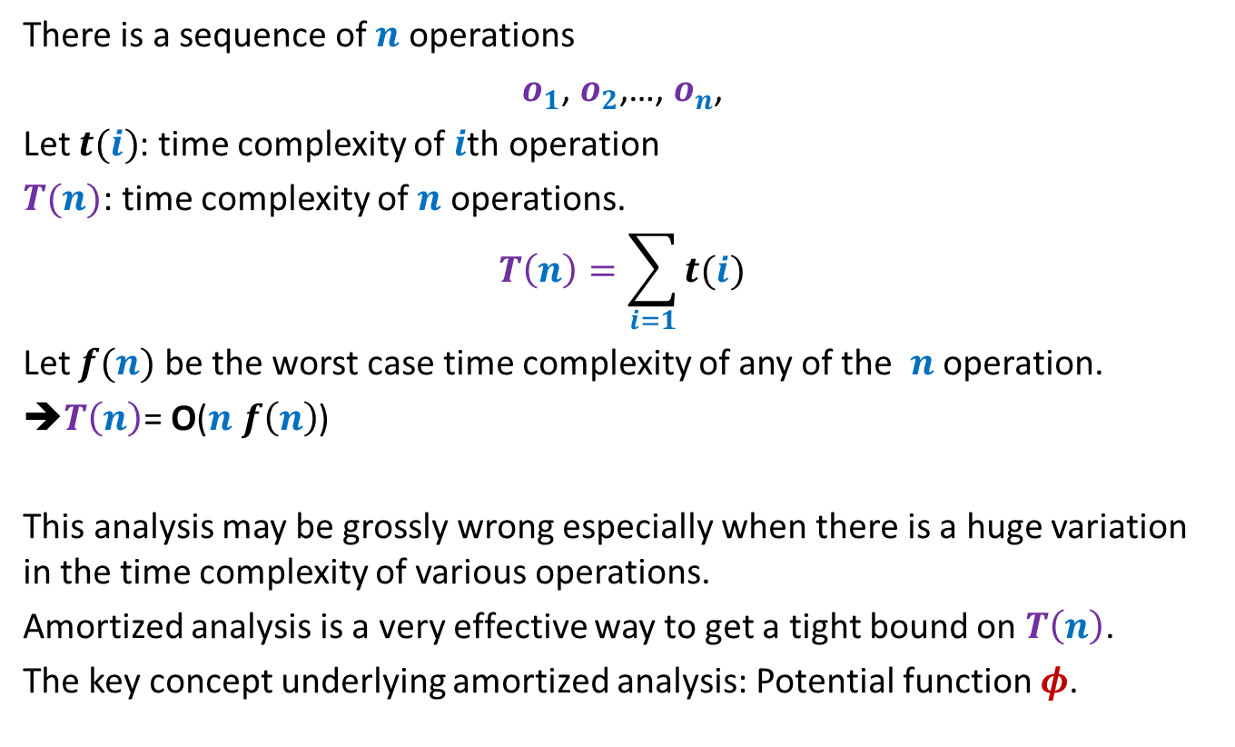
Aim of Amortized Analysis
There is a sequence of $n$ operations
$o_{1}$, $o_{2}$,…, $o_{n}$,
Let $t(i)$: time complexity of $i$th operation
$T(n)$: time complexity of $n$ operations.
$$T\left(n\right)=\sum_{i=1}{t(i)}$$
Let $f(n)$ be the worst case time complexity of any of the $n$ operation.
➔$T\left(n\right)$= O($n f\left(n\right)$)
This analysis may be grossly wrong especially when there is a huge variation in the time complexity of various operations.
Amortized analysis is a very effective way to get a tight bound on $T\left(n\right)$.
The key concept underlying amortized analysis: Potential function $φ$.

Slide 4
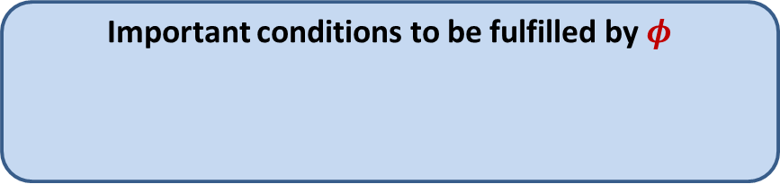
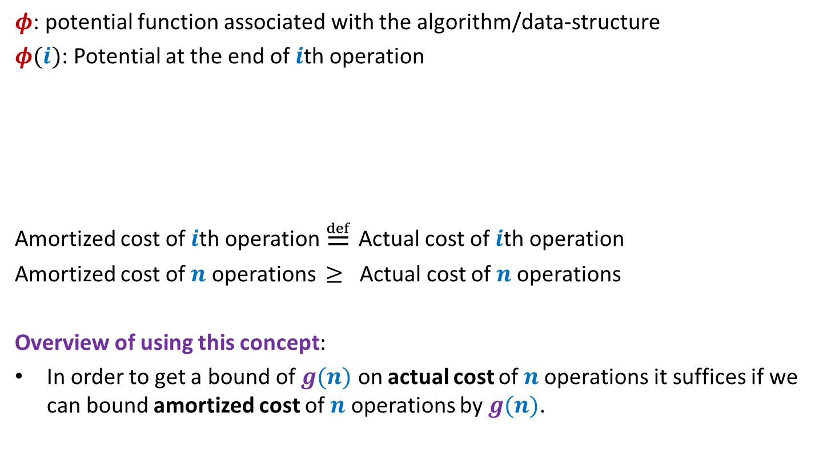



Amortized Cost
$φ$: potential function associated with the algorithm/data-structure
$φ(i)$: Potential at the end of $i$th operation
Amortized cost of $i$th operation $≝$ Actual cost of $i$th operation
Amortized cost of $n$ operations $≥$ Actual cost of $n$operations
Overview of using this concept:
In order to get a bound of $g(n)$ on actual cost of $n$operations it suffices if we can bound amortized cost of $n$ operations by $g(n)$.
Important conditions to be fulfilled by $φ$
$φ(0)$ = $0$
$φ\left(i\right)≥0$ for all $i$
+ $\left(φ\left(i\right)−φ\left(i−1\right)\right)$

Slide 5
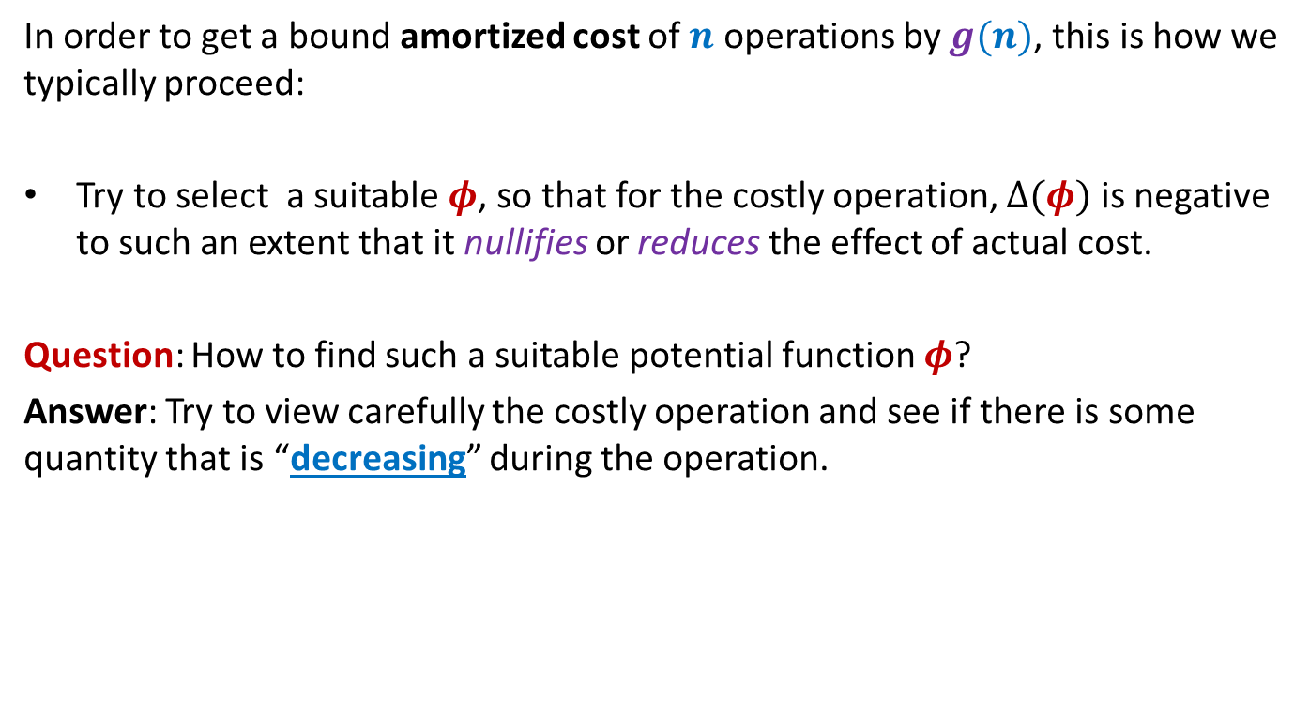
Amortized Cost
In order to get a bound amortized cost of $n$ operations by $g(n)$, this is how we typically proceed:
Try to select a suitable $φ$, so that for the costly operation, $Δ(φ)$ is negative to such an extent that it nullifies or reduces the effect of actual cost.
Question: How to find such a suitable potential function $φ$?
Answer: Try to view carefully the costly operation and see if there is some quantity that is “decreasing” during the operation.

Slide 6
Application 1
Dynamic Tables

Slide 7
Memory Management
What happens if more space is needed by table ?
Table T
Free space
Memory

Slide 8
SPACE and TIME Efficient Dynamic Table
For Insertions Only

Slide 9
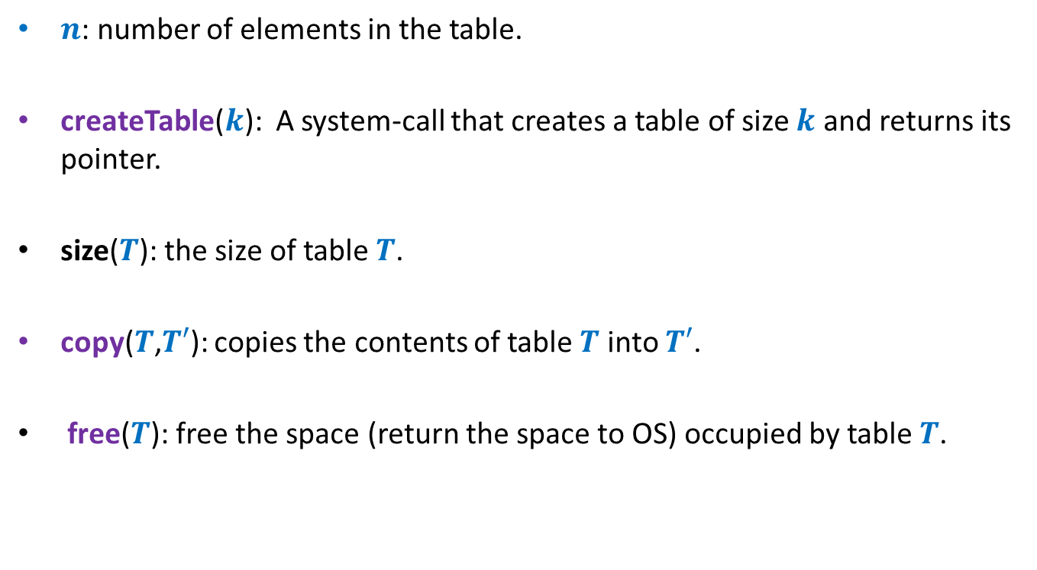
Some notations
$n$: number of elements in the table.
createTable($k$): A system-call that creates a table of size $k$ and returns its pointer.
size($T$): the size of table $T$.
copy($T$,$T′$): copies the contents of table $T$ into $T′$.
free($T$): free the space (return the space to OS) occupied by table $T$.

Slide 10
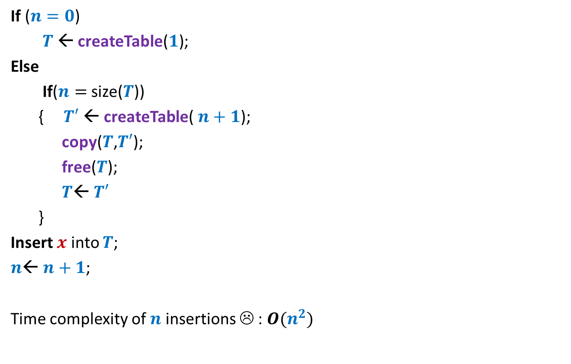



A trivial way to perform Insert($x$)
If ($n=0$)
$T$← createTable($1$);
Else
If($n=$ size($T$))
{ $T′$← createTable($n+1$);
copy($T$,$T′$);
free($T$);
$T$← $T′$
}
Insert $x$ into $T$;
$n$← $n+1$;
Time complexity of $n$ insertions ☹ : $O(n^{2})$
// Table is full !
O($1$)
O($n$)
Idea:
Every time a table is full, create a new table of double the size.

Slide 11



An efficient way to perform Insert($x$)
If ($n=0$)
$T$← createTable($1$);
Else
If($n=$ size($T$))
{ $T′$← createTable($n+1$);
copy($T$,$T′$);
free($T$);
$T$← $T′$
}
Insert $x$ into $T$;
$n$← $n+1$;
// Table is full !
$$2n$$
O($1$)
O($n$)
Observation:
The table is at least half-full always.
So space utilization is at least 50%.

Slide 12
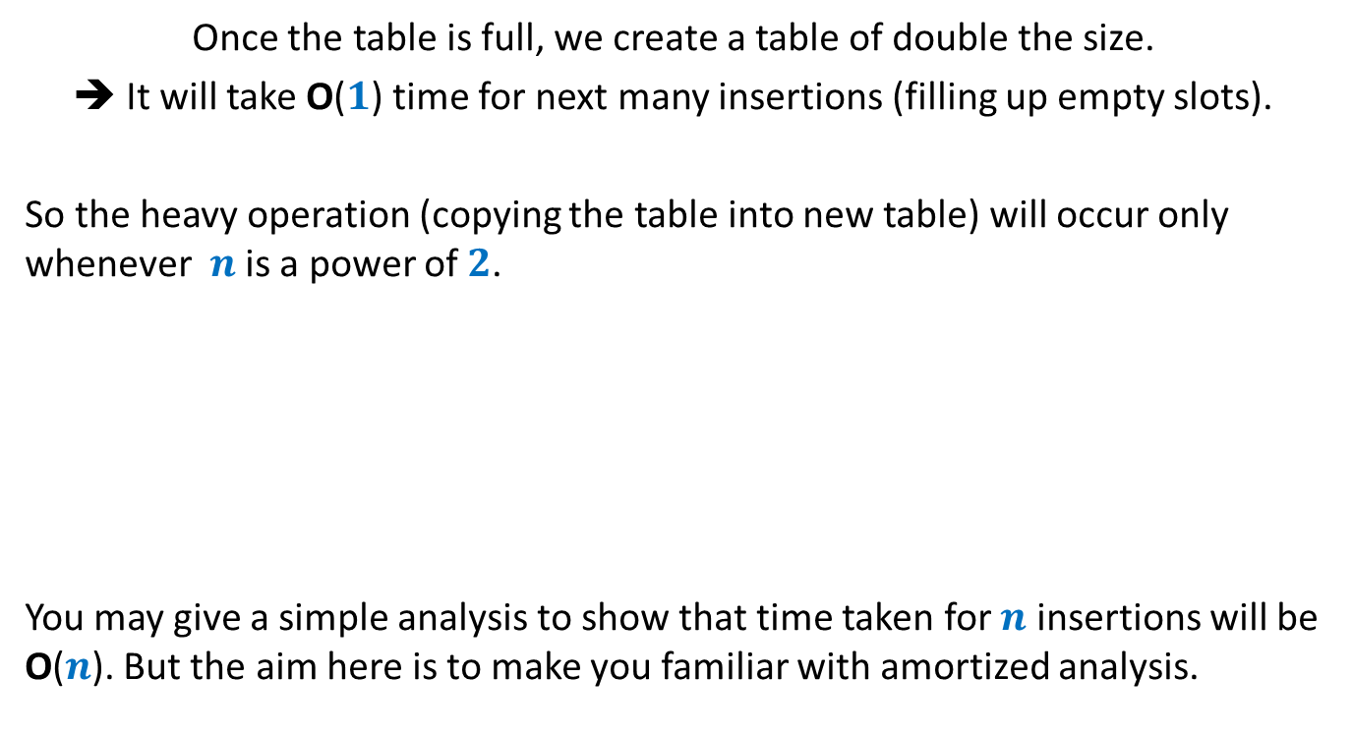

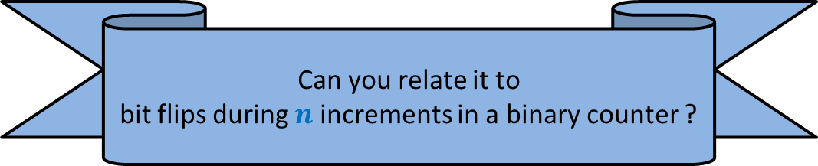
Intuition underlying efficiency of Insert($x$)
Once the table is full, we create a table of double the size.
➔ It will take O($1$) time for next many insertions (filling up empty slots).
So the heavy operation (copying the table into new table) will occur only whenever $n$ is a power of $2$.
You may give a simple analysis to show that time taken for $n$ insertions will be O($n$). But the aim here is to make you familiar with amortized analysis.
Can you relate it to
bit flips during $n$ increments in a binary counter ?

Slide 13

















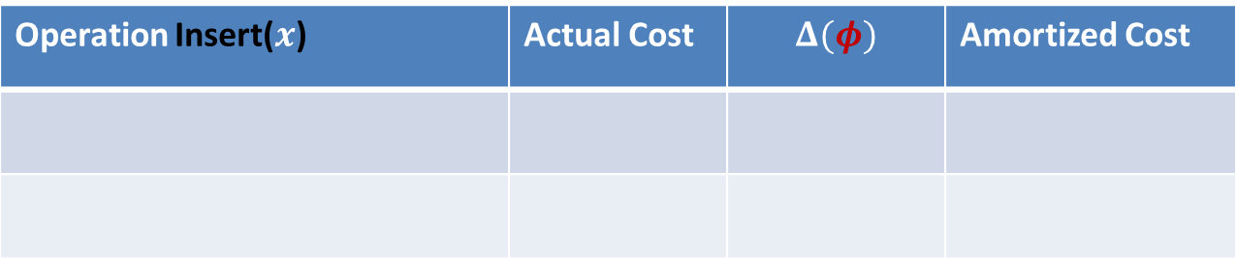


Amortized Analysis of Insert($x$)
$$m$$
$φ$ = $c$ ($m$)
Before Insert($x$)
$$2m$$
$φ$ = $c$ ($2$)
$$x$$
After Insert($x$)
$$m+1$$
Operation Insert($x$) | Actual Cost | $$Δ(φ)$$ | Amortized Cost
Case 1: when table is not full
$$c$$
Case 2: when table is already full
$$cn$$
$$c(2−m)$$
$$c(3−n)$$
$$3c$$
$φ$ at any stage = $c$ ($2n−$ size($T$))
Add some positive quantity to make it non-negative.
But what should it be ?
Apparently everything (size or $n$) seems to have increased.☹
It ensures $Δ(φ)$ = $−c(n−1)$ ☺
But $φ$is not non-negative ☹
How to make it non-negative?
Hint: Us the fact that the table is at least half-full always.
Try “$−c$ size”.
What should be $φ$ ?
Is there anything that has decreased ?
Look carefully the Case 2.

Slide 14



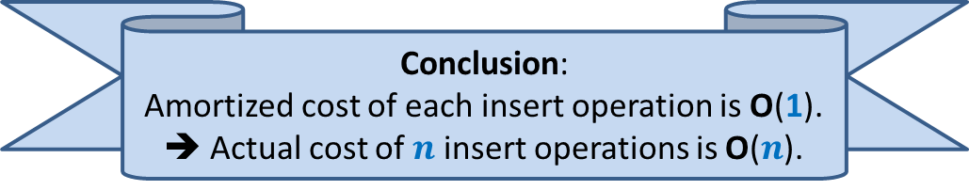
Amortized Analysis of Insert($x$)
Before Insert($x$)
After Insert($x$)
$$x$$
Operation Insert($x$) | Actual Cost | $$Δ(φ)$$ | Amortized Cost
Case 1: when table is not full
$$c$$
$$c(2)$$
$$3c$$
Case 2: when table is already full
$$cn$$
$$c(3−n)$$
$$3c$$
$φ$ at any stage = $c$ ($2n−$ size($T$))
Conclusion:
Amortized cost of each insert operation is O(1).
➔ Actual cost of $n$ insert operations is O($n$).
Analyze Case 1 now.

Slide 15
SPACE and TIME Efficient Dynamic Table
For handling deletions only

Slide 16
Sequence of Deletions
Wastage of space !!

Slide 17


An efficient way to perform delete($x$)
Delete $x$ from $T$;
$n$← $n−1$;
If ($n=0$)
free($T$);
Else
If($n=$ size($T$)/2)
{ $T′$← createTable($n/2$);
copy($T$,$T′$);
free($T$);
$T$← $T′$;
}
// Table is half full !
O($1$)
O($n$)
O($1$)
Observation:
The table is at least half-full always.
So space utilization is at least 50%.

Slide 18
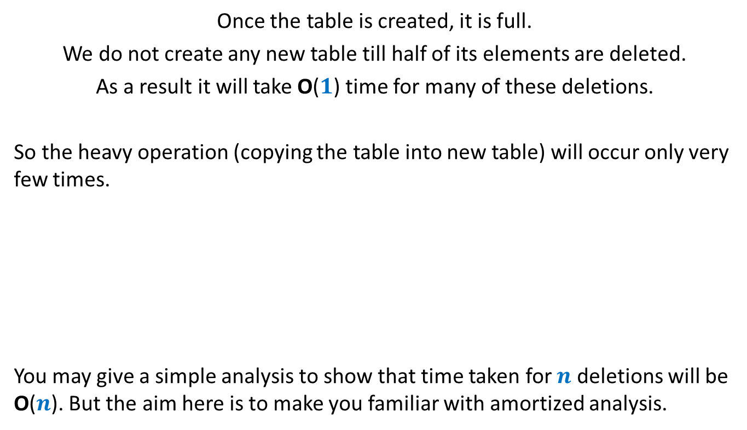
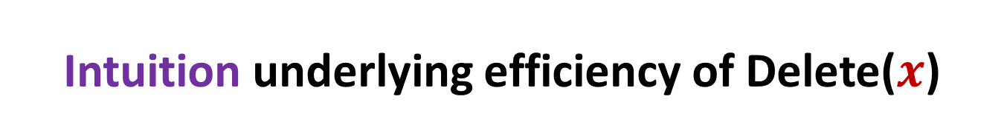
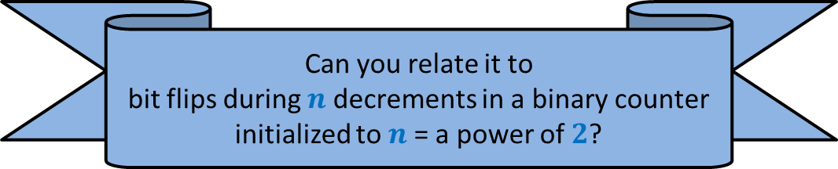
Intuition underlying efficiency of Delete($x$)
Once the table is created, it is full.
We do not create any new table till half of its elements are deleted.
As a result it will take O($1$) time for many of these deletions.
So the heavy operation (copying the table into new table) will occur only very few times.
You may give a simple analysis to show that time taken for $n$ deletions will be O($n$). But the aim here is to make you familiar with amortized analysis.
Can you relate it to
bit flips during $n$ decrements in a binary counter initialized to $n$= a power of $2$?

Slide 19
















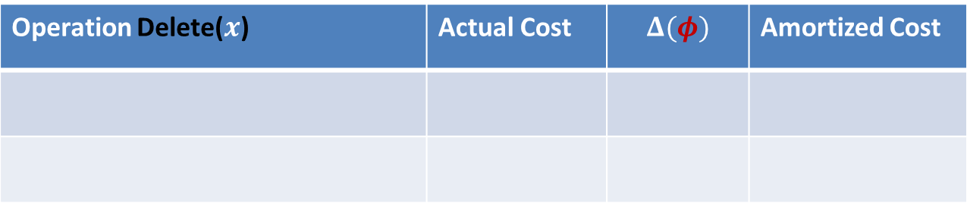


Amortized Analysis of Delete($x$)
$$2m$$
$φ$ = $c$ ($m−1$)
$$x$$
Before Delete($x$)
$$m+1$$
$φ$ = $0$
After Delete($x$)
$$m$$
Operation Delete($x$) | Actual Cost | $$Δ(φ)$$ | Amortized Cost
Case 1: when table does not shrink
$$c$$
$$c$$
$$2c$$
Case 2: when table shrinks to half
$$cn+c$$
$$c(1−n)$$
$$c(1−m)$$
$$2c$$
$φ$ at any stage = $c$ (size($T$)$−n$)
Yes, the number of empty slots has decreased in the table. ☺
So try it as a $φ$.
How can you express number of empty slots in terms of size and $n$ ?
Look carefully at the Case 2.
Is there anything that has decreased ?
What should be $φ$ ?

Slide 20
SPACE and TIME Efficient Dynamic Table
For handling insertions and deletions both

Slide 21






Attempt 1
Seeing the similarity between handling of Insertion and handling of deletion, just combine them in order to handle insertion/deletion.
But there is a serious problem in this algorithm. Can you spot it ?
$$2m$$
$$x$$
$$m+1$$
Delete($x$)
Each operation requires $Θ(m)$ time ☹
Insert($x$)
$$m$$

Slide 22
So there is no point in carrying out amortized analysis of the “Attempt 1” algorithm.
Instead we need to have a new algorithm.

Slide 23
Towards designing new algorithm
Our original algorithm which handles insertions only has some novelty.
So let us try to extend it to handle deletions.
How should this extension look like ?
Spend some time thinking over it.

Slide 24


An efficient way to perform delete($x$)
Delete $x$ into $T$;
$n$← $n−1$;
If ($n=0$)
FreeTable($T$);
Else
If($n=$ size($T$)/2 )
{ $T′$← CreateTable($n/2$);
Copy($T$,$T′$);
FreeTable($T′$);
$T$← $T′$;
}
size($T$)/4
// Table is quarter full !
O($1$)
O($n$)
O($1$)
Idea:
Delay the shrinking

Slide 25


The intuition why this new algorithm handles insertions and deletions efficiently.
Observation: Every time a table is created, it is half-full.
Only two big events can happen in future:
It becomes full
It becomes quarter full
➔ At least $n$ insertions
➔ At least $n/2$ deletions

Slide 26

















Amortized Analysis of Delete($x$)
$$4m$$
$φ$=$c$ ($2m−2$)
$$x$$
Before Delete($x$)
$$m+1$$
$φ$ = $0$
After Delete($x$)
$$2m$$
Operation Delete($x$) | Actual Cost | $$Δ(φ)$$ | Amortized Cost
Case 1: when table does not shrink
$$c$$
$$2c$$
$$3c$$
Case 2: when table shrinks to half
$$cn+c$$
$$c(2−2n)$$
$$<3c$$
$$3c−cn$$
$φ$ used by us for handling insertion = $c$ ($2n−$ size($T$))
Look carefully the Case 2.
How to adapt this $φ$ so that amortized cost is bounded by a constant for deletion as well.

Slide 27
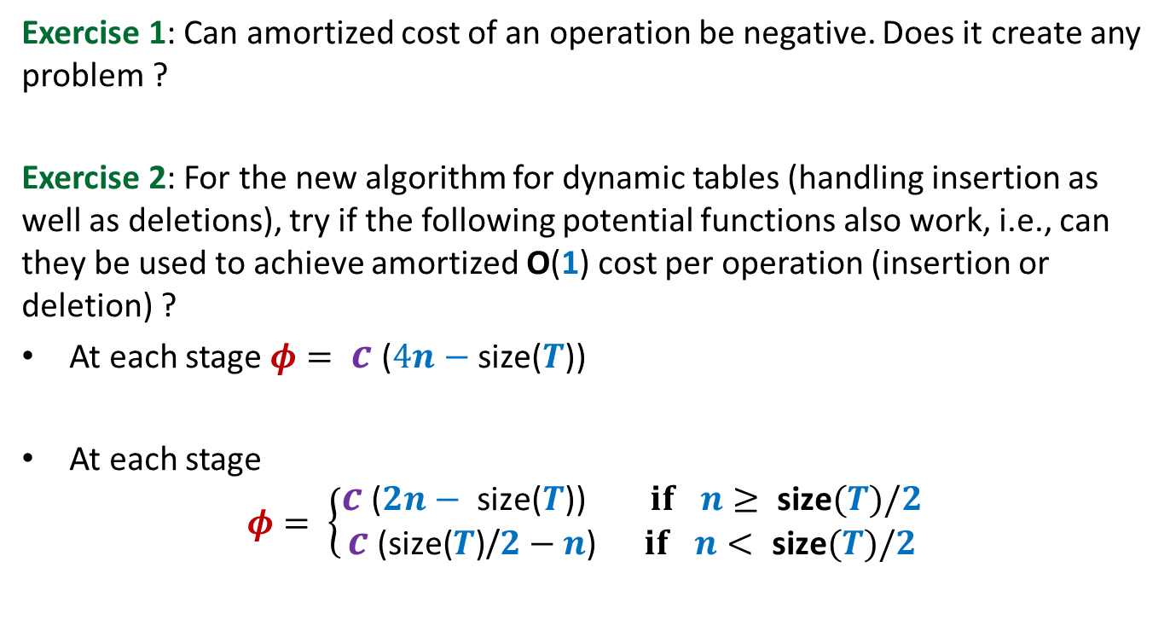
Homework
Exercise 1: Can amortized cost of an operation be negative. Does it create any problem ?
Exercise 2: For the new algorithm for dynamic tables (handling insertion as well as deletions), try if the following potential functions also work, i.e., can they be used to achieve amortized O(1) cost per operation (insertion or deletion) ?
At each stage $φ= c$ ($4n−$ size($T$))
At each stage
$$φ= \left\{\begin{aligned}c\text{ (}2n− \text{size}\text{(}T\text{)) } if n≥ \text{size}(T)/2 \\ c\text{ (}\text{size}\text{(}T\text{)}\text{/}2−n\text{)} if n< \text{size}(T)/2\end{aligned}\right.$$

