Slide 1
Design and Analysis of Algorithms (CS345/CS345A) Jan-April 2014
Lecture 31
Amortized Analysis – III
(Application: Self Organizing Data structures)

Slide 2
Self Organizing Binary Search Trees
For Motivation only

Slide 3
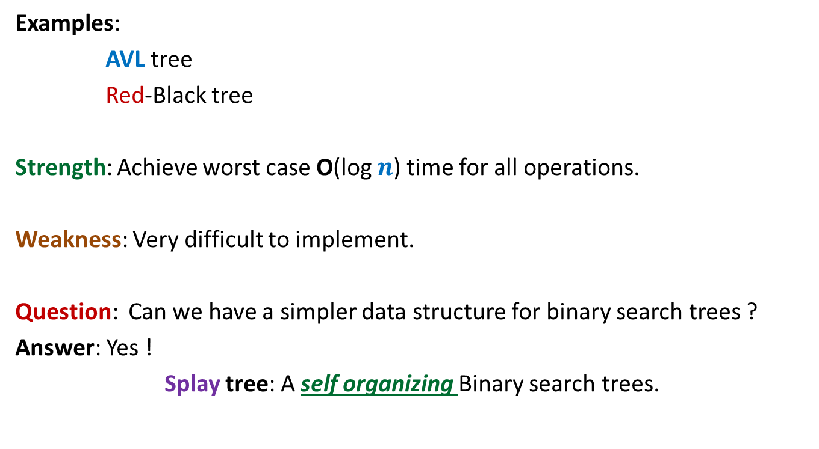
Binary Search Trees
Examples:
AVL tree
Red-Black tree
Strength: Achieve worst case O(log $n$) time for all operations.
Weakness: Very difficult to implement.
Question: Can we have a simpler data structure for binary search trees ?
Answer: Yes !
Splay tree: A self organizing Binary search trees.

Slide 4
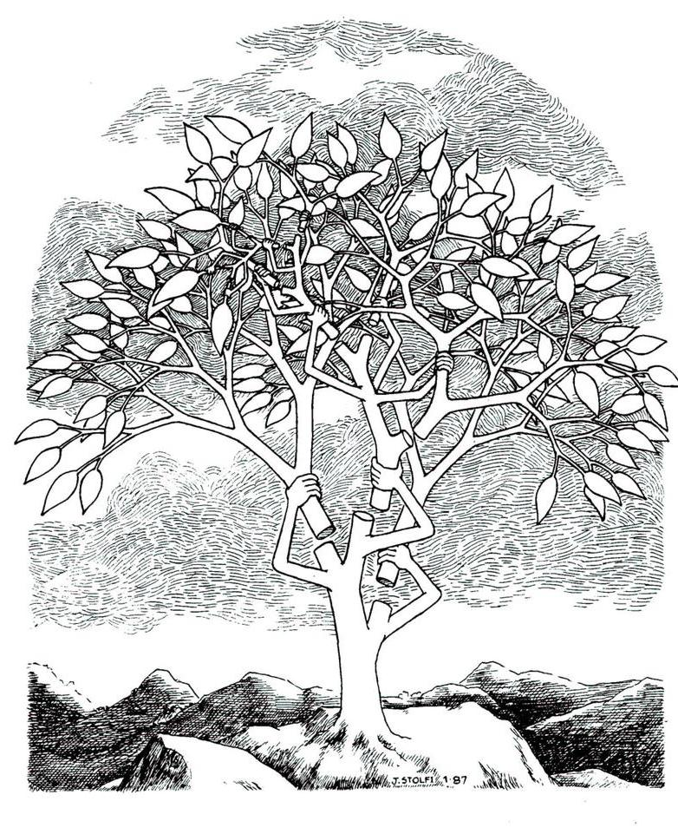
Splay tree: A self organizing Binary search trees.

Slide 5
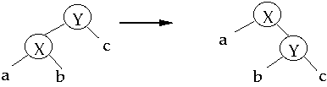
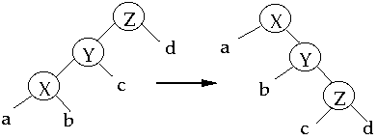
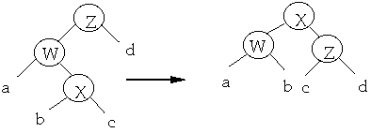
Splay operation Search(x)

Slide 6
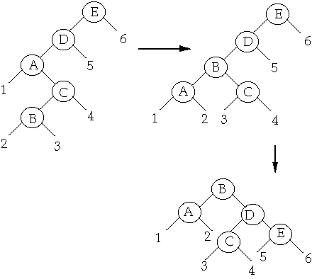
Splay operation Search(B)

Slide 7
Search(x) on a Splay Tree
Perform ordinary search for “x” on the BST.
Bring the element “x” to the root by a sequence of splaying.
Intuition for splaying:
Element accessed more frequently will be closer to the root,
➔ so their search time will be very less.

Slide 8
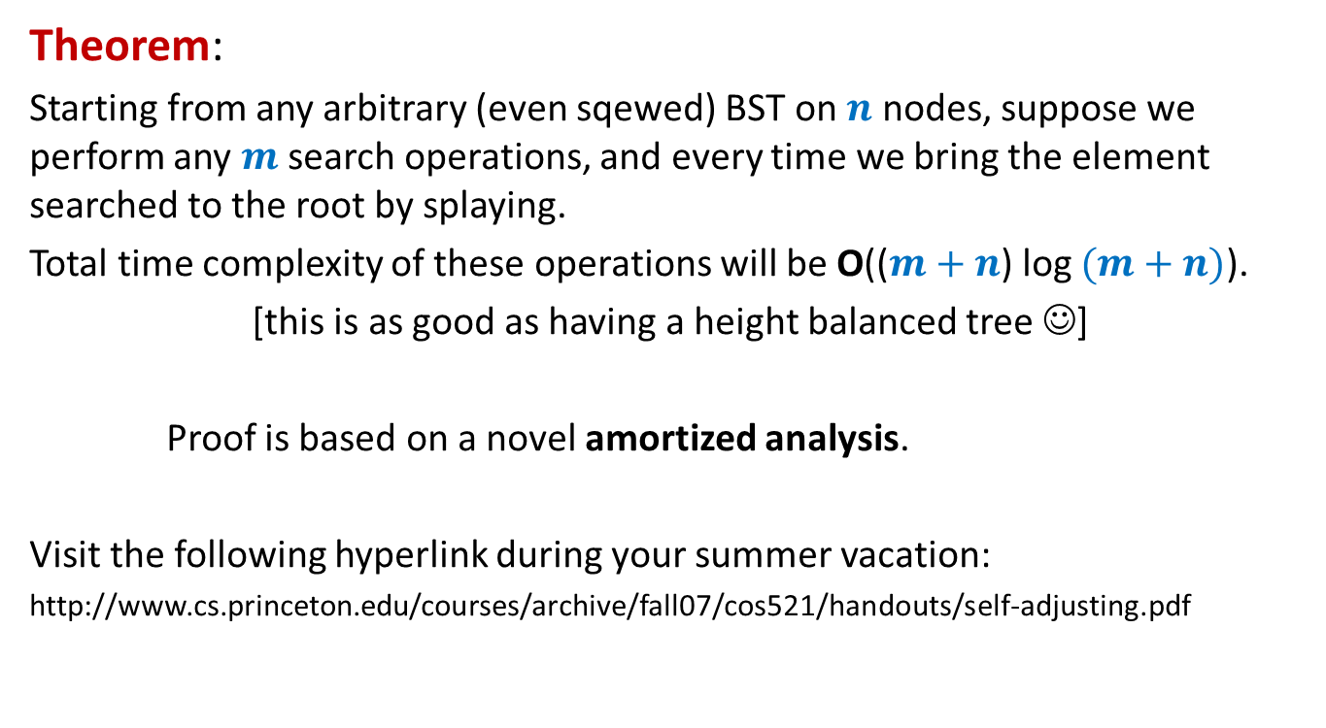
Analysis of Splay trees
Theorem:
Starting from any arbitrary (even sqewed) BST on $n$ nodes, suppose we perform any $m$search operations, and every time we bring the element searched to the root by splaying.
Total time complexity of these operations will be O(($m+n$) log $(m+n)$).
[this is as good as having a height balanced tree ☺]
Proof is based on a novel amortized analysis.
Visit the following hyperlink during your summer vacation:
http://www.cs.princeton.edu/courses/archive/fall07/cos521/handouts/self-adjusting.pdf

Slide 9
Self Organizing LIST
A nice problem to realize the
magical power of amortized analysis

Slide 10
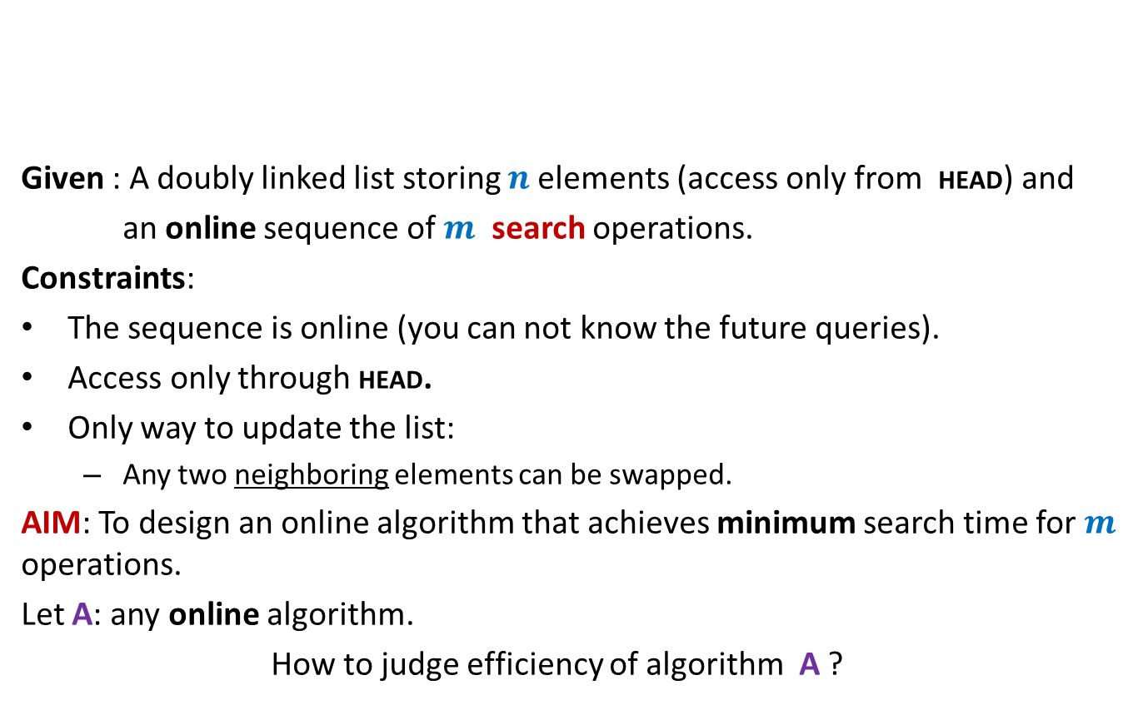
Problem : Online list search
HEAD
Given : A doubly linked list storing $n$elements (access only from HEAD) and
an online sequence of $m$ search operations.
Constraints:
The sequence is online (you can not know the future queries).
Access only through HEAD.
Only way to update the list:
Any two neighboring elements can be swapped.
AIM: To design an online algorithm that achieves minimum search time for $m$ operations.
Let A: any online algorithm.
How to judge efficiency of algorithm A ?
P
A
N
K
R
U
I

Slide 11
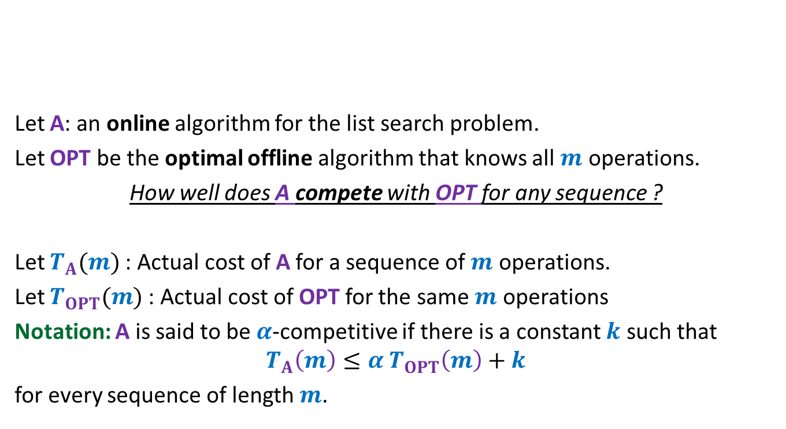
Competitive ratio A novel concept to judge efficiency of A
HEAD
Let A: an online algorithm for the list search problem.
Let OPT be the optimal offline algorithm that knows all $m$ operations.
How well does A compete with OPT for any sequence ?
Let $T_{A}(m)$: Actual cost of A for a sequence of $m$ operations.
Let $T_{OPT}(m)$: Actual cost of OPT for the same $m$ operations
Notation: A is said to be $α$-competitive if there is a constant $k$ such that
$$T_{A}\left(m\right)≤{α T}_{OPT}\left(m\right)+k$$
for every sequence of length $m$.
P
A
N
K
R
U
I

Slide 12
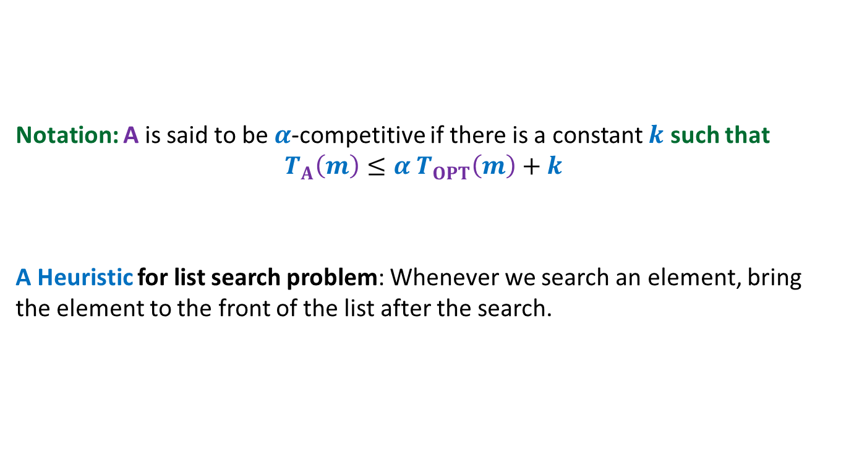
Problem statement
HEAD
Notation: A is said to be $α$-competitive if there is a constant $k$ such that
$$T_{A}\left(m\right)≤{α T}_{OPT}\left(m\right)+k$$
A Heuristic for list search problem: Whenever we search an element, bring the element to the front of the list after the search.
P
A
N
K
R
U
I

Slide 13
Move to Front Algorithm

Slide 14

Move-to-Front algorithm
HEAD
Search(e):
Starting from HEAD pointer, scan linearly till we find element e;
Bring the node storing e to the front of list
A notation:
$r$(e): rank of element e in the list.
P
A
N
K
R
U
I
by a sequence of swaps.
Example: Search(R)

Slide 15


Move-to-Front algorithm Execution of Search(R)
$r$(R) steps for locating R
$r$(R) $−1$ swaps
HEAD
P
A
N
K
R
U
I
HEAD
P
A
N
R
K
U
I
HEAD
P
A
R
N
K
U
I
HEAD
P
R
A
N
K
U
I
HEAD
R
P
A
N
K
U
I

Slide 16
How good is MTF Algorithm ?
MTF versus OPT

Slide 17
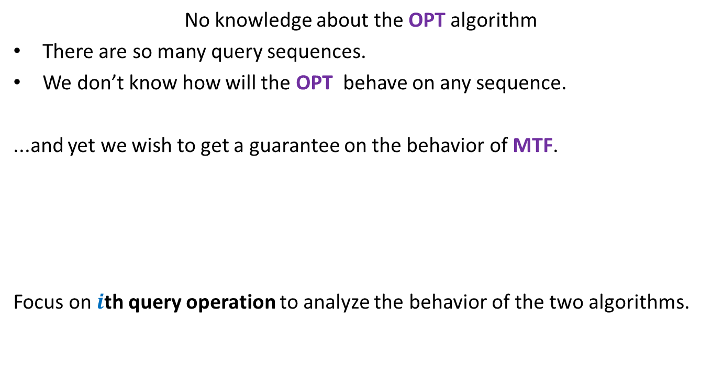
The main challenge
No knowledge about the OPT algorithm
There are so many query sequences.
We don’t know how will the OPT behave on any sequence.
...and yet we wish to get a guarantee on the behavior of MTF.
Focus on $i$th query operation to analyze the behavior of the two algorithms.
Doesn’t this goal look
impossible or unrealistic ?
But the world of algorithms is full of such magical results.
So think over how should the analysis proceed.

Slide 18

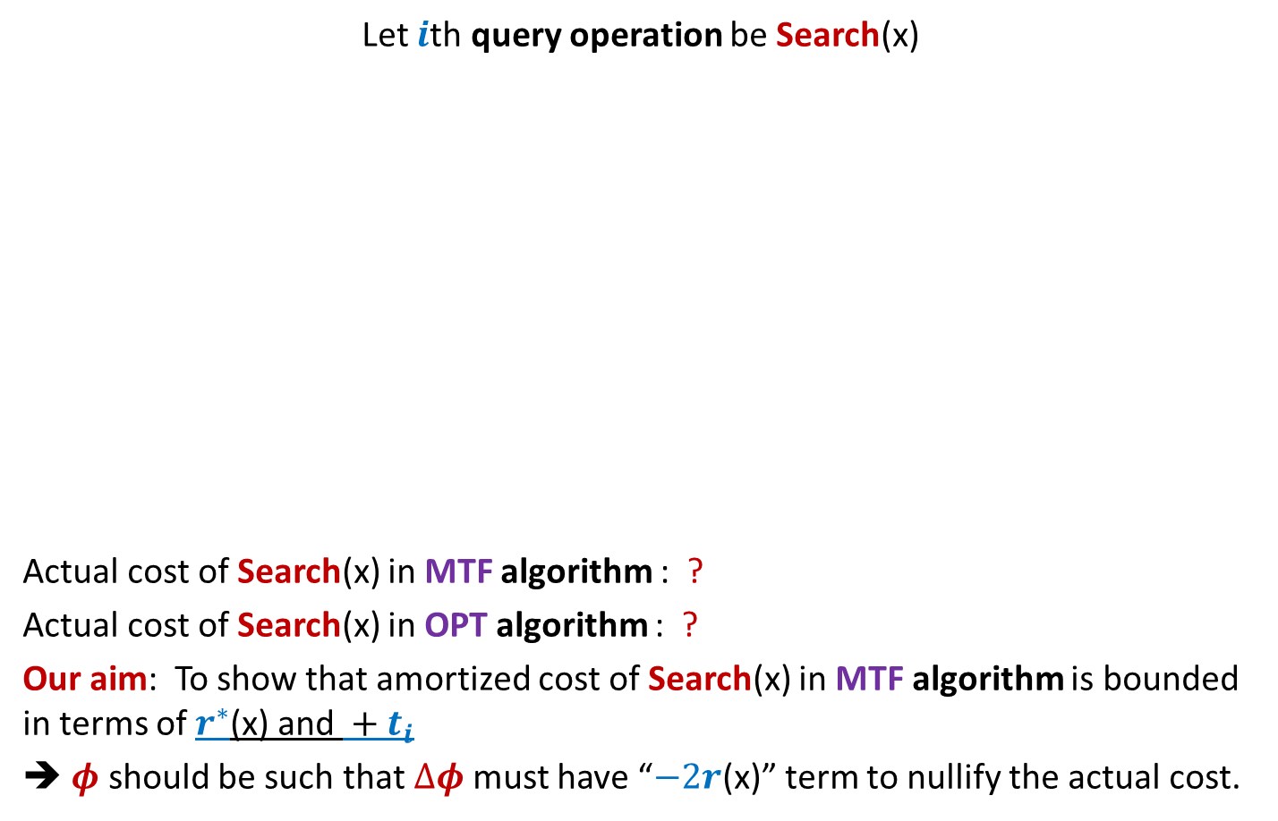





$i$th query operation of MTF and OPT
Let $i$th query operation be Search(x)
Actual cost of Search(x) in MTF algorithm : ?
Actual cost of Search(x) in OPT algorithm : ?
Our aim: To show that amortized cost of Search(x) in MTF algorithm is bounded in terms of $r^{∗}$(x) and $+ t_{i}$
➔ $φ$ should be such that $Δφ$must have “$−2r$(x)” term to nullify the actual cost.
HEAD
…
MTF list
1
2
…
$r$(x)$−1$
$r$(x)
…
x
HEAD
OPT list
…
…
x
…
1
$r^{∗}$(x)
$2r$(x)$−$1
$r^{∗}$(x)$+ t_{i}$
No. of swaps by OPT

Slide 19


What should be the potential function $φ$ ?
The potential of the MTF algorithm after $i$ steps
$φ$($i$) = 2. # inversions
Inversions: {(E,C) , (E,A) , (E,D) , (E,B) , (D,B)}
$φ$($i$) = 10
Note: $φ$($0$)= $0$since two lists are same in the beginning.
and $φ$($i$) $≥0$ always.
➔ $φ$ is a valid potential function.
HEAD
E
C
A
D
B
MTF list
HEAD
C
A
B
D
E
OPT list

Slide 20


Change in potential during $i$th query operation
Let $i$th query operation be Search(x)
$φ$($i$) $− φ$($i−1$) = ?
To find the answer, first execute MTF , and then OPT for $i$th query operation.
After execution of MTF algorithm, “x” comes at the front of the list.
The $r$(x)$−1$ elements preceding it now follow it.
Each such swap either creates a new inversion or destroys an existing one.
HEAD
…
MTF list
1
2
…
$r$(x)$−1$
$r$(x)
…
x
HEAD
OPT list
…
…
x
…
1
$r^{∗}$(x)

Slide 21
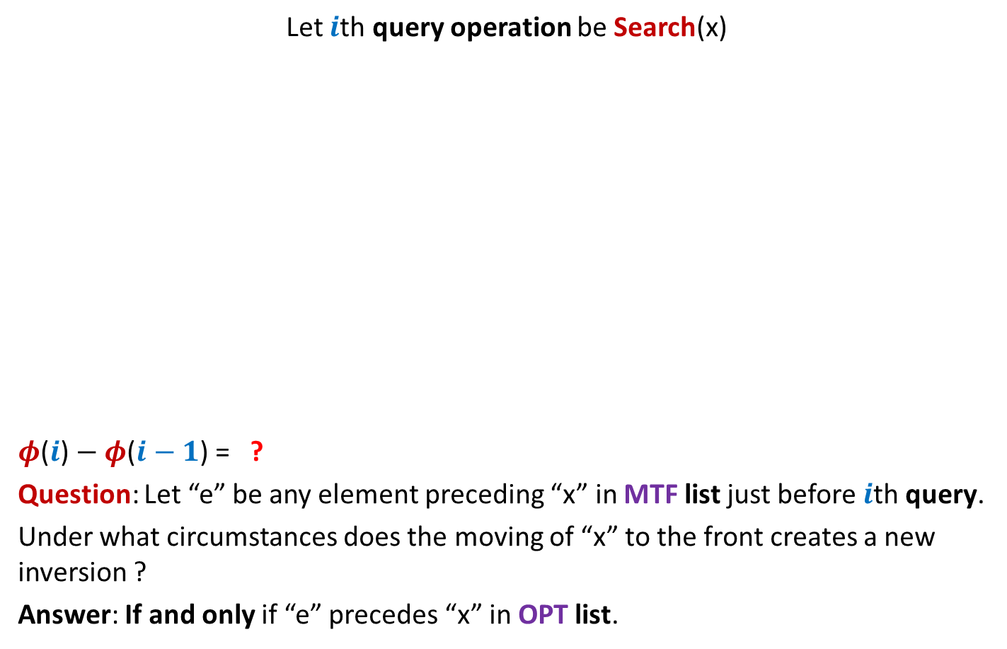
Change in potential during $i$th query operation
Let $i$th query operation be Search(x)
$φ$($i$) $− φ$($i−1$) = ?
Question: Let “e” be any element preceding “x” in MTF list just before $i$th query.
Under what circumstances does the moving of “x” to the front creates a new inversion ?
Answer: If and only if “e” precedes “x” in OPT list.
HEAD
…
MTF list
1
2
…
$r$(x)$−1$
$r$(x)
…
e
x
Inversion (x,e) gets created
Inversion (x,e) gets destroyed
HEAD
OPT list
…
…
e
x
e
…
1
$r^{∗}$(x)

Slide 22




Change in potential during $i$th query operation
Let $i$th query operation be Search(x)
$φ$($i$) $− φ$($i−1$) = ?
Number of new inversions created by MTF = ?
Number of new inversions destroyed by MTF = ?
Number of new inversions created by OPT = ?
HEAD
…
MTF list
1
2
…
$r$(x)$−1$
$r$(x)
…
x
HEAD
OPT list
…
…
x
…
1
$r^{∗}$(x)
$2$ (No. of new inversions created – No. of old inversions destroyed)
$≤2$ ($r^{∗}$(x)$+ t_{i}−1$ $−$ (($r$(x)$− r^{∗}\text{(}\text{x}\text{)}$) )
$≤r^{∗}$(x)$−1$
$≥r$(x)$−r^{∗}$(x)
$$≤ t_{i}$$
No. of swaps by OPT

Slide 23

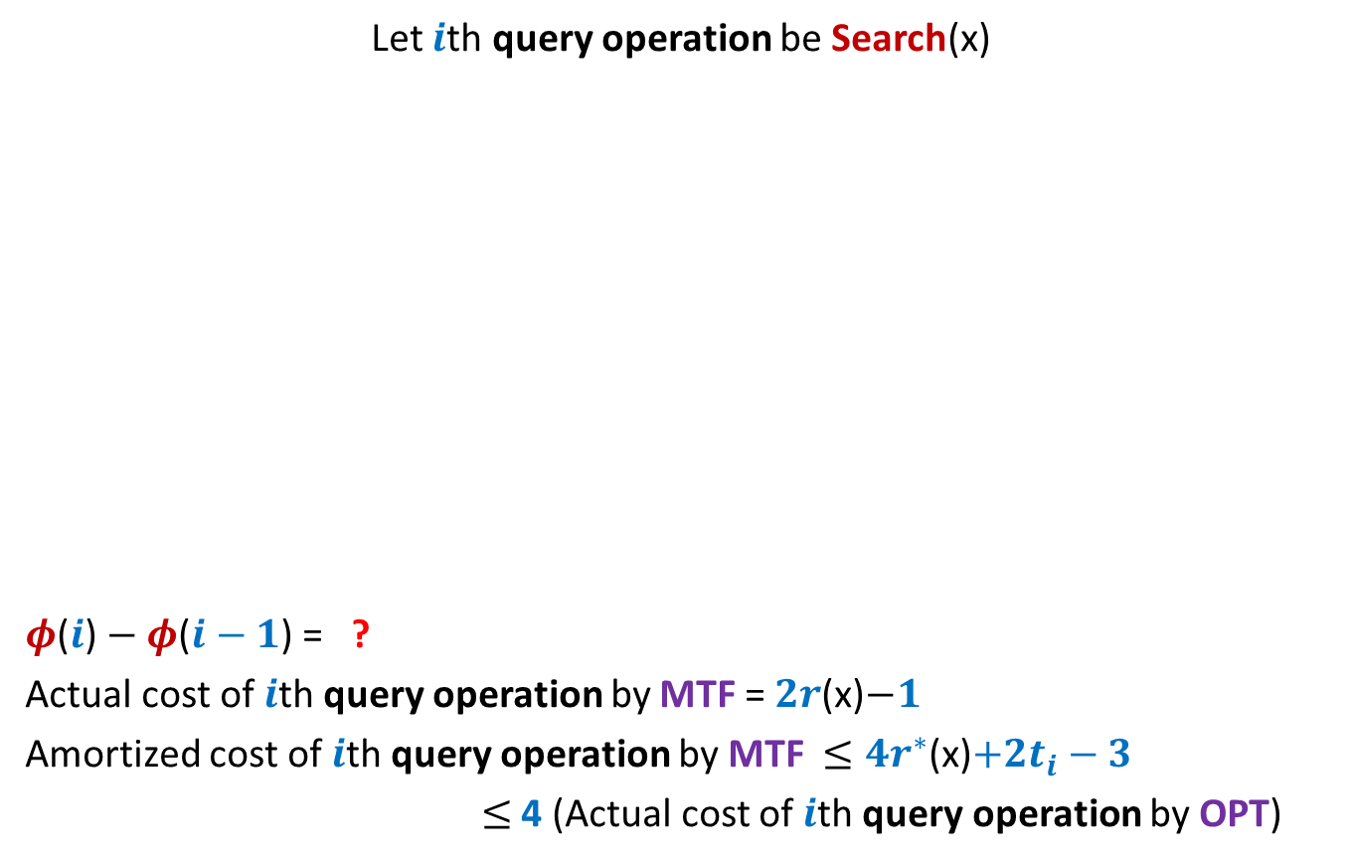



Amortized cost of $i$th query operation by MTF
Let $i$th query operation be Search(x)
$φ$($i$) $− φ$($i−1$) = ?
Actual cost of $i$th query operation by MTF = $2r$(x)$−1$
Amortized cost of $i$th query operation by MTF $≤4r^{∗}$(x)$+2t_{i}−3$
$≤$4 (Actual cost of $i$th query operation by OPT)
HEAD
…
MTF list
1
2
…
$r$(x)$−1$
$r$(x)
…
x
HEAD
OPT list
…
…
x
…
1
$r^{∗}$(x)
$≤{4r}^{∗}$(x)$+ {2t}_{i}−2$ $−$ $2r$(x)
$≤2$ ($r^{∗}$(x)$+ t_{i}−1$ $−$ (($r$(x)$− r^{∗}\text{(}\text{x}\text{)}$) )
$≤2$ (${2r}^{∗}$(x)$+ t_{i}−1$ $−$ $r$(x) )
$≤{4r}^{∗}$(x)$+{2t}_{i}$
$≤{4r}^{∗}$(x)$+{4t}_{i}$
$≤{4(r}^{∗}$(x)$+t_{i})$

Slide 24
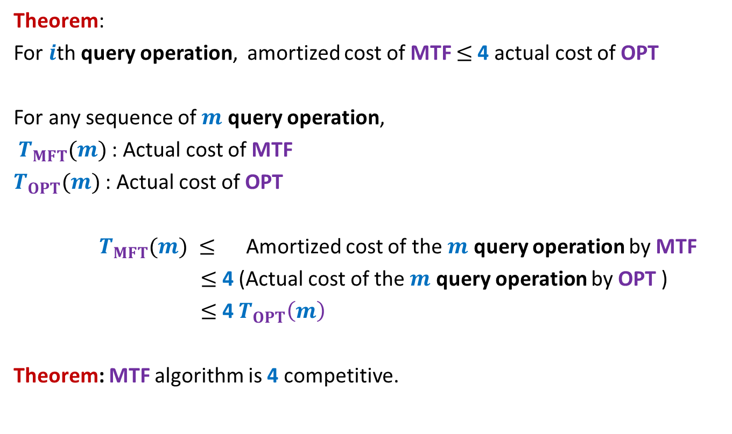
Analysis of MTF versus OPT
Theorem:
For $i$th query operation, amortized cost of MTF $≤$4 actual cost of OPT
For any sequence of $m$ query operation,
$T_{MFT}(m)$: Actual cost of MTF
$T_{OPT}(m)$: Actual cost of OPT
$T_{MFT}(m) ≤$ Amortized cost of the $m$ query operation by MTF
$≤$ 4 (Actual cost of the $m$ query operation by OPT )
$≤$ 4 $T_{OPT}\left(m\right)$
Theorem: MTF algorithm is 4 competitive.

Slide 25
Question : How would anyone have come up with such a magical analysis ?
Answer:
perhaps a persistent meditation on the problem for few months would have led the researcher to come up with this analysis.
I hope some of you are also inspired by such magical and elegant analysis.
Best wishes for the mid semester exam☺

