Slide 1
Design and Analysis of Algorithms (CS345/CS345A)
Lecture 5
Data Structures : The power of Binary Search Tree

Slide 2
Binary Search Tree: Pervasive in the world of data structure

Slide 3
Geometric DATA structures

Slide 4
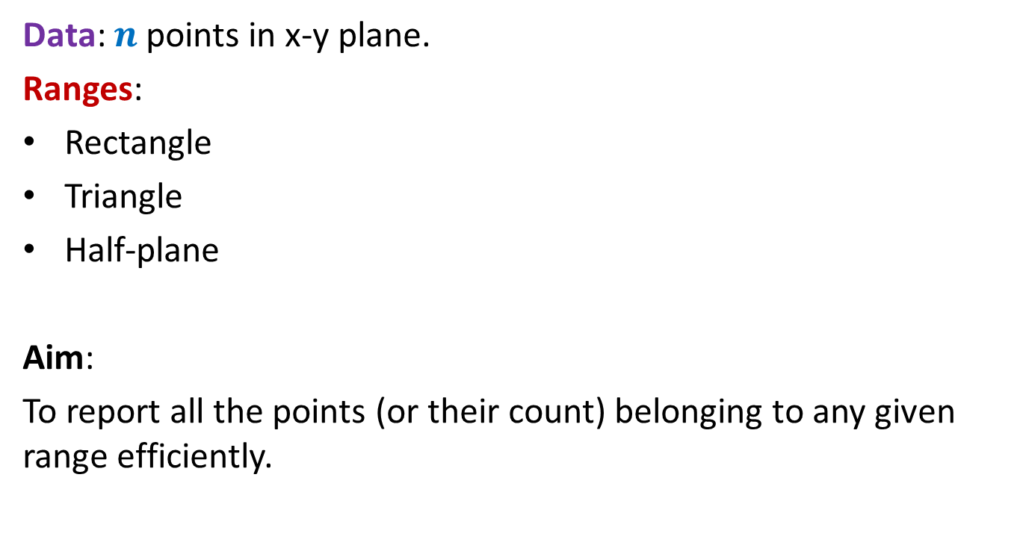
Range searching
Data: $n$ points in x-y plane.
Ranges:
Rectangle
Triangle
Half-plane
Aim:
To report all the points (or their count) belonging to any given range efficiently.

Slide 5
Range searching
Data structure for all these range searching: ??
Rectangle
Triangle
Half-plane
A suitably designed binary search tree

Slide 6

Orthogonal Range searching
Data structure:
size = O($n log n$), Query = O($k+ \log^{2} n$),
Preprocessing time = O($n log n$)
Rectangle
No. of points in query rectangle

Slide 7
DATA structures for Dynamic sequences

Slide 8
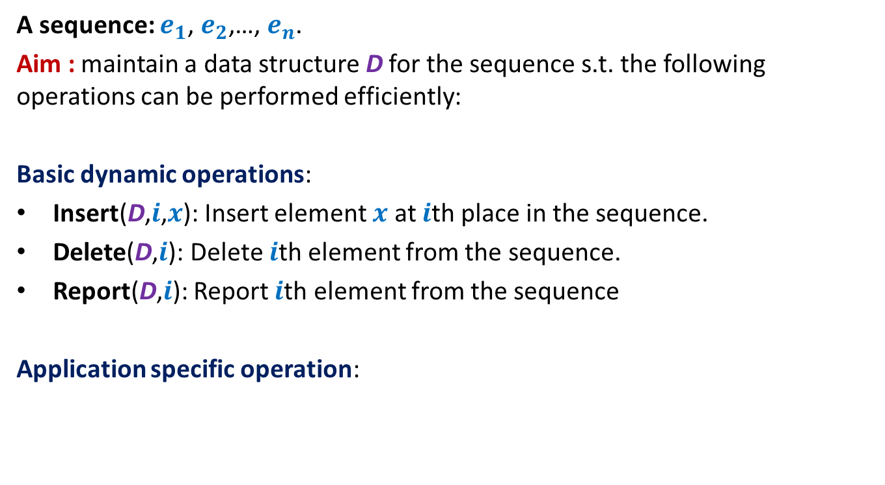
Dynamic Sequence
A sequence: $e_{1}$, $e_{2}$,…, $e_{n}$.
Aim : maintain a data structure D for the sequence s.t. the following operations can be performed efficiently:
Basic dynamic operations:
Insert(D,$i$,$x$): Insert element $x$ at $i$th place in the sequence.
Delete(D,$i$): Delete $i$th element from the sequence.
Report(D,$i$): Report $i$th element from the sequence
Application specific operation:

Slide 9
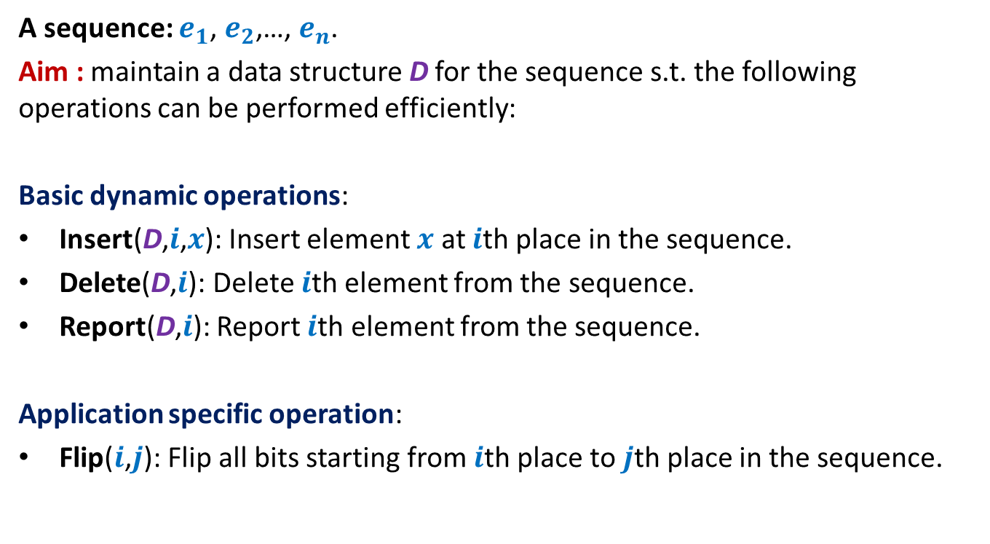
Example 1: sequence of bits
A sequence: $e_{1}$, $e_{2}$,…, $e_{n}$.
Aim : maintain a data structure D for the sequence s.t. the following operations can be performed efficiently:
Basic dynamic operations:
Insert(D,$i$,$x$): Insert element $x$ at $i$th place in the sequence.
Delete(D,$i$): Delete $i$th element from the sequence.
Report(D,$i$): Report $i$th element from the sequence.
Application specific operation:
Flip($i$,$j$): Flip all bits starting from $i$th place to $j$th place in the sequence.

Slide 10
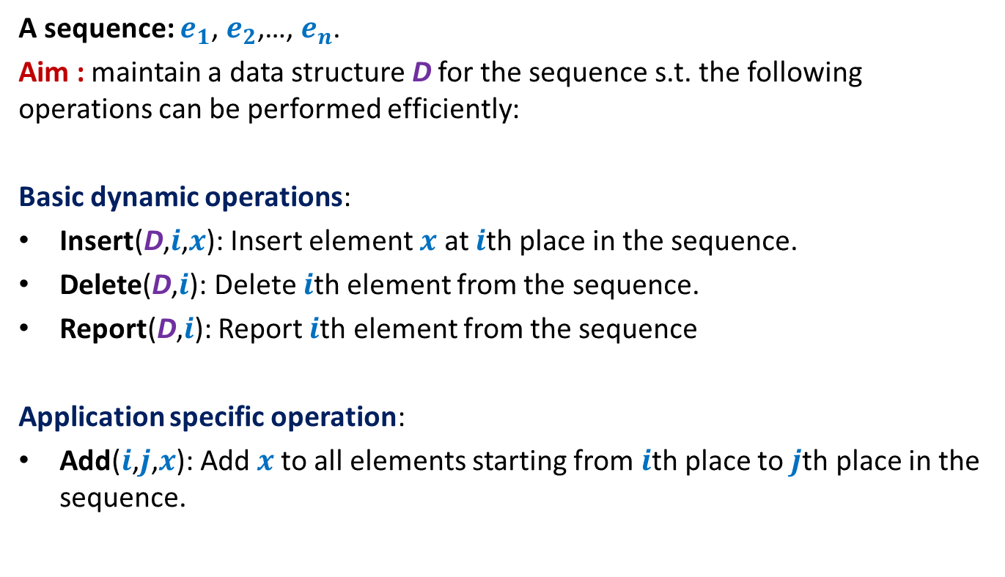
Example 2: sequence of numbers
A sequence: $e_{1}$, $e_{2}$,…, $e_{n}$.
Aim : maintain a data structure D for the sequence s.t. the following operations can be performed efficiently:
Basic dynamic operations:
Insert(D,$i$,$x$): Insert element $x$ at $i$th place in the sequence.
Delete(D,$i$): Delete $i$th element from the sequence.
Report(D,$i$): Report $i$th element from the sequence
Application specific operation:
Add($i$,$j$,$x$): Add $x$to all elements starting from $i$th place to $j$th place in the sequence.

Slide 11
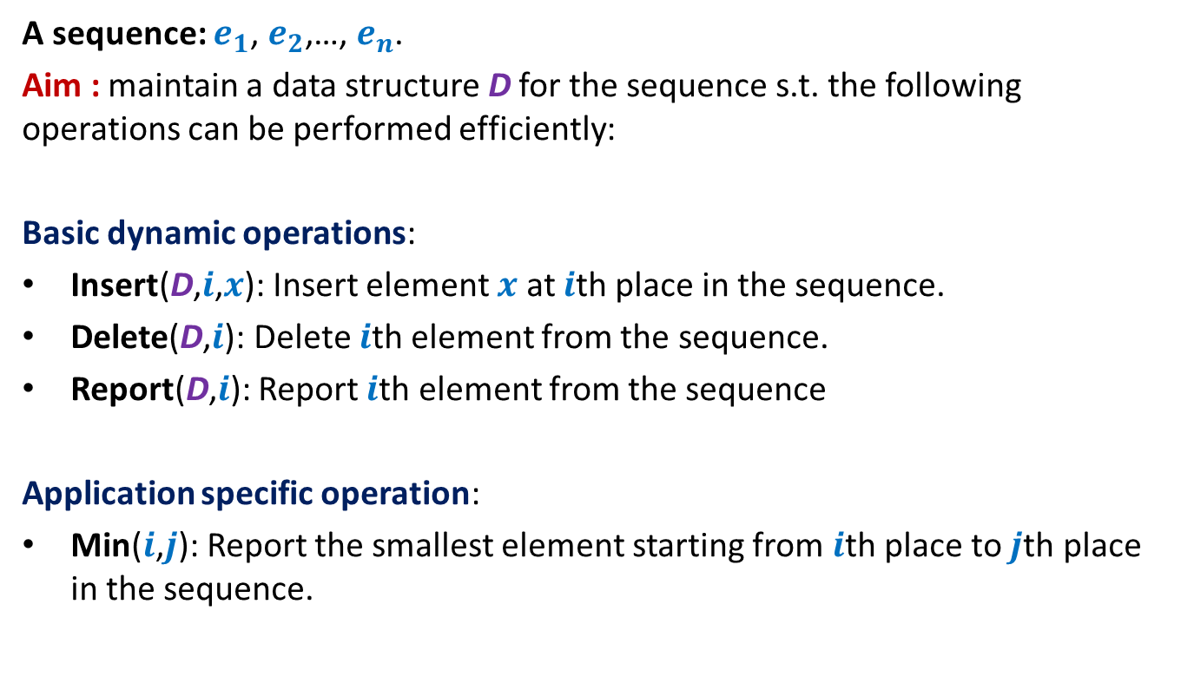
Example 3: sequence of numbers
A sequence: $e_{1}$, $e_{2}$,…, $e_{n}$.
Aim : maintain a data structure D for the sequence s.t. the following operations can be performed efficiently:
Basic dynamic operations:
Insert(D,$i$,$x$): Insert element $x$ at $i$th place in the sequence.
Delete(D,$i$): Delete $i$th element from the sequence.
Report(D,$i$): Report $i$th element from the sequence
Application specific operation:
Min($i$,$j$): Report the smallest element starting from $i$th place to $j$th place in the sequence.

Slide 12
The fundamental question
Question: What makes BST pervasive in the world of data structures ?
Answer: Augmentation : “storing extra fields at each node”
: Additional information

Slide 13
Augmented BST for Dynamic Sequences

Slide 14



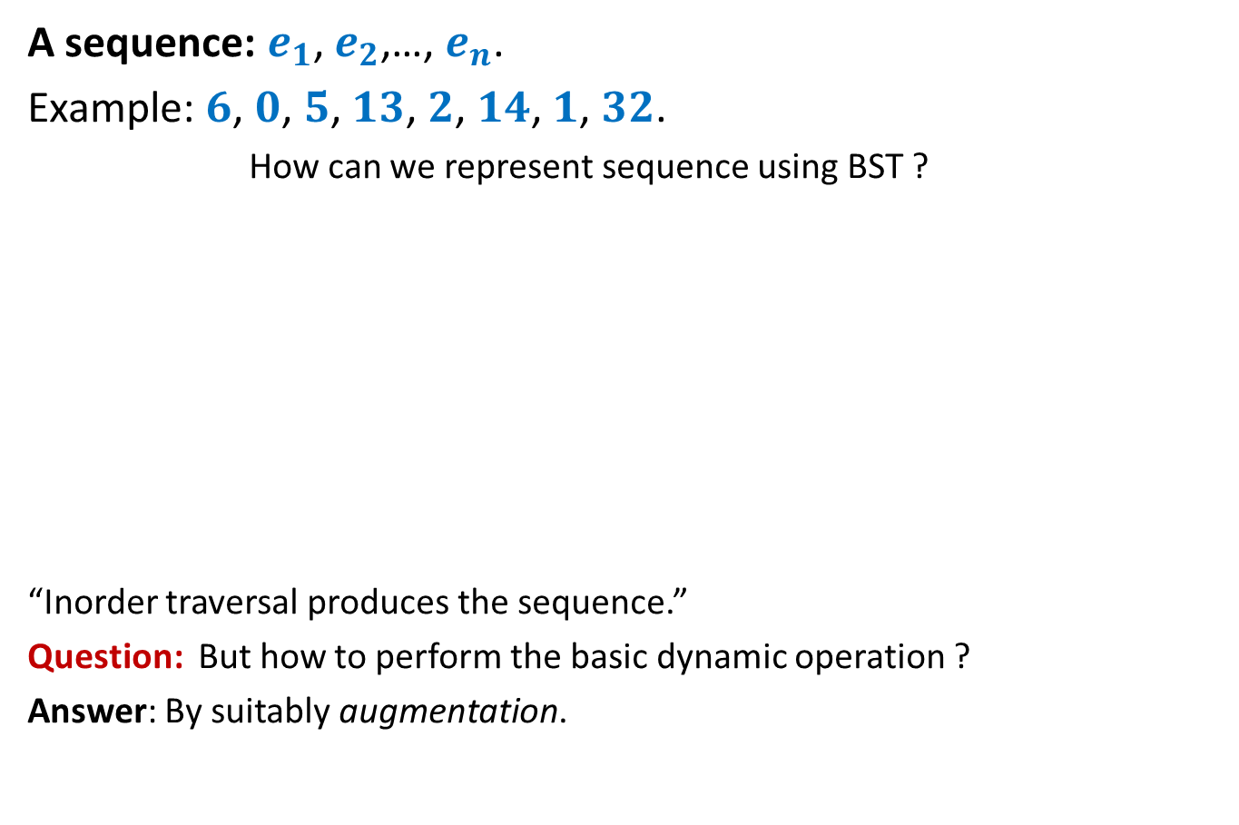





Representing sequence using a BST
A sequence: $e_{1}$, $e_{2}$,…, $e_{n}$.
Example: $6$, $0$, $5$, $13$, $2$, $14$, $1$, $32$.
How can we represent sequence using BST ?
“Inorder traversal produces the sequence.”
Question: But how to perform the basic dynamic operation ?
Answer: By suitably augmentation.
$$2$$
$$0$$
$$1$$
$$6$$
$$5$$
$$14$$
$$32$$
$$13$$

Slide 15
An example of Augmentation: Revisiting BST
We shall now discuss an example of augmenting a BST.
Make sure you understand it fully.

Slide 16
Height Balanced BST (Red-black tree, AVL tree)
Operations you already know
New operation
Search(T,x)
Insert(T,x)
Delete(T,x)
Min(T)
Max(T)
Predecessor(T,x)
Successor(T,x)
8. FindRank(T, x):
return the total number of elements in T that are smaller than x.
Every operation in O(log n) time.

Slide 17
Find-rank(T,x)

Slide 18
A trivial algorithm for Find-rank(T,x)
T
Repeatedly find predecessors of x and stop when you reach the min element.
Time complexity: O (k log n) (where k is rank of x in T)
Homework: Show that all predecessors can be computed in O(k+ log n) time.
46
28
67
5
35
49
2
25
31
41
48
53

Slide 19
Achieving O(log n) time for FindRank(T,x)
Assume without loss of generality that x belongs to T.
View the entire tree T from perspective of the path from x to the root.
How will T look like ?
x
T

Slide 20
Achieving O(log n) time for FindRank(T,x)
Can you identify the elements that contribute to Rank of x in this picture ?
x
T

Slide 21
An elegant solution
Fields associated with a node v in T:
Value(v)
Left(v)
right (v)
parent(v)
Keep one more field
Size(v): The number of nodes stored in the subtree rooted at v.

Slide 22
Algorithm for FindRank(T,x)
High level description
Modify the algorithm for Search(T,x):
rank← 0;
whenever we follow a right link of some node v, increment rank by
size(left(v)) + 1
Time complexity of the algorithm : O(log n)
Are we done ?
No …(We need to efficiently maintain this field under deletion/insertion)

Slide 23
Maintaining size field T under insertion/deletion
High level description
Modify the algorithm for Insert(T,x) and Delete(T,x)
While performing rotations, show that it takes O(1) time to update the size field of the corresponding nodes.
Time complexity of the modified Insert/Delete operation : …
… O(log n) still.

Slide 24
Hopefully you would have understood the idea of augmented BST by now.
So Let us revisit the problem of dynamic sequences.

Slide 25

Representing sequence using a BST
Example: $6$, $0$, $5$, $13$, $2$, $14$, $1$, $32$.
Question: How to perform the basic dynamic operation ?
Answer: By suitably augmentation:
“Keep a size field in each node”
$$2$$
$$0$$
$$1$$
$$6$$
$$5$$
$$14$$
$$32$$
$$13$$

Slide 26
Homework
Give complete details of executing the three basic dynamic sequence operations using the augmented BST.
In the next class, we shall provide solution for the three dynamic sequence problems and the orthogonal range searching. These will be based on suitable augmentation of BST. In order to fully understand these solution that you spend at least 1 hour trying to solve these problems on your own.

