Slide 1
Design and Analysis of Algorithms (CS345/CS345A)
Lecture 7
Augmented BST (Final lecture)
Orthogonal range searching (more details)
Interval tree: an augmented BST used for geometric problems

Slide 2
For the sake of continuity, the slides on orthogonal range searching is appended to the slides of the previous lecture.

Slide 3
interval tree
An augmented BST used for many
geometric problems

Slide 4

Motivation through an application
Given a set of $n$axis-parallel rectangles, determine if any two of them intersect.

Slide 5



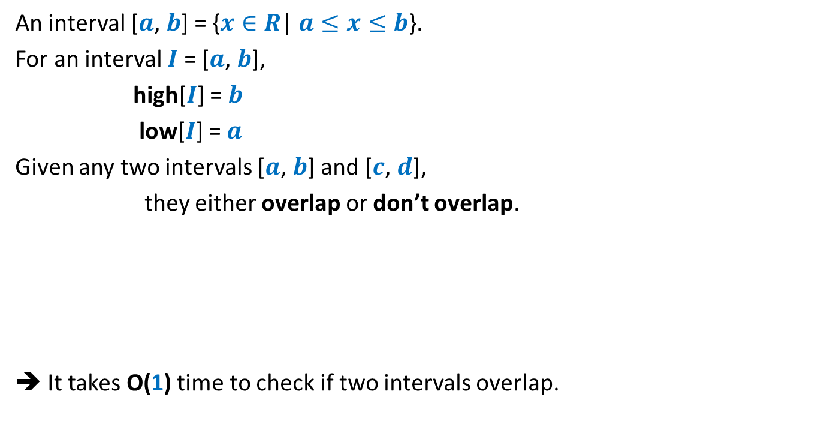


Interval
An interval [$a$, $b$] = {$x∈R$| $a≤x≤b$}.
For an interval $I$ = [$a$, $b$],
high[$I$] = $b$
low[$I$] = $a$
Given any two intervals [$a$, $b$] and [$c$, $d$],
they either overlap or don’t overlap.
➔ It takes O(1) time to check if two intervals overlap.
$$a$$
$$b$$
$$c$$
$$d$$
$$c$$
$$d$$
$$c$$
$$d$$
$$c$$
$$d$$

Slide 6

Problem Definition
Maintain a data structure for a set $S$ of intervals so that the following operations can be performed efficiently.
Overlap($S$,$I$): determine if $I$overlaps any interval from $S$.
Insert($S$,$I$): Insert interval $I$into $S$.
Delete($S$,$I$): Delete $I$from $S$.
1
3
10
19
23
27
4
20
7
11
24
30

Slide 7
How to build a BST on intervals ?
1
3
10
19
23
27
4
20
7
11
24
30

Slide 8
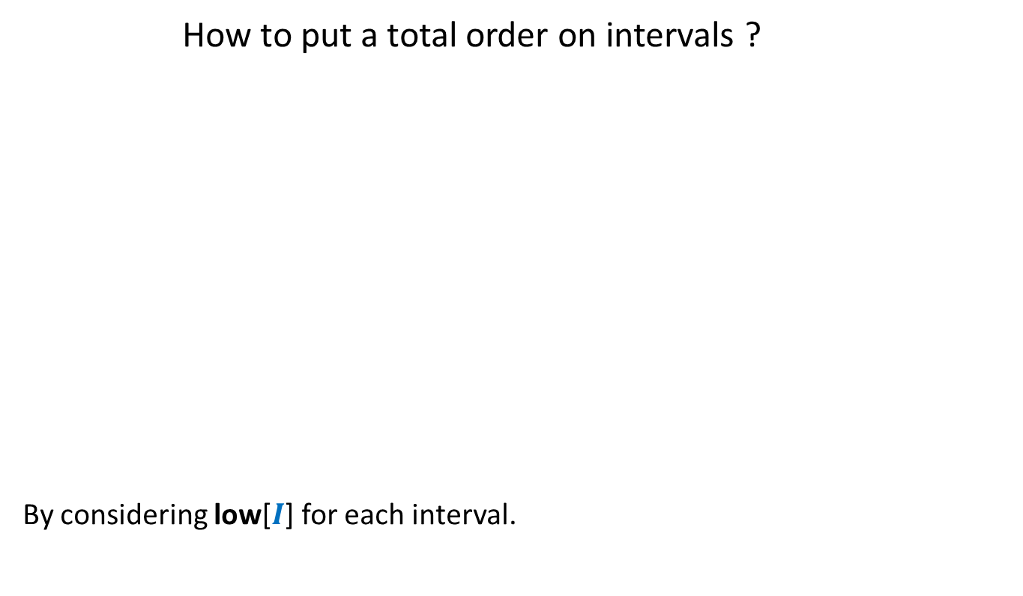
How to build a BST on intervals ?
How to put a total order on intervals ?
By considering low[$I$] for each interval.
1
3
10
19
23
27
4
20
7
11
24
30

Slide 9
How to build a BST on intervals ?
1
3
10
19
23
27
4
20
7
11
24
30

Slide 10

How to augment the BST ?
?
Main objective: How to perform Overlap($S$,$I$) efficiently ?
“determine if a query interval $I$overlaps any interval in tree storing intervals $S$.”
?
?
?
?
?

Slide 11

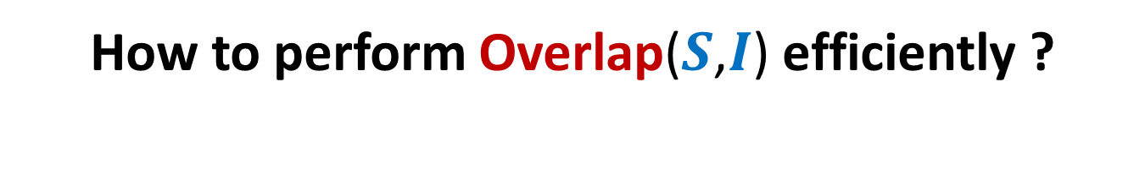





How to perform Overlap($S$,$I$) efficiently ?
$$c$$
$$d$$
$$c$$
$$d$$
$$c$$
$$d$$
$$a$$
$$b$$
$$L$$
$$R$$

Slide 12
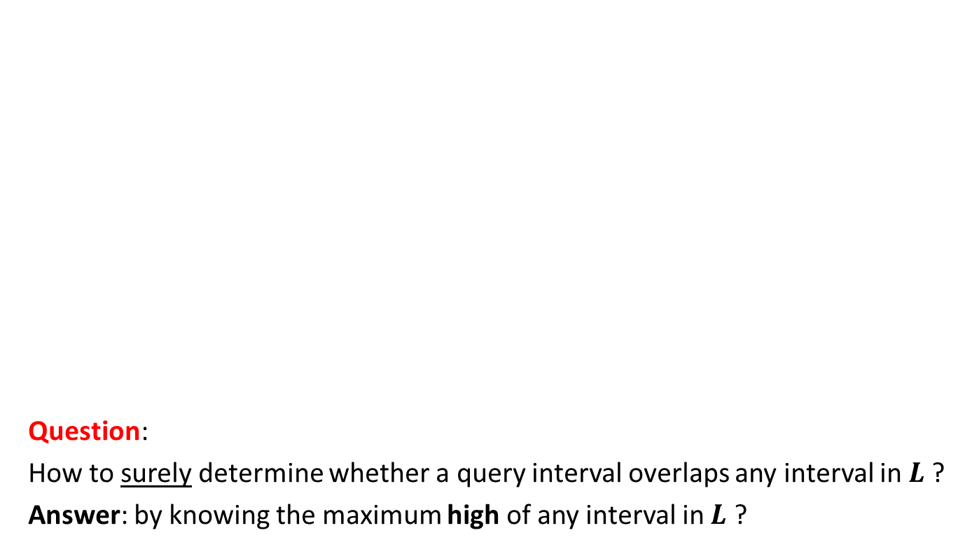
How to perform Overlap($S$,$I$) efficiently ?
$$c$$
$$d$$
$$c$$
$$d$$
$$a$$
$$b$$
Question:
How to surely determine whether a query interval overlaps any interval in $L$?
Answer: by knowing the maximum high of any interval in $L$ ?
$$L$$
$$R$$

Slide 13

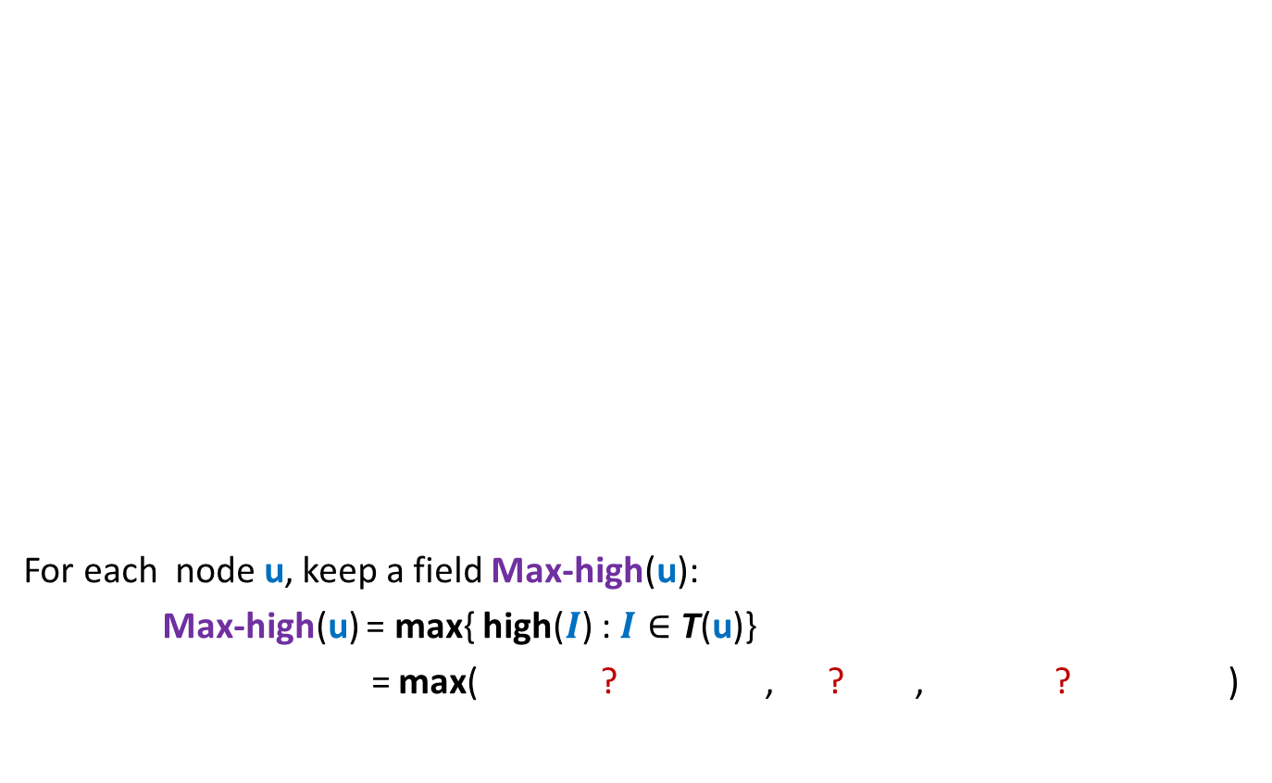


Augmentation of BST
10
30
19
For each node $\text{u}$, keep a field Max-high($\text{u}$):
Max-high($\text{u}$) = max{ high($I$) : $I∈$ T($\text{u}$)}
= max( ? , ? , ? )
4
20
23
27
20
30
1
3
7
11
24
30
3
11
30
This field is efficient to maintain during insertion/deletion
Max-high(left($\text{u}$))
high($\text{u}$)
Max-high(right($\text{u}$))

Slide 14
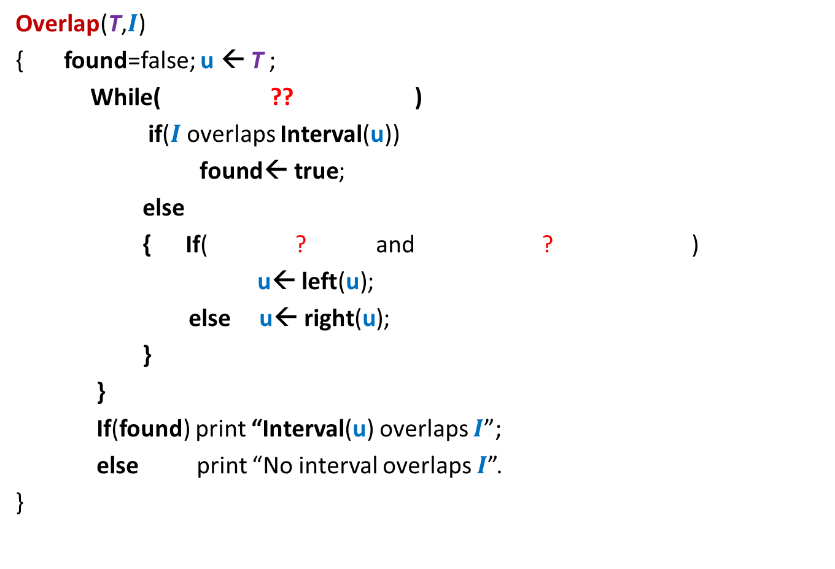





Overlap($T,$ $I$)
$$c$$
$$c$$
$$c$$
$$d$$
$$d$$
$$d$$
Overlap(T,$I$)
{ found=false; $\text{u} \text{← }$T ;
While( ?? )
if($I$overlaps Interval(u))
$\text{found}\text{← }\text{true}$;
else
{ If( ? and ? )
u← $\text{lef}\text{t}\text{(}\text{u}\text{)}$;
else u← $\text{right}\text{(}\text{u}\text{)}$;
}
}
If(found) print “Interval(u) overlaps $I$”;
else print “No interval overlaps $I$”.
}
$\text{u}$<>NULL and not found
$$a$$
u
$$b$$
{
$\text{left}\text{(}\text{u}\text{)}$<> NULL
Max-high(left(u)) $>$Low($I$)

Slide 15

Application
Given a set of $n$axis-parallel rectangles, determine if any two of them intersect.
Spend some time to realize the difficulty of the problem.
Line sweep method

Slide 16
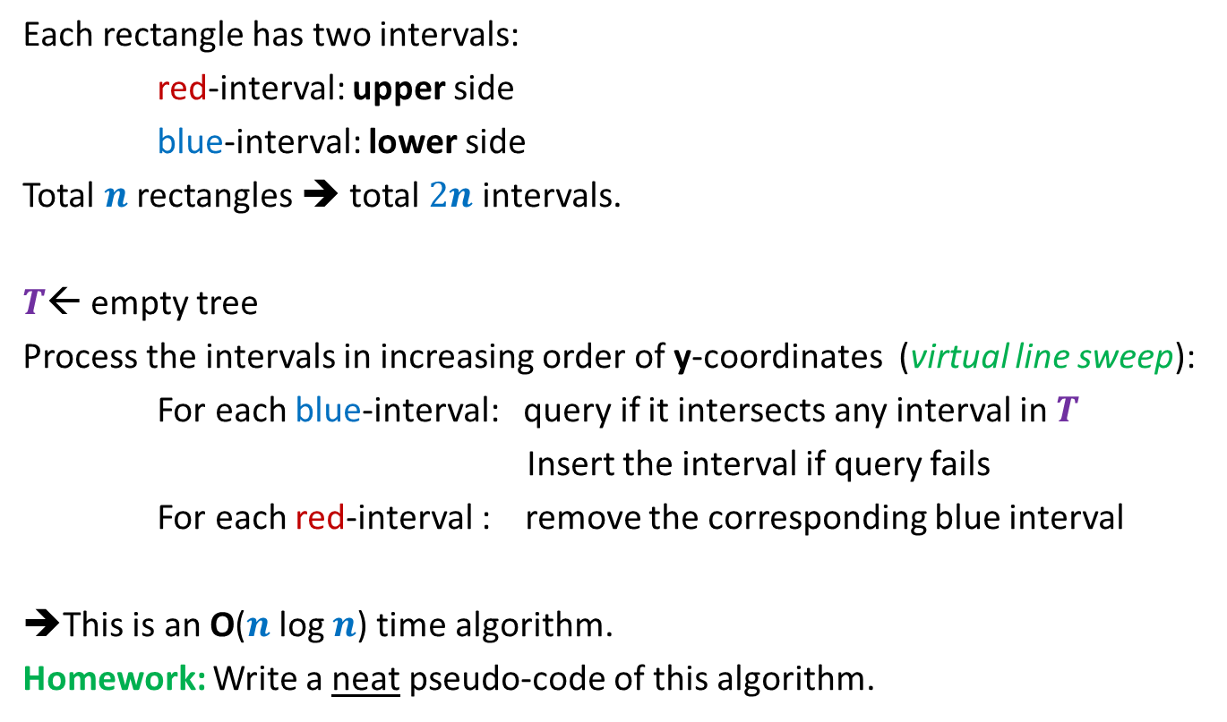
Algorithm
Each rectangle has two intervals:
red-interval: upper side
blue-interval: lower side
Total $n$ rectangles ➔ total $2n$ intervals.
$T$← empty tree
Process the intervals in increasing order of y-coordinates (virtual line sweep):
For each blue-interval: query if it intersects any interval in $T$
Insert the interval if query fails
For each red-interval : remove the corresponding blue interval
➔This is an O($n$log $n$) time algorithm.
Homework: Write a neat pseudo-code of this algorithm.

Slide 17
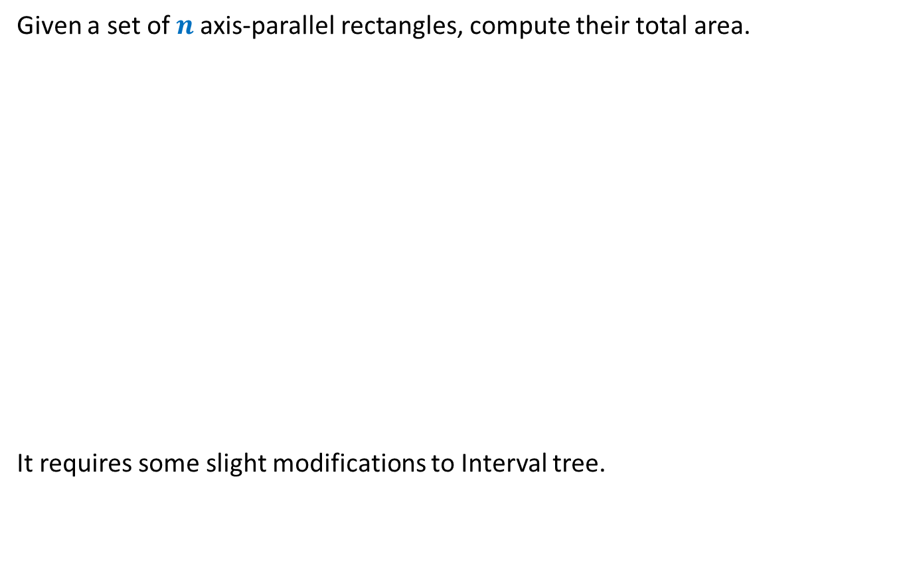
Application 2
Given a set of $n$axis-parallel rectangles, compute their total area.
It requires some slight modifications to Interval tree.
just for a nice trial ☺. Not important from point of view of exams.

