Slide 1
Design and Analysis of Algorithms
(CS345/CS345A)
Lecture 9
Proof of correctness of an algorithm through an example

Slide 2
Motivation
Algorithm designed for a problem is incomplete unless its correctness is established. So, as an important part of the course, one must have a fair amount of understanding about proof of correctness of an algorithm. Proof has to be formal. Many times, one is not even clear about what claim one needs to prove to establish correctness of an algorithm. For almost every algorithm, there is
A short and yet complete formal proof of correctness.
The proof of correctness is based only on a better insight into the algorithm. In this way, a proof just demands a better understanding of the algorithm.
It is hoped that from this lecture, you will be motivated to write short, and yet precise and formal proof of correctness for every algorithm you design.

Slide 3
Proving correctness of an algorithm
Example:
Synchronizing a circuit with minimum delay enhancement

Slide 4
Problem definition
Given:
There is a circuit in the form of a complete binary tree.
Electric signal propagates from root to all leaf nodes.
Each edge has certain delay
The delay in reaching signal to a leaf node = sum of delays on all edges on the path from root.
Objective:
Unfortunately, this delay is not the same for each node. Our aim is enhance delay along certain edges so that
The delay on all paths from root to leaf nodes is the same.
Total delay enhancement is minimum.

Slide 5
An Electric Circuit
Electric signal
6
5
3
2
4
2
2
1
6
2
1
2
3
2
Delay 11 10 14 10 10 11 10 9

Slide 6
Toward designing an algorithm
Electric signal
Delay enhancement: 27
6
5
3
2
4
2
2
1
6
2
1
2
3
2
+3 +4 +4 +4 +3 +4 +5
Delay 11 10 14 10 10 11 10 9
New Delay 14 14 14 14 14 14 14 14

Slide 7
Toward designing an algorithm
Electric signal
Delay enhancement: 27
6
5
3
2
4
2
+4
2
1
6
2
1
2
3
2
+3 +4 +4 +4 +3 +1
Delay 11 10 14 10 10 11 10 9
New Delay 14 14 14 14 14 14 14 14
➔ 23

Slide 8
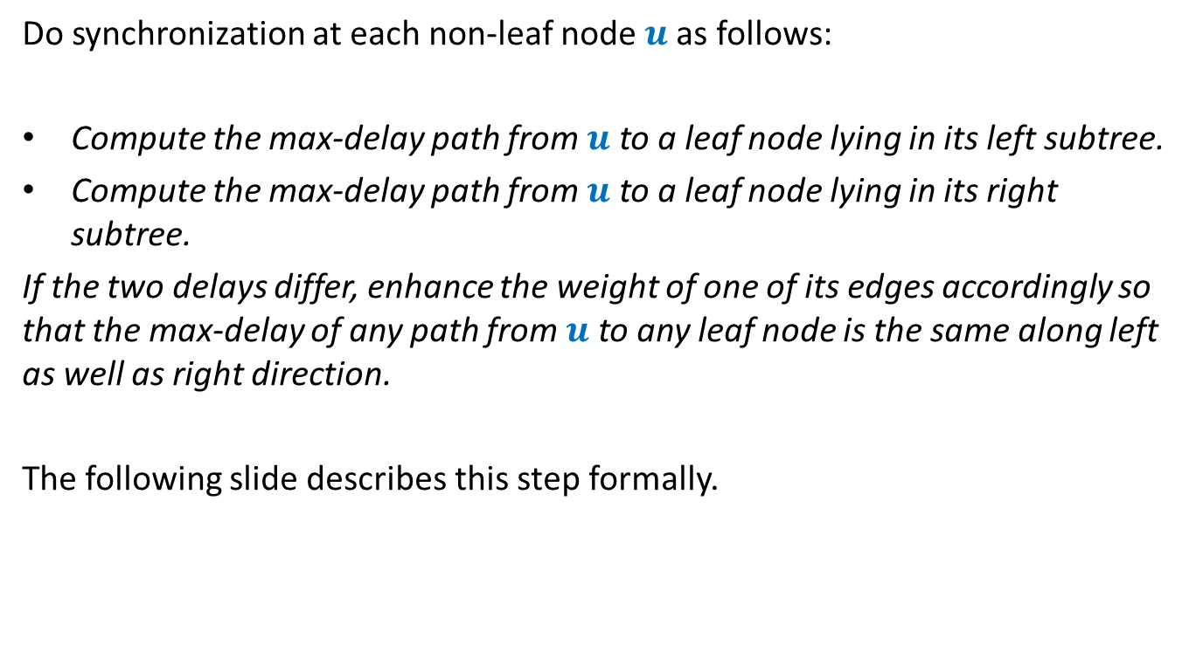
Overview of the algorithm
Do synchronization at each non-leaf node $u$as follows:
Compute the max-delay path from $u$ to a leaf node lying in its left subtree.
Compute the max-delay path from $u$ to a leaf node lying in its right subtree.
If the two delays differ, enhance the weight of one of its edges accordingly so that the max-delay of any path from $u$ to any leaf node is the same along left as well as right direction.
The following slide describes this step formally.

Slide 9


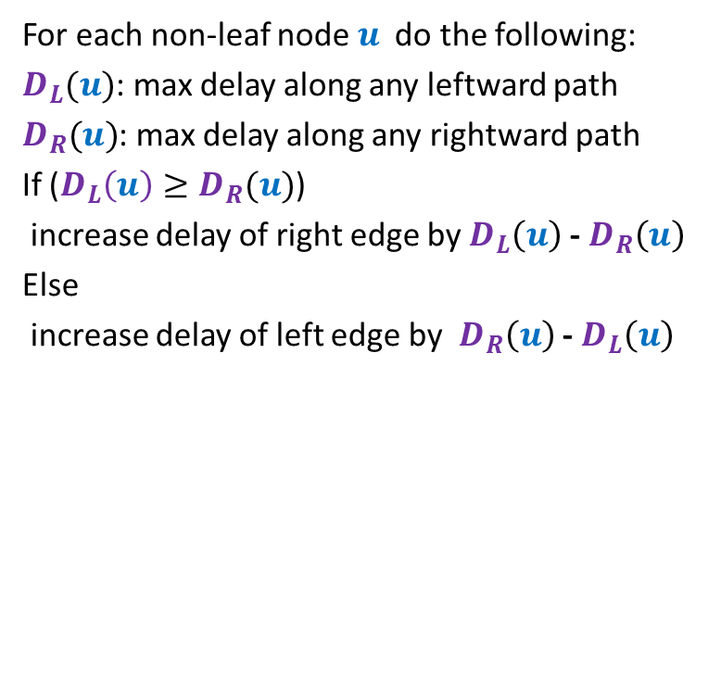





Suppose $D_{L}(u){≥D}_{R}(u)$
For each non-leaf node $u$ do the following:
$D_{L}(u)$: max delay along any leftward path
$D_{R}(u)$: max delay along any rightward path
If ($D_{L}\left(u\right)≥D_{R}(u)$)
increase delay of right edge by $D_{L}\left(u\right)$ - $D_{R}\left(u\right)$
Else
increase delay of left edge by $D_{R}\left(u\right)$ - $D_{L}\left(u\right)$
$$γ$$
u
$$α$$
$$β$$
$$+D_{L}\left(u\right)\text{ − }D_{R}\left(u\right)$$
$$D_{L}(u)$$
$$D_{R}(u)$$

Slide 10
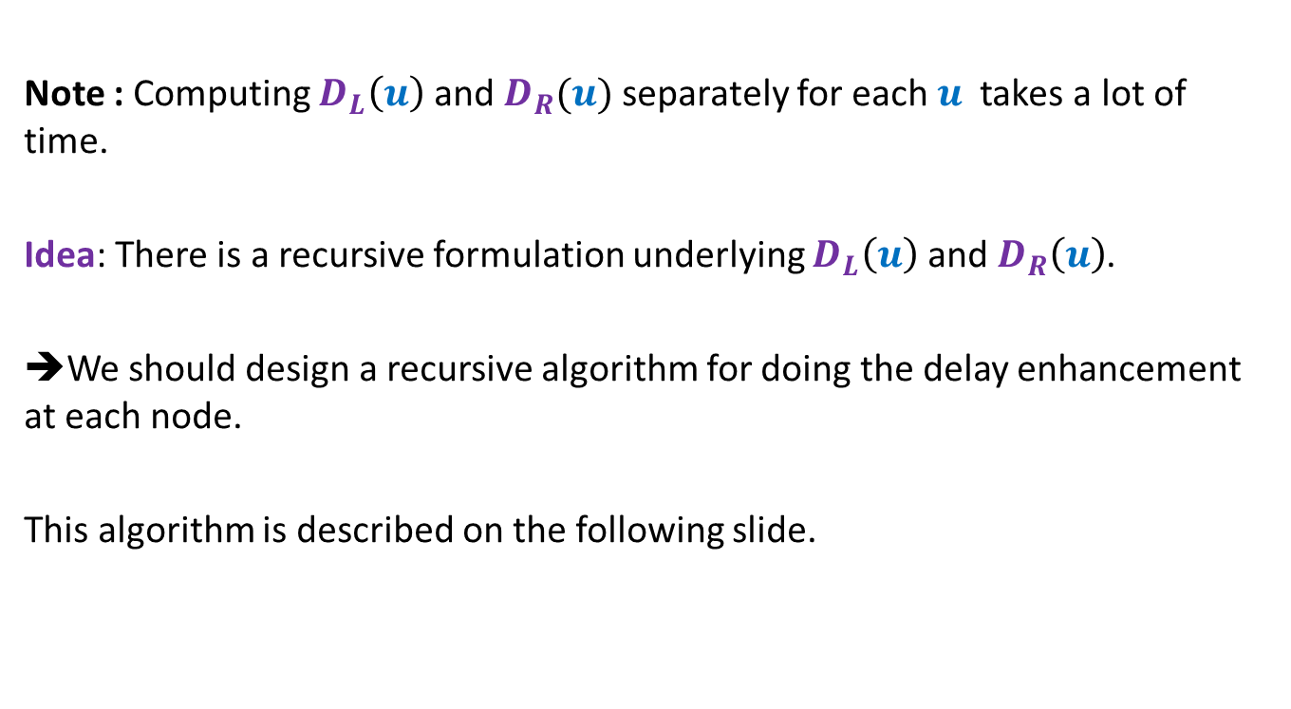
Efficient implementation of the algorithm
Note : Computing $D_{L}\left(u\right)$ and $D_{R}(u)$ separately for each $u$ takes a lot of time.
Idea: There is a recursive formulation underlying $D_{L}\left(u\right)$ and $D_{R}\left(u\right)$.
➔We should design a recursive algorithm for doing the delay enhancement at each node.
This algorithm is described on the following slide.

Slide 11
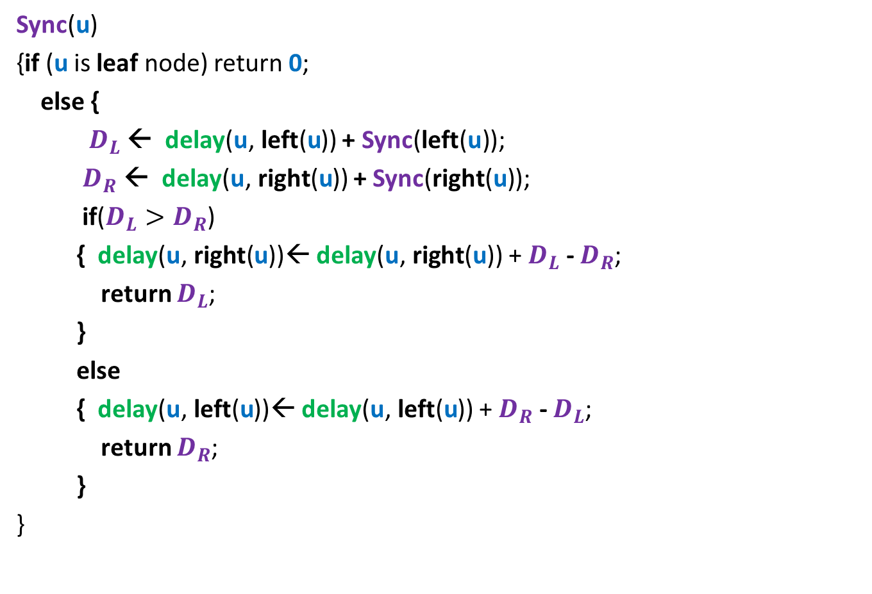

Sync($\text{u}$): A proposed synchronization algorithm
Sync($\text{u}$)
{if ($\text{u}$ is leaf node) return $\text{0}$;
else {
$D_{L}$ ← delay($\text{u}\text{,} \text{left}\text{(}\text{u}$)) + Sync($\text{left}\text{(}\text{u}\text{)}$);
$D_{R}$ ← delay($\text{u}\text{,} \text{right}\text{(}\text{u}$)) + Sync($\text{right}\text{(}\text{u}\text{)}$);
if($D_{L}>D_{R}$)
{ delay($\text{u}\text{,} \text{right}\text{(}\text{u}$))← delay($\text{u}\text{,} \text{right}\text{(}\text{u}$)) + $D_{L}$ - $D_{R}$;
return $D_{L}$;
}
else
{ delay($\text{u}\text{,} \text{lef}\text{t}\text{(}\text{u}$))← delay($\text{u}\text{,} \text{left}\text{(}\text{u}$)) + $D_{R}$ - $D_{L}$;
return $D_{R}$;
}
}
u

Slide 12
Proof of correctness of the algorithm

Slide 13
What claim suffices as a proof ?
Usually it is difficult even to find out the claim whose establishment captures the correctness of the algorithm.
In the current algorithm, what might be this claim ?
Let us have a re-look at the algorithm from point of view of a single node .

Slide 14
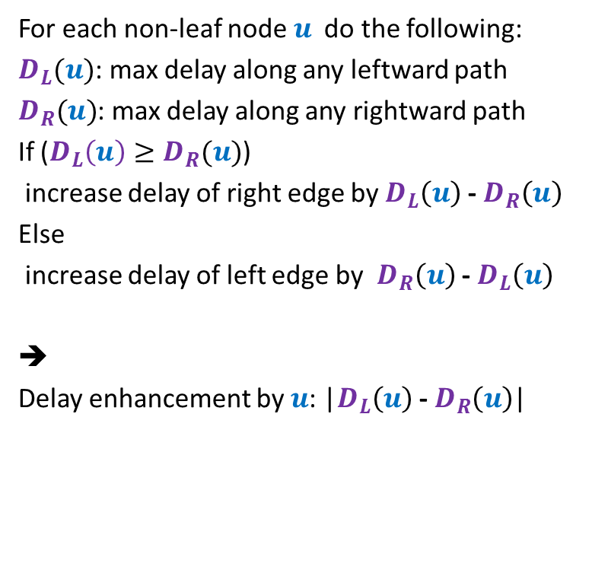
Suppose $D_{L}(u){≥D}_{R}(u)$
For each non-leaf node $u$ do the following:
$D_{L}(u)$: max delay along any leftward path
$D_{R}(u)$: max delay along any rightward path
If ($D_{L}\left(u\right)≥D_{R}(u)$)
increase delay of right edge by $D_{L}\left(u\right)$ - $D_{R}\left(u\right)$
Else
increase delay of left edge by $D_{R}\left(u\right)$ - $D_{L}\left(u\right)$
➔
Delay enhancement by $u$: |$D_{L}\left(u\right)$ - $D_{R}\left(u\right)$|
$$γ$$
u
$$α$$
$$β$$
$$+D_{L}\left(u\right)\text{ − }D_{R}\left(u\right)$$
$$D_{L}(u)$$
$$D_{R}(u)$$

Slide 15

Claim :
In the optimal solution the delay enhancement by $u$= |$D_{R}(u){−D}_{L}(u)$|
Question: How to prove the claim ?
Answer: make careful observations about the algorithm.

Slide 16
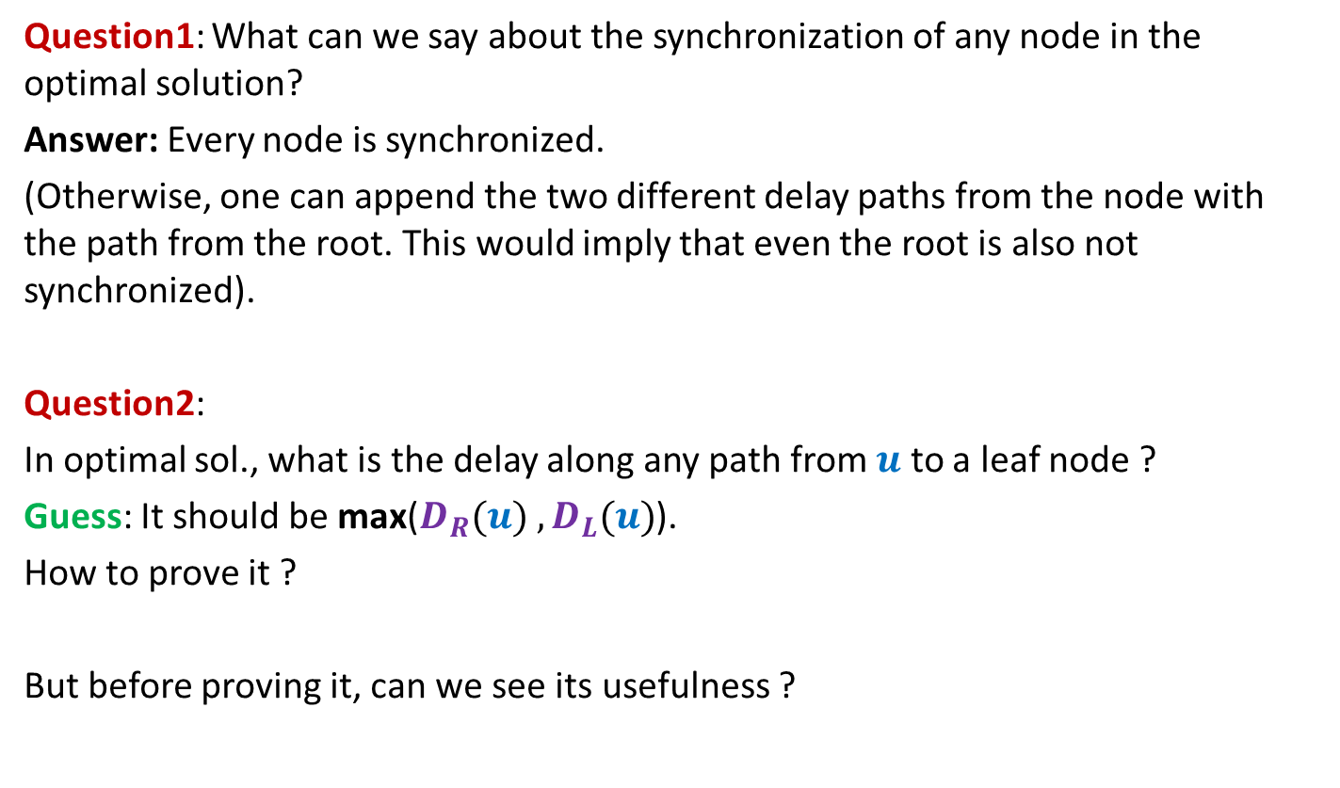
Observations about the algorithm
Question1: What can we say about the synchronization of any node in the optimal solution?
Answer: Every node is synchronized.
(Otherwise, one can append the two different delay paths from the node with the path from the root. This would imply that even the root is also not synchronized).
Question2:
In optimal sol., what is the delay along any path from $u$ to a leaf node ?
Guess: It should be max($D_{R}(u){ ,D}_{L}(u)$).
How to prove it ?
But before proving it, can we see its usefulness ?

Slide 17
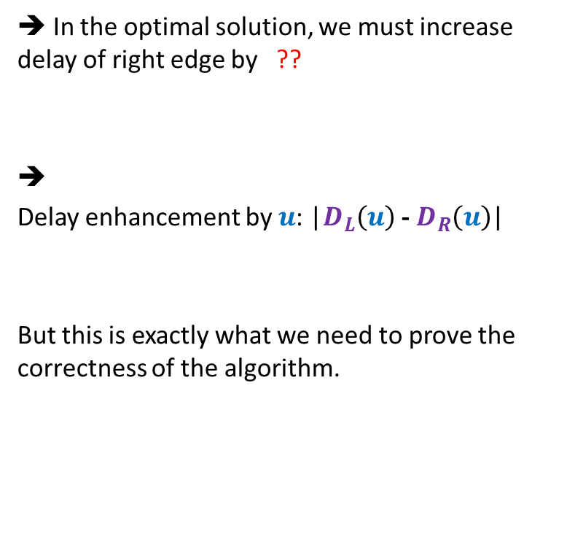

Usefulness of the guess
Suppose $D_{L}(u){≥D}_{R}(u)$
➔ In the optimal solution, we must increase delay of right edge by ??
➔
Delay enhancement by $u$: |$D_{L}\left(u\right)$ - $D_{R}\left(u\right)$|
But this is exactly what we need to prove the correctness of the algorithm.
$D_{L}\left(u\right)$ - $D_{R}\left(u\right)$
$$γ$$
u
$$α$$
$$β$$
$$+D_{L}\left(u\right)\text{ − }D_{R}\left(u\right)$$
$$D_{L}(u)$$
$$D_{R}(u)$$

Slide 18

Proving the guess
Guess : In the optimal solution, the delay along any path from $u$ to any leaf node is max($D_{R}(u){ ,D}_{L}(u)$).
Question: How to prove it ?
Answer: By contradiction.

Slide 19

What if the assertion fails at many nodes ?
Consider the lowest node in the tree where it fails.
In particular, any node with no red descendant will suffice. (can you see why it is difficult to analyze any other “red” nodes ?)
$$u$$

Slide 20





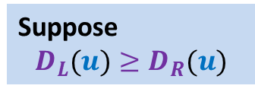


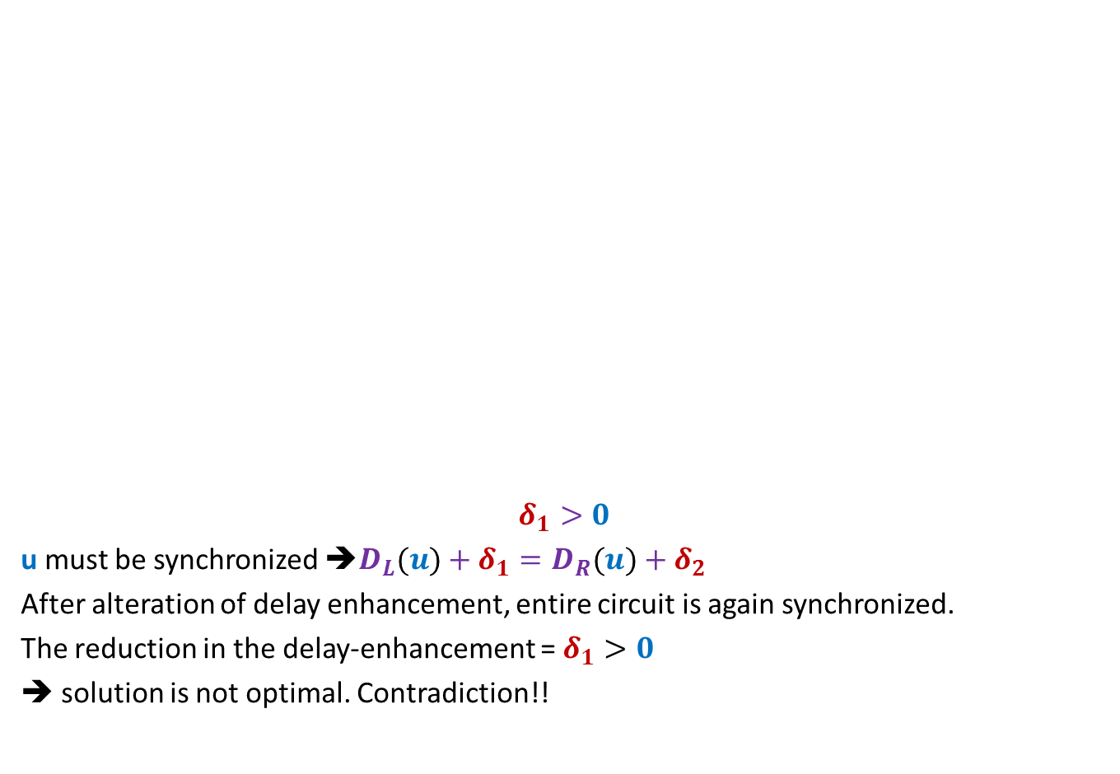












Proof
Suppose
$$D_{L}(u)≥D_{R}(u)$$
$$γ$$
$${+δ}_{3}$$
$$γ$$
$${+δ}_{3}$$
$${+δ}_{1}$$
$$u$$
$$u$$
$$δ_{1}>0$$
u must be synchronized ➔$D_{L}(u)+δ_{1}=D_{R}(u)+δ_{2}$
After alteration of delay enhancement, entire circuit is again synchronized.
The reduction in the delay-enhancement = $δ_{1}>0$
➔ solution is not optimal. Contradiction!!
$$α$$
$${+δ}_{1}$$
$$β$$
$${+δ}_{2}$$
$$α$$
$$β$$
$${+D}_{L}\left(u\right)\text{ − }D_{R}\left(u\right)$$
$$+δ_{2}−δ_{1}$$
$$D_{L}(u)$$
$$D_{R}(u)$$
$$D_{L}(u)$$
$$D_{R}(u)$$

Slide 21
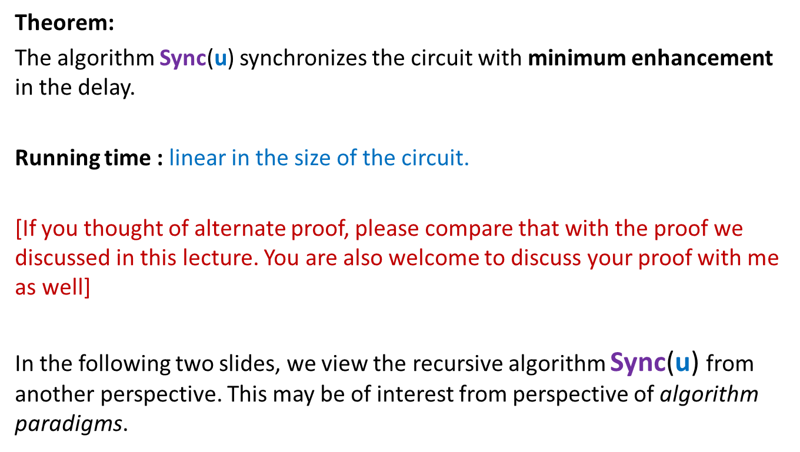
Theorem:
The algorithm Sync($\text{u}$) synchronizes the circuit with minimum enhancement in the delay.
Running time : linear in the size of the circuit.
[If you thought of alternate proof, please compare that with the proof we discussed in this lecture. You are also welcome to discuss your proof with me as well]
In the following two slides, we view the recursive algorithm Sync($\text{u}$) from another perspective. This may be of interest from perspective of algorithm paradigms.

Slide 22

Sync($\text{u}$): Alternate synchronization algorithm
Sync($\text{u}$)
{if ($\text{u}$ is leaf node) return $\text{0}$;
else {
$D_{L}$ ← delay($\text{u}\text{,} \text{left}\text{(}\text{u}$)) + Sync($\text{left}\text{(}\text{u}\text{)}$);
$D_{R}$ ← delay($\text{u}\text{,} \text{right}\text{(}\text{u}$)) + Sync($\text{right}\text{(}\text{u}\text{)}$);
if($D_{L}>D_{R}$)
{ delay($\text{u}\text{,} \text{right}\text{(}\text{u}$))← delay($\text{u}\text{,} \text{right}\text{(}\text{u}$)) + $D_{L}$ - $D_{R}$;
return $D_{L}$;
}
else
{ delay($\text{u}\text{,} \text{lef}\text{t}\text{(}\text{u}$))← delay($\text{u}\text{,} \text{left}\text{(}\text{u}$)) + $D_{R}$ - $D_{L}$;
return $D_{R}$;
}
}
u
Is it really a typical divide and conquer algorithm ?

Slide 23
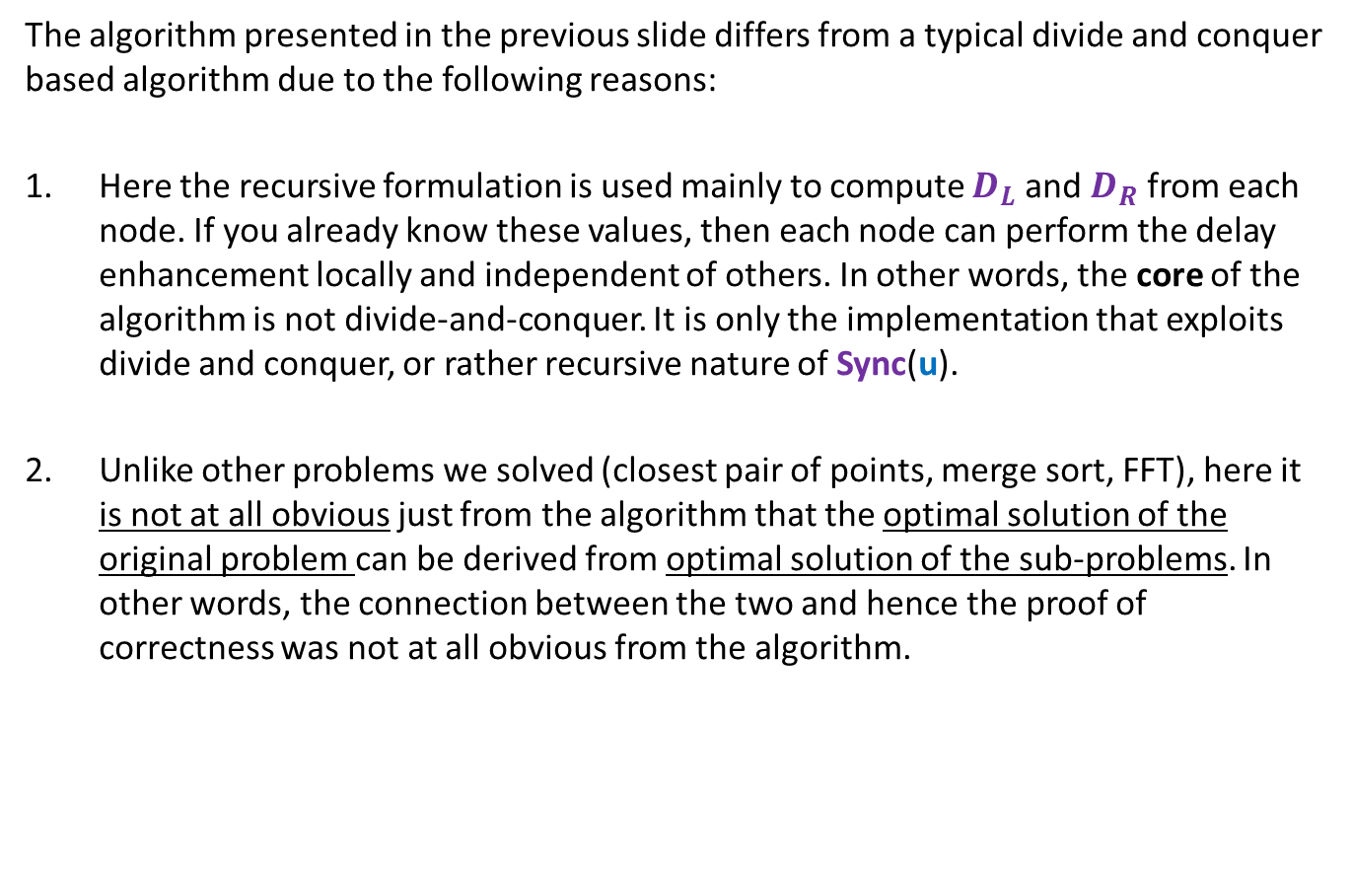
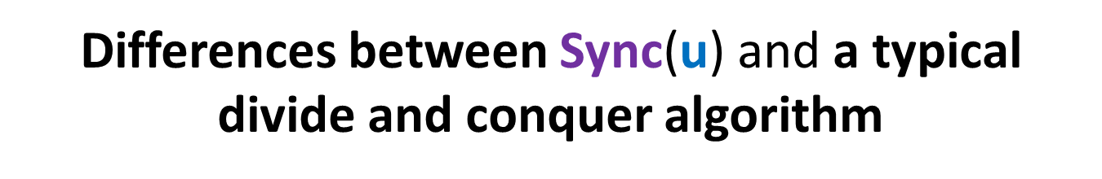
Differences between Sync($\text{u}$) and a typical divide and conquer algorithm
The algorithm presented in the previous slide differs from a typical divide and conquer based algorithm due to the following reasons:
Here the recursive formulation is used mainly to compute $D_{L}$ and $D_{R}$ from each node. If you already know these values, then each node can perform the delay enhancement locally and independent of others. In other words, the core of the algorithm is not divide-and-conquer. It is only the implementation that exploits divide and conquer, or rather recursive nature of Sync($\text{u}$).
Unlike other problems we solved (closest pair of points, merge sort, FFT), here it is not at all obvious just from the algorithm that the optimal solution of the original problem can be derived from optimal solution of the sub-problems. In other words, the connection between the two and hence the proof of correctness was not at all obvious from the algorithm.

