Slide 1
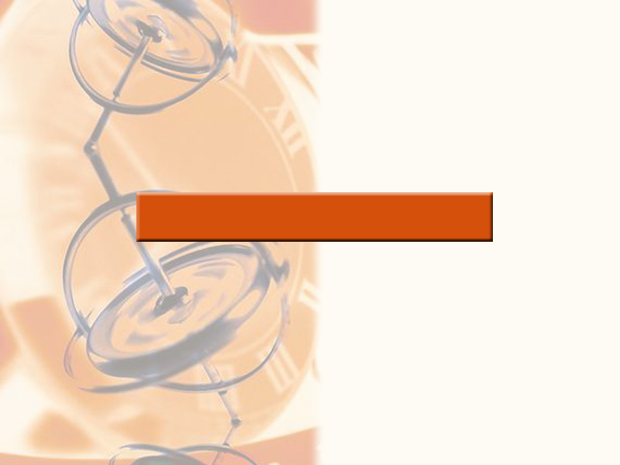
2
LIMITS AND DERIVATIVES

Slide 2
LIMITS AND DERIVATIVES
2.2
The Limit of a Function
In this section, we will learn:
About limits in general and about numerical
and graphical methods for computing them.

Slide 3
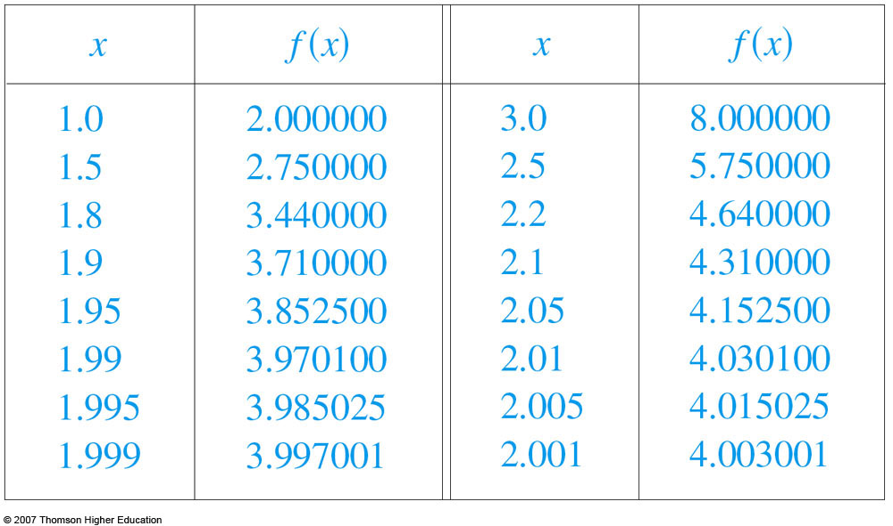
THE LIMIT OF A FUNCTION
Let’s investigate the behavior of the
function f defined by f(x) = x² – x + 2
for values of x near 2.
  The following table gives values of f(x) for values of x close to 2, but not equal to 2.

Slide 4
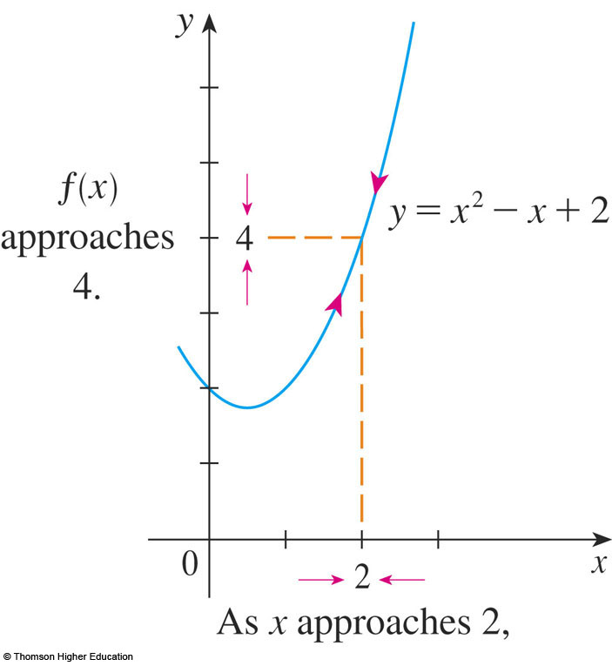
THE LIMIT OF A FUNCTION
From the table and the
graph of f (a parabola)
shown in the figure,
we see that, when x is
close to 2 (on either
side of 2), f(x) is close
to 4.

Slide 5
THE LIMIT OF A FUNCTION
In fact, it appears that
we can make the
values of f(x) as close
as we like to 4 by
taking x sufficiently
close to 2.

Slide 6
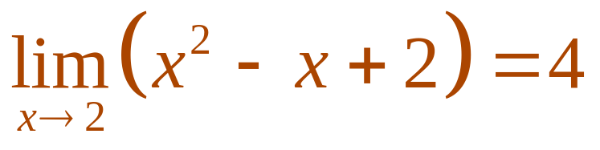
THE LIMIT OF A FUNCTION
We express this by saying “the limit of
the function f(x) = x² – x + 2 as x
approaches 2 is equal to 4.”
  The notation for this is:

Slide 7
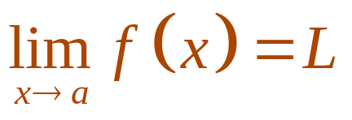
THE LIMIT OF A FUNCTION
Definition 1
In general, we use the following
notation.
  We write
  and say “the limit of f(x), as x approaches a, equals L”
  if we can make the values of f(x) arbitrarily close to L (as close to L as we like) by taking x to be sufficiently close to a (on either side of a) but not equal to a.

Slide 8

THE LIMIT OF A FUNCTION
Roughly speaking, this says that the values
of f(x) tend to get closer and closer to the
number L as x gets closer and closer to the
number a (from either side of a) but x a.
  A more precise definition will be given in Section 2.4.

Slide 9



THE LIMIT OF A FUNCTION
An alternative notation for
is as
which is usually read “f(x) approaches L as
x approaches a.”

Slide 10
THE LIMIT OF A FUNCTION
Notice the phrase “but x a” in the
definition of limit.
  This means that, in finding the limit of f(x) as x approaches a, we never consider x = a.
  In fact, f(x) need not even be defined when x = a.
  The only thing that matters is how f is defined near a.

Slide 11

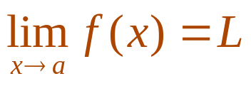
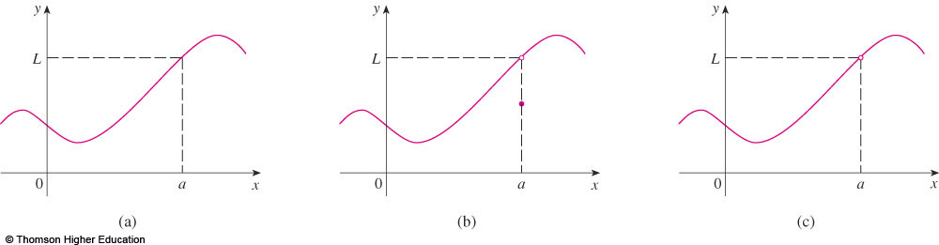
THE LIMIT OF A FUNCTION
The figure shows the graphs of
three functions.
  Note that, in the third graph, f(a) is not defined and, in the second graph, .
  However, in each case, regardless of what happens at a, it is true that .

Slide 12
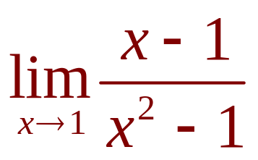
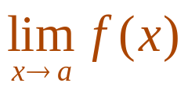
THE LIMIT OF A FUNCTION
Example 1
Guess the value of .
  Notice that the function f(x) = (x – 1)/(x² – 1) is not defined when x = 1.
  However, that doesn’t matter—because the definition of says that we consider values of x that are close to a but not equal to a.

Slide 13
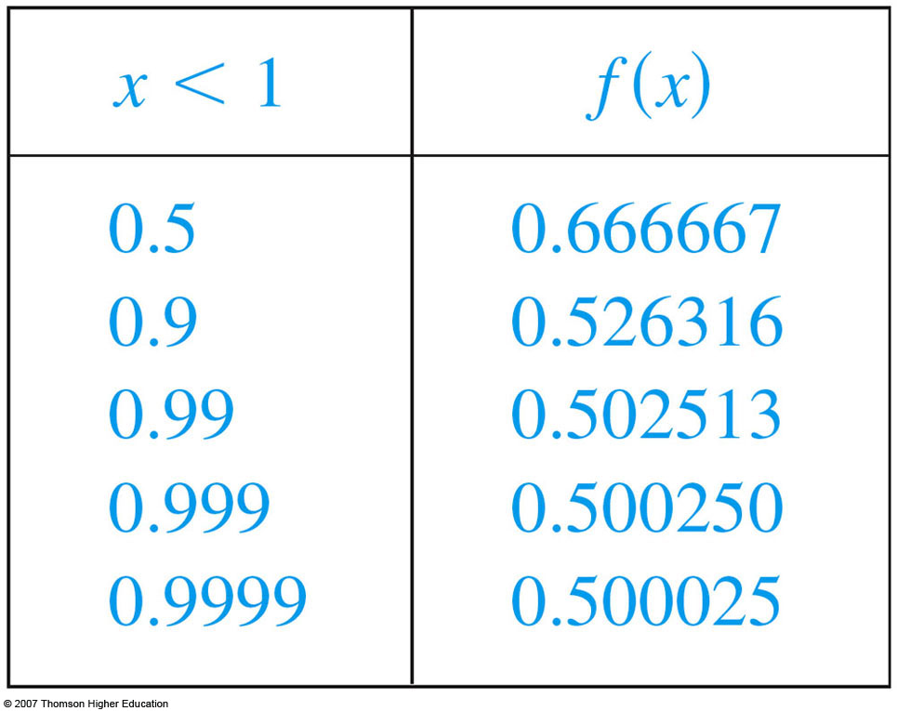
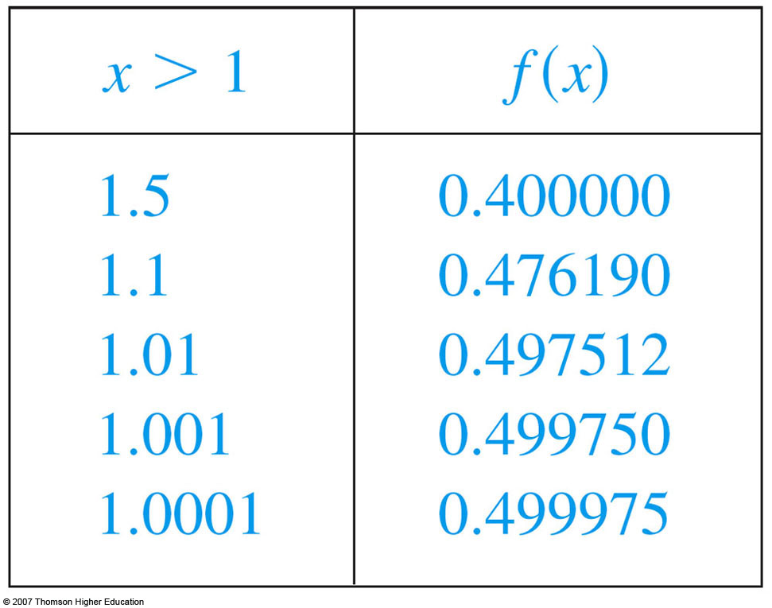
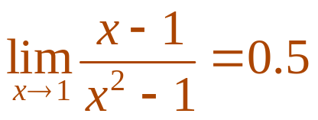
THE LIMIT OF A FUNCTION
Example 1
The tables give values
of f(x) (correct to six
decimal places) for
values of x that
approach 1 (but are not
equal to 1).
  On the basis of the values, we make the guess that

Slide 14
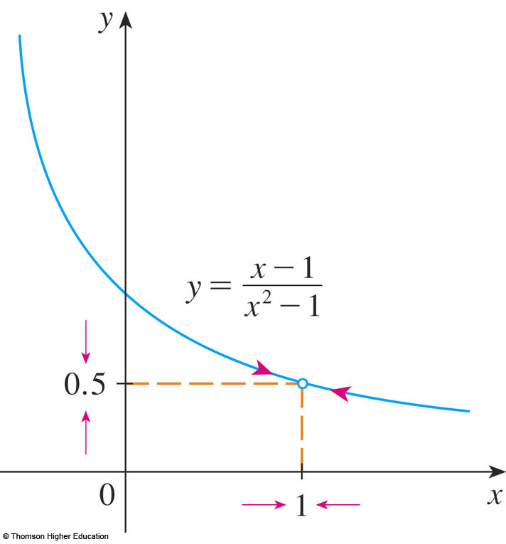
THE LIMIT OF A FUNCTION
Example 1
Example 1 is illustrated by the graph
of f in the figure.

Slide 15
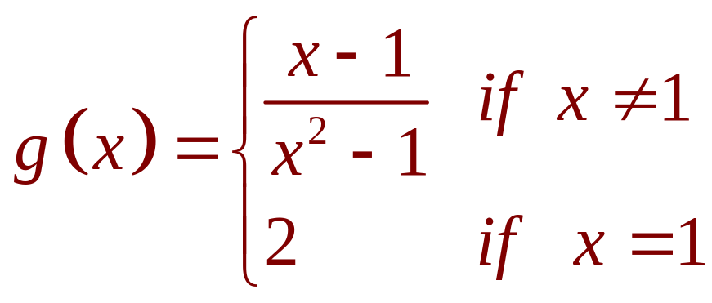
THE LIMIT OF A FUNCTION
Example 1
Now, let’s change f slightly by
giving it the value 2 when x = 1 and calling
the resulting function g:

Slide 16
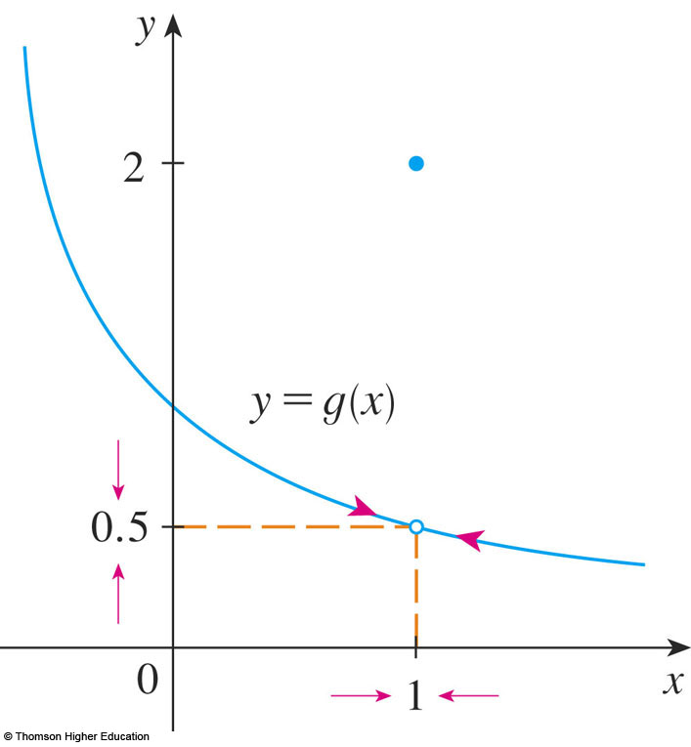
THE LIMIT OF A FUNCTION
Example 1
This new function g still has the
same limit as x approaches 1.

Slide 17
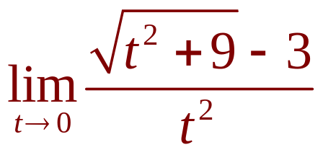
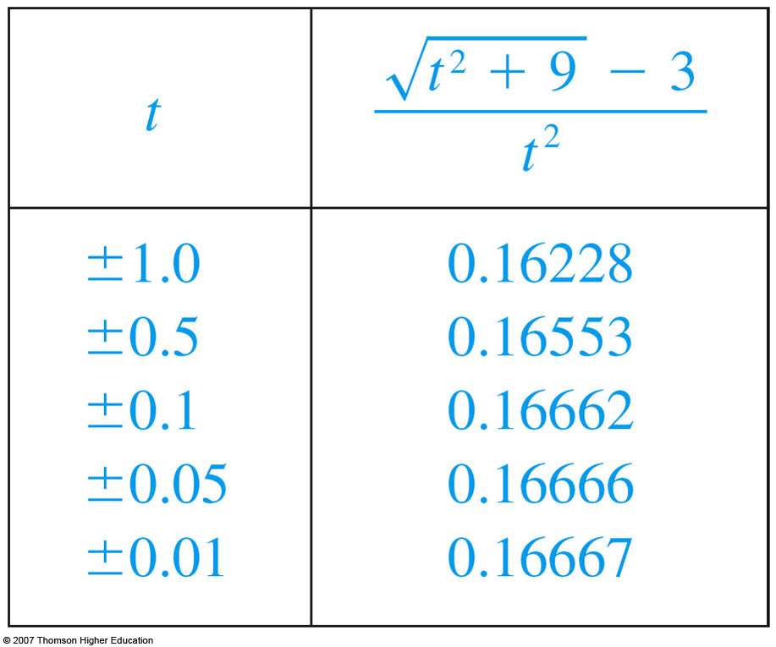
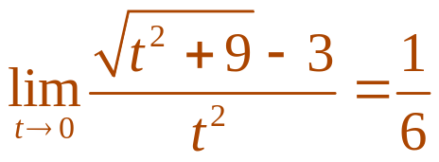
THE LIMIT OF A FUNCTION
Example 2
Estimate the value of .
  The table lists values of the function for several values of t near 0.
  As t approaches 0,
  the values of the function
  seem to approach
  0.16666666…
  So, we guess that:

Slide 18
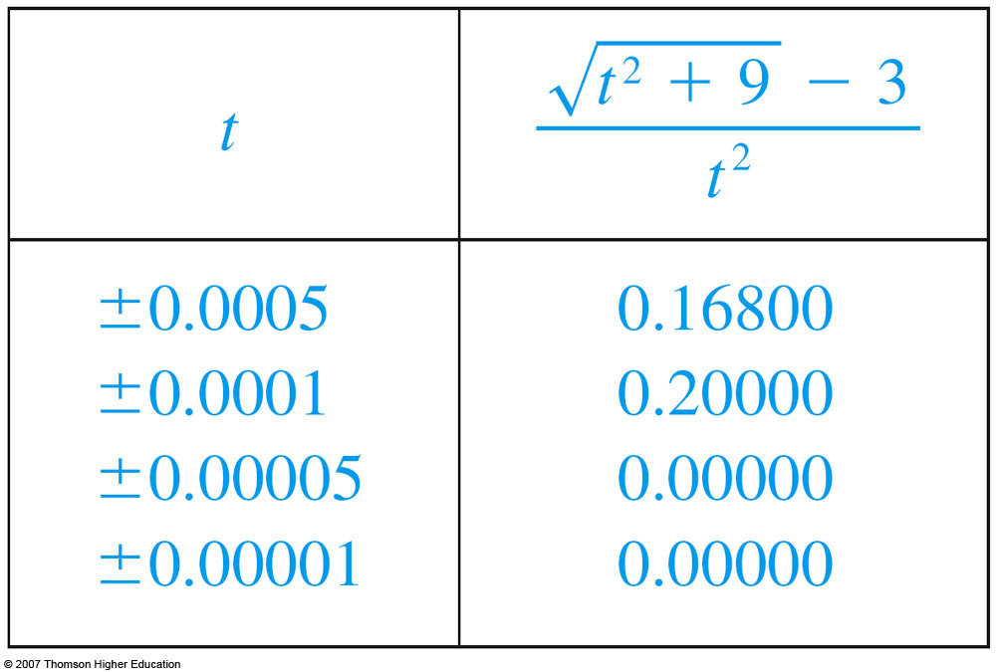
THE LIMIT OF A FUNCTION
Example 2
What would have happened if we
had taken even smaller values of t?
  The table shows the results from one calculator.
  You can see that something strange seems to be happening.
  If you try these
  calculations on your own
  calculator, you might get
  different values but,
  eventually, you will get
  the value 0 if you make
  t sufficiently small.

Slide 19
THE LIMIT OF A FUNCTION
Example 2
Does this mean that the answer is
really 0 instead of 1/6?
  No, the value of the limit is 1/6, as we will show in the next section.

Slide 20
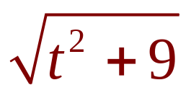

THE LIMIT OF A FUNCTION
Example 2
The problem is that the calculator
gave false values because is
very close to 3 when t is small.
  In fact, when t is sufficiently small, a calculator’s value for is 3.000… to as many digits as the calculator is capable of carrying.

Slide 21
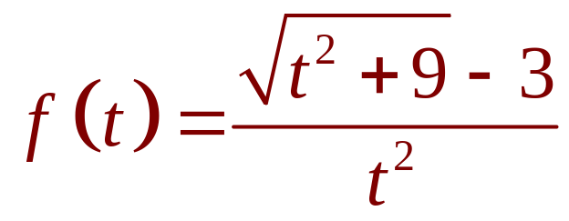
THE LIMIT OF A FUNCTION
Example 2
Something very similar happens when
we try to graph the function
of the example on a graphing calculator
or computer.

Slide 22
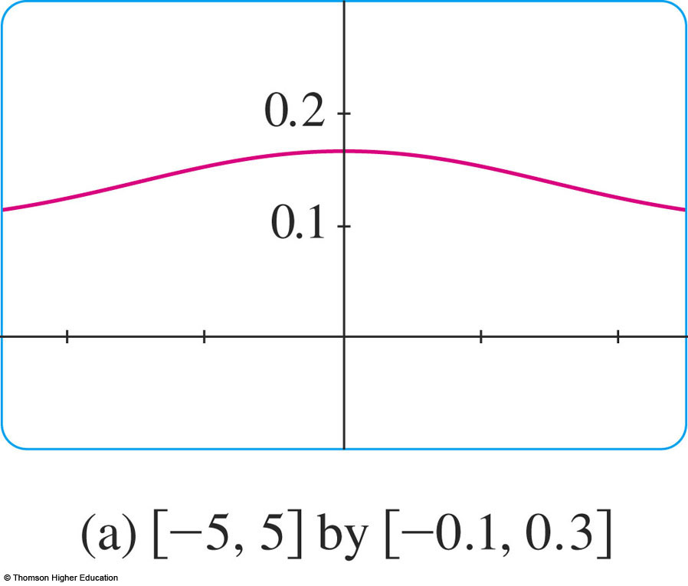
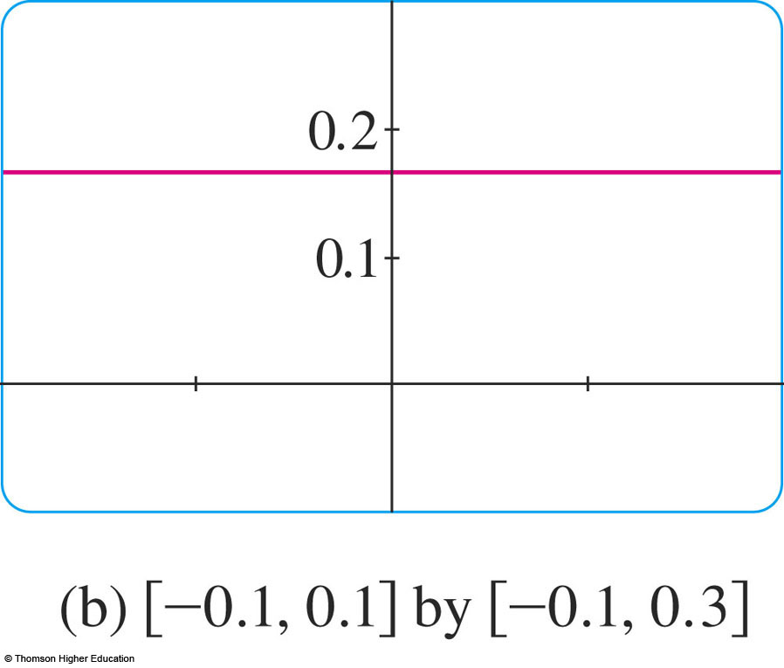
THE LIMIT OF A FUNCTION
Example 2
These figures show quite accurate graphs
of f and, when we use the trace mode (if
available), we can estimate easily that the
limit is about 1/6.

Slide 23
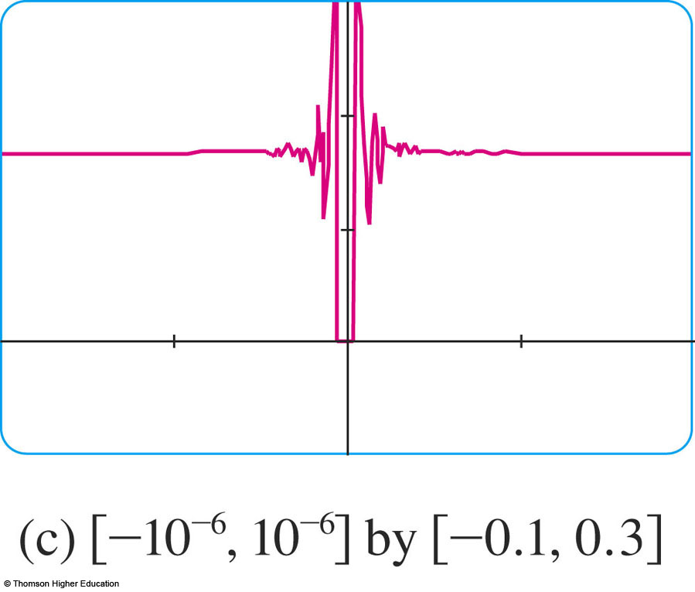
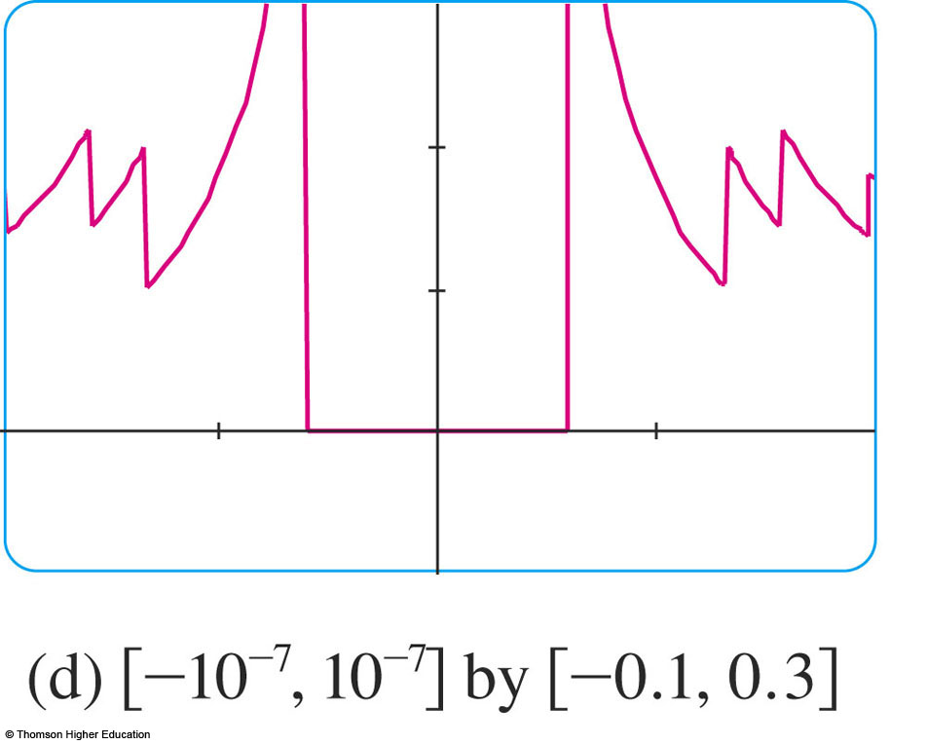
THE LIMIT OF A FUNCTION
Example 2
However, if we zoom in too much, then
we get inaccurate graphs—again because
of problems with subtraction.

Slide 24
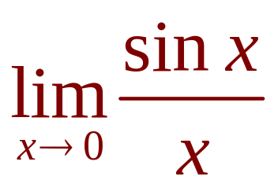

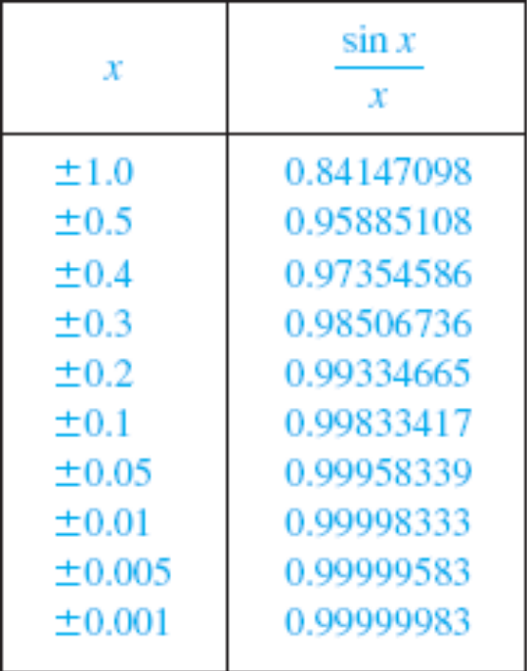
THE LIMIT OF A FUNCTION
Example 3
Guess the value of .
  The function f(x) = (sin x)/x is not defined when x = 0.
  Using a calculator (and remembering that, if , sin x means the sine of the angle
  whose radian measure is x),
  we construct a table of values
  correct to eight decimal places.

Slide 25
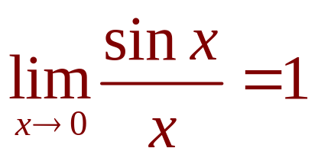
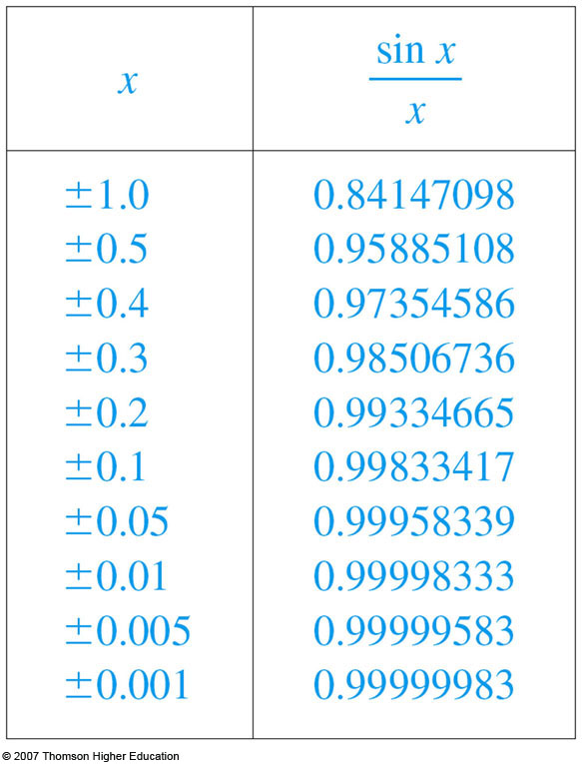
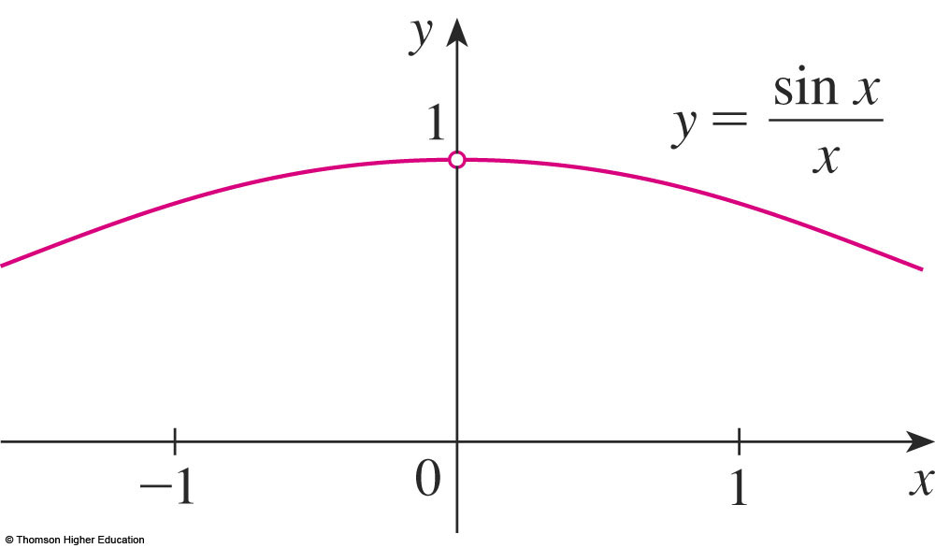
THE LIMIT OF A FUNCTION
Example 3
From the table and the graph, we guess that
  This guess is, in fact, correct—as will be proved later, using a geometric argument.

Slide 26
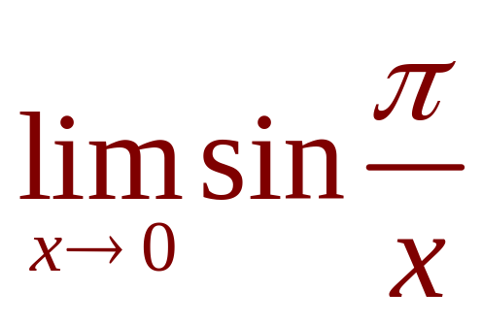

THE LIMIT OF A FUNCTION
Example 4
Investigate .
  Again, the function of f(x) = sin ( /x) is undefined at 0.

Slide 27
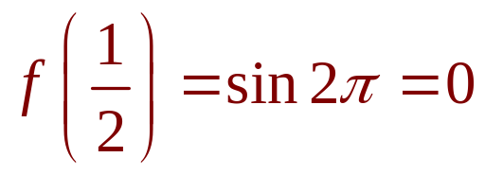
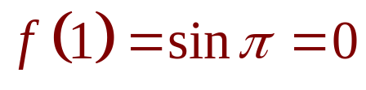
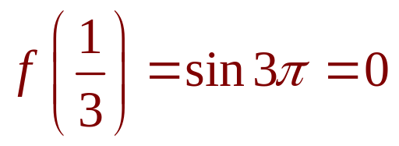
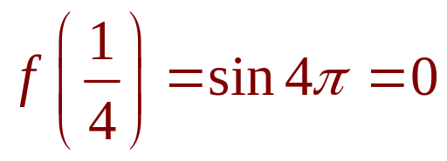
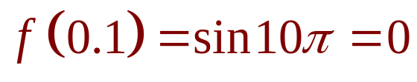
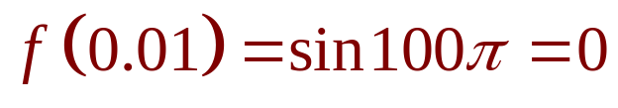
THE LIMIT OF A FUNCTION
Example 4
  Evaluating the function for some small
  values of x, we get:
Similarly, f(0.001) = f(0.0001) = 0.

Slide 28
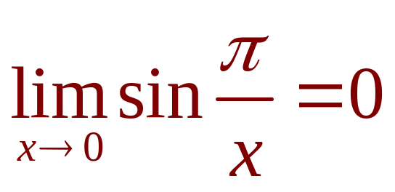
THE LIMIT OF A FUNCTION
Example 4
On the basis of this information,
we might be tempted to guess
that .
  This time, however, our guess is wrong.
  Although f(1/n) = sin n = 0 for any integer n, it is also true that f(x) = 1 for infinitely many values of x that approach 0.

Slide 29
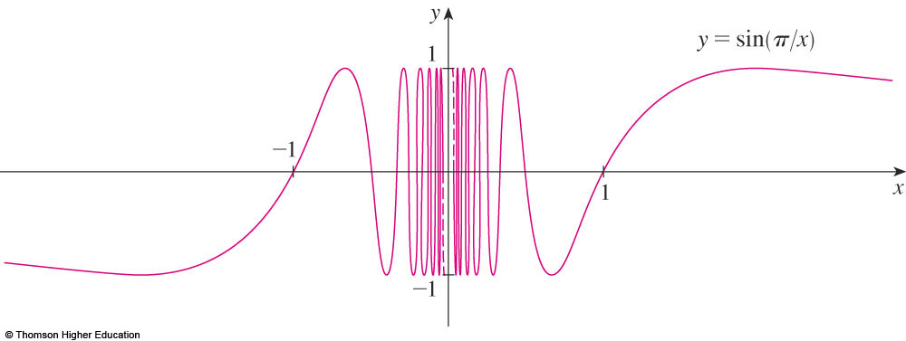
THE LIMIT OF A FUNCTION
Example 4
The graph of f is given in the figure.
  The dashed lines near the y-axis indicate that the values of sin( /x) oscillate between 1 and –1 infinitely as x approaches 0.

Slide 30
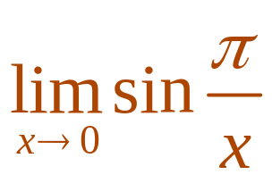
THE LIMIT OF A FUNCTION
Example 4
Since the values of f(x) do not approach a fixed number as approaches 0, does not exist.

Slide 31
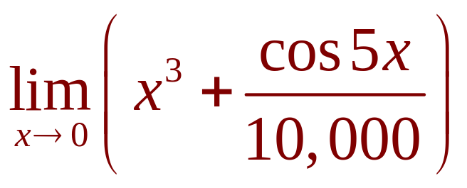
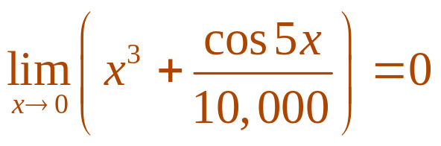
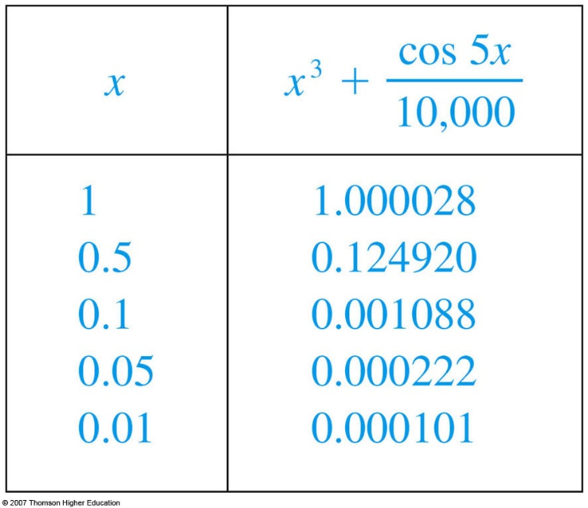
THE LIMIT OF A FUNCTION
Example 5
Find .
As before, we construct a table of values.
  From the table, it appears that:

Slide 32
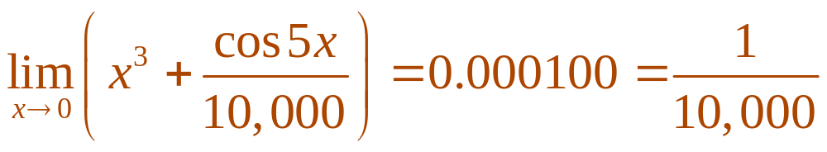
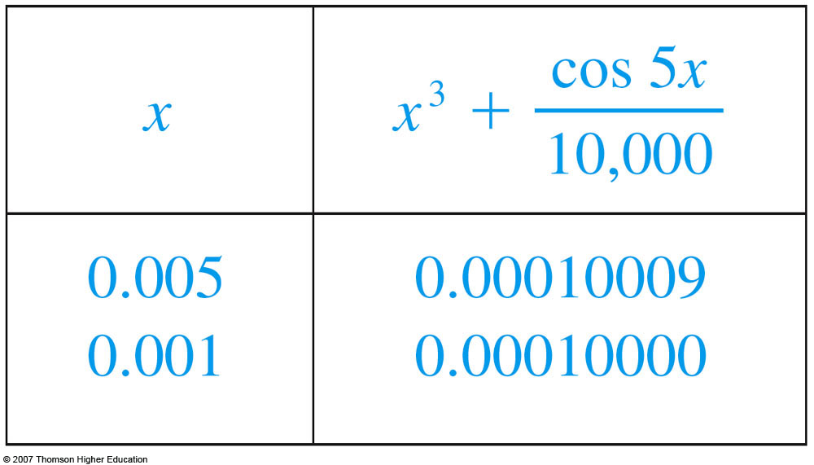
THE LIMIT OF A FUNCTION
Example 5
If, however, we persevere with smaller values of x, this table suggests that:

Slide 33
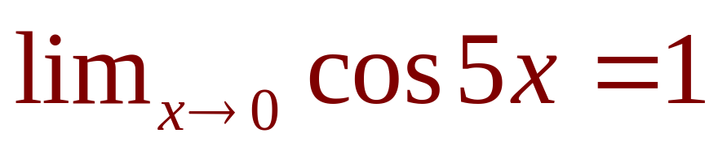
THE LIMIT OF A FUNCTION
Example 5
Later, we will see that:
  Then, it follows that the limit is 0.0001.

Slide 34
THE LIMIT OF A FUNCTION
Examples 4 and 5 illustrate some of the
pitfalls in guessing the value of a limit.
  It is easy to guess the wrong value if we use inappropriate values of x, but it is difficult to know when to stop calculating values.
  As the discussion after Example 2 shows, sometimes, calculators and computers give the wrong values.
  In the next section, however, we will develop foolproof methods for calculating limits.

Slide 35
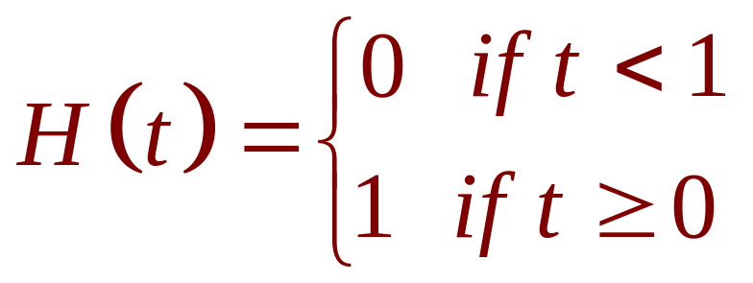
THE LIMIT OF A FUNCTION
Example 6
The Heaviside function H is defined by:
  The function is named after the electrical engineer Oliver Heaviside (1850–1925).
  It can be used to describe an electric current that is switched on at time t = 0.

Slide 36
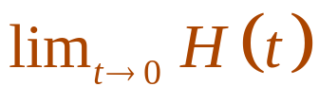
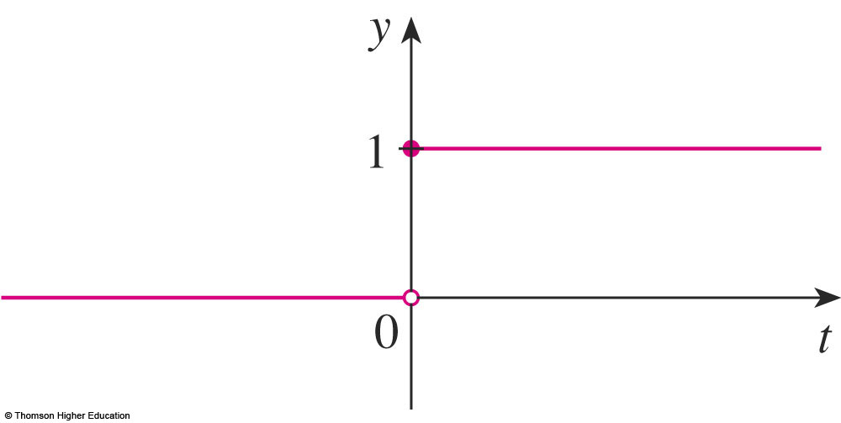
THE LIMIT OF A FUNCTION
Example 6
The graph of the function is shown in
the figure.
  As t approaches 0 from the left, H(t) approaches 0.
  As t approaches 0 from the right, H(t) approaches 1.
  There is no single number that H(t) approaches as t approaches 0.
  So, does not exist.

Slide 37
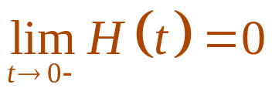



ONE-SIDED LIMITS
We noticed in Example 6 that H(t)
approaches 0 as t approaches 0 from the
left and H(t) approaches 1 as t approaches
0 from the right.
  We indicate this situation symbolically by writing and .
  The symbol ‘ ’ indicates that we consider only values of t that are less than 0.
  Similarly, ‘ ’ indicates that we consider only values of t that are greater than 0.

Slide 38

ONE-SIDED LIMITS
Definition 2
We write
and say the left-hand limit of f(x) as x
approaches a—or the limit of f(x) as x
approaches a from the left—is equal to L if
we can make the values of f(x) arbitrarily
close to L by taking x to be sufficiently close
to a and x less than a.

Slide 39



ONE-SIDED LIMITS
Notice that Definition 2 differs from
Definition 1 only in that we require x to
be less than a.
  Similarly, if we require that x be greater than a, we get ‘the right-hand limit of f(x) as x approaches a is equal to L’ and we write .
  Thus, the symbol ‘ ’ means that we consider only .

Slide 40

ONE-SIDED LIMITS
The definitions are illustrated in the
figures.

Slide 41
ONE-SIDED LIMITS
By comparing Definition 1 with the definition
of one-sided limits, we see that the following
is true:

Slide 42







ONE-SIDED LIMITS
Example 7
The graph of a function g is displayed. Use it
to state the values (if they exist) of:

Slide 43


ONE-SIDED LIMITS
Example 7
From the graph, we see that the values of
g(x) approach 3 as x approaches 2 from the
left, but they approach 1 as x approaches 2
from the right. Therefore, and .

Slide 44

ONE-SIDED LIMITS
Example 7
As the left and right limits are different,
we conclude that does not
exist.

Slide 45



ONE-SIDED LIMITS
Example 7
The graph also shows that
and .

Slide 46


ONE-SIDED LIMITS
Example 7
For , the left and right limits are the
same.
  So, we have .
  Despite this, notice that .

Slide 47


INFINITE LIMITS
Example 8
Find if it exists.
  As x becomes close to 0, x² also becomes close to 0, and 1/x² becomes very large.

Slide 48



INFINITE LIMITS
Example 8
  In fact, it appears from the graph of the function f(x) = 1/x² that the values of f(x) can be made arbitrarily large by taking x close enough to 0.
  Thus, the values of f(x) do not approach a number.
  So, does not exist.

Slide 49

INFINITE LIMITS
Example 8
To indicate the kind of behavior exhibited
in the example, we use the following
notation:
This does not mean that we are regarding ∞ as a number.
Nor does it mean that the limit exists.
It simply expresses the particular way in which the limit does not exist.
1/x² can be made as large as we like by taking x close enough to 0.

Slide 50

INFINITE LIMITS
Example 8
In general, we write symbolically
to indicate that the values of f(x) become
larger and larger—or ‘increase without
bound’—as x becomes closer and closer
to a.

Slide 51
INFINITE LIMITS
Definition 4
Let f be a function defined on both sides
of a, except possibly at a itself. Then,
means that the values of f(x) can be
made arbitrarily large—as large as we
please—by taking x sufficiently close to a,
but not equal to a.

Slide 52



INFINITE LIMITS
Another notation for is:
  Again, the symbol is not a number.
  However, the expression is often read as ‘the limit of f(x), as x approaches a, is infinity;’ or ‘f(x) becomes infinite as x approaches a;’ or ‘f(x) increases without bound as x approaches a.’

Slide 53

INFINITE LIMITS
This definition is illustrated
graphically.

Slide 54

INFINITE LIMITS
A similar type of limit—for functions that
become large negative as x gets close to
a—is illustrated.

Slide 55

INFINITE LIMITS
Definition 5
Let f be defined on both sides of a, except
possibly at a itself. Then,
means that the values of f(x) can be made
arbitrarily large negative by taking x
sufficiently close to a, but not equal to a.

Slide 56

INFINITE LIMITS
The symbol can be read
as ‘the limit of f(x), as x approaches a,
is negative infinity’ or ‘f(x) decreases
without bound as x approaches a.’
  As an example, we have:

Slide 57






INFINITE LIMITS
Similar definitions can be given for the
one-sided limits:
  Remember, ‘ ’ means that we consider only values of x that are less than a.
  Similarly, ‘ ’ means that we consider only .

Slide 58

INFINITE LIMITS
Those four
cases are
illustrated
here.

Slide 59


INFINITE LIMITS
Definition 6
The line x = a is called a vertical asymptote
of the curve y = f(x) if at least one of the
following statements is true.
  For instance, the y-axis is a vertical asymptote of the curve y = 1/x² because .

Slide 60
INFINITE LIMITS
In the figures, the line x = a is a vertical
asymptote in each of the four cases shown.
  In general, knowledge of vertical asymptotes is very useful in sketching graphs.

Slide 61



INFINITE LIMITS
Example 9
Find and .
  If x is close to 3 but larger than 3, then the denominator x – 3 is a small positive number and 2x is close to 6.
  So, the quotient 2x/(x – 3) is a large positive number.
  Thus, intuitively, we see that .

Slide 62

INFINITE LIMITS
Example 9
  Similarly, if x is close to 3 but smaller than 3, then x - 3 is a small negative number but 2x is still a positive number (close to 6).
  So, 2x/(x - 3) is a numerically large negative number.
  Thus, we see that .

Slide 63

INFINITE LIMITS
Example 9
The graph of the curve y = 2x/(x - 3) is
given in the figure.
  The line x – 3 is a vertical asymptote.

Slide 64








INFINITE LIMITS
Example 10
Find the vertical asymptotes of
f(x) = tan x.
  As , there are potential vertical asymptotes where cos x = 0.
  In fact, since as and as , whereas sin x is positive when x is near /2, we have:
  and
  This shows that the line x = /2 is a vertical asymptote.

Slide 65


INFINITE LIMITS
Example 10
Similar reasoning shows that the
lines x = (2n + 1) /2, where n is an
integer, are all vertical asymptotes of
f(x) = tan x.
  The graph confirms this.

Slide 66


INFINITE LIMITS
Example 10
Another example of a function whose
graph has a vertical asymptote is the
natural logarithmic function of y = ln x.
  From the figure, we see that .
  So, the line x = 0 (the y-axis)
  is a vertical asymptote.
  The same is true for
  y = log_{a} x, provided a > 1.

