Slide 1
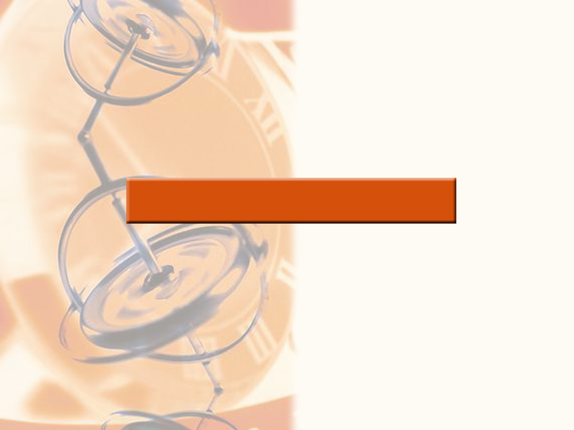
2
LIMITS AND DERIVATIVES

Slide 2
LIMITS AND DERIVATIVES
We have used calculators
and graphs to guess the values
of limits.
  However, we have learned that such methods don’t always lead to the correct answer.

Slide 3
LIMITS AND DERIVATIVES
2.3
Calculating Limits
Using the Limit Laws
In this section, we will:
Use the Limit Laws to calculate limits.

Slide 4
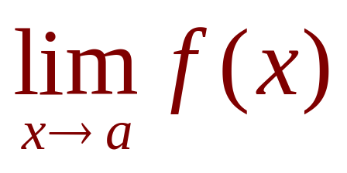
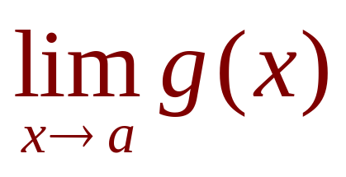
THE LIMIT LAWS
Suppose that c is a constant and
the limits and
exist.

Slide 5
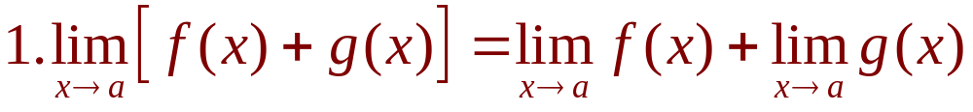
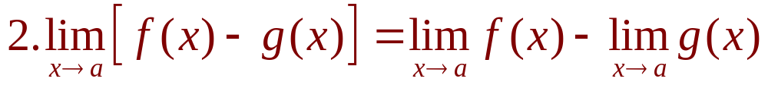
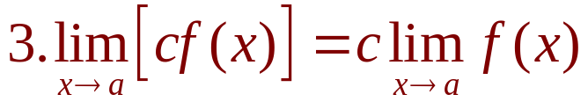
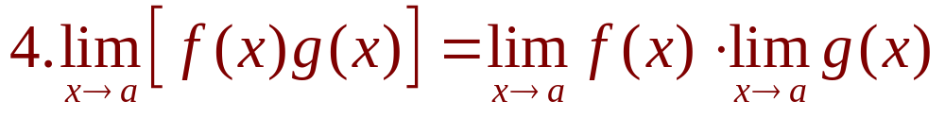
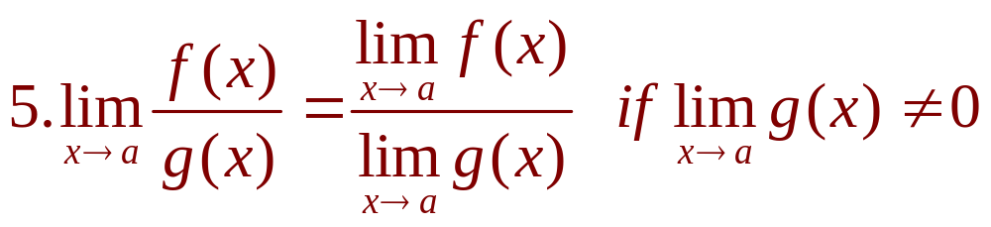
THE LIMIT LAWS
Then,

Slide 6
THE LIMIT LAWS
These laws can be
stated verbally.

Slide 7
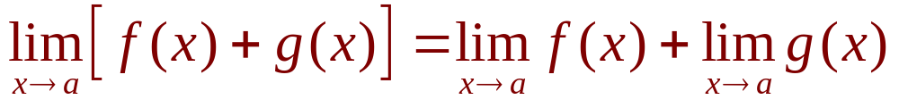
THE SUM LAW
The limit of a sum is the sum
of the limits.

Slide 8
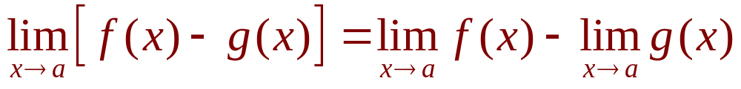
THE DIFFERENCE LAW
The limit of a difference is the
difference of the limits.

Slide 9
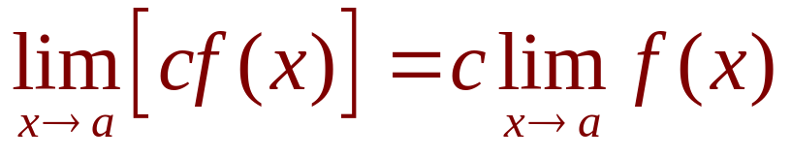
THE CONSTANT MULTIPLE LAW
The limit of a constant times a
function is the constant times the
limit of the function.

Slide 10
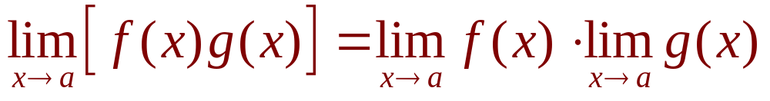
THE PRODUCT LAW
The limit of a product is the
product of the limits.

Slide 11
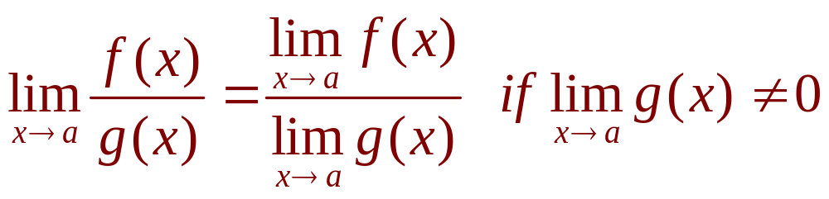
THE QUOTIENT LAW
The limit of a quotient is the quotient
of the limits (provided that the limit of
the denominator is not 0).

Slide 12
THE LIMIT LAWS
It is easy to believe that these
properties are true.
  For instance, if f(x) is close to L and g(x) is close to M, it is reasonable to conclude that f(x) + g(x) is close to L + M.
  This gives us an intuitive basis for believing that the Sum Law is true.

Slide 13
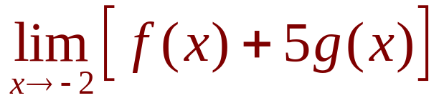
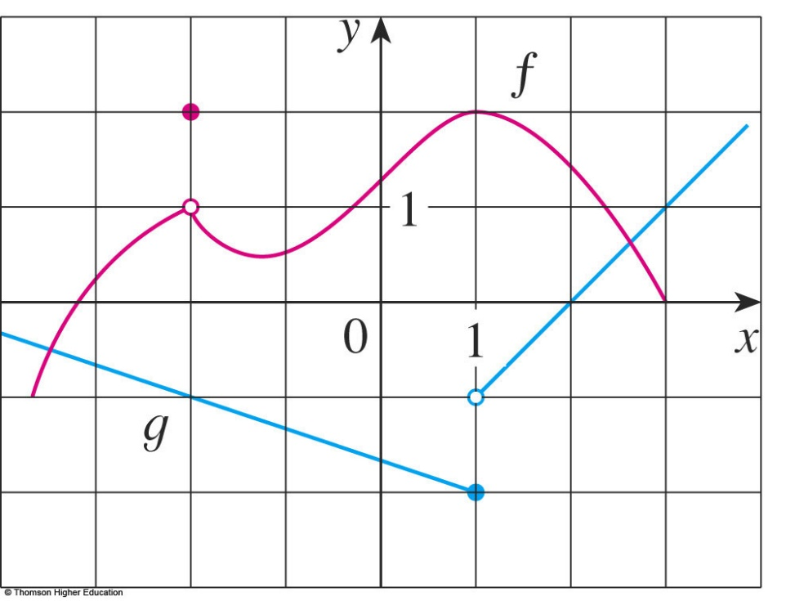
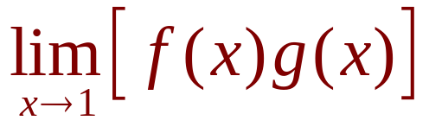
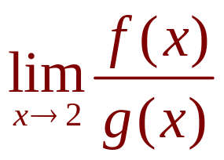
USING THE LIMIT LAWS
Example 1
Use the Limit Laws and the graphs
of f and g in the figure to evaluate the
following limits, if they exist.
a.
b.
c.

Slide 14
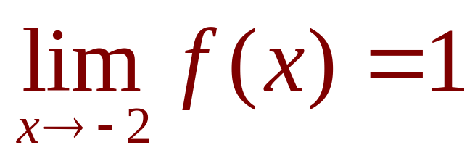
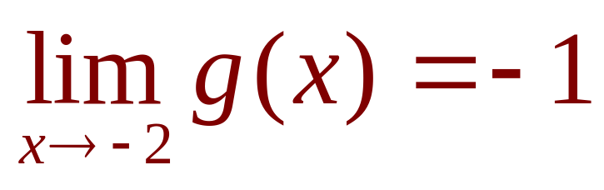
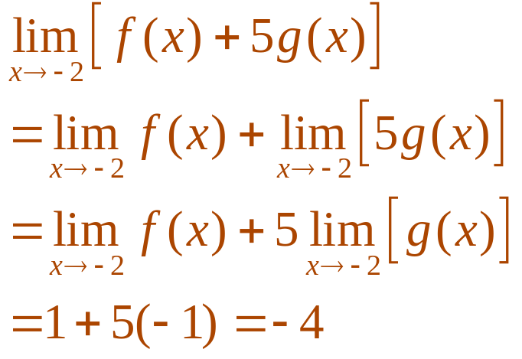
USING THE LIMIT LAWS
Example 1 a
From the graphs, we see that
and .
  Therefore, we have:

Slide 15
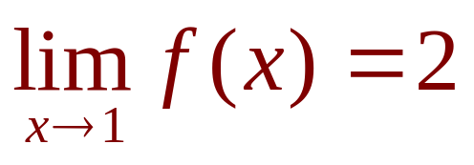
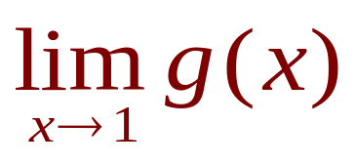
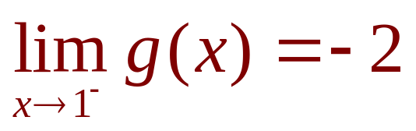
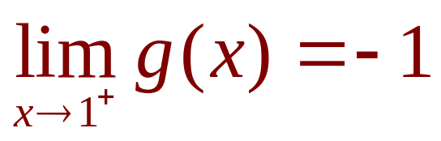
USING THE LIMIT LAWS
Example 1 b
We see that .
However, does not exist—because
the left and right limits are different: and
  So, we can’t use the
  Product Law for the desired
  limit.

Slide 16
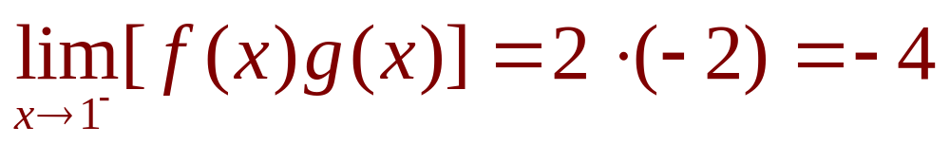
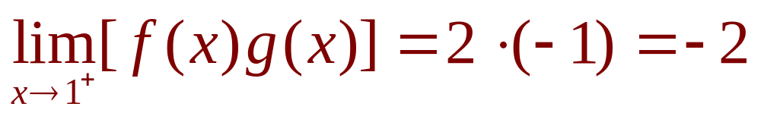
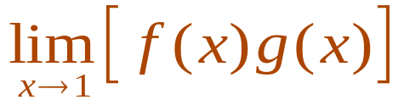
USING THE LIMIT LAWS
Example 1 b
However, we can use the Product Law
for the one-sided limits:
and
  The left and right limits
  aren’t equal.
  So,
  does not exist.

Slide 17
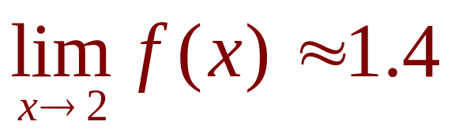
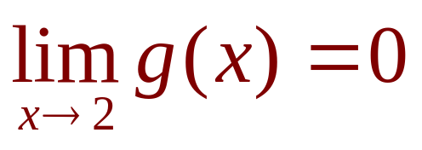
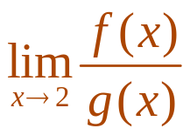
USING THE LIMIT LAWS
Example 1 c
The graphs show that and
.
As the limit of the denominator is 0, we
can’t use the Quotient Law.
  does not exist.
  This is because the
  denominator approaches 0
  while the numerator
  approaches a nonzero
  number.

Slide 18
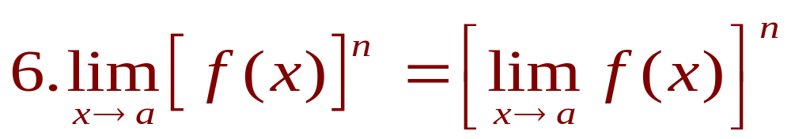
THE POWER LAW
If we use the Product Law repeatedly
with f(x) = g(x), we obtain the Power
Law.
where n is a positive integer

Slide 19
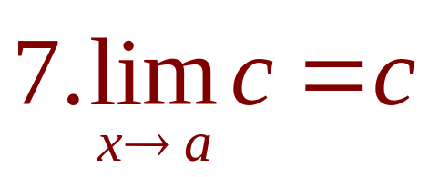
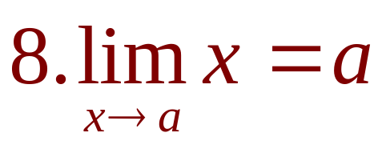
USING THE LIMIT LAWS
In applying these six limit laws, we
need to use two special limits.
  These limits are obvious from an intuitive point of view.
  State them in words or draw graphs of y = c and y = x.

Slide 20
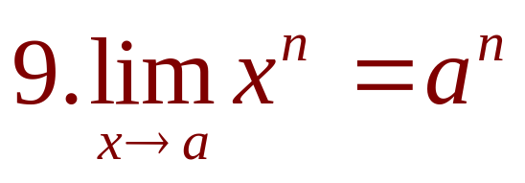
USING THE LIMIT LAWS
If we now put f(x) = x in the Power Law
and use Law 8, we get another useful
special limit.
where n is a positive integer.

Slide 21
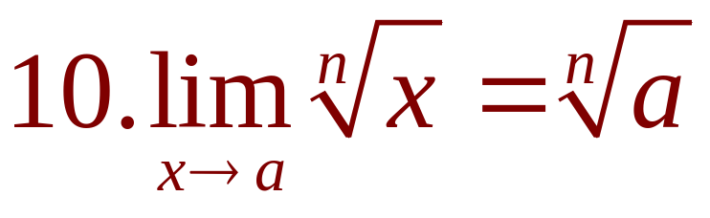
USING THE LIMIT LAWS
A similar limit holds for roots.
  If n is even, we assume that a > 0.

Slide 22
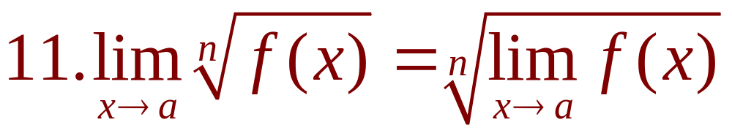
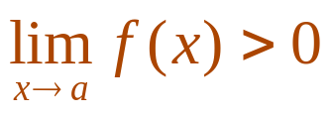
THE ROOT LAW
More generally, we have the
Root Law.
where n is a positive integer.
  If n is even, we assume that .

Slide 23
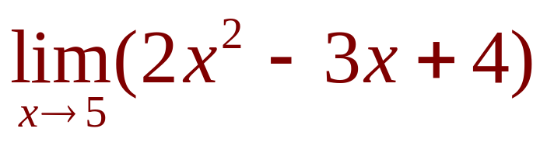
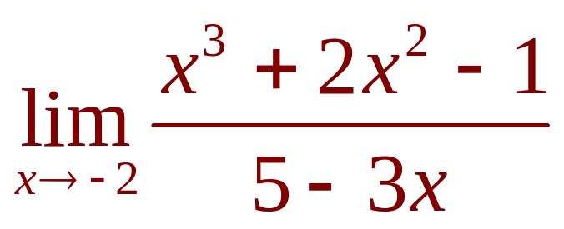
USING THE LIMIT LAWS
Example 2
Evaluate the following limits and
justify each step.
a.
b.

Slide 24
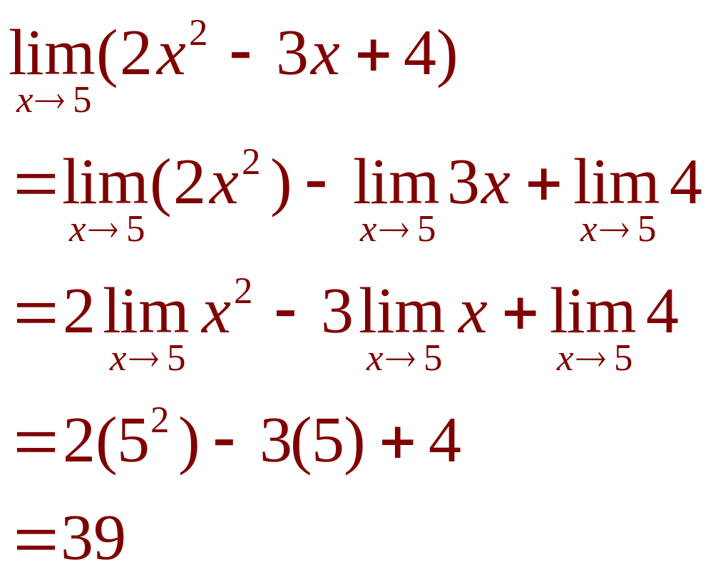
USING THE LIMIT LAWS
Example 2 a
(by Laws 2 and 1)
(by Law 3)
(by Laws 9, 8, and 7)

Slide 25
USING THE LIMIT LAWS
Example 2 b
We start by using the Quotient Law.
However, its use is fully justified only
at the final stage.
  That is when we see that the limits of the numerator
  and denominator exist and the limit of the denominator is not 0.

Slide 26
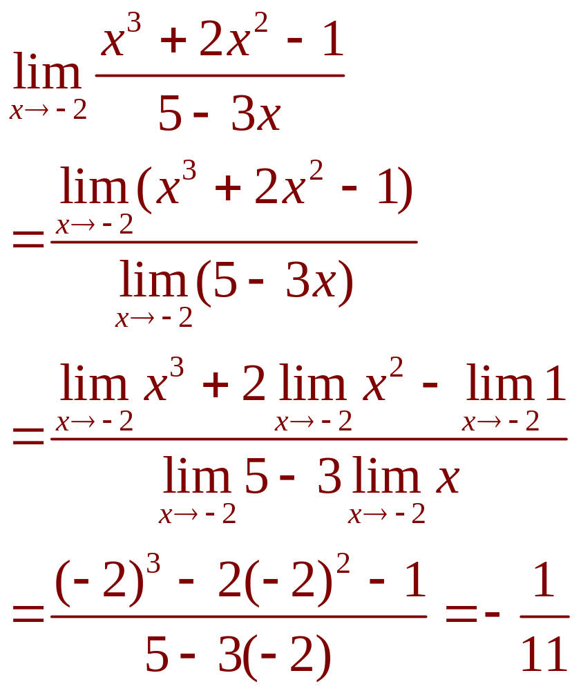
USING THE LIMIT LAWS
Example 2 b
(by Law 5)
(by Laws 1, 2, and 3)
(by Laws 9, 8, and 7)

Slide 27
USING THE LIMIT LAWS
Note
If we let f(x) = 2x² - 3x + 4,
then f(5) = 39.
  In other words, we would have gotten the correct
  answer in Example 2 a by substituting 5 for x.
  Similarly, direct substitution provides the correct
  answer in Example 2 b.

Slide 28
USING THE LIMIT LAWS
Note
The functions in the example are
a polynomial and a rational function,
respectively.
  Similar use of the Limit Laws proves that direct substitution always works for such functions.

Slide 29
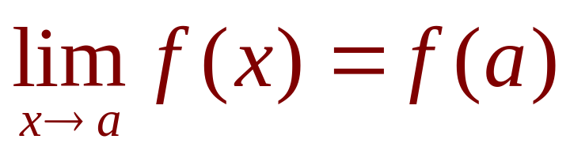
DIRECT SUBSTITUTION PROPERTY
We state this fact as follows.
If f is a polynomial or a rational function
and a is in the domain of f, then

Slide 30
DIRECT SUBSTITUTION PROPERTY
Functions with the Direct Substitution Property
are called ‘continuous at a.’
However, not all limits can be evaluated by
direct substitution—as the following examples
show.

Slide 31
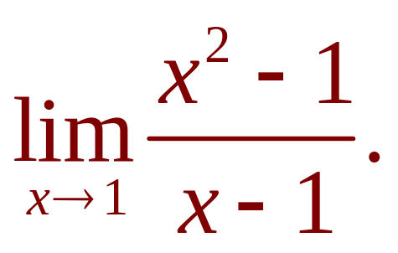
USING THE LIMIT LAWS
Example 3
Find
  Let f(x) = (x² - 1)/(x - 1) .
  We can’t find the limit by substituting x = 1 because
  f(1) isn’t defined.
  We can’t apply the Quotient Law because the limit
  of the denominator is 0.
  Instead, we need to do some preliminary algebra.

Slide 32
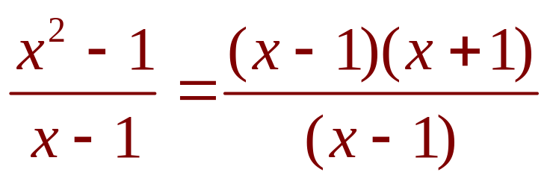


USING THE LIMIT LAWS
Example 3
We factor the numerator as a
difference of squares.
  The numerator and denominator have a common
  factor of x - 1.
  When we take the limit as x approaches 1, we have and so .

Slide 33
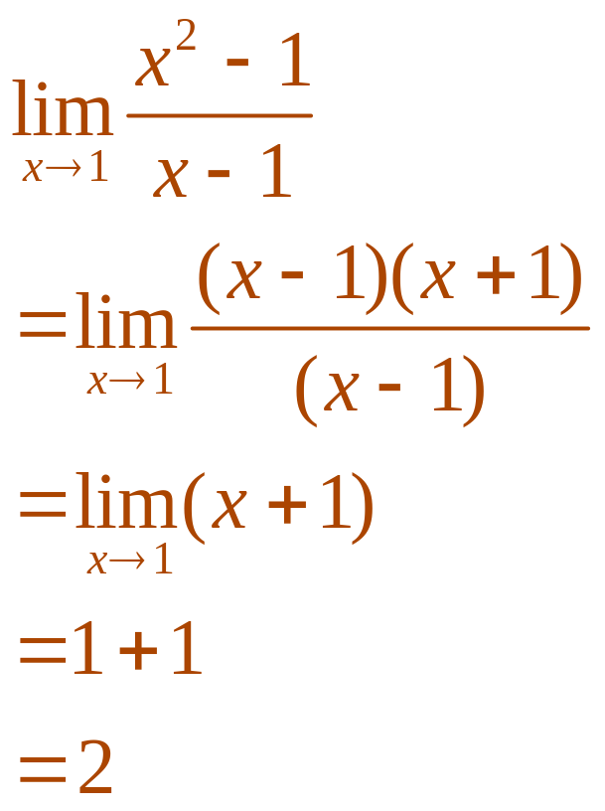
USING THE LIMIT LAWS
Example 3
  Therefore, we can cancel the common factor and compute the limit as follows:

Slide 34
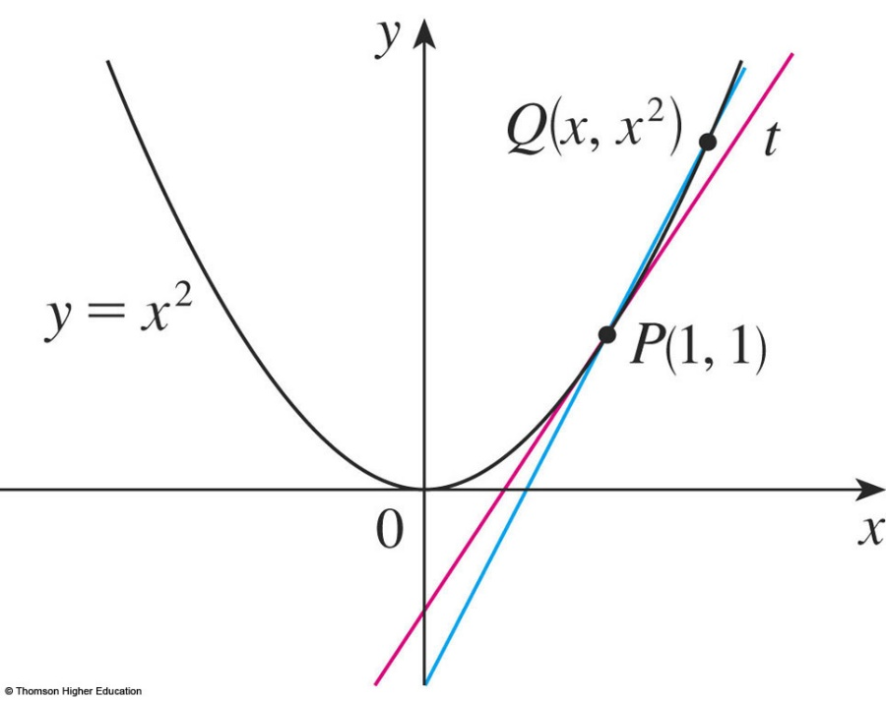
USING THE LIMIT LAWS
Example 3
The limit in the example arose in Section 2.1
when we were trying to find the tangent to the
parabola y = x² at the point (1, 1).

Slide 35
USING THE LIMIT LAWS
Note
In the example, we were able to compute
the limit by replacing the given function
f(x) = (x² - 1)/(x - 1) by a simpler function
with the same limit, g(x) = x + 1.
  This is valid because f(x) = g(x) except when x = 1
  and, in computing a limit as x approaches 1, we don’t consider what happens when x is actually equal to 1.

Slide 36
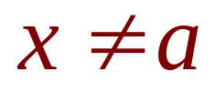
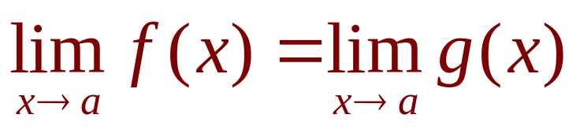
USING THE LIMIT LAWS
Note
In general, we have the following
useful fact.
If f(x) = g(x) when , then , provided the limits
exist.

Slide 37
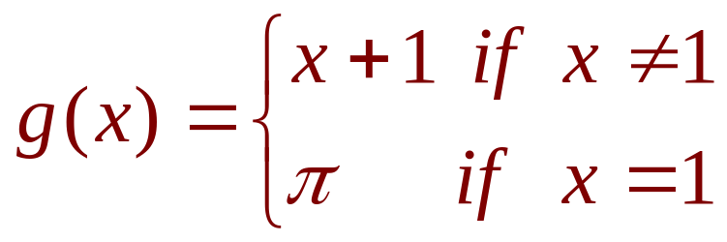
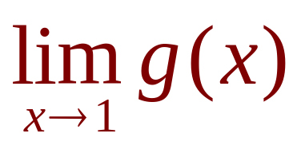



USING THE LIMIT LAWS
Example 4
Find where .
  Here, g is defined at x = 1 and .
  However, the value of a limit as x approaches 1 does
  not depend on the value of the function at 1.
  Since g(x) = x + 1 for , we have
  .

Slide 38


USING THE LIMIT LAWS
Note that the values of the functions in
Examples 3 and 4 are identical except when
x = 1.
So, they have the same limit as x
approaches 1.

Slide 39




USING THE LIMIT LAWS
Example 5
Evaluate
  If we define , then, we can’t compute by letting h = 0 since F(0) is undefined.
  However, if we simplify F(h) algebraically, we find that:

Slide 40


USING THE LIMIT LAWS
Example 5
  Recall that we consider only when letting h approach 0.
  Thus,

Slide 41

USING THE LIMIT LAWS
Example 6
Find
  We can’t apply the Quotient Law immediately—since
  the limit of the denominator is 0.
  Here, the preliminary algebra consists of rationalizing
  the numerator.

Slide 42

USING THE LIMIT LAWS
Example 6
  Thus,

Slide 43


USING THE LIMIT LAWS
Theorem 1
Some limits are best calculated by first finding
the left- and right-hand limits.
The following theorem states that a two-sided
limit exists if and only if both the one-sided
limits exist and are equal.
if and only if
  When computing one-sided limits, we use the fact that the Limit Laws also hold for one-sided limits.

Slide 44





USING THE LIMIT LAWS
Example 7
Show that
  Recall that:
  Since |x| = x for x > 0 , we have:
  Since |x| = -x for x < 0, we have:
  Therefore, by Theorem 1, .

Slide 45

USING THE LIMIT LAWS
Example 7
The result looks plausible from
the figure.

Slide 46



USING THE LIMIT LAWS
Example 8
Prove that does not exist.
  Since the right- and left-hand limits are different, it follows from Theorem 1 that does not exist.

Slide 47


USING THE LIMIT LAWS
Example 8
The graph of the function
is shown in the figure.
It supports the one-sided limits that we
found.

Slide 48





USING THE LIMIT LAWS
Example 9
If
determine whether exists.
  Since for x > 4, we have:
  Since f(x) = 8 - 2x for x < 4, we have:

Slide 49

USING THE LIMIT LAWS
Example 9
The right- and left-hand limits are equal.
Thus, the limit exists and .

Slide 50

USING THE LIMIT LAWS
Example 9
The graph of f is shown in the
figure.

Slide 51






GREATEST INTEGER FUNCTION
The greatest integer function is defined
by = the largest integer that is less
than or equal to x.
  For instance, , , , , and .
  The greatest integer function is sometimes called
  the floor function.

Slide 52


USING THE LIMIT LAWS
Example 10
Show that does not exist.
  The graph of the greatest integer function
  is shown in the figure.

Slide 53







USING THE LIMIT LAWS
Example 10
Since for , we have:
Since for , we have:
As these one-sided limits
are not equal,
does not exist by Theorem 1.

Slide 54
USING THE LIMIT LAWS
The next two theorems
give two additional properties
of limits.

Slide 55


USING THE LIMIT LAWS
Theorem 2
If when x is near a (except
possibly at a) and the limits of f and g
both exist as x approaches a, then

Slide 56



USING THE LIMIT LAWS
Theorem 3
The Squeeze Theorem states that, if
when x is near (except
possibly at a ) and ,
then
  The Squeeze Theorem is sometimes called the Sandwich Theorem or the Pinching Theorem.

Slide 57

THE SQUEEZE THEOREM
The theorem is illustrated by the
figure.
  It states that, if g(x) is squeezed between f(x) and h(x) near a and if f and h have the same limit L at a, then
  g is forced to have the same limit L at a.

Slide 58



USING THE LIMIT LAWS
Example 11
Show that
  Note that we cannot use
  This is because does not exist.

Slide 59



USING THE LIMIT LAWS
Example 11
  However, since ,
  we have:
  This is illustrated by
  the figure.

Slide 60




USING THE LIMIT LAWS
Example 11
We know that: and
Taking f(x) = -x², , and h(x) = x²
in the Squeeze Theorem, we obtain:

