Slide 1
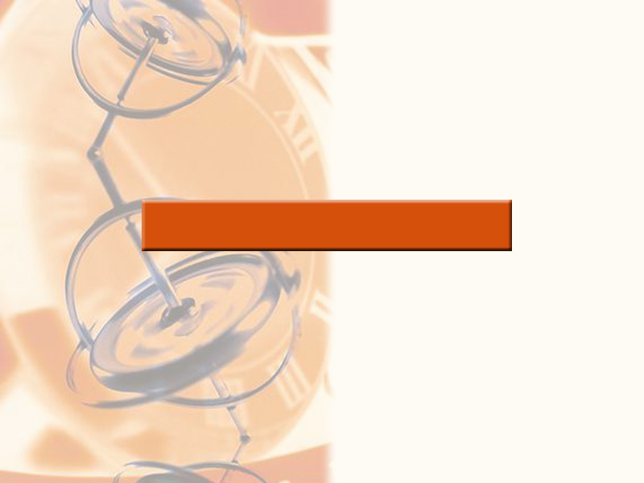
2
LIMITS AND DERIVATIVES

Slide 2
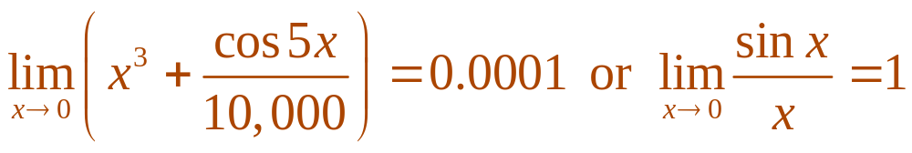
LIMITS AND DERIVATIVES
The intuitive definition of a limit
given in Section 2.2 is inadequate
for some purposes.
  This is because such phrases as ‘x is close to 2’
  and ‘f(x) gets closer and closer to L’ are vague.
  In order to be able to prove conclusively that
  we must make the definition of a limit precise.

Slide 3
LIMITS AND DERIVATIVES
2.4
The Precise Definition
of a Limit
In this section, we will:
Define a limit precisely.

Slide 4
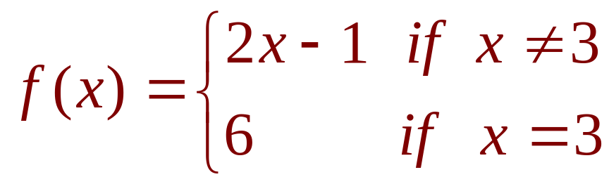

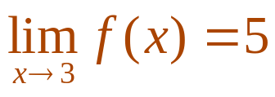
PRECISE DEFINITION OF LIMIT
To motivate the precise definition
of a limit, consider the function
  Intuitively, it is clear that when x is close to 3
  but , then f(x) is close to 5—and so .

Slide 5
PRECISE DEFINITION OF LIMIT
To obtain more detailed information
about how f(x) varies when x is close
to 3, we ask the following question.
  How close to 3 does x have to be so that f(x) differs
  from 5 by less than 0.l?

Slide 6

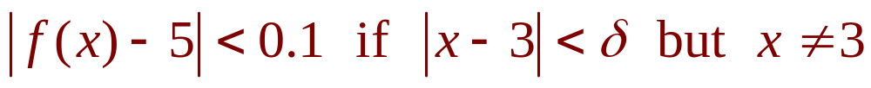
PRECISE DEFINITION OF LIMIT
The distance from x to 3 is |x - 3| and
the distance from f(x) to 5 is |f(x) - 5|.
So, our problem is to find a number
such that

Slide 7
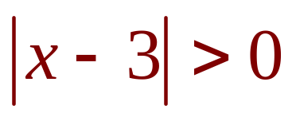
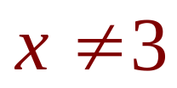
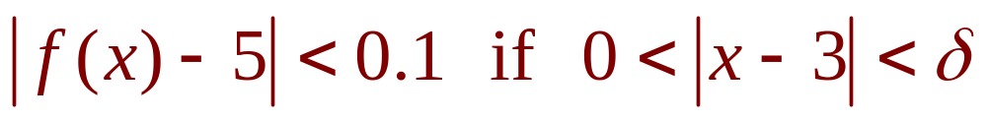
PRECISE DEFINITION OF LIMIT
If , then .
So, an equivalent formulation
of our problem is to find a number
such that

Slide 8
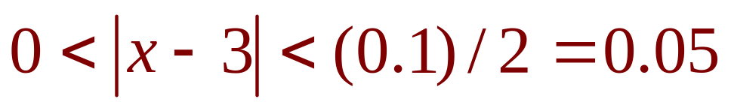
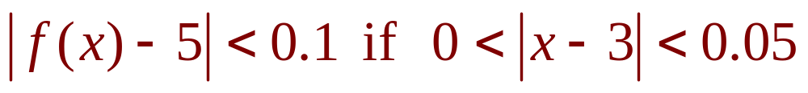

PRECISE DEFINITION OF LIMIT
Notice that, if ,
then
That is,
  Thus, an answer to the problem is given by .
  That is, if x is within a distance of 0.05 from 3,
  then f(x) will be within a distance of 0.1 from 5.

Slide 9
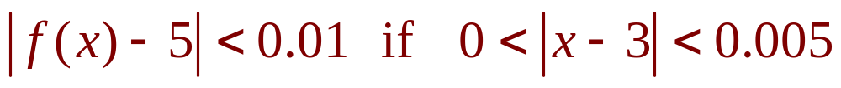
PRECISE DEFINITION OF LIMIT
If we change the number 0.1 in our problem
to the smaller number 0.01, then, by using
the same method, we find that f(x) will differ
from 5 by less than 0.01—provided that x
differs from 3 by less than (0.01)/2 = 0.005

Slide 10
PRECISE DEFINITION OF LIMIT
Similarly,
  The numbers 0.1, 0.01, and 0.001 that we have considered are ‘error tolerances’ that we might allow.

Slide 11
PRECISE DEFINITION OF LIMIT
For 5 to be the precise limit of f(x) as x
approaches 3, we must not only be able to
bring the difference between f(x) and 5 below
each of these three numbers, we must be
able to bring it below any positive number.
  By the same reasoning, we can.

Slide 12

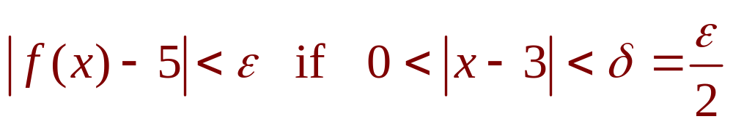



PRECISE DEFINITION OF LIMIT
Definition 1
If we write for an arbitrary positive
number, then we find as before that:
  This is a precise way of saying that f(x) is close to 5 when x is close to 3.
  This is because (1) states that we can make the values of f(x) within an arbitrary distance from 5 by taking
  the values of x within a distance from 3 (but ).

Slide 13
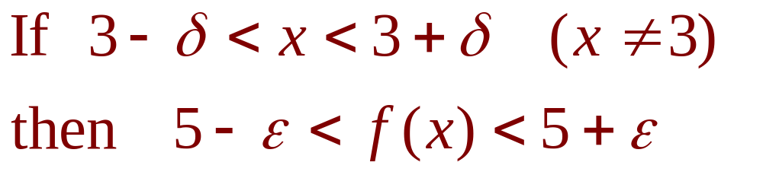
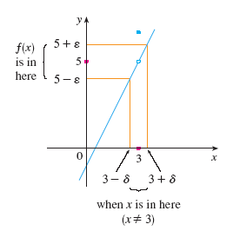
PRECISE DEFINITION OF LIMIT
Note that Definition 1 can be rewritten
as follows.
This is illustrated in
the figure.

Slide 14
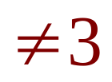
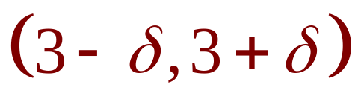
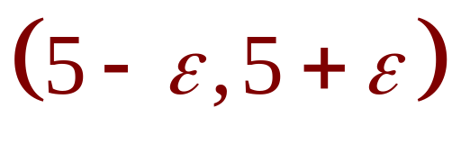
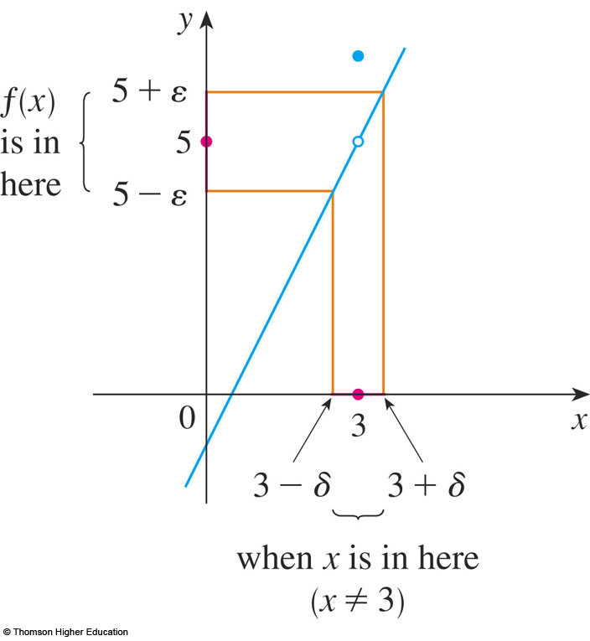
PRECISE DEFINITION OF LIMIT
By taking the values of x ( ) to lie in
the interval , we can make
the values of f(x) lie in the interval .

Slide 15
PRECISE DEFINITION OF LIMIT
Using (1) as a model,
we give a precise definition
of a limit.

Slide 16
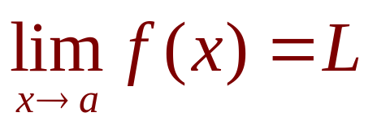

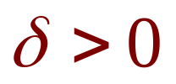
PRECISE DEFINITION OF LIMIT
Definition 2
Let f be a function defined on some open
interval that contains the number a, except
possibly at a itself.
Then, we say that the limit of f(x) as x
approaches a is L, and we write
if, for every number , there is
a number such that

Slide 17

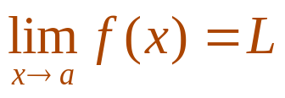
PRECISE DEFINITION OF LIMIT
Since |x - a| is the distance from x to a and
|f(x) - L| is the distance from f(x) to L, and
since can be arbitrarily small, the definition
can be expressed in words as follows.
  means that the distance between f(x)
  and L can be made arbitrarily small by taking the distance from x to a sufficiently small (but not 0).
  Alternatively, means that the values
  of f(x) can be made as close as we please to L
  by taking x close enough to a (but not equal to a).

Slide 18
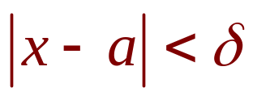


PRECISE DEFINITION OF LIMIT
We can also reformulate Definition 2
in terms of intervals by observing that
the inequality is equivalent to , which in turn can be written
as .

Slide 19
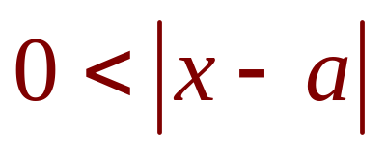
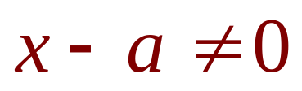
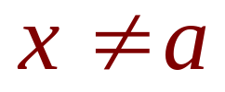
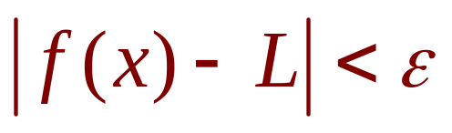
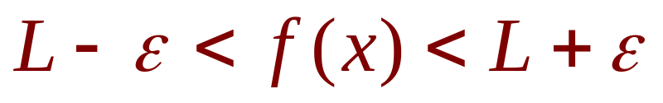
PRECISE DEFINITION OF LIMIT
Also, is true if and only if , that is, .
Similarly, the inequality
is equivalent to the pair of inequalities .

Slide 20
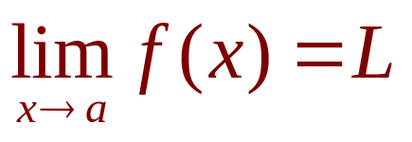
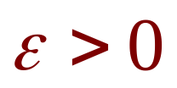

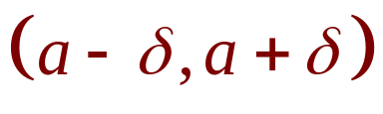

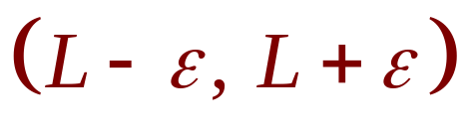
PRECISE DEFINITION OF LIMIT
Therefore, in terms of intervals, Definition 2
can be stated as follows.
means that, for every
(no matter how small is), we can find
such that, if x lies in the open interval
and , then f(x) lies in the open interval .

Slide 21

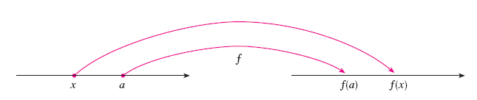
PRECISE DEFINITION OF LIMIT
We interpret this statement geometrically
by representing a function by an arrow
diagram as in the figure, where f maps
a subset of onto another subset of .

Slide 22
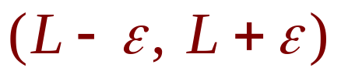
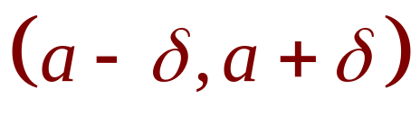
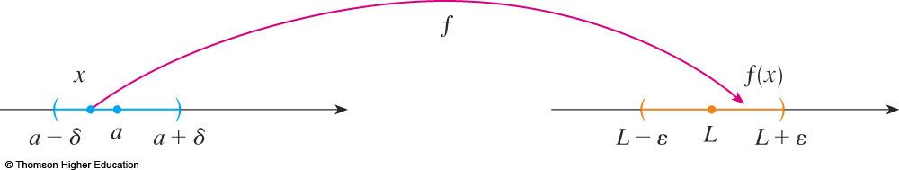
PRECISE DEFINITION OF LIMIT
The definition of limit states that, if any small
interval is given around L, then
we can find an interval around a
such that f maps all the points in
(except possibly a) into the interval .

Slide 23
PRECISE DEFINITION OF LIMIT
Another geometric interpretation
of limits can be given in terms of
the graph of a function.

Slide 24
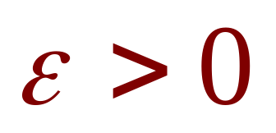
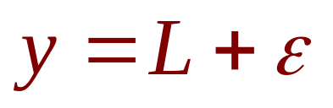
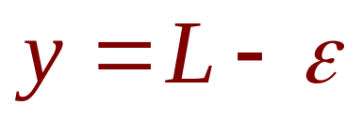
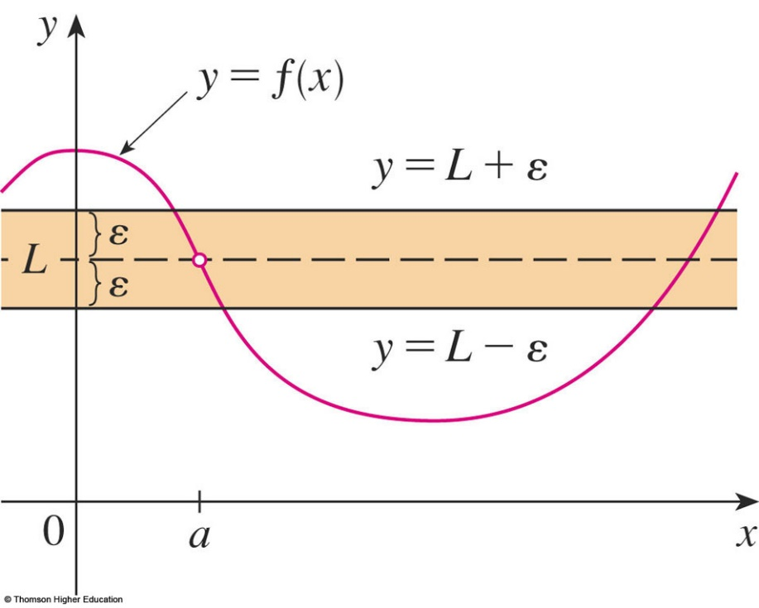
PRECISE DEFINITION OF LIMIT
If is given, then we draw
the horizontal lines and
and the graph of f.

Slide 25
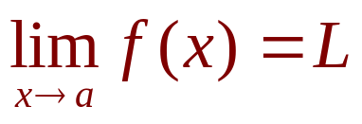

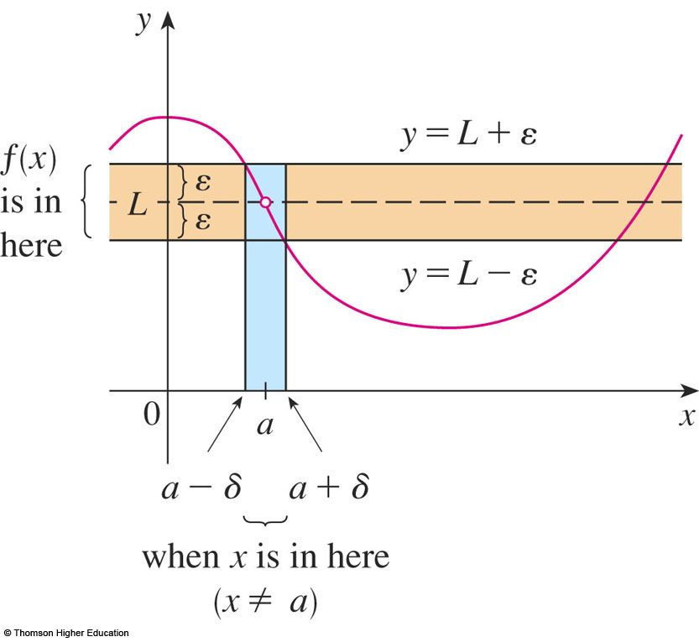
PRECISE DEFINITION OF LIMIT
If , then we can find a number
such that, if we restrict x to lie in the interval
and take , then the curve
y = f(x) lies between
the lines
and .

Slide 26

PRECISE DEFINITION OF LIMIT
You can see that, if such a has been
found, then any smaller will also work.

Slide 27
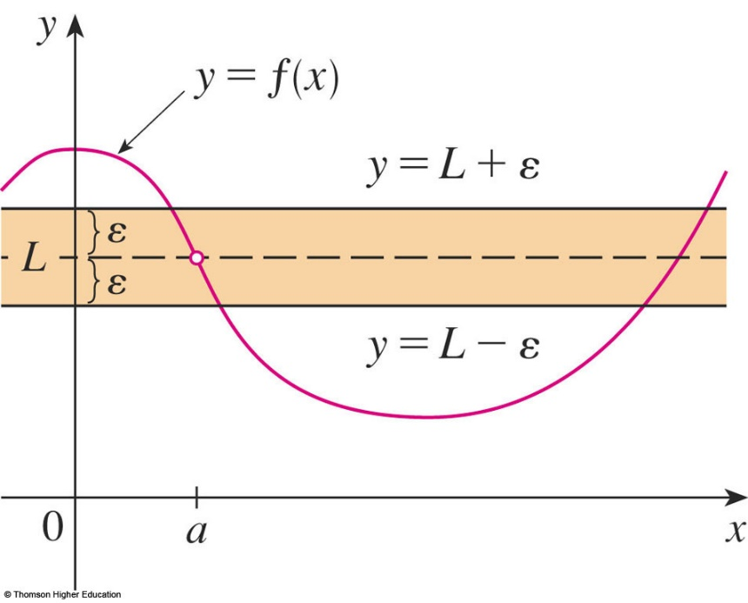

PRECISE DEFINITION OF LIMIT
It is important to realize that the process
illustrated in the figures must work for every
positive number , no matter how small it is
chosen.

Slide 28


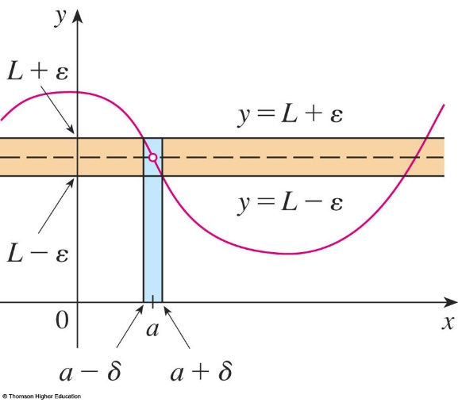
PRECISE DEFINITION OF LIMIT
The third figure shows that, if a
smaller is chosen, then a smaller
may be required.

Slide 29

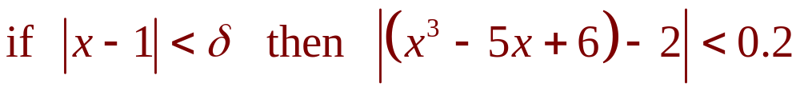


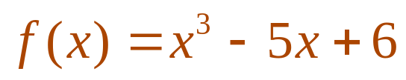
PRECISE DEFINITION OF LIMIT
Example 1
Use a graph to find a number
such that
  In other words, find a number that corresponds
  to in the definition of a limit for the function with a = 1 and L = 2.

Slide 30
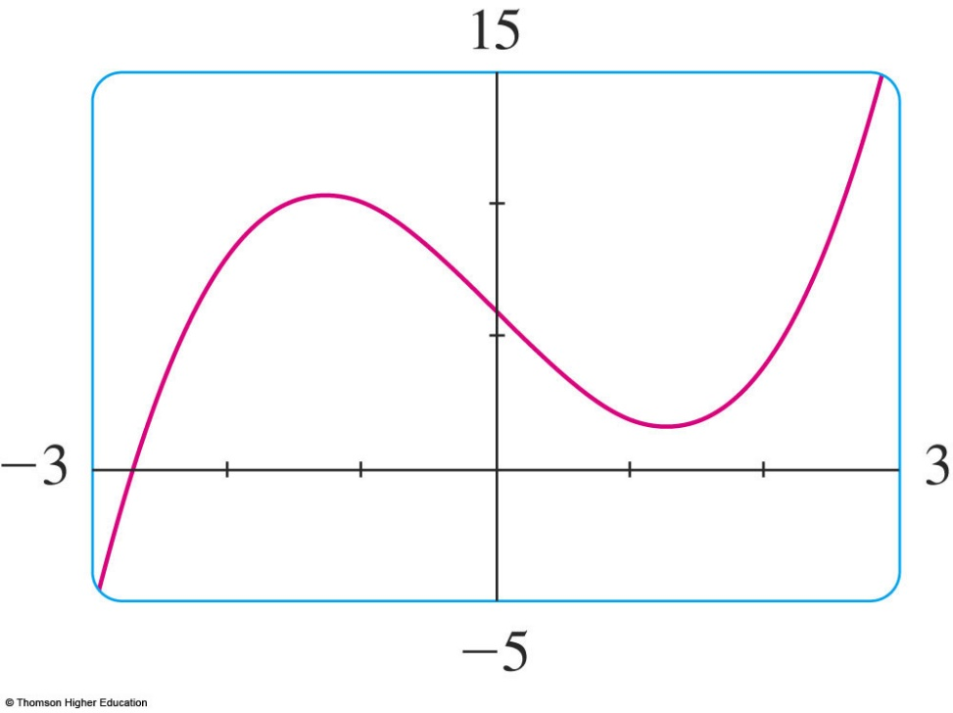
PRECISE DEFINITION OF LIMIT
Example 1
A graph of f is shown.
We are interested in the region near
the point (1, 2).

Slide 31
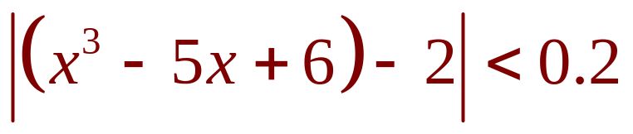
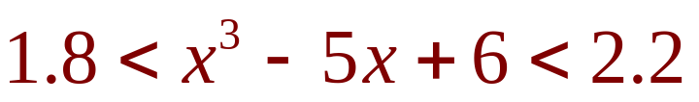
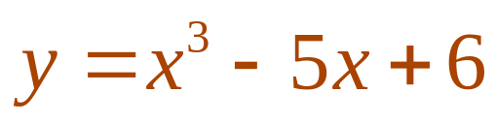
PRECISE DEFINITION OF LIMIT
Example 1
Notice that we can rewrite the inequality
as
  So, we need to determine
  the values of x for which
  the curve
  lies between the
  horizontal lines y = 1.8
  and y = 2.2.

Slide 32
PRECISE DEFINITION OF LIMIT
Example 1
Therefore, we graph the curves ,
y = 1.8, and y = 2.2 near the point (1, 2).
Then, we use the cursor to estimate that
the x-coordinate of the point of intersection
of the line y = 2.2 and the curve
is about 0.911

Slide 33

PRECISE DEFINITION OF LIMIT
Example 1
  Similarly, intersects the line
  y = 1.8 when
  So, rounding to be safe, we can say that

Slide 34
PRECISE DEFINITION OF LIMIT
Example 1
This interval (0.92, 1.12) is not
symmetric about x = 1.
  The distance from x = 1 to the left endpoint is 1 - 0.92
  = 0.08 and the distance to the right endpoint is 0.12

Slide 35
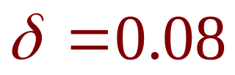


PRECISE DEFINITION OF LIMIT
Example 1
We can choose to be the smaller
of these numbers—that is,
  Then, we can rewrite our inequalities in terms
  of distances:

Slide 36


PRECISE DEFINITION OF LIMIT
Example 1
This just says that, by keeping x
within 0.08 of 1, we are able to keep f(x)
within 0.2 of 2.
  Though we chose ,
  any smaller, positive
  value of would also
  have worked.

Slide 37


PRECISE DEFINITION OF LIMIT
The graphical procedure in the example
gives an illustration of the definition for
However, it does not prove that the limit
is equal to 2.
  A proof has to provide a for every .

Slide 38

PRECISE DEFINITION OF LIMIT
In proving limit statements, it may be
helpful to think of the definition of limit
as a challenge.
  First, it challenges you with a number .
  Then, you must be able to produce a suitable .
  You have to be able to do this for every ,
  not just a particular .

Slide 39


PRECISE DEFINITION OF LIMIT
Imagine a contest between two
people, A and B.
Imagine yourself to be B.
  A stipulates that the fixed number L should be approximated by the values of f(x) to within a degree
  of accuracy (say 0.01).
  Then, B responds by finding a number such that,
  if , then .

Slide 40


PRECISE DEFINITION OF LIMIT
  Then, A may become more exacting and
  challenge B with a smaller value of (say, 0.0001).
  Again, B has to respond by finding a
  corresponding .
  Usually, the smaller the value of , the smaller
  the corresponding value of must be.
  If B always wins, no matter how small A makes , then .

Slide 41

PRECISE DEFINITION OF LIMIT
Example 2
Prove that:

Slide 42


STEP 1: GUESSING THE VALUE
Example 2
The first step is the preliminary
analysis—guessing a value for .
  Let be a given positive number.
  We want to find a number such that
  However,

Slide 43



STEP 1: GUESSING THE VALUE
Example 2
Therefore, we want
That is,
This suggests that we should choose .

Slide 44





STEP 2: PROOF
Example 2
The second step is the proof—
showing that this works.
  Given , choose .
  If , then
  Thus,
  Therefore, by the definition of a limit,

Slide 45

PRECISE DEFINITION OF LIMIT
Example 2
The example is illustrated by
the figure.

Slide 46
PRECISE DEFINITION OF LIMIT
Note that, in the solution of the example,
there were two stages—guessing and
proving.
  We made a preliminary analysis that enabled us
  to guess a value for .
  In the second stage, though, we had to go back and prove in a careful, logical fashion that we had made
  a correct guess.

Slide 47
PRECISE DEFINITION OF LIMIT
This procedure is typical of much
of mathematics.
  Sometimes, it is necessary to first make an intelligent guess about the answer to a problem and then prove that the guess is correct.

Slide 48
PRECISE DEFINITION OF LIMIT
The intuitive definitions of one-sided
limits given in Section 2.2 can be
precisely reformulated as follows.

Slide 49




PRECISE DEFINITION OF LIMIT
Definition 3
Left-hand limit is defined as follows.
if, for every number , there is
a number such that
  Notice that Definition 3 is the same as Definition 2 except that x is restricted to lie in the left half
  of the interval .

Slide 50



PRECISE DEFINITION OF LIMIT
Definition 4
Right-hand limit is defined as follows.
if, for every number , there is
a number such that
  In Definition 4, x is restricted to lie in the right half of the interval .

Slide 51

PRECISE DEFINITION OF LIMIT
Example 3
Use Definition 4
to prove that:

Slide 52





STEP 1: GUESSING THE VALUE
Example 3
Let be a given positive
number.
  Here, a = 0 and L = 0, so we want to find a number such that .
  That is, .
  Squaring both sides of the inequality ,
  we get .
  This suggests that we should choose .

Slide 53





STEP 2: PROOF
Example 3
Given , let .
  If , then .
  So, .
  According to Definition 4, this shows that

Slide 54

PRECISE DEFINITION OF LIMIT
Example 4
Prove that:

Slide 55






STEP 1: GUESSING THE VALUE
Example 4
Let be given.
  We have to find a number such that
  To connect with we write
  Then, we want

Slide 56




STEP 1: GUESSING THE VALUE
Example 4
Notice that, if we can find a positive
constant C such that , then
and we can make by taking .

Slide 57




STEP 1: GUESSING THE VALUE
Example 4
We can find such a number C
if we restrict x to lie in some interval
centered at 3.
  In fact, since we are interested only in values of x
  that are close to 3, it is reasonable to assume that x
  is within a distance 1 from 3, that is, .
  Then, , so .
  Thus, we have , and so C = 7 is a suitable choice for the constant.

Slide 58





STEP 1: GUESSING THE VALUE
Example 4
However, now, there are two restrictions
on , namely
and
  To make sure that both inequalities are satisfied, we take to be the smaller of the two numbers 1 and .
  The notation for this is .

Slide 59





STEP 2: PROOF
Example 4
Given , let .
  If , then
  (as in part l).
  We also have , so
  This shows that .

Slide 60


PRECISE DEFINITION OF LIMIT
As the example shows, it is not always
easy to prove that limit statements are
true using the definition.
  In fact, if we had been given a more complicated function such as
  ,
  a proof would require a great deal of ingenuity.

Slide 61
PRECISE DEFINITION OF LIMIT
Fortunately, this is unnecessary.
  This is because the Limit Laws stated in Section 2.3
  can be proved using Definition 2.
  Then, the limits of complicated functions can be found rigorously from the Limit Laws—without resorting to
  the definition directly.

Slide 62


PRECISE DEFINITION OF LIMIT
For instance, we prove the
Sum Law.
  If and both exist, then

Slide 63

PROOF OF THE SUM LAW
Let be given.
  We must find such that

Slide 64


PROOF OF THE SUM LAW
Definition 5
Using the Triangle Inequality
we can write:

Slide 65











PROOF OF THE SUM LAW
We make less than
by making each of the terms
and less than .
  Since and , there exists a number such that
  Similarly, since , there exists a number
  such that

Slide 66




PROOF OF THE SUM LAW
Let .
  Notice that
  So, and
  Therefore, by Definition 5,

Slide 67

PROOF OF THE SUM LAW
To summarize,
Thus, by the definition of a limit,

Slide 68
INFINITE LIMITS
Infinite limits can also be defined
in a precise way.
  The following is a precise version of Definition 4
  in Section 2.2.

Slide 69


INFINITE LIMITS
Definition 6
Let f be a function defined on some open
interval that contains the number a, except
possibly at a itself.
Then, means that, for every
positive number M, there is a positive
number such that

Slide 70

INFINITE LIMITS
The definition states that the values of f(x)
can be made arbitrarily large (larger than
any given number M) by taking x close
enough to a (within a distance , where
depends on M, but with ).

Slide 71



INFINITE LIMITS
A geometric illustration is shown
in the figure.
  Given any horizontal line y = M, we can find a number such that, if we restrict x to lie in the interval but , then
  the curve y = f(x) lies
  above the line y = M.
  You can see that, if
  a larger M is chosen,
  then a smaller may be
  required.

Slide 72








INFINITE LIMITS
Example 5
Use Definition 6 to prove that
  Let M be a given positive number.
  We want to find a number such that
  However,
  So, if we choose and ,
  then .
  This shows that as .

Slide 73
INFINITE LIMITS
Similarly, the following is
a precise version of Definition 5
in Section 2.2.

Slide 74


INFINITE LIMITS
Definition 7
Let f be a function defined on some open
interval that contains the number a, except
possibly at a itself.
Then, means that, for every
negative number N, there is a positive
number such that

Slide 75

INFINITE LIMITS
This is illustrated by
the figure.

