Slide 1
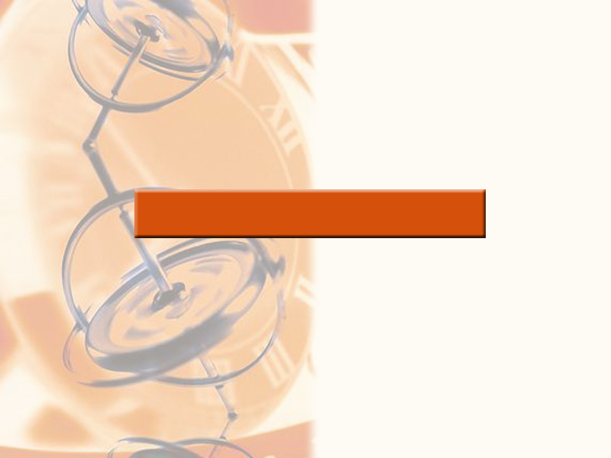
2
LIMITS AND DERIVATIVES

Slide 2
LIMITS AND DERIVATIVES
We noticed in Section 2.3 that the limit
of a function as x approaches a can often
be found simply by calculating the value
of the function at a.
  Functions with this property are called
  ‘continuous at a.’

Slide 3
LIMITS AND DERIVATIVES
2.5
Continuity
In this section, we will:
See that the mathematical definition of continuity
corresponds closely with the meaning of the word
continuity in everyday language.

Slide 4
CONTINUITY
A continuous process is one that
takes place gradually—without
interruption or abrupt change.

Slide 5
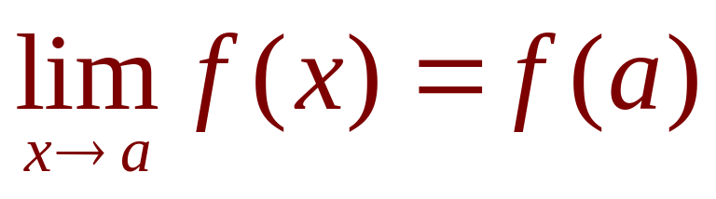
CONTINUITY
1. Definition
A function f is continuous at
a number a if:

Slide 6
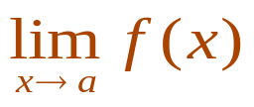
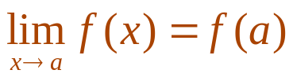
CONTINUITY
Notice that Definition 1
implicitly requires three things
if f is continuous at a:
  f(a) is defined—that is, a is in the domain of f
  exists.
  .

Slide 7
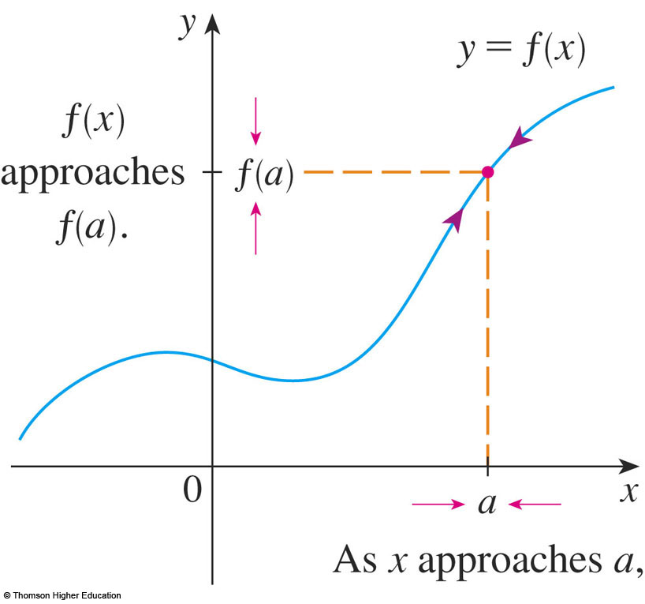
CONTINUITY
The definition states that f is
continuous at a if f(x) approaches f(a)
as x approaches a.
  Thus, a continuous function f
  has the property that a small
  change in x produces only
  a small change in f(x).
  In fact, the change in f(x)
  can be kept as small as we
  please by keeping the
  change in x sufficiently small.

Slide 8
CONTINUITY
If f is defined near a—that is, f is defined on
an open interval containing a, except perhaps
at a—we say that f is discontinuous at a
(or f has a discontinuity at a) if f is not
continuous at a.

Slide 9
CONTINUITY
Physical phenomena are
usually continuous.
  For instance, the displacement or velocity
  of a vehicle varies continuously with time,
  as does a person’s height.

Slide 10
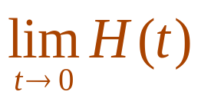
CONTINUITY
However, discontinuities
do occur in such situations as
electric currents.
  See Example 6 in Section 2.2, where the Heaviside function is discontinuous at 0 because
  does not exist.

Slide 11
CONTINUITY
Geometrically, you can think of a function
that is continuous at every number in an
interval as a function whose graph has no
break in it.
  The graph can be drawn without removing
  your pen from the paper.

Slide 12
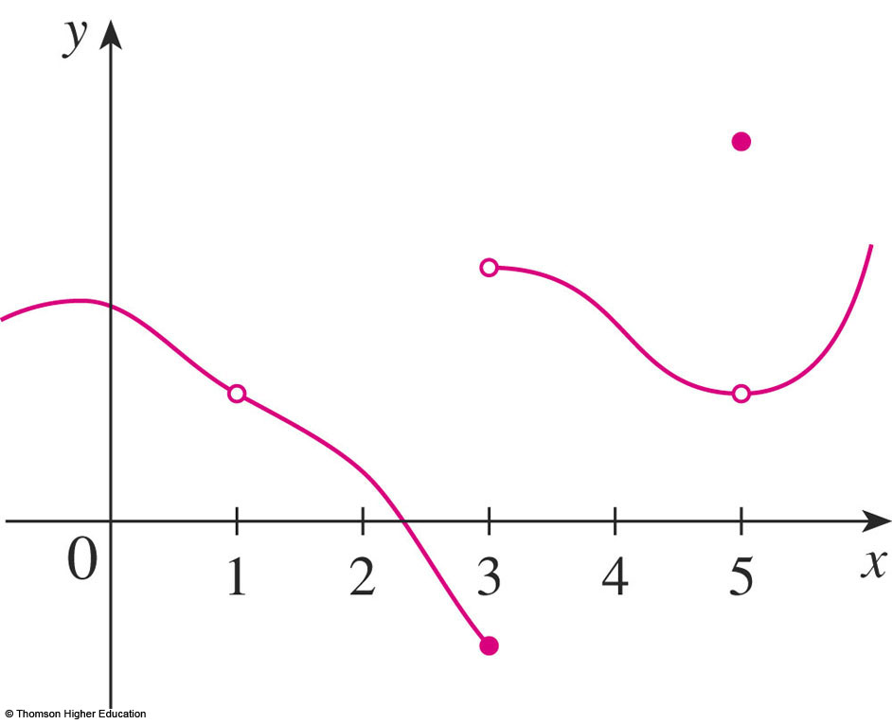
CONTINUITY
Example 1
The figure shows the graph of a
function f.
At which numbers is f discontinuous?
Why?

Slide 13
CONTINUITY
Example 1
It looks as if there is a discontinuity
when a = 1 because the graph has
a break there.
  The official reason that
  f is discontinuous at 1
  is that f(1) is not defined.

Slide 14
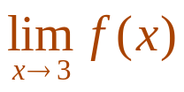
CONTINUITY
Example 1
The graph also has a break when a = 3.
However, the reason for the discontinuity
is different.
  Here, f(3) is defined,
  but does not exist
  (because the left and
  right limits are different).
  So, f is discontinuous
  at 3.

Slide 15
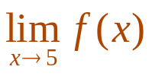
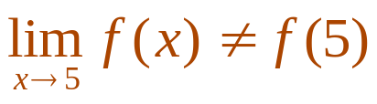
CONTINUITY
Example 1
What about a = 5?
  Here, f(5) is defined and exists (because
  the left and right limits are the same).
  However,
  So, f is discontinuous
  at 5.

Slide 16
CONTINUITY
Now, let’s see how to detect
discontinuities when a function
is defined by a formula.

Slide 17
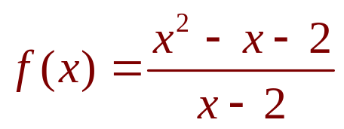
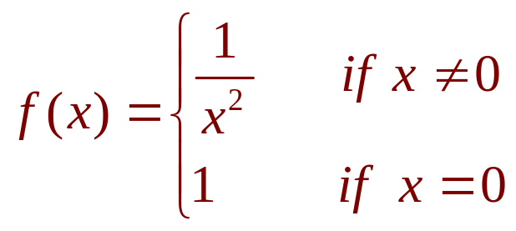
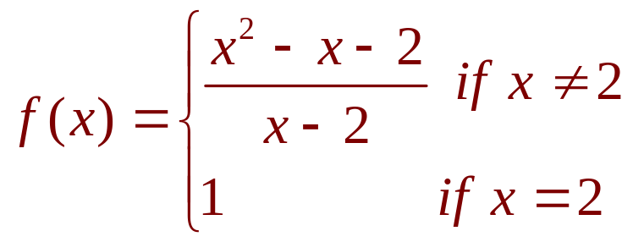
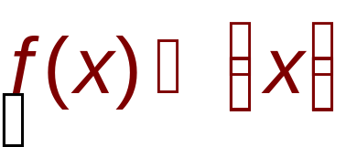
CONTINUITY
Example 2
Where are each of the following functions
discontinuous?
a.
b.
c.
d.

Slide 18
CONTINUITY
Example 2 a
Notice that f(2) is not defined.
So, f is discontinuous at 2.
  Later, we’ll see why f is continuous
  at all other numbers.

Slide 19
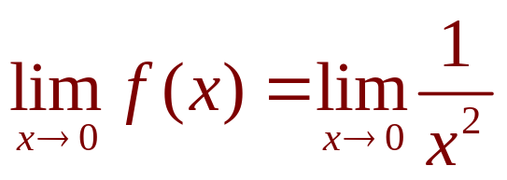
CONTINUITY
Example 2 b
Here, f(0) = 1 is defined.
However, does not exist.
  See Example 8 in Section 2.2.
So, f is discontinuous at 0.

Slide 20
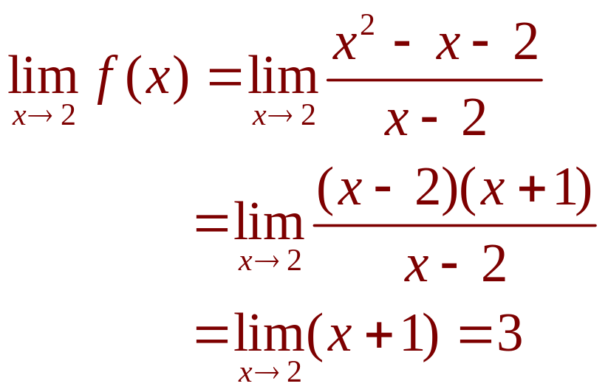
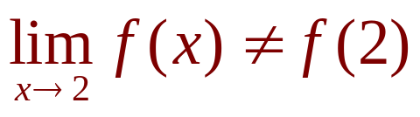
CONTINUITY
Example 2 c
Here, f(2) = 1 is defined and
exists.
However,
So, f is not continuous at 2.

Slide 21
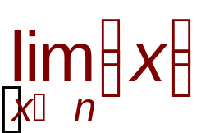
CONTINUITY
Example 2 d
The greatest integer function
has discontinuities at all the integers.
This is because does not exist
if n is an integer.
  See Example 10 in Section 2.3.

Slide 22
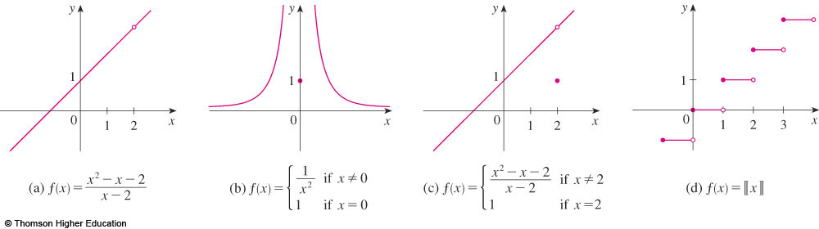
CONTINUITY
The figure shows the graphs of the
functions in Example 2.
  In each case, the graph can’t be drawn without lifting
  the pen from the paper—because a hole or break or jump occurs in the graph.

Slide 23

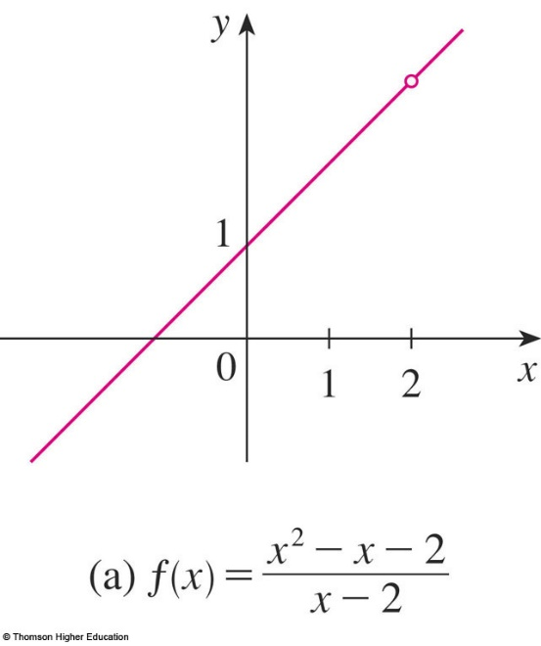
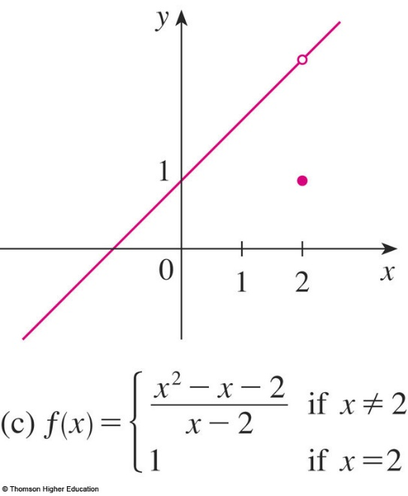
CONTINUITY
The kind of discontinuity illustrated in
parts (a) and (c) is called removable.
  We could remove the discontinuity by redefining f
  at just the single number 2.
  The function is continuous.

Slide 24
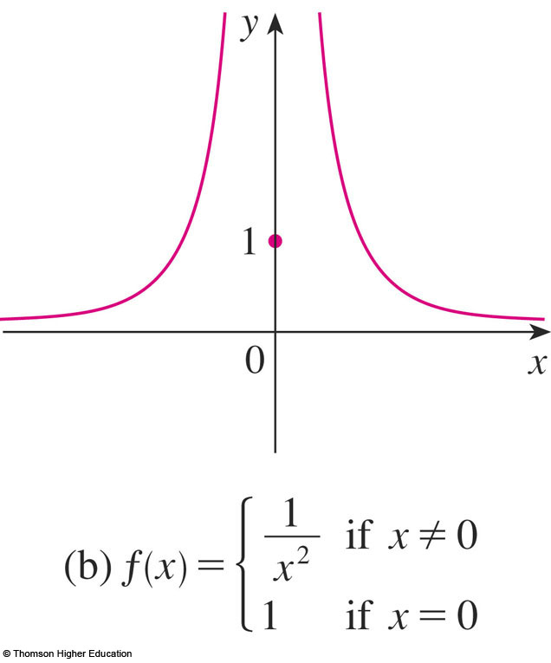
CONTINUITY
The discontinuity in part (b) is called
an infinite discontinuity.

Slide 25
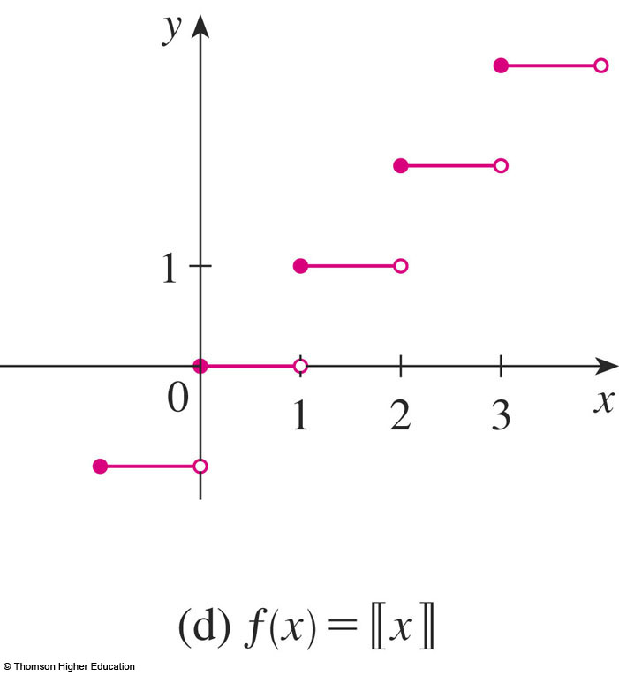
CONTINUITY
The discontinuities in part (d) are
called jump discontinuities.
  The function ‘jumps’ from one value to another.

Slide 26
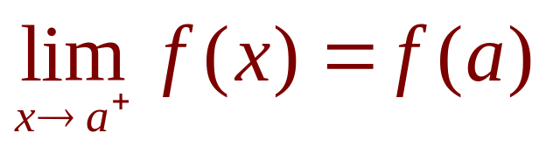
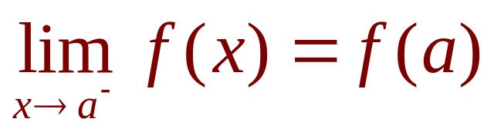
CONTINUITY
2. Definition
A function f is continuous from the right
at a number a if
and f is continuous from the left at a if

Slide 27
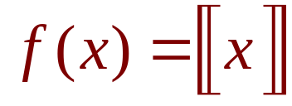
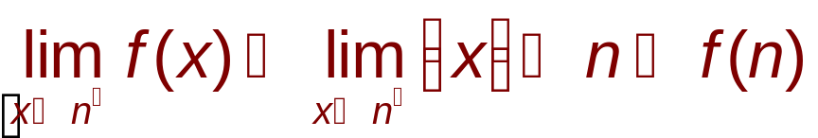
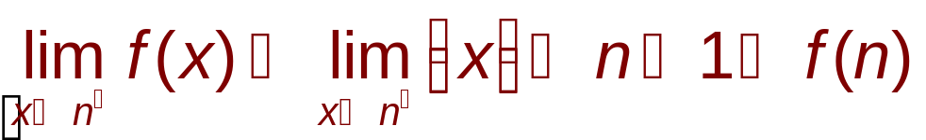
CONTINUITY
Example 3
At each integer n, the function
is continuous from the right but discontinuous
from the left because
but

Slide 28
CONTINUITY
3. Definition
A function f is continuous on an
interval if it is continuous at every
number in the interval.
  If f is defined only on one side of an endpoint of the interval, we understand ‘continuous at the endpoint’
  to mean ‘continuous from the right’ or ‘continuous
  from the left.’

Slide 29
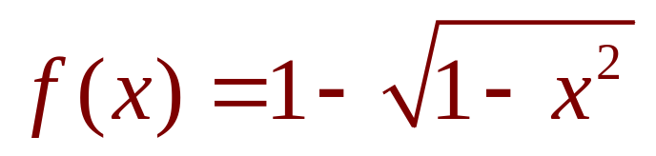
CONTINUITY
Example 4
Show that the function
is continuous on
the interval [-1, 1].

Slide 30
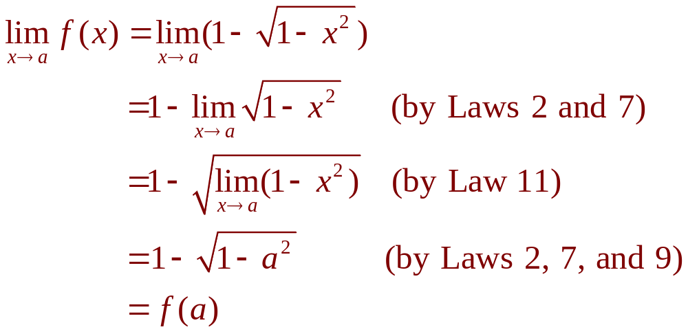
CONTINUITY
Example 4
If -1 < a < 1, then using the Limit Laws,
we have:

Slide 31
CONTINUITY
Example 4
Thus, by Definition 1, f is continuous
at a if -1 < a < 1.
  Similar calculations show that
  So, f is continuous from the right at -1 and continuous from the left at 1.
  Therefore, according to Definition 3, f is continuous
  on [-1, 1].

Slide 32
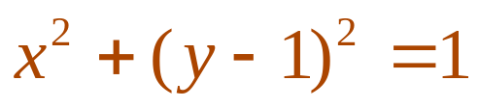
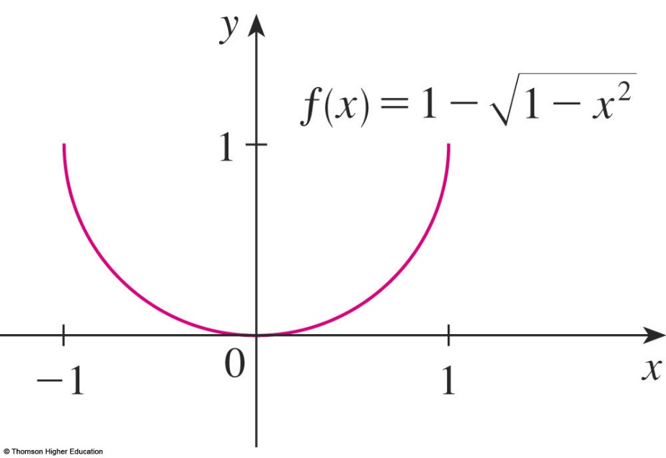
CONTINUITY
Example 4
The graph of f is sketched in
the figure.
  It is the lower half of the circle

Slide 33
CONTINUITY
Instead of always using Definitions 1,
2, and 3 to verify the continuity of
a function, as we did in Example 4,
it is often convenient to use the next
theorem.
  It shows how to build up complicated continuous functions from simple ones.

Slide 34
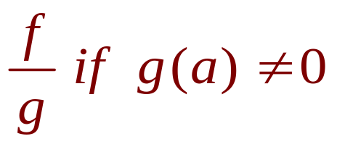
CONTINUITY
4. Theorem
If f and g are continuous at a, and c is
a constant, then the following functions
are also continuous at a:
1. f + g
2. f - g
3. cf
4. fg
5.

Slide 35
CONTINUITY
Each of the five parts of the theorem
follows from the corresponding Limit Law
in Section 2.3.
  For instance, we give the proof of part 1.

Slide 36
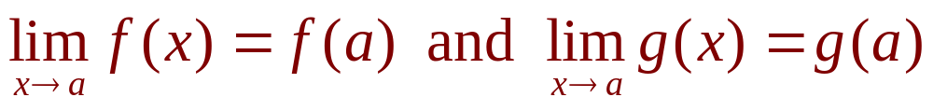
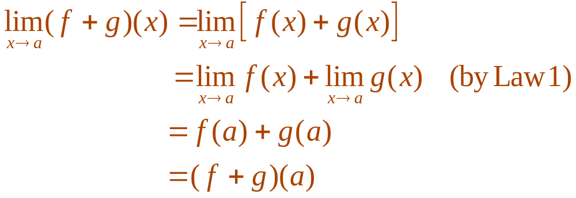
CONTINUITY
Proof
Since f and g are continuous at a,
we have:
  Therefore,
  This shows that f + g is continuous at a.

Slide 37
CONTINUITY
It follows from Theorem 4 and
Definition 3 that, if f and g are continuous
on an interval, then so are the functions
f + g, f - g, cf, fg, and (if g is never 0) f/g.

Slide 38
CONTINUITY
The following theorem was
stated in Section 2.3 as
the Direct Substitution Property.

Slide 39

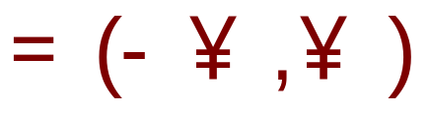
CONTINUITY
5. Theorem
Any polynomial is continuous everywhere—that is, it is continuous on
Any rational function is continuous wherever it is defined—that is, it is continuous on its domain.

Slide 40
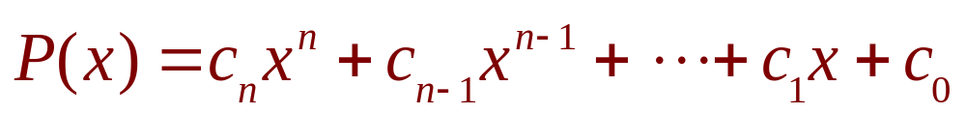
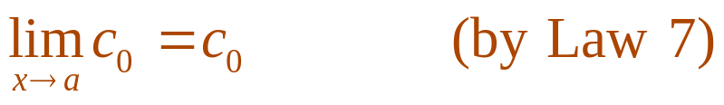
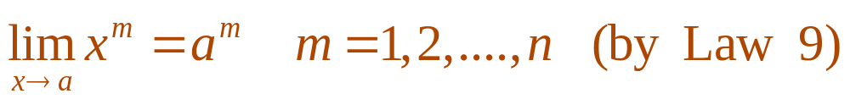
CONTINUITY
Proof a
A polynomial is a function of the form
where c₀, c₁, c₂…., c_{n} are constants.
  We know that
  and
  This equation is precisely the statement that
  the function f(x) = x^{m} is a continuous function.

Slide 41
CONTINUITY
Proof a
  Thus, by part 3 of Theorem 4, the function g(x) = cx^{m} is continuous.
  Since P is a sum of functions of this form and a constant function, it follows from part 1 of Theorem 4 that P is continuous.

Slide 42
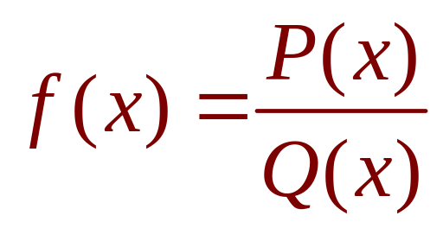

CONTINUITY
Proof b
A rational function is a function of
the form
where P and Q are polynomials.
  The domain of f is
  We know from Proof (a) that P and Q are continuous everywhere.
  Thus, by part 5 of Theorem 4, f is continuous at every number in D.

Slide 43
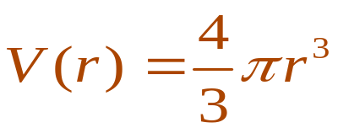
CONTINUITY
As an illustration of Theorem 5,
observe that the volume of a sphere
varies continuously with its radius.
  This is because the formula
  shows that V is a polynomial function of r.

Slide 44
CONTINUITY
Similarly, if a ball is thrown vertically into
the air with a velocity of 50 ft/s, then the
height of the ball in feet t seconds later is
given by the formula h = 50t - 16t².
  Again, this is a polynomial function.
  So, the height is a continuous function
  of the elapsed time.

Slide 45
CONTINUITY
Knowledge of which functions are
continuous enables us to evaluate some
limits very quickly—as the following
example shows.
  Compare it with Example 2(b) in Section 2.3.

Slide 46
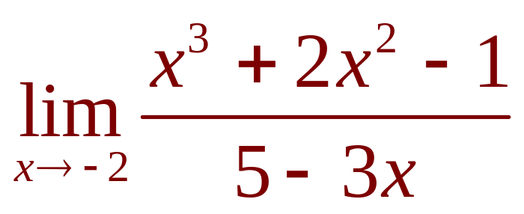
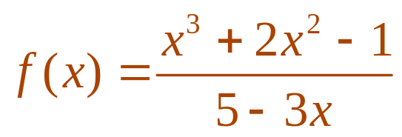
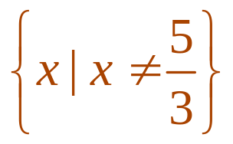
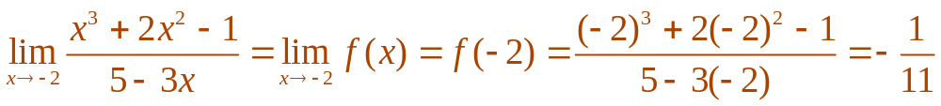
CONTINUITY
Example 5
Find
  The function is rational.
  So, by Theorem 5, it is continuous on its domain,
  which is:
  Therefore,

Slide 47
CONTINUITY
It turns out that most of the familiar
functions are continuous at every
number in their domains.
  For instance, Limit Law 10 is exactly the statement
  that root functions are continuous.

Slide 48
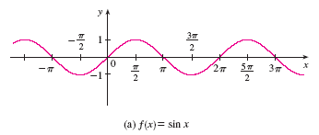
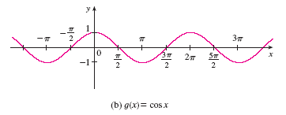
CONTINUITY
From the appearance of the graphs
of the sine and cosine functions, we
would certainly guess that they are
continuous.

Slide 49
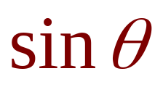

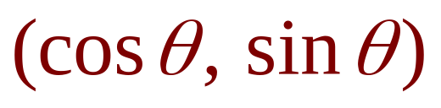



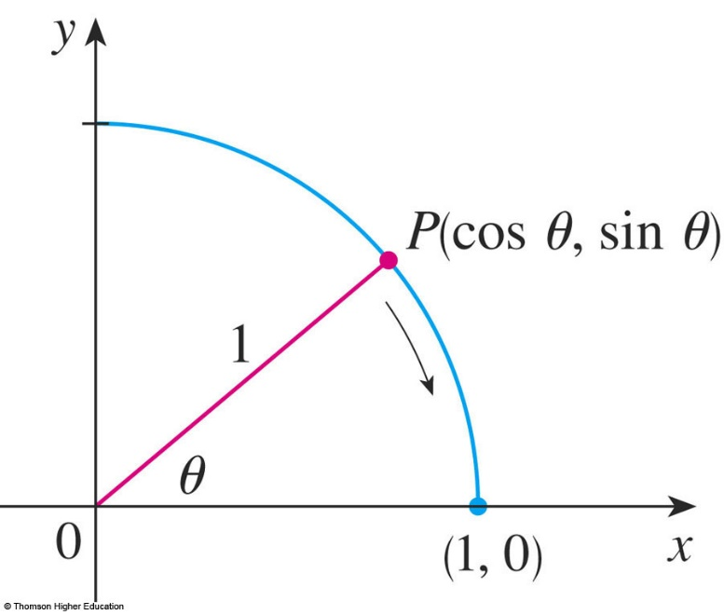

CONTINUITY
6. Definition
We know from the definitions of
and that the coordinates of the
point P in the figure are .
  As , we see that P approaches the point (1, 0) and so and .
  Thus,

Slide 50


CONTINUITY
Since and , the
equations in Definition 6 assert that
the cosine and sine functions are
continuous at 0.
  The addition formulas for cosine and sine can then
  be used to deduce that these functions are continuous everywhere.

Slide 51

CONTINUITY
It follows from part 5 of Theorem 4
that is continuous
except where cos x = 0.

Slide 52



CONTINUITY
This happens when x is an odd integer
multiple of .
So, y = tan x has infinite discontinuities
when
and so on.

Slide 53
CONTINUITY
The inverse function of any
continuous one-to-one function is
also continuous.
  Our geometric intuition makes it seem plausible.
  The graph of f⁻¹ is obtained by reflecting the graph
  of f about the line y = x.
  So, if the graph of f has no break in it, neither does
  the graph of f⁻¹.
  Thus, the inverse trigonometric functions are continuous.

Slide 54


CONTINUITY
In Section 1.5, we defined the
exponential function y = a^{x} so as to fill in
the holes in the graph of y = a^{x} where
x is rational.
  In other words, the very definition of y = a^{x} makes it
  a continuous function on .
  Therefore, its inverse function is continuous on .

Slide 55
CONTINUITY
7. Theorem
The following types of functions
are continuous at every number
in their domains:
  Polynomials
  Rational functions
  Root functions
  Trigonometric functions
  Inverse trigonometric functions
  Exponential functions
  Logarithmic functions

Slide 56


CONTINUITY
Example 6
Where is the function
continuous?
  We know from Theorem 7 that the function y = ln x
  is continuous for x > 0 and y = tan⁻¹x is continuous on .
  Thus, by part 1 of Theorem 4, y = ln x + tan⁻¹x
  is continuous on .
  The denominator, y = x² - 1, is a polynomial—so, it is continuous everywhere.

Slide 57

CONTINUITY
Example 6
  Therefore, by part 5 of Theorem 4,
  f is continuous at all positive numbers x except where x² - 1 = 0.
  So, f is continuous on the intervals
  (0, 1) and .

Slide 58


CONTINUITY
Example 7
Evaluate
  Theorem 7 gives us that y = sin x is continuous.
  The function in the denominator, y = 2 + cos x,
  is the sum of two continuous functions and is therefore continuous.
  Notice that this function is never 0 because for all x and so 2 + cos x > 0 everywhere.

Slide 59


CONTINUITY
Example 7
  Thus, the ratio is continuous everywhere.
  Hence, by the definition of a continuous function,

Slide 60

CONTINUITY
Another way of combining
continuous functions f and g to get
a new continuous function is to form
the composite function
  This fact is a consequence
  of the following theorem.

Slide 61



CONTINUITY
8. Theorem
If f is continuous at b and ,
then
In other words,
  Intuitively, Theorem 8 is reasonable.
  If x is close to a, then g(x) is close to b; and, since f
  is continuous at b, if g(x) is close to b, then f(g(x))
  is close to f(b).

Slide 62


CONTINUITY
Example 8
Evaluate
  As arcsin is a continuous function, we can apply Theorem 8:

Slide 63




CONTINUITY
Let’s now apply Theorem 8 in the special
case where , with n being
a positive integer.
  Then, and
  If we put these expressions into Theorem 8,
  we get:
  So, Limit Law 11 has now been proved. (We assume that the roots exist.)

Slide 64

CONTINUITY
9. Theorem
If g is continuous at a and f is continuous
at g(a), then the composite function
given by is continuous
at a.
  This theorem is often expressed informally by saying
  “a continuous function of a continuous function is
  a continuous function.”

Slide 65



CONTINUITY
Proof
Since g is continuous at a,
we have
  Since f is continuous at b = g(a), we can apply
  Theorem 8 to obtain
  This is precisely the statement that the function
  h(x) = f(g(x)) is continuous at a—that is,
  is continuous at a.

Slide 66


CONTINUITY
Example 9
Where are the following functions
continuous?
a.
b.

Slide 67



CONTINUITY
Example 9 a
We have h(x) = f(g(x)), where
and
  Now, g is continuous on since it is a polynomial,
  and f is also continuous everywhere.
  Thus, is continuous on by Theorem 9.

Slide 68
CONTINUITY
Example 9 b
We know from Theorem 7 that f(x) = ln x
is continuous and g(x) = 1 + cos x is
continuous (because both y = 1 and
y = cos x are continuous).
  Therefore, by Theorem 9, F(x) = f(g(x)) is continuous wherever it is defined.

Slide 69



CONTINUITY
Example 9 b
  Now, ln(1 + cos x) is defined when 1 + cos x > 0.
  So, it is undefined when cos x = -1.
  This happens when
  Thus, F has discontinuities when x is an odd multiple of and is continuous on the intervals between these values.

Slide 70
CONTINUITY
An important property of
continuous functions is expressed
by the following theorem.
  Its proof is found in more advanced books on calculus.

Slide 71

INTERMEDIATE VALUE THEOREM
Suppose that f is continuous on the closed
interval [a, b] and let N be any number
between f(a) and f(b), where .
Then, there exists a number c in (a, b)
such that f(c) = N.

Slide 72
INTERMEDIATE VALUE THEOREM
The theorem states that a continuous
function takes on every intermediate
value between the function values f(a)
and f(b).

Slide 73

INTERMEDIATE VALUE THEOREM
The theorem is illustrated by
the figure.
  Note that the value N can be taken on once [as in (a)]
  or more than once [as in (b)].

Slide 74
INTERMEDIATE VALUE THEOREM
If we think of a continuous function as
a function whose graph has no hole or
break, then it is easy to believe that the
theorem is true.

Slide 75

INTERMEDIATE VALUE THEOREM
In geometric terms, it states that, if any
horizontal line y = N is given between
y = f(a) and f(b) as in the figure, then
the graph of f can’t jump over the line.
  It must intersect y = N
  somewhere.

Slide 76
INTERMEDIATE VALUE THEOREM
It is important that the function in
the theorem be continuous.
  The theorem is not true in general for
  discontinuous functions.

Slide 77
INTERMEDIATE VALUE THEOREM
One use of the theorem is in
locating roots of equations—as in
the following example.

Slide 78




INTERMEDIATE VALUE THEOREM
Example 10
Show that there is a root of the equation
between 1 and 2.
  Let .
  We are looking for a solution of the given equation—
  that is, a number c between 1 and 2 such that f(c) = 0.
  Therefore, we take a = 1, b = 2, and N = 0 in
  the theorem.
  We have
  and

Slide 79

INTERMEDIATE VALUE THEOREM
Example 10
  Thus, f(1) < 0 < f(2)—that is, N = 0 is a number between f(1) and f(2).
  Now, f is continuous since it is a polynomial.
  So, the theorem states that there is a number c between 1 and 2 such that f(c) = 0.
  In other words, the equation
  has at least one root in the interval (1, 2).

Slide 80
INTERMEDIATE VALUE THEOREM
Example 10
  In fact, we can locate a root more precisely by using the theorem again.
  Since
  a root must lie between 1.2 and 1.3.
  A calculator gives, by trial and error,
  So, a root lies in the interval (1.22, 1.23).

Slide 81
INTERMEDIATE VALUE THEOREM
We can use a graphing calculator
or computer to illustrate the use
of the theorem in Example 10.

Slide 82

INTERMEDIATE VALUE THEOREM
The figure shows the graph of f in
the viewing rectangle [-1, 3] by [-3, 3].
  You can see that the graph crosses the x-axis
  between 1 and 2.

Slide 83

INTERMEDIATE VALUE THEOREM
The figure shows the result of zooming
in to the viewing rectangle [1.2, 1.3]
by [-0.2, 0.2].

Slide 84
INTERMEDIATE VALUE THEOREM
In fact, the theorem plays a role in the
very way these graphing devices work.
  A computer calculates a finite number of points
  on the graph and turns on the pixels that contain
  these calculated points.
  It assumes that the function is continuous and takes
  on all the intermediate values between two consecutive points.
  The computer therefore connects the pixels by turning on the intermediate pixels.

