Slide 1

2
LIMITS AND DERIVATIVES

Slide 2
LIMITS AND DERIVATIVES
The problem of finding the tangent line
to a curve and the problem of finding
the velocity of an object both involve finding
the same type of limit—as we saw in
Section 2.1.
  This special type of limit is called a derivative.

Slide 3
LIMITS AND DERIVATIVES
2.7
Derivatives and Rates
of Change
In this section, we will see that:
the derivative can be interpreted as a rate
of change in any of the sciences or engineering.

Slide 4

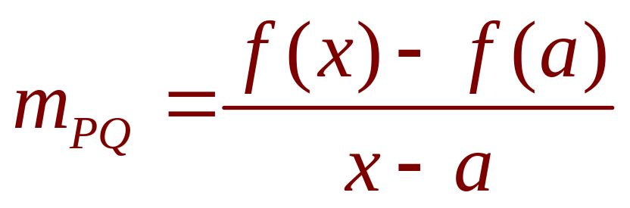
TANGENTS
If a curve C has equation y = f(x) and we want
to find the tangent line to C at the point
P(a,f(a)), then we consider a nearby point
Q(x,f(x)), where , and compute the slope
of the secant line PQ:

Slide 5
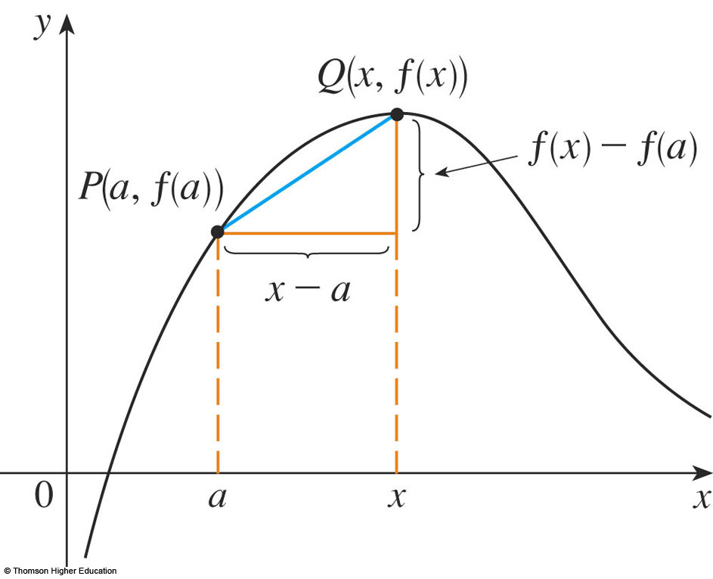
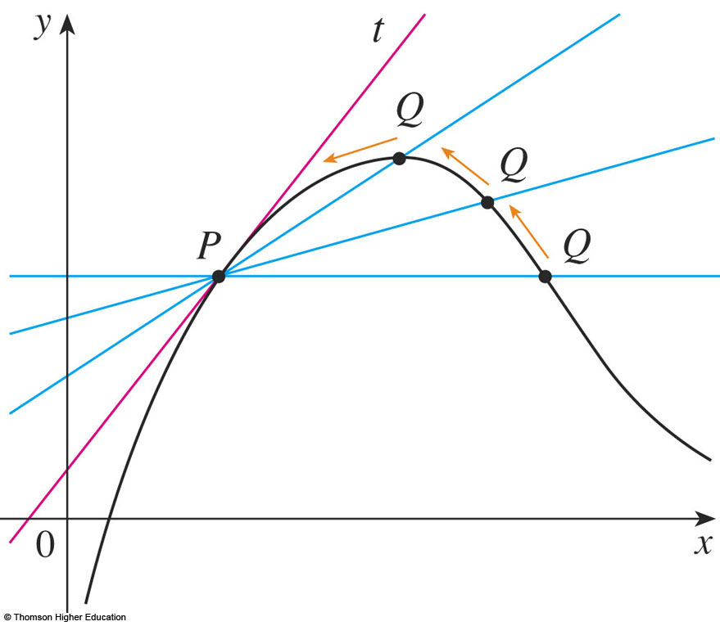
TANGENTS
Then, we let Q approach P along
the curve C by letting x approach a.
  If m_{PQ} approaches a number m, then we define the tangent t to be the line through P with slope m.
  This m amounts to saying that the tangent line is
  the limiting position of the secant line PQ as Q approaches P.

Slide 6
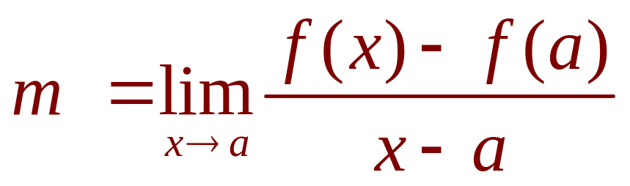
TANGENTS
1. Definition
The tangent line to the curve y = f(x) at the
point P(a,f(a)) is the line through P with slope
provided that this limit exists.

Slide 7
TANGENTS
In our first example, we confirm
the guess we made in Example 1
in Section 2.1.

Slide 8
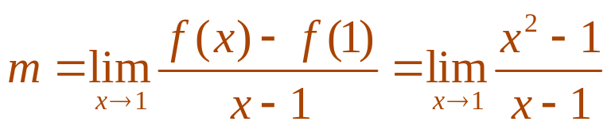
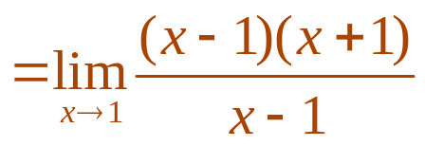
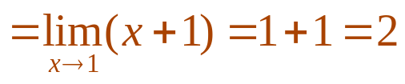
TANGENTS
Example 1
Find an equation of the tangent line to
the parabola y = x² at the point P(1, 1).
  Here, we have a = 1 and f(x) = x².
  So, the slope is:

Slide 9
TANGENTS
Example 1
Using the point-slope form of the
equation of a line, we find that an
equation of the tangent line at (1, 1) is:
y - 1 = 2(x - 1) or y = 2x - 1

Slide 10
TANGENTS
We sometimes refer to the slope of the
tangent line to a curve at a point as the
slope of the curve at the point.
  The idea is that, if we zoom in far enough toward the point, the curve looks almost like a straight line.

Slide 11
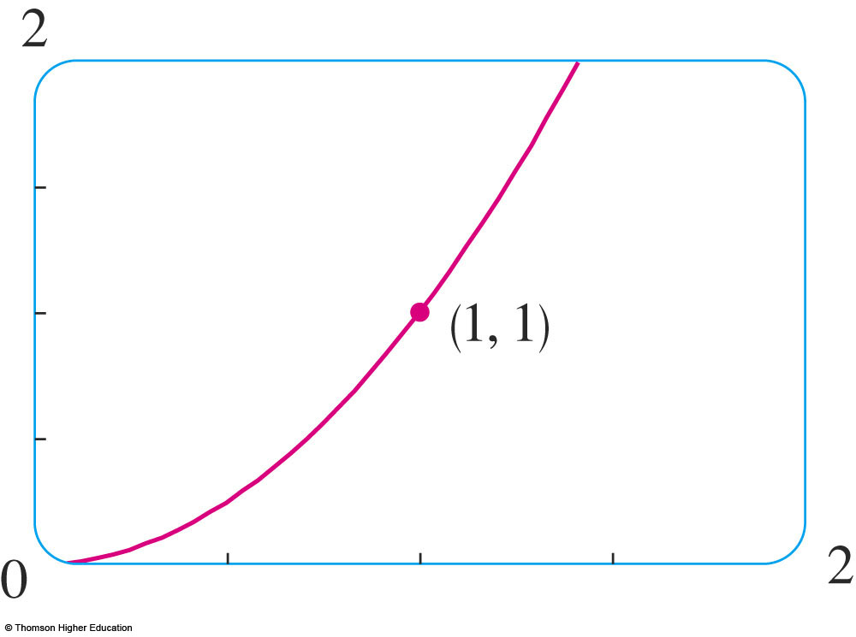
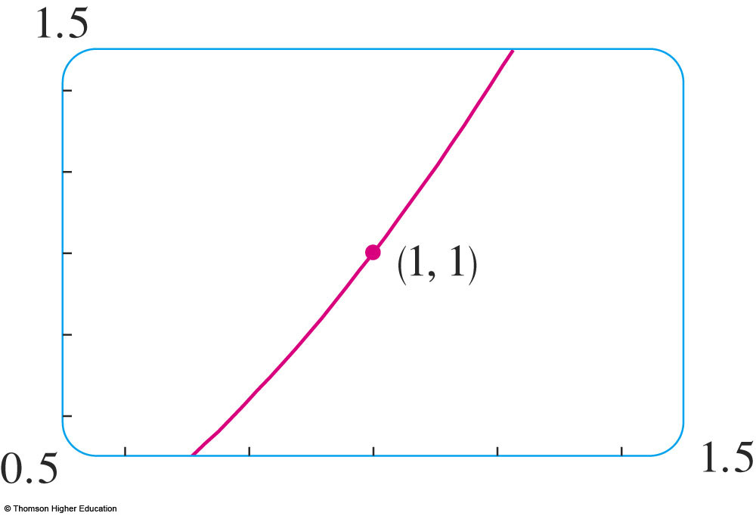
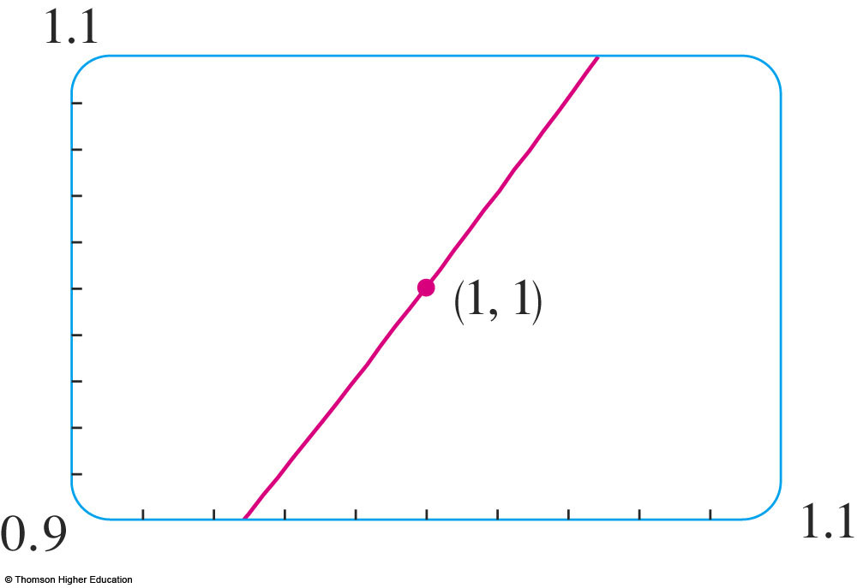
TANGENTS
The figures illustrate this
procedure for the curve
y = x² in Example 1.
  The more we zoom in, the more the parabola looks like a line.
  In other words, the curve becomes almost indistinguishable from its tangent line.

Slide 12
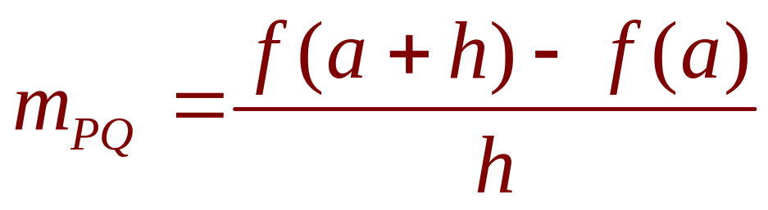
TANGENTS
There is another expression for the slope of a
tangent line that is sometimes easier to use.
If h = x - a, then x = a + h and so the slope
of the secant line PQ is:

Slide 13
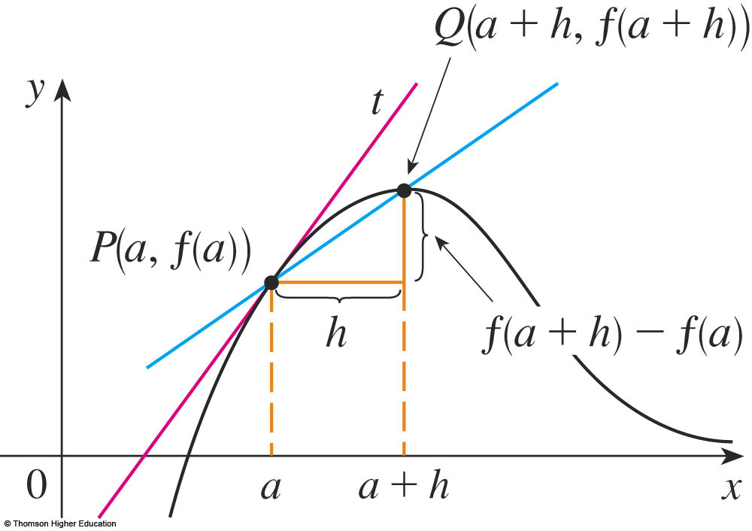
TANGENTS
In the figure, the case h > 0 is illustrated
and Q is to the right of P.
  If it happened that h < 0, Q would be to the left of P.

Slide 14
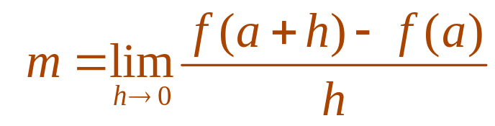
TANGENTS
2. Definition
Notice that, as x approaches a,
h approaches 0 (because h = x - a).
  So, the expression for the slope of the tangent line in Definition 1 becomes:

Slide 15
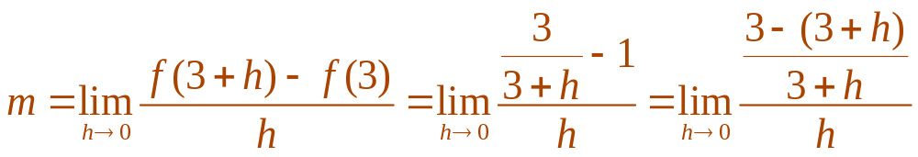
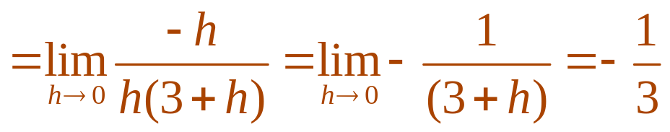
TANGENTS
Example 2
Find an equation of the tangent line to
the hyperbola y = 3/x at the point (3, 1).
  Let f(x) = 3/x
  Then, the slope of the tangent at (3, 1) is:

Slide 16
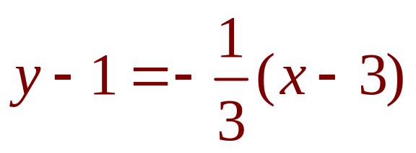
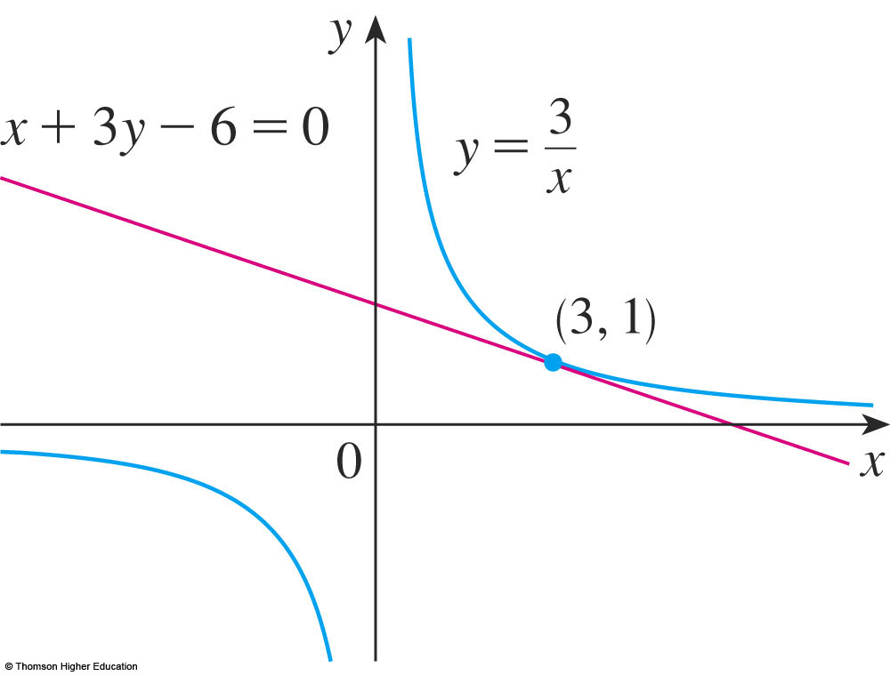
TANGENTS
Example 2
Therefore, an equation of the tangent at the
point (3, 1) is
This simplifies to x + 3y – 6 = 0
  The hyperbola and its tangent are shown in the figure.

Slide 17

VELOCITIES
In Section 2.1, we investigated the motion
of a ball dropped from the CN Tower and
defined its velocity to be the limiting value
of average velocities over
shorter and shorter time
periods.

Slide 18
VELOCITIES
In general, suppose an object moves
along a straight line according to an
equation of motion s = f(t)
  S is the displacement (directed distance) of the object from the origin at time t.
  The function f that describes the motion is called
  the position function of the object.

Slide 19
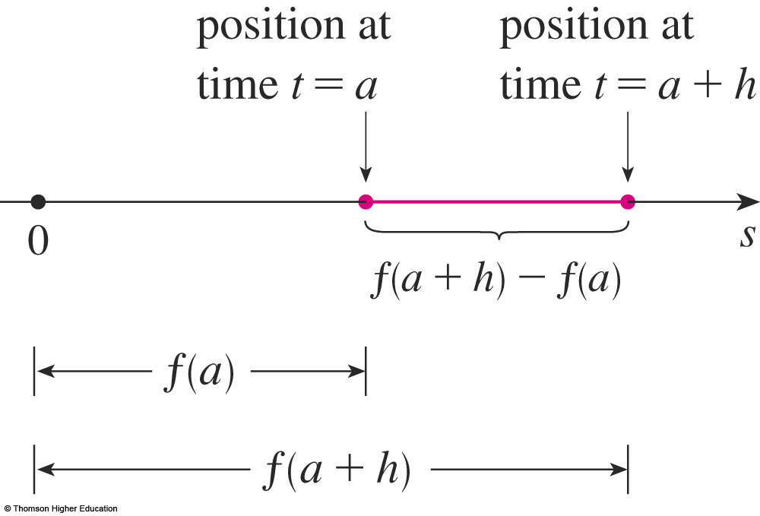
VELOCITIES
In the time interval from t = a to t = a + h,
the change in position is f(a + h) - f(a)

Slide 20
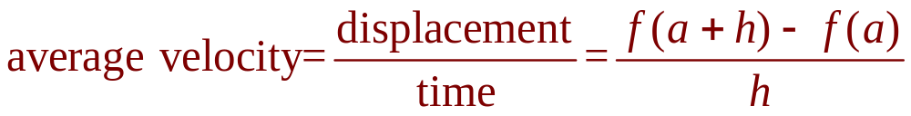
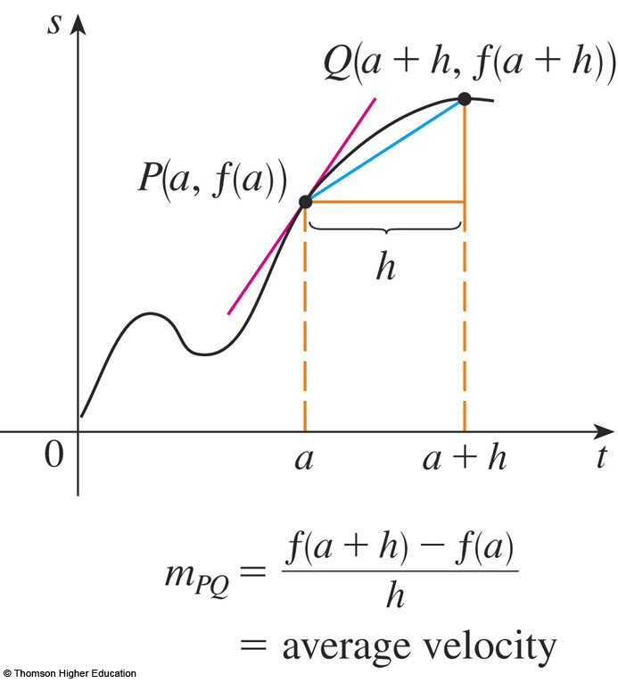
VELOCITIES
The average velocity over this time interval is
  This is the same as the slope of the secant line PQ
  in the second figure.

Slide 21
VELOCITIES
Now, suppose we compute the
average velocities over shorter and
shorter time intervals [a, a + h].
  In other words, we let h approach 0.

Slide 22
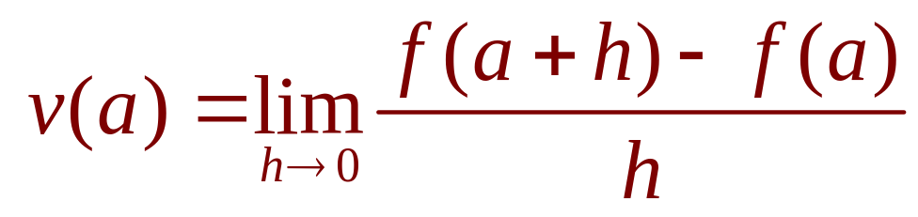
VELOCITIES
3. Definition
As in the example of the falling ball, we
define the velocity (or instantaneous velocity)
v(a) at time t = a to be the limit of these
average velocities:
  This means that the velocity at time t = a is equal to
  the slope of the tangent line at P.
  Compare Equations 2 and 3.

Slide 23
VELOCITIES
Now that we know how to compute
limits, let’s reconsider the problem
of the falling ball.

Slide 24
VELOCITIES
Example 3
Suppose that a ball is dropped from the
upper observation deck of the CN Tower,
450 m above the ground.
What is the velocity of
the ball after 5 seconds?
How fast is the ball
traveling when it hits
the ground?

Slide 25
VELOCITIES
Example 3
We will need to find the velocity both
when t = 5 and when the ball hits the
ground.
  So, it’s efficient to start by finding the velocity at
  a general time t = a

Slide 26
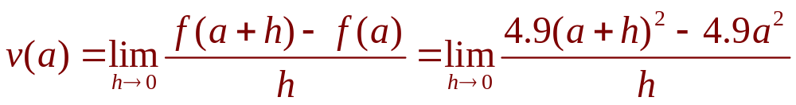
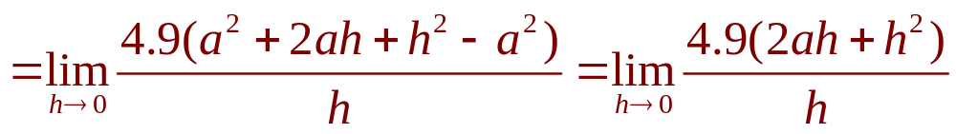
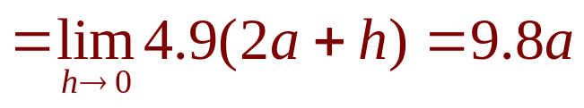
VELOCITIES
Example 3
Using the equation of motion s = f(t) = 4.9t²,
we have:

Slide 27
VELOCITIES
Example 3 a
The velocity after 5 s is:
v(5) = (9.8)(5) = 49 m/s

Slide 28
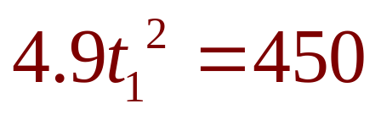
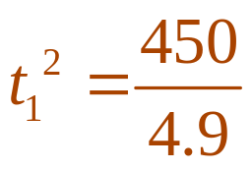
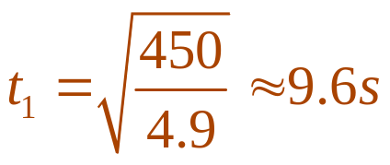
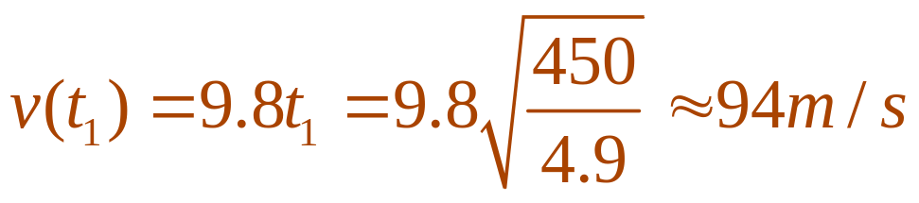
VELOCITIES
Example 3 b
Since the observation deck is 450 m above
the ground, the ball will hit the ground at the
time t₁ when s(t₁) = 450, that is,
  This gives and
  The velocity of the ball as it hits the ground is:

Slide 29
DERIVATIVES
We have seen that the same type of limit
arises in finding the slope of a tangent
line (Equation 2) or the velocity of an
object (Equation 3).

Slide 30
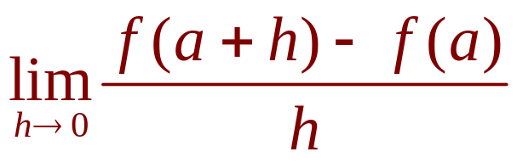
DERIVATIVES
In fact, limits of the form
arise whenever we calculate a rate of change
in any of the sciences or engineering—
such as a rate of reaction in chemistry or
a marginal cost in economics.
  Since this type of limit occurs so widely, it is given a special name and notation.

Slide 31
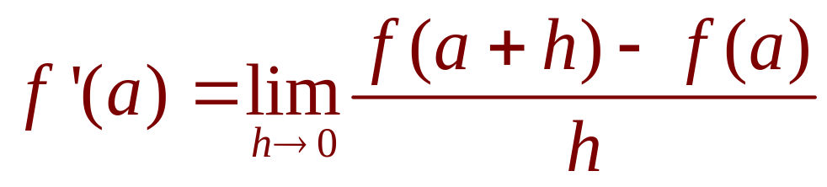
DERIVATIVES
4. Definition
The derivative of a function f at a number a,
denoted by f’(a), is:
if this limit exists.

Slide 32
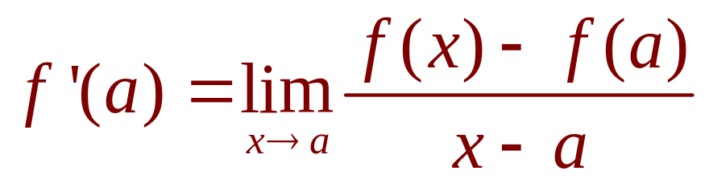
DERIVATIVES
5. Definition
If we write x = a + h, then we have h = x – a
and h approaches 0 if and only if x
approaches a.
Therefore, an equivalent way of stating the
definition of the derivative—as we saw in
finding tangent lines—is:

Slide 33
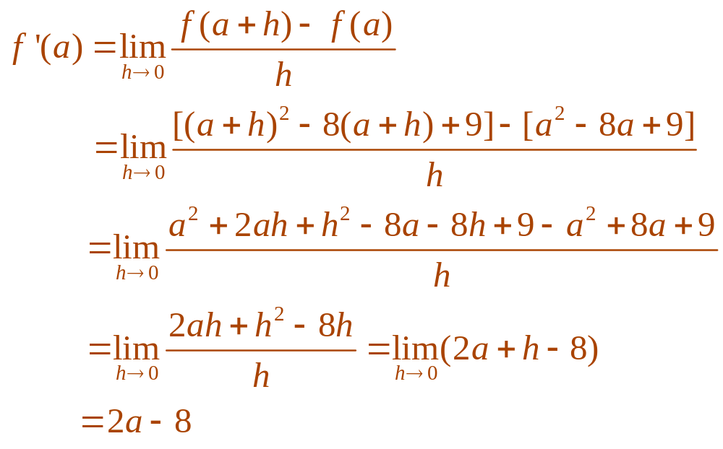
DERIVATIVES
Example 4
Find the derivative of the function
f(x) = x² - 8x + 9 at the number a.
  From Definition 4, we have:

Slide 34
DERIVATIVES
We defined the tangent line to the curve
y = f(x) at the point P(a,f(a)) to be the line that
passes through P and has slope m given by
Equation 1 or 2.
Since, by Definition 4, this is the same as the
derivative f’(a), we can now say the following.
  The tangent line to y = f(x) at (a,f(a)) is the line
  through (a,f(a)) whose slope is equal to f’(a),
  the derivative of f at a.

Slide 35
DERIVATIVES
If we use the point-slope form of the equation
of a line, we can write an equation of the
tangent line to the curve y = f(x) at the point
(a,f(a)):
y - f(a) = f’(a)(x - a)

Slide 36
DERIVATIVES
Example 5
Find an equation of the tangent line
to the parabola y = x² - 8x + 9 at
the point (3, -6).
  From Example 4, we know that the derivative
  of f(x) = x² - 8x + 9 at the number a is f’(a) = 2a - 8
  Therefore, the slope of the tangent line at (3, -6) is
  f’(3) = 2(3) – 8 = -2.

Slide 37
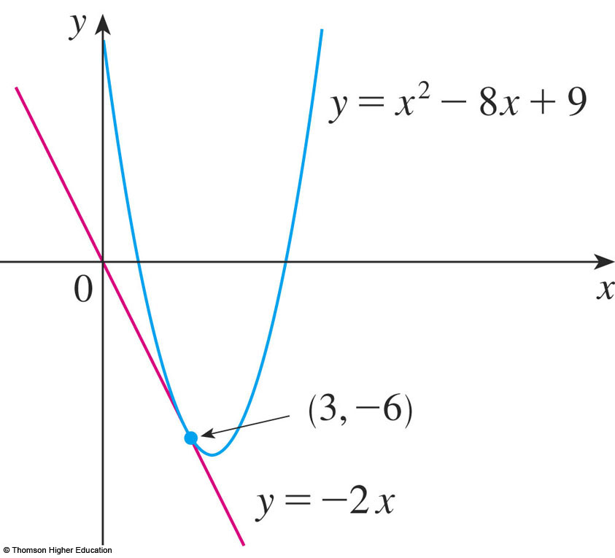
DERIVATIVES
Example 5
  Thus, an equation of the tangent line, shown in the figure is:
  y - (-6) = (-2)(x - 3) or y = -2x

Slide 38
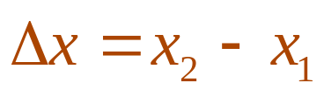
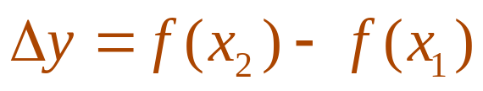
RATES OF CHANGE
Suppose y is a quantity that depends on
another quantity x.
Thus, y is a function of x and we write
y = f(x)
  If x changes from x₁ to x₂ , then the change in x (also called the increment of x) is:
  The corresponding change in y is:

Slide 39
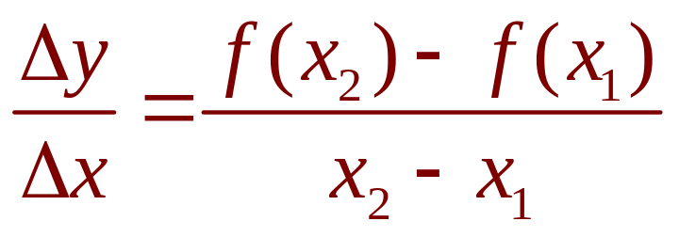
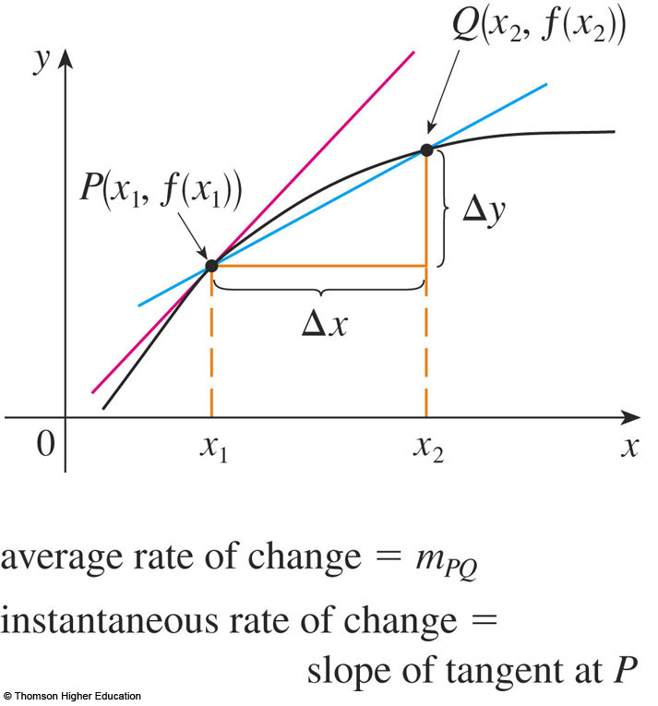
RATES OF CHANGE
The difference quotient
is called the average rate of change of y
with respect to x over
the interval [x₁,x₂] and
can be interpreted as
the slope of the secant
line PQ in the figure.

Slide 40
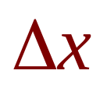
RATES OF CHANGE
By analogy with velocity, we consider
the average rate of change over smaller and
smaller intervals by letting x₂ approach x₁
and, therefore, letting approach 0.
  The limit of these average rates of change is called
  the (instantaneous) rate of change of y with respect
  to x at x = x₁.

Slide 41
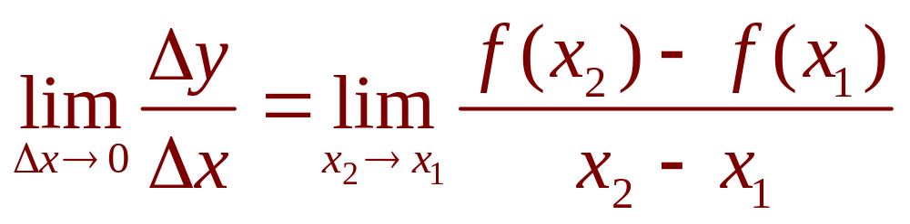
RATES OF CHANGE
This is interpreted as the slope of the tangent
to the curve y = f(x) at P(x₁,f(x₁)):
Instantaneous rate of change =
  We recognize this limit as being the derivative f’(x₁)

Slide 42
RATES OF CHANGE
We know that one interpretation of the
derivative f’(a) is as the slope of the tangent
line to the curve y = f(x) when x = a.
We now have a second interpretation.
  The derivative f’(a) is the instantaneous rate of change of y = f(x) with respect to x when x = a.

Slide 43
RATES OF CHANGE
The connection with the first interpretation
is that, if we sketch the curve y = f(x), then
the instantaneous rate of change is the slope
of the tangent to this curve at the point
where x = a.

Slide 44
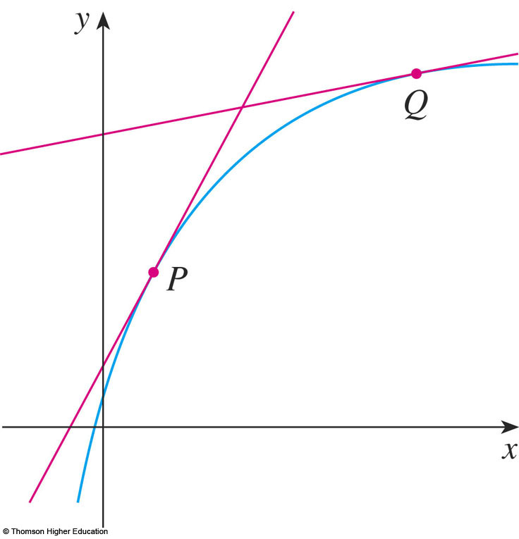
RATES OF CHANGE
This means that:
  When the derivative is large (and therefore the curve
  is steep, as at the point P in the figure), the y-values change rapidly.
  When the derivative is small, the curve is relatively flat and the y-values change slowly.

Slide 45
RATES OF CHANGE
In particular, if s = f(t) is the position function
of a particle that moves along a straight line,
then f’(a) is the rate of change of the
displacement s with respect to the time t.
  In other words, f’(a) is the velocity of the particle
  at time t = a.
  The speed of the particle is the absolute value of
  the velocity, that is, |f’(a)|.

Slide 46
RATES OF CHANGE
In the next example, we discuss
the meaning of the derivative of
a function that is defined verbally.

Slide 47
RATES OF CHANGE
Example 6
A manufacturer produces bolts of a fabric
with a fixed width.
The cost of producing x yards of this fabric
is C = f(x) dollars.
  What is the meaning of the derivative f’(x)?
  What are its units?
  In practical terms, what does it mean to say that f’(1,000) = 9?
  Which do you think is greater, f’(50) or f’(500)?
  What about f’(5,000)?

Slide 48
RATES OF CHANGE
Example 6 a
The derivative f’(x) is the instantaneous
rate of change of C with respect to x.
That is, f’(x) means the rate of change
of the production cost with respect to
the number of yards produced.
  Economists call this rate of change the marginal cost.

Slide 49
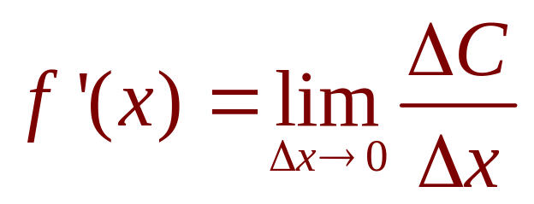
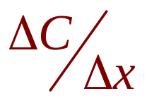


RATES OF CHANGE
Example 6 a
As
the units for f’(x) are the same as
the units for the difference quotient .
  Since is measured in dollars and in yards,
  it follows that the units for f’(x) are dollars per yard.

Slide 50
RATES OF CHANGE
Example 6 b
The statement that f’(1,000) = 9 means that,
after 1,000 yards of fabric have been
manufactured, the rate at which the
production cost is increasing is $9/yard.
  When x =1,000, C is increasing 9 times as fast as x.

Slide 51

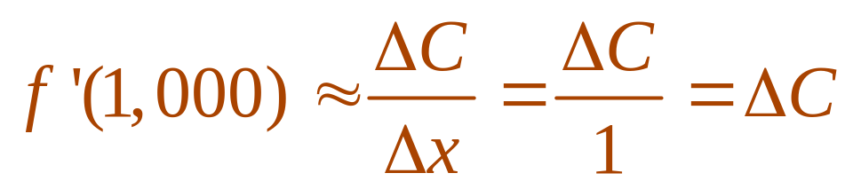
RATES OF CHANGE
Example 6 b
  Since is small compared with x =1,000,
  we could use the approximation
  and say that the cost of manufacturing the 1,000th yard (or the 1,001st) is about $9.

Slide 52
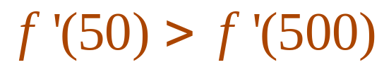
RATES OF CHANGE
Example 6 c
The rate at which the production cost is
increasing (per yard) is probably lower
when x = 500 than when x = 50 (the cost of
making the 500th yard is less than the cost of
the 50th yard) due to economies of scale.
  The manufacturer makes more efficient use of
  the fixed costs of production.
  So,

Slide 53
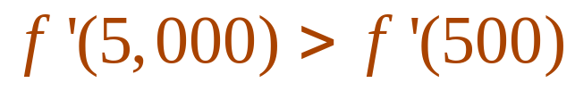
RATES OF CHANGE
Example 6 c
However, as production expands, the resulting
large-scale operation might become
inefficient and there might be overtime costs.
  Thus, it is possible that the rate of increase of costs
  will eventually start to rise.
  So, it may happen that

Slide 54
RATES OF CHANGE
In the following example, we estimate
the rate of change of the national debt
with respect to time.
  Here, the function is defined not by a formula but by
  a table of values.

Slide 55
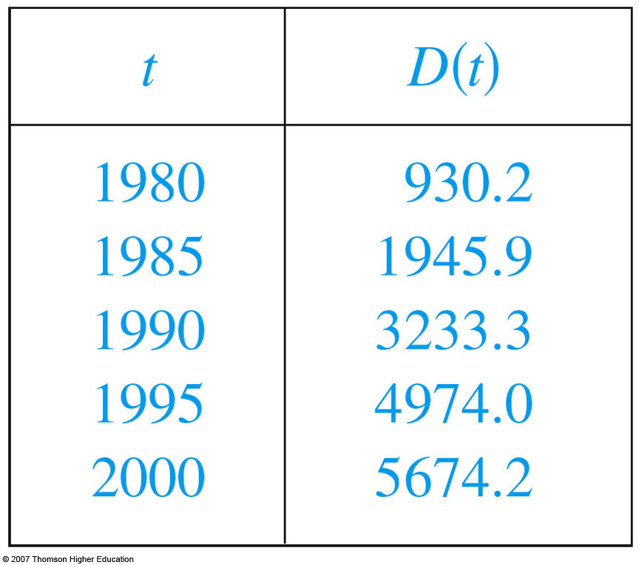
RATES OF CHANGE
Example 7
Let D(t) be the US national debt at time t.
The table gives approximate values of this
function by providing end-of-year estimates,
in billions of dollars, from 1980 to 2000.
Interpret and estimate
the value of D’(1990).

Slide 56
RATES OF CHANGE
Example 7
The derivative D’(1990) means the rate of
change of D with respect to t when t =1990,
that is, the rate of increase of the national
debt in 1990.

Slide 57
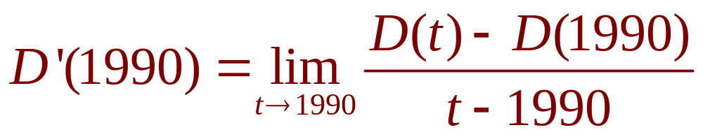
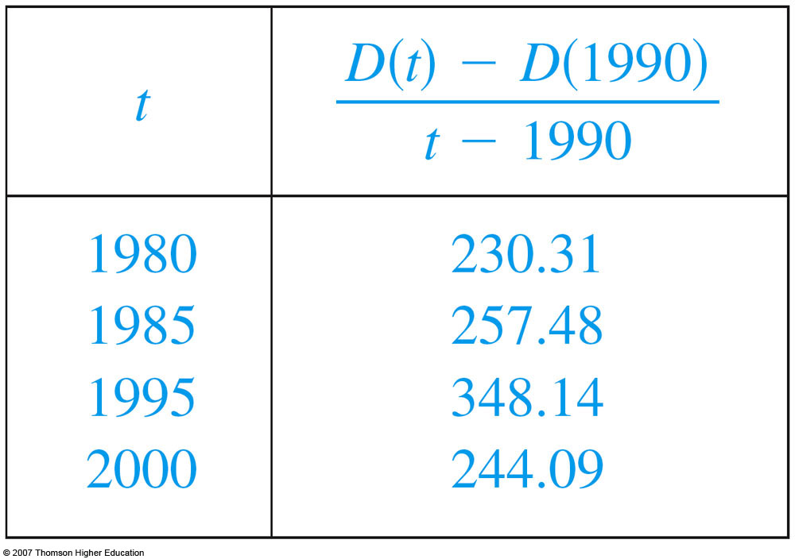
RATES OF CHANGE
Example 7
By Equation 5,
So, we compute and tabulate values of the
difference quotient as follows.

Slide 58
RATES OF CHANGE
Example 7
From the table, we see that D’(1990) lies
somewhere between 257.48 and 348.14
billion dollars per year.
  Here, we are making the reasonable assumption that the debt didn’t fluctuate wildly between 1980 and 2000.

Slide 59
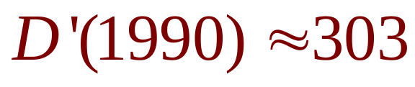
RATES OF CHANGE
Example 7
We estimate that the rate of increase of
the national debt in 1990 was the average of
these two numbers—namely
billion dollars per year.

Slide 60
RATES OF CHANGE
Example 7
Another method would be to plot the
debt function and estimate the slope of
the tangent line when t = 1990.

Slide 61
RATES OF CHANGE
In Examples 3, 6, and 7, we saw three
specific examples of rates of change:
  The velocity of an object is the rate of change of displacement with respect to time.
  The marginal cost is the rate of change of production cost with respect to the number of items produced.
  The rate of change of the debt with respect to time is
  of interest in economics.

Slide 62
RATES OF CHANGE
Here is a small sample of other rates
of change:
  In physics, the rate of change of work with respect to time is called power.
  Chemists who study a chemical reaction are interested in the rate of change in the concentration of a reactant with respect to time (called the rate of reaction).
  A biologist is interested in the rate of change of the population of a colony of bacteria with respect to time.

Slide 63
RATES OF CHANGE
In fact, the computation of rates of
change is important in all the natural
sciences, in engineering, and even in
the social sciences.

Slide 64
RATES OF CHANGE
All these rates of change are derivatives
and can therefore be interpreted as
slopes of tangents.
  This gives added significance to the solution of
  the tangent problem.

Slide 65
RATES OF CHANGE
Whenever we solve a problem involving
tangent lines, we are not just solving
a problem in geometry.
  We are also implicitly solving a great variety of problems involving rates of change in science and engineering.

