Slide 1

4
APPLICATIONS OF DIFFERENTIATION

Slide 2
APPLICATIONS OF DIFFERENTIATION
We have already investigated some applications of derivatives.
However, now that we know the differentiation rules, we are in a better position to pursue
the applications of differentiation in greater depth.

Slide 3
APPLICATIONS OF DIFFERENTIATION
Here, we learn how derivatives affect
the shape of a graph of a function and,
in particular, how they help us locate maximum and minimum values of functions.

Slide 4
APPLICATIONS OF DIFFERENTIATION
Many practical problems require us to minimize a cost or maximize an area or somehow find the best possible outcome
of a situation.
  In particular, we will be able to investigate
  the optimal shape of a can and to explain
  the location of rainbows in the sky.

Slide 5
APPLICATIONS OF DIFFERENTIATION
4.1
Maximum and
Minimum Values
In this section, we will learn:
How to find the maximum
and minimum values of a function.

Slide 6
OPTIMIZATION PROBLEMS
Some of the most important
applications of differential calculus
are optimization problems.
  In these, we are required to find the optimal (best)
  way of doing something.

Slide 7
EXAMPLES
Here are some examples of such problems that we will solve in this chapter.
  What is the shape of a can that minimizes manufacturing costs?
  What is the maximum acceleration of a space shuttle? (This is an important question to the astronauts
  who have to withstand the effects of acceleration.)

Slide 8
EXAMPLES
Here are some more examples.
  What is the radius of a contracted windpipe
  that expels air most rapidly during a cough?
  At what angle should blood vessels branch
  so as to minimize the energy expended by
  the heart in pumping blood?

Slide 9
OPTIMIZATION PROBLEMS
These problems can be reduced to
finding the maximum or minimum values
of a function.
  Let’s first explain exactly what we mean
  by maximum and minimum values.

Slide 10
MAXIMUM & MINIMUM VALUES
Definition 1
A function f has an absolute maximum
(or global maximum) at c if f(c) ≥ f(x) for
all x in D, where D is the domain of f.
The number f(c) is called the maximum value of f on D.

Slide 11
MAXIMUM & MINIMUM VALUES
Definition 1
Similarly, f has an absolute minimum at c
if f(c) ≤ f(x) for all x in D and the number f(c)
is called the minimum value of f on D.
The maximum and minimum values of f
are called the extreme values of f.

Slide 12
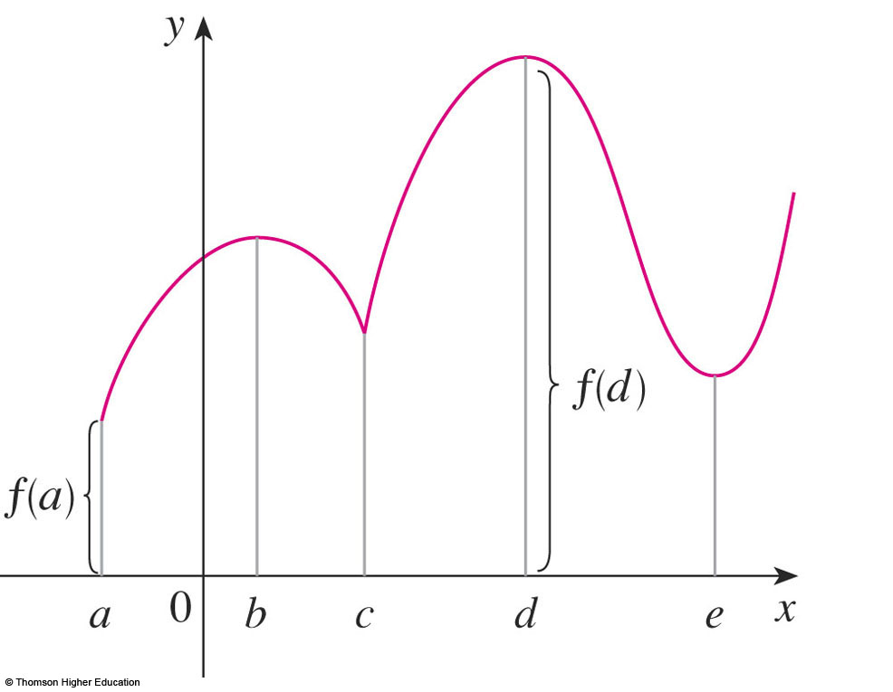
MAXIMUM & MINIMUM VALUES
The figure shows the graph of a function f
with absolute maximum at d and absolute minimum at a.
  Note that (d, f(d)) is
  the highest point on
  the graph and (a, f(a))
  is the lowest point.

Slide 13
LOCAL MAXIMUM VALUE
If we consider only values of x near b—for instance, if we restrict our attention to the interval (a, c)—then f(b) is the largest of those values of f(x).
  It is called a local
  maximum value of f.

Slide 14
LOCAL MINIMUM VALUE
Likewise, f(c) is called a local minimum value of f because f(c) ≤ f(x) for x near c—for instance, in the interval (b, d).
  The function f also has
  a local minimum at e.

Slide 15
MAXIMUM & MINIMUM VALUES
Definition 2
In general, we have the following definition.
A function f has a local maximum (or relative maximum) at c if f(c) ≥ f(x) when x is near c.
  This means that f(c) ≥ f(x) for all x in some
  open interval containing c.
  Similarly, f has a local minimum at c if f(c) ≤ f(x)
  when x is near c.

Slide 16
MAXIMUM & MINIMUM VALUES
Example 1
The function f(x) = cos x takes on its (local
and absolute) maximum value of 1 infinitely many times—since cos 2nπ = 1 for any integer n and -1 ≤ cos x ≤ 1 for all x.
Likewise, cos (2n + 1)π = -1 is its minimum value—where n is any integer.

Slide 17
MAXIMUM & MINIMUM VALUES
Example 2
If f(x) = x², then f(x) ≥ f(0) because
x² ≥ 0 for all x.
  Therefore, f(0) = 0 is the absolute (and local) minimum value of f.

Slide 18
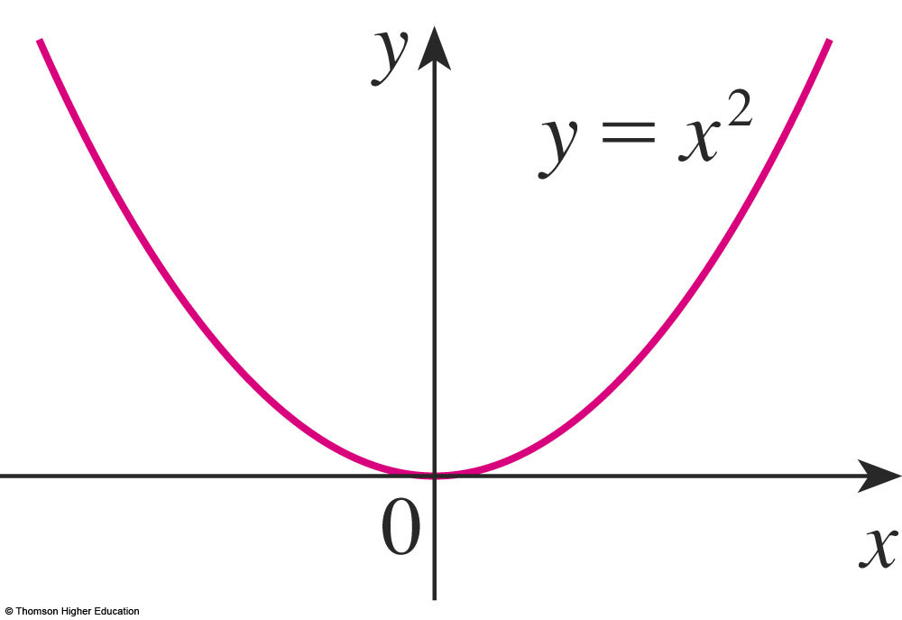
MAXIMUM & MINIMUM VALUES
Example 2
This corresponds to the fact that the origin
is the lowest point on the parabola y = x².
  However, there is no highest point on the parabola.
  So, this function has no maximum value.

Slide 19
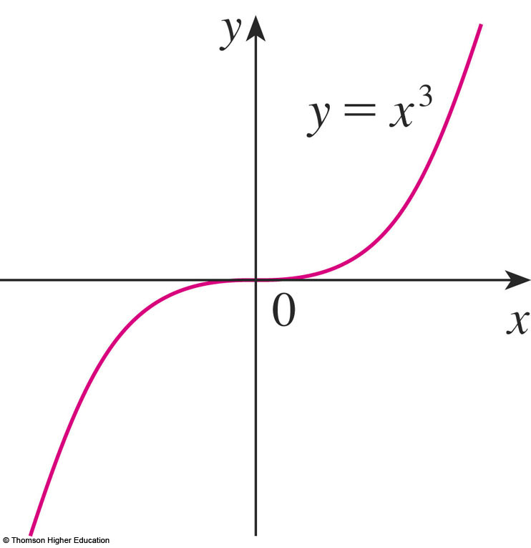
MAXIMUM & MINIMUM VALUES
Example 3
From the graph of the function f(x) = x³,
we see that this function has neither
an absolute maximum value nor an absolute minimum value.
  In fact, it has no local
  extreme values either.

Slide 20
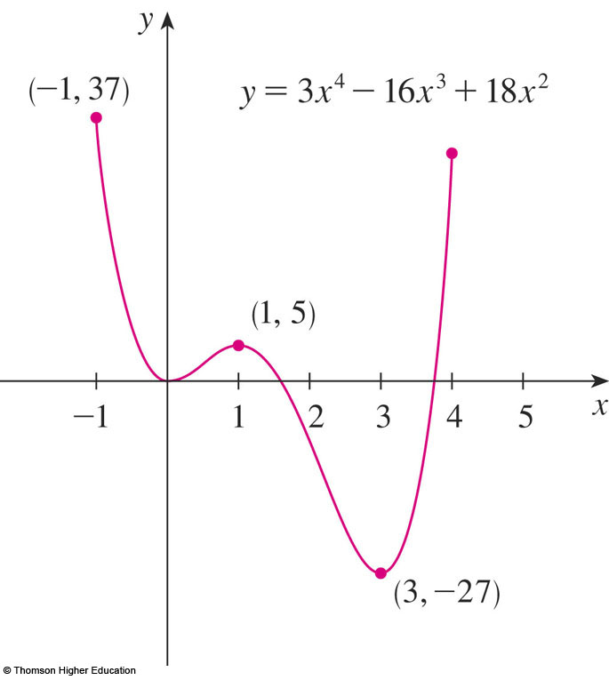
MAXIMUM & MINIMUM VALUES
Example 4
The graph of the function
f(x) = 3x⁴ – 16x³ + 18x² -1 ≤ x ≤ 4
is shown here.

Slide 21
MAXIMUM & MINIMUM VALUES
Example 4
You can see that f(1) = 5 is a local maximum, whereas the absolute maximum is f(-1) = 37.
  This absolute maximum
  is not a local maximum
  because it occurs at
  an endpoint.

Slide 22
MAXIMUM & MINIMUM VALUES
Example 4
Also, f(0) = 0 is a local minimum and
f(3) = -27 is both a local and an absolute minimum.
  Note that f has
  neither a local nor
  an absolute maximum
  at x = 4.

Slide 23
MAXIMUM & MINIMUM VALUES
We have seen that some functions have extreme values, whereas others do not.
The following theorem gives conditions
under which a function is guaranteed to possess extreme values.

Slide 24
EXTREME VALUE THEOREM
Theorem 3
If f is continuous on a closed interval [a, b], then f attains an absolute maximum value f(c) and an absolute minimum value f(d) at some numbers c and d in [a, b].

Slide 25
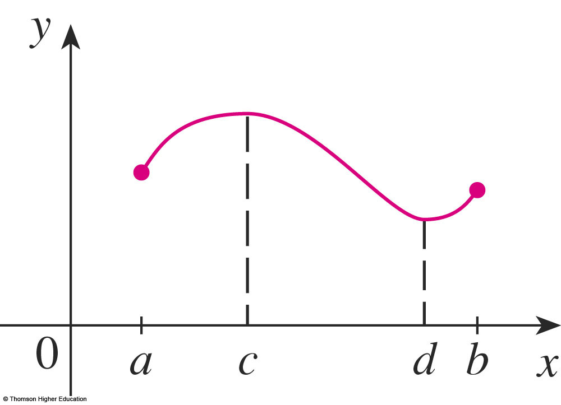
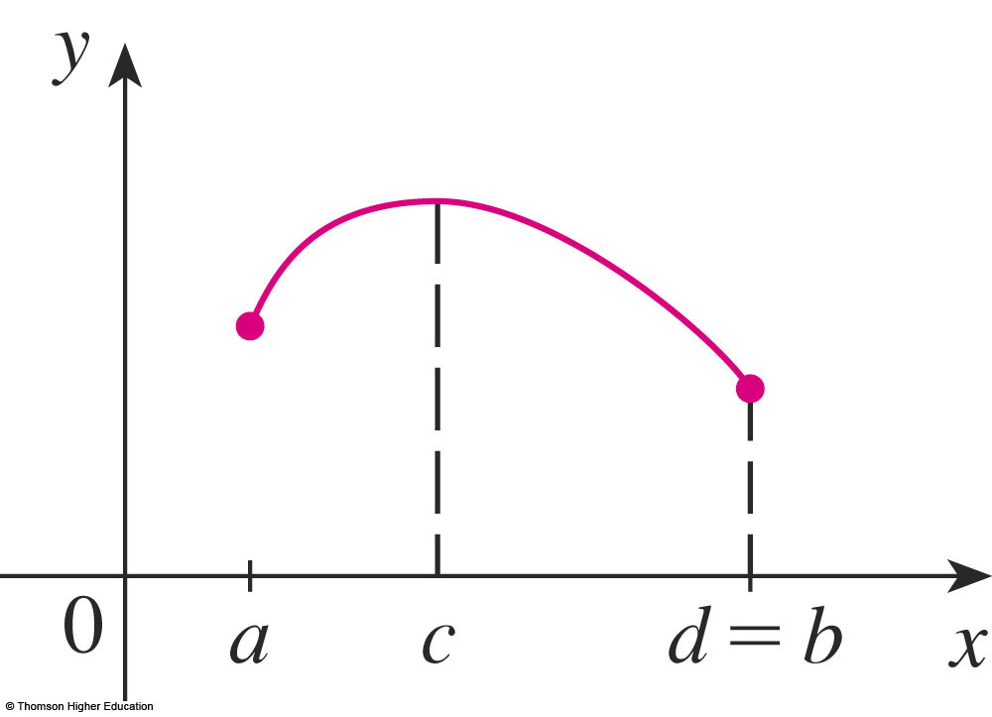
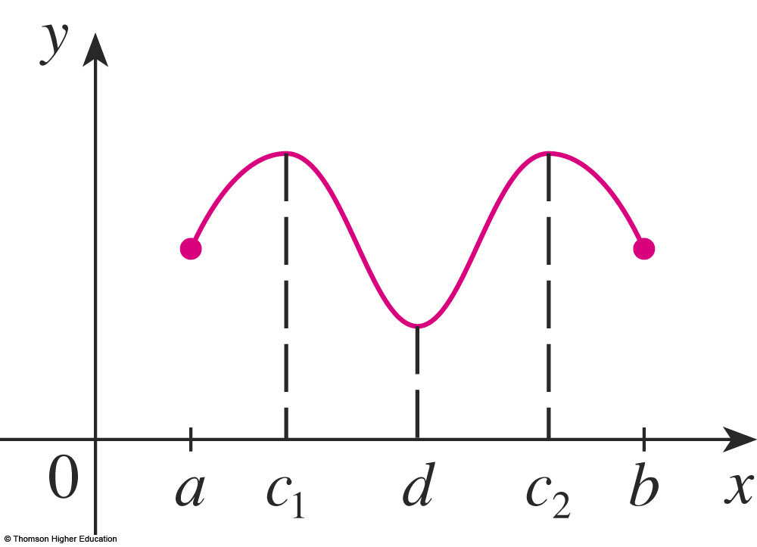
EXTREME VALUE THEOREM
The theorem is illustrated in the figures.
  Note that an extreme value
  can be taken on more than once.

Slide 26
EXTREME VALUE THEOREM
Although the theorem is intuitively
very plausible, it is difficult to prove
and so we omit the proof.

Slide 27
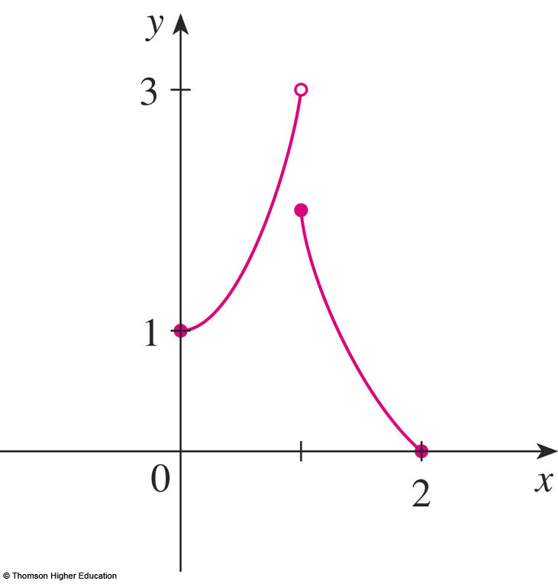
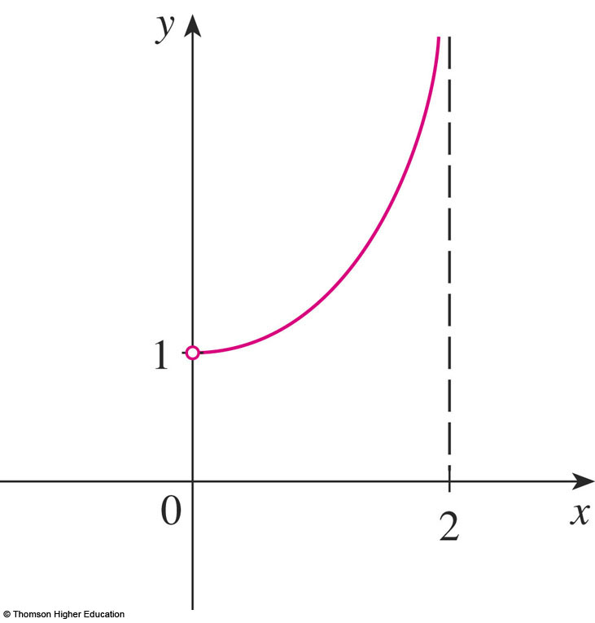
EXTREME VALUE THEOREM
The figures show that a function need not possess extreme values if either hypothesis (continuity or closed interval) is omitted from the theorem.

Slide 28
EXTREME VALUE THEOREM
The function f whose graph is shown is defined on the closed interval [0, 2] but has
no maximum value.
  Notice that the range of f
  is [0, 3).
  The function takes on values
  arbitrarily close to 3, but never
  actually attains the value 3.

Slide 29
EXTREME VALUE THEOREM
This does not contradict the theorem because f is not continuous.
  Nonetheless, a discontinuous
  function could have maximum
  and minimum values.

Slide 30
EXTREME VALUE THEOREM
The function g shown here is continuous
on the open interval (0, 2) but has neither
a maximum nor a minimum value.
  The range of g is (1, ∞).
  The function takes on
  arbitrarily large values.
  This does not contradict
  the theorem because
  the interval (0, 2) is not closed.

Slide 31
EXTREME VALUE THEOREM
The theorem says that a continuous function on a closed interval has a maximum value
and a minimum value.
However, it does not tell us how to find these extreme values.
  We start by looking for local extreme values.

Slide 32
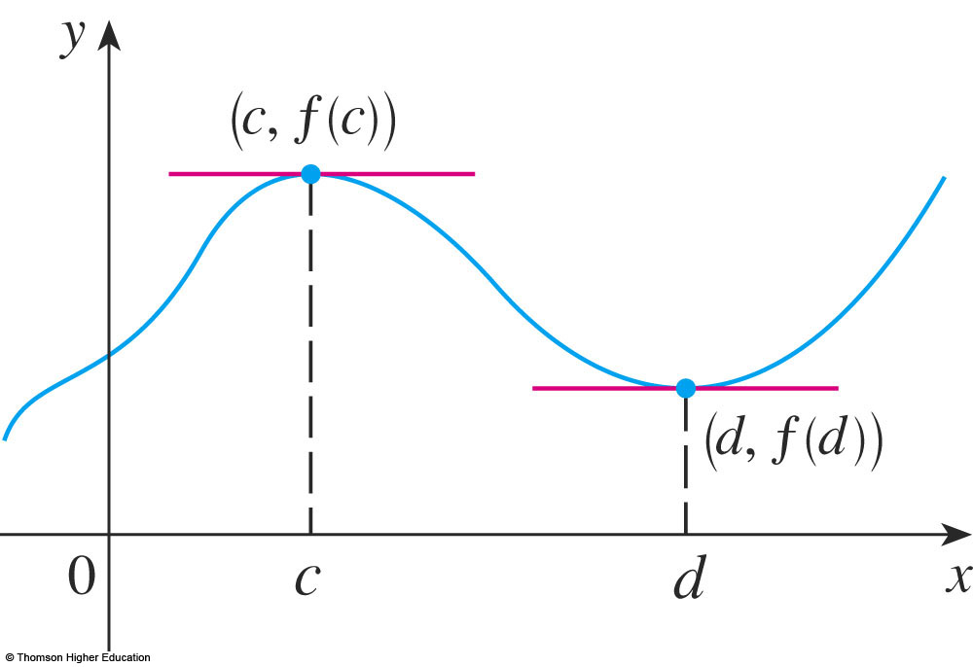
LOCAL EXTREME VALUES
The figure shows the graph of a function f
with a local maximum at c and a local minimum at d.

Slide 33
LOCAL EXTREME VALUES
It appears that, at the maximum and minimum points, the tangent lines are horizontal and therefore each has slope 0.

Slide 34
LOCAL EXTREME VALUES
We know that the derivative is the slope
of the tangent line.
  So, it appears that f ’(c) = 0 and f ’(d) = 0.

Slide 35
LOCAL EXTREME VALUES
The following theorem says that
this is always true for differentiable functions.

Slide 36
FERMAT’S THEOREM
Theorem 4
If f has a local maximum or
minimum at c, and if f ’(c) exists, then f ’(c) = 0.

Slide 37
FERMAT’S THEOREM
Proof
Suppose, for the sake of definiteness, that f has a local maximum at c.
Then, according to Definition 2, f(c) ≥ f(x)
if x is sufficiently close to c.

Slide 38
FERMAT’S THEOREM
Proof (Equation 5)
This implies that, if h is sufficiently close to 0, with h being positive or negative, then
f(c) ≥ f(c + h)
and therefore
f(c + h) – f(c) ≤ 0

Slide 39
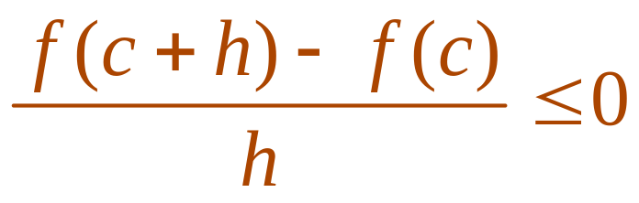
FERMAT’S THEOREM
Proof
We can divide both sides of an inequality by a positive number.
  Thus, if h > 0 and h is sufficiently small,
  we have:

Slide 40
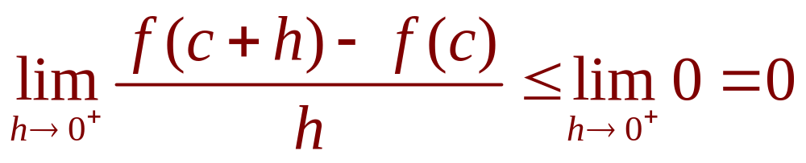
FERMAT’S THEOREM
Proof
Taking the right-hand limit of both sides
of this inequality (using Theorem 2 in Section 2.3), we get:

Slide 41
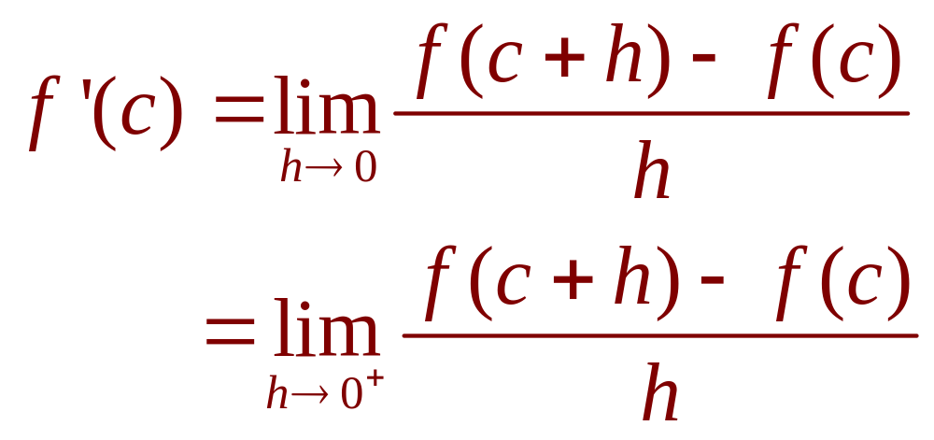
FERMAT’S THEOREM
Proof
However, since f ’(c) exists,
we have:
  So, we have shown that f ’(c) ≤ 0.

Slide 42
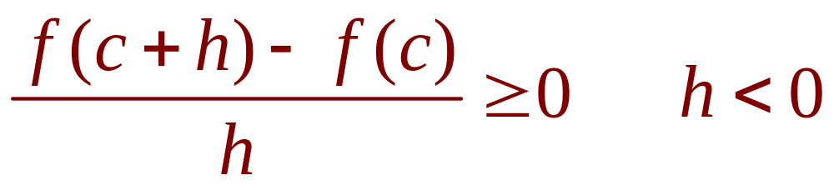
FERMAT’S THEOREM
Proof
If h < 0, then the direction of the inequality in Equation 5 is reversed when we divide by h:

Slide 43
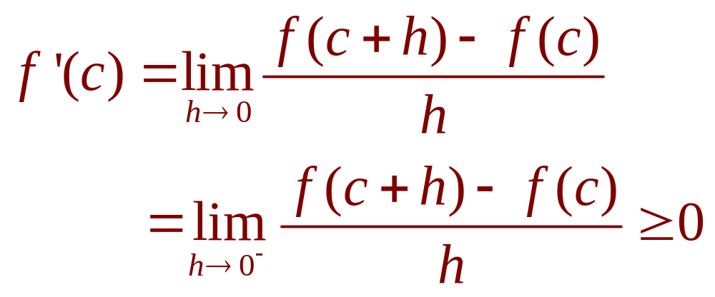
FERMAT’S THEOREM
Proof
So, taking the left-hand limit,
we have:

Slide 44
FERMAT’S THEOREM
Proof
We have shown that f ’(c) ≥ 0 and also
that f ’(c) ≤ 0.
Since both these inequalities must be true, the only possibility is that f ’(c) = 0.

Slide 45
FERMAT’S THEOREM
Proof
We have proved the theorem for
the case of a local maximum.
  The case of a local minimum can be proved
  in a similar manner.
  Alternatively, we could use Exercise 76
  to deduce it from the case we have just proved.

Slide 46
FERMAT’S THEOREM
The following examples caution us
against reading too much into the theorem.
  We can’t expect to locate extreme values
  simply by setting f ’(x) = 0 and solving for x.

Slide 47

FERMAT’S THEOREM
Example 5
If f(x) = x³, then f ’(x) = 3x², so f ’(0) = 0.
  However, f has no maximum or minimum at 0—as you can see from the graph.
  Alternatively, observe
  that x³ > 0 for x > 0
  but x³ < 0 for x < 0.

Slide 48
FERMAT’S THEOREM
Example 5
The fact that f ’(0) = 0 simply means that the curve y = x³ has a horizontal tangent
at (0, 0).
  Instead of having
  a maximum or minimum
  at (0, 0), the curve crosses
  its horizontal tangent there.

Slide 49
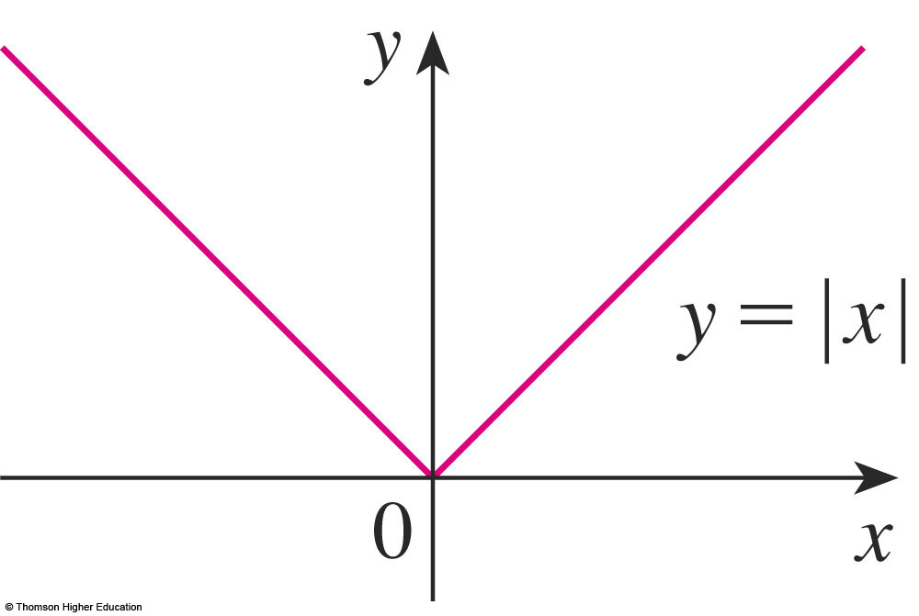
FERMAT’S THEOREM
Example 6
The function f(x) = |x| has its (local and absolute) minimum value at 0.
  However, that value can’t be found by setting f ’(x) = 0.
  This is because—as
  shown in Example 5
  in Section 2.8—f ’(0)
  does not exist.

Slide 50
WARNING
Examples 5 and 6 show that we must
be careful when using the theorem.
  Example 5 demonstrates that, even when f ’(c) = 0, there need not be a maximum or minimum at c.
  In other words, the converse of the theorem
  is false in general.
  Furthermore, there may be an extreme value
  even when f ’(c) does not exist (as in Example 6).

Slide 51
FERMAT’S THEOREM
The theorem does suggest that we should
at least start looking for extreme values of f
at the numbers c where either:
  f ’(c) = 0
  f ’(c) does not exist

Slide 52
FERMAT’S THEOREM
Such numbers are given a special name—critical numbers.

Slide 53
CRITICAL NUMBERS
Definition 6
A critical number of a function f is
a number c in the domain of f such that either f ’(c) = 0 or f ’(c) does not exist.

Slide 54
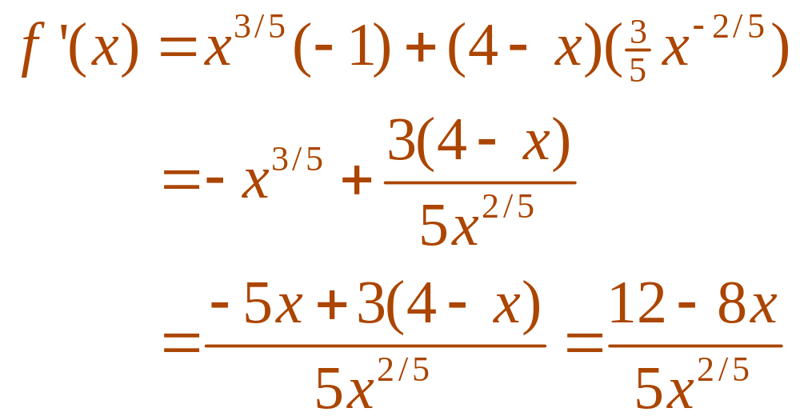
CRITICAL NUMBERS
Example 7
Find the critical numbers of
f(x) = x^{3/5}(4 - x).
  The Product Rule gives:

Slide 55

CRITICAL NUMBERS
Example 7
  The same result could be obtained by
  first writing f(x) = 4x^{3/5} – x^{8/5}.
  Therefore, f ’(x) = 0 if 12 – 8x = 0.
  That is, x = , and f ’(x) does not exist
  when x = 0.
  Thus, the critical numbers are and 0.

Slide 56
CRITICAL NUMBERS
In terms of critical numbers, Fermat’s Theorem can be rephrased as follows (compare Definition 6 with Theorem 4).

Slide 57
CRITICAL NUMBERS
Theorem 7
If f has a local maximum or
minimum at c, then c is a critical number of f.

Slide 58
CLOSED INTERVALS
To find an absolute maximum or minimum
of a continuous function on a closed interval, we note that either:
  It is local (in which case, it occurs at
  a critical number by Theorem 7).
  It occurs at an endpoint of the interval.

Slide 59
CLOSED INTERVALS
Therefore, the following
three-step procedure always works.

Slide 60
CLOSED INTERVAL METHOD
To find the absolute maximum and minimum values of a continuous function f on a closed interval [a, b]:
  Find the values of f at the critical numbers of f
  in (a, b).
  Find the values of f at the endpoints of the interval.
  The largest value from 1 and 2 is the absolute maximum value. The smallest is the absolute minimum value.

Slide 61
CLOSED INTERVAL METHOD
Example 8
Find the absolute maximum
and minimum values of the function
f(x) = x³ – 3x² + 1 -½ ≤ x ≤ 4

Slide 62
CLOSED INTERVAL METHOD
Example 8
As f is continuous on [-½, 4], we
can use the Closed Interval Method:
f(x) = x³ – 3x² + 1
f ’(x) = 3x² – 6x = 3x(x – 2)

Slide 63
CLOSED INTERVAL METHOD
Example 8
As f ’(x) exists for all x, the only critical numbers of f occur when f ’(x) = 0, that is, x = 0 or x = 2.
Notice that each of these numbers lies in
the interval (-½, 4).

Slide 64
CLOSED INTERVAL METHOD
Example 8
The values of f at these critical numbers
are: f(0) = 1 f(2) = -3
The values of f at the endpoints of the interval are: f(-½) = 1/8 f(4) = 17
  Comparing these four numbers, we see that
  the absolute maximum value is f(4) = 17 and
  the absolute minimum value is f(2) = -3.

Slide 65
CLOSED INTERVAL METHOD
Example 8
Note that the absolute maximum occurs
at an endpoint, whereas the absolute minimum occurs at a critical number.

Slide 66
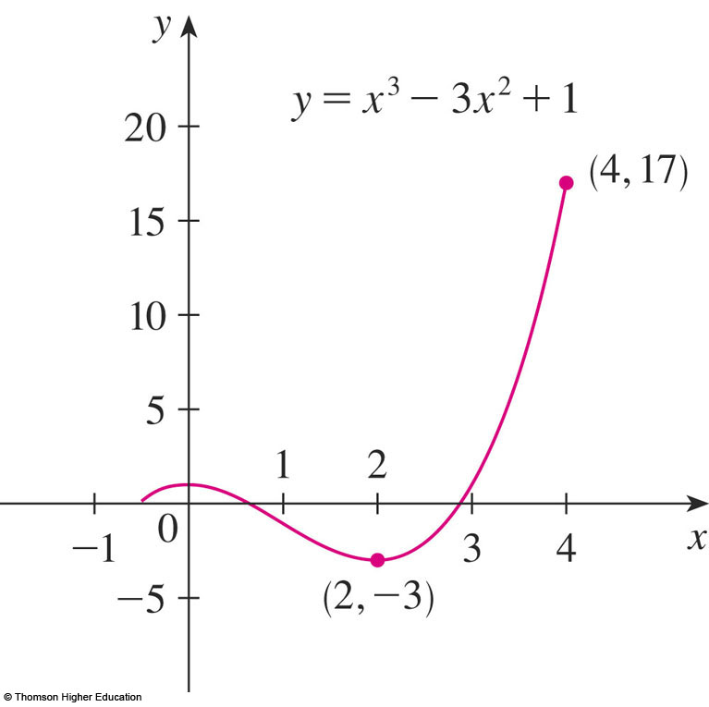
CLOSED INTERVAL METHOD
Example 8
The graph of f is sketched here.

Slide 67
EXACT VALUES
If you have a graphing calculator or
a computer with graphing software, it is possible to estimate maximum and minimum values very easily.
  However, as the next example shows,
  calculus is needed to find the exact values.

Slide 68
EXACT VALUES
Example 9
Use a graphing device to estimate
the absolute minimum and maximum values
of the function f(x) = x – 2 sin x, 0 ≤ x ≤ 2π.
Use calculus to find the exact minimum
and maximum values.

Slide 69
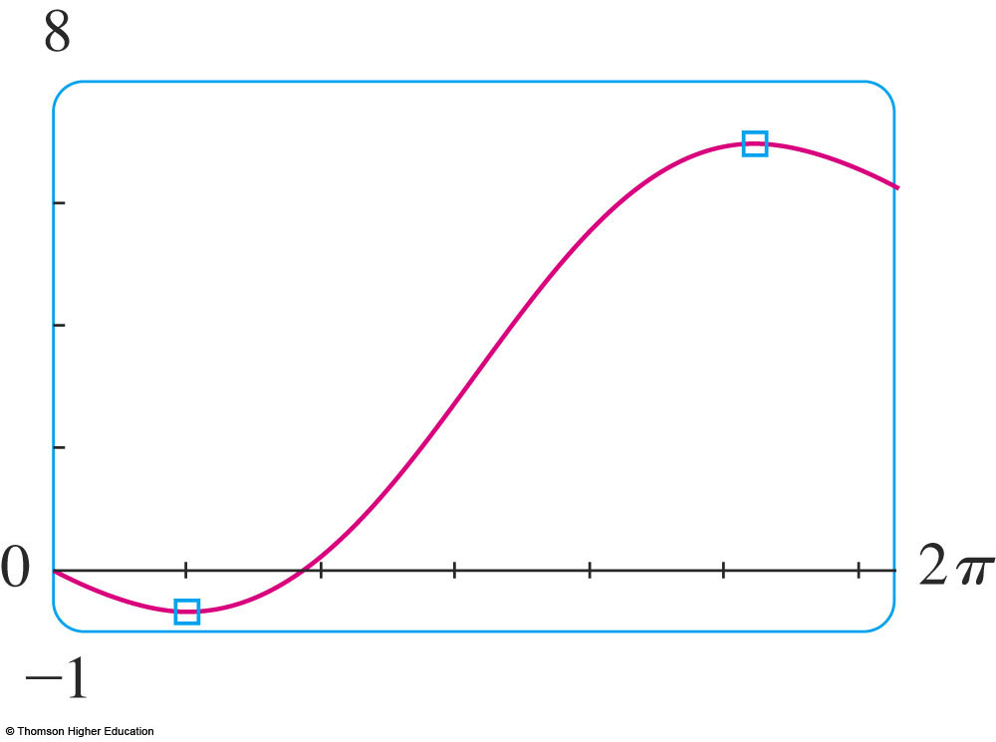
EXACT VALUES
Example 9 a
The figure shows a graph of f in
the viewing rectangle [0, 2π] by [-1, 8].

Slide 70
EXACT VALUES
Example 9 a
By moving the cursor close to the maximum point, we see the y-coordinates don’t change very much in the vicinity of the maximum.
  The absolute
  maximum value
  is about 6.97
  It occurs when
  x ≈ 5.2

Slide 71
EXACT VALUES
Example 9 a
Similarly, by moving the cursor close to
the minimum point, we see the absolute minimum value is about –0.68 and it occurs when x ≈ 1.0

Slide 72
EXACT VALUES
Example 9 a
It is possible to get more accurate estimates by zooming in toward
the maximum and minimum points.
However, instead, let’s use calculus.

Slide 73
EXACT VALUES
Example 9 b
The function f(x) = x – 2 sin x is continuous on [0, 2π].
As f ’(x) = 1 – 2 cos x, we have f ’(x) = 0 when cos x = ½.
  This occurs when x = π/3 or 5π/3.

Slide 74
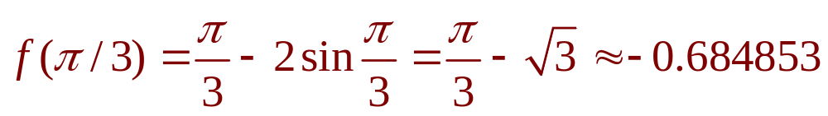
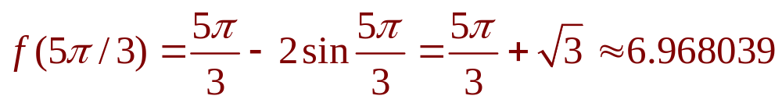
EXACT VALUES
Example 9 b
The values of f at these critical points
are
and

Slide 75
EXACT VALUES
Example 9 b
The values of f at the endpoints
are
f(0) = 0
and
f(2π) = 2π ≈ 6.28

Slide 76
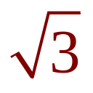
EXACT VALUES
Example 9 b
Comparing these four numbers and
using the Closed Interval Method, we see
the absolute minimum value is
f(π/3) = π/3 -
and the absolute maximum value is
f(5π/3) = 5π/3 +
  The values from (a) serve as a check on our work.

Slide 77

MAXIMUM & MINIMUM VALUES
Example 10
The Hubble Space Telescope was deployed on April 24, 1990, by the space shuttle Discovery.

Slide 78
MAXIMUM & MINIMUM VALUES
Example 10
A model for the velocity of the shuttle
during this mission—from liftoff at t = 0
until the solid rocket boosters were jettisoned
at t = 126 s—is given by:
v(t) = 0.001302t³ – 0.09029t² + 23.61t – 3.083 (in feet per second)

Slide 79
MAXIMUM & MINIMUM VALUES
Example 10
Using this model, estimate the absolute maximum and minimum values of
the acceleration of the shuttle between
liftoff and the jettisoning of the boosters.

Slide 80
MAXIMUM & MINIMUM VALUES
Example 10
We are asked for the extreme values
not of the given velocity function,
but rather of the acceleration function.

Slide 81
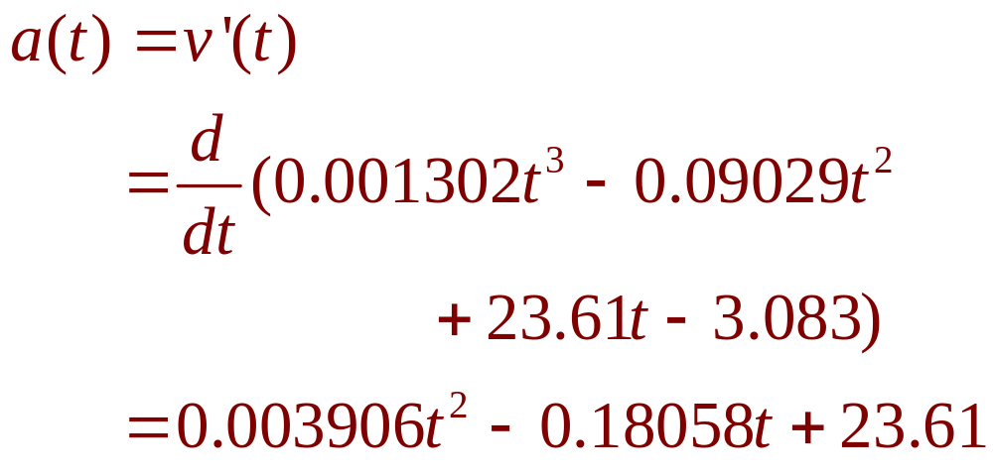
MAXIMUM & MINIMUM VALUES
Example 10
So, we first need to differentiate to find
the acceleration:

Slide 82
MAXIMUM & MINIMUM VALUES
Example 10
We now apply the Closed Interval Method
to the continuous function a on the interval
0 ≤ t ≤ 126.
Its derivative is:
a’(t) = 0.007812t – 0.18058

Slide 83
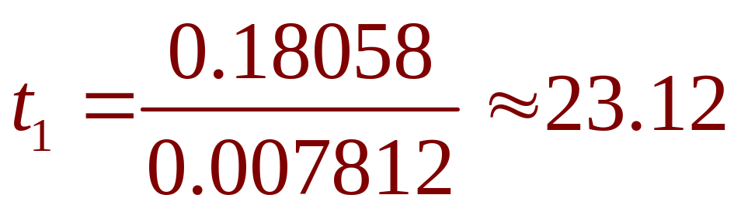
MAXIMUM & MINIMUM VALUES
Example 10
The only critical number occurs
when a’(t) = 0:

Slide 84
MAXIMUM & MINIMUM VALUES
Example 10
Evaluating a(t) at the critical number
and at the endpoints, we have:
a(0) = 23.61 a(t₁) ≈ 21.52 a(126) ≈ 62.87
  The maximum acceleration is about 62.87 ft/s².
  The minimum acceleration is about 21.52 ft/s².

