Slide 1

4
APPLICATIONS OF DIFFERENTIATION

Slide 2
APPLICATIONS OF DIFFERENTIATION
We will see that many of the results
of this chapter depend on one central fact—the Mean Value Theorem.

Slide 3
APPLICATIONS OF DIFFERENTIATION
4.2
The Mean Value Theorem
In this section, we will learn about:
The significance of the mean value theorem.

Slide 4
MEAN VALUE THEOREM
To arrive at the theorem, we
first need the following result.

Slide 5
ROLLE’S THEOREM
Let f be a function that satisfies the following three hypotheses:
  f is continuous on the closed interval [a, b]
  f is differentiable on the open interval (a, b)
  f(a) = f(b)
Then, there is a number c in (a, b) such
that f’(c) = 0.

Slide 6
ROLLE’S THEOREM
Before giving the proof, let’s look
at the graphs of some typical functions
that satisfy the three hypotheses.

Slide 7
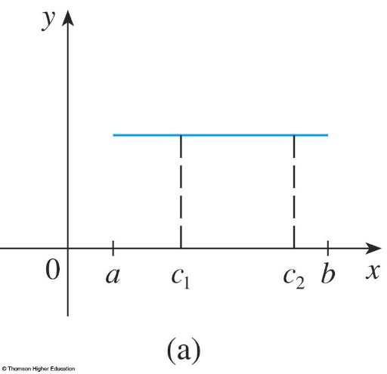
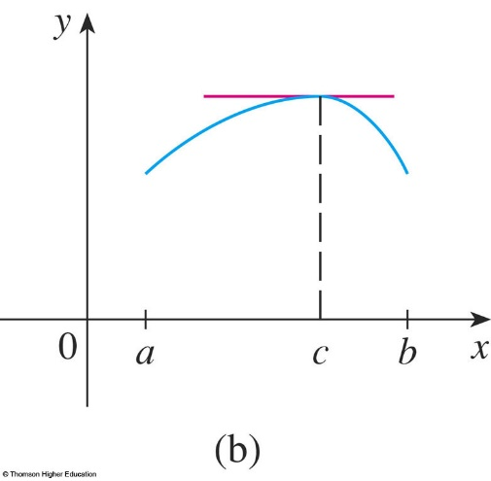
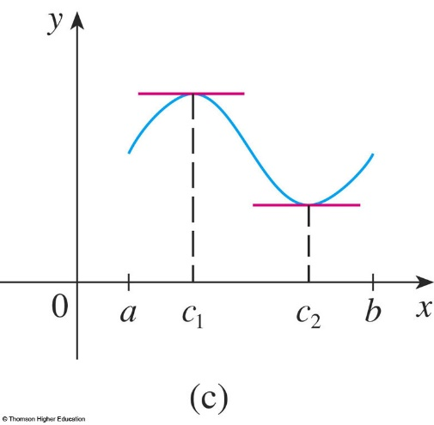
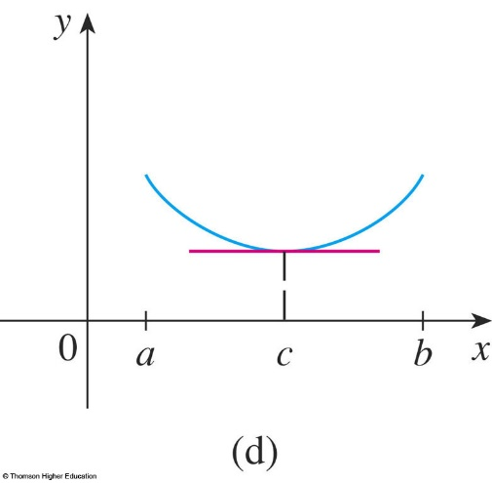
ROLLE’S THEOREM
The figures show the graphs of
four such
functions.

Slide 8
ROLLE’S THEOREM
In each case, it appears there is at least one point (c, f(c)) on the graph where the tangent is
horizontal
and thus
f’(c) = 0.
  So, Rolle’s
  Theorem is
  plausible.

Slide 9
ROLLE’S THEOREM
Proof
There are three cases:
  f(x) = k, a constant
  f(x) > f(a) for some x in (a, b)
  f(x) < f(a) for some x in (a, b)

Slide 10

ROLLE’S THEOREM
Proof—Case 1
f(x) = k, a constant
  Then, f ’(x) = 0.
  So, the number c can be
  taken to be any number
  in (a, b).

Slide 11


ROLLE’S THEOREM
Proof—Case 2
f(x) > f(a) for some x
in (a, b)
  By the Extreme Value Theorem (which we can apply by hypothesis 1), f
  has a maximum value somewhere in [a, b].

Slide 12
ROLLE’S THEOREM
Proof—Case 2
  As f(a) = f(b), it must attain this maximum value at a number c in the open interval (a, b).
  Then, f has a local maximum
  at c and, by hypothesis 2, f
  is differentiable at c.
  Thus, f ’(c) = 0 by Fermat’s Theorem.

Slide 13
ROLLE’S THEOREM
Proof—Case 3
f(x) < f(a) for some x
in (a, b)
  By the Extreme Value
  Theorem, f has a minimum
  value in [a, b] and, since
  f(a) = f(b), it attains this
  minimum value at a number
  c in (a, b).
  Again, f ’(c) = 0 by
  Fermat’s Theorem.

Slide 14
ROLLE’S THEOREM
Example 1
Let’s apply the theorem to the position function s = f(t) of a moving object.
  If the object is in the same place at two different
  instants t = a and t = b, then f(a) = f(b).
  The theorem states that there is some instant of
  time t = c between a and b when f ’(c) = 0; that is,
  the velocity is 0.
  In particular, you can see that this is true when
  a ball is thrown directly upward.

Slide 15
ROLLE’S THEOREM
Example 2
Prove that the equation
x³ + x – 1 = 0
has exactly one real root.

Slide 16
ROLLE’S THEOREM
Example 2
First, we use the Intermediate Value Theorem (Equation 10 in Section 2.5)
to show that a root exists.
  Let f(x) = x³ + x – 1.
  Then, f(0) = – 1 < 0 and f(1) = 1 > 0.
  Since f is a polynomial, it is continuous.
  So, the theorem states that there is a number c
  between 0 and 1 such that f(c) = 0.
  Thus, the given equation has a root.

Slide 17
ROLLE’S THEOREM
Example 2
To show that the equation has no
other real root, we use Rolle’s Theorem and argue by contradiction.

Slide 18
ROLLE’S THEOREM
Example 2
Suppose that it had two roots a and b.
  Then, f(a) = 0 = f(b).
  As f is a polynomial, it is differentiable on (a, b)
  and continuous on [a, b].
  Thus, by Rolle’s Theorem, there is a number c
  between a and b such that f ’(c) = 0.
  However, f ’(x) = 3x² + 1 ≥ 1 for all x
  (since x² ≥ 0), so f ’(x) can never be 0.

Slide 19
ROLLE’S THEOREM
Example 2
  This gives a contradiction.
      So, the equation can’t have two real roots.

Slide 20
ROLLE’S THEOREM
Our main use of Rolle’s Theorem is in proving the following important theorem—which was first stated by another French mathematician, Joseph-Louis Lagrange.

Slide 21
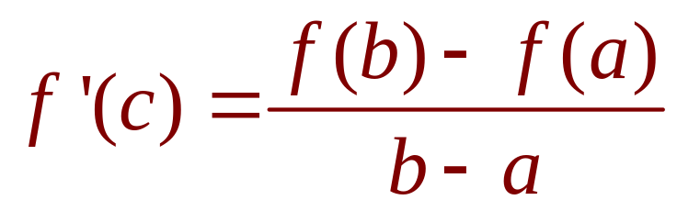
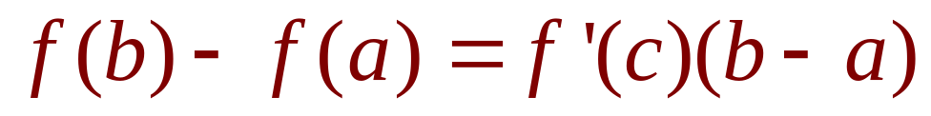
MEAN VALUE THEOREM
Equations 1 and 2
Let f be a function that fulfills two hypotheses:
  f is continuous on the closed interval [a, b].
  f is differentiable on the open interval (a, b).
Then, there is a number c in (a, b) such that
or, equivalently,

Slide 22
MEAN VALUE THEOREM
Before proving this theorem,
we can see that it is reasonable by interpreting it geometrically.

Slide 23
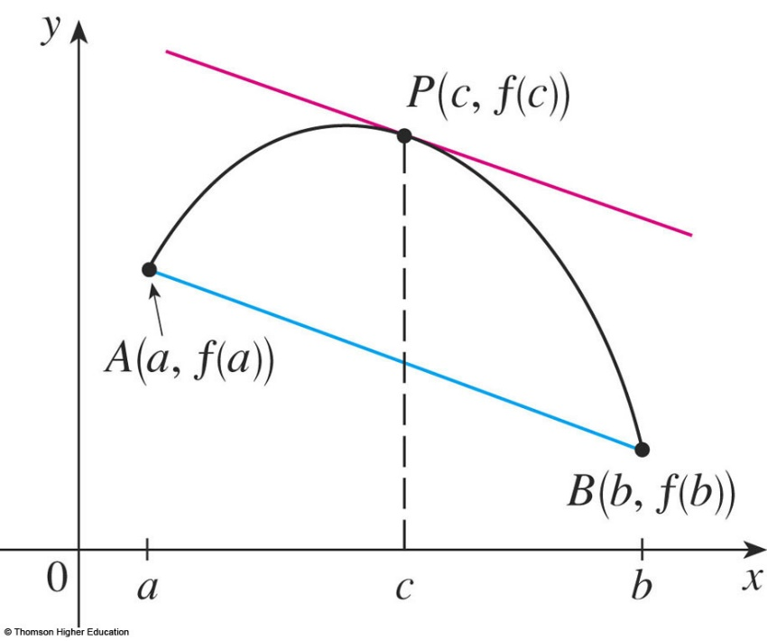
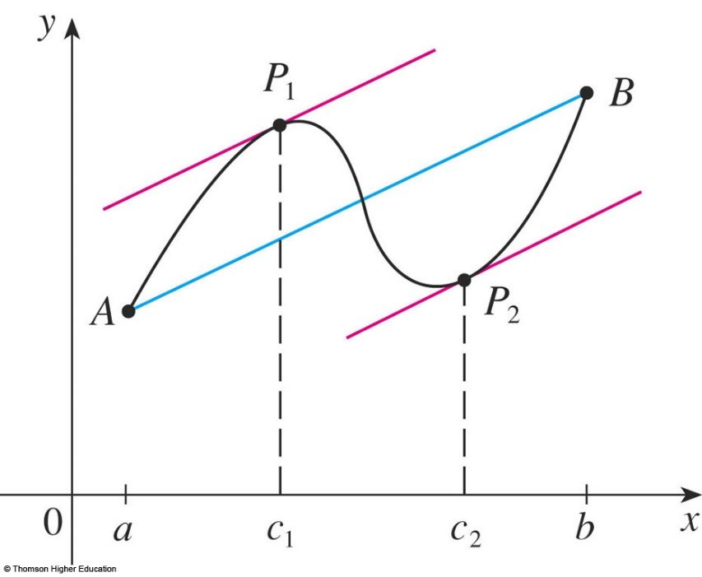
MEAN VALUE THEOREM
The figures show the points A(a, f(a)) and
B(b, f(b)) on the graphs of two differentiable functions.

Slide 24
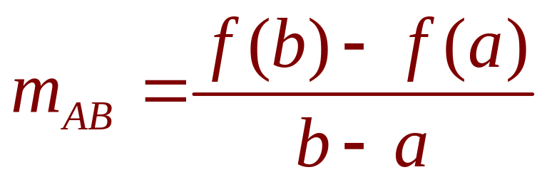
MEAN VALUE THEOREM
Equation 3
The slope of the secant line AB is:
  This is the same expression as on the right side
  of Equation 1.

Slide 25
MEAN VALUE THEOREM
f ’(c) is the slope of the tangent line at (c, f(c)).
  So, the Mean Value Theorem—in the form given by Equation 1—states that there is at least one point
  P(c, f(c)) on the graph where the slope of the tangent line is the same as the slope of the secant line AB.

Slide 26
MEAN VALUE THEOREM
In other words, there is a point P
where the tangent line is parallel to
the secant line AB.

Slide 27
PROOF
We apply Rolle’s Theorem to a new function h defined as the difference between f and the function whose graph
is the secant line AB.

Slide 28
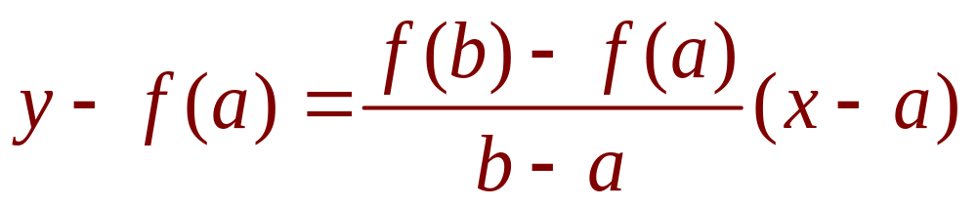
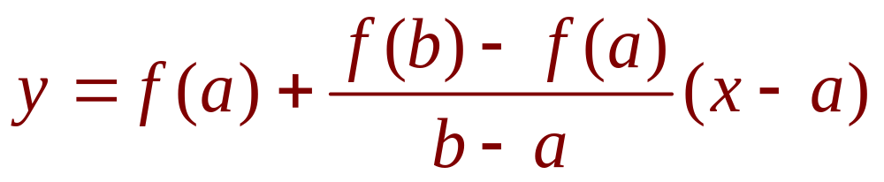
PROOF
  Using Equation 3, we see that the equation of the line AB can be written as:
  or as:

Slide 29
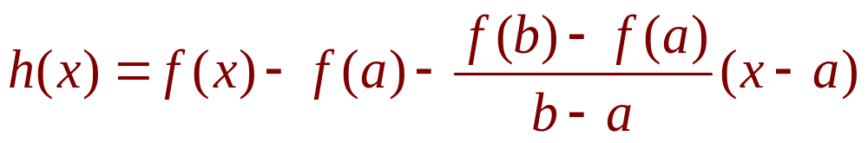
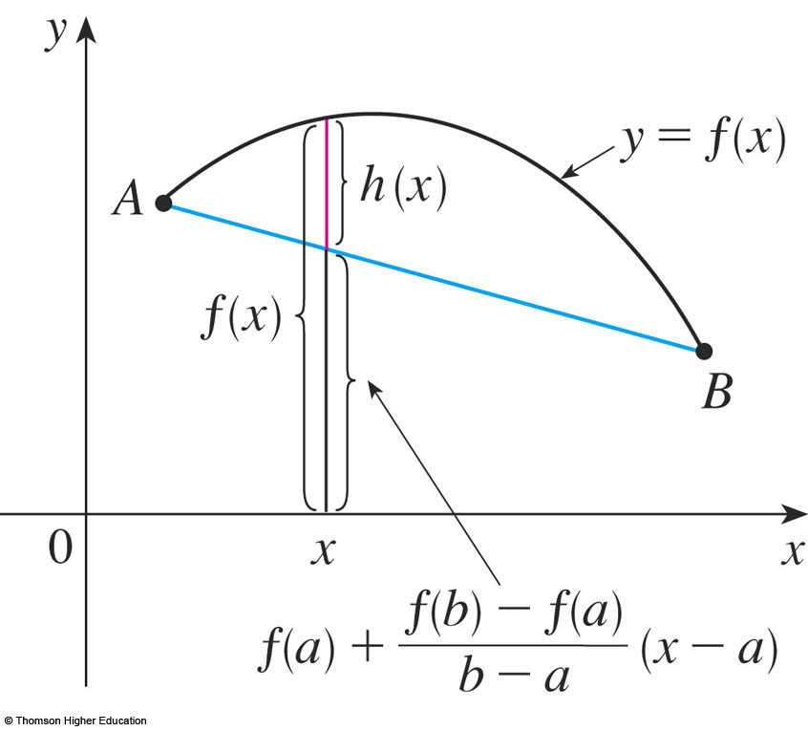
MEAN VALUE THEOREM
Equation 4
So, as shown in the figure,

Slide 30
MEAN VALUE THEOREM
First, we must verify that h satisfies the three hypotheses of Rolle’s Theorem—as follows.

Slide 31
HYPOTHESIS 1
The function h is continuous on [a, b] because it is the sum of f and a first-degree polynomial, both of which are continuous.

Slide 32
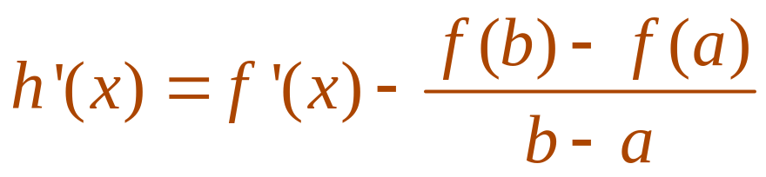
HYPOTHESIS 2
The function h is differentiable on (a, b) because both f and the first-degree polynomial are differentiable.
  In fact, we can compute h’ directly from Equation 4:
  Note that f(a) and [f(b) – f(a)]/(b – a) are constants.

Slide 33
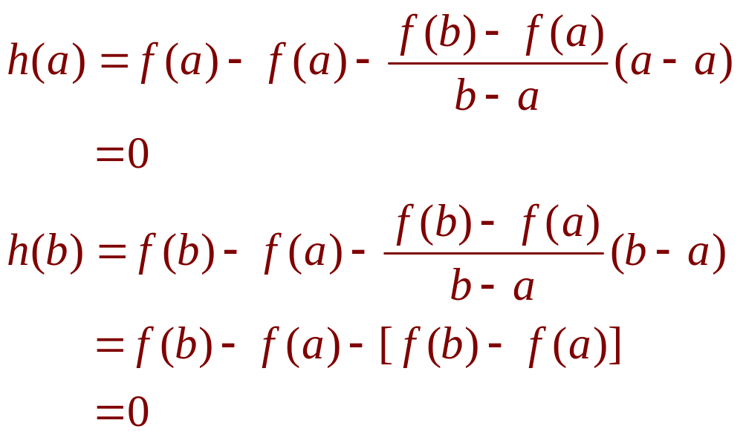
HYPOTHESIS 3
Therefore, h(a) = h(b).

Slide 34
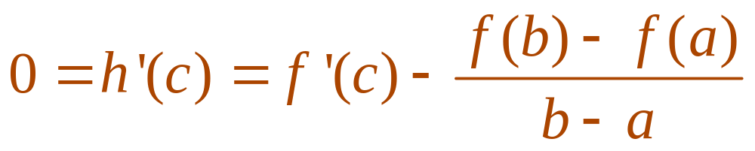

MEAN VALUE THEOREM
As h satisfies the hypotheses of Rolle’s Theorem, that theorem states there is
a number c in (a, b) such that h’(c) = 0.
  Therefore,
  So,

Slide 35
MEAN VALUE THEOREM
Example 3
To illustrate the Mean Value Theorem with a specific function, let’s consider
f(x) = x³ – x, a = 0, b = 2.

Slide 36
MEAN VALUE THEOREM
Example 3
Since f is a polynomial, it is continuous
and differentiable for all x.
So, it is certainly continuous on [0, 2]
and differentiable on (0, 2).
  Therefore, by the Mean Value Theorem,
  there is a number c in (0,2) such that:
  f(2) – f(0) = f ’(c)(2 – 0)

Slide 37

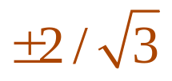
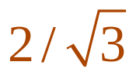
MEAN VALUE THEOREM
Example 3
Now, f(2) = 6, f(0) = 0, and f ’(x) = 3x² – 1.
So, this equation becomes
6 = (3c² – 1)² = 6c² – 2
  This gives c² = , that is, c = .
  However, c must lie in (0, 2), so c = .

Slide 38
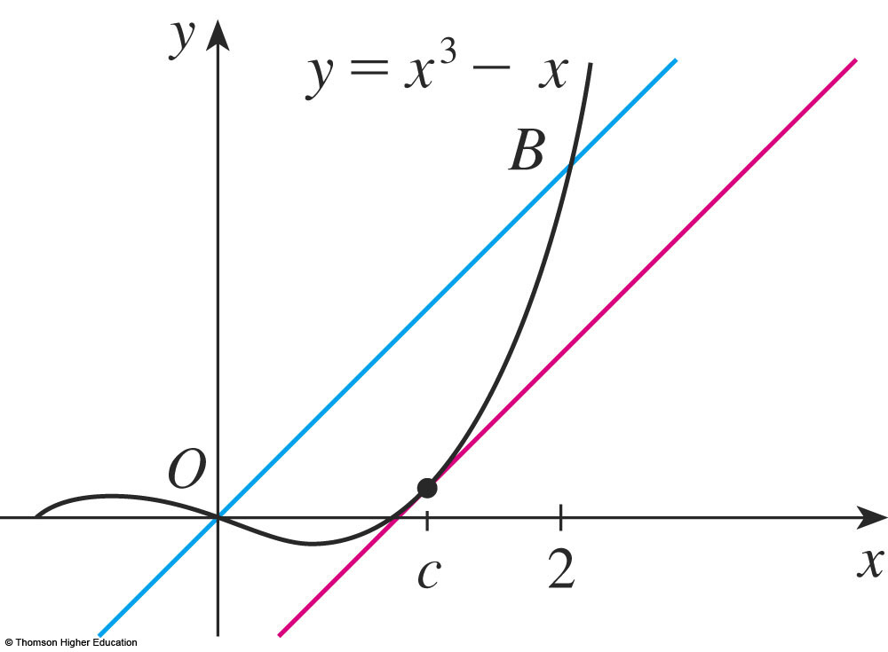
MEAN VALUE THEOREM
Example 3
The figure illustrates this calculation.
  The tangent line at this value of c is parallel
  to the secant line OB.

Slide 39
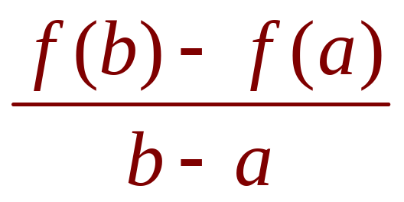
MEAN VALUE THEOREM
Example 4
If an object moves in a straight line with position function s = f(t), then the average velocity between t = a and t = b is
and the velocity at t = c is f ’(c).

Slide 40
MEAN VALUE THEOREM
Example 4
Thus, the Mean Value Theorem—in the form of Equation 1—tells us that, at some time
t = c between a and b, the instantaneous velocity f ’(c) is equal to that average velocity.
  For instance, if a car traveled 180 km in 2 hours, the speedometer must have read 90 km/h at least once.

Slide 41
MEAN VALUE THEOREM
Example 4
In general, the Mean Value Theorem can be interpreted as saying that there is a number
at which the instantaneous rate of change
is equal to the average rate of change over
an interval.

Slide 42
MEAN VALUE THEOREM
The main significance of the Mean Value Theorem is that it enables us to obtain information about a function from information about its derivative.
  The next example provides an instance
  of this principle.

Slide 43
MEAN VALUE THEOREM
Example 5
Suppose that f(0) = -3 and f ’(x) ≤ 5
for all values of x.
How large can f(2) possibly be?

Slide 44
MEAN VALUE THEOREM
Example 5
We are given that f is differentiable—and therefore continuous—everywhere.
In particular, we can apply the Mean Value Theorem on the interval [0, 2].
  There exists a number c such that
  f(2) – f(0) = f ’(c)(2 – 0)
  So, f(2) = f(0) + 2 f ’(c) = – 3 + 2 f ’(c)

Slide 45
MEAN VALUE THEOREM
Example 5
We are given that f ’(x) ≤ 5 for all x.
So, in particular, we know that f ’(c) ≤ 5.
  Multiplying both sides of this inequality by 2,
  we have 2 f ’(c) ≤ 10.
  So, f(2) = – 3 + 2 f ’(c) ≤ – 3 + 10 = 7
  The largest possible value for f(2) is 7.

Slide 46
MEAN VALUE THEOREM
The Mean Value Theorem can be used
to establish some of the basic facts of differential calculus.
  One of these basic facts is the following theorem.
  Others will be found in the following sections.

Slide 47
MEAN VALUE THEOREM
Theorem 5
If f ’(x) = 0 for all x in an
interval (a, b), then f is constant
on (a, b).

Slide 48
MEAN VALUE THEOREM
Theorem 5—Proof
Let x₁ and x₂ be any two numbers
in (a, b) with x₁ < x₂.
  Since f is differentiable on (a, b), it must be differentiable on (x₁, x₂) and continuous on [x₁, x₂].

Slide 49
MEAN VALUE THEOREM
Th. 5—Proof (Eqn. 6)
By applying the Mean Value Theorem to f on the interval [x₁, x₂], we get a number c such that x₁ < c < x₂ and
f(x₂) – f(x₁) = f ’(c)(x₂ – x₁)

Slide 50
MEAN VALUE THEOREM
Theorem 5—Proof
Since f ’(x) = 0 for all x, we have f ’(c) = 0.
So, Equation 6 becomes
f(x₂) – f(x₁) = 0 or f(x₂) = f(x₁)
  Therefore, f has the same value at any two numbers
  x₁ and x₂ in (a, b).
  This means that f is constant on (a, b).

Slide 51
MEAN VALUE THEOREM
Corollary 7
If f ’(x) = g ’(x) for all x in an interval (a, b), then f – g is constant on (a, b).
That is, f(x) = g(x) + c where c is
a constant.

Slide 52
MEAN VALUE THEOREM
Corollary 7—Proof
Let F(x) = f(x) – g(x).
Then,
F’(x) = f ’(x) – g ’(x) = 0
for all x in (a, b).
  Thus, by Theorem 5, F is constant.
  That is, f – g is constant.

Slide 53
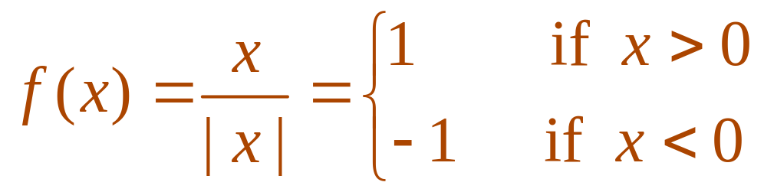
NOTE
Care must be taken in applying
Theorem 5.
  Let
  The domain of f is D = {x | x ≠ 0} and f ’(x) = 0
  for all x in D.

Slide 54
NOTE
However, f is obviously not a constant function.
This does not contradict Theorem 5 because D is not an interval.
  Notice that f is constant on the interval (0, ∞)
  and also on the interval (-∞, 0).

Slide 55
MEAN VALUE THEOREM
Example 6
Prove the identity
tan⁻¹ x + cot ⁻¹ x = π/2.
  Although calculus isn’t needed to prove this
  identity, the proof using calculus is quite simple.

Slide 56
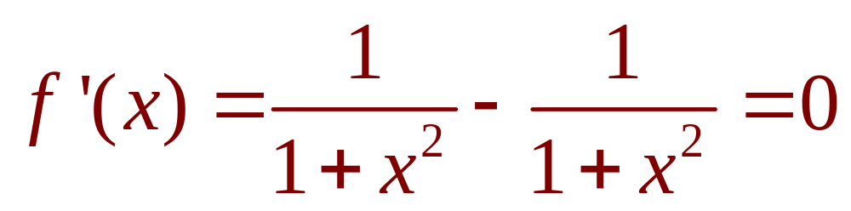
MEAN VALUE THEOREM
Example 6
If f(x) = tan⁻¹ x + cot ⁻¹ x ,
then
for all values of x.
  Therefore, f(x) = C, a constant.

Slide 57
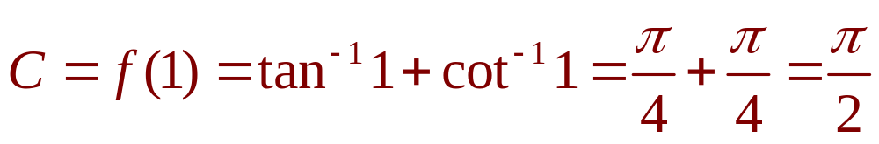
MEAN VALUE THEOREM
Example 6
To determine the value of C, we put x = 1 (because we can evaluate f(1) exactly).
Then,
  Thus, tan⁻¹ x + cot⁻¹ x = π/2.

