Slide 1

4
APPLICATIONS OF DIFFERENTIATION

Slide 2
APPLICATIONS OF DIFFERENTIATION
Many applications of calculus depend
on our ability to deduce facts about
a function f from information concerning
its derivatives.

Slide 3
APPLICATIONS OF DIFFERENTIATION
4.3
How Derivatives Affect
the Shape of a Graph
In this section, we will learn:
How the derivative of a function gives us the direction
in which the curve proceeds at each point.

Slide 4
DERIVATIVES AND GRAPH SHAPE
As f’(x) represents the slope of the curve
y = f(x) at the point (x, f(x)), it tells us
the direction in which the curve proceeds
at each point.
  Thus, it is reasonable to expect that
  information about f’(x) will provide us
  with information about f(x).

Slide 5
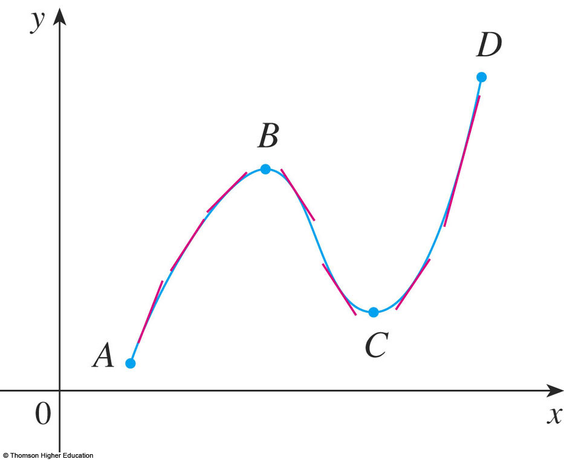
WHAT DOES f’ SAY ABOUT f ?
To see how the derivative of f can
tell us where a function is increasing
or decreasing, look at the figure.
  Increasing functions
  and decreasing
  functions were
  defined in Section 1.1

Slide 6
WHAT DOES f’ SAY ABOUT f ?
Between A and B and between C and D, the tangent lines have positive slope.
So, f’(x) > 0.

Slide 7
WHAT DOES f’ SAY ABOUT f ?
Between B and C, the tangent lines
have negative slope.
So, f’(x) < 0.

Slide 8
WHAT DOES f’ SAY ABOUT f ?
Thus, it appears that f increases when
f’(x) is positive and decreases when f’(x)
is negative.
  To prove that this
  is always the case,
  we use the Mean
  Value Theorem.

Slide 9
INCREASING/DECREASING TEST (I/D TEST)
If f’(x) > 0 on an interval, then f is increasing on that interval.
If f’(x) < 0 on an interval, then f is decreasing on that interval.

Slide 10
I/D TEST
Proof a
Let x₁ and x₂ be any two numbers in
the interval with x₁ < x₂.
According to the definition of an increasing function, we have to show that f(x₁) < f(x₂).

Slide 11
I/D TEST
Proof a (Equation 1)
Since we are given that f’(x) > 0, we know that f is differentiable on [x₁, x₂].
So, by the Mean Value Theorem, there is
a number c between x₁ and x₂ such that:
f(x₂) – f(x₁) = f’(c)(x₂ – x₁)

Slide 12
I/D TEST
Proof a and b
Now, f’(c) > 0 by assumption and x₂ – x₁ > 0 because x₁ < x₂ .
Thus, the right side of Equation 1 is positive.
So, f(x₂) – f(x₁) > 0 or f(x₁) < f(x₂)
  This shows that f is increasing.
  Part (b) is proved similarly.

Slide 13
I/D TEST
Example 1
Find where the function
f(x) = 3x⁴ – 4x³ – 12x² + 5
is increasing and where it is decreasing.

Slide 14
I/D TEST
Example 1
f’(x) = 12x³ - 12x² - 24x = 12x(x – 2)(x + 1)
  To use the ID Test, we have to know where
  f’(x) > 0 and where f’(x) < 0.
  This depends on the signs of the three factors
  of f’(x)—namely, 12x, x – 2, and x + 1.

Slide 15
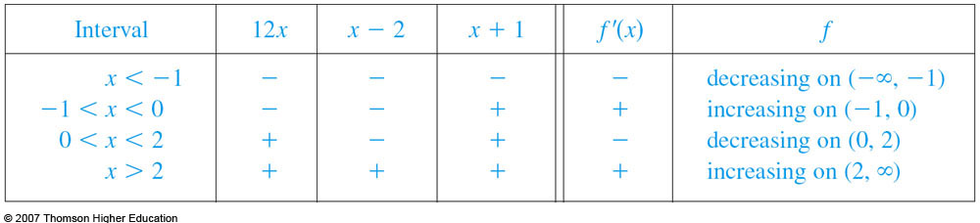
I/D TEST
Example 1
We divide the real line into intervals
whose endpoints are the critical numbers
-1, 0, and 2 and arrange our work in
a chart.

Slide 16
I/D TEST
Example 1
A plus sign indicates the given expression
is positive.
A minus sign indicates it is negative.
The last column gives the conclusion
based on the I/D Test.

Slide 17
I/D TEST
Example 1
For instance, f’(x) < 0 for 0 < x < 2.
So, f is decreasing on (0, 2).
  It would also be true to say that f is decreasing
  on the closed interval.

Slide 18
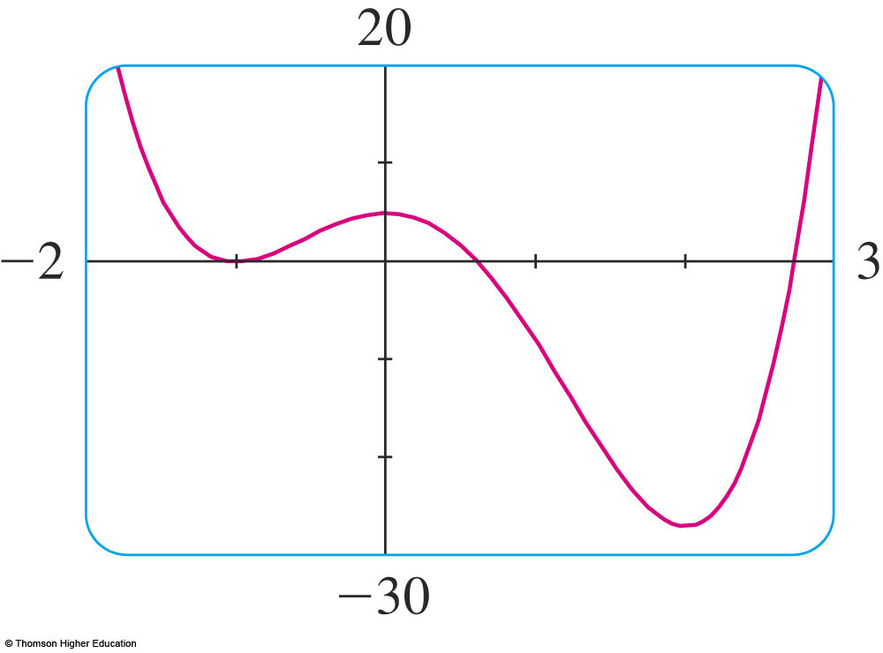
I/D TEST
Example 1
The graph of f confirms
the information
in the chart.

Slide 19
WHAT DOES f’ SAY ABOUT f ?
Recall from Section 4.1 that, if f has a local maximum or minimum at c, then c must be
a critical number of f (by Fermat’s Theorem).
  However, not every critical number gives rise
  to a maximum or a minimum.
  So, we need a test that will tell us whether or not f
  has a local maximum or minimum at a critical number.

Slide 20
WHAT DOES f’ SAY ABOUT f ?
You can see from the figure that f(0) = 5 is
a local maximum value of f because f increases on (-1, 0) and decreases on (0, 2).
  In terms of derivatives,
  f’(x) > 0 for -1 < x < 0
  and f’(x) < 0 for 0 < x < 2.

Slide 21
WHAT DOES f’ SAY ABOUT f ?
In other words, the sign of f’(x)
changes from positive to negative at 0.
  This observation is the basis of the following test.

Slide 22
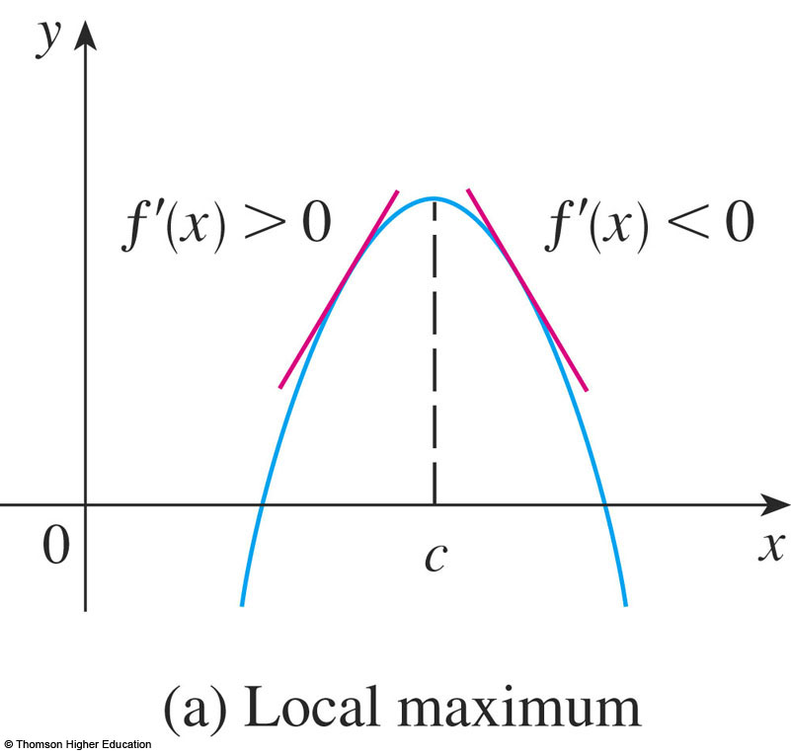
FIRST DERIVATIVE TEST
Suppose that c is a critical number of
a continuous function f.
a. If f’ changes from
positive to negative
at c, then f has
a local maximum at c.

Slide 23
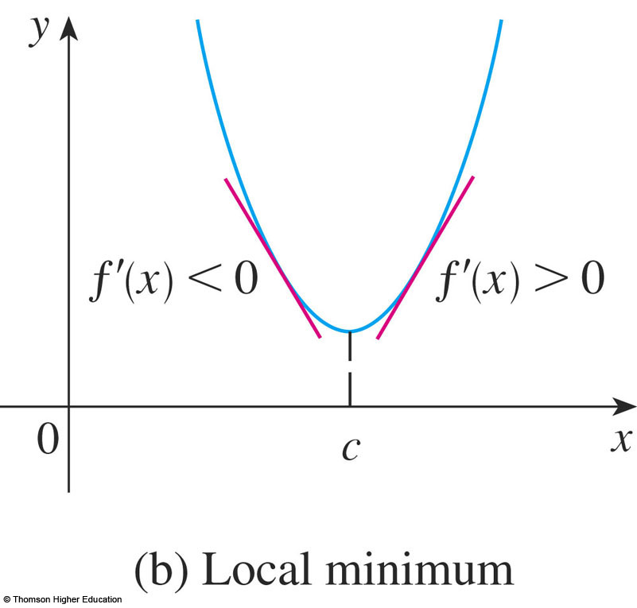
FIRST DERIVATIVE TEST
b. If f’ changes from negative to
positive at c, then f has a local minimum at c.

Slide 24
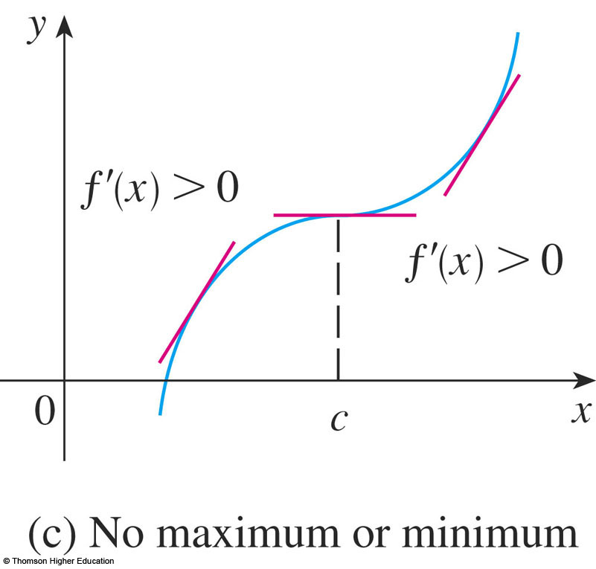
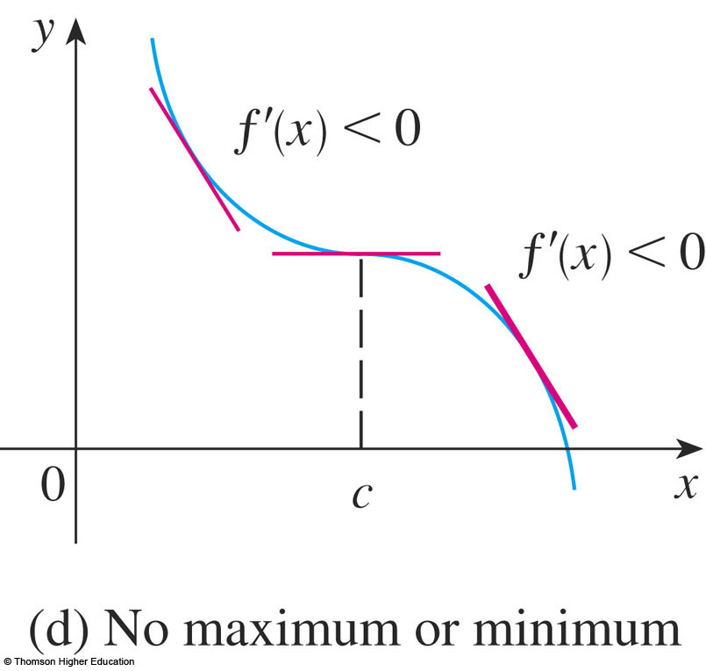
FIRST DERIVATIVE TEST
c. If f’ does not change sign at c—for example, if f’ is positive on both sides of c or negative on both sides—then f has no local maximum or minimum at c.

Slide 25
FIRST DERIVATIVE TEST
The First Derivative Test is a consequence of the I/D Test.
  For instance, in (a), since the sign of f’(x) changes
  from positive to negative at c, f is increasing to the left
  of c and decreasing to the right of c.
  It follows that f has
  a local maximum at c.

Slide 26
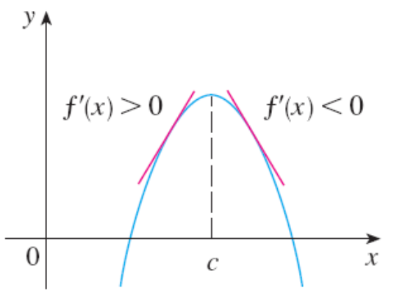
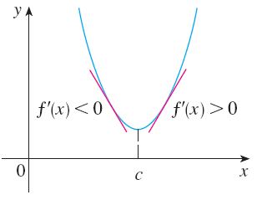
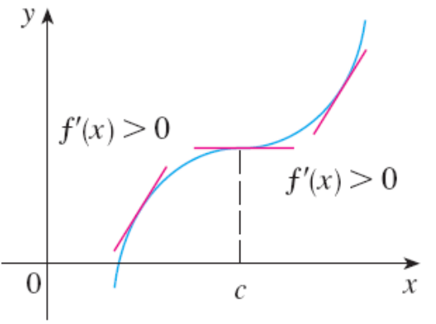
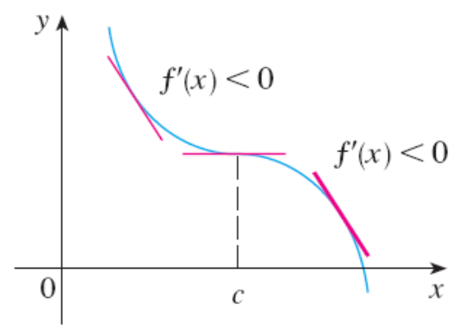
FIRST DERIVATIVE TEST
It is easy to remember the test by visualizing diagrams.

Slide 27
WHAT DOES f’ SAY ABOUT f ?
Example 2
Find the local minimum and
maximum values of the function f
in Example 1.

Slide 28
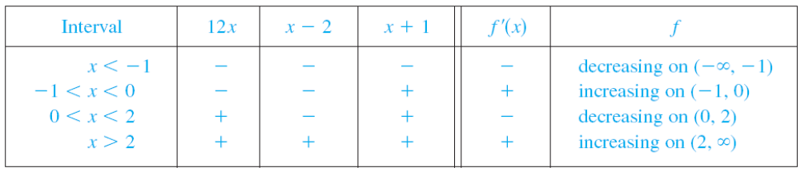
WHAT DOES f’ SAY ABOUT f ?
Example 2
From the chart in the solution to Example 1, we see that f’(x) changes from negative to positive at -1.
  So, f(-1) = 0 is a local minimum value by
  the First Derivative Test.

Slide 29
WHAT DOES f’ SAY ABOUT f ?
Example 2
Similarly, f’ changes from negative to positive at 2.
  So, f(2) = -27 is also a local minimum value.

Slide 30
WHAT DOES f’ SAY ABOUT f ?
Example 2
As previously noted, f(0) = 5 is
a local maximum value because f’(x) changes from positive to negative at 0.

Slide 31
WHAT DOES f’ SAY ABOUT f ?
Example 3
Find the local maximum and minimum values of the function
g(x) = x + 2 sin x 0 ≤ x ≤ 2π

Slide 32
WHAT DOES f’ SAY ABOUT f ?
Example 3
To find the critical numbers of g,
we differentiate:
  g’(x) = 1 + 2 cos x
  So, g’(x) = 0 when cos x = - ½.
  The solutions of this equation are 2π/3 and 4π/3.

Slide 33
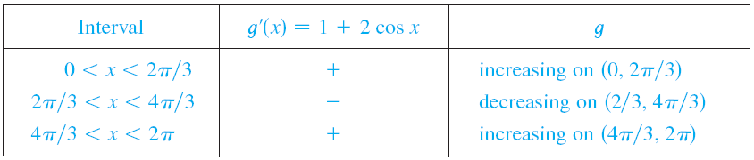
WHAT DOES f’ SAY ABOUT f ?
Example 3
As g is differentiable everywhere,
the only critical numbers are 2π/3 and 4π/3.
So, we analyze g in the following table.

Slide 34
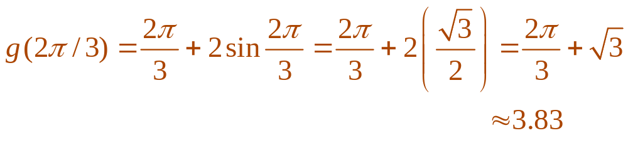
WHAT DOES f’ SAY ABOUT f ?
Example 3
As g’(x) changes from positive to negative
at 2π/3, the First Derivative Test tells us
that there is a local maximum at 2π/3.
  The local maximum value is:

Slide 35
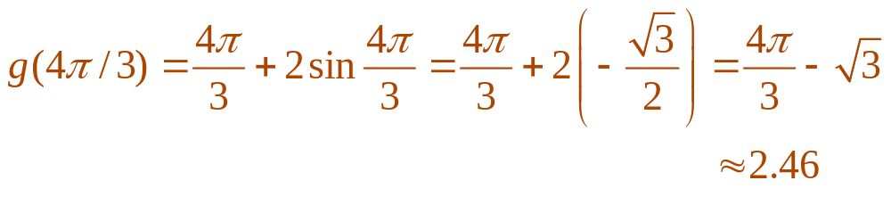
WHAT DOES f’ SAY ABOUT f ?
Example 3
Likewise, g’(x) changes from negative to positive at 4π/3.
  So, a local minimum value is:

Slide 36
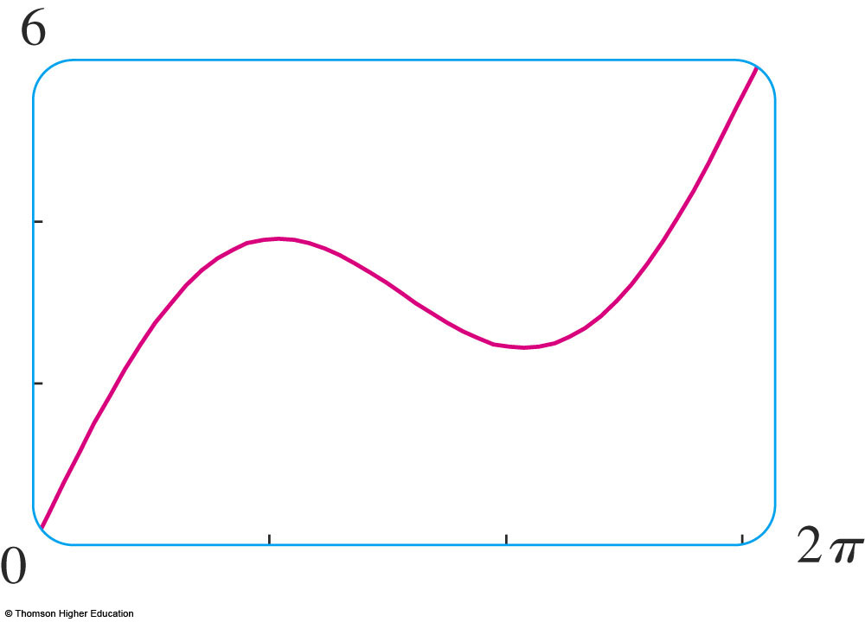
WHAT DOES f’ SAY ABOUT f ?
Example 3
The graph of g supports our conclusion.

Slide 37
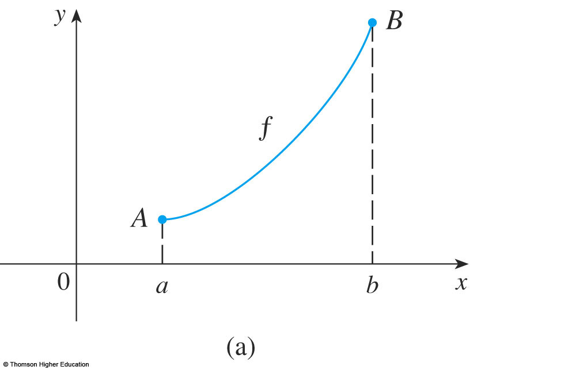
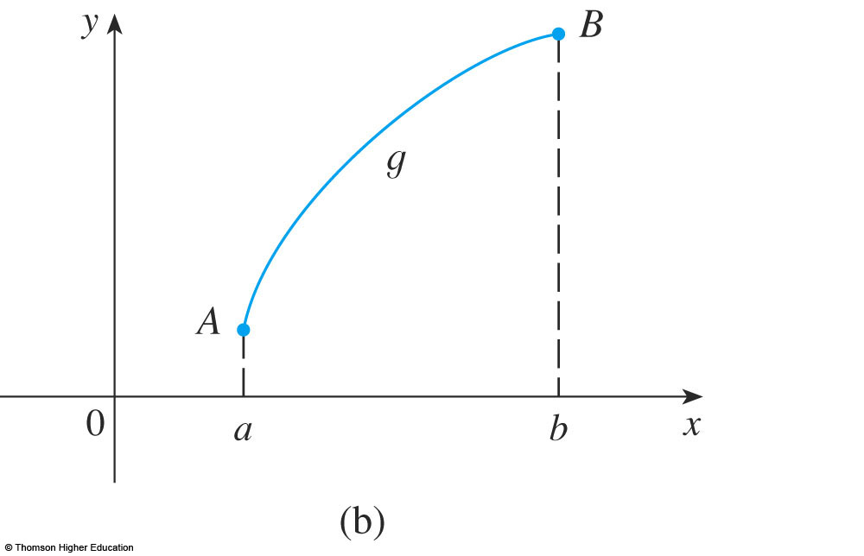
WHAT DOES f’’ SAY ABOUT f ?
The figure shows the graphs of
two increasing functions on (a, b).

Slide 38
WHAT DOES f’’ SAY ABOUT f ?
Both graphs join point A to point B, but
they look different because they bend in different directions.
  How can we distinguish between these two types
  of behavior?

Slide 39
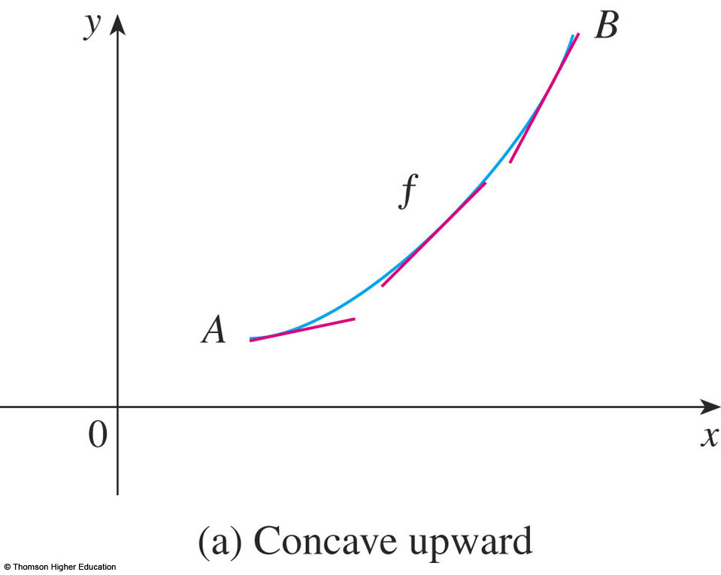
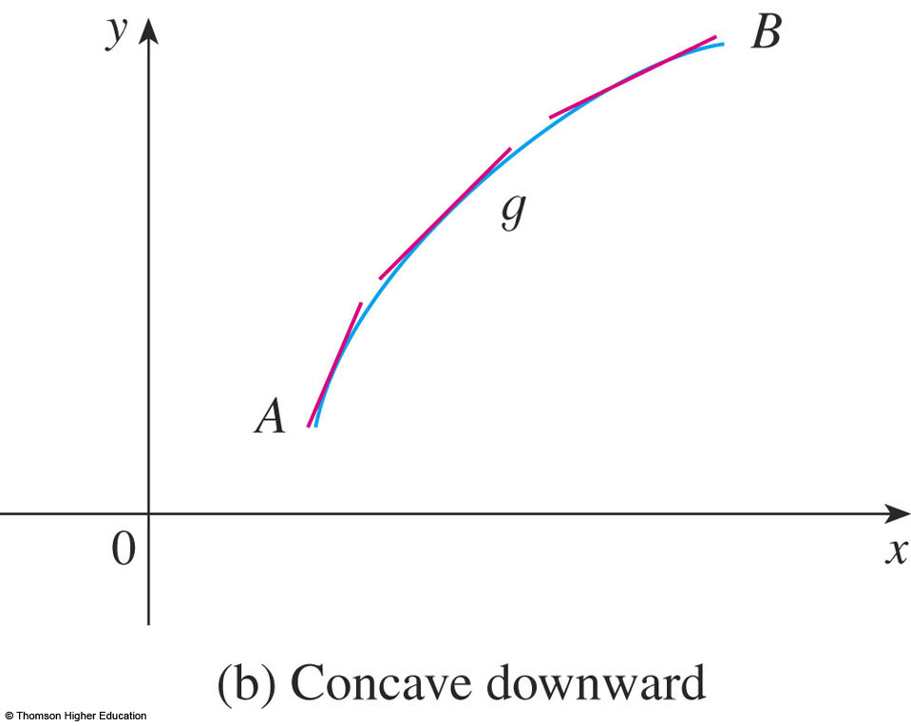
WHAT DOES f’’ SAY ABOUT f ?
Here, tangents to these curves have been drawn at several points.

Slide 40
CONCAVE UPWARD
In the first figure, the curve lies
above the tangents and f is called
concave upward on (a, b).

Slide 41
CONCAVE DOWNWARD
In the second figure, the curve lies
below the tangents and g is called
concave downward on (a, b).

Slide 42
CONCAVITY—DEFINITION
If the graph of f lies above all of
its tangents on an interval I, it is called concave upward on I.
If the graph of f lies below all of its tangents
on I, it is called concave downward on I.

Slide 43
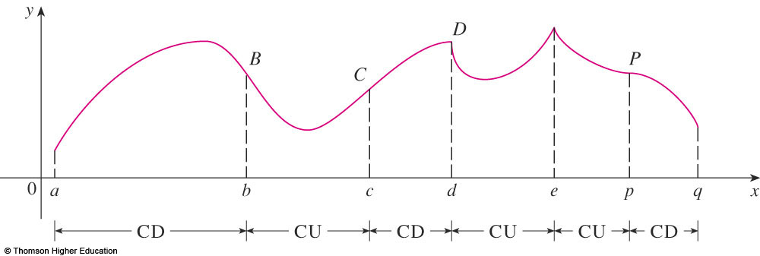
CONCAVITY
The figure shows the graph of a function that is concave upward (CU) on the intervals (b, c), (d, e), and (e, p) and concave downward (CD) on the intervals (a, b), (c, d), and (p, q).

Slide 44
CONCAVITY
Let’s see how the second derivative helps determine the intervals of concavity.

Slide 45
CONCAVITY
From this figure, you can see that, going from left to right, the slope of the tangent increases.
  This means that the derivative f’ is an increasing function and therefore its derivative f” is positive.

Slide 46
CONCAVITY
Likewise, in this figure, the slope of
the tangent decreases from left to right.
So, f’ decreases and therefore f’’ is negative.
  This reasoning can be
  reversed and suggests
  that the following
  theorem is true.

Slide 47
CONCAVITY TEST
If f’’(x) > 0 for all x in I, then the graph of f
is concave upward on I.
If f’’(x) < 0 for all x in I, then the graph of f
is concave downward on I.

Slide 48
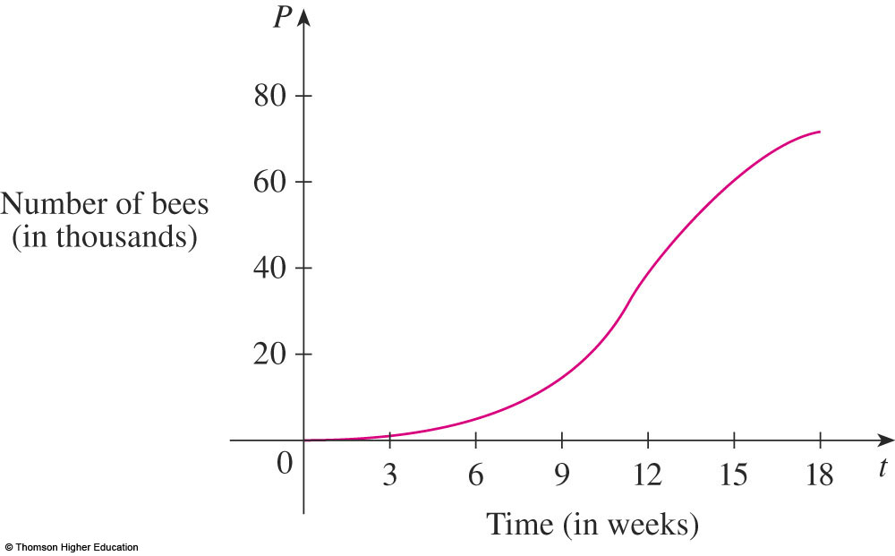
CONCAVITY
Example 4
The figure shows a population graph for Cyprian honeybees raised in an apiary.
  How does the rate of population increase change
  over time?
  When is this rate highest?
  Over what
  intervals is P
  concave upward or
  concave downward?

Slide 49
CONCAVITY
Example 4
By looking at the slope of the curve as t increases, we see that the rate of increase
of the population is initially very small.
  Then, it gets larger
  until it reaches
  a maximum at
  about t = 12 weeks,
  and decreases as
  the population
  begins to level off.

Slide 50
CONCAVITY
Example 4
As the population approaches its
maximum value of about 75,000 (called
the carrying capacity), the rate of increase, P’(t), approaches 0.
  The curve
  appears to be
  concave upward
  on (0, 12) and
  concave downward
  on (12, 18).

Slide 51
INFLECTION POINT
In the example, the curve changed from concave upward to concave downward at approximately the point (12, 38,000).
  This point is called
  an inflection point
  of the curve.

Slide 52
INFLECTION POINT
The significance of this point is that
the rate of population increase has its maximum value there.
  In general, an inflection point is a point where
  a curve changes its direction of concavity.

Slide 53
INFLECTION POINT—DEFINITION
A point P on a curve y = f(x) is called
an inflection point if f is continuous there
and the curve changes from concave upward to concave downward or from concave downward to concave upward at P.

Slide 54
INFLECTION POINT
For instance, here, B, C, D, and P are
the points of inflection.
  Notice that, if a curve has a tangent at a point of inflection, then the curve crosses its tangent there.

Slide 55
INFLECTION POINT
In view of the Concavity Test, there is
a point of inflection at any point where the second derivative changes sign.

Slide 56
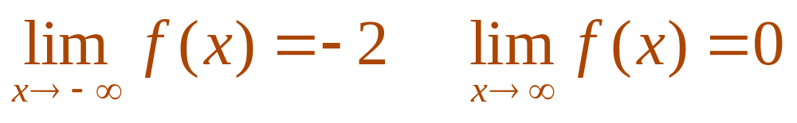
WHAT DOES f’’ SAY ABOUT f ?
Example 5
Sketch a possible graph of a function f
that satisfies the following conditions:
  (i) f’(x) > 0 on (-∞ , 1), f’(x) < 0 on (1, ∞)
  (ii) f’’(x) > 0 on (-∞, -2) and (2, ∞), f’’(x) < 0 on (-2, 2)
  (iii) ,

Slide 57
WHAT DOES f’’ SAY ABOUT f ?
E. g. 5—Condition i
The first condition tells us that f
is increasing on (-∞ , 1) and decreasing on (1, ∞).

Slide 58
WHAT DOES f’’ SAY ABOUT f ?
E. g. 5—Condition ii
The second condition says that f
is concave upward on (-∞, -2) and (2, ∞), and concave downward on (-2, 2).

Slide 59
WHAT DOES f’’ SAY ABOUT f ?
E. g. 5—Condition iii
From the third condition, we know
that the graph of f has two horizontal asymptotes:
  y = -2
  y = 0

Slide 60
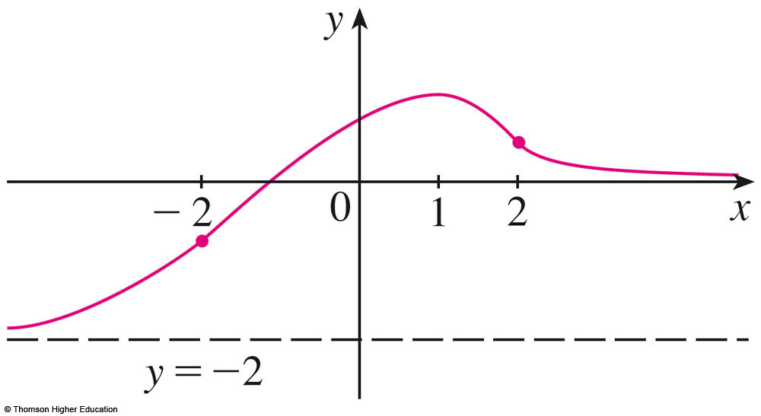
WHAT DOES f’’ SAY ABOUT f ?
E. g. 5—Condition iii
We first draw the horizontal asymptote
y = -2 as a dashed line.
  We then draw the graph of f approaching this asymptote at the far left—increasing to its maximum point at x = 1 and decreasing toward the x-axis at the far right.

Slide 61
WHAT DOES f’’ SAY ABOUT f ?
E. g. 5—Condition iii
We also make sure that the graph has inflection points when x = -2 and 2.
  Notice that we made the curve bend upward for x < -2 and x > 2, and bend downward when x is between -2 and 2.

Slide 62
WHAT DOES f’’ SAY ABOUT f ?
Another application of the second derivative is the following test
for maximum and minimum values.
  It is a consequence of the Concavity Test.

Slide 63
SECOND DERIVATIVE TEST
Suppose f’’ is continuous near c.
If f’(c) = 0 and f’’(c) > 0, then f has
a local minimum at c.
If f’(c) = 0 and f’’(c) < 0, then f has
a local maximum at c.

Slide 64
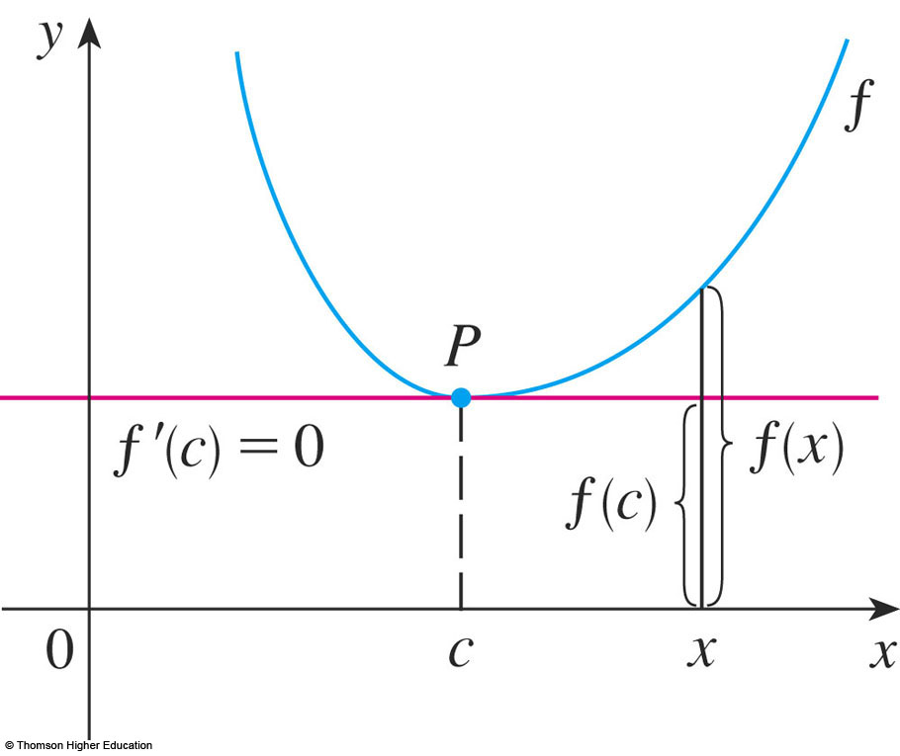
SECOND DERIVATIVE TEST
For instance, (a) is true because f’’(x) > 0 near c, and so f is concave upward near c.
  This means that
  the graph of f lies
  above its horizontal
  tangent at c, and so
  f has a local minimum
  at c.

Slide 65
WHAT DOES f’’ SAY ABOUT f ?
Example 6
Discuss the curve
y = x⁴ – 4x³
with respect to concavity, points of inflection, and local maxima and minima.
Use this information to sketch the curve.

Slide 66
WHAT DOES f’’ SAY ABOUT f ?
Example 6
If f(x) = x⁴ – 4x³, then:
f’(x) = 4x³ – 12x² = 4x²(x – 3)
f’’(x) = 12x² – 24x = 12x(x – 2)

Slide 67
WHAT DOES f’’ SAY ABOUT f ?
Example 6
To find the critical numbers, we set f’(x) = 0 and obtain x = 0 and x = 3.
To use the Second Derivative Test,
we evaluate f’’ at these critical numbers:
f’’(0) = 0 f’’(3) = 36 > 0

Slide 68
WHAT DOES f’’ SAY ABOUT f ?
Example 6
As f’(3) = 0 and f’’(3) > 0, f(3) = -27 is
a local minimum.
As f’’(0) = 0, the Second Derivative Test gives no information about the critical number 0.

Slide 69
WHAT DOES f’’ SAY ABOUT f ?
Example 6
However, since f’(x) < 0 for x < 0 and also
for 0 < x < 3, the First Derivative Test tells
us that f does not have a local maximum or minimum at 0.
  In fact, the expression for f’(x) shows that
  f decreases to the left of 3 and increases to
  the right of 3.

Slide 70
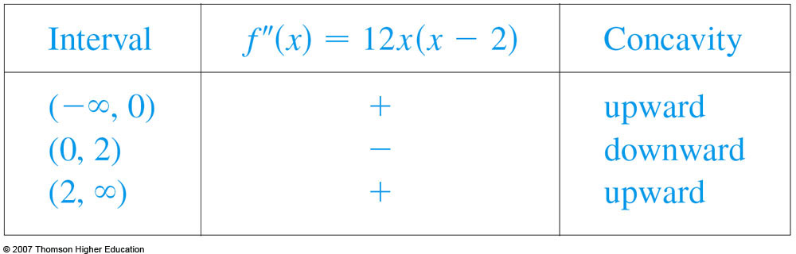
WHAT DOES f’’ SAY ABOUT f ?
Example 6
As f’’(x) = 0 when x = 0 or 2, we divide
the real line into intervals with those numbers as endpoints and complete the following chart.

Slide 71
WHAT DOES f’’ SAY ABOUT f ?
Example 6
The point (0, 0) is an inflection point—since the curve changes from concave upward to concave downward there.

Slide 72
WHAT DOES f’’ SAY ABOUT f ?
Example 6
Also, (2, -16) is an inflection point—since
the curve changes from concave downward
to concave upward there.

Slide 73
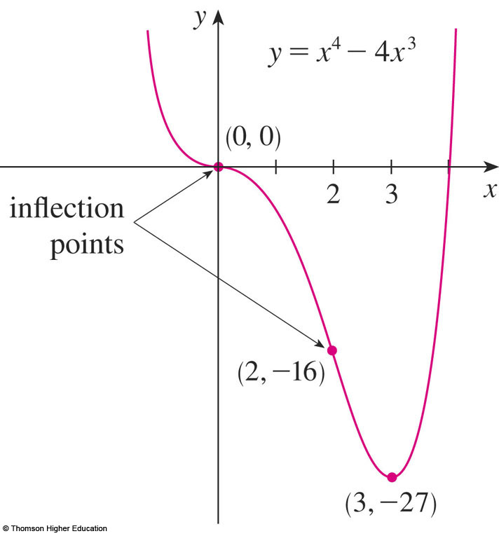
WHAT DOES f’’ SAY ABOUT f ?
Example 6
Using the local minimum, the intervals
of concavity, and the inflection points,
we sketch the curve.

Slide 74
NOTE
The Second Derivative Test is inconclusive when f’’(c) = 0.
  In other words, at such a point, there might be
  a maximum, a minimum, or neither (as in the example).

Slide 75
NOTE
The test also fails when f’’(c) does not exist.
In such cases, the First Derivative Test must be used.
  In fact, even when both tests apply, the First Derivative Test is often the easier one to use.

Slide 76
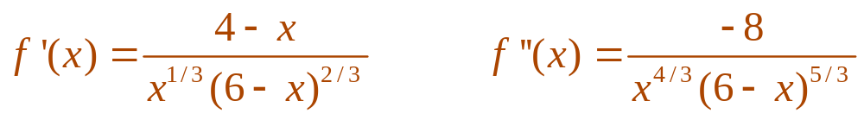
WHAT DOES f’’ SAY ABOUT f ?
Example 7
Sketch the graph of the function
f(x) = x^{2/3}(6 – x)^{1/3}
  You can use the differentiation rules to check that
  the first two derivatives are:
  As f’(x) = 0 when x = 4 and f’(x) does not exist when
  x = 0 or x = 6, the critical numbers are 0, 4, and 6.

Slide 77
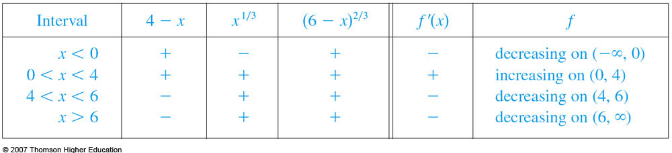
WHAT DOES f’’ SAY ABOUT f ?
Example 7
To find the local extreme values, we
use the First Derivative Test.
  As f’ changes from negative to positive at 0,
  f(0) = 0 is a local minimum.

Slide 78
WHAT DOES f’’ SAY ABOUT f ?
Example 7
  Since f’ changes from positive to negative at 4,
  f(4) = 2^{5/3} is a local maximum.
  The sign of f’ does not change at 6, so there is
  no minimum or maximum there.

Slide 79
WHAT DOES f’’ SAY ABOUT f ?
Example 7
The Second Derivative Test could be
used at 4, but not at 0 or 6—since f’’ does not exist at either of these numbers.

Slide 80
WHAT DOES f’’ SAY ABOUT f ?
Example 7
Looking at the expression for f’’(x)
and noting that x^{4/3} ≥ 0 for all x,
we have:
  f’’(x) < 0 for x < 0 and for 0 < x < 6
  f’’(x) > 0 for x > 6

Slide 81
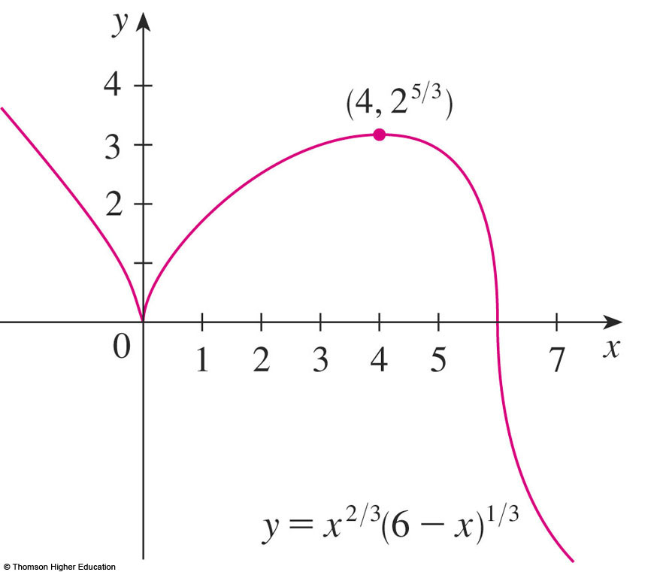
WHAT DOES f’’ SAY ABOUT f ?
Example 7
So, f is concave downward on (-∞, 0) and
(0, 6) and concave upward on (6, ∞), and
the only inflection point is (6, 0).
  Note that the curve
  has vertical tangents
  at (0, 0) and (6, 0)
  because |f’(x)| → ∞
  as x → 0 and as x → 6.

Slide 82
WHAT DOES f’’ SAY ABOUT f ?
Example 8
Use the first and second derivatives
of f(x) = e^{1/x}, together with asymptotes,
to sketch its graph.
  Notice that the domain of f is {x | x ≠ 0}.
  So, we check for vertical asymptotes by
  computing the left and right limits as x → 0.

Slide 83
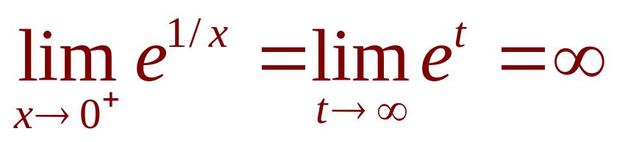
WHAT DOES f’’ SAY ABOUT f ?
As x → 0⁺, we know that t = 1/x → ∞.
So,
  This shows that x = 0 is a vertical asymptote.

Slide 84
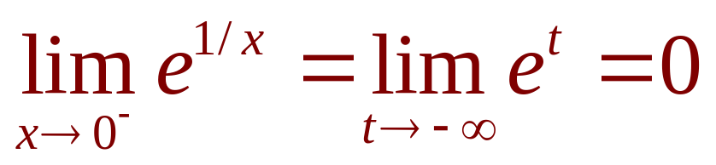
WHAT DOES f’’ SAY ABOUT f ?
As x → 0⁻, we know that t = 1/x → -∞.
So,

Slide 85
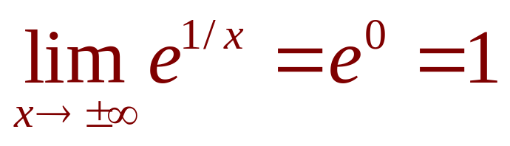
WHAT DOES f’’ SAY ABOUT f ?
As x → ±∞, we have 1/x → 0.
So,
  This shows that y = 1 is a horizontal asymptote.

Slide 86
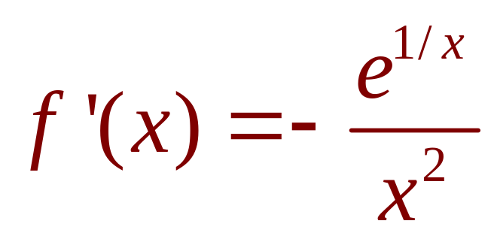
WHAT DOES f’’ SAY ABOUT f ?
Now, let’s compute the derivative.
The Chain Rule gives:
  Since e^{1/x} > 0 and x² > 0 for all x ≠ 0, we have
  f’(x) < 0 for all x ≠ 0.
  Thus, f is decreasing on (-∞, 0) and on (0, ∞) .

Slide 87
WHAT DOES f’’ SAY ABOUT f ?
There is no critical number.
So, the function has no maximum
or minimum.

Slide 88
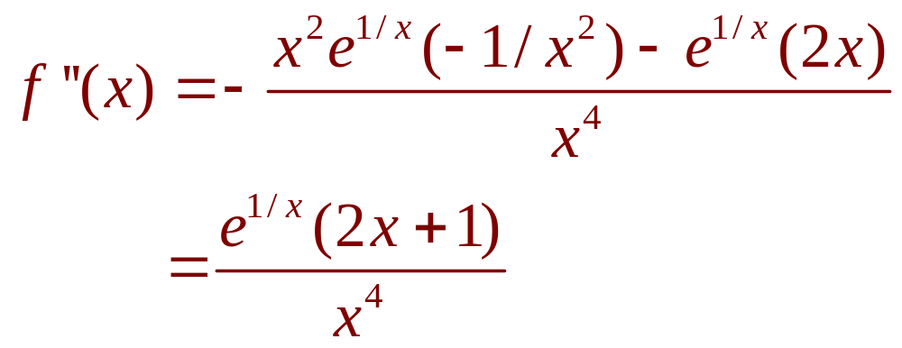
WHAT DOES f’’ SAY ABOUT f ?
The second derivative is:

Slide 89
WHAT DOES f’’ SAY ABOUT f ?
As e^{1/x} > 0 and x⁴ > 0, we have:
f’’(x) > 0 when x > -½ (x ≠ 0)
f’’(x) < 0 when x < -½
  So, the curve is concave downward on (-∞, -½)
  and concave upward on (-½, 0) and on (0, ∞).
  The inflection point is (-½, e⁻²).

Slide 90
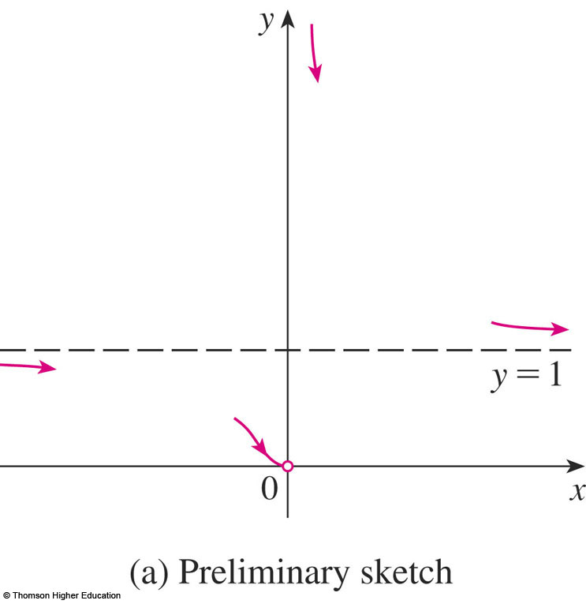
WHAT DOES f’’ SAY ABOUT f ?
To sketch the graph of f, we first draw
the horizontal asymptote y = 1 (as a dashed line), together with the parts of the curve
near the asymptotes
in a preliminary sketch.

Slide 91
WHAT DOES f’’ SAY ABOUT f ?
These parts reflect the information concerning limits and the fact that f is decreasing on both (-∞, 0) and (0, ∞).
  Notice that we have
  indicated that f(x) → 0
  as x → 0⁻ even though
  f(0) does not exist.

Slide 92
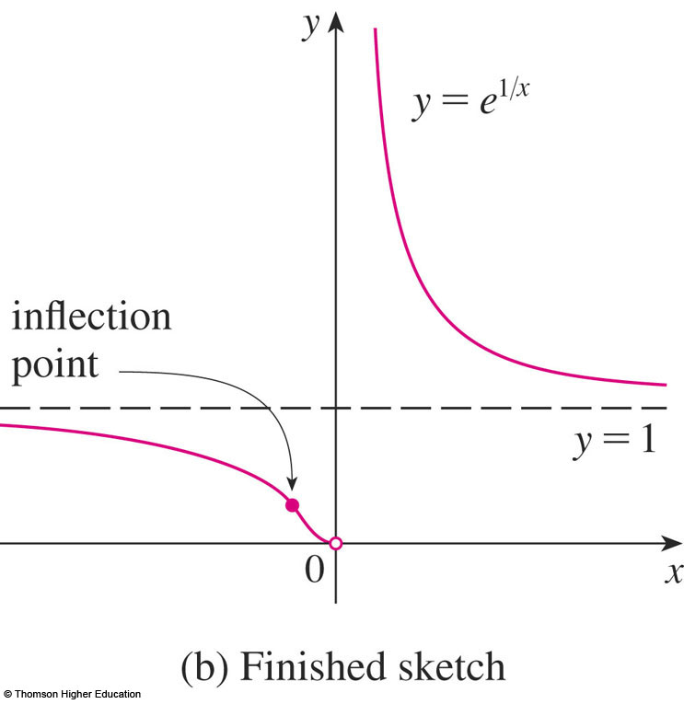
WHAT DOES f’’ SAY ABOUT f ?
Here, we finish the sketch by
incorporating the information concerning concavity and the inflection point.

Slide 93
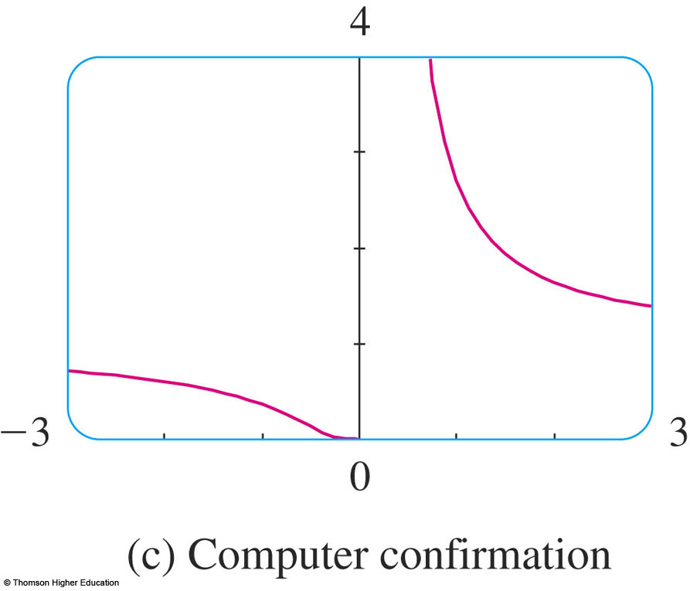
WHAT DOES f’’ SAY ABOUT f ?
Finally, we check our work with
a graphing device.

