Slide 1



Radio Transmission
(Large-Scale Fading)
Department of Computer System Engineering, University Of Engineering and Technology Peshawar.
Radio Transmission

Slide 2
Radio Wave Propagation
Mechanisms very diverse
reflection, diffraction and scattering
In urban areas where there is no direct LOS, high rise buildings cause severe diffraction loss
Waves travel along different paths of varying lengths
interaction causes multi-path fading
Strength decreases as the distance between the transmitter and receiver increases
Radio Transmission

Slide 3
Propagation Models
Have traditionally focused on predicting the average received signal strength in close spatial proximity to a particular location
Models that predict mean signal strength for an arbitrary transmitter receiver (T-R) separation
– Useful for estimating the radio coverage area of a transmitter - large-scale models
Radio Transmission

Slide 4
Propagation Models 2
Large scale models have T-Rs of several hundred or thousands of meters
Models that can characterize the rapid fluctuations of received signal strength over short distances (few wavelengths) or short duration (second) are called small-scale or fading models
Radio Transmission

Slide 5
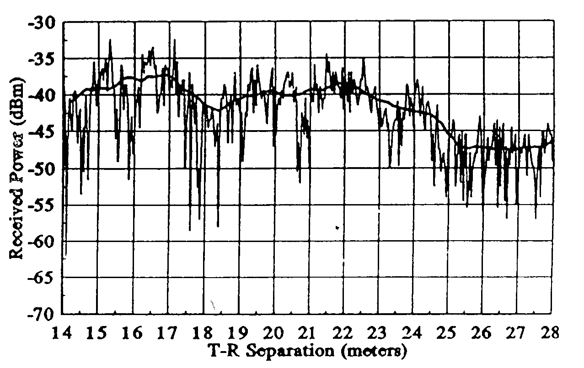
Typical Look
Radio Transmission

Slide 6
Free Space Propagation Model
Predicts received signal strength when Transmitter
(T) and Receiver (R) have direct Line of Sight (LOS)
Satellite & Microwave LOS radio links
As with most large scale models, the free space model predicts that the received power decays as a function of T-R separation raised to some power (power law function)
Radio Transmission

Slide 7
Isotropic Antenna
G = 1
4
2
G =
_{λ}2
A
A =
ea
ea
4π
Radio Transmission

Slide 8
Free Space Equation
– For a T-R distance of d
W
= P ⋅
rav
r
^{A}ea
_{λ} 2
P
P ( d ) =
t
r
4 π d 4 π
2
P_{t} - transmitted power,
P_{r}(d) - received power (change of notation !! P_{r}(d) ≡ W_{rav}),
Isotropic receiver and transmitter antenna used
Radio Transmission

Slide 9
Friis Free Space Equation
– For a T-R distance of d
P_{t} G _{t} G _{r} λ
2
P_{r} ( d ) =
2 _{L}
( 4 π ) ² d
P_{t} - transmitted power,
P_{r}(d) - received power,
G_{t} & G_{r} - transmitter & receiver antenna gains, L - system loss factor not related to propagation (L >= 1), λ - wavelength in meters
Radio Transmission

Slide 10
Antenna Gain
The gain of an antenna is related to its effective aperture, A_{e}, by:
4 π _{A}
G =
λ
2
e
A_{e} is related the physical size of the antenna, and
λ is related to the carrier frequency by:
c ₌ 2π c
f - the carrier frequency in Hz,
ω_{c} - carrier frequency in radians/sec,
c - speed of light in m/sec
8
λ =
f ω _{c}
EXAMPLE
f = 1 GHz →
3 ⋅ 10 m / s
λ =
= 0 . 3 m = 30 cm
9
10 1 / s
Radio Transmission

Slide 11
Units
P_{t} and P_{r} must be in the same units [W, mW]
G_{t} & G_{r} are dimensionless
L is due to transmission line attenuation, filter & antenna losses
Friis shows that the received power falls off as the square of d - 20 dB/decade
Radio Transmission

Slide 12
EIRP
Isotropic radiator is an ideal antenna which radiates power with unit gain uniformly in all directions - reference antenna gain in wireless systems
Effective Isotropic Radiated Power (EIRP) is defined as
EIRP = P_{t}G_{t}
Represents the maximum radiated power available from the transmitter in the direction of antenna gain as compared to an isotropic radiator
Radio Transmission

Slide 13
ERP
In practice, effective radiated power (ERP) is used instead to denote the max radiated power as compared to an half-wave-dipole antenna
Dipole antenna gain = 1.64, ERP will be 2.15dB smaller than the EIRP for the same transmission system
dBi - dB gain wrt to an isotropic source
dBd - dB gain wrt to a half wave dipole
Radio Transmission

Slide 14
Path Loss
Path Loss represents signal attenuation as a positive quantity measured in dB
P
⎡
⎢
⎢
⎢
2
⎤
⎥
GG λ
PL (dB) =10 log =−10 log
t
r
⎥
t
₂ ⎥
P
2
⎢
(4π ) d
⎥
⎥⎦
r
⎢
⎣
If antenna gains G_{r} are G_{r} equal to 1
⎡
⎢
⎢
⎢
⎢
2
⎤
⎥
PL(dB) = −10 log
λ
⎥
2
₂ ⎥
(4 π ) d
⎥
⎥⎦
⎢
⎣
Radio Transmission

Slide 15
Far Field
Friis model is only valid for received powers, P_{r} at distances d, which are in the far field or Fraunhofer region.
Far field of a transmitting antenna is defined as the region beyond the far field distance d_{f}, which is related to the largest linear dimension of the antenna aperture and/or carrier wavelength.
Radio Transmission

Slide 16
Fraunhofer Distance
Fraunhofer distance is given by
2 D
2
d =
l
f
D_{l} is the largest physical liner dimension of the antenna
To be in the far-field region, d_{f} must satisfy
d_{f} >> D_{l} and d_{f} >> λ
Radio Transmission

Slide 17
Distance d = 0
The received power equation does not hold for d = 0.
Large scale models use a close-in distance
d₀ - received power reference point
The received power at any distance d > d₀
may be related to P_{r}(d₀ ) at d₀
P_{r}(d₀ ) may be predicted or determined through empirical measurements
Radio Transmission

Slide 18


Proportions
Calculating height of an inaccessible point
measurable quantities
H(d₀ )
d₀
H(d)
Not measurable directly
d
H (d) = H(d₀) ^{d}
d0
Radio Transmission

Slide 19
Received power P_{r}(d)
_{λ} 2
P
P ( d ) =
⋅ t
r
( 4 π ) ² d
2
d
2
P (d ) = con ⋅ ^{Pt}
P (d ) = con⋅ ^{Pt}
con= P (d )⋅
0
r
r 0
r 0
P
d ² d ²
0
t
d₀ must be chosen to be in the far-field region
d
⎞2
⎛
P (d ) = P (d )
⎜
0
⎟
d ≥ d ≥ d
0 f
r r
⎜
⎟
0
⎜ d ⎟
⎝
⎠
⎡
P (d )
⎤
⎥
⎥
d
⎢
⎛ ⎞
P (d) [dBm]=10log
r
20log
⎜ ⎟
; d ≥d₀ ≥d_{f} .
⎢
0
0
r
⎜ ⎟
⎢
⎥
d
⎢0.001W⎥
⎜ ⎟
⎜ ⎟
⎢⎣
⎥⎦
⎝ ⎠
Radio Transmission

Slide 20
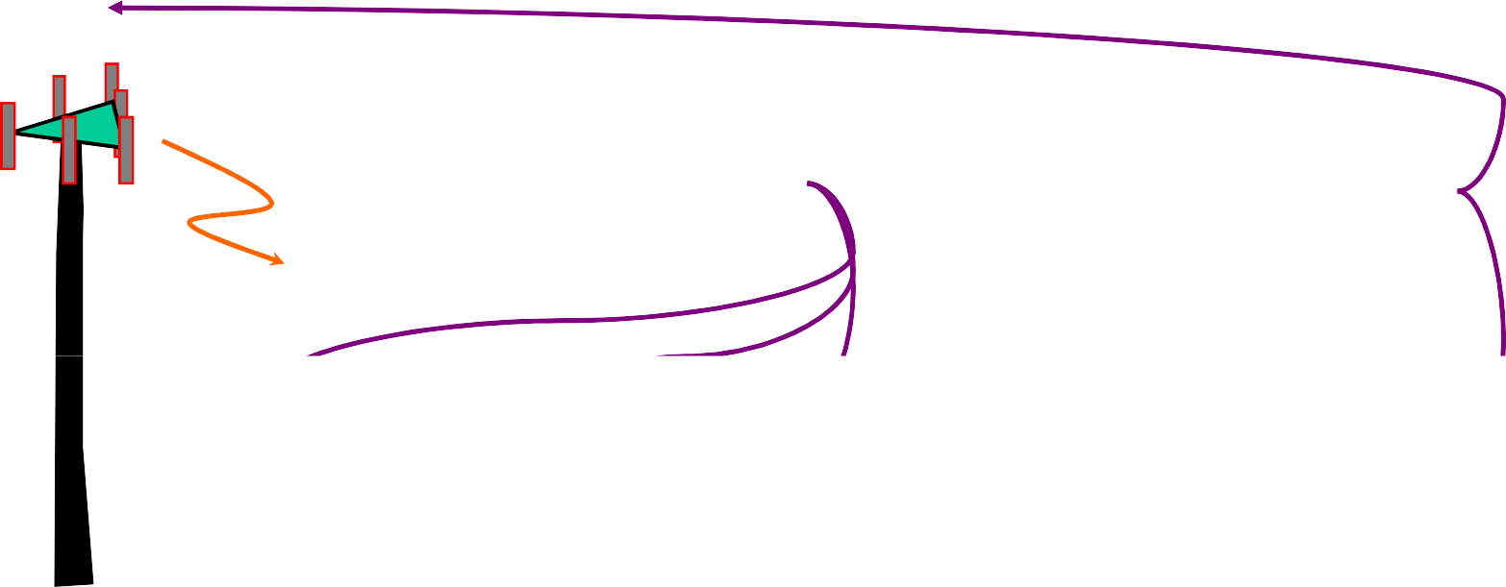


Received power P_{r}(d)
P_{t}
measurabl e quantities
not measurabl e
d₀
P_{r} (d₀ )
P_{r}(d)
BS
d
d
⎞2
⎛
P (d ) = P (d )
⎜
0
⎟
d ≥ d ≥ d
0 f
r r
⎜
⎟
0
⎜ d ⎟
⎝
⎠
Radio Transmission

Slide 21
Ground Reflection (2-ray) Model
•In a mobile radio channel, a single direct path between the base station and a mobile is exception rather then rule
•Two ray ground reflection model is reasonably accurate for predicting the large scale signal strength over distances of several kilometers for mobile radio systems
Radio Transmission

Slide 22

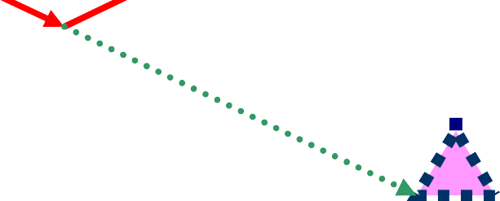
Two Ray Model
d’
d₀
^{E}TOT
h_{t} E_{O}
d’’
h_{r}
d
E d
⎛ d ' ⎞ E d
⎛ d '' ⎞
⎛
⎞
⎛
⎞
E (d,t) =
0 0
cos⎜ω t − ⎟⎟ −
c
0 0
cos⎜ω t − ⎟⎟
c
_{C} ⎜
_{C} ⎜
TOT
d '
⎝
⎝
⎠⎠
d ''
⎝
⎝
⎠⎠
Radio Transmission

Slide 23
Two Ray Model
⎛
d
⎞ 2
P_{r} (d ) = P_{r} (d )
⎜
0
⎟
d ≥ d ≥ d
0 f
⎜
⎟
0
⎜ d ⎟
⎝
⎠
E (d ) = ^{E0 d 0}
(d > d > d )
θ
d
0
f
d – reference
0
distance
⎛ _{t −} d ⎞ ⎞
E (d , t ) = ^{E0 d 0} cos ⎛ ω
⎜
_{C} ⎜
⎟ ⎟ (d > d )
θ
d
⎝
⎝
c ⎠ ⎠
0
E ( d , t ) = E
( d ' , t ) − E
( d ' ', t )
TOT
LOS
REF
⎛ _{t −} d ' ⎞ ⎞ ₋ E d
⎛ _{t −} d '' ⎞ ⎞
E (d , t ) = ^{E d}
cos⎛ω
cos⎛ω
0 0
⎜
⎝
⎜
⎟ ⎟
0 0
⎜
⎝
⎜
⎟ ⎟
TOT
d '
C
⎝
c ⎠ ⎠ d ' '
C
⎝
c ⎠ ⎠
Radio Transmission

Slide 24
Two Ray Model Approximations
d ' = (h_{t} − h_{r} ) ² + d ² ; d ' ' = (h_{t} + h_{r} ) ² + d ² ;
2h h
E d E d
E d
d >>h_{t} + h_{r} ;
⇒ d ''−d '≈ ;
t r
⇒ ≈
≈
0 0 0 0
0 0
d
d
d '
d ''
⎛ 2πh h ⎞
2 πh_{t} h_{r}
E (d ) = 2 ^{E0 d 0} sin ⎜
t r
λ d
⎟
⎠
for
< 0 .3 rad
TOT
d
⎝
λ d
_{(d ) =} 4πE d h h
2 2
E
P = PG G ^{h h}
0 0 t r
t r
TOT
λ
_{d} 2
r t r t
_{d} 4
Radio Transmission

Slide 25
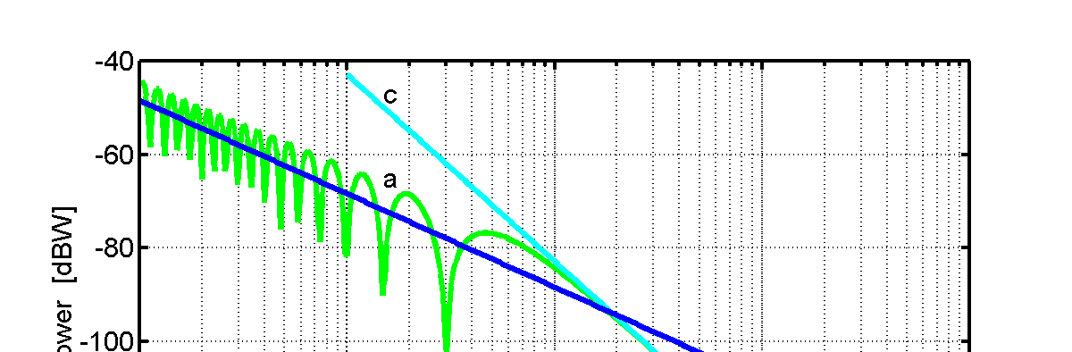
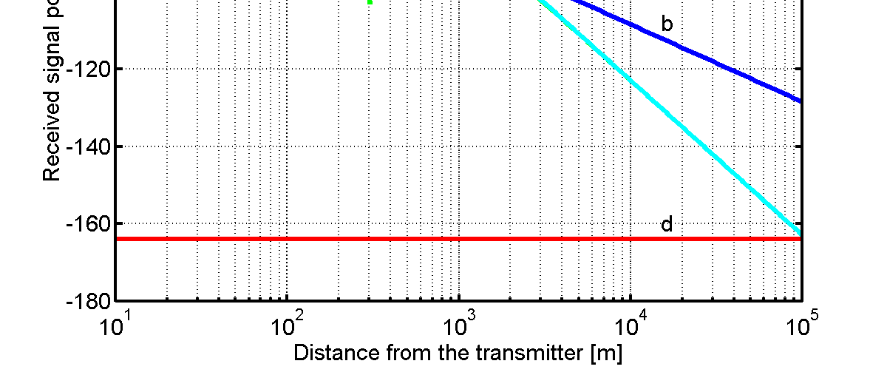
Two Ray Model Path Loss
Pt=1;transmitted power[W] Gt=1;trans antenna gain Gr=1;receiver antenna gain
0.15 [m] wavelength
1990 mHz carrier frequency ht=15;
hr=1.5;
Large SNR
P
P (d ) = con⋅ ^{t}
r
_{d} 2
1/d²
1/d⁴
_{h}2 _{h}2
P_{r} = P_{t} G_{r} G_{t}
t r
_{d} 4
Noise level
Radio Transmission

Slide 26
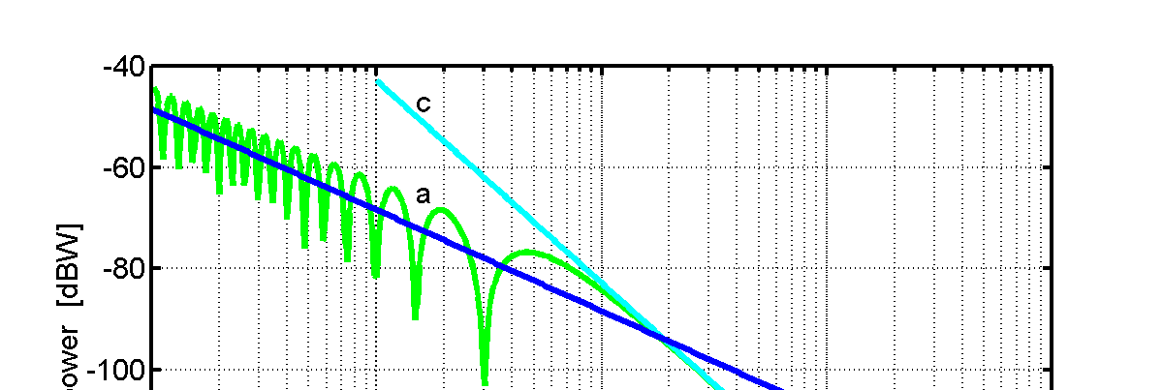
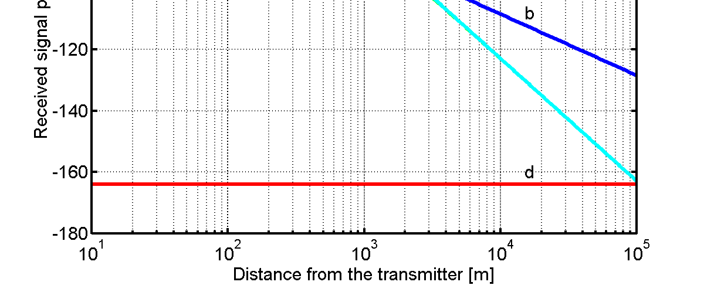




Two Ray Model -The Model of ‘Distance Filtering’
We wish it was like
Pt=1;transmitted power[W] Gt=1;trans antenna gain Gr=1;receiver antenna gain
0.15 [m] wavelength
1990 mHz carrier frequency ht=15;
hr=1.5;
s
^{thi}This is
1/d²
how it
is
1/d⁴
Radio Transmission

Slide 27
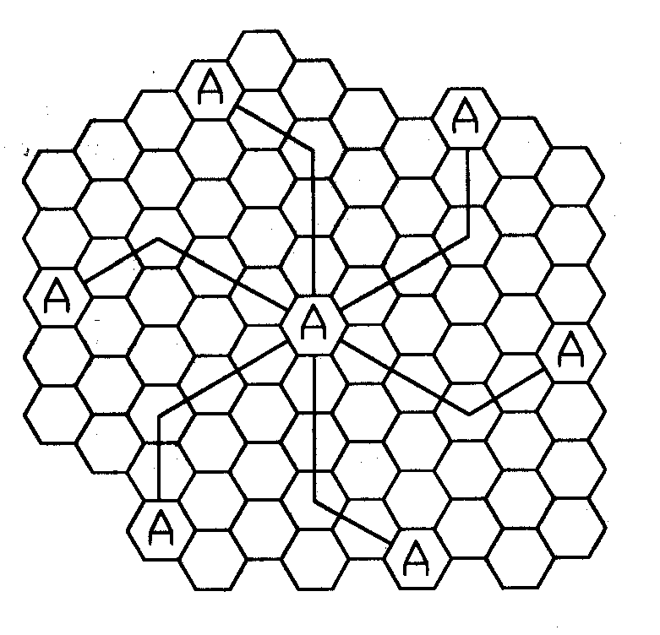
Distance between interfering cells
•D²=[(j·R)²+ (i·R)² - (i·R) (j·R) cos(120^{O} )]
D = 3 R j² +i² + j ⋅i = R 3N
D
D = R 3 N
R – cell radius N- cluster size
D – distance between interfering cells
j=2
Radio Transmission

Slide 28
Simpler SIR
– Considering only the first layer of interfering cells & if all these BS are equidistant
S (D / R)^{n}
( 3N )^{n}
=
=
I
i₀ i₀
– i0 - number of neighboring/interfering co- channel cells
Radio Transmission

Slide 29
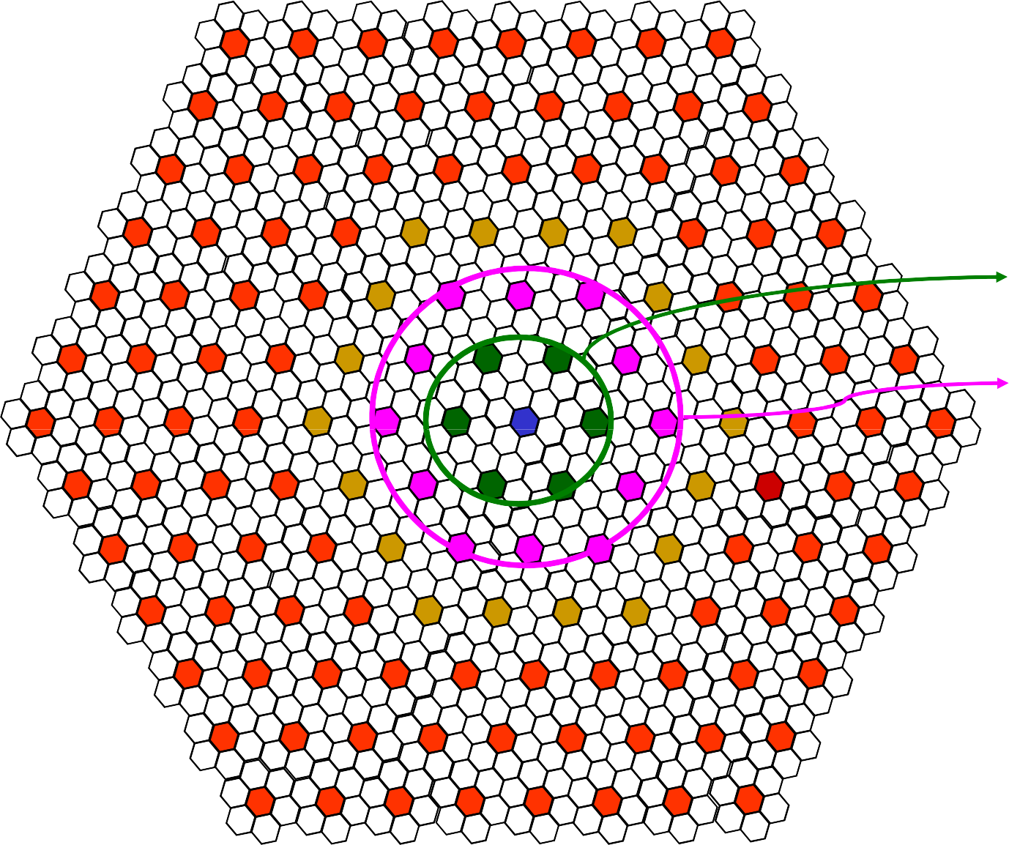
1 → 6
2 → 12
3 → 18
…
k → 6k
Radio Transmission

Slide 30
Interference Limitation
S
_{R} − n
=
D_{K} < kR 3 N
I
i
0
∑
i =1
( D )
n
i
S
_{R}−n
S ( 3N )^{n}
=
=
K
_{6 ⋅ ∑ k}1−n
k =0
I
∑6 ⋅ k(kR
k =0
I
K
3N )^{−n}
k – circle of interfering cels
Radio Transmission

Slide 31
Interference Limitation
S ( 3N )^{n}
=
I
K
6 ⋅ ∑ k
k =0
1−n
– Considering K layers of interfering cells
– For N fixed, n=2 and the number of layers K→∞; S/I →0
K
1
I = lim O ( ∑ ) = ∞
k = 0 ^{k}
K → ∞
Radio Transmission

Slide 32
Log-distance Path Loss Model
Average received power decreases as the n-th power of the relative distance between the transmitter and the receiver
The average large scale path loss for an arbitrary T-R separation is expressed as function of distance using a path-loss exponent
⎛ d ⎞
n
⎛ d ⎞
PL [dB] = PL(d ) + 10 n log
PL (d ) ∝ _{⎜ d}
⎟
⎜⎜ _{d ⎟}⎟
⎝ 0 ⎠
0
⎝ 0 ⎠
Radio Transmission

Slide 33
Log-distance Path Loss Model
n - the rate at which the path loss increases
– For free space n=2
d₀ – close-in reference distance
The value of n depends on the specific propagation environment
Radio Transmission

Slide 34
Example
Environment | Path Loss Exponent, n
Free space | 2
Urban area cellular radio | 2.7 to 3.5
Shadowed urban cellular radio | 3 to 5
Inbuilding LOS | 1.6 to 1.8
Obstructed in building | 4 to 6
Obstructed in factories | 2 to 3
Radio Transmission

Slide 35
Log-normal Shadowing 1
The log distance Model does not consider the effects of environmental clutter
– Large discrepancies
It has been shown that path loss at a particular location is random, and distributed log-normally
⎛ d ⎞
PL(d ) = PL(d ) + X_{σ} = PL(d ) + 10n log
⎜
⎟⎟ + X_{σ}
0
⎜
d
⎝ 0 ⎠
Radio Transmission

Slide 36
Log-normal Shadowing 2
P_{r} = P_{t} − PL(d )
X_{σ} - zero mean Gaussian distributed random variable (dB) with standard deviation σ (dB)
d₀, n and σ statistically describe the path loss model for an arbitrary location
Radio Transmission

Slide 37
Log-normal Shadowing 3
n and σ are in practice computed from measured data using linear regression (fitting)
PL(d₀) is based either on close-in measurements or on a free space assumption from transmitter to d₀
A number of practical models exist for predicting path loss in “real” propagation conditions
Radio Transmission

Slide 38
A Cell Design Problem
A GSM-1800 operator provides cellular coverage in Karachi (Area: 2500 km²) with 49 microcells of similar hexagonal geometry. If a mobile unit is considered to be located at the edge of a cell, find the Signal to Noise Ratio (SNR) that is ensured for 90% of the time at the mobile unit.
Assume the following: The close-in reference distance d₀ = 1 km. Transmitter power P_{t} = 10W, the receiver and the transmitter antenna gains are G_{t}=3 dB and G_{r}=0 dB, respectively. The propagation beyond the close-in distance occurs with a path loss exponent n=4 and follows a log-normal distribution with standard deviation σ=6.5dB. Normal temperature in Karachi is 27^{O} C and the noise figure of the mobile unit is 10dB.
Radio Transmission

Slide 39
Okumura Model 1
Okumura 1963;
Okumura-Hata; ITU-R recommendation P.529-2; pages 5-7, 1995.
Applicable for frequencies in the range 150 MHz to 1920 MHz
Distances of 1 km to 100 km
Effective antenna heights from 30m to 1000m (hills!!)
Radio Transmission

Slide 40
Okumura Model 2
Set of curves giving the median attenuation G
relative to free space – A_{mu} (Graph)
in an urban area over quasi-smooth terrain
mobile antenna height of 3m
Developed form extensive measurements
Path loss is calculated by determining A_{mu} from the curves and adding correction factors
Type of terrain
Radio Transmission

Slide 41
Okumura Model 3
L₅₀ (dB) = L_{F} + A_{mu} ( f , d ) − G(h_{te} ) − G(h_{re} ) − G_{AREA}
L₅₀ - 50th percentile value of the propagation path loss (median “average” not mean-square average)
L_{F} Free space propagation loss (Formula)
A_{mu}- Median attenuation relative to free space (G)
G(h_{he}) - Base station antenna height gain factor (F)
G(h_{re}) - Mobile antenna height gain factor (F)
G_{AREA} - Gain due to the type of environment (G)
Radio Transmission

Slide 42
Free Space Propagation Loss
L
(dB ) = L
A
( f , d ) − G (h
) − G (h ) −
50
F
mu
te
re ^{G}AREA
The free space propagation loss is given by formula:
⎡
⎢
⎢
⎢
⎢
G_{t} G_{r} λ
2
⎤
⎥
L_{F} [dB ] = −10 log
⎥
2
₂ ⎥
(4 π ) d
⎥
⎥⎦
⎢
⎣
Radio Transmission

Slide 43
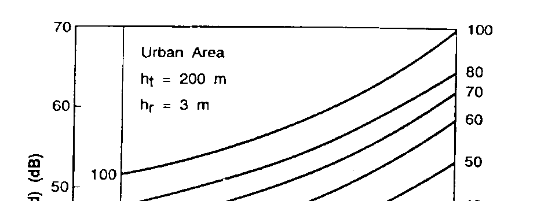
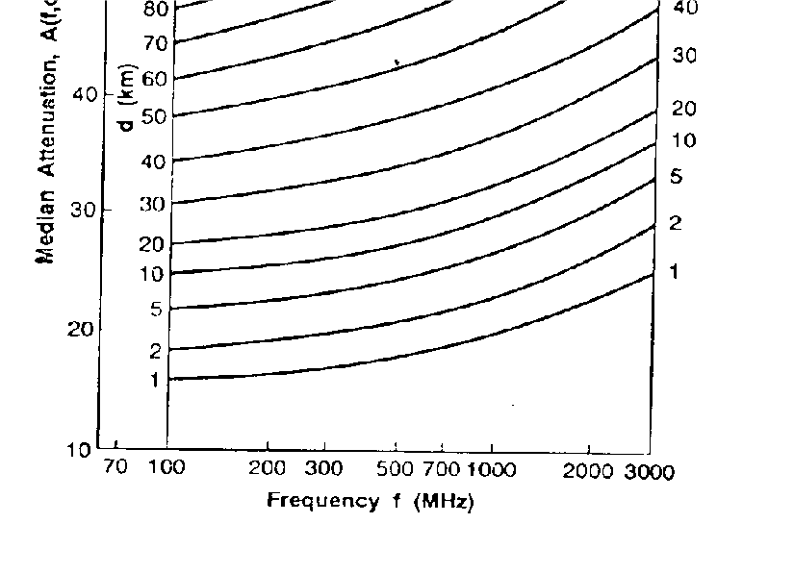
^{A}mu
( f , d ) − G(h
L
(dB) = L + A
) − G(h ) −
50
F mu
te
re ^{G}AREA
Median attenuation with respect to free space loss
Radio Transmission

Slide 44
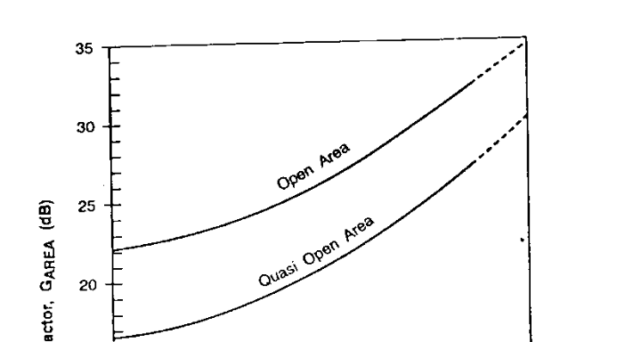
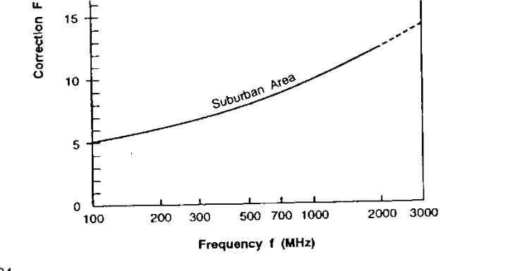
^{G}AREA
Gain due to the type of environment
L (dB) = L
50 F mu
A (f,d)− G(h
) − G( _{re} ) −
h
te
^{G}AREA
Radio Transmission

Slide 45
Antenna gain factors G(h_{he}),G(h_{re})
Okumura found that for heights less than 3 m
G(h_{he}) -varies at a rate of 20 dB/decade
G(h_{re}) - varies 10dB/decade
⎛
h
⎞
G(h ) = 20 log
⎜
te
⎟
1000m > h > 10m
te
⎝ 200 ⎠
re
⎛
h
⎞
G(h ) = 10 log
⎜
re
⎟
h ≤ 3m
re
⎝ 3 ⎠
re
⎛
h
⎞
G(h ) = 20 log
⎜
re
⎟
10m > h > 3m
re
⎝ 3 ⎠
re
Radio Transmission

Slide 46
Other Corrections
Can be applied to Okumura’s model
Terrain undulation height
Isolated ridge height
Average slope of terrain and
Mixed land-sea parameters
All available as Okumura curves (Oku68)
Radio Transmission

Slide 47
Okumura Model Summary
Okumura’s model is wholly based on measured data (empirical)
Extrapolations can be made to obtain values outside the measurement range
Simplest and the best in terms of accuracy (the best tradeoff in terms of simplicity-accuracy)
Major disadvantage – decreased accuracy in situations of rapid changes in terrain
Radio Transmission

Slide 48
Hata Propagation Model
An empirical formulation of graph path loss data provided by Okumura
Curves from Okumura model replaced by formulas
Valid from 150 to 1500 MHz
Presents an urban area propagation loss as a standard formula
– correction equations for application to other situations
Radio Transmission

Slide 49
Urban Path Loss Equation
L₅₀ (urban)(dB) = 69.55 + 26.16 log f_{c} −13.82 log h_{te}
a(h_{re} ) + (44.9 − 6.55 log h_{te} ) log d
fc - Frequecny in MHz from 150-1500MHz
h_{he} -BS antenna heing in meters from 30-200 m
h_{re} - MS antenna height in meters from 1-10 m
d - T-R separation distance in km
a(h_{re} ) - correction factor for effective MS antenna height (size of the coverage area)
Radio Transmission

Slide 50
Mobile antenna correction factor a(h_{re} )
Small to medium size city
a(h_{re} ) = (1.1log f_{c} − 0.7)h_{re} − (1.56 log f_{c} − 0.8) dB
Large city
2
a(h_{re} ) = 8.29(log1.54h_{re} ) − 1.1 dB
2
a(h_{re} ) = 3.2(log11.75h_{re} ) − 4.97 dB
for f_{c} ≤ 300MHz for f_{c} ≥ 300MHz
Radio Transmission

Slide 51
Suburban and Rural Path Loss Equation
Suburban area
L (dB) = L (urban) − 2[log( f / 28)]² − 5.4
50 50 c
Open rural area
L₅₀ (dB) = L₅₀ (urban)
− 4.78(log f )² −18.33log f − 40.98
c c
Radio Transmission

Slide 52
Hata-model Summary
Simple and sufficiently accurate
Presents significant practical value
Compares very favorably with Okumura’s model for d > 1 km (in fact it has been derived from Okumura model)
Suitable for large cell mobile systems planning
Extensions and corrections for smaller cells are available
Radio Transmission

